Slide 1
Some interesting sites:
Steven Drucker’s links

Slide 2
Community aggregators
http://slashdot.org
http://www.digg.com
http://www.techmeme.com/
http://del.icio.us/
http://www.similicio.us/
http://technorati.com/
http://netvibes.com

Slide 3
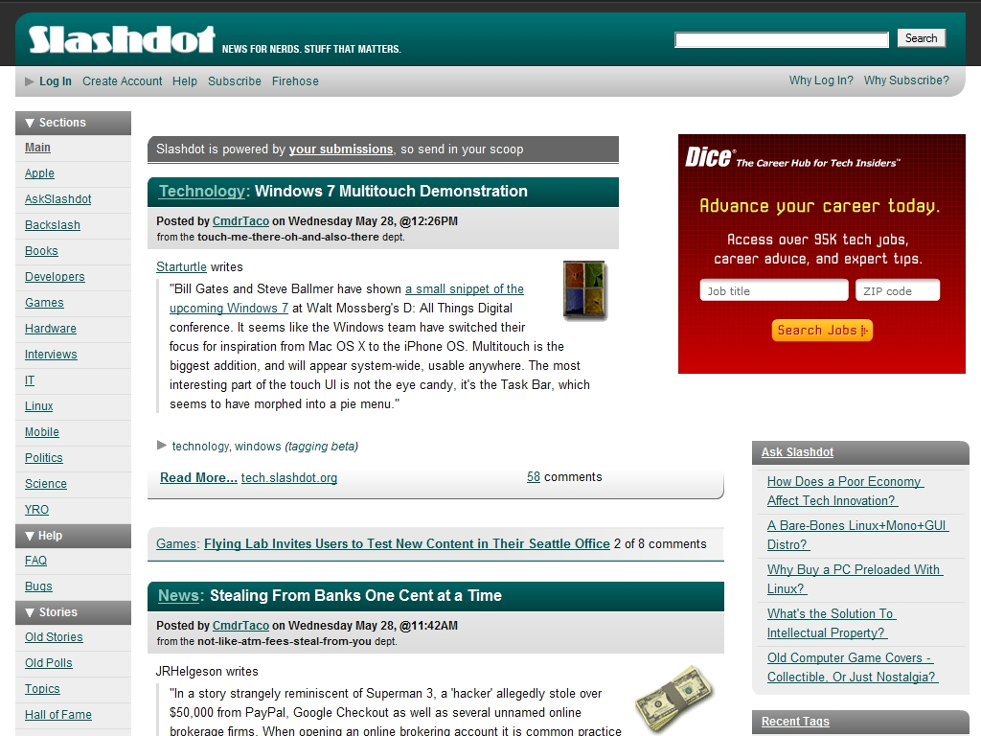
http://slashdot.org

Slide 4
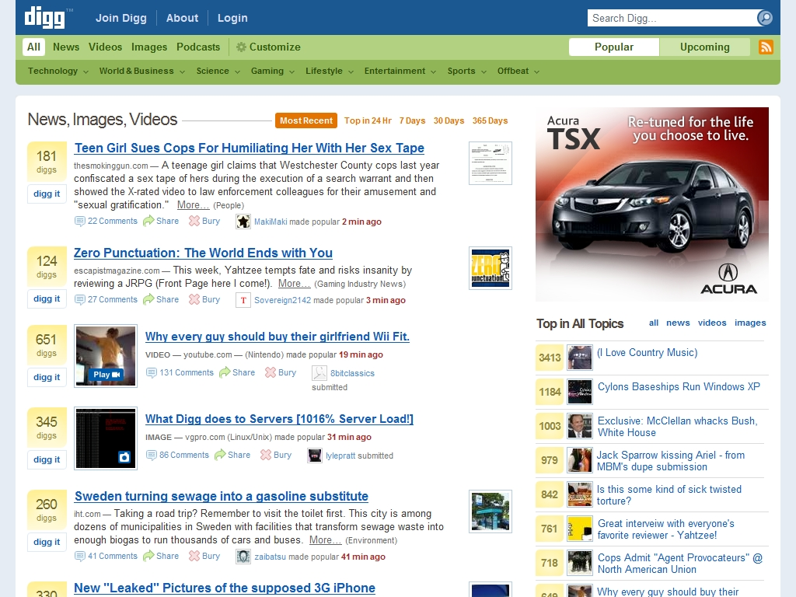

http://www.digg.com

Slide 5
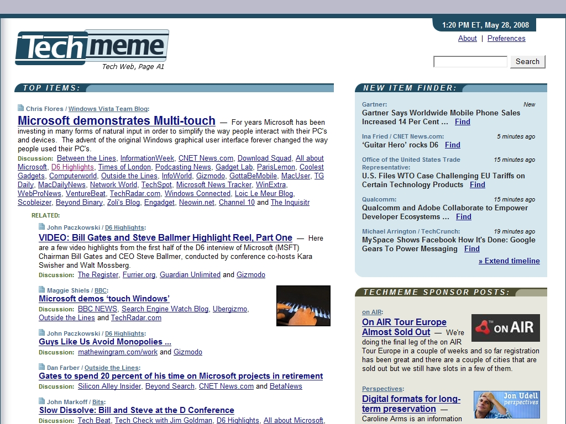
http://www.techmeme.com/

Slide 6
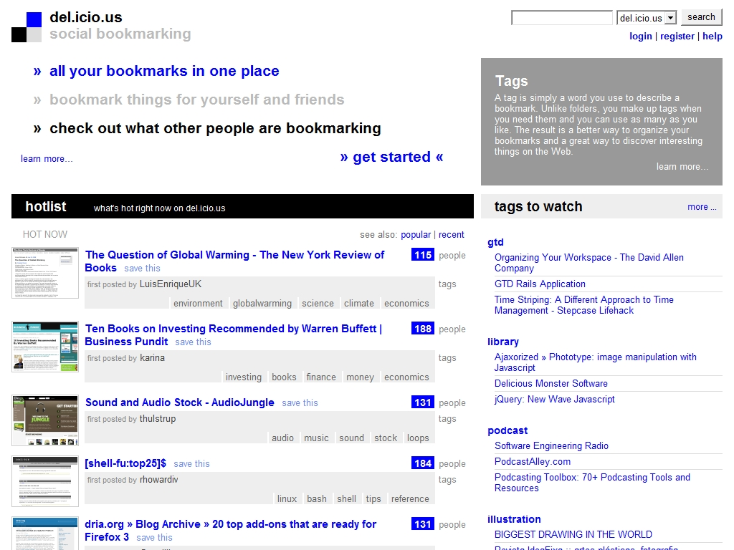
http://del.icio.us/

Slide 7
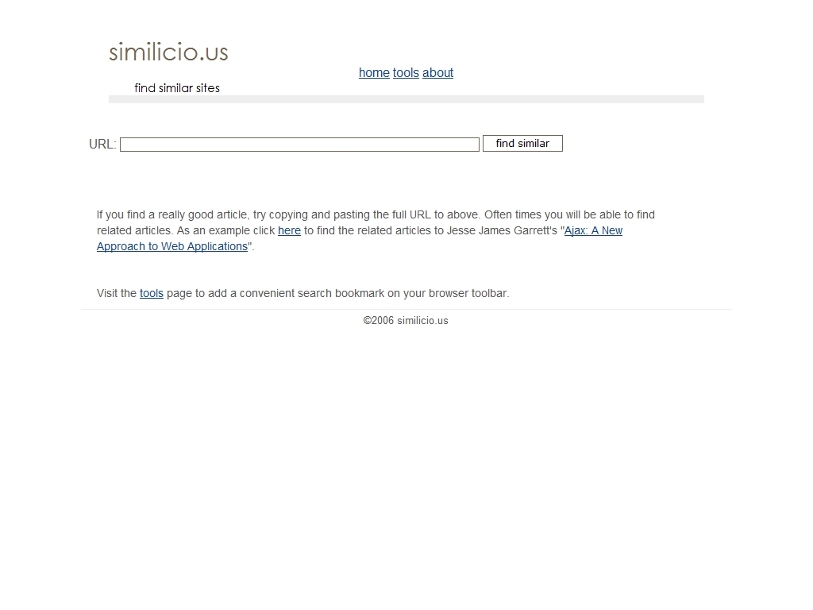
http://www.similicio.us/

Slide 8

http://technorati.com/

Slide 9
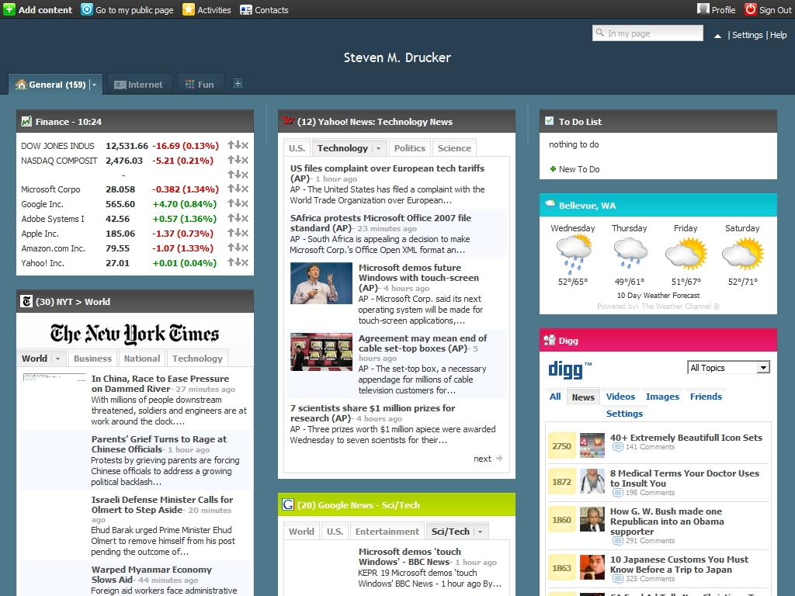
http://netvibes.com

Slide 10
Some verticals
www.imdb.com
www.dpreview.com
www.avsforum.com
www.zillow.com
www.redfin.com
www.tripadvisor.com
www.tripit.com
www.seat-guru.com

Slide 11
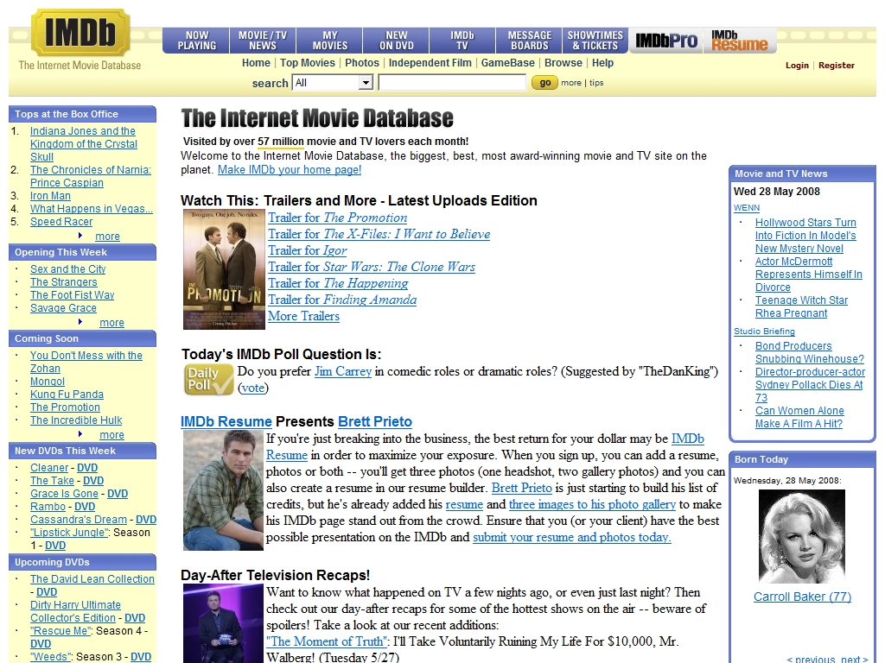
www.imdb.com

Slide 12
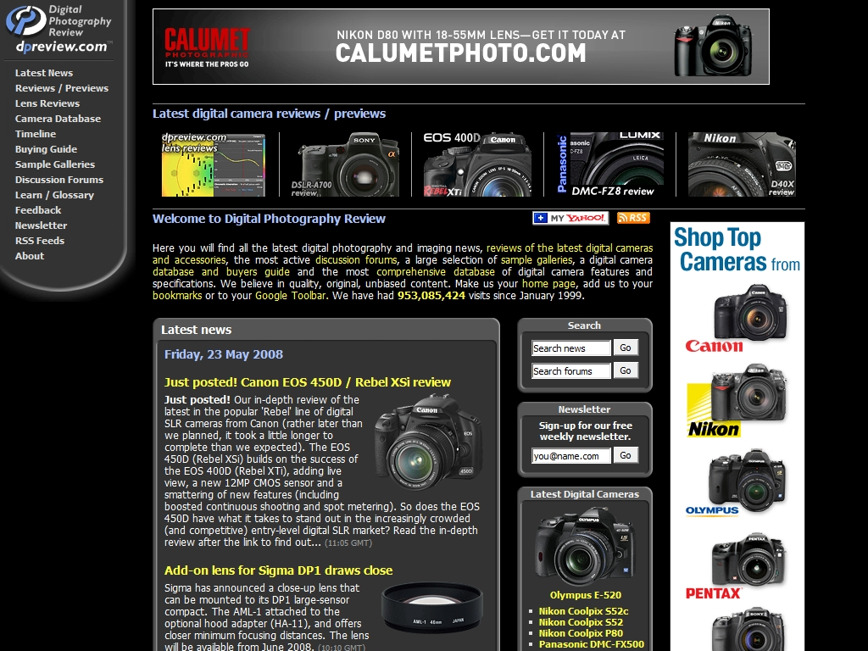
www.dpreview.com

Slide 13
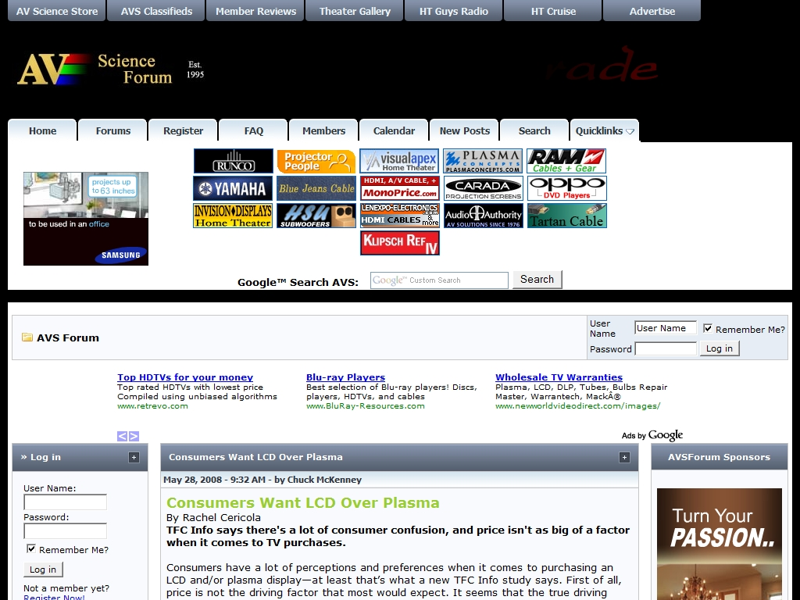
www.avsforum.com

Slide 14

http://www.zillow.com/

Slide 15
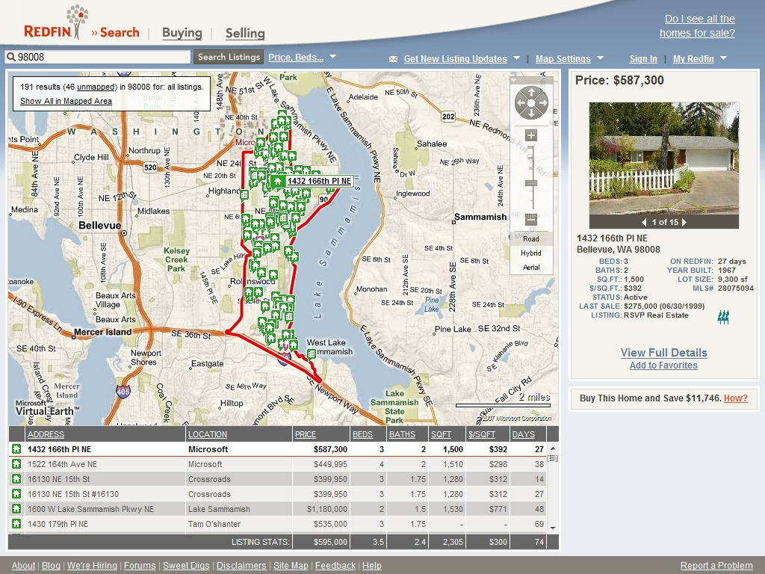
http://www.redfin.com/search#search_location=98008

Slide 16
Some interesting blogs
http://www.richardbanks.com/trends/
http://www.boingboing.net/
http://www.engadget.com
http://www.gizmodo.com
http://lifehacker.com/
http://www.43folders.com/
http://www.kk.org/cooltools
http://www.smashingmagazine.com/
http://www.smashingmagazine.com/2007/10/30/65-excellent-flash-designs/
http://www.seomoz.org/web2.0
http://neoformix.com/
http://datamining.typepad.com/data_mining
http://www.infosthetics.com/

Slide 17
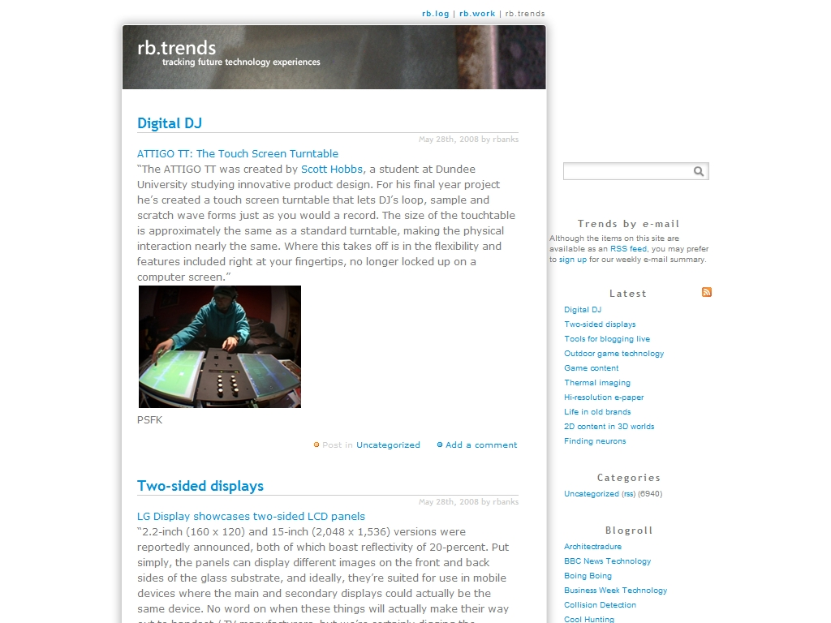
http://www.richardbanks.com/trends/

Slide 18

http://www.boingboing.net/

Slide 19

http://www.engadget.com

Slide 20

http://www.gizmodo.com

Slide 21

http://lifehacker.com/

Slide 22

http://www.43folders.com/

Slide 23
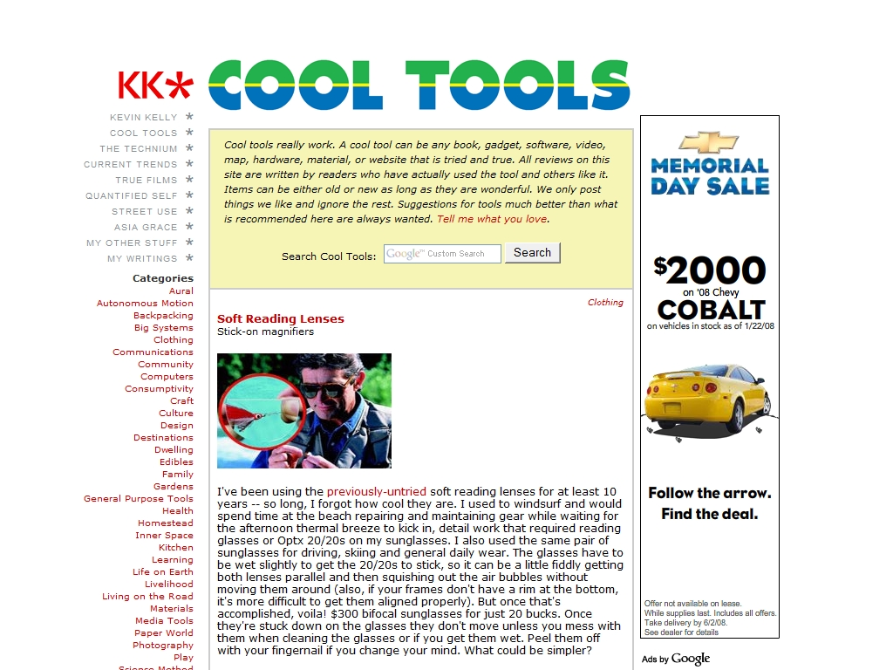
http://www.kk.org/cooltools

Slide 24

http://www.smashingmagazine.com/
http://www.smashingmagazine.com/2007/10/30/65-excellent-flash-designs/

Slide 25

http://www.seomoz.org/web2.0

Slide 26
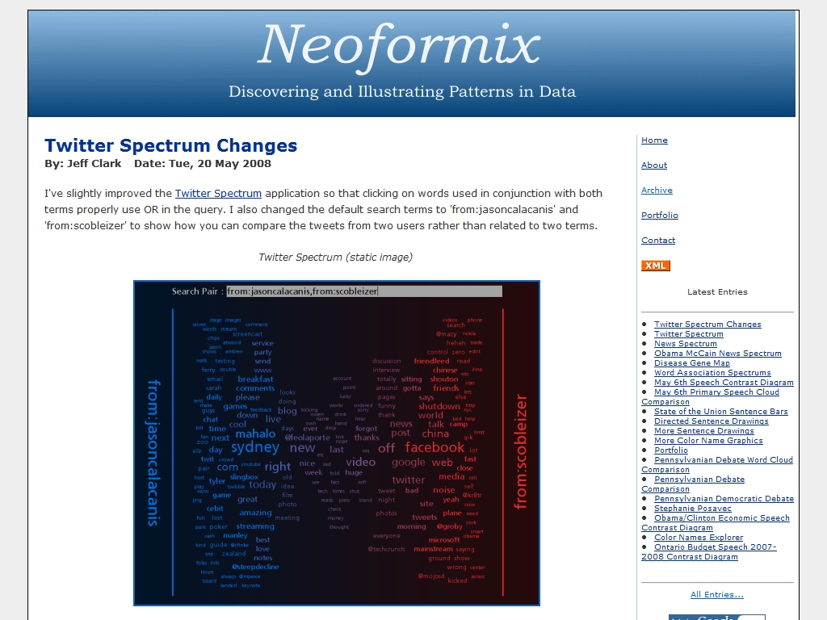
http://neoformix.com/

Slide 27
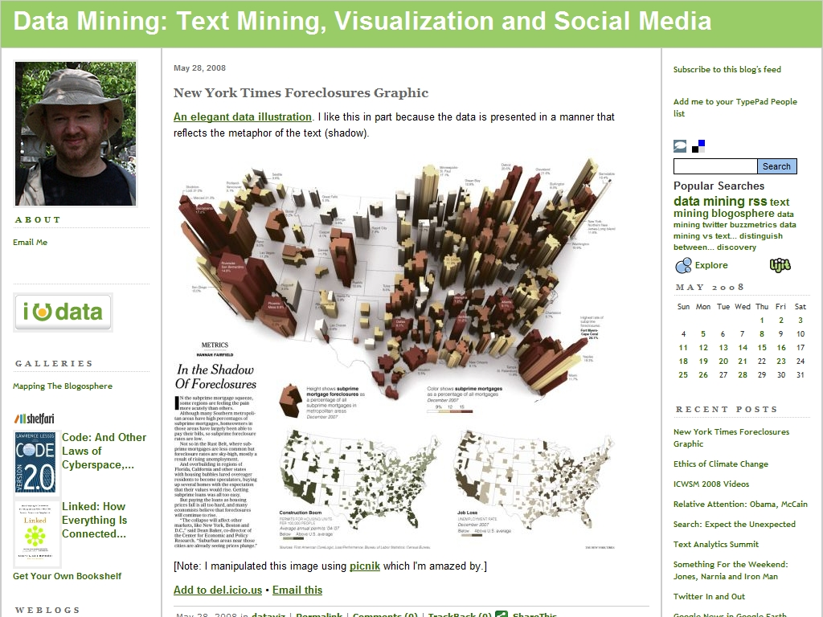
http://datamining.typepad.com/data_mining

Slide 28
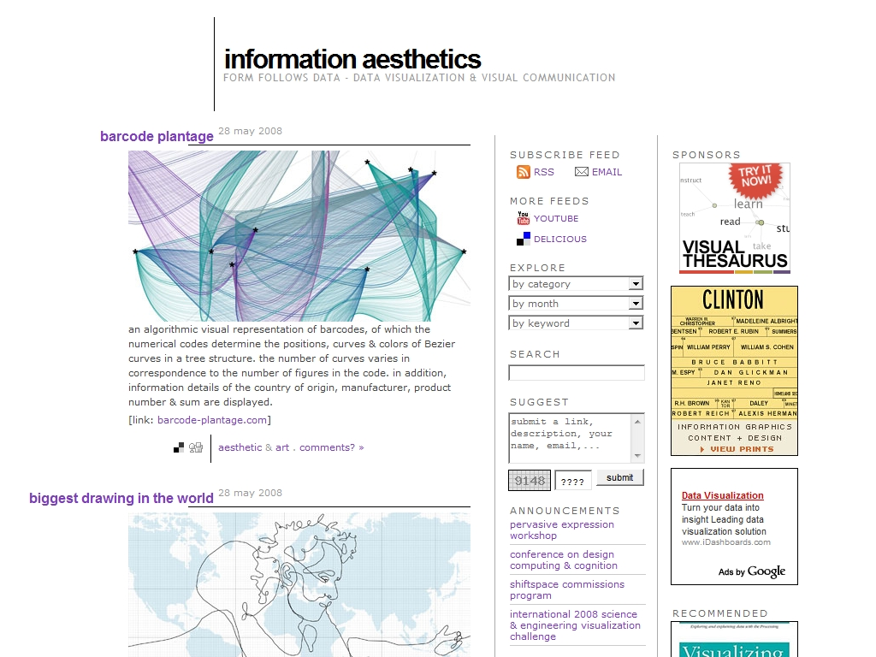
http://www.infosthetics.com/

Slide 29
“Make” fun
http://www.howtoons.com
http://www.hackaday.com/
http://makezine.com/

Slide 30
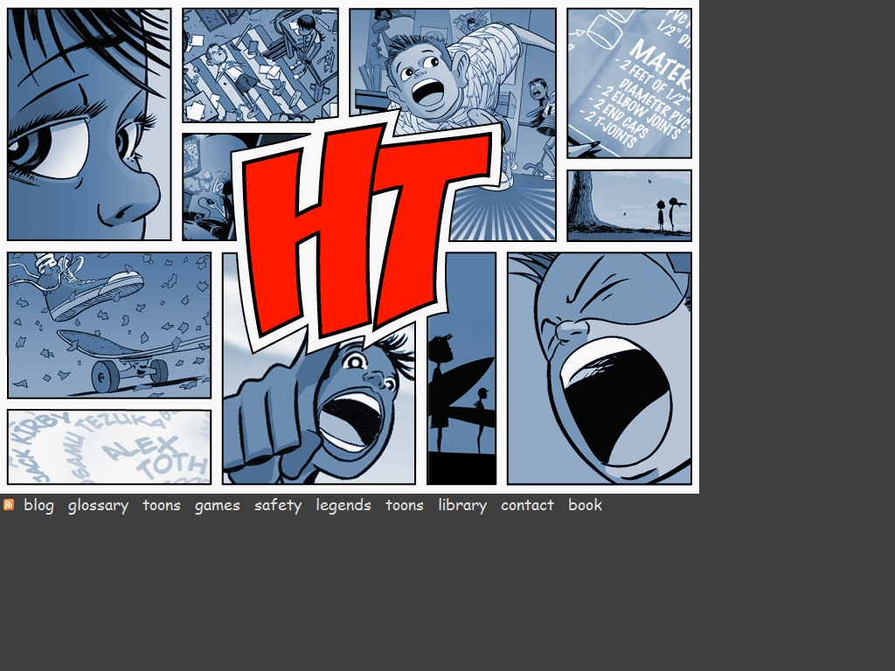
http://www.howtoons.com

Slide 31

http://www.hackaday.com/

Slide 32

http://makezine.com/

Slide 33
Cool Visualizations
http://www.nytimes.com/interactive/2008/02/23/movies/20080223_REVENUE_GRAPHIC.html#
http://www.babynamewizard.com/voyager#prefix=STE&ms=false&sw=f&exact=false
http://www.gapminder.org/
http://www.wefeelfine.org/
http://www.prefuse.org/gallery/
  http://www.prefuse.org/gallery/zipdecode/
http://services.alphaworks.ibm.com/manyeyes/page/About_Many_Eyes.html

Slide 34
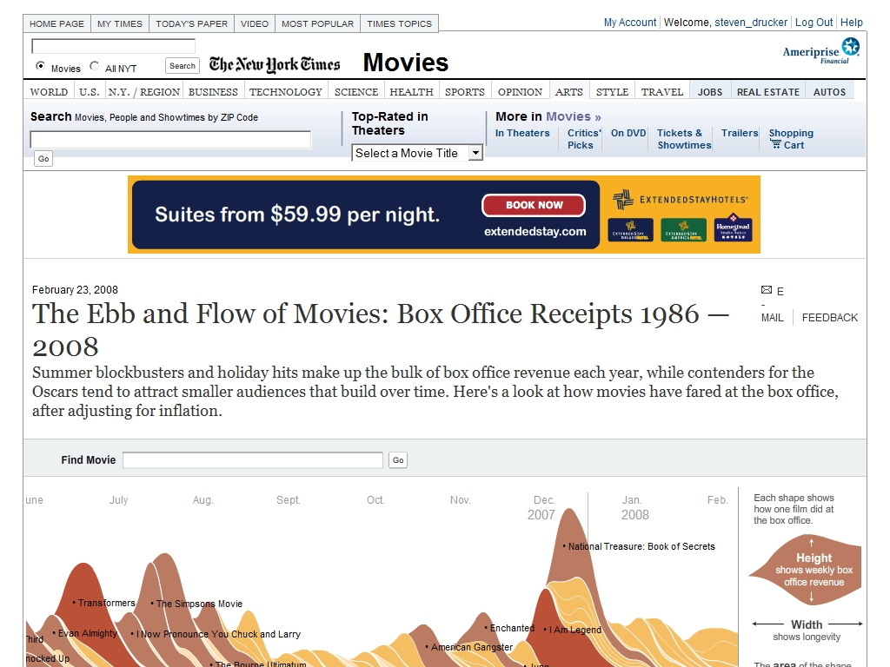
http://www.nytimes.com/interactive/2008/02/23/movies/20080223_REVENUE_GRAPHIC.html#

Slide 35
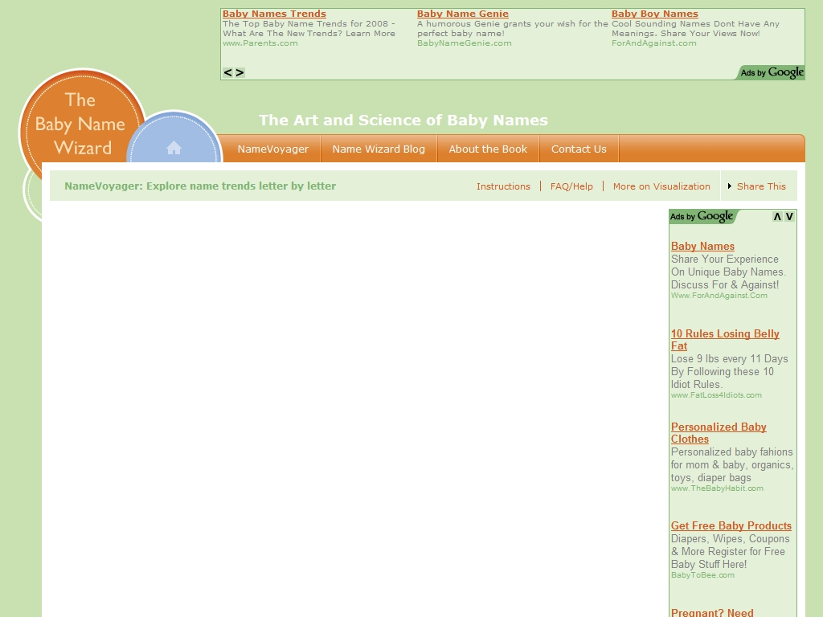
http://www.babynamewizard.com/voyager#prefix=STE&ms=false&sw=f&exact=false

Slide 36
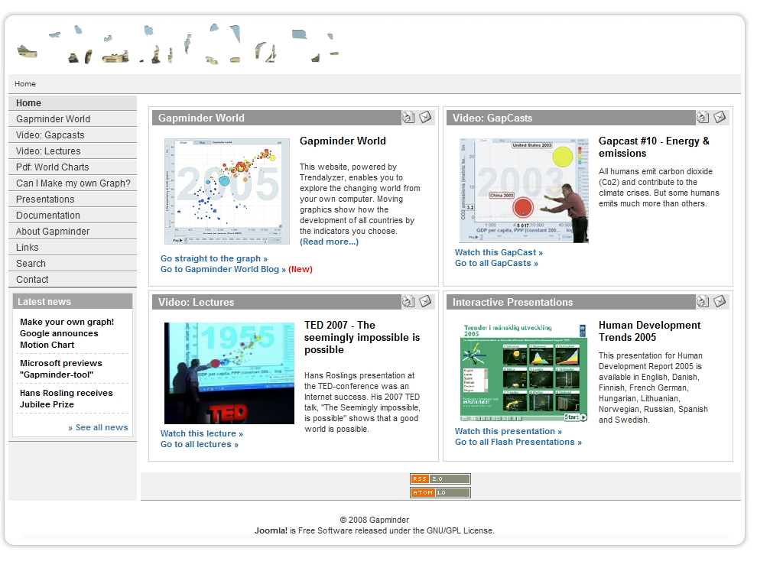
http://www.gapminder.org/

Slide 37
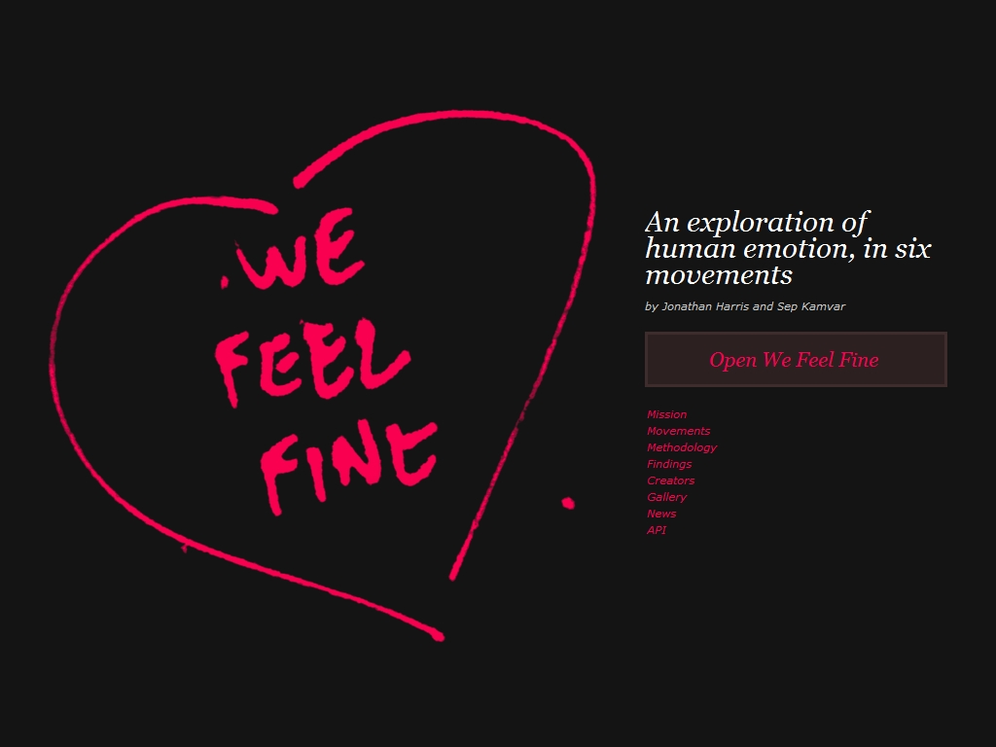
http://www.wefeelfine.org/

Slide 38
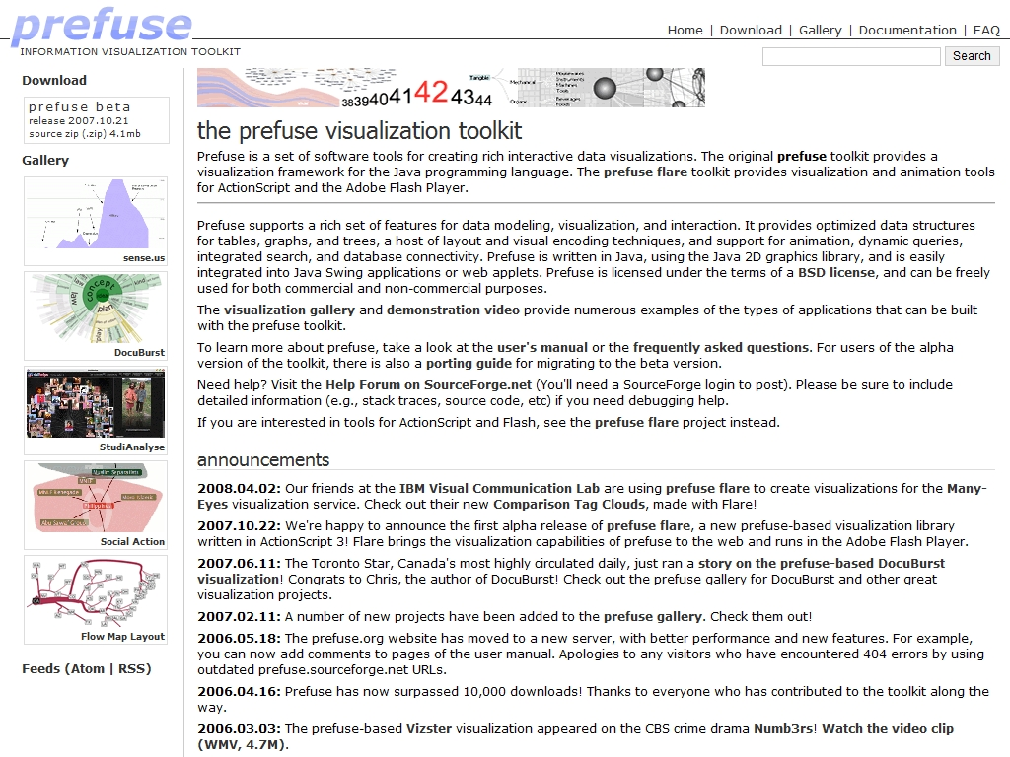
http://www.prefuse.org/gallery/

Slide 39
Photo Fun
http://www.worth1000.com
  http://www.worth1000.com/cache/gallery/contestcache.asp?contest_id=8417&display=photoshop
http://www.picnik.com
http://www.tabblo.com/studio

Slide 40
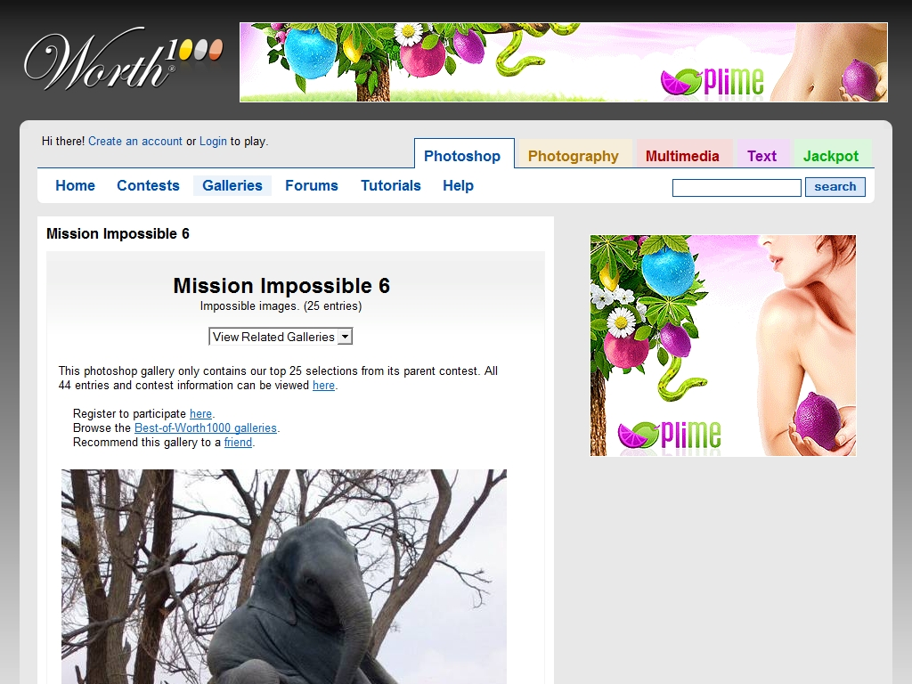
  http://www.worth1000.com/cache/gallery/contestcache.asp?contest_id=8417&display=photoshop

Slide 41
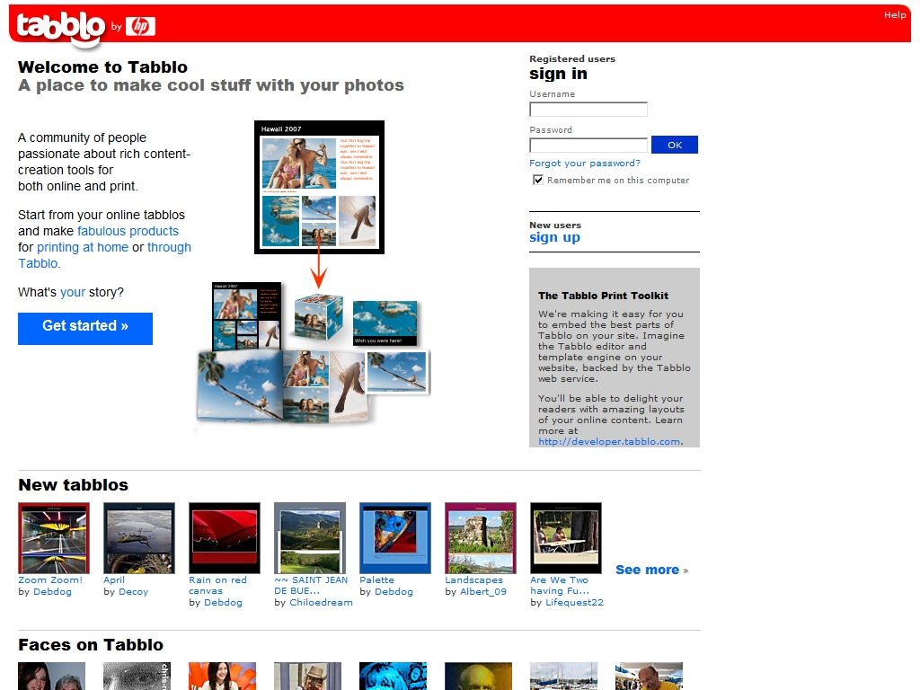
http://www.tabblo.com/studio

Slide 42
Fun art
http://interact10ways.com/usa/information_interactive.htm
http://interact10ways.com/usa/light_interactive.htm
http://interact10ways.com/usa/space_interactive.htm

Slide 43
Fun art/programming
http://www.dhteumeuleu.com/
  http://www.dhteumeuleu.com/run/image-flow/
  http://www.dhteumeuleu.com/run/rotate3D/
  http://www.dhteumeuleu.com/run/gallery-3D/
  http://www.dhteumeuleu.com/run/ragdoll-2/
  http://www.dhteumeuleu.com/run/nav-3D/
  http://www.dhteumeuleu.com/run/drag-3x/
  http://www.dhteumeuleu.com/run/x-zoom/
www.bit-101.com

Slide 44
Some research
Facetted browsing:
  http://research.microsoft.com/~sdrucker
  http://simile.mit.edu/
    http://simile.mit.edu/exhibit/
    http://simile.mit.edu/timeplot/
    http://simile.mit.edu/timeline/

Slide 45
Processing
http://processing.org
  http://portfolio.barbariangroup.com/nextfest/applet/index.html
  http://www.tom-carden.co.uk/p5/tube_map_travel_times/applet/
  http://www.turbulence.org/spotlight/thinking/chess.html
  http://www.ortho-type.it/beta033/
http://ejohn.org/blog/processingjs/

Slide 46
Cool videos?
http://www.cs.cmu.edu/~johnny/kt/
  http://www.cs.cmu.edu/~johnny/kt/video/fightclub2.mov
http://youtube.com/watch?v=MKyH8B1yOf8
  (synthetic instrument)
http://youtube.com/watch?v=M0ODskdEPnQ
  (bumptop)

