Slide 1
Chapter 1: Object-Oriented Programming Using C++

Slide 2
Objectives
Looking ahead – in this chapter, we’ll consider:
Abstract Data Types
Encapsulation
Inheritance
Pointers
Polymorphism

Slide 3
Objectives (continued)
C++ and Object-Oriented Programming (OOP)
The Standard Template Library (STL)
Vectors in the STL
Data Structures and OOP

Slide 4
Abstract Data Types
Proper planning is essential to successful implementation of programs
Typical design methodologies focus on developing models of solutions before implementing them
These models emphasize structure and function of the algorithms used
Initially our attention is on what needs to be done, not how it is done
So we define program behavior in terms of operations to be performed on data

Slide 5
Abstract Data Types (continued)
The details will emerge as we refine the definitions of the operations
Only then will implementation of those operations be carried out
As part of this implementation, we must choose appropriate data structures
A data structure is a technique of storing and organizing data so it can be used efficiently
In our program models, data structures are described by abstract data types (ADTs)

Slide 6
Abstract Data Types (continued)
ADTs are defined indirectly, in terms of operations to be performed rather than in terms of its inner structure
ADTs can then be implemented through class definitions in an object-oriented language
For example, consider a stack ADT:

Slide 7
Abstract Data Types (continued)
A stack is a last-in first-out (LIFO) linear structure where items can only be added and removed from one end
Operations on this stack ADT might include:
PUSH – add an item to the stack
POP – remove the item at the top of the stack
TOP – return the value of the item at the top of the stack
EMPTY – determine if the stack is empty
CREATE – create a new empty stack
Notice these simply describe the things we can do, not how they are done
These details will be reserved for implementation

Slide 8
Encapsulation
Fundamental to object-oriented programming (OOP) is the notion of an object
An object is a data structure, combined with the operations pertinent to that structure
Most object-oriented languages (OOLs) define objects through the use of a class
A class is a template which implements the ADT defining the objects the class creates
Within a class, the data elements are called data members, and the operations methods, function members, or member functions

Slide 9
Encapsulation (continued)
The combination of data members and methods in a class is referred to as data encapsulation
An object, then, can also be defined as the instantiation of a class, creating an entity that can be used in a program
This concept is a very powerful and useful tool in modern programming
In non-OOLs, the program code itself is responsible for determining the associations between data and functions
In contrast, data encapsulation binds the data structure and its operations together in the class
The program can then focus on the manipulation of these objects through their associated methods

Slide 10
Encapsulation (continued)
This approach has several advantages:
The strong link between data and operations better mimics real-world behavior, on which program models are based
Errors in implementation are confined to the methods of a particular class in which they occur, making them easier to detect and correct
Details of the implementation of the object can be hidden from other objects to prevent side effects from occurring
This last point illustrates the principle of information-hiding
Our use of an object is based on what it does for us, not how it goes about doing it
So an object can be looked at as a black box, with specific user-available methods and a well-defined behavior

Slide 11
Encapsulation (continued)
These user-accessible components comprise an object’s public interface; the remaining methods and data are private

Slide 12
Encapsulation (continued)
Information-hiding also means that every object we use is independent of all other objects, unless we define methods for communicating between objects
Even then, the degree to which the objects interact is precisely defined by the communication methods, known as message passing
This is analogous to function calls in classical programming
An object responds to a message by executing the appropriate method to return information

Slide 13
Encapsulation (continued)
The class as a creator of objects allows great freedom to define objects of the same class with different properties
Default parameters in constructors, combined with well-crafted methods, allow objects to exhibit considerable flexibility
Generic classes offer further flexibility by allowing type parameters to generalize data members and methods
This allows objects to be modified or replaced by other objects that are more efficient or better suited to particular circumstances while the user interface and message passing remains the same

Slide 14
Inheritance
Inheritance is a technique of reusing existing class definitions to derive new classes
These new classes (called derived classes or subclasses or child classes) can inherit the attributes and behavior of the pre-existing classes (called base classes or superclasses or parent classes)
This relationship of classes through inheritance forms a hierarchy, which can be diagrammed
Information hiding can be extended through this hierarchy by the access the base class allows the derived class(es)
Derived classes can then add, delete, & modify methods and data members in their own definitions (known as overriding)

Slide 15
Inheritance (continued)
The amount of access, and level of modifications, are controlled by specifying public, protected, or private in the derived class header
A derived class with public inheritance preserves the access classes of the base class
A derived class with protected inheritance treats public and protected members of the base class as protected; private members remain private
Finally, derived classes with private inheritance treat all members of the base class as private

Slide 16
Inheritance (continued)
Derived classes are also not limited to a single base class for their inherited attributes
Multiple inheritance is the capability provided in some OOLs (like C++) that allows a derived class to inherit from more than one base class
This can create problems if the base classes have a common ancestor in the inheritance hierarchy
In this situation, the derived class could inherit multiple copies of the same member, causing possible errors
This is referred to as the diamond problem, due to the way the inheritance diagram is formed

Slide 17
Inheritance (continued)

Slide 18
Inheritance (continued)
In this figure the two classes B and C inherit from A, and D inherits from B and C
The problem occurs if D uses a method defined in A (and doesn’t override it)
If B and C both override it, D could potentially have two copies with different behaviors, leading to a compiler error
To avoid this, classes B and C inherit class A as “virtual”
This treats A as a direct base class of D, so only one copy of A is available to inherit, eliminating the ambiguity

Slide 19
Pointers
A variable defined in a program has two important attributes
Its content or value (what it stores)
Its location or address (where it is)
Normally, we access a variable’s contents by specifying the variable’s name in an operation
However, it is possible to store a variable’s address in another variable
This new variable is called a pointer; it allows us access to the original variable’s value through its address
A pointer is a variable whose value is the address of another variable in memory

Slide 20
Pointers (continued)
Pointers are defined much the same as other variables
They have a type; in this case the type of variable they point to
They have a user-defined name
The name is preceded by an asterisk (“*”) to indicate the variable is a pointer
Given the declarations
int i=15,j,*p,*q;
i and j are integer variables, while p and q are pointers to integer variables
If the variable i is at memory location 1080, and each variable occupies two bytes, figure 1-1a illustrates this layout

Slide 21
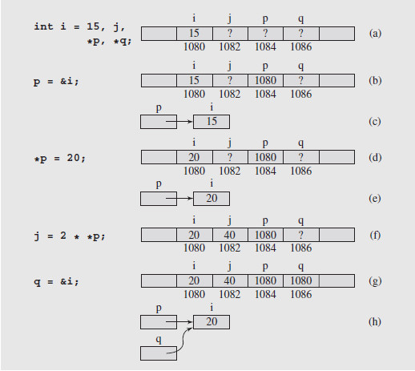
Pointers (continued)
Fig. 1-1 Changes of values after assignments are made using pointer variables; note that (b) and (c) show the same situation, and so do (d) and (e), (g) and (h), (i) and (j), (k) and (l), and (m) and (n)

Slide 22
Pointers (continued)
To assign a variable’s address to a pointer, the address-of operator (&) is placed before the variable
For pointer p to point to variable i, we write
p = &i;
This pointer is then said to point to that variable
This is shown in figure 1-1(b); a common way to draw this relationship is shown in figure 1-1(c)
To access the value a pointer points to, we have to dereference the pointer, using the dereference operator, an asterisk (“*”)
So *p refers to the location stored in p, the address of i

Slide 23
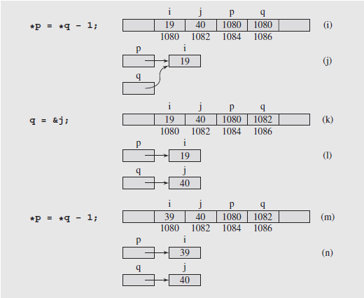
Pointers (continued)
This is shown in figure 1.1(d); figures (e) to (n) show other examples

Slide 24
Pointers (continued)
In addition to variables, pointers can be used to access dynamically created locations
These are created during runtime using the memory manager
Two functions are used to handle dynamic memory
To allocate memory, new is used; it returns the address of the allocated memory, which can be assigned to a pointer
p = new int;
To release the memory pointed at, delete is used
delete p;
Care must be exercised when using this type of memory operation

Slide 25
Pointers (continued)
One problem can arise when an object is deleted without modifying the value of the pointer
The pointer still points to the memory location of the deallocated memory
This creates the dangling reference problem
Attempting to dereference the pointer will cause an error
To avoid this, after deleting the object, the pointer should be set to a known address or NULL, which is equivalent to 0
p = NULL; or p = 0;

Slide 26
Pointers (continued)
The second type of problem that can occur with dynamic memory usage is the memory leak
This occurs when the same pointer is used in consecutive allocations, such as:
p = new int;
p = new int;
Since the second allocation occurs without deleting the first, the memory from the first allocation becomes inaccessible
Depending on code structure, this leak can accumulate until no memory is available for further allocation
To avoid this, memory needs to be deallocated when no longer in use

Slide 27
Pointers (continued)
Pointers and Arrays
Pointers’ ability to access memory locations through their addresses provides us with numerous processing advantages
Typically, arrays in C++ are declared before they can be used, known as static declaration
This means the size of the array must be determined before it is used
This is wasteful if the array is too large, or a limitation if the array is too small
However, the name of an array is nothing more than a label for the beginning of the array in memory, so it is a pointer

Slide 28
Pointers (continued)
Pointers and Arrays (continued)
For example, an array declared:
int temp[7];
would appear in memory as:
In array notation, we access the elements by subscripting: temp[0], temp[1], … etc.
But we can also dereference the pointer to achieve the same results: *temp is equivalent to temp[0]
And we can access additional elements through pointer arithmetic

Slide 29
Pointers (continued)
Pointers and Arrays (continued)
In pointer arithmetic, we can add an offset to the base address of the array: temp + 1, temp + 2, … etc. and dereference the result
So *(temp + 1) is the same as temp[1], *(temp + 2) is equivalent to temp[2], etc.
And as long as we don’t try to change the value of temp, we can use this alternate approach to access the array’s elements
Now remember that a pointer can be used in the allocation of memory without a name, through the use of new
This means that we can also declare an array dynamically, via
int *p; p = new int[n];
As long as the value of n is known when the declaration is executed, the array can be of arbitrary size

Slide 30
Pointers (continued)
Pointers and Arrays (continued)
Now, a reference to an element of the array is constructed by adding the element’s location to p and dereferencing, as before
And we can assign other pointers to the array by simply declaring them and copying the value of p into the new pointer, if needed
This also allows us to conveniently dispose of an array when we no longer need it, using:
delete[] p;
The brackets indicate that an array is to be deleted; p is the pointer to that array

Slide 31
Pointers (continued)
Pointers and Copy Constructors
A potential problem can arise when copying data from one object to another if one of the data members is a pointer
The default behavior is to copy the items member by member
Because the value of a pointer is an address, this address is copied to the new object
Consequently the new object’s pointer points to the same data as the old object’s pointer, instead of being distinct
To correct this, the user must create a copy constructor which will copy not only the pointer, but the object the pointer points to
This conflict is illustrated in figure 1-2(a) and (b); the resolution is shown in figure 1-2(c) and (d)

Slide 32
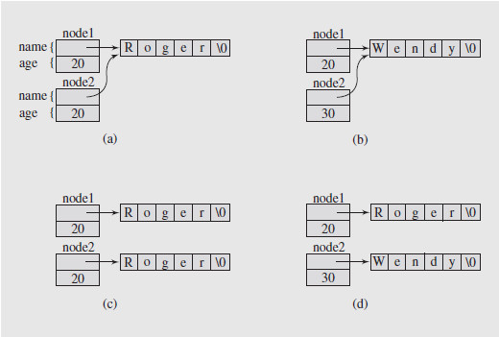
Pointers (continued)
Pointers and Copy Constructors (continued)
Fig. 1-2 Illustrating the necessity of using a copy constructor for objects with pointer members

Slide 33
Pointers (continued)
Pointers and Destructors
When a local object goes out of scope, the memory associated with it is released
Unfortunately, if one of the object members is a pointer, the pointer’s memory is released, leaving the object pointed at inaccessible
To avoid this memory leak, objects that contain pointers need to have destructors written for them
A destructor is a code construct that is automatically called when its associated object is deleted
It can specify special processing to occur, such as the deletion of pointer-linked memory objects

Slide 34
Pointers (continued)
Pointers and Reference Variables
There is a close correspondence between pointers and reference variables
This is because reference variables are implemented as constant pointers
Given the declarations:
int n = 5,*p = &n,&r = n;
a change to the value of n via any of the three will be reflected in the other two
Thus n = 7 or *p = 7, or r = 7 accomplishes the same result; the value of n is now 7
So we can dereference a pointer, or use a reference directly to access the original object’s value

Slide 35
Pointers (continued)
Pointers and Reference Variables (continued)
We do have to exercise care in declaring pointers, though, because
int *const
declares a constant pointer to an integer, while
const int *
declares a pointer to a constant integer
The latter can cause errors if we attempt to assign a value through a dereferenced pointer
Reference variables are valuable in working with functions, as they allow us to modify the values of arguments
They can also be returned from a function
While pointers can be used instead, they have to be dereferenced

Slide 36
Pointers (continued)
Pointers and Reference Variables (continued)
We do have to be careful when we use references in classes
It is possible to compromise information hiding if a public method returns a reference to a private data member
This reference, as an address, allows bypassing of the protection mechanisms provided in the class definition
Data corruption can result

Slide 37
Pointers (continued)
Pointers and Functions
The same characteristics of variables – value (or contents) and location (or address) – can also be applied to functions
A function’s value is the result it returns, and its address is the memory location of the function’s body
So we can use a pointer to a function to access it
Given a function temp, its name, temp, is a pointer to the function and *temp is the function itself
Following the dereferenced pointer with an argument list will call the function and pass the argument values
Using this we can implement functionals, functions that take functions as arguments

Slide 38
Polymorphism
Polymorphism is the ability, in many OOLs, to create objects of different types that respond to method calls having the same name
They differ in that they respond according to type-specific behavior
Which method is called depends on the time at which the decision is made about the call
This decision is referred to as binding, and can occur in different ways
Static binding determines the function call at compile time
Dynamic binding delays the decision until run time

Slide 39
Polymorphism (continued)
In C++, dynamic binding can be implemented by declaring the method virtual
This allows the method to be selected based on the value the pointer has instead of its type
With static binding, a method is chosen based on the pointer’s type
This mechanism gives us a very powerful OOP tool
We can send messages to different objects without having to know any of the details of the receiver
It is the receiving object’s responsibility to determine how to handle the message

Slide 40
C++ and Object-Oriented Programming (OOP)
All of our previous concepts are predicated on the idea that C++ is an OOL
While it does implement typical OOL features, C++ does not enforce this approach so it is not a “pure” OOL like Smalltalk
This allows programmers to use procedural aspects of the language and choose which object-oriented features to use
However, the use of these features does provide a powerful object-oriented environment

Slide 41
The Standard Template Library (STL)
While C++ is a powerful language in its own right, recent additions have added even more capabilities
Of these, perhaps the most influential is the Standard Template Library (STL)
It provides three generic entities: containers, iterators, and algorithms, and a set of classes that overload the function operator called function objects
It also has a ready-made set of common classes for C++, such as containers and associative arrays
These can be used with any built-in type and with any user-defined type that supports some elementary operations

Slide 42
The Standard Template Library (continued)
STL algorithms are independent of containers, which significantly reduces the complexity of the library
The results of the STL are achieved through using templates
This allows the use of static binding polymorphism (as opposed to run-time or dynamic binding polymorphism) which is frequently more efficient

Slide 43
The Standard Template Library (continued)
Containers
A container is a data structure that is typically designed to hold objects of the same type
Although the number of possible organizations of this data is unlimited, only a few are practical and implemented in the STL
Containers are implemented as template classes whose methods specify operations on the data in the structures as well as the structures themselves
A number of these methods are common to all containers, while some are more specific to the container they are defined in
The data stored in containers can be of any type and must supply some basic methods and operations
This is especially necessary if pointers are involved

Slide 44
The Standard Template Library (continued)
Iterators
An iterator is an object that accesses the elements of a container
The STL implements five types of iterators
Input iterators, which can read a sequence of values
Output iterators, which can write a sequence of values
Forward iterators, which can be read, written to, or moved forward
Bidirectional iterators, which behave like forward iterators but can also move backwards
Random iterators that can move freely in any direction at one time
Essentially, an iterator is a generalized pointer, and can be dereferenced and manipulated like a pointer
These capabilities make iterators a major feature that allows the generality of the STL

Slide 45
The Standard Template Library (continued)
Algorithms
About 70 generic functions, known as algorithms, are provided in the STL
These perform operations such as searching and sorting
Each is implemented to require a certain level of iterator (and therefore will work on any container that provides an interface by iterators)
Algorithms are in addition to the methods provided by containers, but some algorithms are implemented as member functions for efficiency

Slide 46
The Standard Template Library (continued)
Function Objects
The STL also provides classes that overload the function operator (the operator())
Classes that do this are called function objects
They are useful for maintaining state information in functions that are passed to other functions
Regular function pointers can also be used as function objects
The STL makes heavy use of function objects, since function pointers are inadequate for some manipulations, like those involving built-in operators

Slide 47
Vectors in the STL
A vector is one of the simplest containers in the STL
The elements of vectors are stored contiguously in memory and the entire structure is treated like a dynamic array
Like dynamic arrays, vectors exhibit low memory utilization, good locality of reference, and good data cache utilization
Vectors allow random access, so elements can be referenced using indices
The vector’s structure is able to efficiently allocate the memory needed for data storage
This is useful for storing lists whose length may not be known prior to setting up the list but where removal is rare

Slide 48
Vectors in the STL (continued)
Vectors are incorporated into code by including the vector library:
#include <vector>
The class definition of a vector includes four constructors as well as numerous other functions for manipulating the vector structure and its elements
Adding new elements is quick and easy, unless the vector’s size has reached its capacity
Then, some overhead is required to resize the vector
Otherwise inserting a new element occurs in constant time

Slide 49
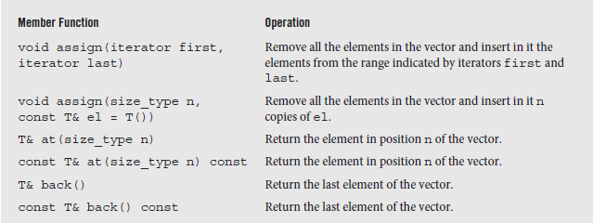
Vectors in the STL (continued)
In addition to the traditional array notation, a vector’s elements can be accessed using iterators
This requires the dereferencing notation used for pointers
A partial list of the member functions of the class vector is shown below; the remainder is on pages 28 and 29.
Fig. 1-3 An alphabetical list of member functions in the class vector (partial)

Slide 50
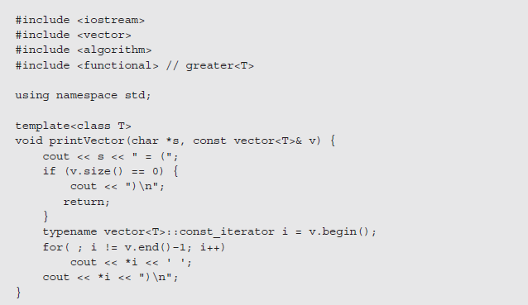
Vectors in the STL (continued)
An example of vector member functions is given in the following program
Fig. 1-4 A program demonstrating the operation of vector member functions

Slide 51
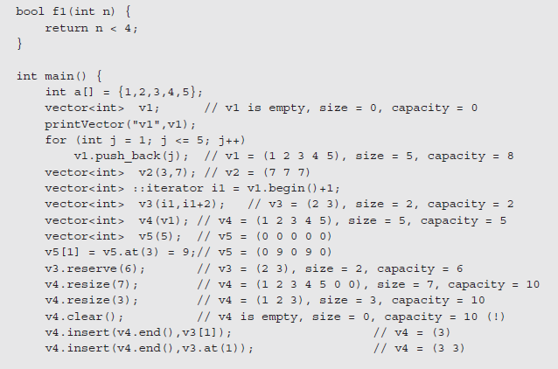
Vectors in the STL (continued)
Fig. 1-4 (continued)

Slide 52
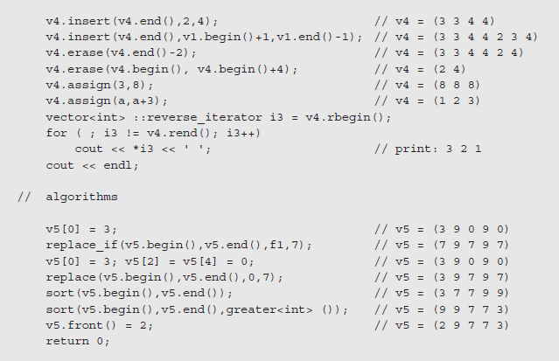
Vectors in the STL (continued)
Fig. 1-4 (concluded)

Slide 53
Data Structures and OOP
The notion of a data type is an abstraction that allows us to hide the details of how the type is implemented
To use effectively, we concern ourselves with the operations that can be performed on it that make it distinctive
While a given programming language may incorporate some data types, the user may have to define their own
These new types typically have a distinct organization that can be exploited to define the type’s behavior
The task then is to study the structure of these types in terms of time and space requirements so we can determine their usefulness

Slide 54
Data Structures and OOP (continued)
This is the opposite of OOP, where we focus on behavior and try to match the data types to the desired operations efficiently
We can look at the field of data structures as a tool building effort that focuses on creating efficient objects that can be incorporated into programs
From this perspective, classes are defined in terms of the mechanisms of the class, typically hidden from the user
By using the features of OOP, the classes can be designed and modified behind the protections afforded by principles of encapsulation and data hiding

Slide 55
Data Structures and OOP (continued)
These protections ensure that the tools that are created are used only in the way that is allowed by the public interface of the class

