Slide 1
Aspect-based Sentiment Analysis for Vietnamese
Group 11
Vu Hai Dang - 20225962
Nguyen Minh Khoi - 20226050
Le Dai Lam - 20225982
Pham Thanh Nam - 20225989
Bui Hoang Viet - 20226073

Slide 2
01
02
03
Introduction
Related work
Dataset
04
Model Architecture
05
06
Experiment & Result
Improvement

Slide 3
01.
Introduction

Slide 4
Introduction
This work aimed to solve the Aspect-based Sentiment Analysis (ABSA) problem for Vietnamese. Specifically, we focus on 2 sub-tasks of the Aspect Category Sentiment Analysis (ACSA):
  Aspect Category Detection (ACD): Detect Aspect#Category pairs in each review (e.g., HOTEL#CLEANLINESS, RESTAURANT#PRICES, SERVICE#GENERAL, etc.)
  Sentiment Polarity Classification (SPC): Classify the Sentiment Polarity (Positive, Negative, Neutral) of each Aspect#Category pair.

Slide 5
02.
Related work
BERT
RoBERTa
PhoBERT

Slide 6
BERT

Slide 7
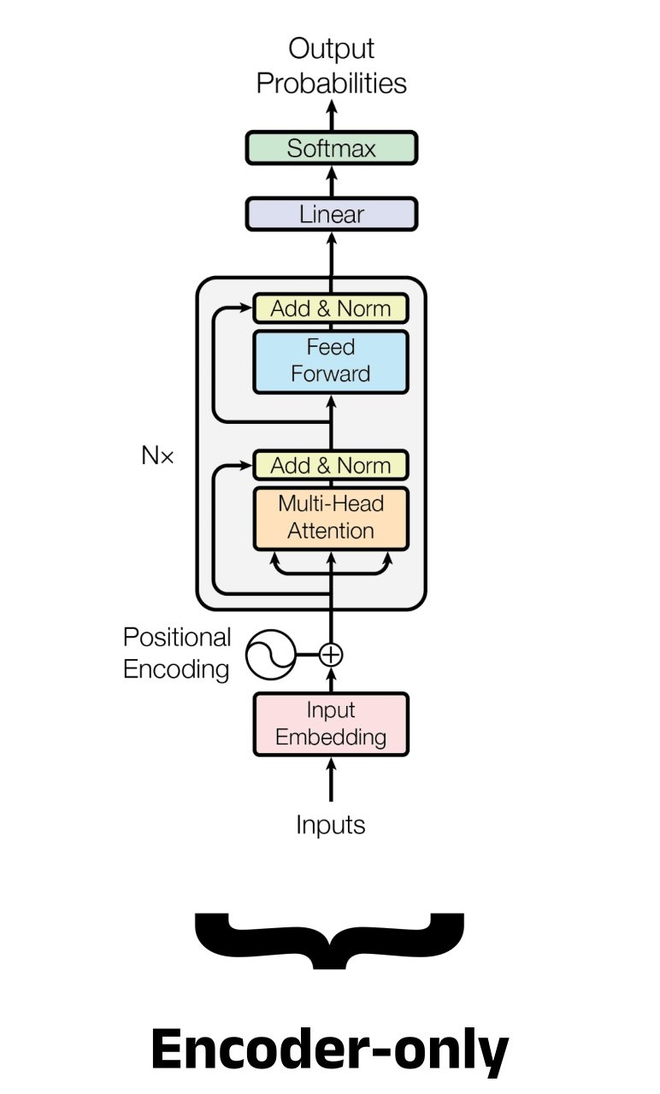
BERT
BERT (Bidirectional Encoder Representations from Transformers)
Developed by Google in 2018, revolutionized NLP.
Its pre-training involves Masked Language Modeling and Next Sentence Prediction on vast text corpora.
BERT can learn rich language representations.
After pre-training, it can be fine-tuned for various downstream tasks like sentiment analysis or question.

Slide 8
RoBERTa

Slide 9
RoBERTa
RoBERTa, (a robustly optimized BERT approach) by Facebook AI (2019), significantly improved upon BERT's performance.
It achieved this by training longer on substantially more data (160GB vs. 16GB), using larger batch sizes, and implementing dynamic masking. Crucially, RoBERTa also removed BERT's Next Sentence Prediction objective, focusing solely on the Masked Language Model task.
These refinements allowed RoBERTa to learn more generalized and robust language representations, consistently outperforming BERT on various NLP benchmarks and advancing the state of the art.

Slide 10
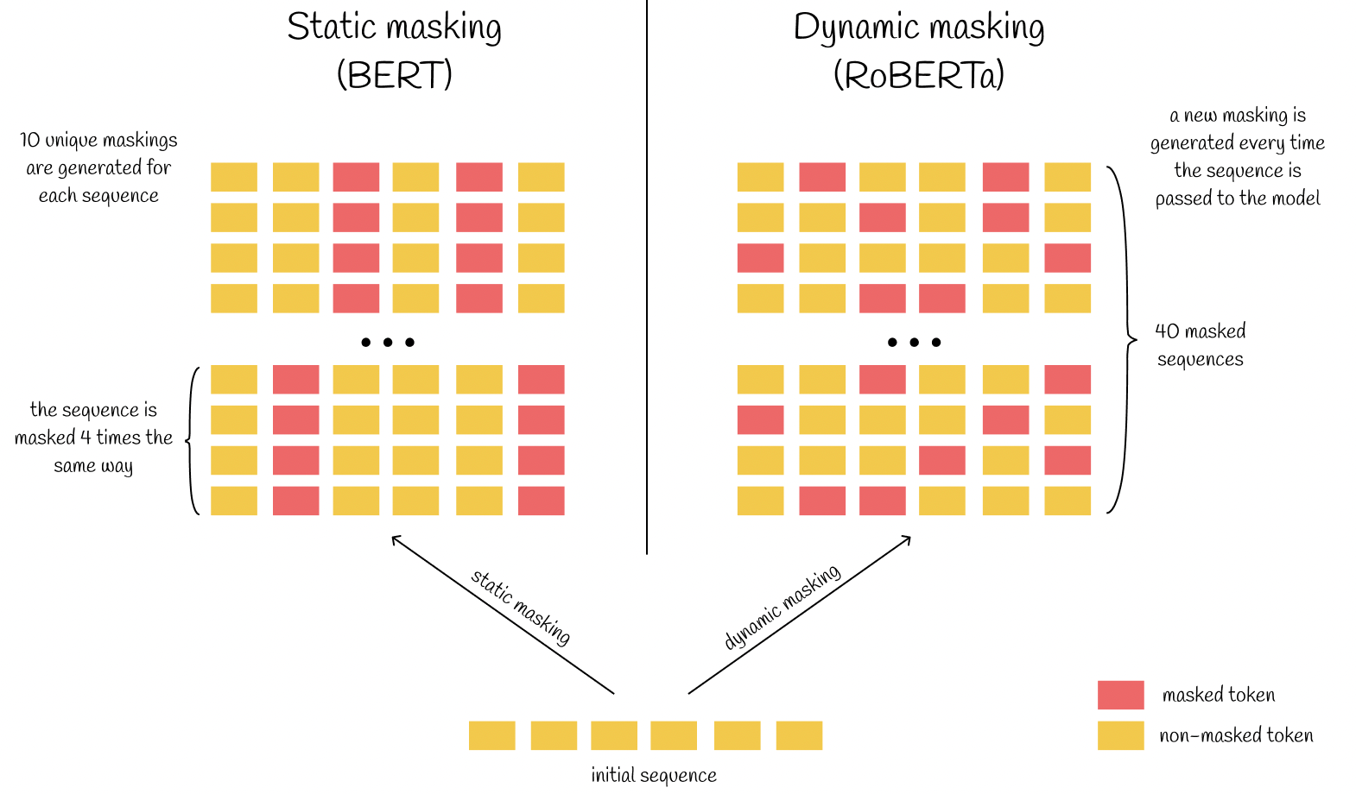
RoBERTa
More Data
Longer Training and Larger Batches
Dynamic Masking
Removal of the Next Sentence Prediction (NSP) Objective
Byte-Pair Encoding (BPE) Tokenization

Slide 11
PhoBERT

Slide 12

PhoBERT
A SOTA pre-trained language model specifically designed for the Vietnamese language. Released by VinAI Research.
PhoBERT’s architecture is based on RoBERTa
Train on an enormous dataset of Vietnamese text, comprising approximately 20-35GB of raw text data.

Slide 13
03.
Dataset
Dataset
Preprocessing pipeline

Slide 14
Dataset
Domain | Dataset | No. Reviews | No. Aspect# Cate,Polarity | Avg. Length | Vocab Size
Hotel | Training | 3,000 | 13,948 | 47 | 3,908
 | Dev | 2,000 | 7,111 | 23 | 2,745
 | Test | 600 | 2,584 | 30 | 1,631
The dataset primarily focuses on hotel reviews, a common and rich source of aspect-level sentiment. The core task defined for this dataset is Aspect Category Sentiment Analysis (ACSA). This involves two main sub-problems:
Aspect Category Detection: Identifying the entity (E) and attribute (A) pairs (e.g., "ROOMS#DESIGN","SERVICE#GENERAL")
Sentiment Polarity Classification: Assigning one of three sentiment polarization labels ("Positive", "Negative", "Neutral") to each detected Entity#Attribute pair.

Slide 15
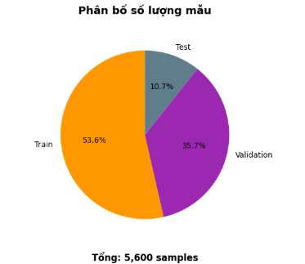
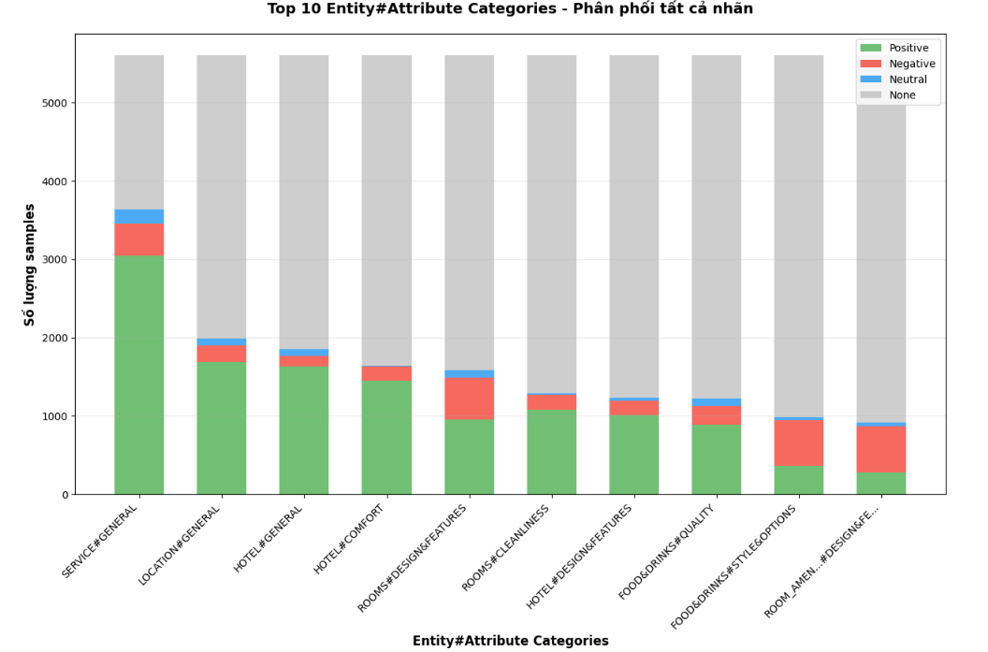
Dataset Overview

Slide 16
Data preprocessing pipeline
Remove HTML
Standardize Unicode
Normalize Acronym
Word Segmentation
Remove unnecessary character
Delete the HTML codes in the original dataset.
Perform the charset standardization from Windows-1252 to UTF-8 and standardized common Vietnamese dataset.
Do the segmentation for Vietnamese words before starting further processing, and we used the VnCoreNLP toolkit to implement that step.
Remove unnecessary characters, this helps to reduce the number of feature dimensions for sentence, increase the speed, avoids bad influence on the model results.

Slide 17
04.
Model
Architechture
ACSA - v1
ACSA – v2

Slide 18
Model
Architechture
We implemented end-to-end models with the same architecture in two approaches: Multi-task and Multi-task with Multibranch to handle both ACD and SPC task simultaneously using PhoBERTbase as a pre-trained language model for Vietnamese.
Based on the original BERT paper, the model achieved the best results when concatenating the last four layers of BERT together.

Slide 19
ASCA – v1
Multi-task Approach

Slide 20
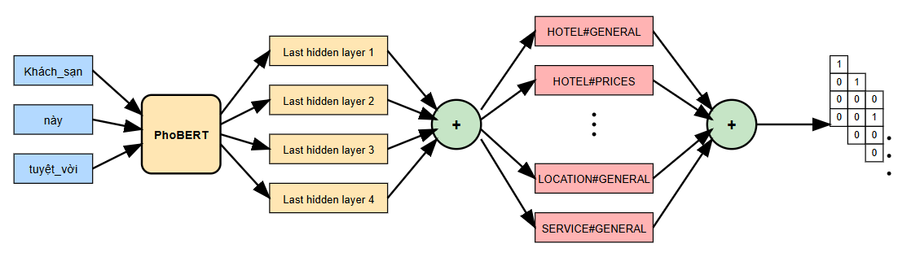
ASCA – v1
Multi-task Approach
The model is constructed with the output as a list of C one-hot vectors, where C is the number of aspects present in the dataset used.
We will not simply feedforward the learned feature to each Dense layer one-by-one. Instead, we will concatenate them into a single Dense l

Slide 21
ASCA – v1
Multi-task Approach
Each vector has 4 components: Positive, Negative, Neutral, None.
If a label exists, its corresponding component is set to 1; otherwise, it is 0.

Slide 22
ASCA – v1
Multi-task Approach
We use Softmax function because the key issue here is that the polarities within an Aspect# Category are not entirely independent. For example: If the Aspect# Category is strongly Positive, it's less likely to be Negative or Neutral.
The Concatenation mixes the independent Aspect# Category, Polarity information and allows the network to learn complex/shared relationships between them.

Slide 23
ASCA – v2
Multi-task with Multi-branch Approach

Slide 24
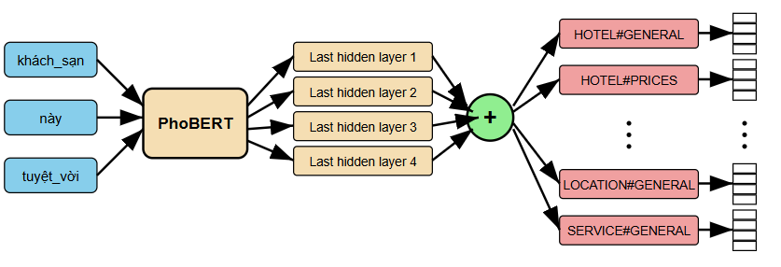
ASCA – v2
Multi-task with Multi-branch Approach
Differs from ASCA – v1: branches into multiple sub-models using C Dense layers (34 for Hotel and 12 for Restaurant), without concatenating them into one
Each Dense layer predicts its corresponding task independently. Therefore, each model will predict each task independently, not sharing parameters between them.

Slide 25
ASCA – v2
Multi-task with Multi-branch Approach
The Softmax function is applied here to get the probability distribution over the 4 polarity classes directly without converting them into one-hot vectors.
Therefore, the categorical_cross_entropy loss function will be used to treat each Dense layer as a multi-class classification problem.

Slide 26
05.
Experiment &
Result
ACSA - v1
ACSA – v2

Slide 27
5.1 Experimental Setup

Slide 28
5.1. Experimental Setup
The experiments were conducted on the VLSP 2018 ABSA dataset (Hotel domain). The dataset comprises:
  Training set: 3,000 reviews with 13,948 Aspect# Category, Polarity annotations.
  Development set: 2,000 reviews with 7,111 annotations.
  Test set: 600 reviews with 2,584 annotations.

Slide 29
5.1. Experimental Setup
The Hotel domain includes 34 distinct Aspect# Category pairs. For model training and evaluation, the following configurations were employed:
  Pre-trained model: PhoBERT.
  Input sequence length: 256 tokens.
  Batch size: 20.
  Number of epochs: 20, with early stopping applied.
  Optimizer: AdamW.
  Learning rate schedule: Linear decay with a warm-up phase covering 10% of the total steps.
  Initial learning rate: 2 × 10−4

Slide 30
5.2 Result on the Hotel Domain

Slide 31
5.2. Result on the Hotel Domain
The models were evaluated on two tasks:
  Aspect Category Detection (ACD): Identifying the presence of specific Aspect#Category pairs in reviews.
  Aspect Category Detection with Sentiment Polarity Classification (ACD + SPC): Identifying Aspect# Category pairs along with their associated sentiment polarity (Positive, Negative, Neutral).
  The evaluation metric used was the micro F1-score, Precision and Recall.

Slide 32
5.2. Result on the Hotel Domain
Task | Method | Precision | Recall | F1-score
Aspect# Category | VLSP best submission | 76.00 | 66.00 | 70.00
 | Bi-LSTM+CNN | 84.03 | 72.52 | 77.85
 | BERT-based Hierarchical | - | - | 82.55
 | Multi-task | 87.45 | 78.17 | 82.55
 | Multi-task Multi-branch | 63.21 | 57.86 | 60.42
Aspect# Category, Polarity | VLSP best submission | 66.00 | 57.00 | 61.00
 | Bi-LSTM+CNN | 76.53 | 66.04 | 70.90
 | BERT-based Hierarchical | - | - | 74.69
 | Multi-task | 81.90 | 73.22 | 77.32
 | Multi-task Multi-branch | 57.55 | 52.67 | 55.00

Slide 33
06.
Improvement

Slide 34
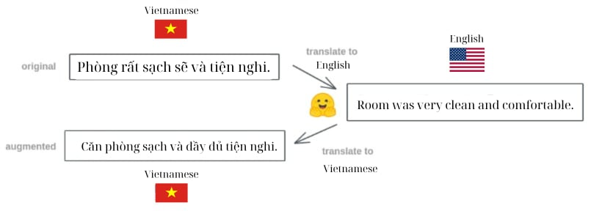
Back-Translation for Data Augmentation
Goal: Increase lexical diversity & generalization without modifying model architecture and partially address data imbalance.
Method: Translate reviews Vietnamese → English → Vietnamese using MarianMT:
  Models: opus-mt-vi-en, opus-mt-en-vi
  Selected ~7% of original training set (≈ 200/3000 reviews)
Result
  Training data: ↑ from 3,000 to ~3,200
  +1% improvement in micro F1-score (0.7255->0.7378)
  Better handling of rare aspect-polarity pairs

Slide 35
Conclusion
The experimental results on the VLSP 2018 ABSA Hotel dataset highlight the effectiveness of our proposed Multi-task learning approach based on PhoBERT.
The model achieved the highest performance across two main tasks:
  Aspect Category Detection (ACD): 82.55% F1-score
  ACD with Sentiment Polarity Classification (ACD + SPC): 77.32% F1-score
In summary, the combination of PhoBERT and multi-task learning not only improves the accuracy of aspect-level sentiment analysis but also demonstrates strong generalizability across finegrained classification tasks.

Slide 36
Thank you for listening!

