Slide 1
OS Project:
Scheduling Algorithms in Multiprocessor Systems
Group member:
Nguyễn Minh Khôi 20226050 Vũ Hải Đăng 20225962 Lê Đại Lâm 20225982

Slide 2
01
Introduction
02
First-Come, First-Served
03
Shortest Job First
04
Shortest Time-to-Completion First
05
Round Robin
06
Priority Scheduling
07
Multilevel Feedback Queue

Slide 3
01
Introduction
x
y

Slide 4
Introduction
Scheduling algorithms benefits:
Optimizing processor usage
Reducing latency
Workloads are distributed evenly across multiple processors
Algorithm
First-Come, First-Served
Shortest Job First
Shortest Time-to-Completion First
Round Robin
Priority Scheduling
Multilevel Feedback Queue

Slide 5
Challenges of Scheduling
Load Balancing: Distributing tasks evenly across processors to avoid overload and underutilization, maximizing system performance.
Processor Affinity: Processes run faster on processors they’ve previously used due to caching. Maintaining this affinity is challenging in dynamic systems.
Synchronization: Ensuring processes on different processors can communicate without causing data inconsistencies, race conditions, or deadlocks.
Scalability: As processors increase, managing scheduling, load balancing, and synchronization becomes more complex. Scalability is vital for efficient performance in larger systems.

Slide 6
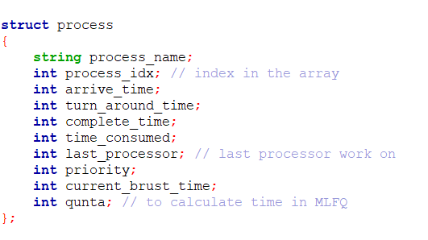
Implementation
We will implement algorithms using four processors. The implementation consists of the following main components:
Process: Represents a task or operation to be executed.
WillGotoProcessor[4]: This array permanently stores the IDs of the processes assigned to each processor.
The match_preferences(): Function assists in reassigning processes, prioritizing reallocation to the CPU a process last used if that CPU is free, which helps to optimize performance

Slide 7
02
First-Come, First-Served (FCFS)
404 NOT FOUND

Slide 8
First-Come, First-Served (FCFS)
A non-preemptive scheduling algorithm where processes are executed in the order they arrive without interruption until completion:
Each processor can handle one process at a time.
When all processors are occupied, new arriving processes are stored in a waiting queue until a processor becomes free.
Once a process is completed, the processor marks the process as finished. Completed processes are recorded, and the system stops once all processes are completed.

Slide 9
First-Come, First-Served (FCFS)
Function FCFS(n, processes[])
For each time unit t:
1. Handle arriving processes:
While processes arrive at time t:
If a processor is idle, assign the process to it.
2. Add unprocessed processes to the waiting queue:
For each arriving process with no available processor:
Add the process to the waiting queue.
3. Process tasks:
For each processor:
If idle, mark it as idle.
Else, process for 1 unit of time.
If a process completes:
Mark it as finished.
4. Process waiting queue:
If there are idle processors, assign waiting processes from the queue.
5. Check termination:
If all processes are finished, print results and exit.

Slide 10
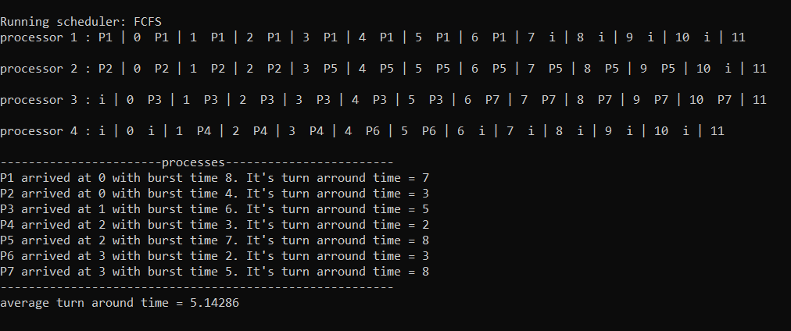
First-Come, First-Served (FCFS)

Slide 11
First-Come, First-Served (FCFS)
Advantages
Disadvantages
Simplicity: FCFS is easy to implement and understand.
Predictability: FCFS provides predictable execution by following a fixed order of arrival.
Inefficiency: FCFS may lead to long waiting times for processes with short burst times if they are queued after long tasks, known as the convoy effect.
Poor Load Balancing: FCFS doesn’t consider load distribution among processors, so some processors may remain idle while others are overloaded.
Lack of Prioritization: Processes are not prioritized by urgency or processing time, which can lead to inefficient use of processor time.

Slide 12
03
Shortest Job First

Slide 13
Shortest Job First
Each processor can handle one process at a time.
Processes are sorted by burst time, and a priority queue (waiting) is used to manage processes based on their burst time.
Once a process is completed, the processor marks the process as finished. Completed processes are recorded, and the system stops once all processes are complete.

Slide 14
Shortest Job First
Function SJF(n, processes[])
For each time unit t:
1. Handle arriving processes:
For each process that arrives at time t:
If a processor is idle, assign the process.
Else, add the process to the waiting queue.
2. Execute processes:
For each processor:
If idle, assign the shortest job from the waiting queue.
Else, process for 1 unit of time, update its state.
If process finishes or needs next phase, handle transition.
3. Check termination:
If all processes have finished, print the results and exit.

Slide 15
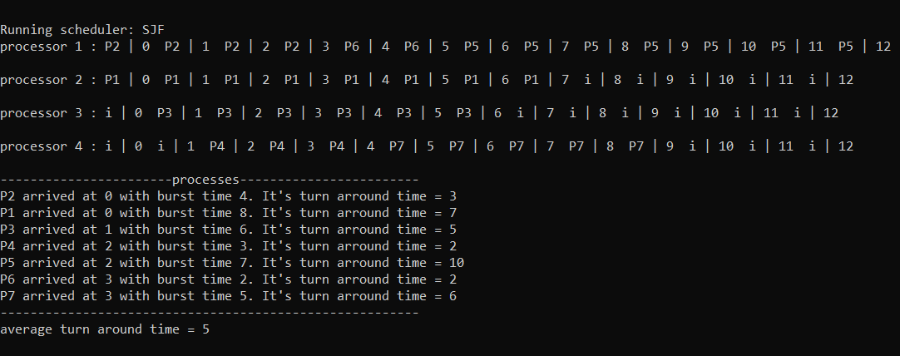
Shortest Job First

Slide 16
Shortest Job First
Advantages
Disadvantages
Complexity: Using a priority queue adds complexity compared to simpler FCFS scheduling, especially when dynamically sorting by burst time.
Starvation: Processes with long burst times may experience starvation if shorter tasks continuously enter the queue.
Efficiency: SJF reduces the average waiting time by prioritizing processes with shorter burst times.
Better Load Balancing: By selecting the shortest job next, SJF ensures quicker process turn overs, which can help distribute the load among processors more evenly.

Slide 17
04
Shortest Time-to-Completion First

Slide 18
Shortest Time-to-Completion First
Using a priority queue, waiting, to manage processes waiting for execution.
At each time unit t, processes that are ready are added to the waiting queue if no CPU is available.
The process with the shortest remaining burst time is selected for each available CPU to optimize processing time and reduce wait time.
The match_preferences() function assists in reassigning processes, prioritizing reallocation to the CPU a process last used if that CPU is free, which helps to optimize performance.

Slide 19
Shortest Job First
Function STCF(n, processes[])
For each time unit t:
1. Handle arriving processes:
While processes arrive at time t:
Add them to the waiting queue with their burst time.
2. Reassign processors:
For each processor:
If not idle, add the process to the waiting queue and clear the processor.
Assign the next process from the waiting queue to the processor.
3. Execute processes:
For each processor:
If idle, mark it as idle.
Else, process for 1 unit of time, update its state.
If process finishes, handle transitions or termination.
4. Check termination:
If all processes are finished, print results and exit.

Slide 20
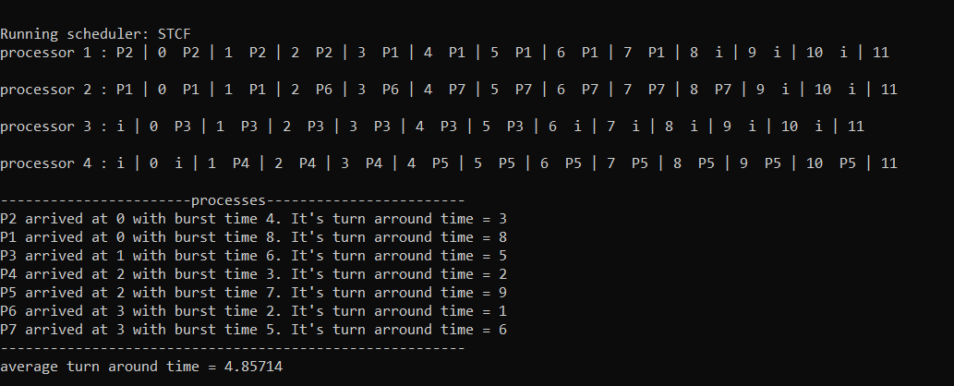
Shortest Time-to-Completion First

Slide 21
Shortest Time-to-Completion First
Advantages
Disadvantages
Minimized Average Wait Time: STCF selects the process with the shortest remaining time, minimizing the average wait time and improving scheduling efficiency.
Reduced Latency: Prioritizing the reassignment of processes to previously used CPUs reduces latency due to caching
High Resource Contention: When many processes have significantly different burst times, some may experience longer wait times due to competition for resources.

Slide 22
05
Round Robin

Slide 23
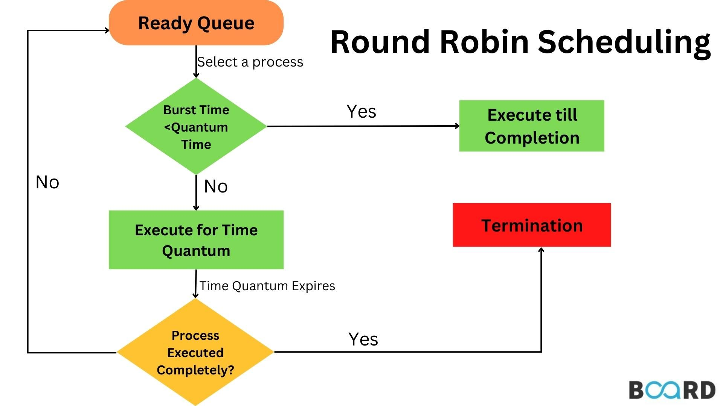
Round Robin
Purpose
Efficient CPU scheduling for multi-processor systems
Ensures fairness and optimal resource allocation
Working principle
Processes are managed in a queue
Each process runs for a fixed time(time slice)on available CPUs
Unfinished processes return to the queue
Optimazation
Processes prioritize the last-used CPU to reduce overhead

Slide 24
Round Robin
Function round_robin(n, processes[])
Initialize:
Queue my_queue, time_slice
For each time unit t:
1. Handle arrivals:
For each arriving process:
If processor idle, assign it; else, add to my_queue
2. Execute processes:
For each processor:
If idle:
If my_queue has processes, assign one
Else:
Run process for 1 unit of time
If time_slice or burst complete:
If finished, update times, else push back to queue
Assign new process if needed
3. Match processors:
Call match_preferences
4. Check termination:
If all processes finished, print results and exit

Slide 25
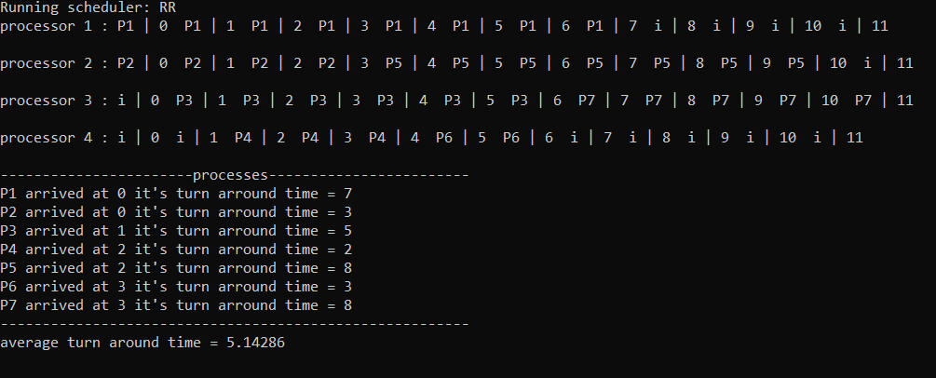
Round Robin

Slide 26
Round Robin
Advantage
Disadvantage
Ensures fairness and prevents starvation
Simple to implement with a queue and time slice
Well-suited for time-sharing systems.
High overhead from frequent context switches.
Not efficient for long or CPU-bound tasks.
Challenging to select the optimal time slice.

Slide 27
06
Priority Scheduling

Slide 28
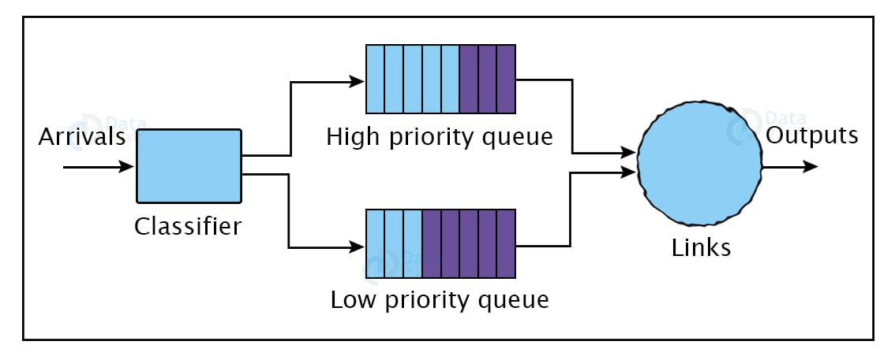
Priority Scheduling
Purpose
Efficiently schedules processes based on priority
Ensure fair and balanced CPU-used
Working principle
Processes are assigned to CPUs based on their priority
Higher-priority processes are scheduled first
Processes awaiting execution are managed in a priority queue
Optimazation
Reassigns processes to their previous CPUs to reduce context switching and improve efficiency

Slide 29
Priority Scheduling
Function Priority(n, processes[])
Initialize:
priority_queue waiting_queue
For each time unit t:
1. Handle arriving processes:
For each process that arrives at time t:
If a processor is idle, assign the process to it.
Else, add the process to the waiting queue.
2. Execute processes:
For each processor:
If idle, assign the highest-priority process from the waiting queue.
Else, process for 1 unit of time, update its state.
If process finishes or needs next phase, handle transition.
3. Check termination:
If all processes have finished, print the results and exit.

Slide 30
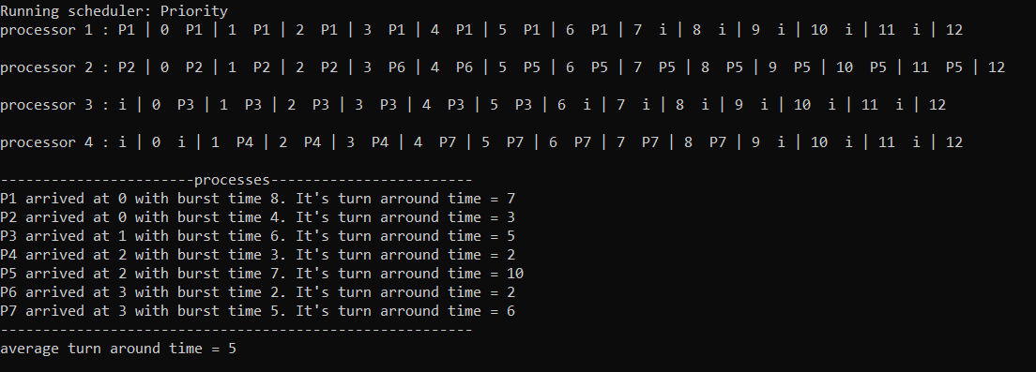
Priority Scheduling

Slide 31
Priority Scheduling
Advantage
Disadvantage
Fair CPU time distribution.
Balances workloads efficiently across multiple processors
Handles multiple processes without prioritization bias
High overhead from queue management.
Inefficient with varying burst times
Delays for high-priority processes

Slide 32
07
Multilevel Feedback Queue

Slide 33
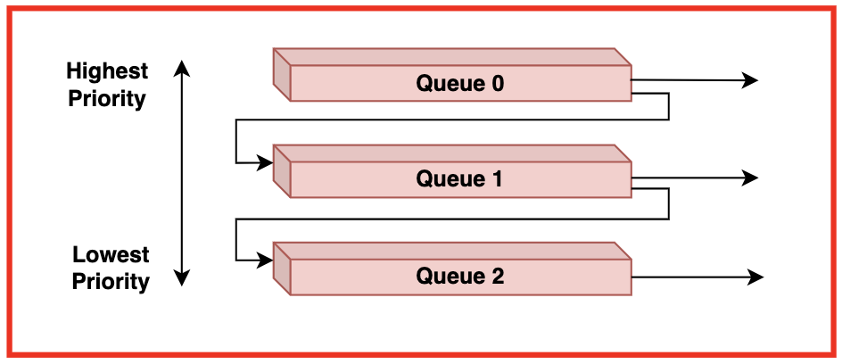
Multilevel Feedback Queue
Purpose
Efficiently schedules processes using multiple priority queues
Ensures fairness by adjusting priorities based on process behavior.
Working principle
Processes are assigned to queues based on priority and behavior
Higher-priority processes get CPU first, lower-priority ones wait
Processes exceeding their time are moved to lower-priority queues
Optimazation
Reassigns processes to their last-used CPU to minimize context switching.

Slide 34
Multilevel Feedback Queue
Function MLFQ(n, processes[])
Initialize priority queues, processors, and variables.
For each time unit t:
1. Handle arriving processes:
Assign to idle processors, preempt lower-priority processes, or add to Queue 0.
2. Update running processes:
Track execution, check quantum/burst completion.
If quantum exceeded, demote process to a lower-priority queue.
If burst completed, mark process as finished.
3. Assign idle processors:
Allocate processes from the highest-priority non-empty queue.
If all processes are finished:
Print results and terminate.

Slide 35
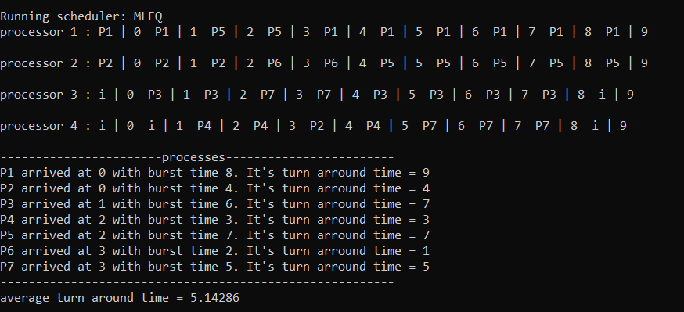
Multilevel Feedback Queue

Slide 36
Multilevel Feedback Queue
Advantage
Disadvantage
Prioritizes important processes, reducing latency
Supports real-time systems efficiently
Allows dynamic priority adjustments for fairness.
Complex to implement and maintain
Risk of starving low-priority processes
High overhead from frequent context switches.

Slide 37
Result
Algorithm | Average Round Time (s)
First-Come, First-Served | 20.65
Shortest Job First | 14.45
Shortest Time-to-Completion First | 14.175
Round Robin | 21.5
Priority Scheduling | 18.475
Multilevel Feedback Queue | 27.625
In environments where accurate burst time predictions are not feasible, algorithms RR or MLFQ are more suitable due to their flexibility.
SJF and STCF require the system to predict the burst time of processes, which is often difficult in real-world systems.

Slide 38
Comparision
Algorithm | Advantages | Disadvantages | Suitability in Multi processor systems
FCFS | Simple, no starvation. | High waiting time, no load balancing. | Poor, lacks flexibility.
SJF | Minimizes waiting time. | Needs burst time prediction, may starve long tasks. | Good if proper prediction.
STCF | Minimizes response time. | High overhead, sync challenges. | Effective with low load.
RR | Fair, good for interactive tasks. | Frequent context switches. | Fair but less efficient.
Priority | Critical tasks prioritized. | Low-priority starvation. | Ideal for real-time systems.
MLFQ | Adaptive, balances workloads. | Complex | Well-suited for multiprocessor systems, as multiple queues can help distribute tasks.

