Slide 1
Group 5
2D Laplace Equations-Successive Over Relaxation Method
Apply for 2D-Steady heat distribution

Slide 2
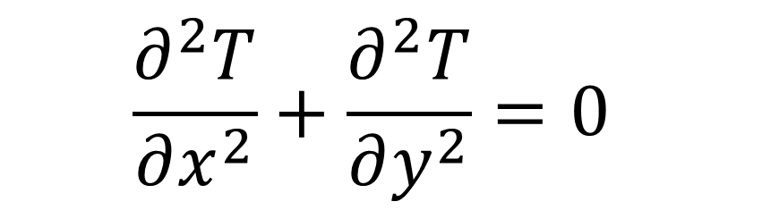
2D Laplace Equations
$$\frac{∂^{2}T}{∂x^{2}}+\frac{∂^{2}T}{∂y^{2}}=0$$

Slide 3
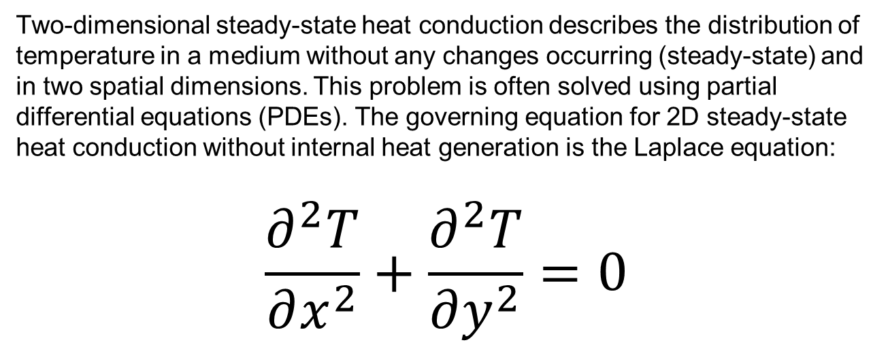
Steady 2D heat conduction
Two-dimensional steady-state heat conduction describes the distribution of temperature in a medium without any changes occurring (steady-state) and in two spatial dimensions. This problem is often solved using partial differential equations (PDEs). The governing equation for 2D steady-state heat conduction without internal heat generation is the Laplace equation:
$$\frac{∂^{2}T}{∂x^{2}}+\frac{∂^{2}T}{∂y^{2}}=0$$

Slide 4
Theoretical basis of Physics
1, Fourier's Law of Heat Conduction
Fourier's law describes how heat conduction occurs through a material:
q = −k.∇ T
Where:
q is the heat flux vector, representing the amount of heat flowing through a unit area per unit time.
k is the thermal conductivity of the material.
∇ T is the temperature gradient
2, Principle of Energy Conservation
In the steady - state condition, the balance of heat at any point in the material can be described by the equation:
∇q + Q = 0
where Q is a heat source or sink. In the absence of any heat sources or sinks, this simplifies to:
∇q = 0

Slide 5
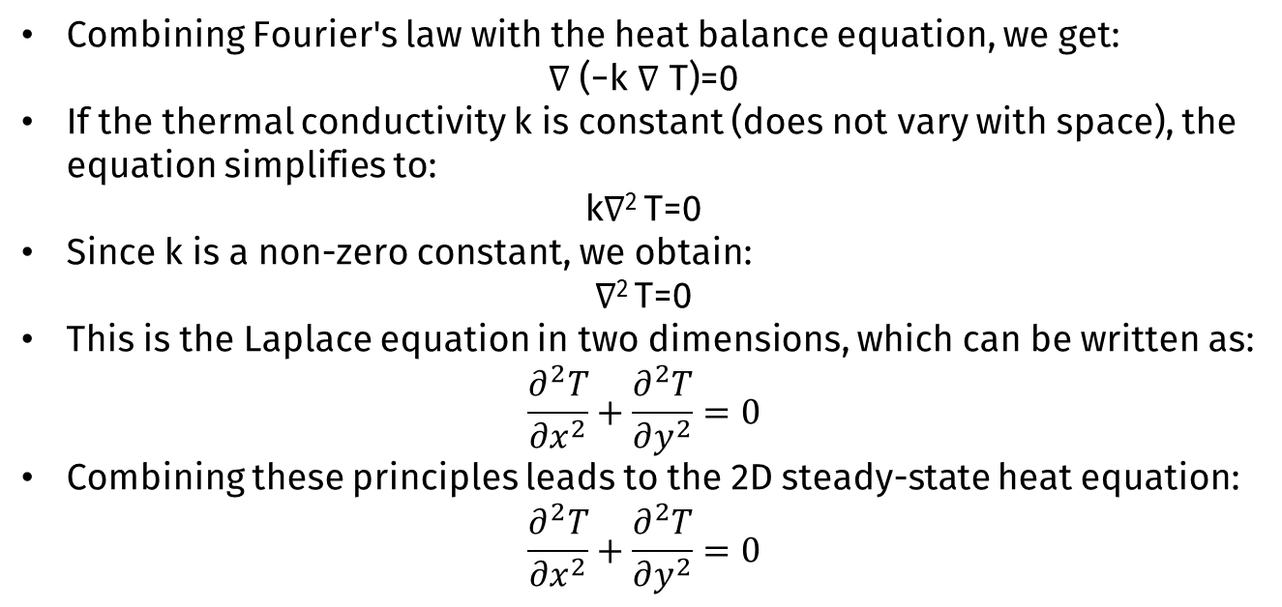
Theoretical basis of Physics
Combining Fourier's law with the heat balance equation, we get:
∇ (−k ∇ T)=0
If the thermal conductivity k is constant (does not vary with space), the equation simplifies to:
k∇² T=0
Since k is a non-zero constant, we obtain:
∇² T=0
This is the Laplace equation in two dimensions, which can be written as:
$$\frac{∂^{2}T}{∂x^{2}}+\frac{∂^{2}T}{∂y^{2}}=0$$
Combining these principles leads to the 2D steady-state heat equation:
$$\frac{∂^{2}T}{∂x^{2}}+\frac{∂^{2}T}{∂y^{2}}=0$$

Slide 6
The idea of Iterative method
1, An initial solution is guessed and new values are computed.
2, Based on the newly computed values, answer solution is sought.
3, The procedure is repeated until a specified convergence criterion has been reached.
4, The various formulations of the iterative method can be divided into two categories.

Slide 7
01
Jacobi Iteration Method

Slide 8

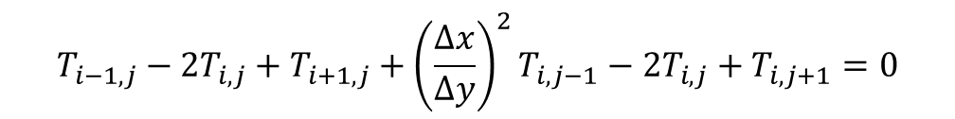
The Jacobi Iteration Method
The dependent variable at each grid point is solved ( at the new iteration k+1 level), using initial guessed values or previously computed values (at the new iteration k level).
The computation is carried out until a specified convergence criterion is met
$$\frac{∂^{2}T}{∂x^{2}}+\frac{∂^{2}T}{∂y^{2}}=0$$
$$T_{i−1,j}−2T_{i,j}+T_{i+1,j}+{\left(\frac{∆x}{∆y}\right)}^{2}T_{i,j−1}−2T_{i,j}+T_{i,j+1}=0$$

Slide 9

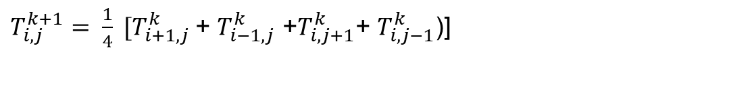
The Jacobi Iteration Method
$$T_{i+1,j}+T_{i−1,j}+{β^{2}T}_{i,j+1}+β^{2}T_{i,j−1}−2{(1+β^{2})T}_{i,j}=0$$
$T_{i,j}^{k+1}= \frac{1}{2(1+β^{2})} [T_{i+1,j}^{k}$+ $T_{i−1,j}^{k+1}$ + $β^{2}(T_{i,j+1}^{k}$+ $T_{i,j−1}^{k+1}$)]
Now let$∆x=∆y$, then $β=1$ and the Jacobi equation reduces to:
$T_{i,j}^{k+1}= \frac{1}{4} [T_{i+1,j}^{k}$+ $T_{i−1,j}^{k}$ +$T_{i,j+1}^{k}$+ $T_{i,j−1}^{k}$)]

Slide 10
02
SOR using Gauss-Seidel Iteration Method

Slide 11
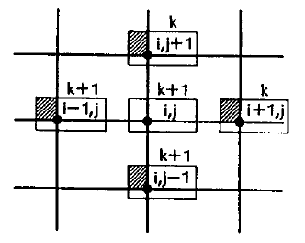
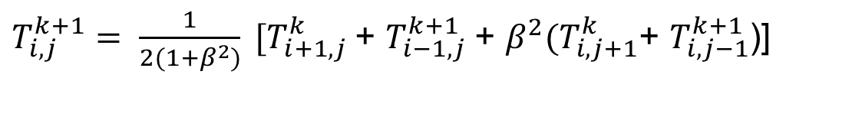
Gauss-Seidel Iteration Method
It is an improve of the Jacobi method by using the newly computed values of the dependent variable
Increases the convergence rate
Lead to less computation time
$T_{i,j}^{k+1}= \frac{1}{2(1+β^{2})} [T_{i+1,j}^{k}$+ $T_{i−1,j}^{k+1}$ + $β^{2}(T_{i,j+1}^{k}$+ $T_{i,j−1}^{k+1}$)]

Slide 12
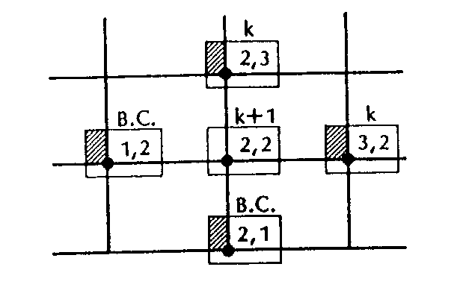
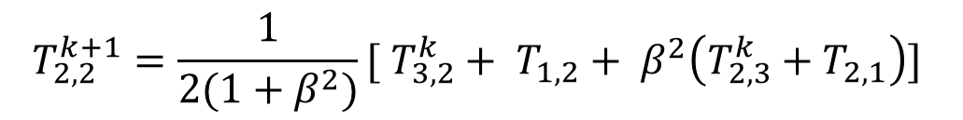
Gauss-Seidel Iteration Method
For the computation of the first point
$$T_{2,2}^{k+1}=\frac{1}{2(1+β^{2})}[ T_{3,2}^{k}+ T_{1,2}+ β^{2}\left(T_{2,3}^{k}+T_{2,1}\right)]$$

Slide 13
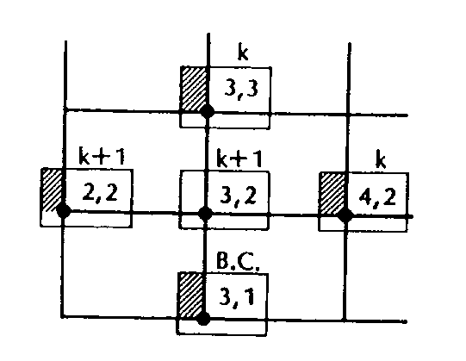
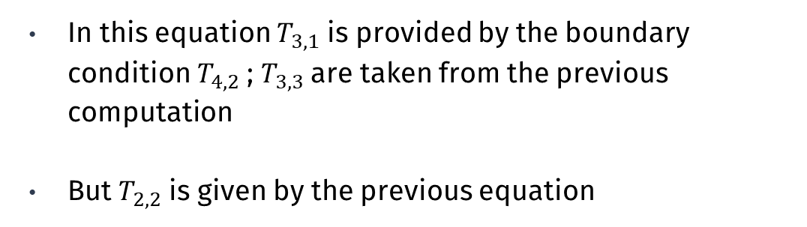
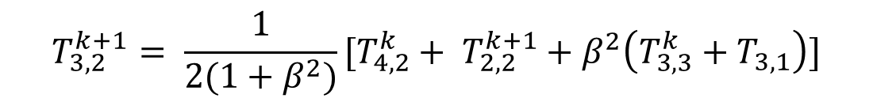

Gauss-Seidel Iteration Method
$$T_{3,2}^{k+1}= \frac{1}{2(1+β^{2})}[T_{4,2}+T_{2,2}+β^{2}\left(T_{3,3}+T_{3,1}\right)]$$
For point (3,2):
In this equation $T_{3,1}$ is provided by the boundary condition $T_{4,2}$ ; $T_{3,3}$ are taken from the previous computation
But $T_{2,2}$ is given by the previous equation
$$T_{3,2}^{k+1}= \frac{1}{2(1+β^{2})}[T_{4,2}^{k}+ T_{2,2}^{k+1}+β^{2}\left(T_{3,3}^{k}+T_{3,1}\right)]$$

Slide 14
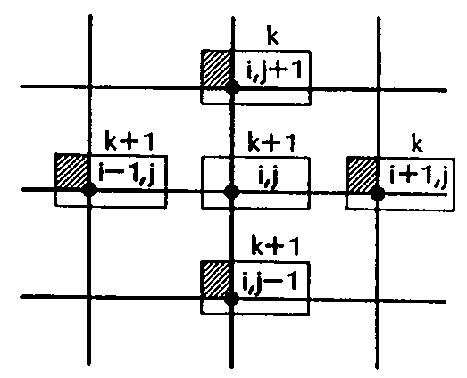
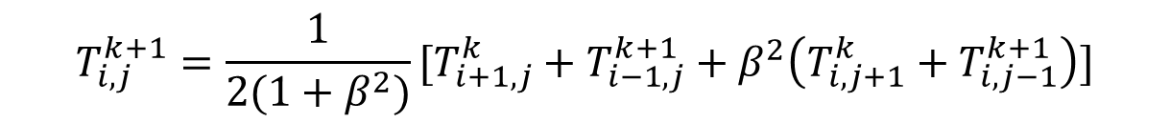
Gauss-Seidel Iteration Method
Finally, the general formulation provides the equation
$$T_{i,j}^{k+1}=\frac{1}{2(1+β^{2})}[T_{i+1,j}^{k}+T_{i−1,j}^{k+1}+β^{2}\left(T_{i,j+1}^{k}+T_{i,j−1}^{k+1}\right)]$$
This is a point iteration method, since only one unknown is being required

Slide 15
Successive Over Relaxation Method
1, First, consider the point Gauss-Seidel iteration method:
$$T_{i,j}^{k+1}=\frac{1}{2(1+β^{2})}[T_{i+1,j}^{k}+T_{i−1,j}^{k+1}+β^{2}\left(T_{i,j+1}^{k}+T_{i,j−1}^{k+1}\right)]$$
2, Adding to the right-hand side $T_{i,j}^{k+1}$- $T_{i,j}^{k+1}$ and collecting terms:
$$T_{i,j}^{k+1}=T_{i,j}^{k}+\frac{1}{2(1+β^{2})}[T_{i+1,j}^{k}+T_{i−1,j}^{k+1}+β^{2}\left(T_{i,j+1}^{k}+T_{i,j−1}^{k+1}\right)−2(1+β^{2})T_{i,j}^{k}]$$

Slide 16
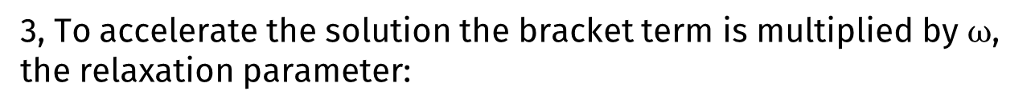
Successive Over Relaxation Method
3, To accelerate the solution the bracket term is multiplied by $⍵$, the relaxation parameter:
$$T_{i,j}^{k+1}=T_{i,j}^{k}+\frac{⍵}{2(1+β^{2})}[T_{i+1,j}^{k}+T_{i−1,j}^{k+1}+β^{2}\left(T_{i,j+1}^{k}+T_{i,j−1}^{k+1}\right)−2(1+β^{2})T_{i,j}^{k}]$$
4, The formulation is rearranged as:
$$T_{i,j}^{k+1}={(1−\text{ω})T}_{i,j}^{k}+\frac{⍵}{2(1+β^{2})}[T_{i+1,j}^{k}+T_{i−1,j}^{k+1}+β^{2}\left(T_{i,j+1}^{k}+T_{i,j−1}^{k+1}\right)]$$

Slide 17
Successive Over Relaxation Method
Theorems can show that 0 < ω < 2 is a condition for a scheme to converge.
If we choose 0 < ω < 1 the solution called under-relaxation, and the convergence will be slower
If ω =1 we just have the Gauss-Seidel iteration method.
If we choose 1< ω < 2 it is called successive over-relaxation
$$T_{i,j}^{k+1}={(1−\text{ω})T}_{i,j}^{k}+\frac{⍵}{2(1+β^{2})}[T_{i+1,j}^{k}+T_{i−1,j}^{k+1}+β^{2}\left(T_{i,j+1}^{k}+T_{i,j−1}^{k+1}\right)]$$

Slide 18
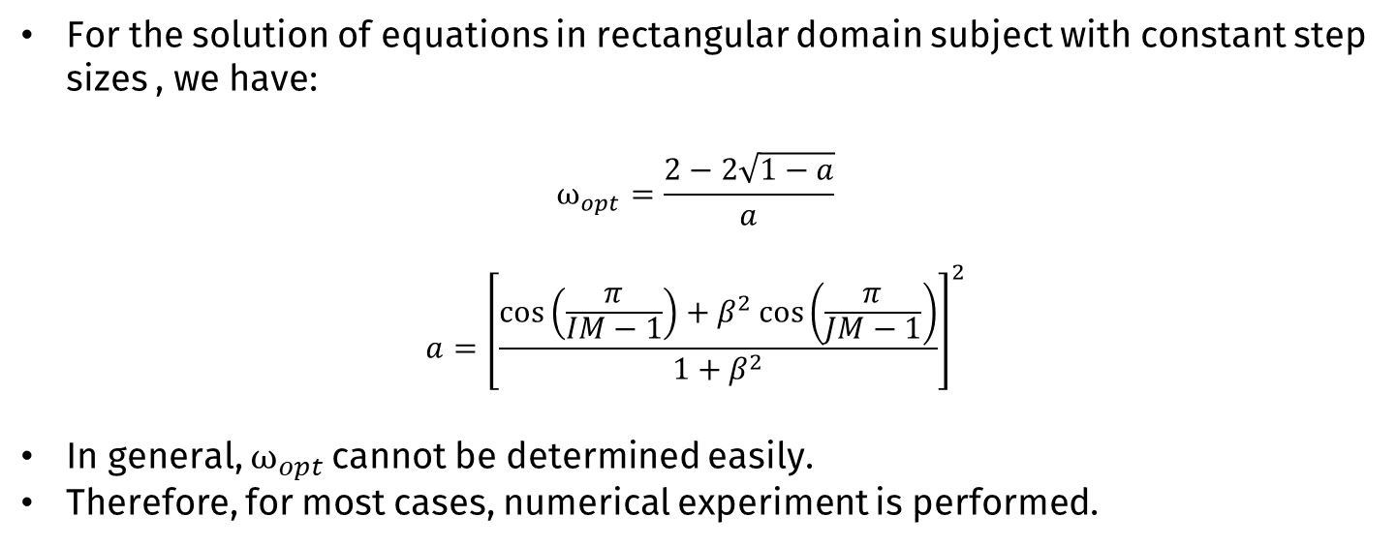
Successive Over Relaxation Method
For the solution of equations in rectangular domain subject with constant step sizes , we have:
$$⍵_{opt}=\frac{2−2\sqrt{1−a}}{a}$$
$$a={\left[\frac{\cos\left(\frac{π}{IM−1}\right)+β^{2}\cos\left(\frac{π}{JM−1}\right)}{1+β^{2}}\right]}^{2}$$
In general, $⍵_{opt}$cannot be determined easily.
Therefore, for most cases, numerical experiment is performed.

Slide 19
03
Nine-point Laplacian

Slide 20
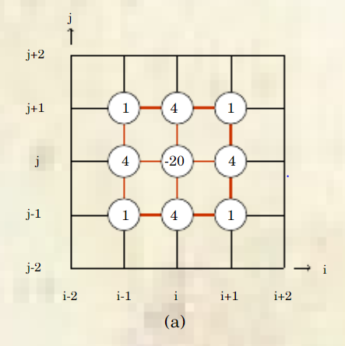
Nine-point Laplacian
By applying Taylor expansion for function of two variables, then we also have another approximation of 2D Laplacian is the Nine-point Laplacian:
$∇^{2}f\left(x,y\right)=\frac{1}{6h^{2}}[4T\left(x−h,y\right)+4T\left(x+h,y\right)+4T\left(x,y−h\right)+4T\left(x,y+h\right)$+ T$\left(x−h,y−h\right)+ \text{T}\left(x+h,y−h\right)+\text{T}\left(x−h,y+h\right)\text{+}\text{T}\left(x+h,y+h\right)−20T(x,y)]$ =0
With h=2, then we have:
$T_{i,j}^{(k+1)}=\frac{1}{5}[T_{i−1,j}^{(k+1)}$+ $T_{i+1,j}^{(k)}$+ $T_{i,j−1}^{(k+1)}$+ $T_{i,j+1}^{(k)}]+\frac{1}{20}[T_{i−1,j−1}^{(k+1)}$+ $T_{i+1,j−1}^{(k+1)}$+ $T_{i−1,j+1}^{(k)}$+ $T_{i+1,j+1}^{(k)}]$

Slide 21
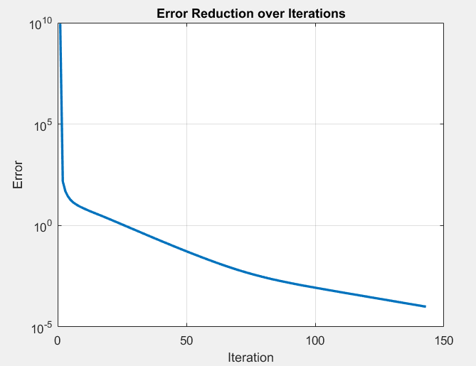
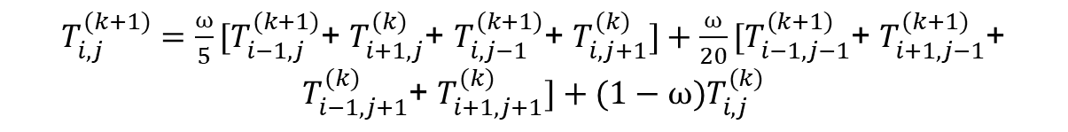
SOR using Nine-point Laplacian
SOR method for the nine-point Laplacian:
$T_{i,j}^{(k+1)}=\frac{⍵}{5}[T_{i−1,j}^{(k+1)}$+ $T_{i+1,j}^{(k)}$+ $T_{i,j−1}^{(k+1)}$+ $T_{i,j+1}^{(k)}]+\frac{⍵}{20}[T_{i−1,j−1}^{(k+1)}$+ $T_{i+1,j−1}^{(k+1)}$+ $T_{i−1,j+1}^{(k)}$+ $T_{i+1,j+1}^{(k)}]+(1−⍵)T_{i,j}^{(k)}$

Slide 22
04
Find relaxation parameter

Slide 23
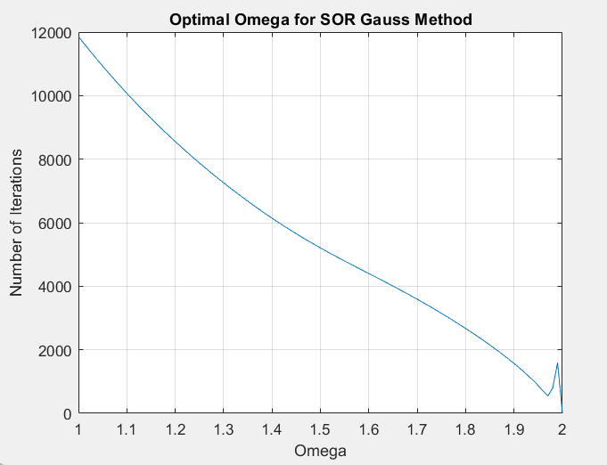
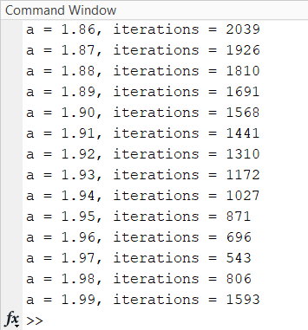
a. Find relaxation parameter of Sor Gauss
We find the number of iterations for each ω from 1 to 2.

Slide 24
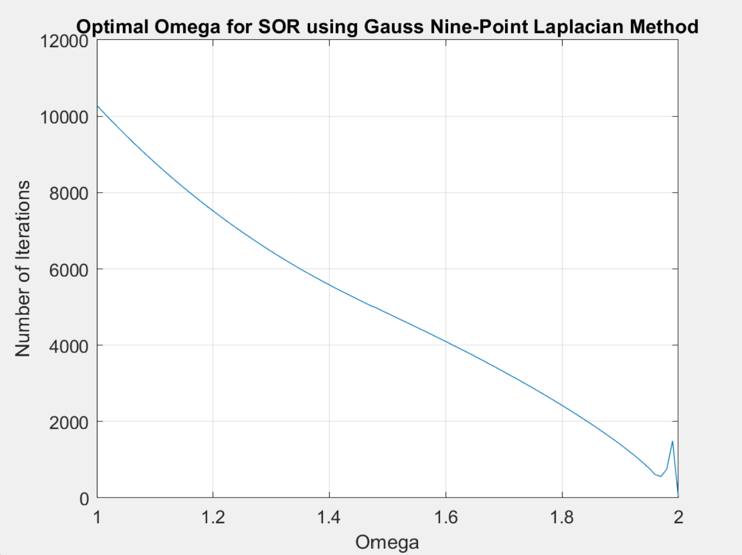
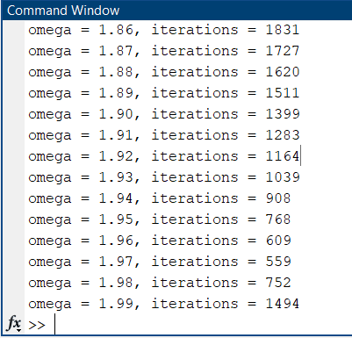
b. Find relaxation parameter of SOR using Nine-point Laplacian
We find the number of iterations for each ω from 1 to 2.

Slide 25
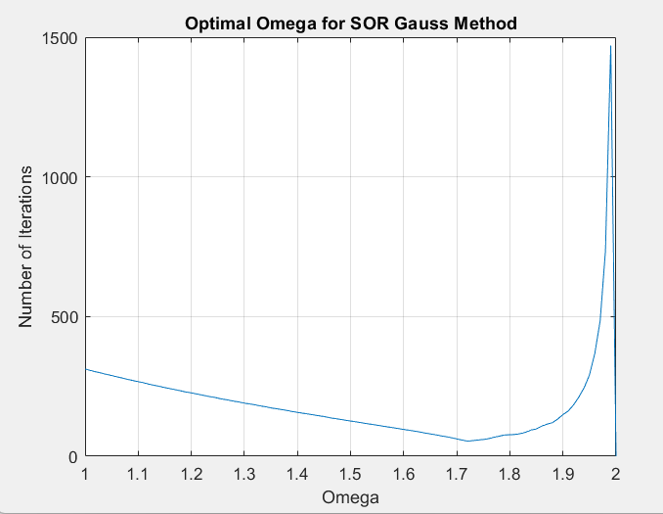
Comment
In both situation, ω is approximately equal ( around 1.97 )
After experimentation and changing various factors, we found that the relaxation factor ω only depends on the number of divisions of the edges (nx, ny) rather than different methods or temperature values.
Ex: nx=ny= 20 -> ω is nearly 1.72

Slide 26
05
Comparison with different initial values

Slide 27
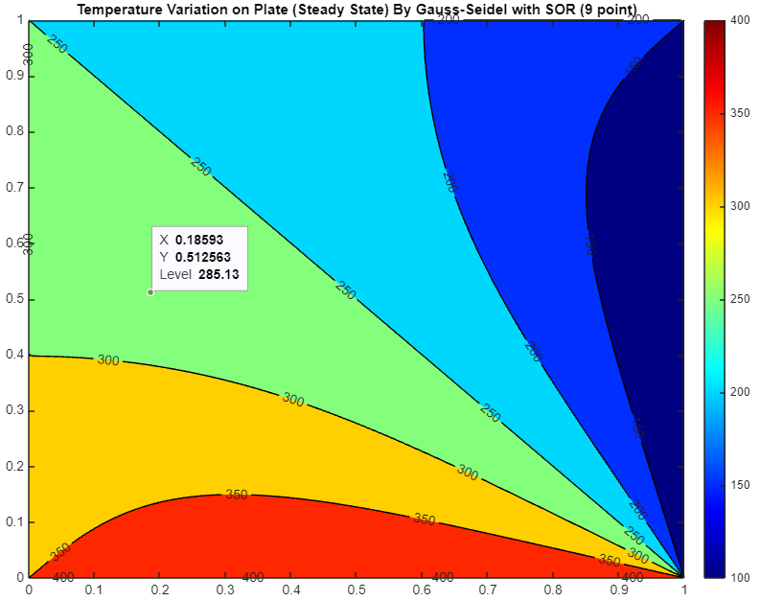
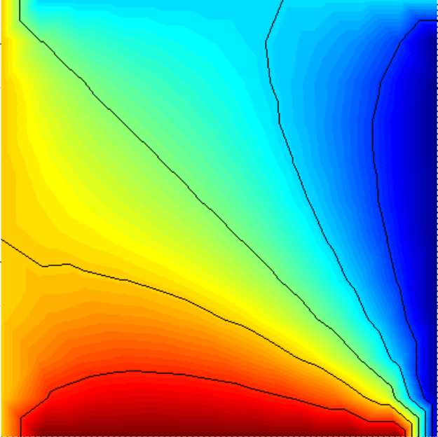
Left border | Right border | Bottom border | Top border
300 | 100 | 400 | 200
Example 1:
Plot by Mathlab
Results of FEATool

Slide 28
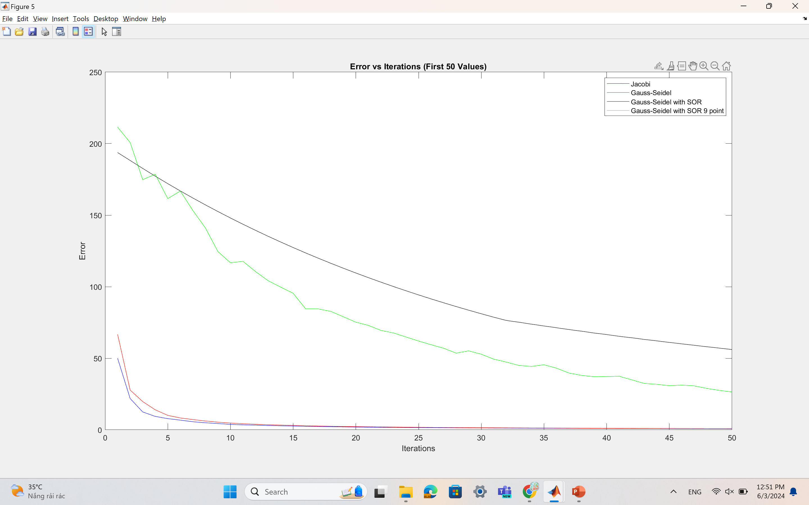
Method | Time(s) | Iiterations
Jacobi | 6.594078 | 18424
Gauss-Seidel | 3.700655 | 10726
SOR | 0.202659 | 498
9-point SOR | 0.254031 | 526

Slide 29
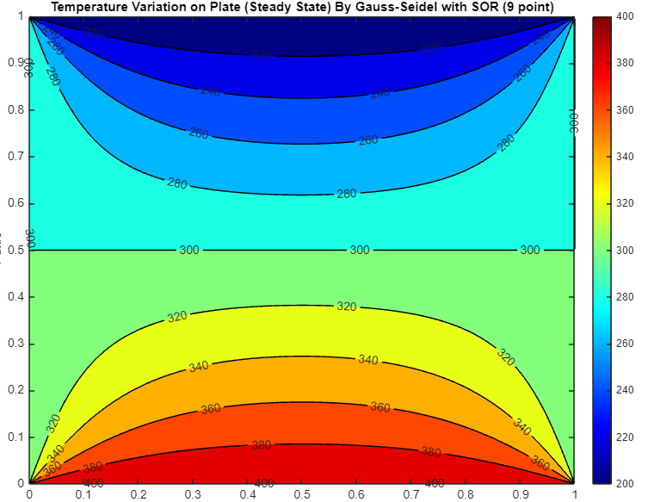
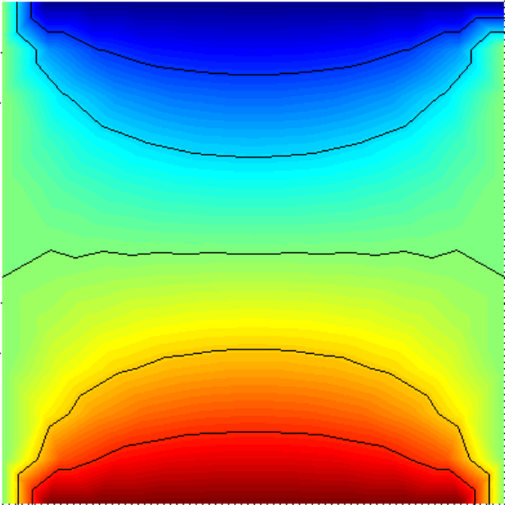
Left border | Right border | Bottom border | Top border
300 | 300 | 400 | 200
Example 2:
Plot by Mathlab
Results of FEATool

Slide 30
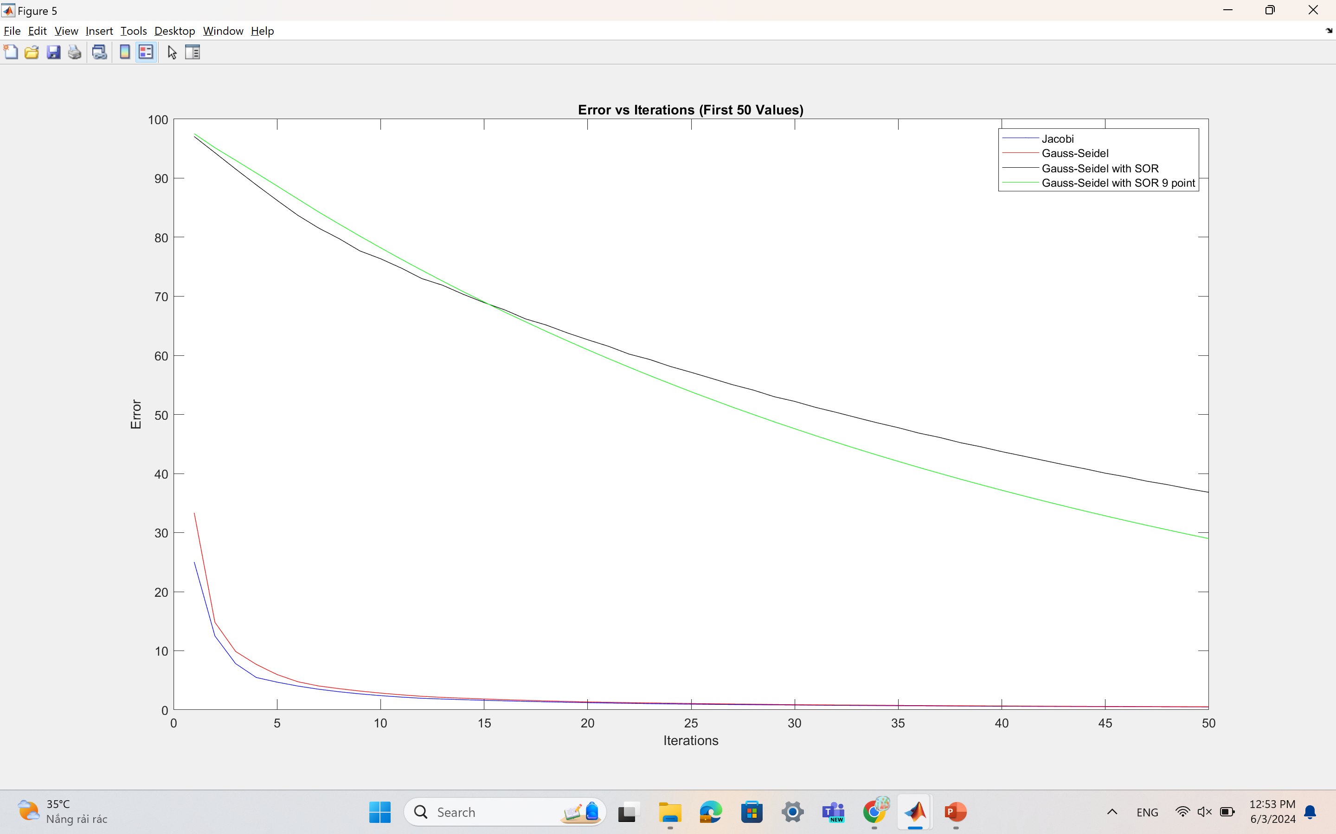
Method | Time(s) | Iiterations
Jacobi | 6.088104 | 17038
Gauss-Seidel | 3.481157 | 9875
SOR | 0.200293 | 471
9-point SOR | 0.250775 | 512

Slide 31
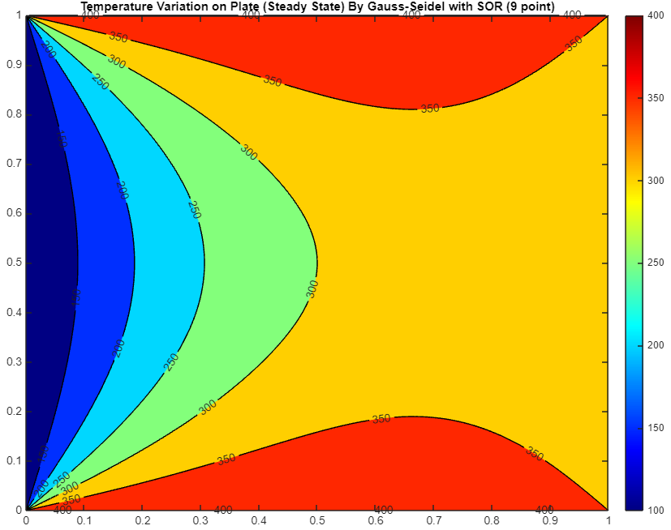
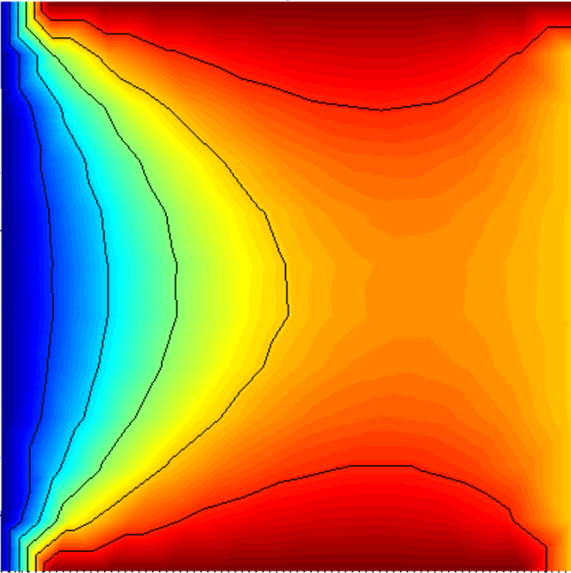
Left border | Right border | Bottom border | Top border
100 | 300 | 400 | 400
Example 3:
Plot by Mathlab
Results of FEATool

Slide 32
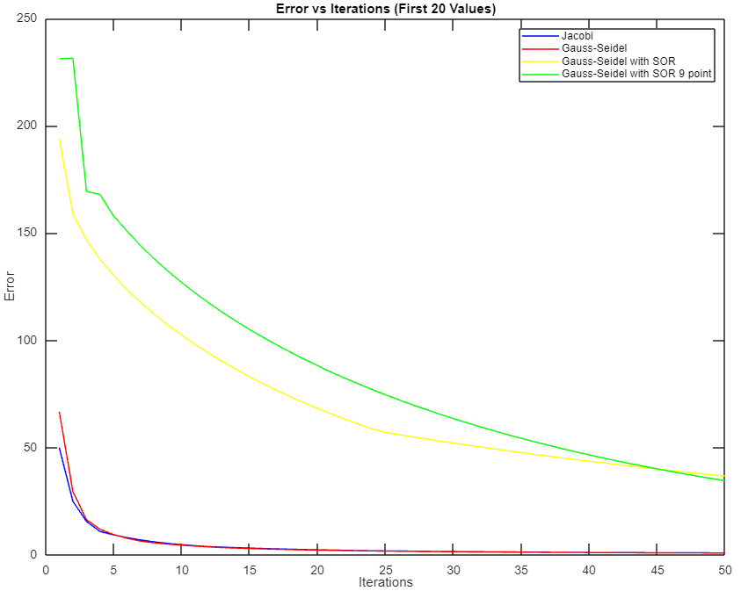
Method | Time(s) | Iterations
Jacobi | 6.046164 | 17068
Gauss-Seidel | 3.494897 | 9834
SOR | 0.193138 | 470
9-point SOR | 0.243434 | 512

Slide 33
Conclusion
Superior Performance of SOR: The Successive Over-Relaxation (SOR) method significantly reduces both the number of iterations and computation time compared to Gauss-Seidel and Jacobi methods.
Comparison of 5-point vs. 9-point SOR: Both SOR variations perform similarly with marginal differences. The standard 5-point SOR is slightly more efficient, needing fewer iterations and less time than the 9-point version.
Convergence Analysis: Initially, SOR appears less stable than other methods but quickly surpasses them in convergence speed after initial iterations, effectively minimizing errors faster.
Conclusion:
SOR stands out for rapid convergence and reduced computational demands, making it an optimal choice for solving high-precision and time-sensitive engineering problems.

Slide 34

Thanks!
Do you have any questions?
Please keep this slide for attribution

