Slide 1

CST 499 Final Project Presentation
Notes:
Include a title slide at the beginning of your presentation. This is the slide where you will include the same information that would go on the first page (or the title page) of your paper, such as your name, the instructor's name, the course, the due date, and the title of your presentation. Follow the same first page or title page requirements for the academic formatting style you are asked to use.

Slide 2
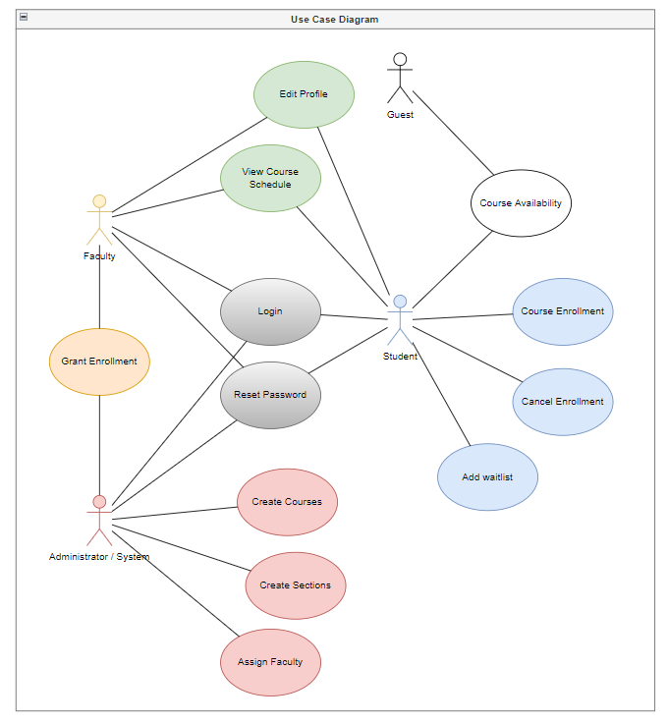
Software Requirements Specification
Intended Audience
Product Scope
Product Functions
Classes and Characteristics
Software Interfaces
System Features
Notes:
Note: The “Notes” area of a PowerPoint typically serves as private notes for a presenter to reference during a presentation (like index cards). However, when your assignment is a PowerPoint that you will submit, the notes should act as the written component of your assignment. Treat the notes area of each slide as a paragraph of an academic paper. You should include complete sentences that explain and support the main idea on the slide, and include in-text citations for any information from outside sources.

Slide 3
Enrollment Registration System – Landing Page
Overview
Nav Bar
Menu

Slide 4
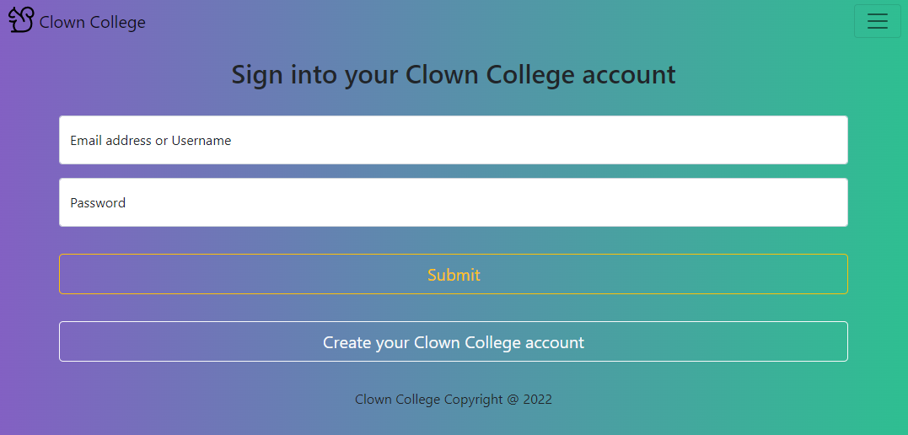
Enrollment Registration System – Login Page
Overview
Input
Submit

Slide 5
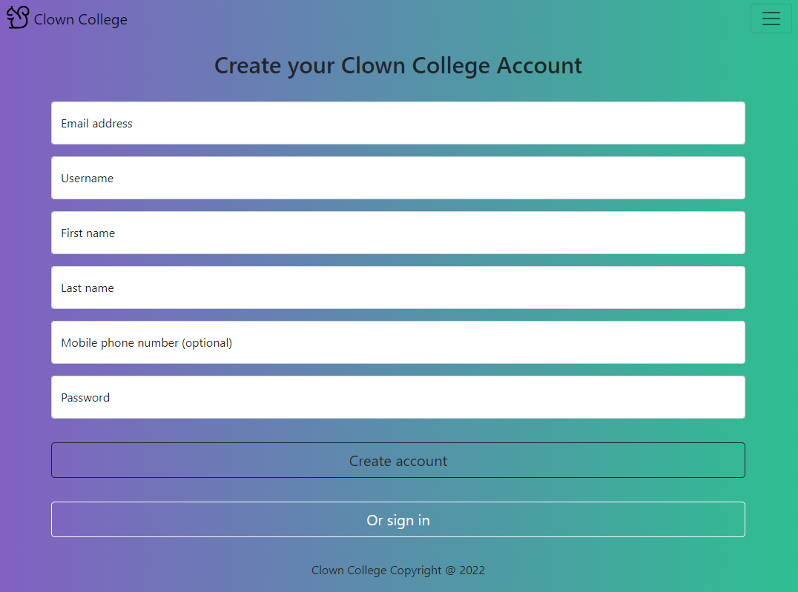
Enrollment Registration System – Enrollment Page
Overview
Input
Create account

Slide 6
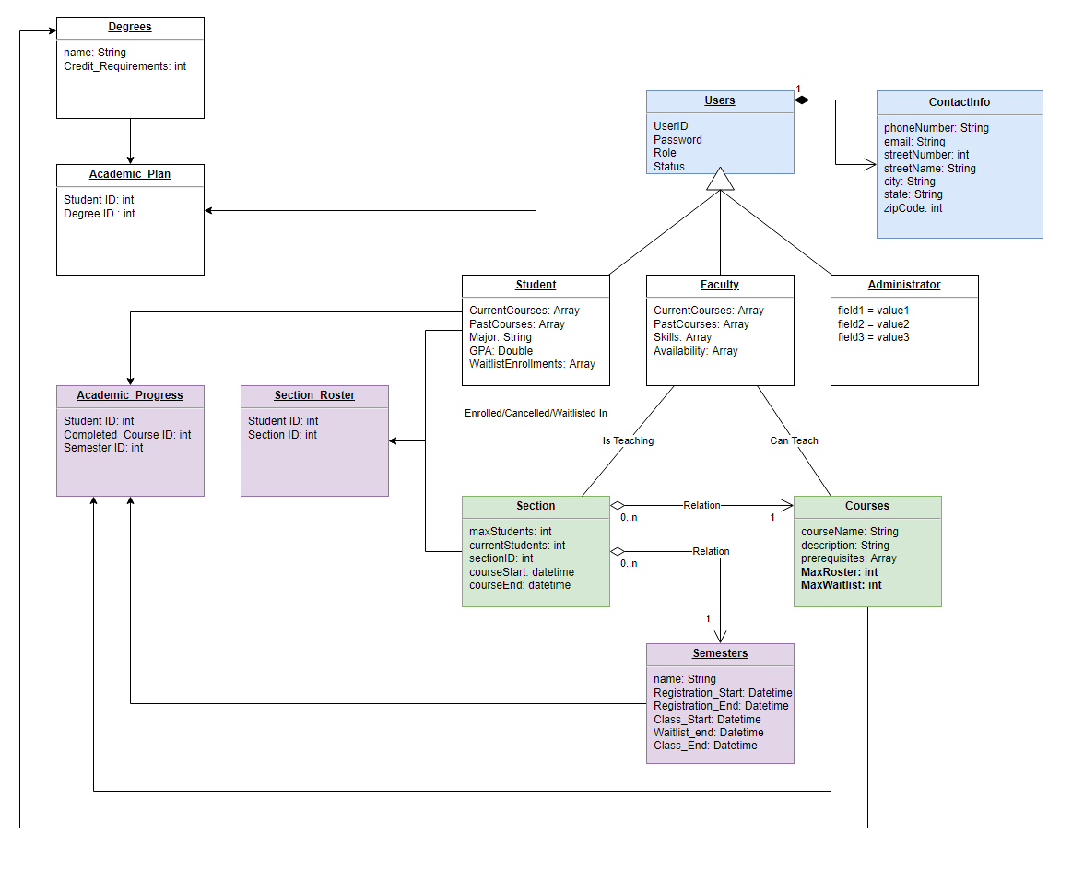
Enrollment Registration System – MySQL Database
Tables
Relationships
Integration

Slide 7
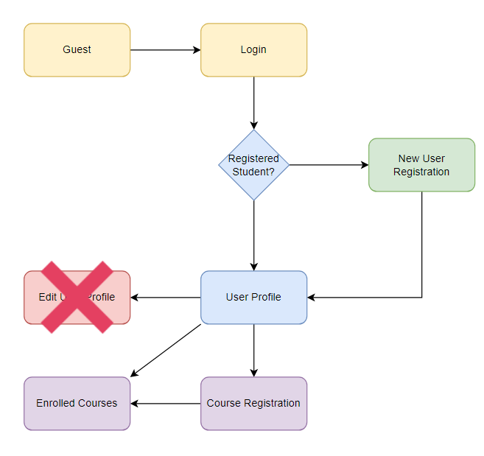
Enrollment Registration System – PHP Code
Overview
Process
Integration

Slide 8
References
Connolly, R., & Hoar, R. (2018). Fundamentals of web development (2nd ed.). Pearson.
Spillner, A., Linz, T., & Schaefer, H. (2014). Software testing foundations: A study guide for the certified tester exam (4th ed.). Rocky Nook.
Tsui, F., Karam, O., & Bernal, B. (2018). Essentials of software engineering (4th ed.). Jones & Bartlett Learning.

