Slide 1
Dijkstra’s pathfinding Algorithm vs A*

Slide 2
Quick note on
Space Complexity
Amount of memory an algorithm uses based on set size
Time Complexity
Amount of time an algorithm takes from start to finish
Big-O Notation
Worst case time complexity excluding coefficients and lower order terms

Slide 3
Big-O
Ex. Where n is the size of a set
Imagine an algorithm that takes 5n³ + 3n time to run.
1: 8 units of “time”/computations
2: 52
3: 144
…
We can safely say as n increases, n³ has the most effect
Therefore, big-O of 5n³ + 3n is O(n³)

Slide 4
Dijkstra’s Pathfinding Algorithm
Uniform Cost Search
Space complexity
O(|V|²)
Keep track of all possible paths
Time complexity
If |E| > |V|² , then O(|V|²)
Every node was visited and all possible paths recorded
If |E| < |V|² , then O(|E|log(|V|))
Removing minimum node, adding new node, calculating shortest edge
http://www-m3.ma.tum.de/foswiki/pub/MN0506/WebHome/dijkstra.pdf
http://matwbn.icm.edu.pl/ksiazki/cc/cc35/cc3536.pdf

Slide 5
When |E| < |V|²
Each vertex can be connected to V-1 vertices, let’s call each E_{i}
Updating each vertex’s weight in (common heap) implementation takes O(log(V))
There are E₁ -> E_{v} edges group, we’ll generalize as E
So, O(E*log(V))

Slide 6
A* Pathfinding Heuristic
Guided Breadth first search
Space Complexity
O(n) where n is length of solution path
Absolute worst case: O(|V|)
Time Complexity
O(n) where n is length of solution path
Absolute worst case: O(|V|)

Slide 7
A* Developed in 1968
To improve path planning done by Shakey the Robot
To develop faster alternative to Dijkstra’s Algorithm
Find heuristic that was optimal under certain conditions
Uses what “appears” to be shortest path to increase speed

Slide 8
Dijkstra vs A*
Difference only in how candidates are weighed
Dijkstra
Cost of edge + cost of the path so far = length of current path
A*
Cost of edge + cost of the path so far + Estimated cost to reach target

Slide 9
Dijkstra vs A*
Dijkstra’s Algorithm is actually a special case for A*
Estimated cost to each node is 0
Estimation might seem counter intuitive
Exists only where it can
If estimation can’t occur, A* acts exactly like Dijkstra’s Algorithm

Slide 10
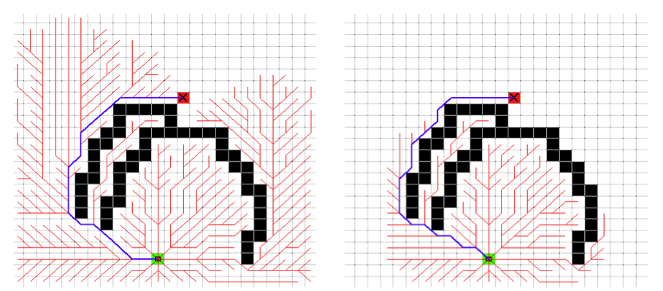
Example 1
Left: Dijkstra’s Algorithm Right: A* Algorithm
Red: Expanded nodes Blue: Shortest path taken

Slide 11
Admissibility
A* works when estimation is admissible
Never overestimates the actual cost
Common in search algorithms:
i.e. the cost it estimates to reach the goal is not higher than the lowest possible cost from the current point in the path.

Slide 12
n is a node
h is a heuristic
h(n) - cost by h to reach goal node from node n
h*(n) – actual cost to reach goal from node n
h(n) is admissible only if,
For all n, h(n) <= h*(n)
f(n) is calculated with the heuristic function as follows:
f(n) – result amount
g(n) – cost from start to current node
h(n) – estimated cost from current node to goal
f(n) = g(n) + h(n) - If h(n) is overestimated, one may overshoot optimal path

Slide 13
Approximations
Depending on application, speed may be weighed more importantly than correctness
Approximate heuristic can give less correct paths faster
Video game pathfinding
Need of small space complexity
Navigation (without pre-compiled paths)

Slide 14
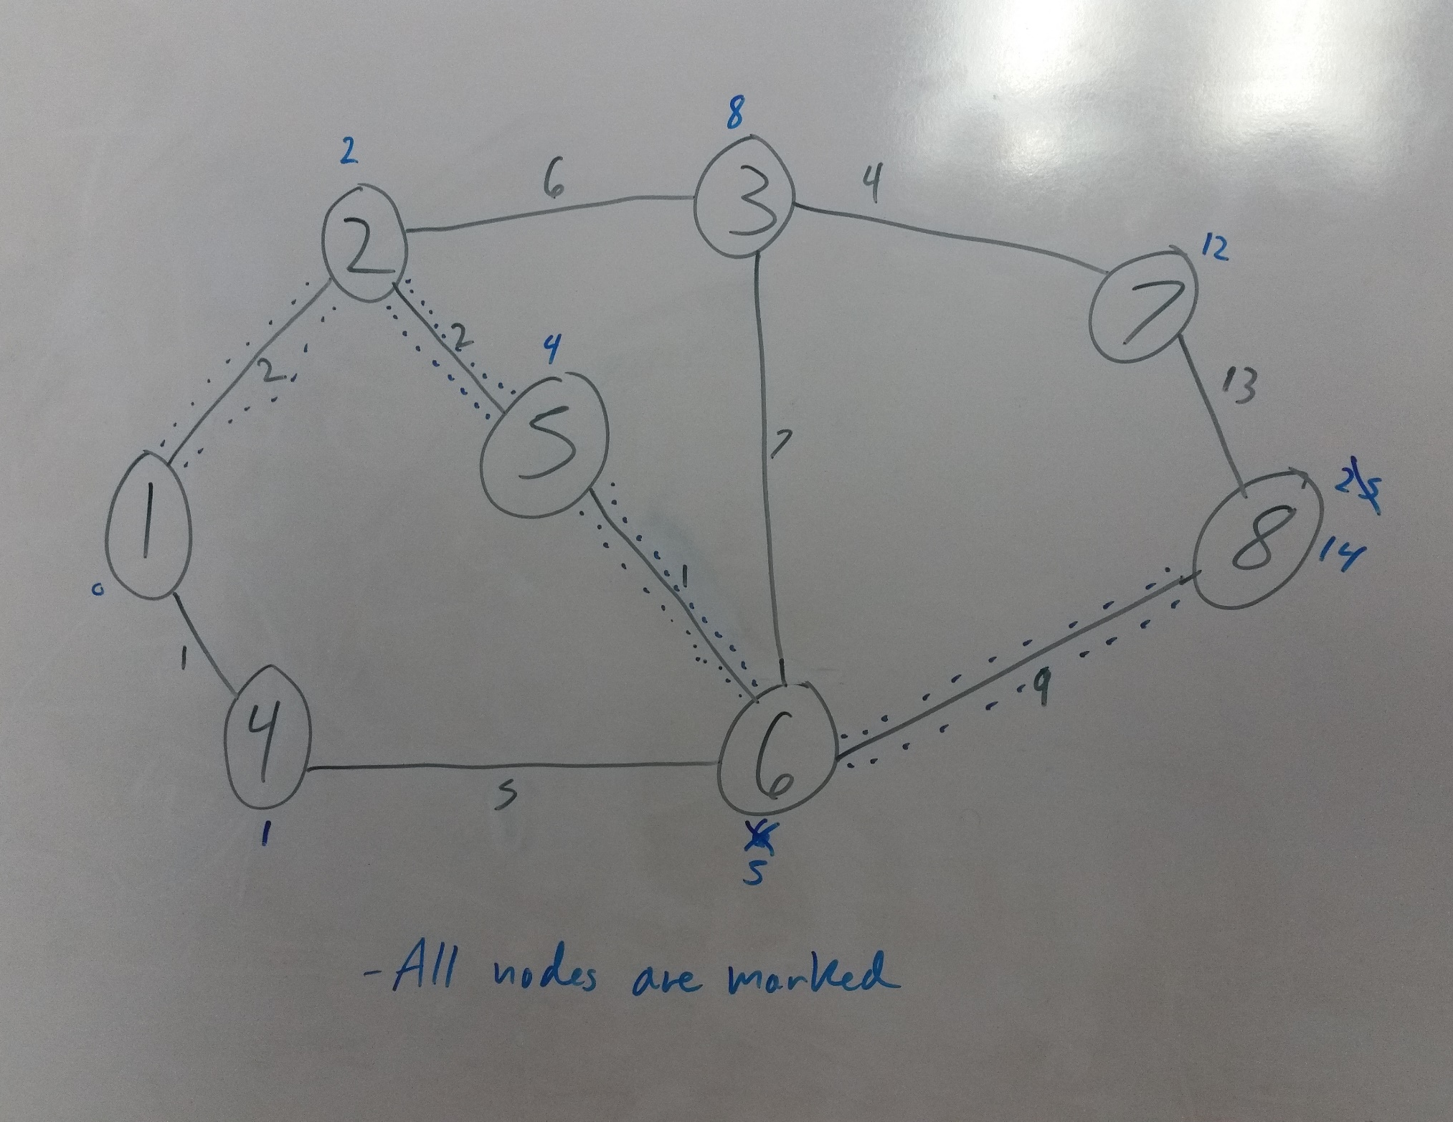
Dijkstra’s Algo Ex.

Slide 15
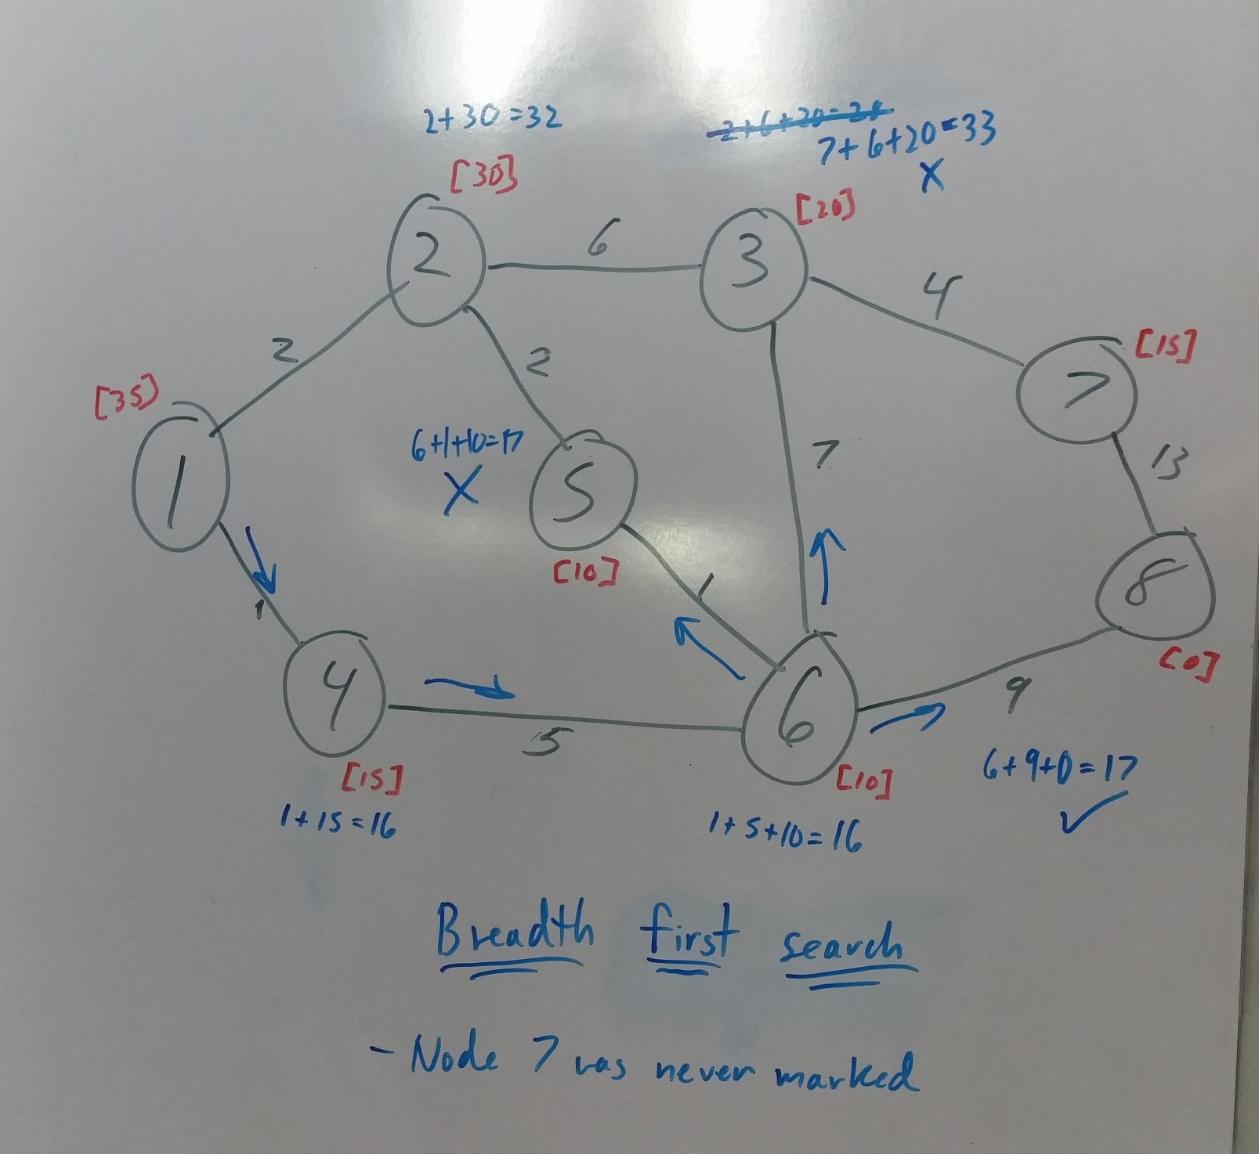
A * Ex.
A* Example of admissible heuristic that isn’t perfect
Rounded up to nearest value divisible by 5
Took heuristic from nodes physically closer to goal
15

Slide 16
Short Example
Dijkstra’s Algorithm would be too slow, and you can’t tell exact from approximate
https://www.youtube.com/watch?v=DlkMs4ZHHr8

