Slide 1
Dijkstra’s pathfinding Algorithm vs a popular pathfinding heuristic

Slide 2
Dijkstra’s Pathfinding Algorithm
Uniform Cost Search
Space complexity
O(|V|²)
Time complexity
If |E| > |V|² , then O(|V|²)
If |E| < |V|² , then O(|E|log(|V|))
http://www-m3.ma.tum.de/foswiki/pub/MN0506/WebHome/dijkstra.pdf
http://matwbn.icm.edu.pl/ksiazki/cc/cc35/cc3536.pdf

Slide 3
A* Pathfinding Heuristic
Guided Breadth first search
Space Complexity
O(n) where n is length of solution path
Absolute worst case: O(|V|)
Time Complexity
O(n) where n is length of solution path
Absolute worst case: O(|V|)

Slide 4
A* Developed in 1968
To improve path planning done by Shakey the Robot
To develop faster alternative to Dijkstra’s Algorithm
Find heuristic that was optimal under certain conditions
Uses what “appears” to be shortest path to increase speed

Slide 5
“Real world” example
http://stevengantz.com/GraphTheoryProject2016/

Slide 6
Dijkstra vs A*
Difference only in how candidates are weighed
Dijkstra
Cost of edge + cost of previous node = length of current path
A*
Cost of edge + cost of previous node + Estimated cost to reach target

Slide 7
Dijkstra vs A*
Dijkstra’s Algorithm is actually a special case for A*
Estimated cost to each node is 0
Estimation might seem counter intuitive
Exists only where it can
If estimation can’t occur, A* acts exactly like Dijkstra’s Algorithm

Slide 8

Estimation example
Graph with weights can be drawn on 2D coordinate plane
Estimation could be found using Distance formula
How I implemented shortest paths in example using pixel coordinates

Slide 9
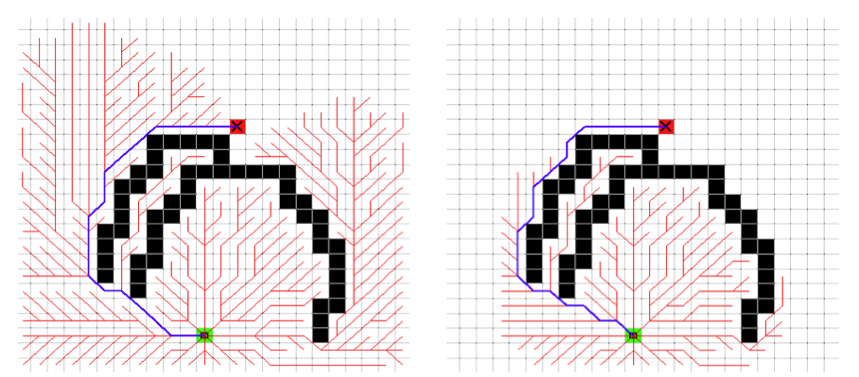
Example 1
Left: Dijkstra’s Algorithm Right: A* Algorithm
Red: Expanded nodes Blue: Shortest path taken

Slide 10
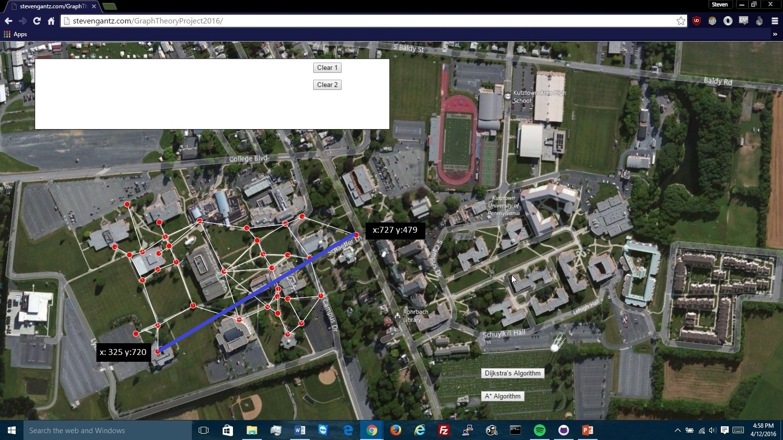

Slide 11
Admissibility
A* works when estimation is admissible
Never overestimates the actual cost
Common in search algorithms:
i.e. the cost it estimates to reach the goal is not higher than the lowest possible cost from the current point in the path.

Slide 12
n is a node
h is a heuristic
h(n) - cost by h to reach goal node from node n
h*(n) – actual cost to reach goal from node n
h(n) is admissible only if,
For all n, h(n) <= h*(n)
f(n) is calculated with the heuristic function as follows:
f(n) – result amount
g(n) – cost from start to current node
h(n) – estimated cost from current node to goal
f(n) = g(n) + h(n) - If h(n) is overestimated, one may overshoot optimal path

Slide 13
A* prevalence in AI

