Slide 1


Slide 2
(Usabilla) Data Visualization at UWV
Usabilla360 ‘data-visualization’
12-01-17

Slide 3
What data do you analyze?
We collect a lot more usabilla data (from more different campaigns) than we actually visualize.
We tend to vizualize only the usabilla data we use for periodic monitoring
(-> KPI’s)
Our focus for data visualization is to make it easy to interpret and ‘welcoming’ also for employees who are new to KPI’s and data-driven working.
We try to achieve this by making our visuals as ‘ergonomic as possible’.

Slide 4
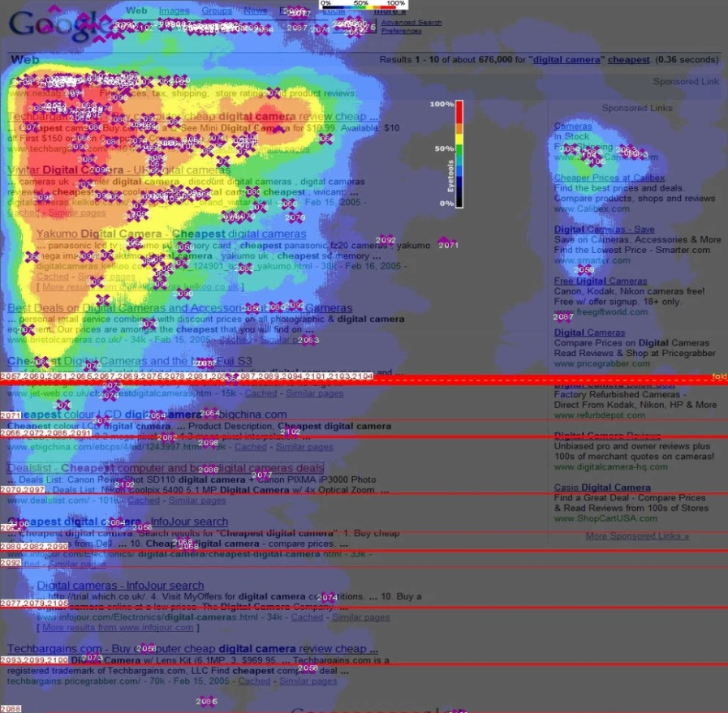
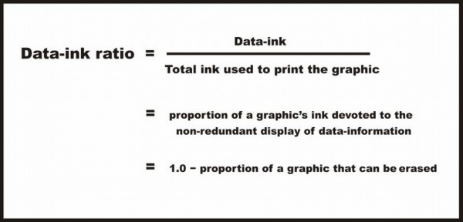
Making UWV visuals ‘ergonomic’
Quit screaming colors. (only ok for alarm function)
Uphold Edward Tufte’s Data Ink Ratio;
- no decorative elements & no unneeded detail
- no fat lines
only add numbers or lines if they truely aid reading
keep it ‘D.R.Y.’ (don’t repeat yourself)
- Regard Location & reading direction
- Choose the appropriate graph/table

Slide 5
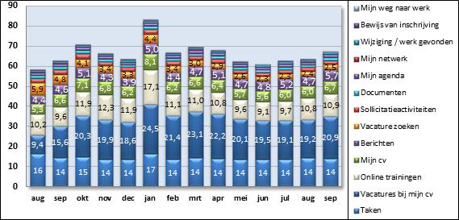
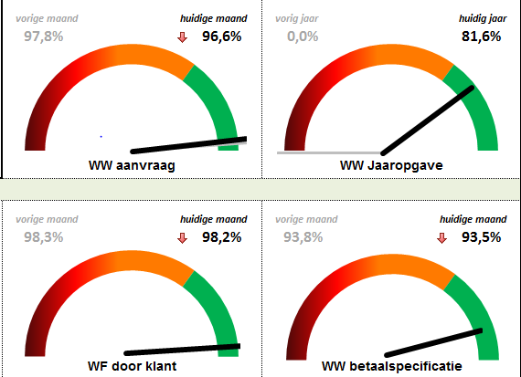
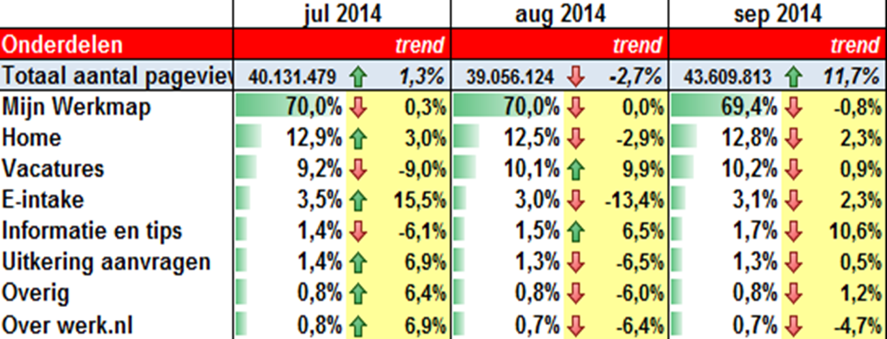
What we didn’t want (old visuals)

Slide 6
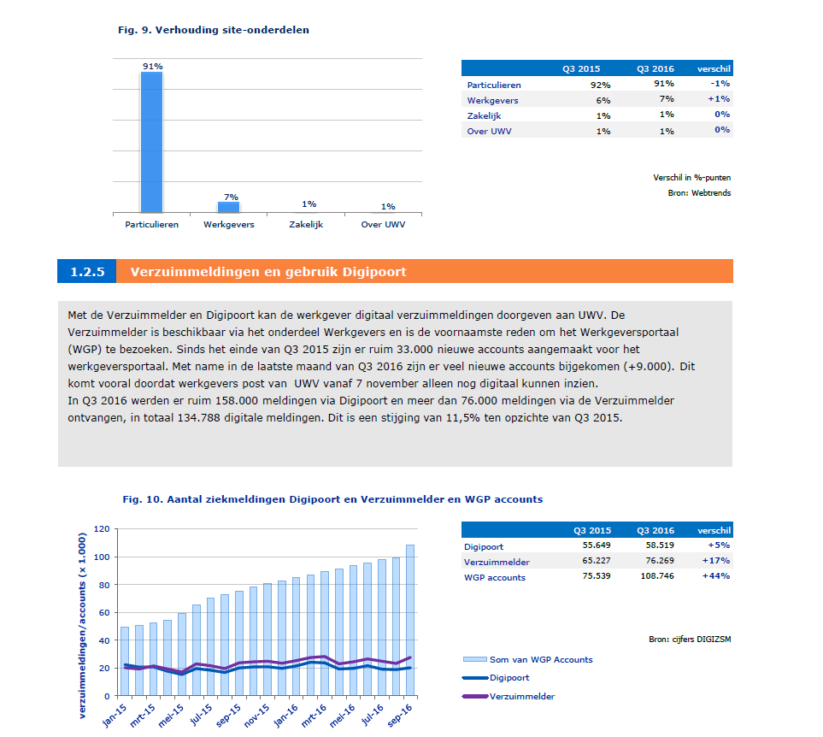
Screenshot report (excel)

Slide 7
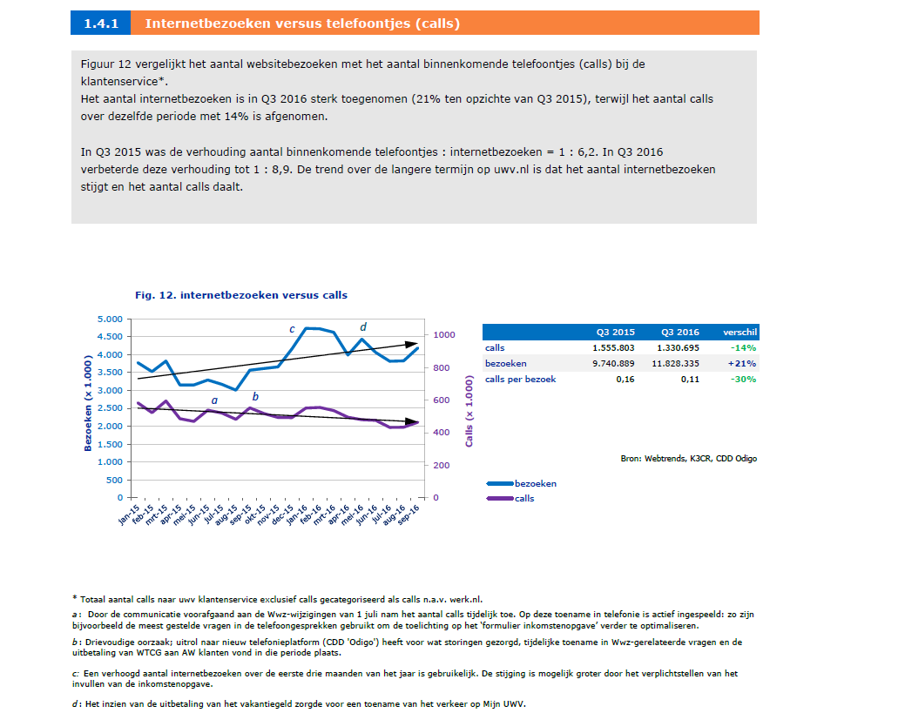
Screenshot report (excel, 2)

Slide 8
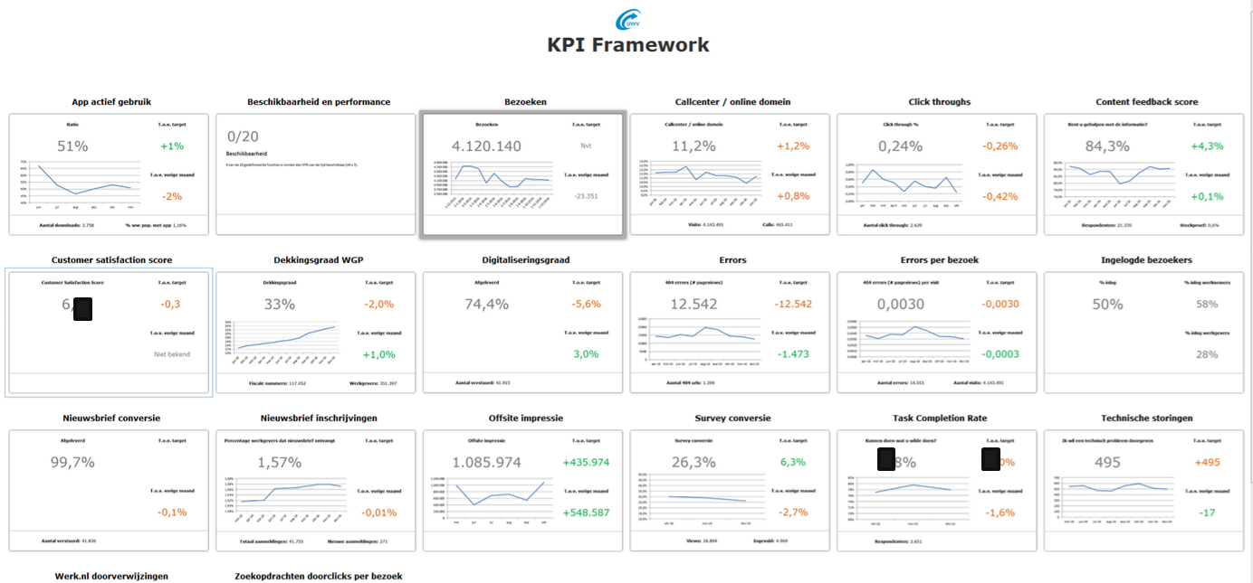
Screenshot provisional dashboard (1)

Slide 9
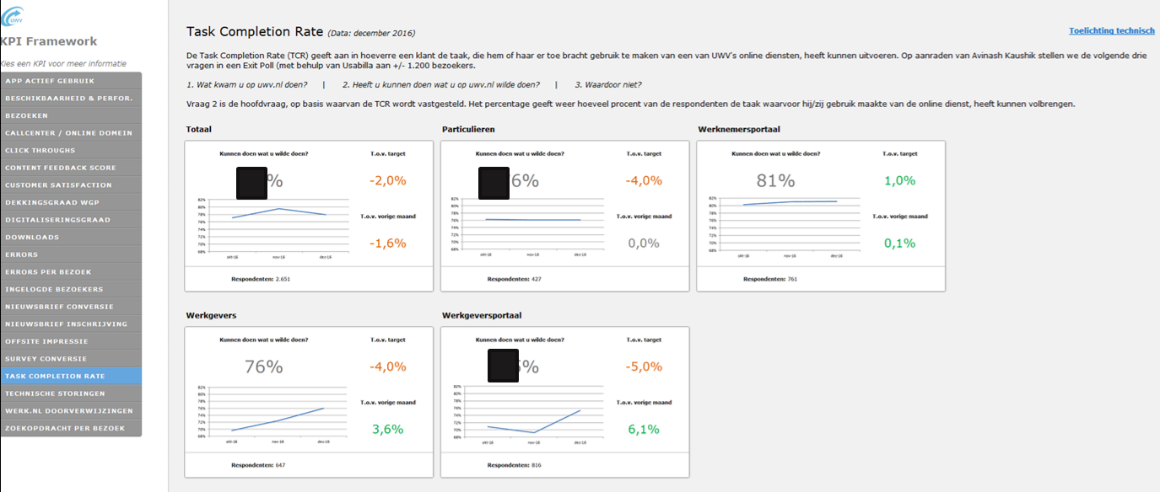
Screenshot provisional dashboard (2)

Slide 10
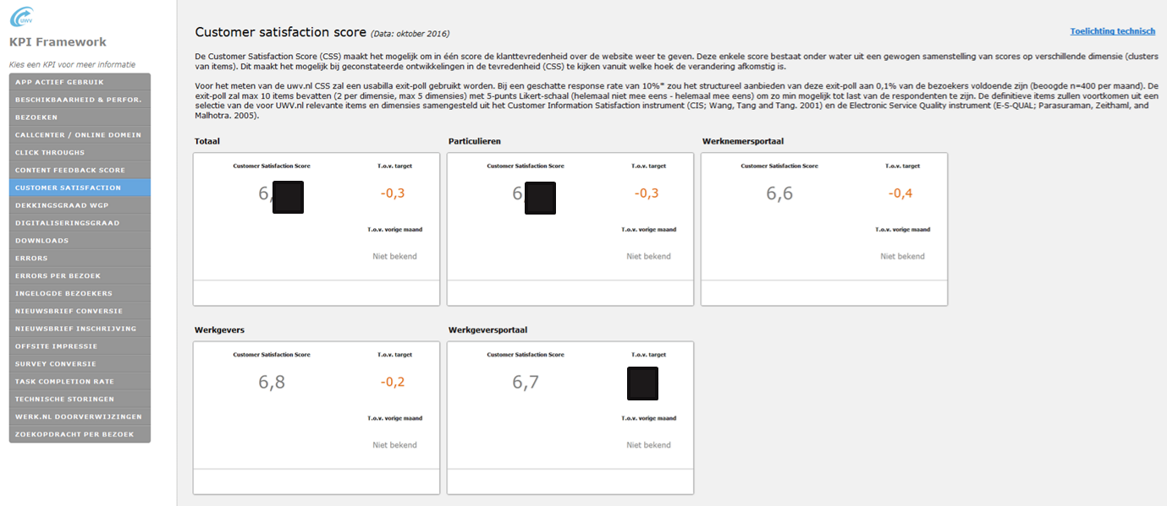
Screenshot provisional dashboard (3)

Slide 11
Making UWV visuals ‘ergonomic’ recap
Ergonomic data-visualization, recap
Color
Data-ink ratio
Location & reading direction
- Choosing the right form (table/chart etc)
Recommended literature: stephen few

Slide 12
What is the purpose of your analysis and visualization?
Big picture:
To transform the decision-making from intuition or opinion, to decision-making based on actual data (among which customer feedback) by means of KPI’s.
For now:
Visualization –if done right- can make data more inviting and so help employees accept and use it as guiding information for decision-making.

Slide 13
For whom is the analysis or report meant?
For now pretty much all levels.
We have started creating one base KPI Dashboard and plan on implementing filters that can easily be activated by users to select segments that match their interests.
(Because of the size of UWV we believe it will be better not to have different base dashboards to keep it more maintainable and controllable)

Slide 14
What is done with the analysis or report?
By getting management involved when forming the ‘business goals’ that would lead to the KPI’s we tried to make sure the KPI’s would be in management’s view compatible with their informal short cycle performance evaluation of e.g. parts of a customer journey but also of employee and division performance and their decision-making.
For now the provisionary KPI dashboard is presented to management on a monthly basis. It is difficult to say exactly how this is being used.

Slide 15
What are the problems you encounter?
Software acquirement
Technical (combining data sources)
Privacy/legal (combining data sources)
Analytical (reducing complexity to a single scale (kpi) not always easy)
Workload
Different levels of understanding throughout the organization

Slide 16
Questions?
Questions?

