Slide 1
GitHub
A guide for ISA GitHub users

Slide 2
Index
What is GitHub? 3
GitHub and ISA 4
Key Concepts 5
Make a User Account 6
Installing GitHub Desktop 8
Making a Repository 10
Adding Users to a Repository 11
Creating Branches 12
Committing a Change 13
Submitting a Pull Request 15
Accepting a Pull Request 17
Viewing History and Reverting changes 18

Slide 3
What GitHub is
GitHub is a repository hosting service that manages and controls project revisions

Slide 4
What GitHub will do for ISA
Allow us to develop software simultaneously
Share project folders via cloud storage

Slide 5
Key Concepts
The repository corresponds to the collaborated work of the team across one or many branches. All contributors have their own copy of it.
Each fork of the main repo corresponds to a contributor's work. A fork is really a GitHub construct to store a clone of the repo in your user account. As a clone, it will contain all the branches in the main repository at the time you made the fork.
Each branch within the fork and/or in the main repo can correspond to several kinds of things, depending on how you want to work. Each branch could refer to a version of the project but can also correspond to different channels of development, like hotfixes or experimental work.
The pull request corresponds to the task. Every time I want to contribute an isolated finished task to the main repo, I create a pull request corresponding to the commits made in that task. These commits are pulled from either my fork or my branch to the main repo.
A commit is a set of changes to the code. This is one of the most interesting things about Git. You don't transfer files, you transfer logs of changes.

Slide 6
Making a User Account
https://github.com/

Slide 7
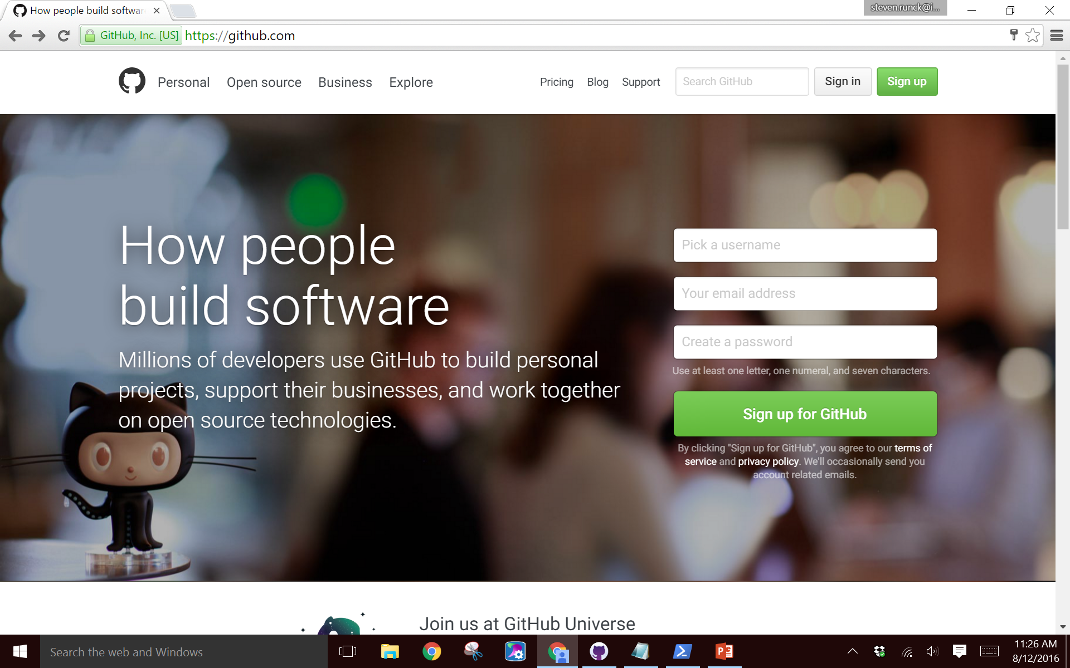

Slide 8
Installing GitHub
https://desktop.github.com
Two Versions of GitHub
Online: Full access to administrative tools. Accept pull requests here.
Desktop: Manages locally stored content; make changes, create pull requests

Slide 9
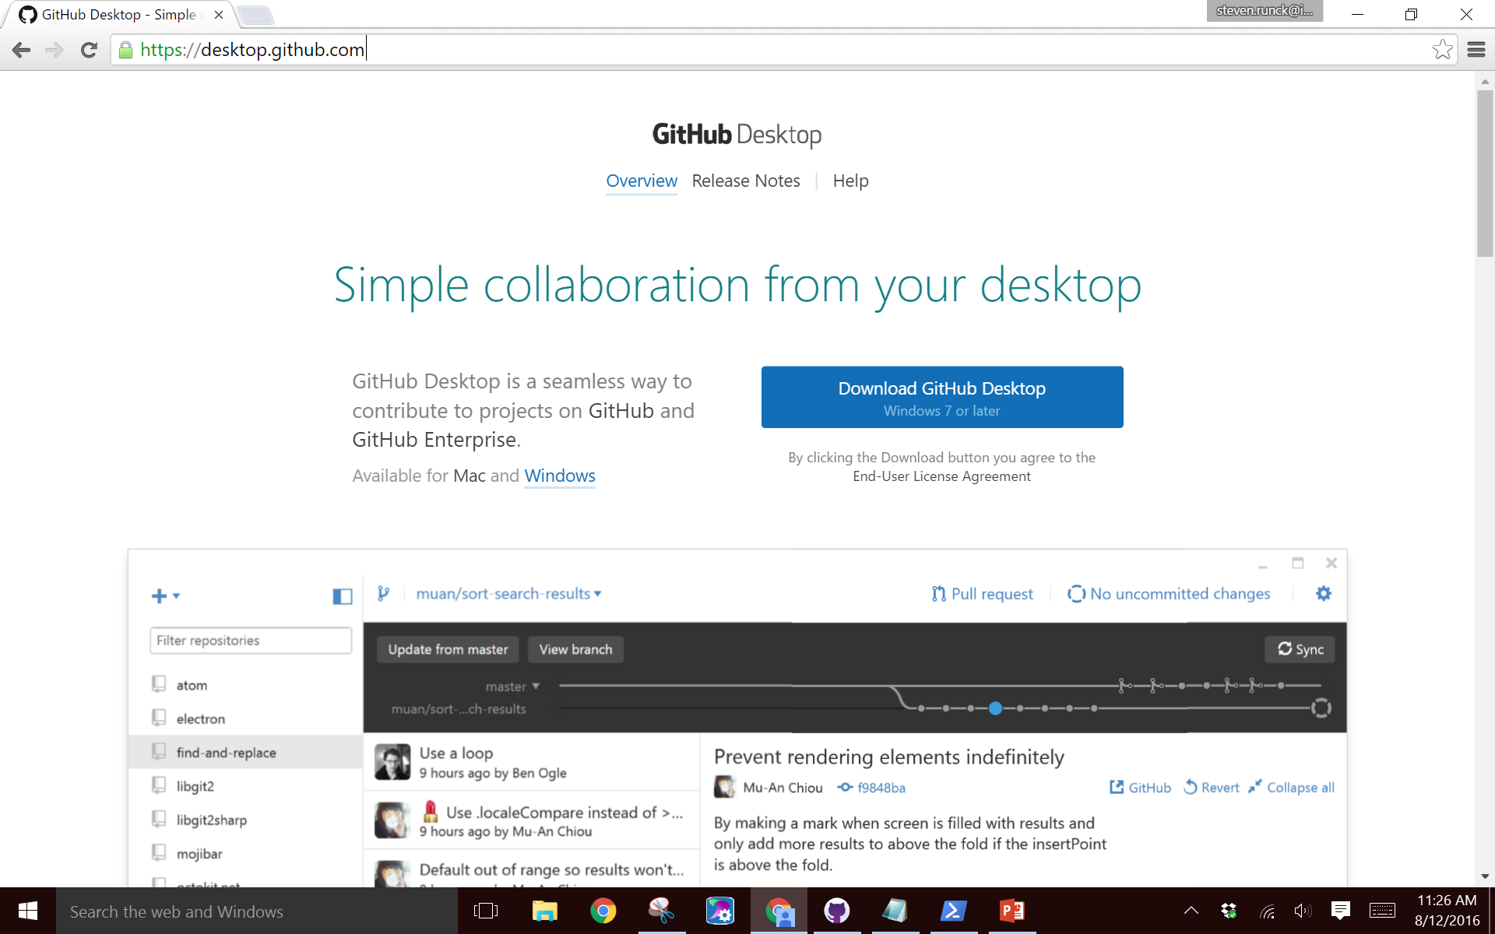

Slide 10
Making a Repository
Two ways:
Online: Click user icon in top right > your profile > repository tab > new
Desktop: Drag an existing folder into the repository sidebar

Slide 11
Adding Users to a Repository
On https://github.com log in and view your repository.
Navigate to settings > collaborators, then type in the user address and incite

Slide 12
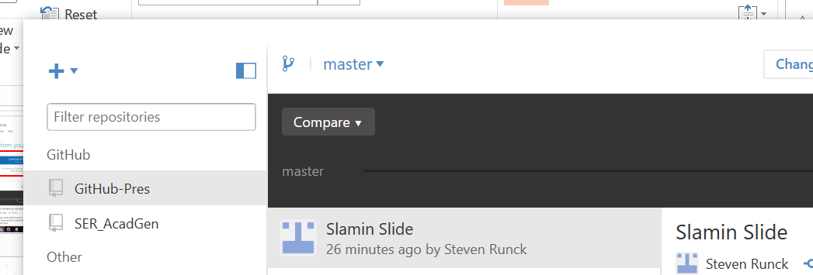
Creating a Branch
In GitHub desktop click the branch button to the right of the repository toolbar

Slide 13
Committing a change
Only logs the changes you have made, a commit does not make these changes viewable to anyone.
Toggle views form History to Changes
Write a summary statement
A proper summary statement will finish this sentence: “When applied, this change will…”
Commit to master

Slide 14
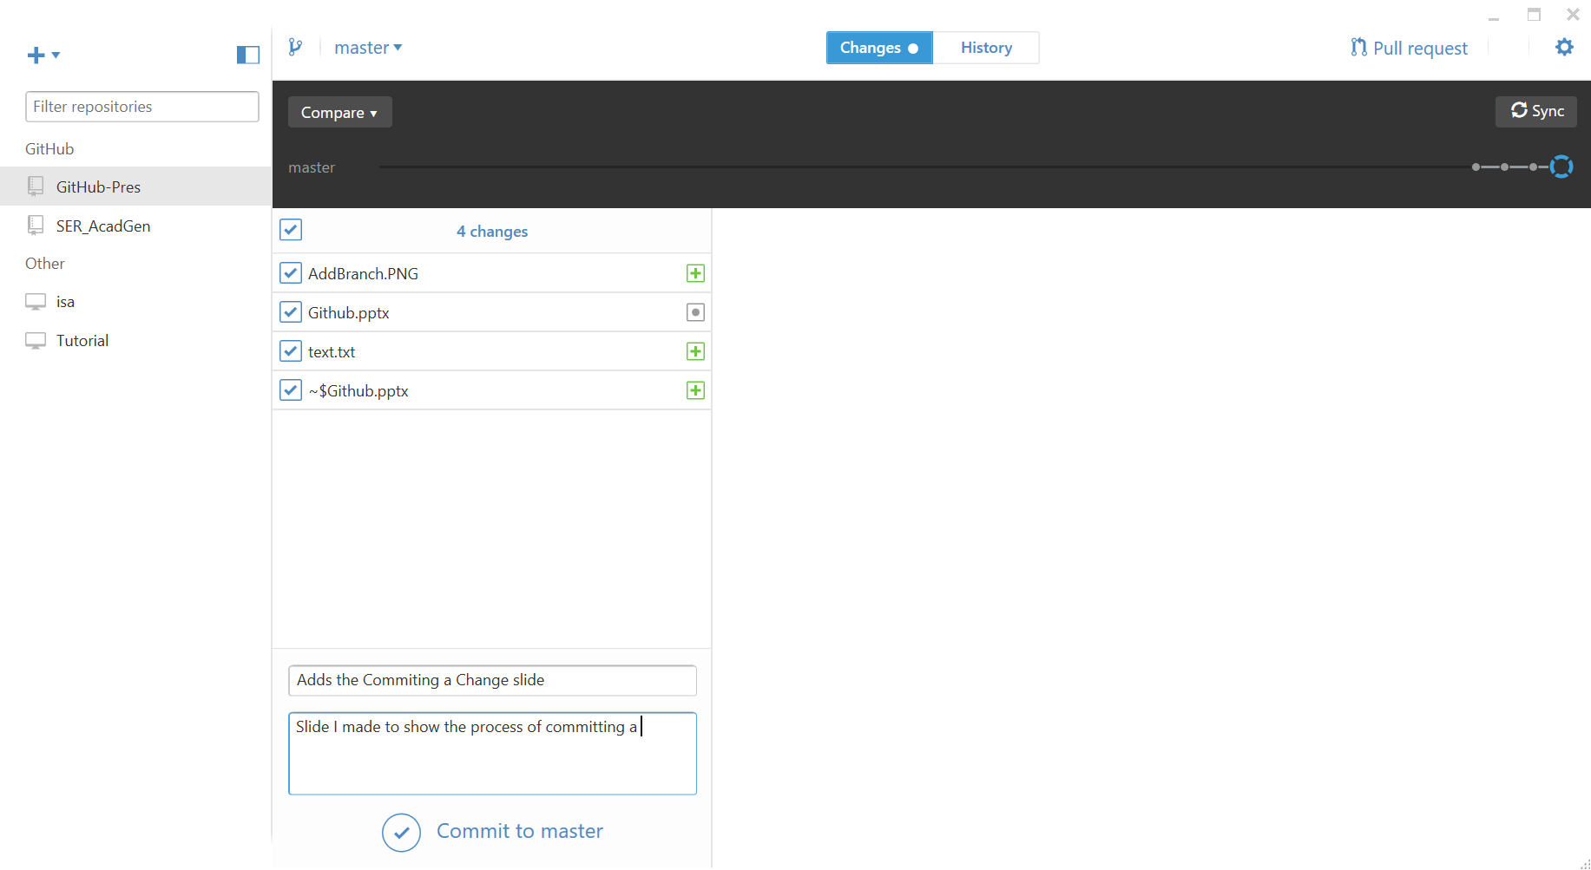

Slide 15
Submitting a Pull Request
A pull request is a request to merge your changes to a branch
Up until your pull request is accepted, all changes to the program are exclusively local

Slide 16
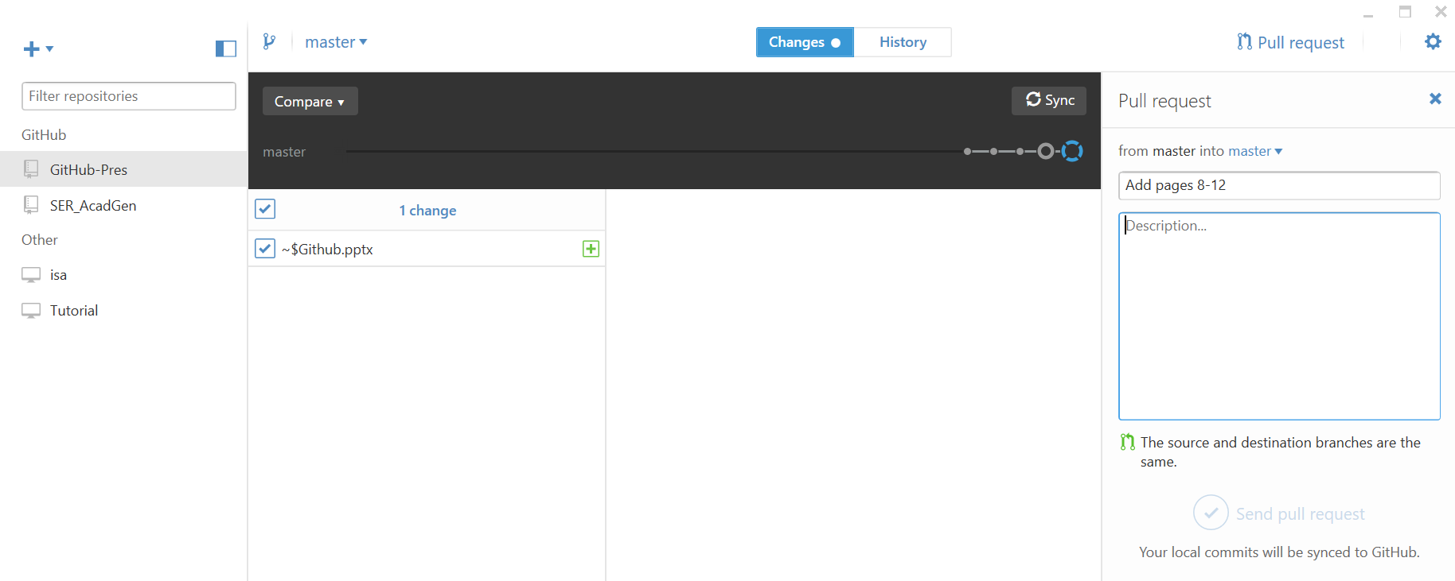

Slide 17
Accepting Pull Requests
In order for changes to be distributed, a pull request must be made and then accepted
To view the pull request log into the GitHub website and view your repository page then click the Pull Request tab

Slide 18
Viewing History and Reverting changes
To navigate the history of changes, go to the desktop version of GitHub and click on the history tab.
Switch click on the change you wish to view
Click the revert button

Slide 19
