Slide 1
Teaching Creative Coding and Expressive Instrument Design with SparkFun Qwiic Connect Sensors and Max/MSP
Steven Kemper, Ph.D.
Associate Professor of Computer Music and Digital Arts
Oberlin Conservatory of Music
skemper@oberlin.edu
ww.stevenkemper.com

Slide 2
Creative Coding
Project-based programming skills
Advanced music technology concepts

Slide 3
New Computer-based Instruments/Interfaces for Musical Expression
Exploring new sounds
Relationships between physical actions/sound

Slide 4
Technical Elements
Sensors (hardware)
Microcontroller (hardware)
Arduino IDE (software)
Max (software)

Slide 5
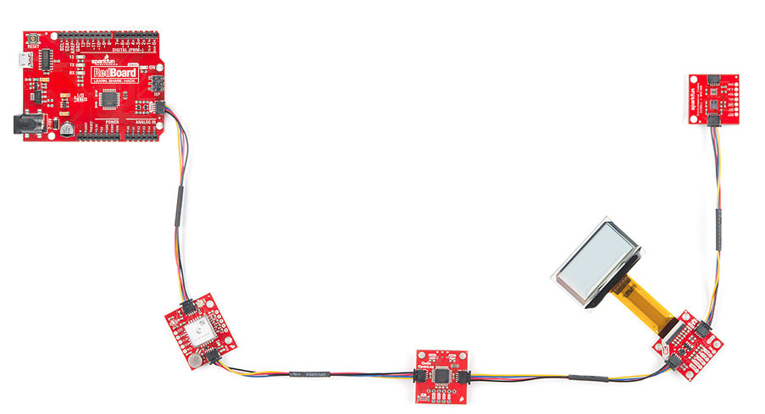
Sensors
SparkFun Qwiic I2C prototyping protocol
https://www.sparkfun.com/
Also compatible with Adafruit STEMMA
https://www.adafruit.com/

Slide 6
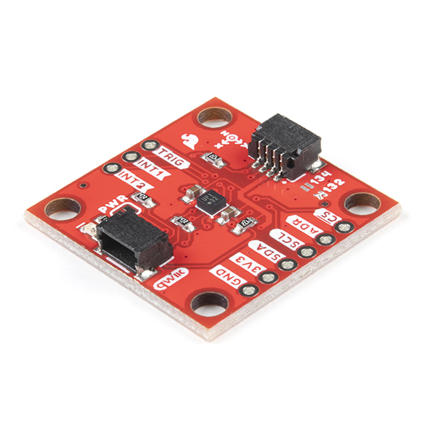
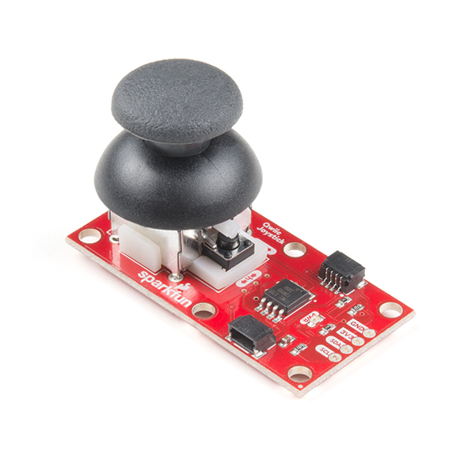
Today’s sensors
KX132 Triple Axis Accelerometer
Qwiic Joystick

Slide 7
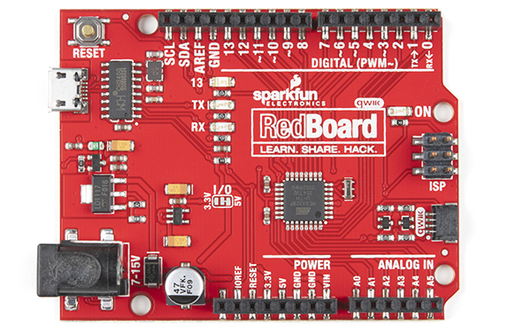
Arduino Microcontroller
Open-source single-platform microcontroller
Analog/digital inputs and outputs
SparkFun Redboard Qwiic
Arduino Uno

Slide 8
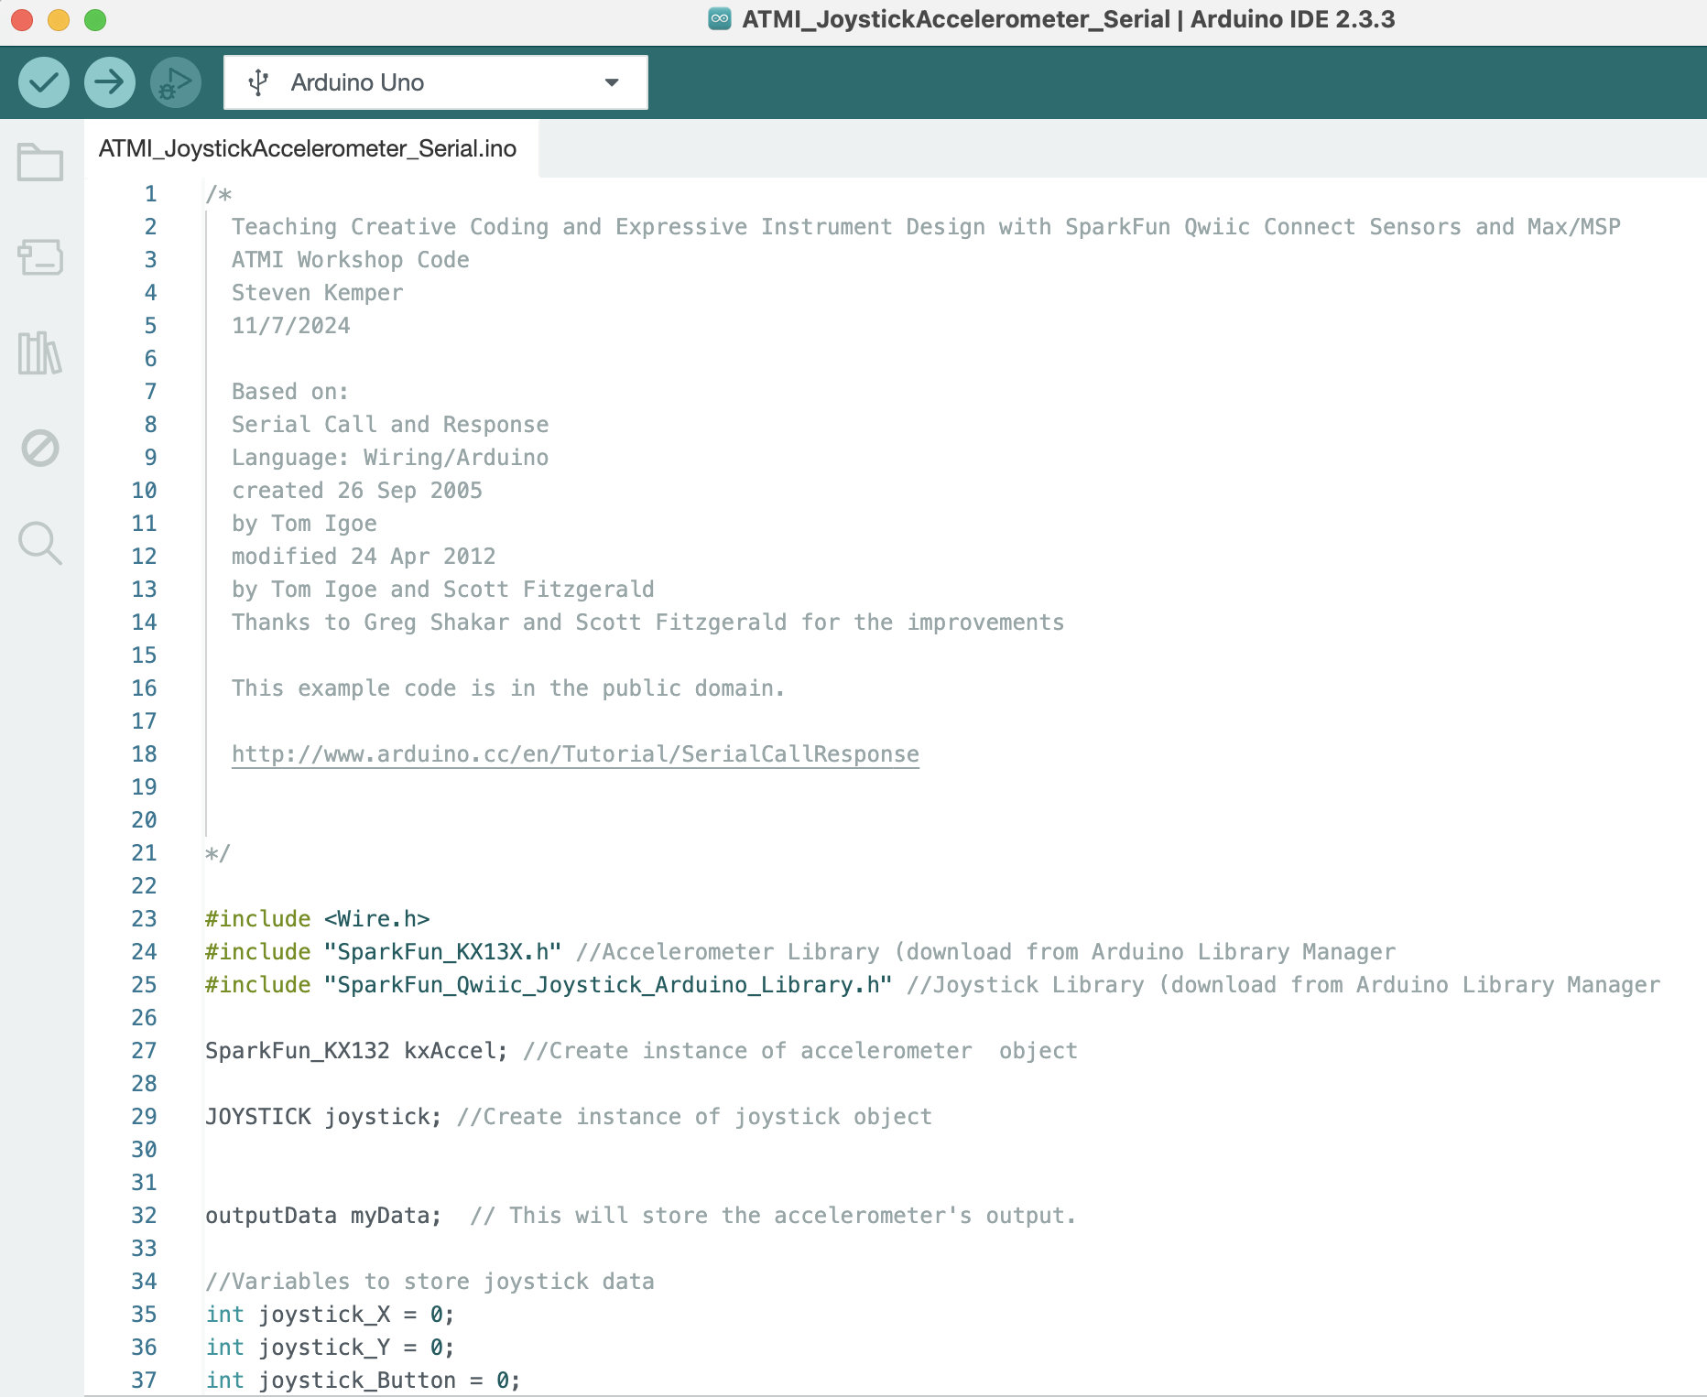
Arduino IDE (software)
Integrated Development Environment
Upload code to Arduino microcontroller

Slide 9
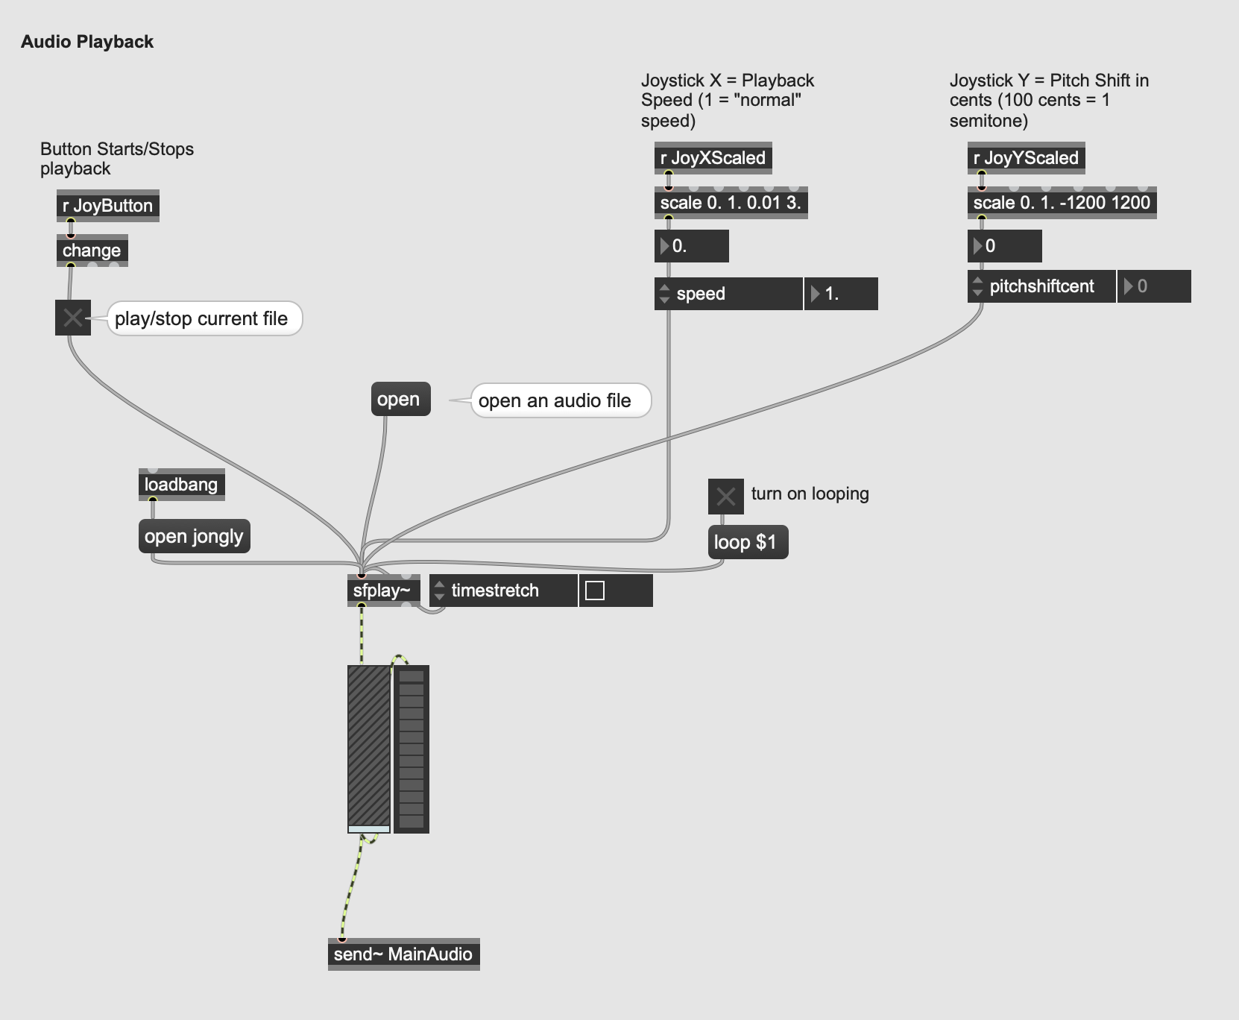
Max (software)
AKA Max/MSP
Visual programming language for music/multimedia

Slide 10
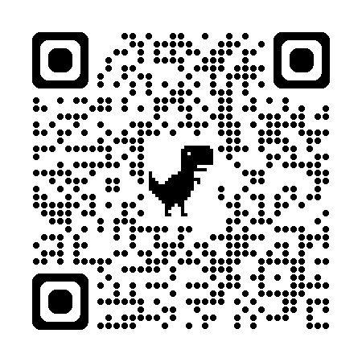
Workshop Code
Max software: https://cycling74.com/downloads
Arduino IDE: https://www.arduino.cc/en/software (not needed today)
Workshop code: https://github.com/StevenTK/Qwiic-Max

