Slide 1
Teaching the Ancients to Type: Better Unicode Text Entry for Ancient Greek
Steven Tammen
Greek, Classical Culture, and Computer Science
Dec ‘19

Slide 2
The main idea
“Native” and “non-native” languages
Different groups may need to type in other languages a little bit, but not very often
Academics
Business people
Start with ancient Greek

Slide 3
Why is typing non-native languages important?
Business and government
Globalized economy, multinational corporations
Diplomacy, military intelligence
Computerized text is dominant: Email, reports, meeting notes, etc.
Phone input is slow, voice recognition is not there yet, and Google translate is not good enough for things that demand accuracy

Slide 4
Why is typing non-native languages important?
Digital humanities
Accessing digital lexicons
Searches
Typing notes with non-native vocab
Typesetting academic works

Slide 5
Why is typing non-native languages important?
Language pedagogy/Computer aided language learning (CALL)
Full recall questions instead of forced multiple choice from lack of user input
Autograded assignments (cf. WebAssign)
Interfacing with digitized text libraries

Slide 6
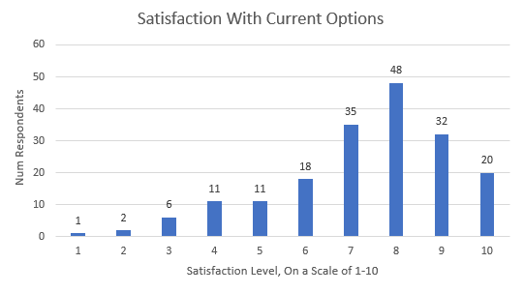
Why not use other options? Why this project?

Slide 7
Why not use other options? Why this project?
Open source, fully customizable
Intuitive and internally consistent
Minimal interference with normal computer use
Multiple languages
Nonstandard keyboard layouts

Slide 8
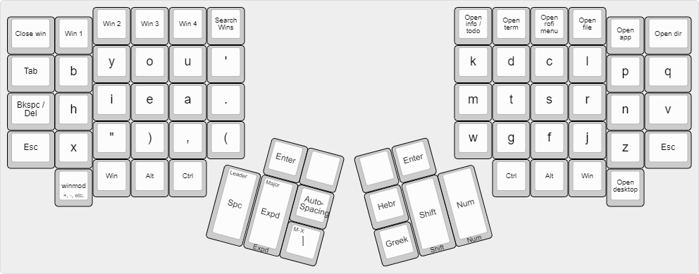
Ok, I’m biased….

Slide 9
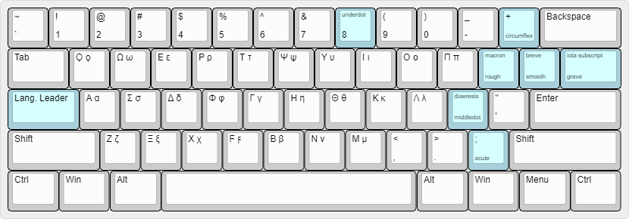
Example: Greek

Slide 10
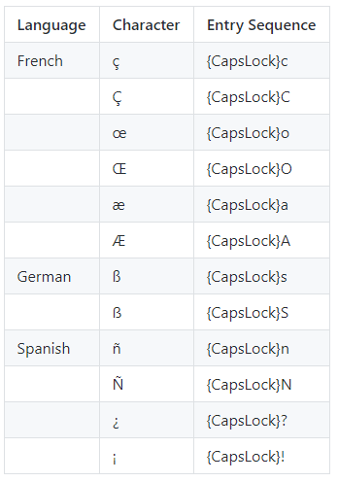
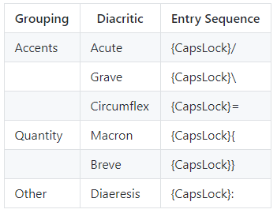
Example: Latin-script languages
German
French
Spanish
Italian
Latin

Slide 11
What exactly was your research…?
Software design and implementation (programming!)
Layout design: typing mechanics, mapping algorithms
Investigation into typing and language pedagogy overlap
Neuroscience and cognitive psychology
Hierarchical process control
Spaced repetition

Slide 12
Appendix

Slide 13
Letter placements
Keep things consistent to avoid unexpected behavior: the “principle of least astonishment”
Phonetic correspondences
Visual correspondences
Transcription correspondences
Raw optimality

Slide 14
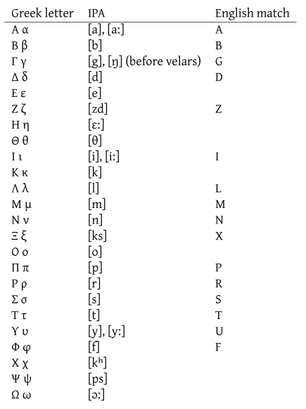
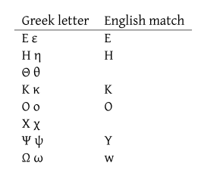

Phonetic Correspondences
Visual Correspondences

Slide 15
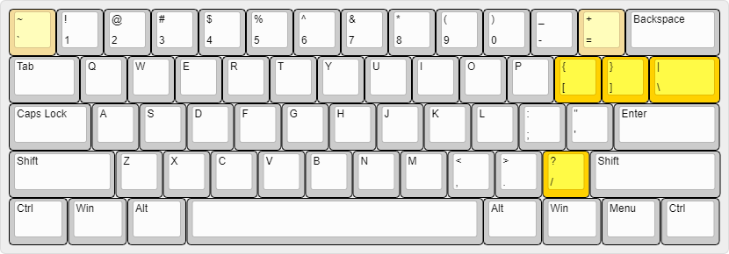
Unused unshifted punctuation: Greek

Slide 16
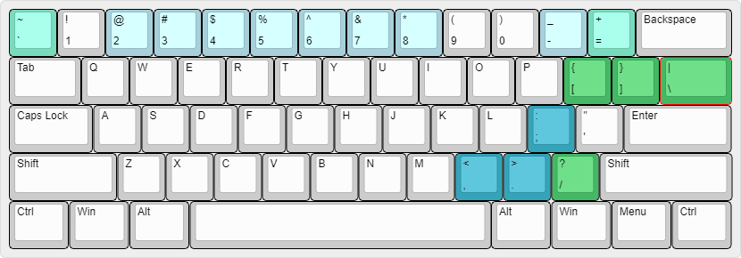
Unused shifted punctuation: Greek

