Slide 1
The relationship of Disciples And Teachers In Ancient Biography
Steven Tammen

Slide 2
On Citations
All quotes and references have been properly cited within the paper itself. The full citations have been omitted here for reasons of space. The works drawn from are listed below.
Armstrong, A. H., trans. Plotinus I: Porphyry on Plotinus, Ennead 1. Cambridge: Harvard University Press, 1989.
Jones, Christopher P., trans. The Life of Apollonius of Tyana: Books I-IV. Cambridge: Harvard University Press, 2005.
Norman, A. F., trans. Libanius: Autobiography and Selected Letters I. Cambridge: Harvard University Press, 1992.
All quoted scripture comes from the 2011 English Standard Version.

Slide 3
Purpose and scope
This presentation will examine four ancient biographical sources – Philostratus' Life of Apollonius of Tyana, Porphyry's Life of Plotinus, Libanius' autobiography, and the Christian gospels – to broadly outline the relationship between disciples and teachers in ancient biography.
Rather than arguing for some unified theory to explain all the nuance in the relationship, this presentation will examine some of the features of the relationship (as presented in the sources), and make the case that disciples played more of a role than simply acting as passive listeners.
The extent to which the biographies are a faithful and accurate portrayal of their subjects is a topic that will not be examined – the biographies are simply treated as works of literature, and analyzed accordingly.
Cf. Cornelia Vogel’s statement on the so called Socratic problem: “The ‘real’ Socrates we have not: what we have is a set of interpretations each of which represents a ‘theoretically possible’ Socrates.”

Slide 4
Assumptions
For the sake of comparison, the concept of “disciple” (from Latin discipulus, “student”, and ultimately from disco, “I learn”) is treated as consistent across the disciplines of religion, philosophy, and rhetoric. A more fine-grained analysis would be necessary for any work with smaller scope.
One might note, for example, that students of sophists like Libanius commonly went on to become sophists or teachers themselves (eventually moving on from their teacher), while disciples of philosophers very commonly remained disciples until the death of their teacher. Other distinctions could easily be made, and should be made in the case of a more focused study.
Similarly, it is taken for granted that the four biographies examined are close enough in their particular manifestation of the genre to be generally comparable.
Biography as a genre is difficult to define with specificity. Some other biographies overlap more with panegyric and hagiography, such as Eusebius’ Life of Constantine, which make generalizability a bit of problem. That is to say, the features pointed out in this presentation do not necessarily have wider applicability outside of this specific context.

Slide 5
Topical Outline
Time permitting, the following topics will covered:
Teachers as Former Students
Disciples Not Understanding Their Teachers
Disciples’ Asking Questions
Disciples Being Given Authority
Teachers Caring for Their Disciples
Disciples’ Dedication to Their Teachers
Disciples Organizing Their Teachers’ Legacies

Slide 6
But First… Who Are Our Subjects?
For those unfamiliar with the subjects of the biographies, it will prove useful to briefly discuss who they were and what they did. Such an understanding will be important for grasping many of the points made.

Slide 7
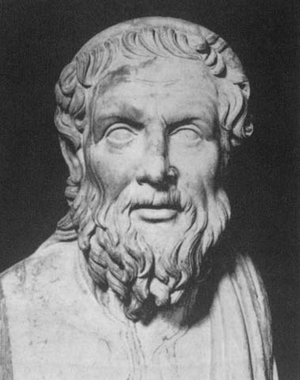
Apollonius of Tyana
Apollonius of Tyana was a travelling so called “pagan holy man”, dedicated to the neo-Pythagorean school of philosophy. People, both in antiquity and today, often compare him to Jesus Christ. He is portrayed as travelling widely to discuss philosophy with others, most notably to Mesopotamia to talk to the magi (where he meets his most notable disciple, Damis), to India to talk to the Indian sages, and to Ethiopia to talk to the gymnosophists.
He is portrayed as having clashes with both Nero and Domitian, who are painted rather unfavorably. Some of this might be influenced by the fact that his biographer, Philostratus, was writing at the behest of empress Julia Domna (wife of Septimius Severus).
Life: c. 15 to c. 100 AD
Biography: c. 220 to c. 240 AD

Slide 8
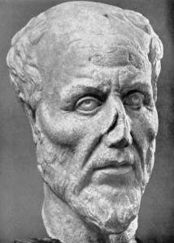
Plotinus
Plotinus was an influential neo-Platonic philosopher, perhaps the most famous of all such philosophers. He studied with Origen under Ammonius in Alexandria before settling in Rome.
Porphyry, Plotinus’ biographer and self-proclaimed intellectual heir, published Plotinus’s writings in six sets of nine, known collectively as The Enneads (Greek: Ἐννεάδες).
Life: c. 204 to 270 AD
Biography: c. 270 AD

Slide 9
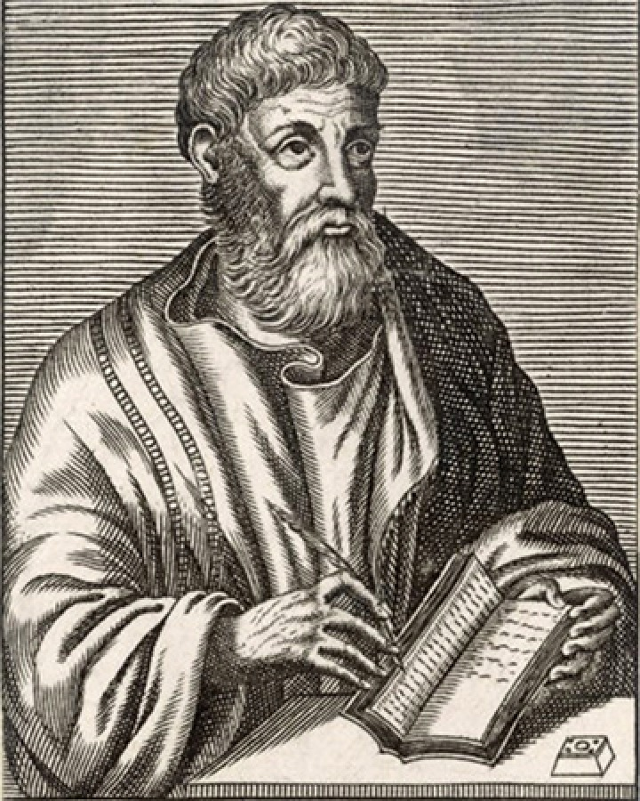
Libanius
Libanius was a sophist and a teacher of rhetoric. After being educated in Athens, he started his career in Constantinople, but was exiled to Nicomedia. Eventually he accepted the chair of rhetoric at Antioch, his home town, where he stayed until his death.
Libanius was a traditionalist pagan upset by the lack of respect Christians showed to the gods and their temples. He was friends with the emperor Julian.
Libanius often clashed with provincial governors, most of whom he did not hold in very high esteem.
Aside from his orations and declamations, Libanius left us a wealth of private letters, more than what we have from Cicero.
Life: c. 314 to c. 392 AD
Autobiography: first written in 374 and revised throughout his life

Slide 10
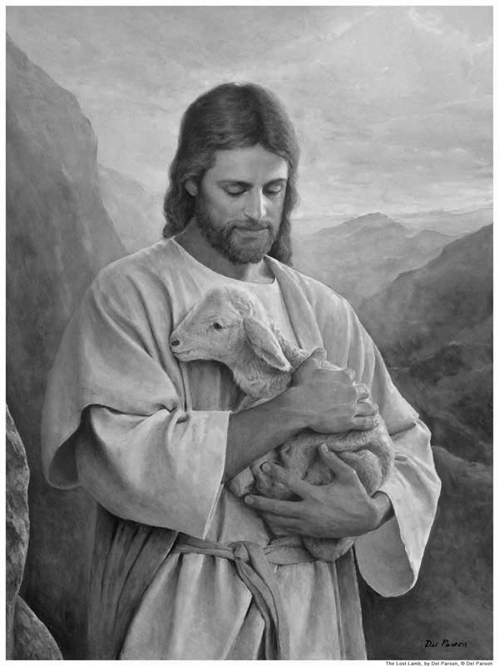
Jesus Christ
Jesus Christ was a Jewish teacher who lived during the early 1st century. He taught throughout the countryside (especially in Galilee), and was a big enough threat to the Jewish ruling classes that they convinced Pontius Pilate, the governor of Judea at the time, to crucify him.
Christians believe, among other things, that Jesus was conceived by the Holy Spirit, was born of a virgin named Mary, performed miracles, founded the Church, died by crucifixion as a sacrifice to achieve atonement for mankind’s sins, rose from the dead, and ascended into Heaven, whence he will return to judge the world.
Life: c. 2 BC to c. 33 AD
Gospels: Mid-Late 1st century AD

Slide 11
On Teachers as Former Students
Plotinus: started his study at age 28; initially dissatisfied with teachers;, studied with Ammonius for 11 years; settled in Rome at age 40.
Apollonius: quickly surpassed his early teacher, Euxenus; portrayed as very astute from a young age; not much formal training outside of his early years; developed thought over course of his life.
Jesus: Luke 2:46-47 – Jesus learning at temple at the age of 12; doctrine of kenosis; also portrayed as very astute from young age; thorough understanding of OT by the start of his ministry at age 30.
Libanius: originally somewhat of a bad student; later so determined that he would follow his teachers around until they gave some instruction; stayed above the fray of warring factions of teachers/disciples in Athens.

Slide 12
On Disciples Not Understanding Their Teachers
Apollonius: 2.5 – Damis not understanding Apollonius points regarding knowledge and proximity to the heavens.
Jesus: Matthew 16:6-7– The 12 not understanding Jesus’ statement: “Be on your guard against the yeast of the Pharisees and Sadducees.” After discussing it among themselves, they decide that Jesus is telling them this because they didn’t bring any bread with them.
Plotinus: Porphyry, Amelius, et al. don’t understand Plotinus’ statement about the gods: “They ought to come to me, not I to them.” “What he meant by this exalted utterance we could not understand and did not dare to ask.”
Amelius has been Plotinus’ disciple for 18 years by this point, and he still didn’t get it ⇒ not simply due to age or inexperience.

Slide 13
On Disciples Asking Questions
Disciples free to ask questions ⇒ had enough autonomy in the relationship to control what topics were covered, at least to an extent.
Plotinus: said to actively encourage questions; Amelius thought Plotinus was too willing to answer questions; Porphyry says that Plotinus viewed questions as a necessary part of the intellectual process.
Jesus: also said to be happy to explain things; Olivet Discourse as answer to question by some of the disciples; not just questions regarding interpretation of parables (though these were frequent).
Apollonius: Damis blocking discussion in 4.15 to force Apollonius to talk about his supposed meeting with Akhilleus.

Slide 14
On Disciples Being Given Authority
When teachers were unable to address concerns due to considerations of distance, volume, or busyness, disciples were sometimes given authority to act as if they spoke for the teacher directly.
Jesus: sending out disciples in pairs, both the 12 and the 70 (or 72, depending on mss.); Luke 10:16 “Whoever listens to you listens to me; whoever rejects you rejects me; but whoever rejects me rejects him who sent me.”
Plotinus: Amelius writing defense of Plotinus’ teachings regarding the charge that he was appropriating ideas of Numenius; Amelius tasked with disabusing Porphyry of his mistaken views; ⇒ Amelius writes of Plotinus’ doctrine as though he were Plotinus himself.

Slide 15
On Teachers’ Care for Their Disciples
Teachers fulfilling pseudo-paternal role ⇒ power gap ⇒ teachers carry more authority than their disciples just as fathers carry more authority than their children.
Libanius: Libanius distressed at deaths of his pupils; uses simile to compare himself to a father’s untimely burying of many good sons; relationship was evidently close enough with some of his disciples that he buried them – a responsibility generally reserved for family.
Plotinus: Plotinus stopping Porphyry from committing suicide ⇒ had to know Porphyry well enough to infer that he was thinking about suicide ⇒ implies a relationship based on more than just professional matters. Depression not well understood in antiquity ⇒ must have known Porphyry on deeply personal level.
Jesus: portrayed as compassionate and caring; Jesus as the great physician; metaphor of the shepherd and the sheep in John 10 ⇒ sheep absolutely helpless, power gap larger, but shepherd protects sheep with his life.

Slide 16
On Disciples’ Dedication to Their Teachers
Disciples were generally unwilling to support their teachers when negative consequences were involved – not necessarily reciprocity in care.
Jesus: Matthew 26:35 – Peter says (and other disciples affirm): “Even if I have to die with you, I will never disown you.” Yet in the verses immediately following, none of the disciples were capable of staying awake to keep watch. When Jesus was subsequently arrested “all the disciples deserted him and fled.” (Peter, of course, goes on to deny Jesus 3 times).
Apollonius: book 4 – Philolaus, a philosopher fleeing Rome because of Nero’s persecution of philosophers, tries to convince Apollonius and company to stop going towards Rome and instead run away; Apollonius’ “disciple count” drops from 34 to 8; disciples came up with lame excuses as they “ran as fast as they could away from Nero and philosophy.”
Plotinus: abandonment on deathbed after he contracted disease of bowels. Refused to submit to an enema and insisted on “greeting everyone by word of mouth” ⇒ died alone, despite all he did to help others throughout his life.

Slide 17
On Disciples Organizing Their Teachers’ Legacies
More than any other aspect of the relationship, it is the disciples’ control over their teachers’ legacies that defines their status as independent, autonomous agents. For Porphyry, Damis, and the Apostles of Jesus Christ, the recording and organization of their masters’ teaching fundamentally changed the way they interacted with their teachers – before their death to an extent, but especially after.
Apollonius: Philostratus presents Damis’ relationship with Apollonius almost entirely through his task of recording Apollonius words and actions. He was so persistent, in fact, that Apollonius sent him to Nerva in 8:28 so that he could die without Damis being there to record it.
Plotinus: Porphyry as compiler; organized Plotinus’ written legacy into the Enneads essentially as he saw fit; relationship changed from one of disciple and friend to one of public relations manager… both for Plotinus, but also for himself as the main recipient of Plotinus’ legacy.

Slide 18
On Disciples Organizing Their Teachers’ Legacies
Jesus: “Division of labor” among Apostles (and their associates: Luke the physician, who wrote under the authority of Paul, and Mark, who wrote under the authority of Peter): While all the gospels cover Jesus’ life and teaching, they go about doing it in slightly different ways.
Matthew’s gospel was primarily targeted at a Jewish audience, and thus contains more Hebraisms and allusions to Old Testament prophecy than the other gospels.
Mark’s gospel was primarily written for the gentiles, and is focused on aspects of Jesus’ life and ministry that correspond to the theme of Jesus coming to save sinners.
Luke is very empirical in his gospel – in much the same way Thucydides is in his History of the Peloponnesian War – and has more parables than the other synoptics.
John’s gospel is the most theologically dense of the four, containing many teachings of Jesus (the vine and the branches in John 15, e.g.) not found in the other three.
In this way, none of the Apostles took full control of Jesus’ legacy, but they all played a part in continuing his work in the world.

Slide 19
Legacies: Libanius as a “Control group”
The biographies discussed in this section so far – the Life of Apollonius of Tyana, the Life of Plotinus, and the gospels – were all written or heavily influenced by disciples of the teachers that are the subjects.
For this reason, it is unsurprising that they contain a proportionally large amount of material focused on themselves and other disciples – regarding their (own) actions and contributions to their teachers’ lives and works.
Libanius’ autobiography does not contain much about Libanius’ disciples, their personalities, or their influence on him. Most of what it does contain is limited to their effect on him: when they die, he is sad; when they are successful, he is happy; etc.
This is not surprising; in fact, it makes perfect sense for his autobiography to focus upon himself. What is surprising is the extent that this makes his autobiography different from the biographies previously discussed – while these biographies obviously do talk about their subjects, the amount of material on other things (like the personalities of their disciples and interactions with them) is quite significant when compared to the relative focus of Libanius’ writing.

Slide 20
Legacies: Libanius as a “Control group”
It is difficult to say for sure why this disparity exists. Perhaps disciples felt they had something to gain by inserting themselves into the lives of teachers. Perhaps they simply included more information about their own lives or experiences because that is what they knew and felt most comfortable talking about. Whatever the reason, its existence makes it clear that disciples did significantly influence how the biographies of their teachers were written. This observation, in turn, brings us full circle: because disciples played an active role in the propagation of their teacher’s legacy by influencing the writing of their biographies, they were not merely passive listeners.

Slide 21
Questions?
Summary
This presentation has examined four ancient biographical sources to get an overview of some of the characteristics of the relationship between disciples and teachers in antiquity, and to show that disciples played active rather than passive roles in the lives and legacies of their teachers.
The full paper may be viewed on my website, either directly or through my CV:
https://steventammen.com/writings/disciples-and-teachers-in-ancient-biography.pdf
https://steventammen.com/CV.pdf

