Slide 1
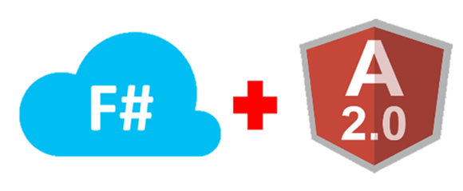
Welcome to CodeCamp AF!
Presented by Christopher Brown & Steven U

Slide 2
Agenda
8:30-8:45 - Signing in and team organization! We'll have a sign in site that will assign you to teams!
8:45-9:30 - Machine setup, and introducing VS Code!
9:30-10:30 - Steven U will show you TypeScript, and how to create Single-Page-Applications in Angular2.
10:30-12:00 - Angular2 exercise
12:00-12:45 - Lunch
12:45-1:45 - Christopher Brown talks about F#, introducing the language and a few F# specific tools.
1:45- 3:15 - Backend services exercise
3:15-4:00 - Team Demos, and wrap up.

Slide 3
Angular2 Machine setup (WindowS)
Required tools:
Powershell
Chocolatey
Google Chrome
Visual Studio Code
NodeJS
Angular 2 CLI
Setup Steps:
Install Chocolatey via Powershell
iex ((new-object net.webclient).DownloadString('https://chocolatey.org/install.ps1'))
Choco Install
googlechrome -y
visualstudiocode -y
nodejs -y
Restart Powershell
npm update –g nodejs@latest
npm install –g @angular/cli

Slide 4
Demo: Visual Studio Code
Code Window
Folder Explorer
Output and Terminal Windows
Command Pallette
Extension Manager
Git Integration
Search and Debug Tabs Useful Keyboard Shortcuts
Shortcut | Description
Ctrl + Shift + P | Open Command Pallette
Ctrl + ` | Open Command Line Prompt
Alt + Shift + F | Auto Format Code
Ctrl + P | Find File

Slide 5
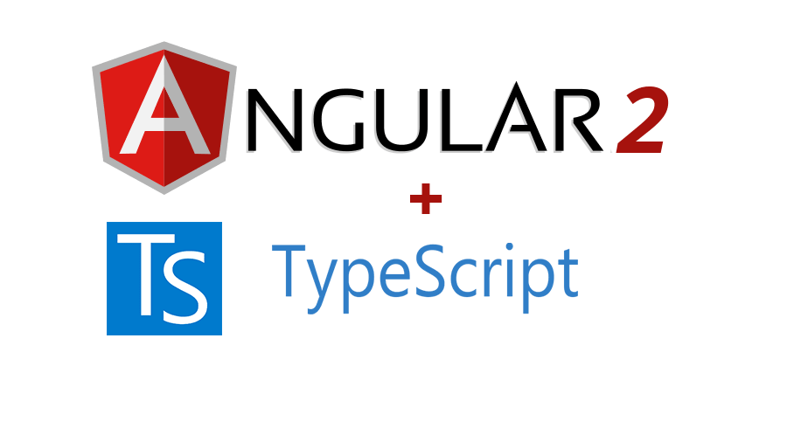

Slide 6

Angular 2 – Why Use it?
Open Source (https://github.com/angular/angular)
Supported heavily by both Google and Microsoft
Component based architecture
Performant
Testable
TypeScript
Notes:
Performant (uses virtual DOM)
Designed with testability in mind
How does it differ from react

Slide 7

Typescript – Why Use it?
Open Source (https://github.com/Microsoft/TypeScript)
Owned by Microsoft, heavily supported by Google
AndersHejlsberg (C# lead architect)
Optional statically typed object-oriented programming language
Superset of JavaScript
“Anything stupid you want to do in JS, you can still do in TS” – Steven U
Superset of ES5 & ES6
Eases Migration Path to ECMAScript 6
Notes:
Transpiles to JS
OO pillars (Abstraction, Encapsulation, Inheritance, Polymorphism)
Better IDE experience

Slide 8
Typescript – Types
let <name>: <type> = <value>; //*let is block scoped
Type | SYNTAX
Numeric | number
Text | string
Boolean | boolean
Array | boolean[]
Interface | interface
Dynamic | any
Generic | <T>
Union | string|number
Intersection | extend<T, U>
Tuple | [string, number]
Notes:
Let vs Var: Scoping
Var is global scoped
Let is block scoped
For (var i) example loop example

Slide 9
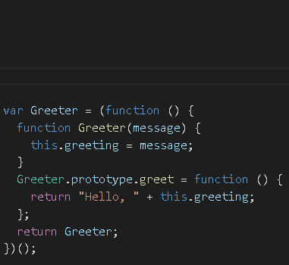
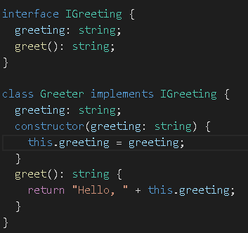
TypeScript – Classes
JavaScript
TypeScript
Notes:
TS class vs JS prototype iife pattern

Slide 10
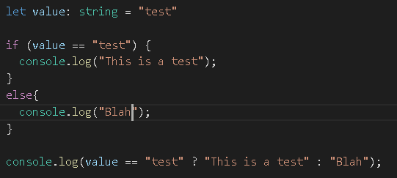
TypeScript – Language (Continued)
Conditional

Slide 11
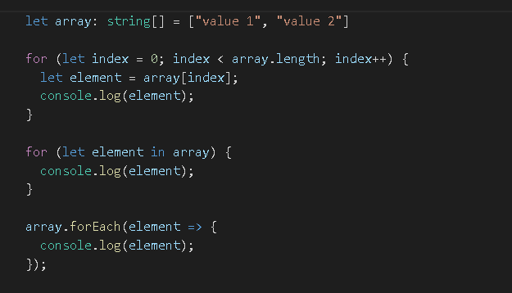
TypeScript – Language (Continued)
Loop

Slide 12
Exercise – Typescript playground
https://www.typescriptlang.org/play/
Write a class called LunchProxy which contains the following
Properties:
BaseURL (i.e. http://localhost...)
OverallVotingAggregate (direction of votes overall)
DummyRestaurantNames (collection of names)
Methods:
CreateLunch(name, date) returns dummy list of restaurant names
UpVote(name) – increments overall voting property
DownVote(name) – Decrement overall voting property and prints name to console if overall is negative
FinalizeLunch() – returns a single dummy name
Loop through the list and print to even indexes to console

Slide 13
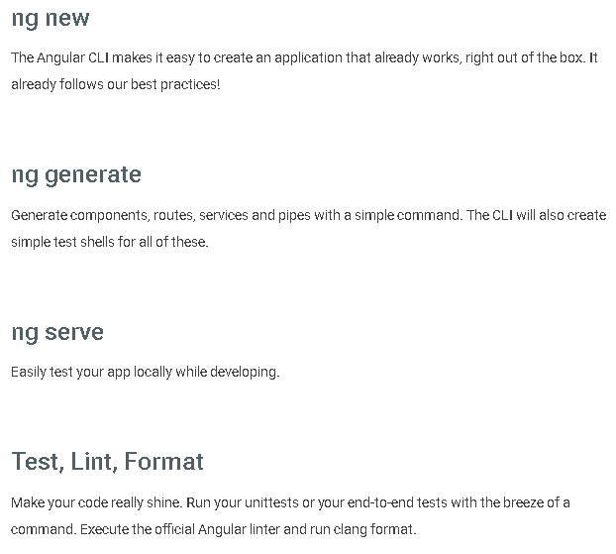
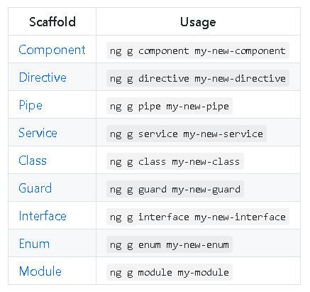
Angular command line interface (ng cli)
Notes:
The CLI was developed with one thought in mind: Keep developers out of npm and javascript HELL
You can still customize your development pipeline if you wish since it just uses NPM packages

Slide 14
Exercise ng cli tutorial
Create a new angular project called DevDay
Run ng new
Ensure environment/project is configured correctly
Run npm install
Run ng serve
Run ng test
Notes:
ng new DevDay
ng generate service LunchProxy copy paste code over from playground into TS file
Ng test
Ng serve

Slide 15
Angular 2 – Project structure
<project root>
src
index.html
app
app.component
app.module.ts
component folder()
css, html, spec, ts files
…
node_modules
e2e
…
Notes:
E2e – protractor tests
Node_modules – equivalent of nugget packages
App.module.ts <- the root module
@NgModule decorator identifies an angular module which are loaded into apps
Components – mvvm/mvc pattern
made up of css, html, tests, and TS files
Components control views modules do not

Slide 16



Testing - jasmine
Jasmine – JavaScript testing framework
Karma – Continuous test runner
Protractor – End to End Integration Tests
Notes:
Describe structure of testing framework

Slide 17
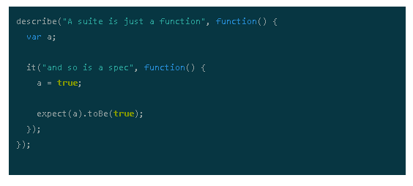
Jasmine Testing

Slide 18
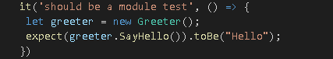
module testing VS Component testing
Module Testing Setup
Notes:
There are two types of tests that can be written
Component tests run in the context of angular
Module tests can run on basic typescript classes

Slide 19
Exercise - Testing
Generate LunchProxy service
Run ng test
Module Test
Write test that ensures create lunch returns only 5 names
Write test that ensures a specific list of strings is returned
implement service method to make test pass ☺
Notes:
Instruct to ignore existing test and write test like previous slide

Slide 20
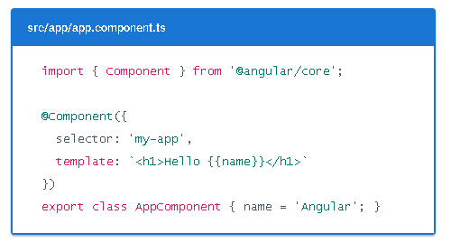
Angular - Components
Component: the combination of an HTML template and a component class that controls a portion of the screen.
Notes:
Components are one of the key features of Angular2. Understanding is pivotal
Walk through basic file:
Imports
Component decorator
Selector (show usage in index.html)
Inline Html template
Class definition
Take a look at app.component.ts generated out of the box- Show how it can be a separate file (as CLI creates)

Slide 21
Walkthrough: app.component.ts
Notes:
Ng ClI creates your first component for you.

Slide 22
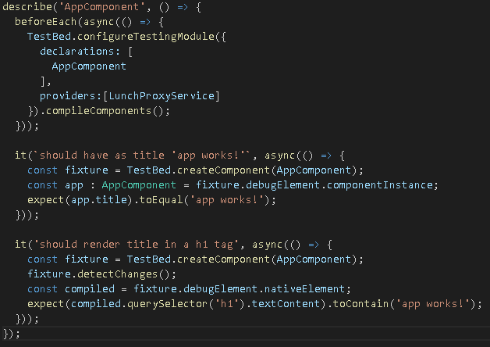
module testing VS Component testing
Component Testing Setup
Notes:
Component tests run in the context of angular
Module tests can run on basic typescript classes
Test event bindings

Slide 23
Exercise - Testing
Run ng test
Component Test
Add a new component called CreateLunch
Add a test to the app.component.spec.ts file that ensures the create lunch component has been added to the app componenent
Implement to make test pass ☺
Notes:
Show dependency injection slide
schemas: [NO_ERRORS_SCHEMA]

Slide 24
Angular – Key Concepts
Interpolation
<h1>Hello {{name}}</h1>Directives
Add component called sample1 that uses interpolation to display a property.
Note: Use TDD (see app.component.spec.ts for example)
Stretch: Let others perform the same exercise without looking at the example ☺
Notes:
component/template duality from MVC or MVVM
Angular, the component plays the part of the controller/viewmodel, and the template represents the view

Slide 25
Angular – Key Concepts
Directive
<div (myClick)="clickMessage()” clickable>click with myClick</div>
Add a component called sample2 that contains a button which prints “Hello world” to the console when the button is pressed.
Stretch:
Add test to ensure correct method is called when clicked
Notes:
component/template duality from MVC or MVVM
Angular, the component plays the part of the controller/viewmodel, and the template represents the view

Slide 26
Angular – Key Concepts
Property Binding
<button [disabled]=“isFormPopulated">Cancel is disabled</button>
Add a component called sample3 that has a label and a button. When the button is clicked, toggle whether the label is hidden
Stretch:
Add test similar to sample2 to ensure click event method.
Add test to ensure label is populated after button is clicked
Notes:
component/template duality from MVC or MVVM
Angular, the component plays the part of the controller/viewmodel, and the template represents the view

Slide 27
Angular – Key Concepts (template syntax)
Asterisk
<p *ngIf=“SomeCollection.length > 3">There are many!</p>
<li *ngFor="let item of items"></li>
Add a component called sample4 that has an array of strings that is bound to an unordered list in the UI.
Stretch:
Add test to ensure there are the same number of list item tags as there are indexes in the array
Notes:
component/template duality from MVC or MVVM
Angular, the component plays the part of the controller/viewmodel, and the template represents the view

Slide 28
Angular – Key Concepts
Two-way binding
<input [(ngModel)]="username">
Create a component called Sample5 that contains an input box and a label that are bound to the same property
Stretch:
Add test to ensure that the value in the input box is the same as the value in the label
Notes:
component/template duality from MVC or MVVM
Angular, the component plays the part of the controller/viewmodel, and the template represents the view

Slide 29
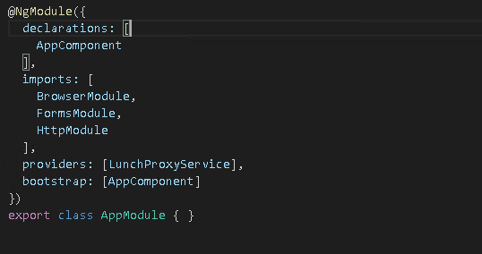
Angular 2 - Dependency Injection
First class citizen of Angular2

Slide 30
Exercise
Ladies and gentlemen, devs and testers, it’s time for your dev org lunch location vote. Voting is open until 11:20am.
The voting rules:
Upvoting
Each voter can upvote each of the choices avail.
Downvoting
Each voter can downvote zero or one choice.
Each upvote counts as a +1, each downvote a -2.
Your choices for today, curated with care:

Slide 31
Exercise (part 1)
Design a component that looks like the following.
Write test to ensure string is displayed when button is clicked.
The button should get the winner from the service.

Slide 32
Add the following business rules to CreateLunch
Form should post a request back to the service containing user inputs
Disable create lunch button once the form has been submitted
Display the request parameters in the labels to the right
The returned restaurants should be displayed in a list below
Each option should have its own set of upvote and downvote buttons
Tests:
Write a test that ensures the "create lunch" button is present in the component
Write a test that ensures the backing component fields are bound to the input values when the create lunch button is clicked.

Slide 33
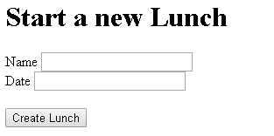

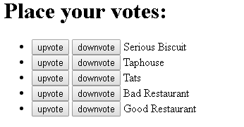
Ui mockup

Slide 34
Additional Content (if needed)
Shared State
Disable components depending on where you are in the process
Hint: add a new service to track state and share it between components

Slide 35
Areas not covered
Routing
Mocking
Lifecycle hooks
Observables vs promises
Component interaction
Notes:
Observable supports cancel and is more flexible with nested components (1 or more event handlings can be applied)

Slide 36
Additional references
Typescript Documentation:
https://www.typescriptlang.org/docs/tutorial.html
Typescript Playground:
https://www.typescriptlang.org/play/
Angular 2 Documentation:
https://angular.io/docs/ts/latest/guide/learning-angular.html
Tour of Heroes:
https://angular.io/docs/ts/latest/tutorial/
John Papa’s Blog:
https://johnpapa.net/
Ionic 2 Getting started:
https://ionicframework.com/docs/intro/tutorial/

Slide 37
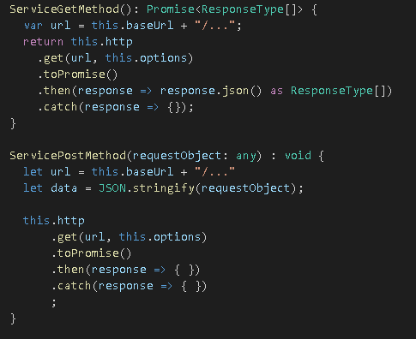
HTTP Glue code

