Slide 1

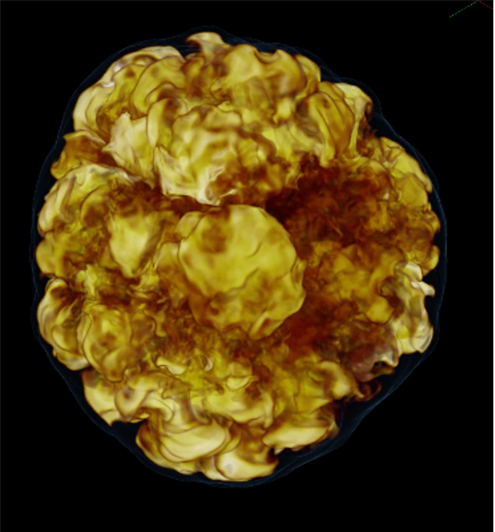
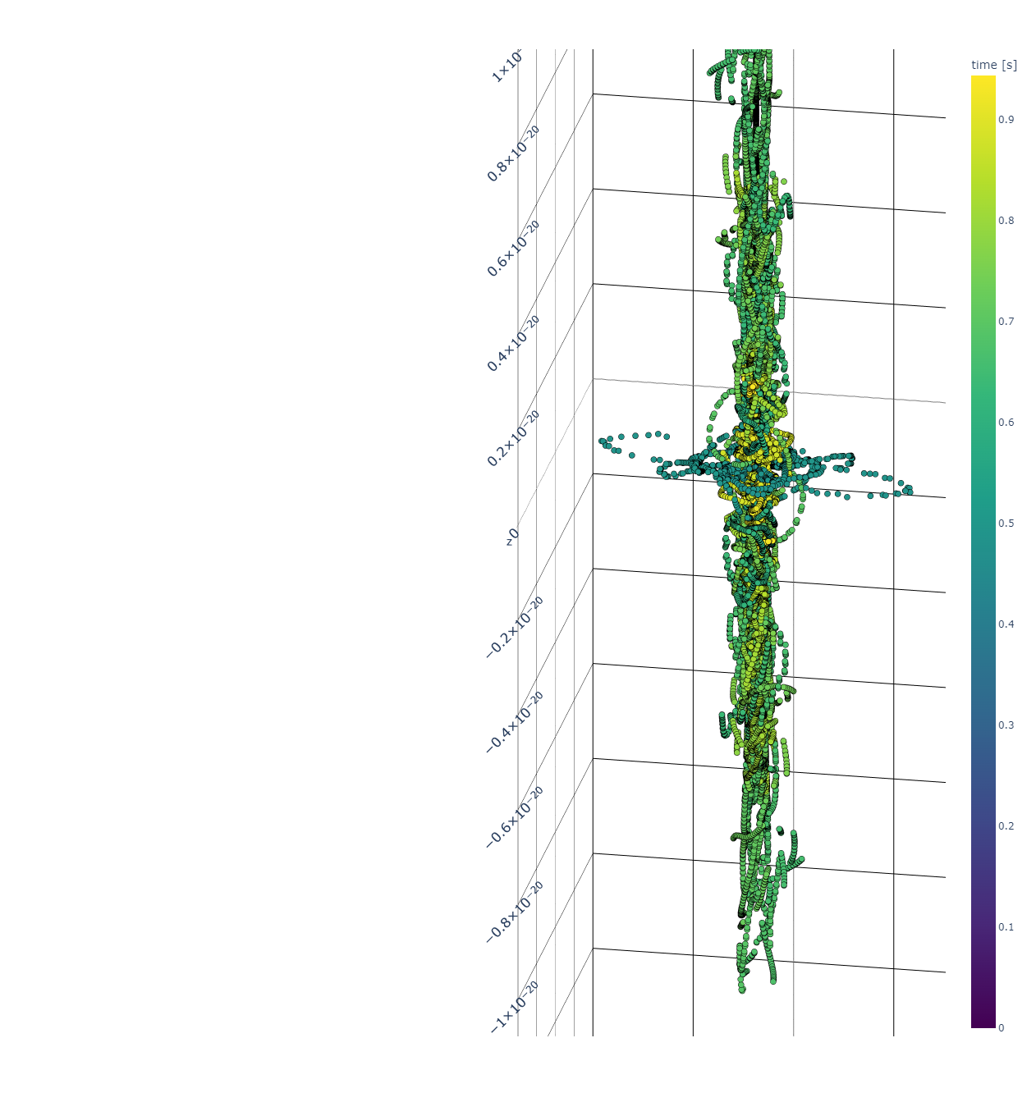
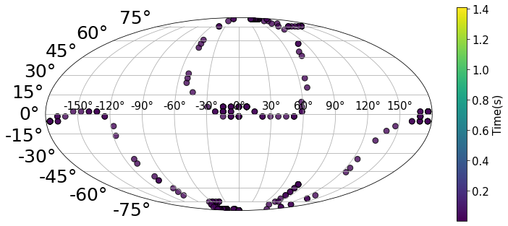
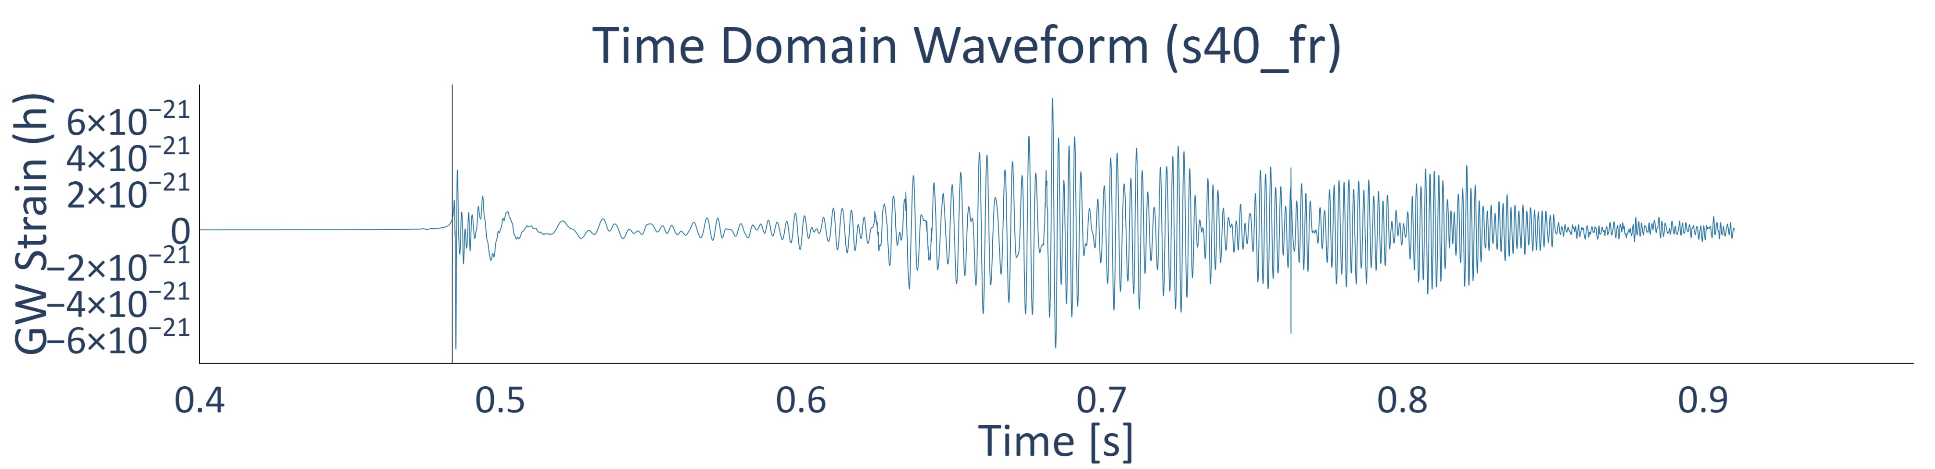
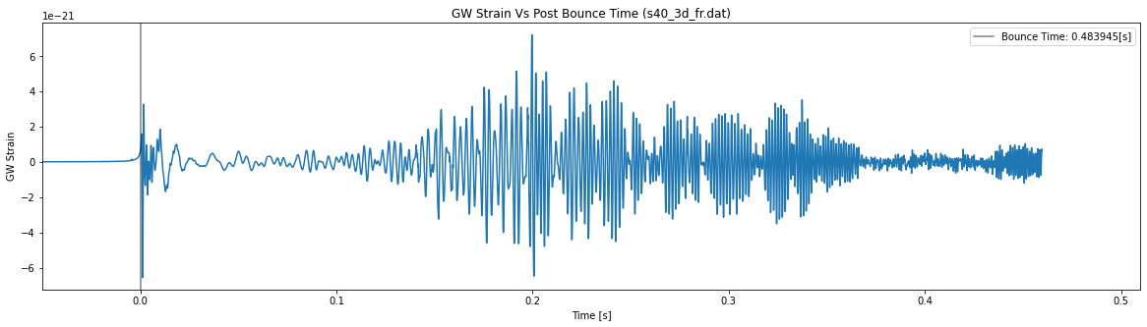
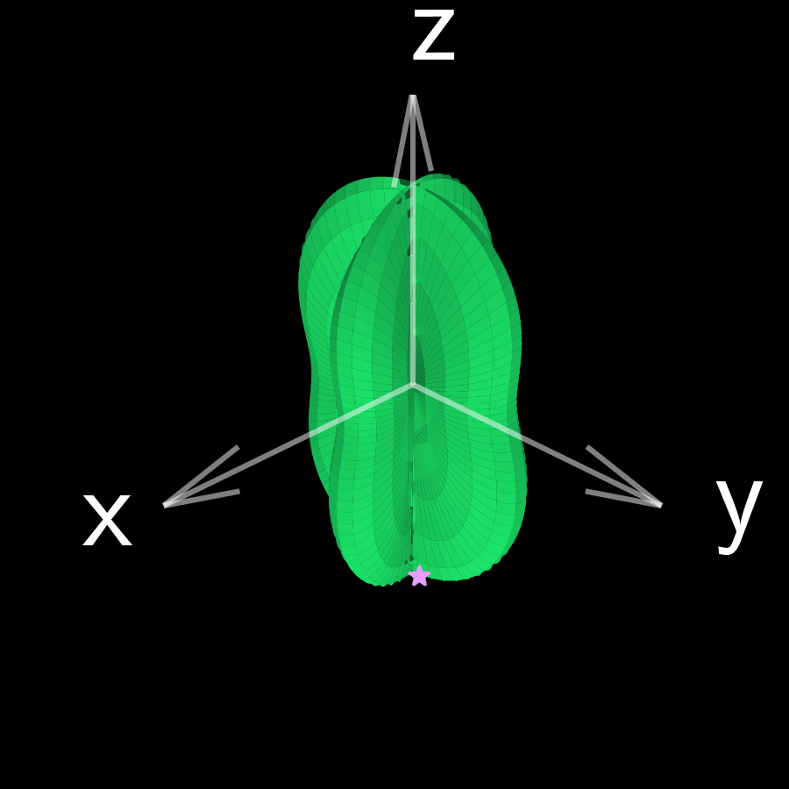
CCSN Rotation’s Effects on GW Emission Direction
Steven VanCamp & Michael A. Pajkos & Dr. Sean Couch
vancam25@msu.edu
Introduction
Results
Gravitational wave studies provide a unique insight on the inner workings of phenomena where light is unable to escape. Our project focused on core collapse supernovae, a source of ripples in space and time called gravitational waves. We explored the possible connections between gravitational waves and the overall shape of the resulting supernova explosion. We focused on how gravitational wave intensity and emission direction correlate to supernova rotation and the internal movement of matter.
Max Strain 3D Scatter Plot (s40_fr)
Max Strain Scatter (0.48,0.49 [s])
GW signal from No/Slow/Fast rotator supernova varies in both emission direction and intensity
Rotating supernovae preferentially produce GWs along the axis of rotation
GW maximum strain may trace a continuous path as time progresses for rotating supernovae
Methods
Conclusions
Non-rotating supernovae radiate GWs roughly isotropically
Supernova rotation has an influence on GW intensity and emission direction
There is a possible connection between GW emission direction and matter instabilities
Simulations ran with FLASH Multiphysics software
Supernova data from Pan+ (2021)
Calculated gravitational wave (GW) signal (h) from the matter motion within the supernova
We calculate h for every viewing angle producing a 3D surface, for every time step
We identify the maximum GW strain at each time step, at a specific viewing angle
From here we derive the spectrograms, maximum strain scatter plots, and other products
References
Dubey, A., Antypas, K., Ganapathy, M. K., et al. 2009, Parallel Computing, 35, 512
Fryxell, B., Olson, K., Ricker, P., et al. 2000, The Astrophysical Journal Supplement Series, 131, 273
Ken-ichi. Oohara, Takashi. Nakamura, Masaru. Shibata, Chapter 3. A Way to 3D Numerical Relativity, Progress of Theoretical Physics Supplement, Volume 128, March 1997, Pages 183–249
Pan K.-C., Liebendörfer M., Couch S. M., Thielemann F. -K., 2021, The Astrophysical Journal, 914, 140
Preferred GW amplitude colored by time
GWs emission dominates along the equator at early times and along the axis of rotation at later times

