Slide 1
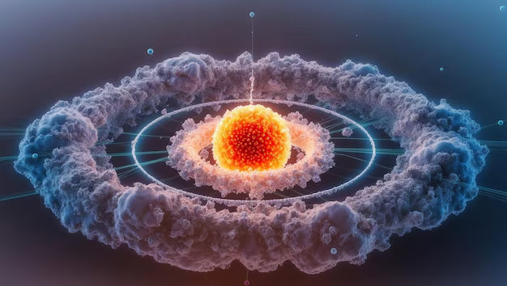
LECTURE 4A — GENERAL CHEMISTRY
QUANTUM NUMBERS
& ATOMIC ORBITALS
Understanding the Quantum Mechanical Model of the Atom
n, l, m_{l}, m_{s} · Orbital Shapes · Radial Nodes
45-Minute Lecture · University General Chemistry

Slide 2
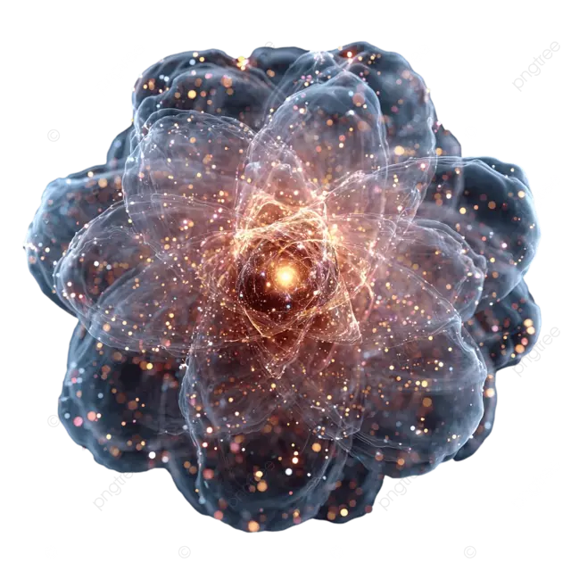
4A | QUANTUM NUMBERS
CONTENTS
01
Quantum Mechanical Model
Why classical physics failed
Probability distributions & wave functions
02
The Four Quantum Numbers
n, l, m_{l}, m_{s} — the complete address
Shells, subshells & electron capacity
03
Orbital Shapes & Nodes
s, p, d orbital geometries
Radial & angular nodes
02

Slide 3
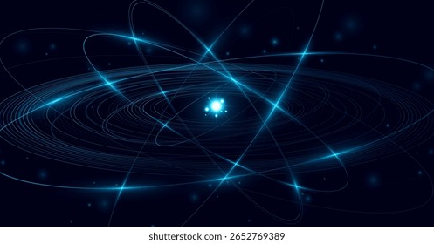
01
THE QUANTUM MECHANICAL MODEL
From Classical Failure to Quantum Success

Slide 4
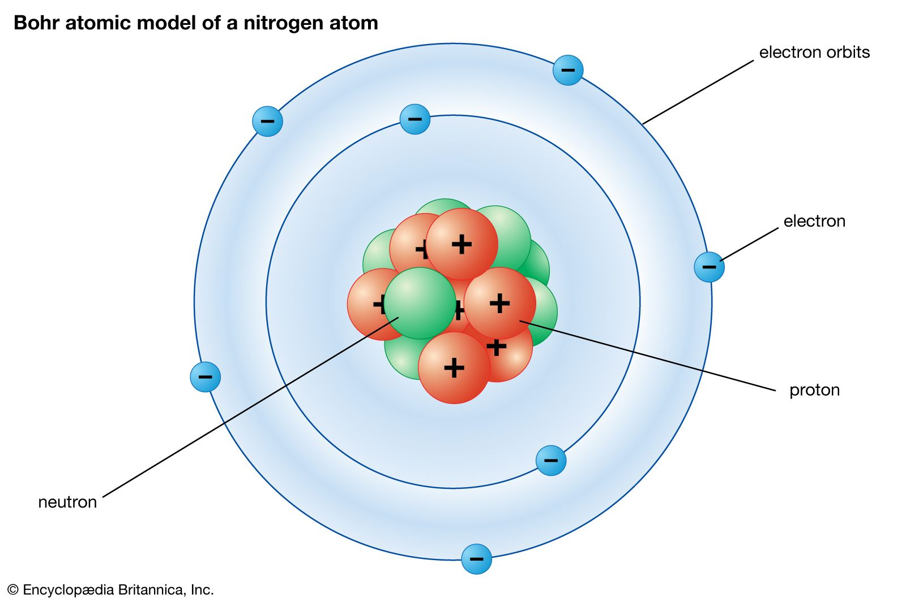
4A | QUANTUM NUMBERS
Classical Physics Failed to Describe the Atom
The Bohr Model (1913) successfully explained hydrogen's line spectrum — but failed completely for multi-electron atoms.
The Fatal Flaw:
Classical electrodynamics predicts an orbiting electron should continuously radiate energy and spiral into the nucleus.
Yet atoms are stable. This contradiction demanded a fundamentally new approach.
The Bohr model — accurate for hydrogen only
Key Insight: Electrons do NOT travel in predictable paths. A new model was needed.
04

Slide 5
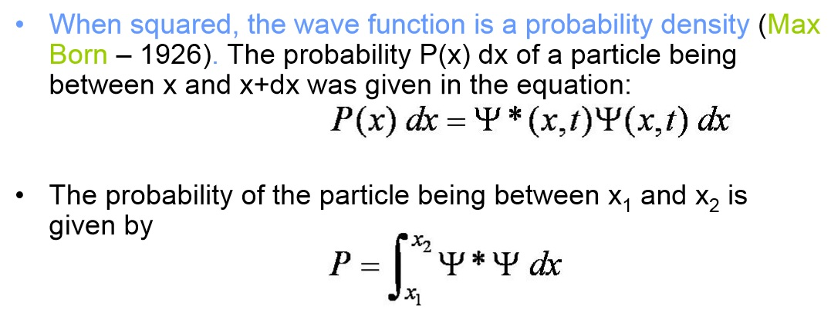
4A | QUANTUM NUMBERS
Electrons Exist as Probability Distributions
Born Interpretation (1926): Probability Density = $$∣ψ∣^{2}$$
In quantum mechanics, electrons are described by wave functions ($$ψ$$).
The square of the wave function $$∣ψ∣^{2}$$ gives the probability density of finding an electron at a point.
We can no longer pinpoint an electron's location — only the probability of finding it in a certain region.
Definition: An orbital is a region of space where there is a high probability ($$\&gt;90\%$$) of finding an electron.
05

Slide 6

02
THE FOUR QUANTUM NUMBERS
n, l, m_{l}, m_{s} — The Complete Address of Every Electron

Slide 7
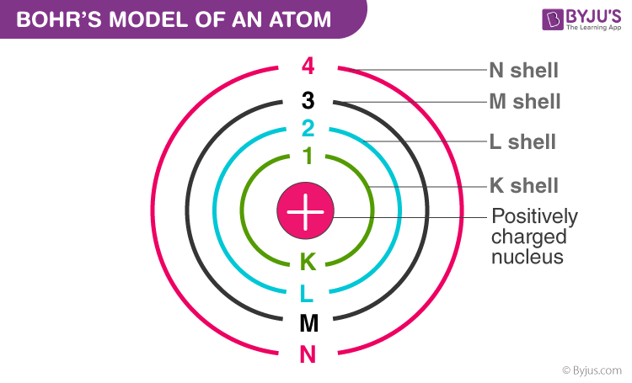
4A | QUANTUM NUMBERS
The Principal Quantum Number (n) — Energy Level
n
Principal Quantum Number
Defines the principal energy level (shell)
Allowed values: n = 1, 2, 3, 4, ...
What n determines:
Size of the orbital (larger n = larger orbital)
Energy of the electron (higher n = higher energy)
Average distance from the nucleus
Max electrons per shell = $$2n^{2}$$
07

Slide 8
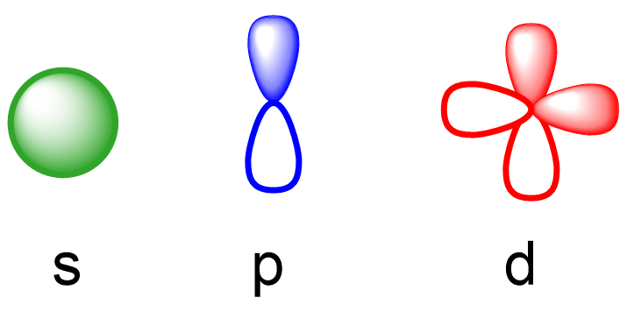
4A | QUANTUM NUMBERS
The Angular Momentum Quantum Number (l) — Shape
l
Angular Momentum Quantum Number
Defines the shape of the orbital (subshell)
Allowed values: l = 0, 1, 2, ..., (n − 1)
l Value | Letter | Subshell | Shape
0 | s | s subshell | Spherical
1 | p | p subshell | Dumbbell
2 | d | d subshell | Cloverleaf
3 | f | f subshell | Complex
Rule: The number of possible l values for a given n equals n.
08

Slide 9
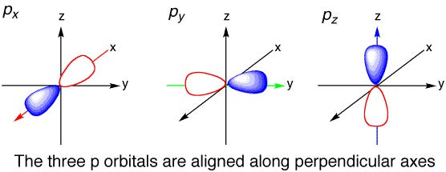
4A | QUANTUM NUMBERS
The Magnetic Quantum Number (m_{l}) — Orientation
m_{l}
Magnetic Quantum Number
Defines the spatial orientation of the orbital
Allowed values: m_{l} = −l, ..., 0, ..., +l
Examples:
l = 0 (s):
m_{l} = 0 only
→ 1 orbital
l = 1 (p):
m_{l} = −1, 0, +1
→ 3 orbitals
l = 2 (d):
m_{l} = −2, −1, 0, +1, +2
→ 5 orbitals
l = 3 (f):
m_{l} = −3 to +3
→ 7 orbitals
Number of orbitals per subshell = $$2l+1$$
09

Slide 10
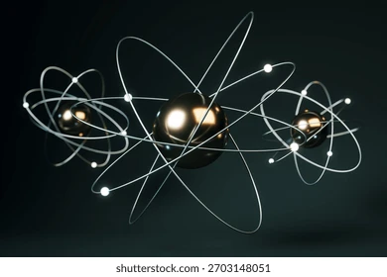
4A | QUANTUM NUMBERS
The Spin Quantum Number (m_{s}) — Electron Spin
m_{s}
Spin Quantum Number
Describes the intrinsic angular momentum of the electron
Allowed values: m_{s} = +½ or −½
↑
↓
Spin Up
m_{s} = +½
Spin Down
m_{s} = −½
Pauli Exclusion Principle: Each orbital holds max 2 electrons with opposite spins.
10

Slide 11
4A | QUANTUM NUMBERS
Quantum Numbers — Summary Table
Symbol | Name | Allowed Values | Describes
n | Principal | 1, 2, 3, 4, ... | Energy level, size, distance from nucleus
l | Angular Momentum | 0, 1, 2, ..., (n − 1) | Orbital shape (s, p, d, f)
ml | Magnetic | −l, ..., 0, ..., +l | Spatial orientation of the orbital
ms | Spin | +½ or −½ | Electron spin direction
Key Relationships
Subshells per shell = $$n$$
Orbitals per subshell = $$2l+1$$
Max electrons per shell = $$2n^{2}$$
11

Slide 12
4A | QUANTUM NUMBERS
How Many Electrons Fit in Each Shell?
Shell (n) | Subshells (l) | Orbitals | Max Electrons | Configuration
n = 1 | 1s | 1 | 2 | 1s
n = 2 | 2s, 2p | 1 + 3 = 4 | 8 | 2s² 2p⁶
n = 3 | 3s, 3p, 3d | 1 + 3 + 5 = 9 | 18 | 3s² 3p⁶ 3d¹⁰
n = 4 | 4s, 4p, 4d, 4f | 1 + 3 + 5 + 7 = 16 | 32 | 4s² 4p⁶ 4d¹⁰ 4f¹⁴
n = 5 | 5s, 5p, 5d, 5f, 5g | 1 + 3 + 5 + 7 + 9 = 25 | 50 | ... (theoretical)
The Pattern
Number of subshells
= n
Number of orbitals
= n²
Max electrons
= 2n²
12

Slide 13
03
ORBITAL SHAPES & NODES
Visualizing Where Electrons Can Be Found

Slide 14
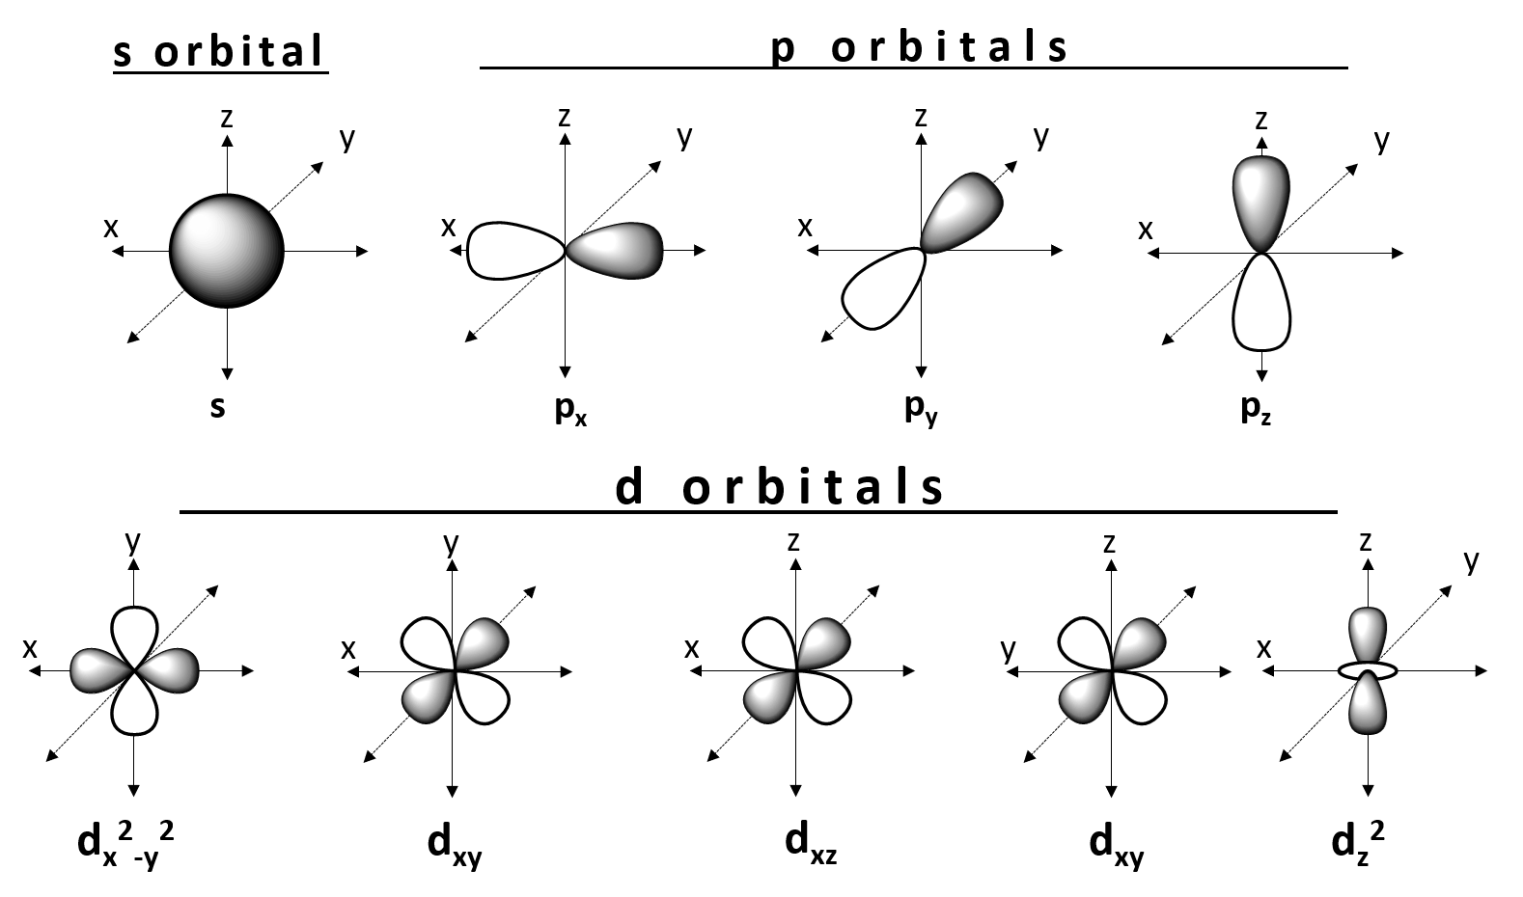
4A | QUANTUM NUMBERS
s Orbitals — Perfectly Spherical
s
l = 0
All s orbitals are spherically symmetric — the electron probability depends only on distance from the nucleus, not direction.
Key properties:
1s: no nodes, highest density at nucleus
2s: 1 radial node (spherical shell of zero probability)
3s: 2 radial nodes
Radial nodes in s orbitals = $$n−1$$
14

Slide 15
4A | QUANTUM NUMBERS
p Orbitals — The Dumbbell Shape
p
l = 1
Three p orbitals per subshell, oriented along perpendicular axes:
p_{x} — along x-axis | p_{y} — along y-axis | p_{z} — along z-axis
Key properties:
Two lobes with a nodal plane through the nucleus
1 angular node (planar surface, \(\psi = 0\))
All three are degenerate (equal energy)
Angular nodes in p orbitals = $$l=1$$
15

Slide 16
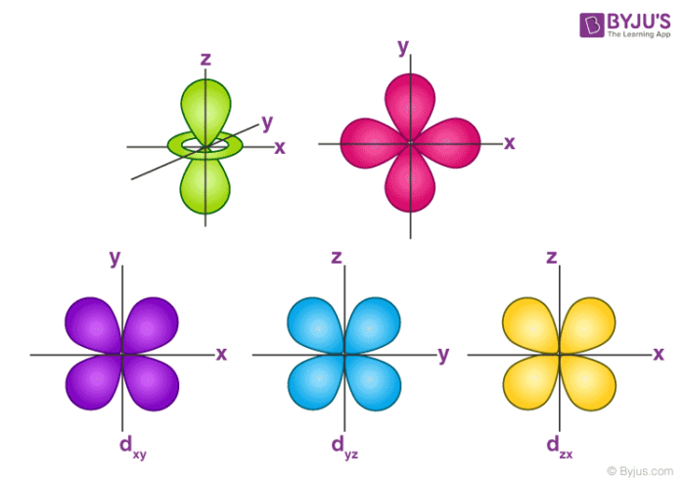
4A | QUANTUM NUMBERS
d Orbitals — The Cloverleaf Family
d
l = 2
Five d orbitals (d_{xy}, d_{xz}, d_{yz}, d_{x²−y²}, d_{z²})
Four cloverleafs: d_{xy}, d_{xz}, d_{yz}, d_{x²−y²}
Two lobes along axes, 2 angular nodes each
One unique: d_{z²}
Two lobes on z-axis + doughnut in xy plane
All five are degenerate in isolated atoms
Angular nodes in d orbitals = $$l=2$$
16

Slide 17
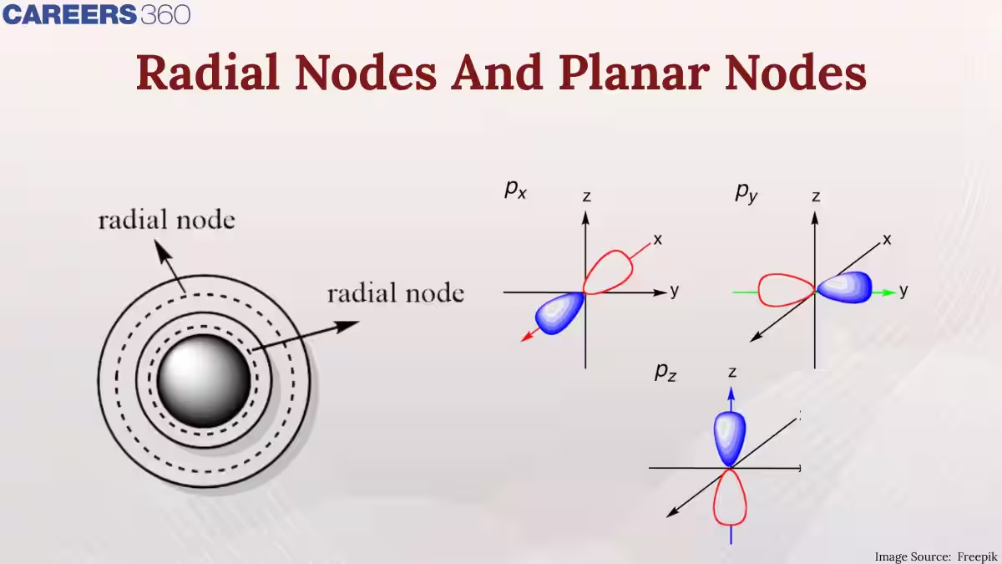
4A | QUANTUM NUMBERS
What Are Nodes? — Regions of Zero Probability
A node is where $$ψ=0$$ — zero probability of finding the electron. No classical analog exists.
Radial Nodes
Angular Nodes
Spherical surfaces where the probability of finding the electron drops to exactly zero.
Like the layers of an onion — spherical shells of zero electron density separating regions of non-zero probability.
Planar surfaces (flat planes) passing through the nucleus where $$ψ=0$$.
These create the characteristic shapes of p and d orbitals — the nodal planes that separate the lobes.
Radial nodes = $$n−l−1$$
Angular nodes = $$l$$
17

Slide 18
4A | QUANTUM NUMBERS
Counting Nodes — The Node Formula
Total nodes = $$n−1$$ Radial nodes = $$n−l−1$$ Angular nodes = $$l$$
Orbital | n | l | Radial | Angular | Total
1s | 1 | 0 | 0 | 0 | 0
2s | 2 | 0 | 1 | 0 | 1
2p | 2 | 1 | 0 | 1 | 1
3s | 3 | 0 | 2 | 0 | 2
3p | 3 | 1 | 1 | 1 | 2
3d | 3 | 2 | 0 | 2 | 2
4f | 4 | 3 | 0 | 3 | 3
Quick Check: Radial + Angular should always equal n − 1. Verify: 3p → 1 + 1 = 2 = 3 − 1 ✓
18

Slide 19
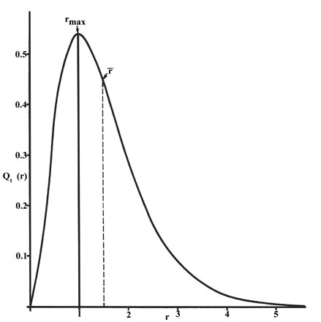
4A | QUANTUM NUMBERS
Radial Probability Distribution
Radial Probability = $$4πr^{2}∣R(r)∣^{2}$$ — probability at distance r from nucleus
The radial probability distribution shows the probability of finding the electron at a specific distance r from the nucleus, regardless of direction.
Key features:
For 1s: maximum at r = a₀ (Bohr radius ≈ 52.9 pm)
Each radial node creates a separate peak
Higher n → more peaks, farther from nucleus
Radial probability distribution for 1s orbital
Most probable distance increases with n, but the electron can be found at any distance.
19

Slide 20
4A — LECTURE SUMMARY
KEY TAKEAWAYS
1
Four quantum numbers (n, l, m_{l}, m_{s}) completely describe every electron in an atom.
4
Total nodes = n − 1; Radial = n − l − 1; Angular = l
2
n = size/energy, l = shape, m_{l} = orientation, m_{s} = spin
5
Each orbital holds max 2 electrons with opposite spins (Pauli exclusion).
3
s orbitals are spherical, p are dumbbell, d are cloverleaf.
Next: 4B — Electron Configuration & Exceptions
General Chemistry · Quantum Numbers & Atomic Orbitals

