Slide 1
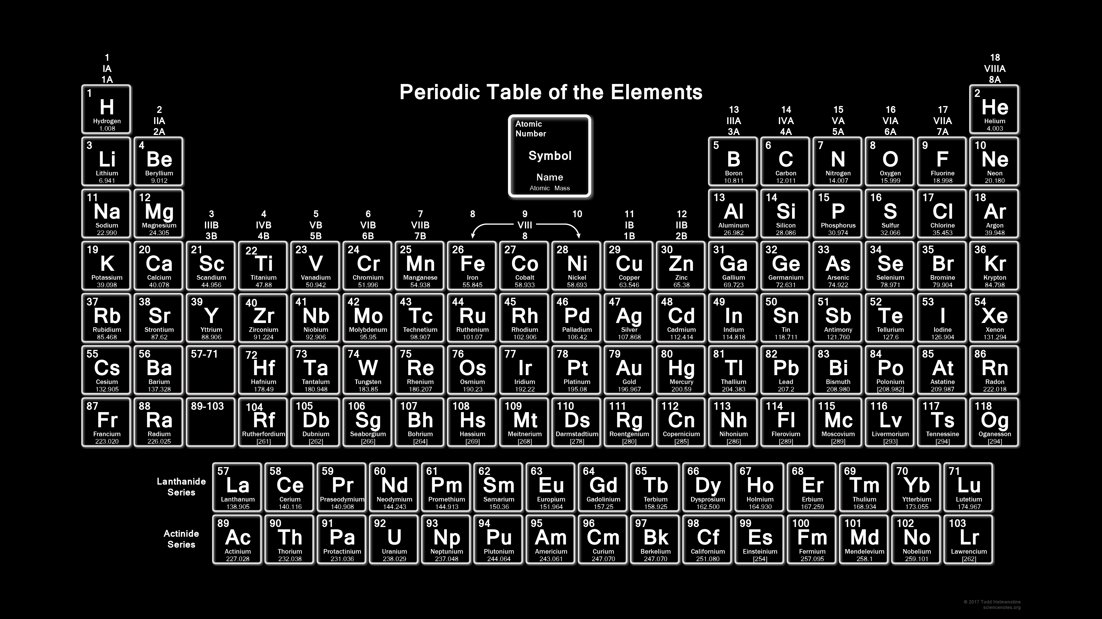
Periodic Trends
Atomic Radius · Ionization Energy · Electron Affinity · Electronegativity
TOPIC 5 · GENERAL CHEMISTRY

Slide 2
01
The Basics
Periodic Table & Effective Nuclear Charge
CONTENTS
02
Atomic & Ionic Radius
Five key trends that explain why elements behave the way they do.
How atomic and ionic size changes across the table
03
Ionization Energy
Energy required to remove an electron
04
Electron Affinity
Energy change when adding an electron
05
Electronegativity
Attracting power for bonding electrons
06
Summary
Connecting all trends together
Periodic Trends

Slide 3
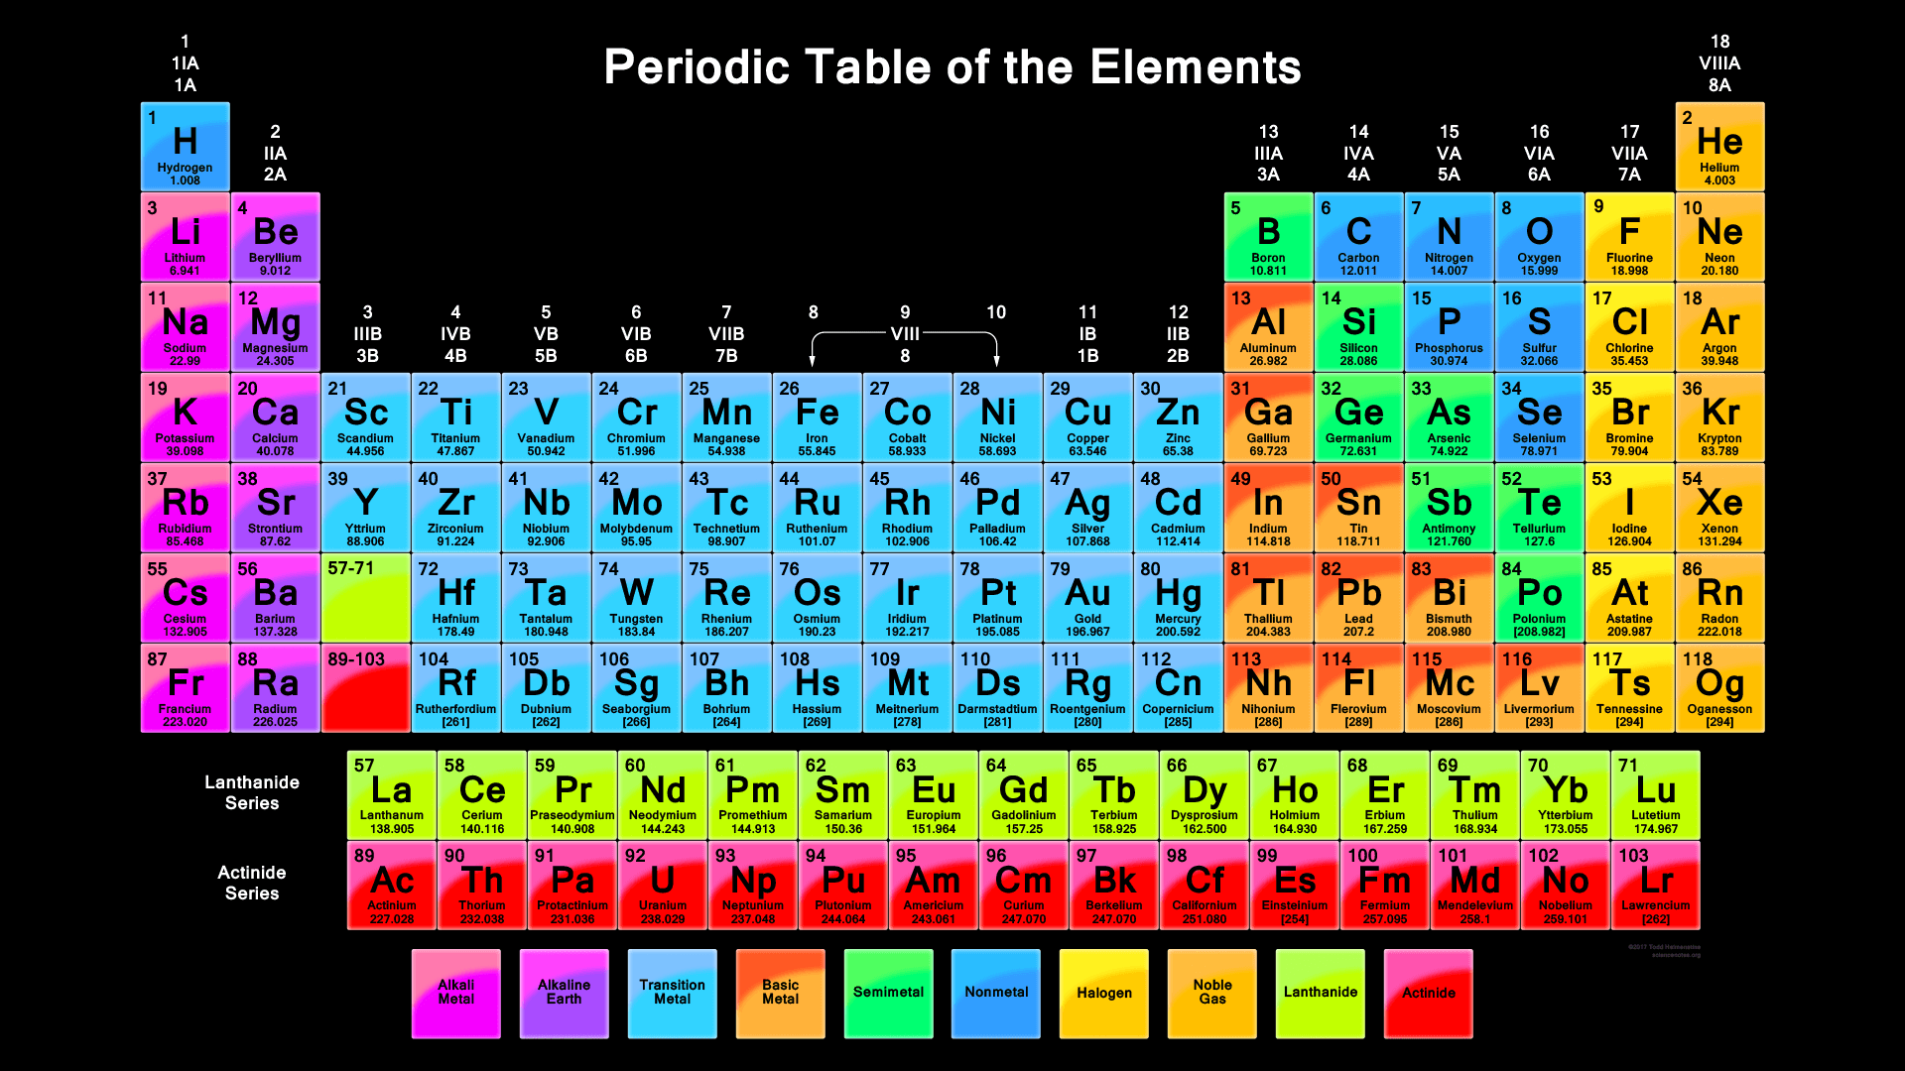
The Periodic Table — Our Roadmap
Metals
Left side + center. Lose electrons easily. Shiny, conductive, malleable.
Nonmetals
Upper right. Gain or share electrons. Poor conductors, brittle.
Metalloids
Groups (columns) = elements with similar valence electron configurations
Periods (rows) = same principal quantum number (n) for outer shell
Position on the table determines properties
Staircase line. Properties in between — semiconductors.
Periodic Trends

Slide 4
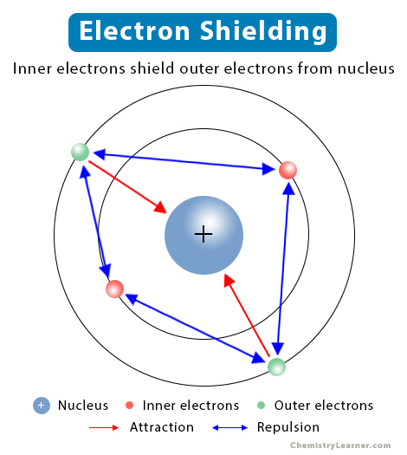
The Big Idea: Effective Nuclear Charge (Z_{eff})
KEY CONCEPT
Z_{eff} = net positive charge "felt" by valence electrons
Inner electrons shield outer e⁻ from the full nuclear charge
Higher Z_{eff} → electrons pulled closer & tighter
Z_{eff} = Z - S
Z = atomic number (protons) · S = shielding electrons
Why Z_{eff} matters:
It explains ALL periodic trends. Atomic size, ionization energy, electron affinity, electronegativity — all trace back to how strongly the nucleus pulls on electrons.
Periodic Trends

Slide 5
Z_{eff} Increases Across a Period
↑ Z_{eff} increases →
Na
Mg
Al
Ar
Z = 11
Z = 12
Z = 13
Z = 18
Same n=3 shell — but more protons pulling each time
What happens?
1. Same number of electron shells (same period)
2. More protons added → stronger nuclear charge
3. Added electrons go into the same shell — poor shielding
4. Result: Z_{eff} increases significantly across a period
Periodic Trends

Slide 6
Z_{eff} Stays Similar Down a Group
What happens going down?
1. A new electron shell is added each step
2. Outer electrons are farther from the nucleus
3. More inner electrons = more shielding
4. The extra nuclear charge is mostly canceled out
Li (n=2)
more shells
Na (n=3)
Result: Z_{eff} increases only slightly
The outer electron "feels" a similar pull in each case
Key Takeaway:
Going down a group, the increasing atomic size (more shells) has a much bigger effect than the small increase in Z_{eff}.
K (n=4)
Periodic Trends

Slide 7
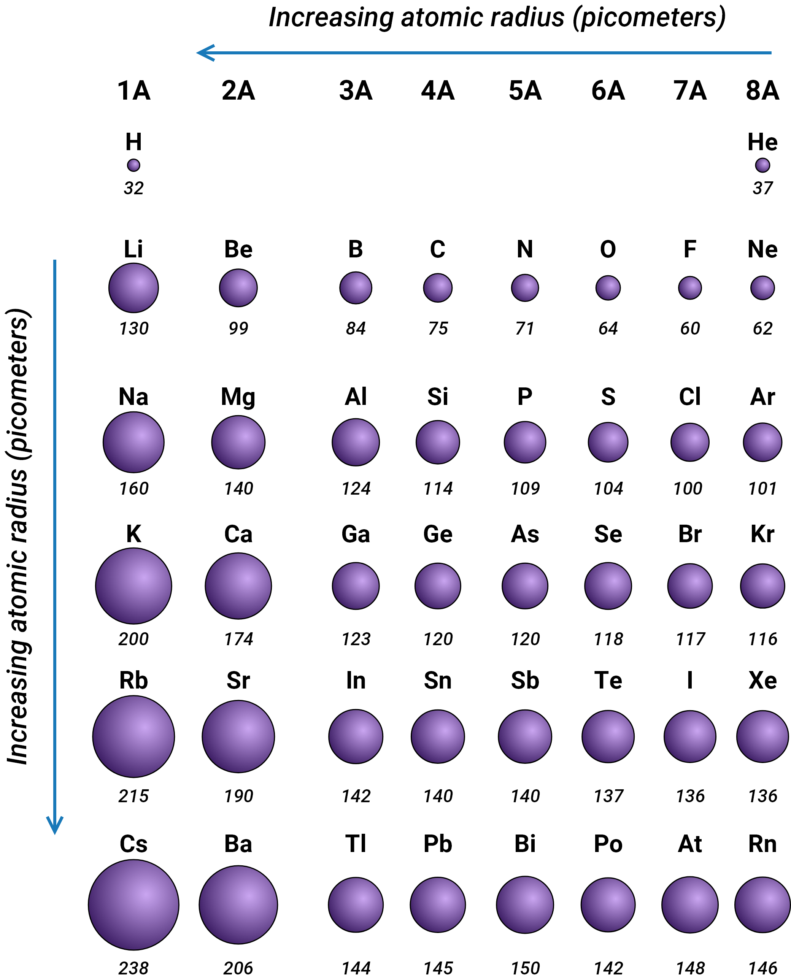
01
Atomic & Ionic Radius
How big are atoms and ions?

Slide 8
What Is Atomic Radius?
Measured in picometers (pm)
1 pm = 10⁻¹² m. Typical atomic radii range from 30 to 300 pm.
No sharp edge
Electrons exist as a probability cloud. Radius is a defined measurement, not a physical boundary.
Nucleus
r = radius
Bonded atoms only
Radius is measured between two identical bonded atoms — not for isolated atoms.
Atomic radius = ½ × distance between nuclei
Periodic Trends

Slide 9
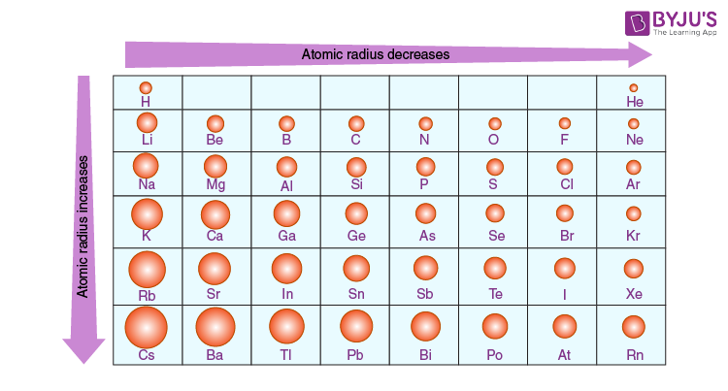
Atomic Radius Decreases Across a Period
THE TREND
Radius decreases →
Why?
Same shell, more protons
→ stronger Z_{eff}
→ electrons pulled tighter
→ smaller radius
Example: Period 2
Li (152 pm) → Ne (38 pm)
Left to Right: More protons + same shell = stronger pull = smaller atoms
Periodic Trends

Slide 10
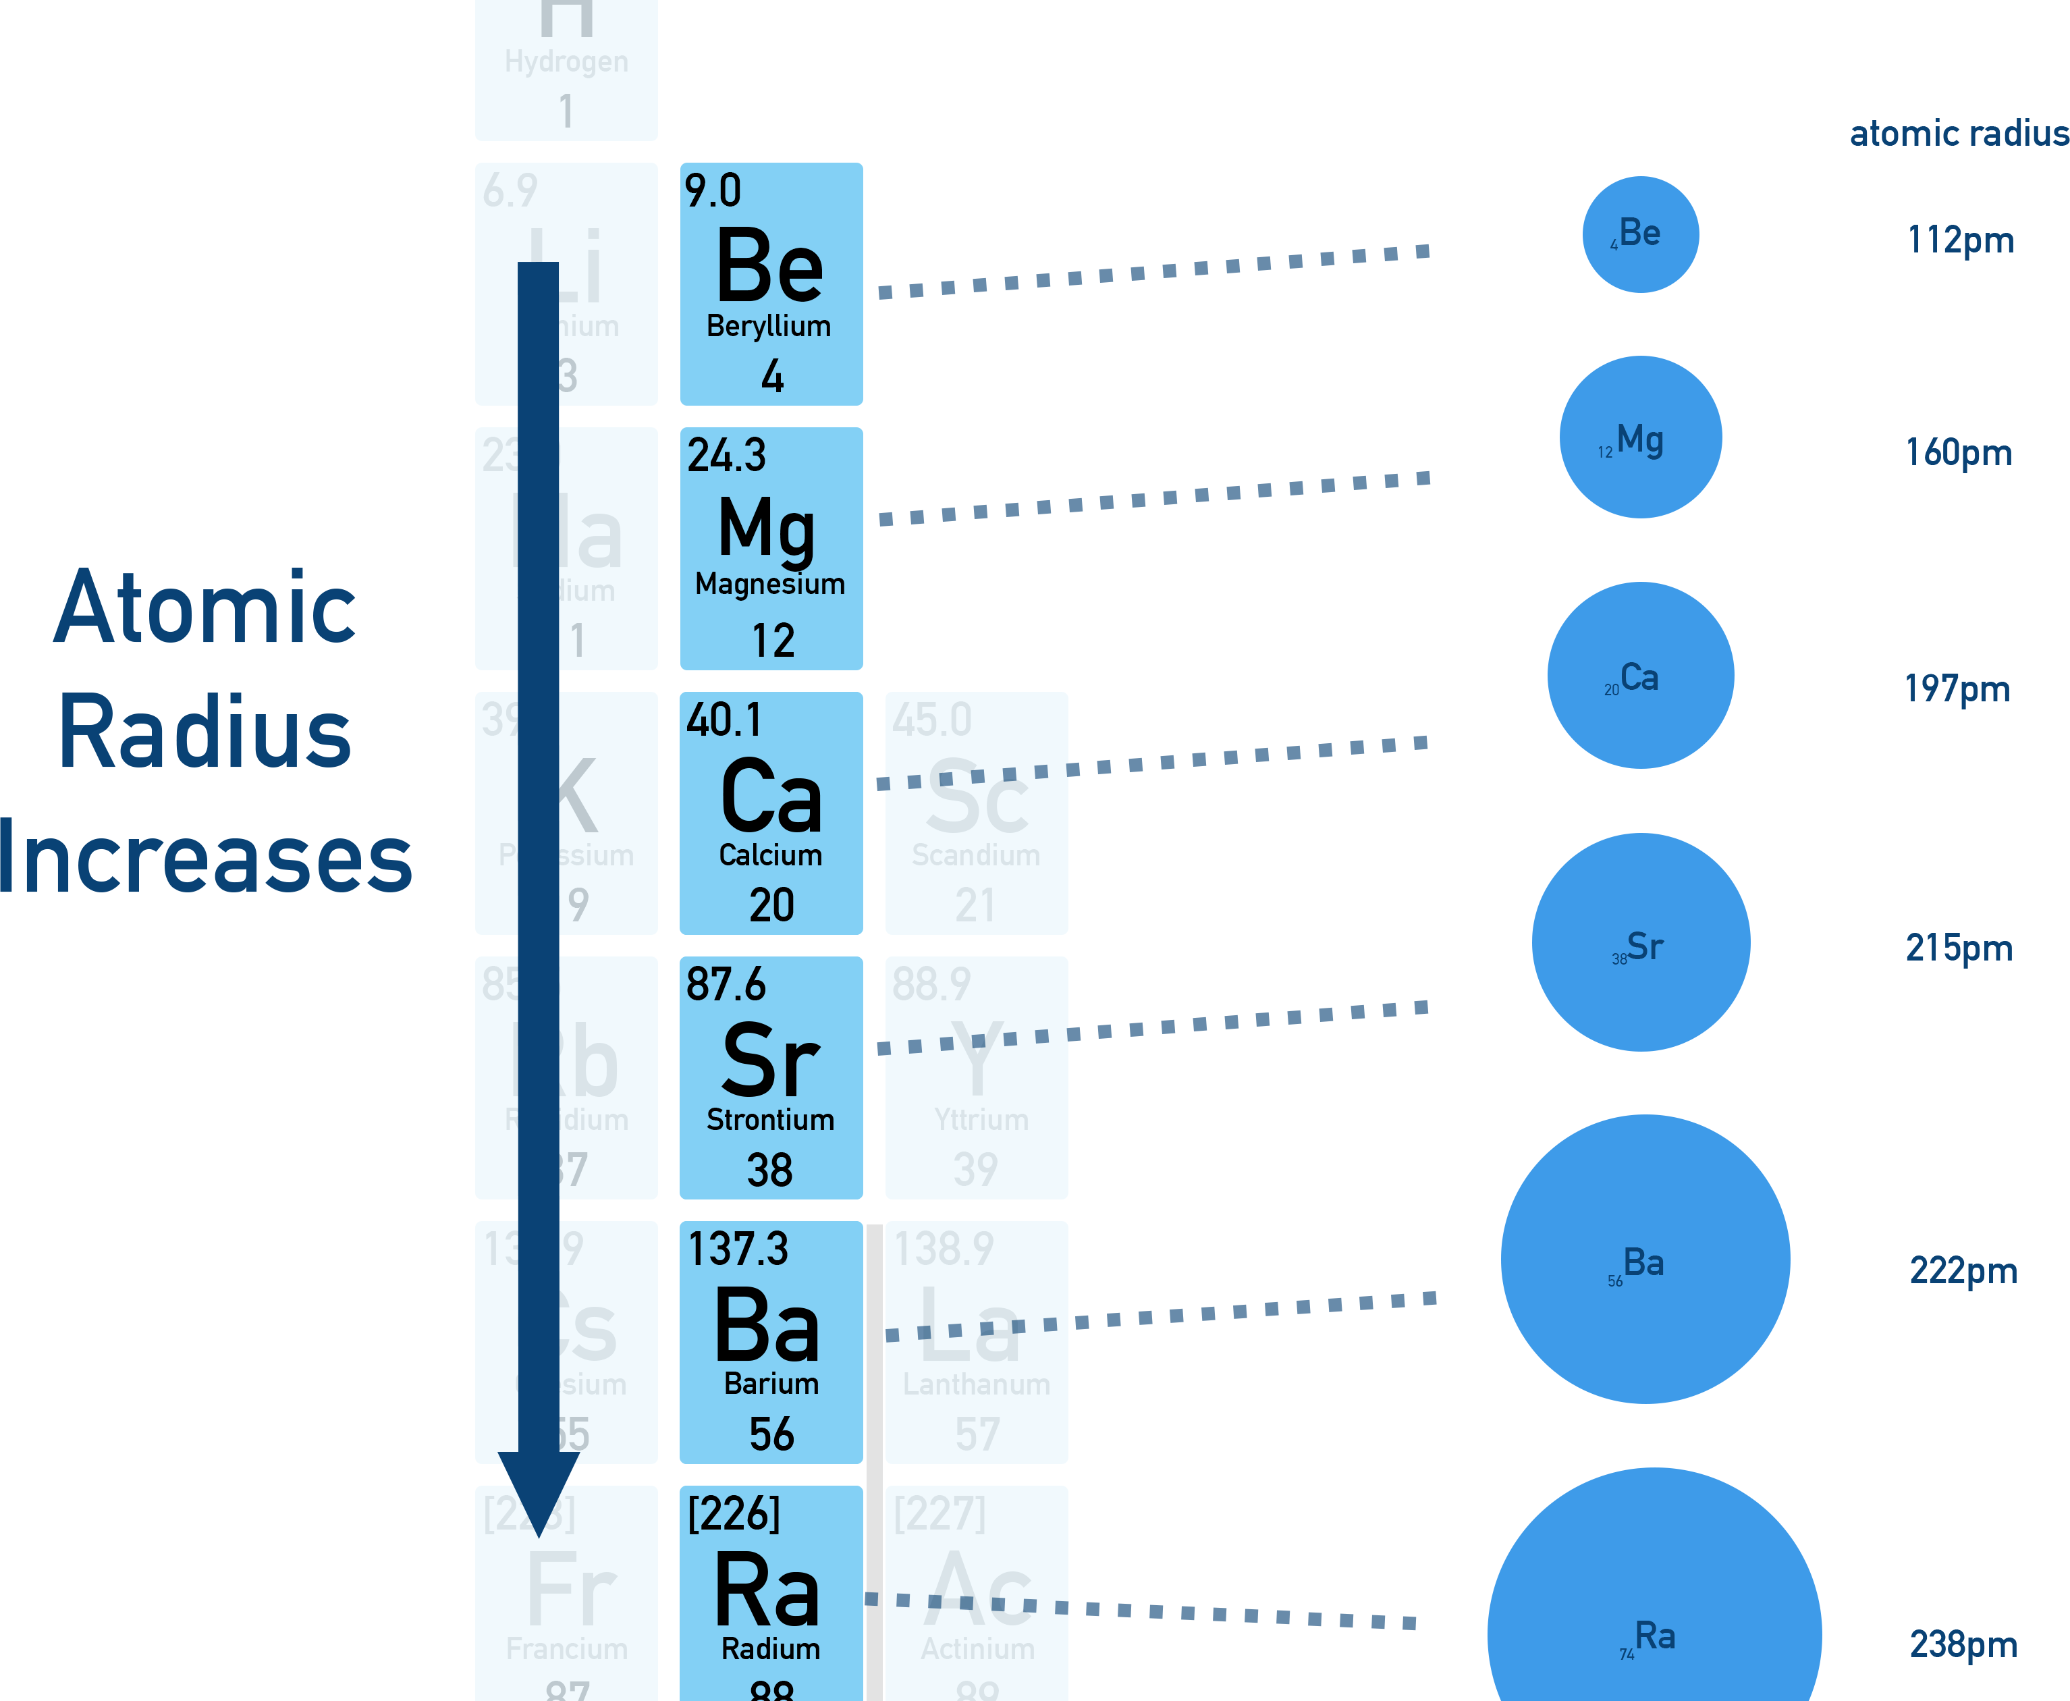
Atomic Radius Increases Down a Group
THE TREND
Radius increases ↓
Why?
New electron shell added
→ outer electrons farther from nucleus
→ more shielding
→ larger radius
Example: Group 1
Li (152 pm) → Na (186 pm)
→ K (227 pm) → Rb (248 pm)
Periodic Trends

Slide 11
Ionic Radius — Cations vs. Anions
CATION (+)
ANION (-)
Na⁺
Na atom
Cl atom
Cl⁻
loses e⁻
gains e⁻
Why smaller?
• Lost valence shell electron(s)
• Less electron-electron repulsion
• Same protons pulling fewer e⁻
→ Radius shrinks
Why larger?
• Gained electron(s) into existing shell
• More electron-electron repulsion
• Same protons pulling more e⁻
→ Radius expands
Na atom: 186 pm → Na⁺ ion: 102 pm
Cl atom: 100 pm → Cl⁻ ion: 181 pm
Periodic Trends

Slide 12
Isoelectronic Series: Same e⁻, Different Z
Same number of electrons — but different nuclear charge → different sizes
Species | O²⁻ | F⁻ | Na⁺ | Mg²⁺
Radius (pm) | 140 | 133 | 102 | 72
All have 10 electrons (same as Ne) — but nuclear charge increases: O (8+) → F (9+) → Na (11+) → Mg (12+)
Ne 38 pm
Na⁺ 102 pm
Mg²⁺ 72 pm
O²⁻ 140 pm
F⁻ 133 pm
More protons = stronger pull = smaller radius →
Periodic Trends

Slide 13
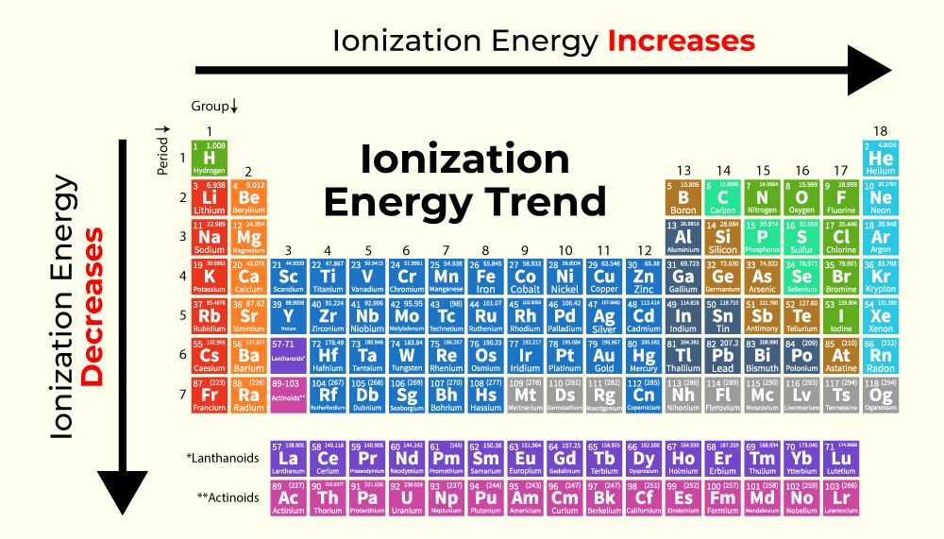
02
Ionization Energy
How much energy to remove an electron?

Slide 14
What Is Ionization Energy?
X(g) → X⁺(g) + e⁻
Energy required to remove one mole of electrons from one mole of gaseous atoms (kJ/mol)
FIRST IE
SECOND IE
Removing the first electron
From a neutral atom
Easiest electron to remove
Removing the second electron
From a positive ion (harder!)
Always: IE₂ > IE₁
Example: Na → Na⁺ + e⁻ IE₁ = 496 kJ/mol
Example: Na⁺ → Na²⁺ + e⁻ IE₂ = 4562 kJ/mol
Big jump in IE reveals valence electron count! Na: IE₁ = 496, IE₂ = 4562 → 1 valence e⁻
Periodic Trends

Slide 15
Ionization Energy Increases Across a Period
THE TREND
IE increases →
Why?
Higher Z_{eff}
→ stronger hold on electrons
→ harder to remove an e⁻
→ higher IE
Period 3 (kJ/mol):
Na 496 → Mg 738 → Al 578
General rule: Metals have low IE (lose e⁻ easily) · Nonmetals have high IE (hold e⁻ tightly)
Periodic Trends

Slide 16
Ionization Energy Decreases Down a Group
THE TREND
IE decreases ↓
Why?
Outer electrons are farther away
→ more shielding from inner shells
→ weaker attraction to nucleus
→ easier to remove = lower IE
Group 1 (kJ/mol):
Li 520 > Na 496 > K 419 > Rb 403 > Cs 376
Periodic Trends

Slide 17
Exceptions to the IE Trend
DROP: GROUP 2 → 3
DROP: GROUP 15 → 16
Be (900) > B (801) · Mg (738) > Al (578)
N (1402) > O (1314) · P (1012) > S (1000)
Group 2: ns² (full s-subshell)
Group 3: ns² np¹ (one p electron)
→ p electron is higher energy and
partially shielded by s electrons
Group 15: np³ (half-filled = stable)
Group 16: np⁴ (paired electrons)
→ paired e⁻ in same orbital repel each other
→ one e⁻ is easier to remove
ns² full = stable
np¹ higher E
np³ half-full = stable
np⁴ paired = repel
The p¹ electron is easier to remove than a full s² electron → IE drops
Electron pairing adds repulsion → IE drops slightly
Periodic Trends

Slide 18
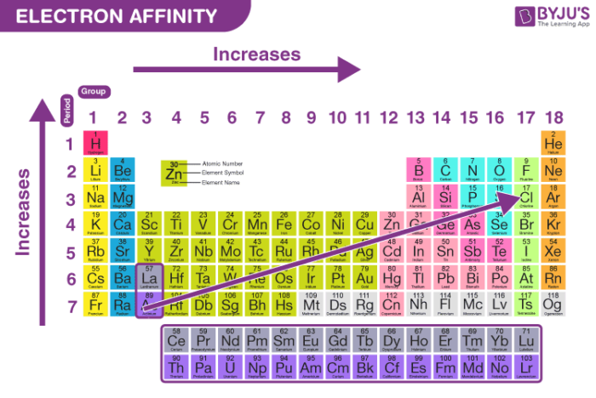
03
Electron Affinity
Energy change when adding an electron

Slide 19
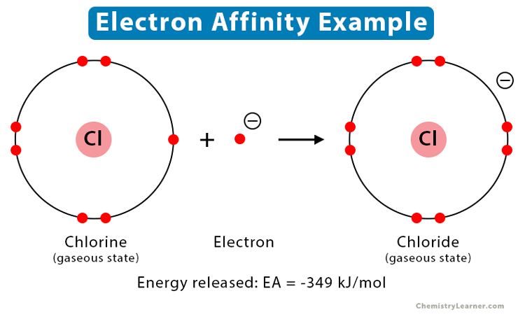
What Is Electron Affinity?
X(g) + e⁻ → X⁻(g)
Energy change when an atom gains an electron
Negative EA = energy released (exothermic)
More negative = stronger attraction for electrons
Positive EA = energy absorbed (endothermic)
Adding an electron is unfavorable
Halogens (Group 17) have the most negative EA — they really want that extra electron to fill their valence shell and achieve a noble gas configuration.
Periodic Trends

Slide 20
Electron Affinity Trend
GENERAL PATTERN
Left → Right: EA becomes more negative
Nonmetals strongly attract electrons
Top → Bottom: EA becomes less negative
Larger atoms hold added e⁻ less tightly
EXCEPTIONS
• Group 2 & 15: low/positive EA
(full/half-full subshells = stable)
• Noble gases: positive EA
(already stable — don't want e⁻)
Key idea: Atoms want to reach a stable electron configuration — EA reflects how much they "want" that extra e⁻
Periodic Trends

Slide 21
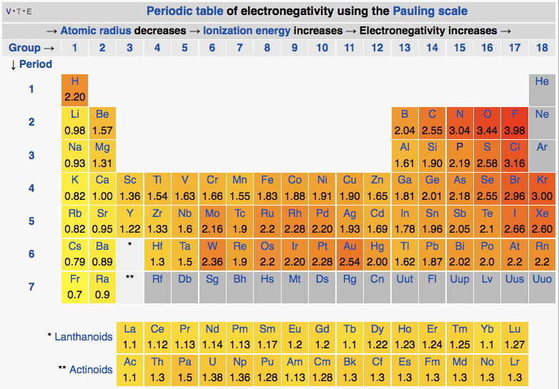
04
Electronegativity
How strongly does an atom attract bonding electrons?

Slide 22
What Is Electronegativity?
Ability of an atom to attract shared electrons in a chemical bond
Unitless scale (Pauling scale) · Fluorine = 4.0 (most electronegative) · Francium = 0.7 (least)
NOT THE SAME AS EA
WHY IT MATTERS
Electron Affinity:
• For an isolated atom in gas phase
• Energy change (kJ/mol)
Electronegativity:
• For an atom in a bond
• Relative attraction (unitless)
Determines:
• Bond polarity (ionic vs. covalent)
• Which atom pulls electrons harder
• Partial charges (δ+ and δ-)
• Molecular polarity
Periodic Trends

Slide 23
Electronegativity Trend
THE TREND
→ Increases left to right
Higher Z_{eff} = stronger pull
↑ Increases bottom to top
Smaller atoms = bonding e⁻ closer
KEY VALUES
F = 4.0 · O = 3.5 · N = 3.0
C = 2.5 · H = 2.1
Metals: EN < 1.5
Nonmetals: EN > 2.5
Fluorine is the most electronegative element — it wants electrons more than anything
Periodic Trends

Slide 24
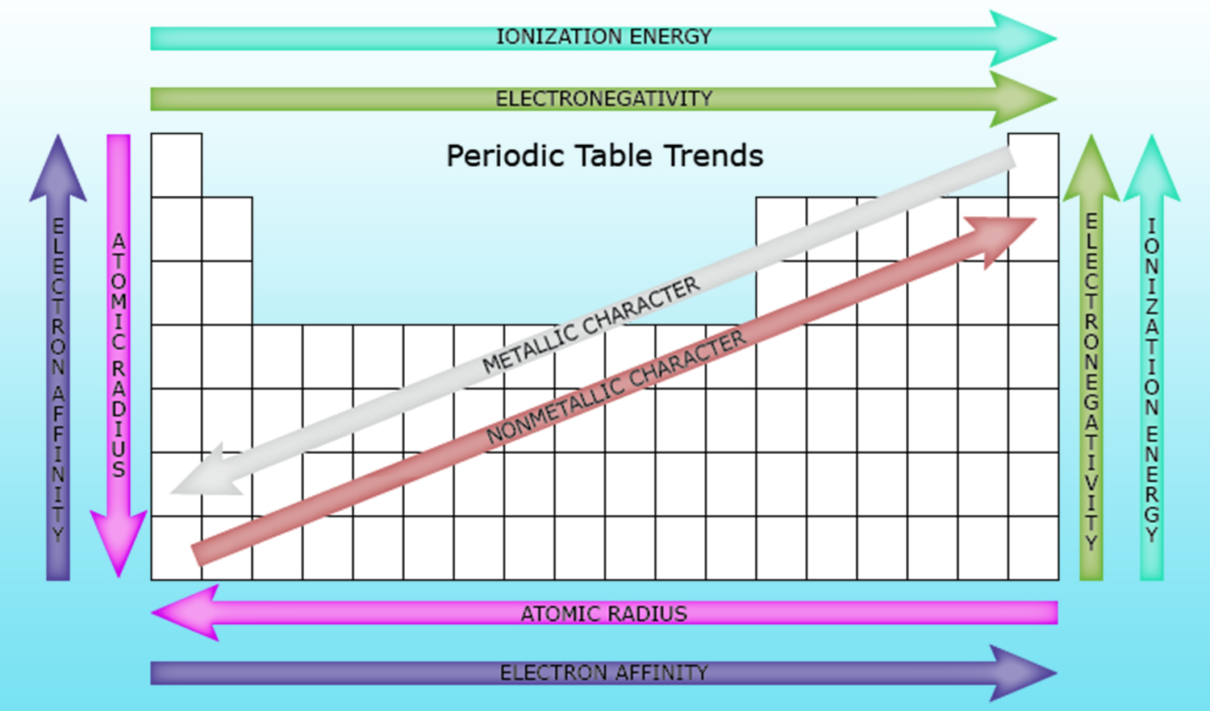
All Trends — One Visual Summary
THE FOUR TRENDS
Atomic Radius
Increases ↓ and ←
Ionization Energy
Increases ↑ and →
Electron Affinity
More negative → and ↑
Electronegativity
Increases ↑ and →
The "Why" behind everything: Z_{eff} and atomic size
Understand these two concepts and all trends follow logically
Periodic Trends

Slide 25
Key Takeaways
Z_{eff} drives everything — understand it and all trends follow
Across a period: Z_{eff} ↑ → radius ↓, IE ↑, EN ↑
Down a group: shielding ↑ → radius ↑, IE ↓, EN ↓
All trends are interconnected — understand WHY, not just memorize
TOPIC 6 · IONIC BONDING & NOMENCLATURE

