Slide 1
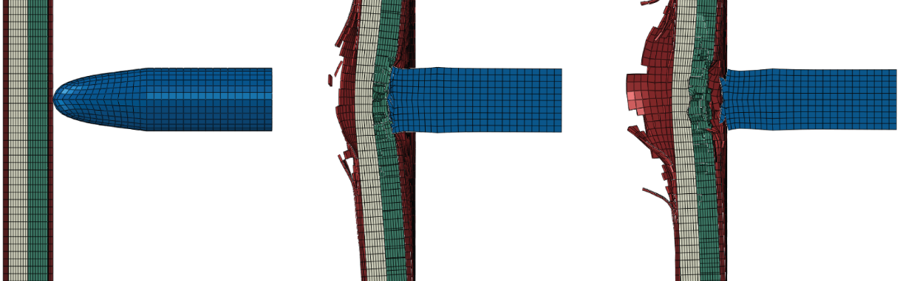
Armor Ballistics & Bullet Chemistry
Pressure vs Steel
Presented by
Hudson 8(7)
Raymond 8(6)

Slide 2
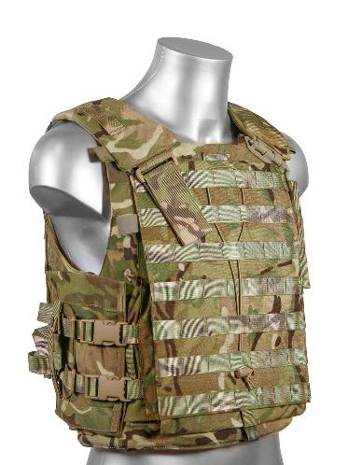
What is Armor?
Armor is the protective layer that prevents most physical force from damaging the body
For example, Armor can stop shrapnel from reaching the body by blocking it off, or letting it embed into the armor if the armor is not strong enough to deflect the force
In this discussion, we will focus on how armor can stop bullets, and how bullets penetrate armor
Notes:
```

Slide 3
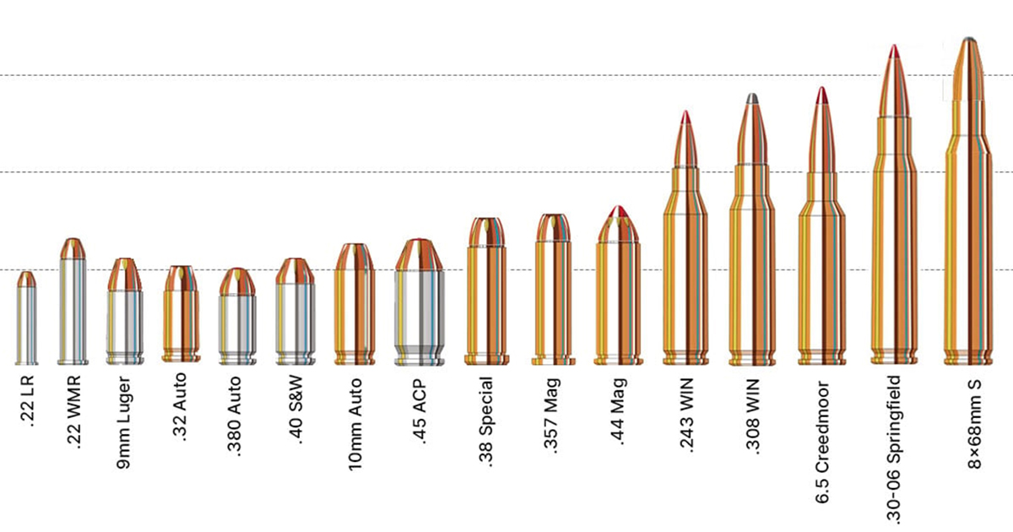

What is Bullet Calibre?
Calibre means The diameter of a bullet
Calibre only means the size of the bullet, while other factors affect penetration and velocity more.
Power is decided by Cartridge, which is bullet length, gunpowder, and pressure

Slide 4
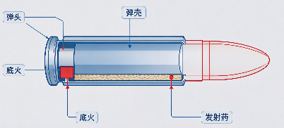
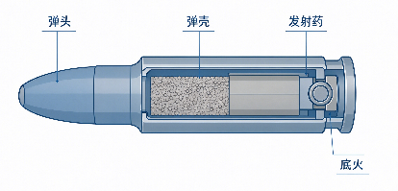
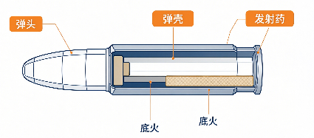
Bullet Structure
Quiz: Which of the following is the correct bullet structure?
A
B
C
Notes:
They are all wrong @hudson

Slide 5
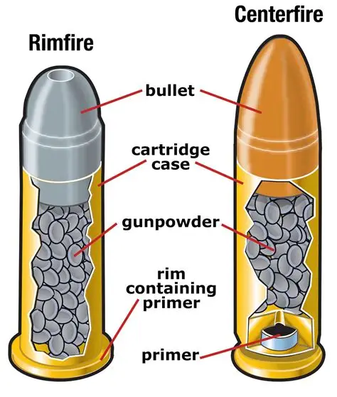
Bullet Structure
Primer: Ignites the gunpowder when struck
by firing pin
Cartridge Case: Holds the bullet, gunpowder,
and primer together
Bullet: The projectile being fired

Slide 6

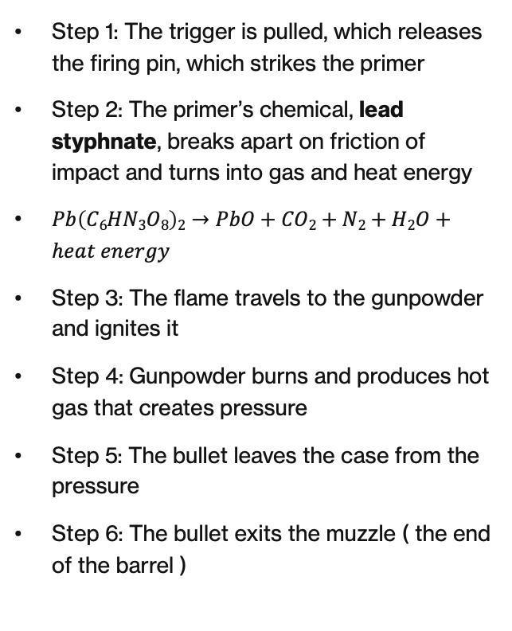
Chemical Reaction:
The Exothermic Oxidation Reaction
Step 1: The trigger is pulled, which releases the firing pin, which strikes the primer
Step 2: The primer’s chemical, lead styphnate, breaks apart on friction of impact and turns into gas and heat energy
$Pb\left(C6HN3O8\right)2→PbO+CO2+N2+H2O+heat energy$
Step 3: The flame travels to the gunpowder and ignites it
Step 4: Gunpowder burns and produces hot gas that creates pressure
Step 5: The bullet leaves the case from the pressure
Step 6: The bullet exits the muzzle ( the end of the barrel )

Slide 7
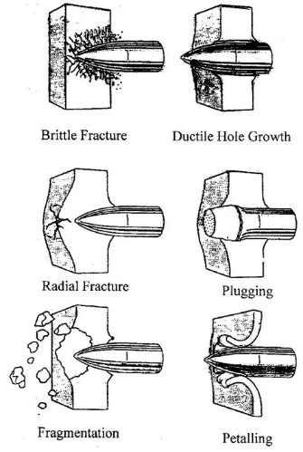
Force Against Armor
When a bullet hits armor, one of three things will happen:
1. Penetration: punches through
2. Deflection: redirected or bounces off
3. Absorption: Stops the bullet and aborbs the energy

Slide 8
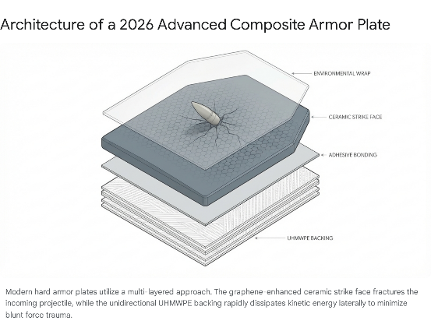
What makes
Armor
Strong?
Composite Layers work best
Outer layer: Ceramic to break down bulelts
Middle layer: Adhesive Layer to Slow down bullets and hold together the armor
Inner layer: Steel or Kevlar to catch any fragments of bullets
Innermost layer: Spall or other materials to stick to any remaining hazards
Remember: Some armor do not have to be worn on humans, it can be used to fortify a position or grounding

Slide 9
Conclusion
Factors that shape armor:
Hardness, Strength, Ductility, Mass
Factors that shape bullets:
Velocity, Shape, Mass, Material
The armor wins if it can spread the energy of the bulelt over a large area
The bullet wins if it can concentrate enough energy onto one spot.

Slide 10
That was simple
Now…
Moving on.

Slide 11
Modern Ammunition
Don’t Panic, its actually simple

Slide 12
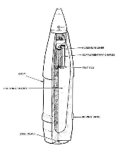
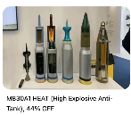
MODERN MUNITIONS
AMMUNITION · 01
Kinetic & Chemical Energy Rounds
HEAT
HE
High-Explosive Anti-Tank
High Explosive
Principle
Principle
Shaped charge with conical copper liner creates a high-velocity metal jet (~8–10 km/s) that penetrates armor via hydrodynamic flow.
Thin-walled shell filled with high explosive. Detonation produces blast overpressure and fragmentation effects against soft targets.
Performance
Variants
Penetration measured in RHAe; modern rounds exceed 800–1000 mm. Effectiveness independent of impact velocity.
HE-Frag, HEAT-MP (multi-purpose), and programmable airburst (e.g., 40 mm, 120 mm) for enhanced lethality against infantry.
Counters
Fuzing
ERA, NERA, and composite arrays disrupt the jet. Spaced armor and cages also degrade performance.
Point-detonating, delayed, proximity, or time fuzes. Modern systems use electronic multi-mode fuzes selectable in-flight.
Use Cases
Role
Main battle tanks, ATGMs, recoilless rifles, and infantry portable systems (RPG-7, Javelin, etc.).
Infantry support, fortification reduction, light armor defeat, and area suppression. Primary secondary armament for MBTs.
01 / 06

Slide 13
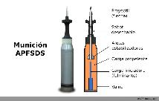

MODERN MUNITIONS
AMMUNITION · 02
Armor-Piercing Kinetic Rounds
AP / APHE
APFSDS
Armor-Piercing / Armor-Piercing High-Explosive
Armor-Piercing Fin-Stabilized Discarding Sabot
AP Principle
Design
Solid dense projectile (steel or tungsten) relies on kinetic energy and sectional density to punch through armor plate.
Long-rod penetrator (L/D > 20) of tungsten or depleted uranium, held by a lightweight sabot that discards after muzzle exit.
APHE
Velocity
AP shell with a small explosive burster and base fuze. After penetration the charge detonates, increasing behind-armor effect (spall + blast).
Muzzle velocities typically 1,500–1,800 m/s. Penetration scales with velocity² and length of the rod.
Era
Material Edge
Dominant WWII through early Cold War. Largely superseded by the Armor-Piercing Discarding Sabot and later APFSDS for main tank guns.
DU self-sharpens on impact (adiabatic shear); tungsten tends to mushroom. Both remain in service worldwide.
Legacy Use
Modern Status
Still found in older AFVs, naval secondary batteries, and some medium-caliber autocannon ammunition.
Primary anti-armor round for 120 mm and 125 mm tank guns (M829A4, DM63, 3BM60, etc.).
02 / 06

Slide 14
MODERN MUNITIONS
AMMUNITION · 03
Specialized Kinetic & Squash-Head Rounds
HESH
APCR
High-Explosive Squash Head
Armor-Piercing Composite Rigid
Mechanism
Construction
Plastic explosive spreads on impact then detonates, sending a shock wave through the armor that spalls fragments from the inner face.
Lightweight alloy
Advantage
Performance
Effective against spaced or lightly angled armor; does not require penetration of the main plate. Good against fortifications.
Higher muzzle velocity than full-caliber AP due to lower mass, improving short-range penetration.
Limitation
Evolution
Largely defeated by modern composite and spaced arrays that absorb or disrupt the shock wave before it reaches the inner face.
Just evolved from previous ones
Users
Historical Note
Historically British (L31), still used by some nations for secondary roles; largely replaced by HEAT and APFSDS for primary anti-armor.
Widely used by German (Pzgr. 40) and Soviet forces in WWII. Now essentially obsolete in modern tank ammunition inventories.
03 / 06

Slide 15
MODERN MUNITIONS
ARMOR SYSTEMS · 05
ERA — Explosive Reactive Armor
ERA consists of a sandwich of metal plates with a high-explosive layer between them. When struck by a shaped-charge jet or high-velocity penetrator the explosive detonates, driving the plates outward and sideways to disrupt the threat. Used on armored vehicles
Classic Design
Heavy ERA
Two steel plates + explosive sheet. Detonation throws plates at high speed, lengthening and breaking the HEAT jet.
Thicker plates and optimized explosives (Kontakt-5, Relikt) also degrade long-rod APFSDS(Armor-Piercing Fin-Stabilized Discarding Sabot) by inducing cracks and fracture.
s
Trade-offs
Modern Trends
Hazard to nearby troops; if there are people near them they will get blasted; single-use per ERA; can be defeated by tandem warheads that trigger the ERA early. Tandem Warheads are basically the anti-ERA missile
Modular bolt-on packages (flexible armor add-on), dual-threat (HEAT + KE) double defense tiles that require both CE and KE to defeat.
05 / 06

Slide 16
MODERN MUNITIONS
ARMOR SYSTEMS · 04
NERA — Non-Explosive Reactive Armor
NERA uses inert materials (rubber, polymers, or composites) sandwiched between metal plates. Upon impact the layers deform and bulge, disrupting the path of a shaped-charge jet or long-rod penetrator without any explosive component.
How It Works
Advantages
Applications
Impact energy causes the elastomer or polymer layer to expand rapidly, moving the outer and inner metal plates. This motion shears and stretches the penetrating jet or rod, reducing residual penetration.
No explosive hazard to nearby infantry or vehicle. Can be fitted more densely. Multiple layers can be stacked. Lower logistic and safety burden than ERA.
Integrated into modern composite arrays (Chobham derivatives, Relikt-style packages, and many Western modular kits). Often used in conjunction with ERA on high-threat arcs.
04 / 06

Slide 17
MODERN MUNITIONS
ARMOR SYSTEMS · 06
Composite & Appliqué Armor
Composite Armor
Appliqué Armor
Multi-material arrays
Add-on protective packages
Core Idea
Definition
Layers of steel, ceramics (alumina, boron carbide, silicon carbide), polymers, and sometimes depleted uranium or titanium arranged to defeat both KE and CE threats.
Additional armor plates or modules bolted, welded, or hung onto an existing vehicle structure to raise protection levels without redesigning the base vehicle.
Chobham & Derivatives
Materials
British-developed ceramic-composite packages used on Challenger, Abrams, Leopard 2, and many modern tanks. Exact compositions remain classified which means we don’t know either. Ask CIA.
Rolled homogeneous armor (RHA) plates, high-hardness steel, composite tiles, or hybrid ERA/NERA packages. Often modular for field replacement.
Function
Purpose
Ceramics fracture and erode the penetrator; ductile backings catch fragments; angled or spaced layers induce yaw and reduce residual velocity.
Rapid capability upgrade, theater-specific protection, urban, or life-extension of older platforms against evolving threats.
Integration
Examples
Usually integral to the hull and turret structure rather than purely add-on, though modular composite blocks are increasingly common.
Tank Urban Survival Kit (TUSK) kits for Abrams, Leopard 2A4 upgrades, T-72/T-90 (All 3 are American tanks) appliqué packages, and many IFV/APC up-armor kits (British) fielded since the 2000s.
06 / 06

Slide 18
Summary:
Counters!
ARMOR COUNTERS
Steel Armor < APFSDS, HEAT
Steel Armor > Small bullets, Shrapnel
Composite Armor < fire, tandem
Composite Armor > HEAT, KE
ERA < APFSDS, HEAT, APS, AP
ERA > HEAT, RPG rounds
NERA < Heavy HEAT
NERA > RPG, Weak HEAT, APFSDS
APFSDS: Armor-Piercing Fin-Stabilized Discarding Sabot
HEAT: High-Explosive Anti-Tank
KE: Kenetic Energy Munition
ERA: Explosive Reactive Armor
RPG: Ruchnoy Protivotankoviy Granatomyot
Or hand-held anti-tank grenade launcher. (火箭筒)
NERA: Non-Explosive Reactive Armor

Slide 19
Thanks for listening!
Sponsered by Singularity Lab
Script by Hudson 8-7
PPT by Raymond 8-6
this took way too long

