Slide 1
PennSwipe Exchange
real-time bid/ask marketplace for Penn dining swipes
Steven (Chuyue Wang) | CIS 1962 Final Project

Slide 2
The Problem
Penn students on residential dining plans end the semester with mismatched swipes
Some have surplus swipes about to expire
Others run out and need more
Today's solution: disorganized GroupMe chats and word of mouth
No price discovery, no fairness, no record
2 / 11

Slide 3
The Solution
(this may not be allowed by school tho lol)
A central limit order book for swipes, priced in Dining Dollars
Buyers post bids (max price they'll pay)
Sellers post asks (min price they'll accept)
When prices cross, trades execute automatically
All balances are simulated in-app — easy to demo and deploy
3 / 11

Slide 4
Core Features
JWT auth with starting balances
Live order book (bids vs asks)
Automatic order matching engine
Real-time updates over WebSockets
Personal dashboard: balances, open orders, history
Global trade history with price chart
Animated UI transitions
4 / 11

Slide 5
Tech Stack: Frontend
Tech | Use
React 18 + Vite | UI framework
TypeScript | Type safety end-to-end
React Router v6 | 7 routes (Home, Login, Register, Book, Dashboard, History, Profile)
Tailwind CSS | Styling
Recharts | Price-over-time chart
Framer Motion (extra credit) | Animated order rows + trade toasts
5 / 11

Slide 6
Tech Stack: Backend
Tech | Use
Express.js + TypeScript | REST API
Socket.io (extra credit) | Real-time order book + trade feed
Prisma ORM (extra credit) | Type-safe DB access + migrations
PostgreSQL (Supabase) | Users, Orders, Trades
JWT + bcrypt | Auth & password hashing
Deployment: Vercel (frontend) · Render (backend) · Supabase (DB)
6 / 11

Slide 7
How It Works: The Matching Engine
1
User submits order
POST /api/orders
2
Matching service checks the opposite side of the book
bids vs. asks at compatible prices
3
If a match exists: both orders marked FILLED
Trade row created, balances updated atomically
4
If no match: order rests as OPEN
Sits in the book until a counterparty arrives
5
Socket.io broadcasts orderBookUpdate + tradeExecuted
Every connected client updates instantly
7 / 11

Slide 8
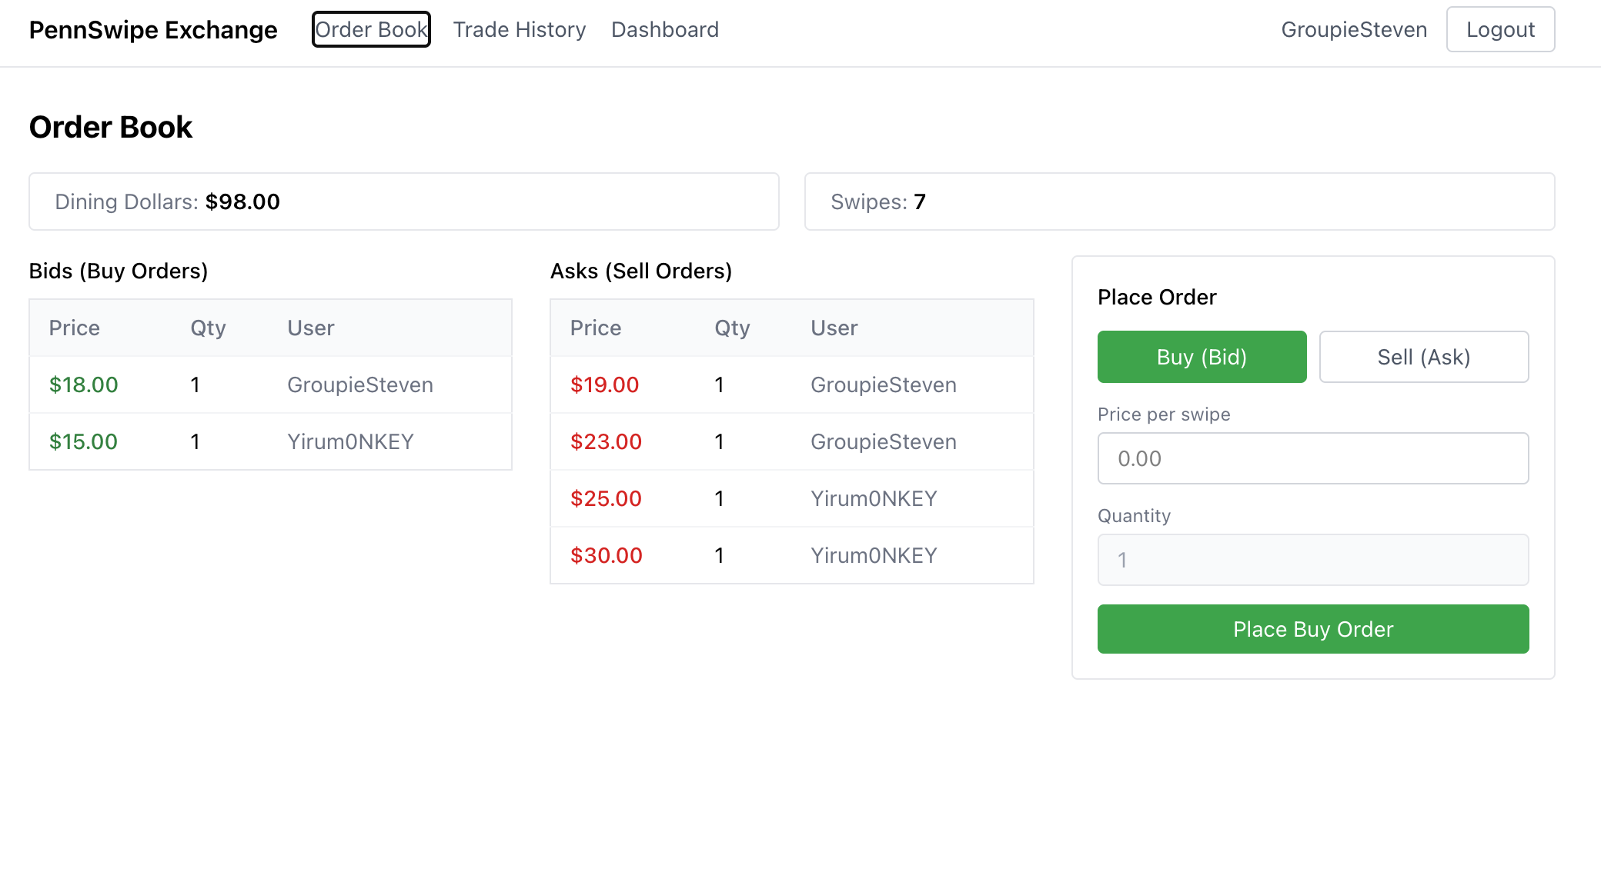
Live Demo（https://pennswipe-exchange.vercel.app/）
8 / 11

Slide 9
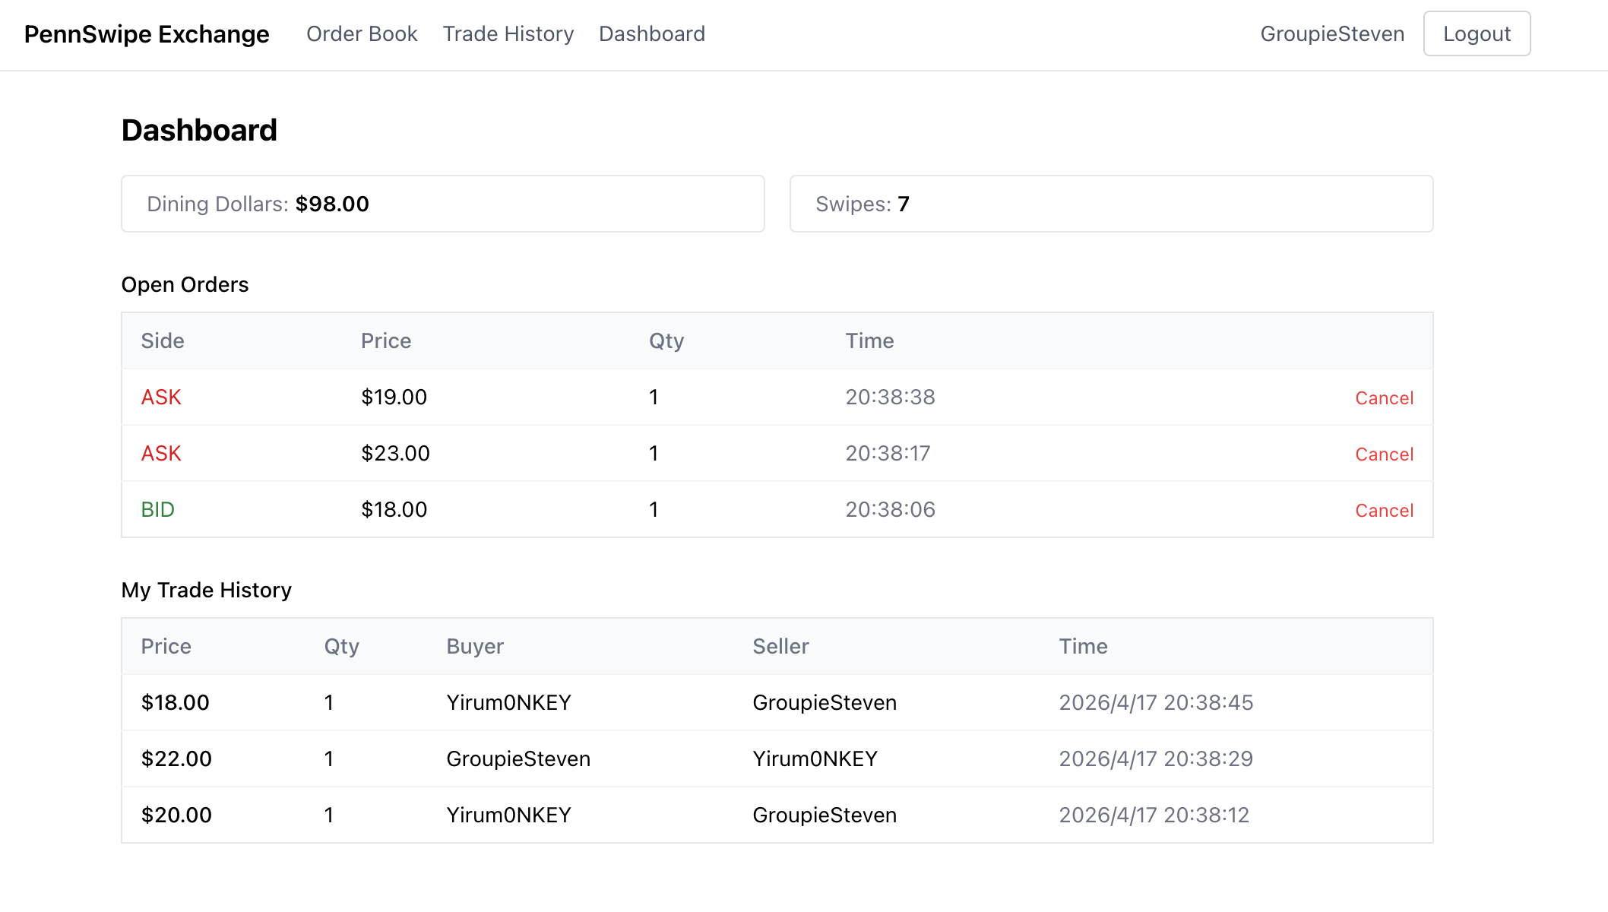
Live Demo
8 / 11

Slide 10
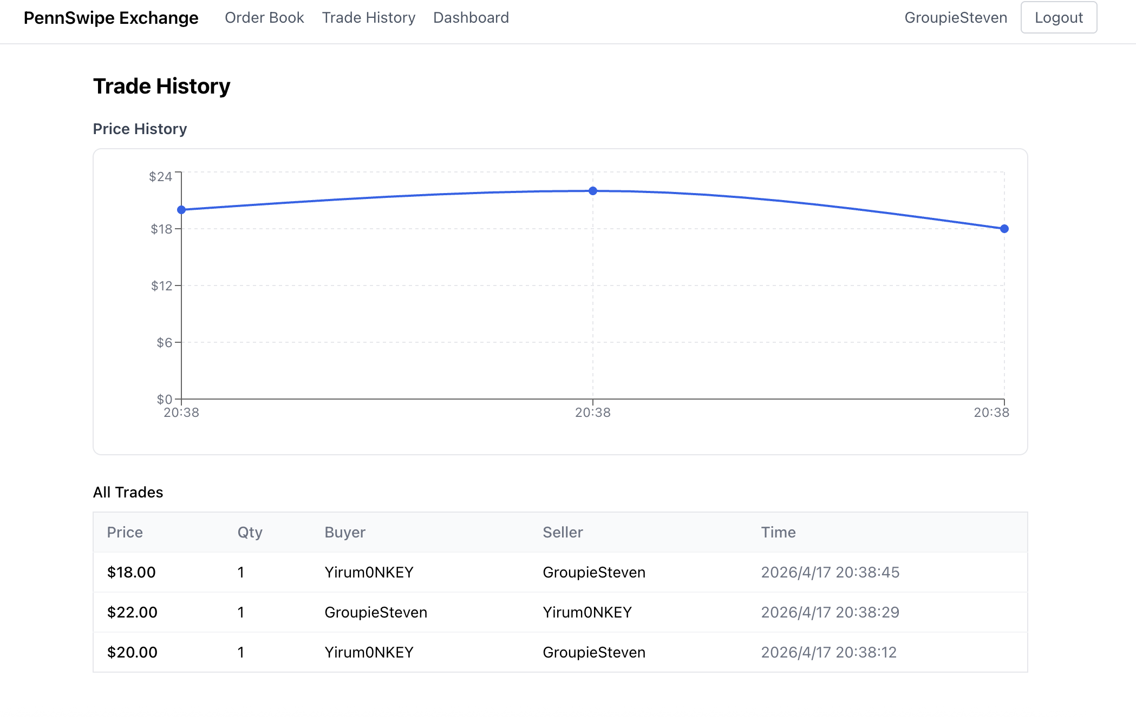
Live Demo
8 / 11

Slide 11
Reflection: What I Learned
Hardest part
Matching engine + keeping balances consistent across two users in one transaction
Biggest win
Socket.io, which turned a static page into alive trades
Trade-off
All-or-nothing fills (no partial matches) kept the matcher simple
9 / 11

Slide 12
Future Directions
Partial fills — let a 5-swipe ask match against a 2-swipe bid
Market orders — buy/sell at best available price
Real Penn auth (PennKey SSO) + actual swipe integration
Mobile app — most trades would happen on phones near dining halls
Order expiration & price alerts
Anti-abuse: rate limiting, sybil protection
10 / 11

Slide 13
Thank You
Questions?
Steven (Chuyue Wang) · CIS 1962 Final Project

