Slide 1
Stock Price Forecasting with Data Science
Team Members: Trung Nguyen, Zehao (Steven) Wang, Lily Swan

Slide 2

Introduction
Stock market: a marketplace where individuals and institutions engage in the buying and selling of financial securities
Stock markets generate huge amounts of data every day
Stock prices are predicted to determine the future performances and values of companies’ stock

Slide 3
Problem Statement
Predicting stock growth is crucial for both consumers and companies.
Consumers
Aids Investment Decisions
Increases financial security
Provide market trend research
Companies
Enhances market competitiveness
Guides strategic company moves such as expansions or research allocation
Provide market insight

Slide 4
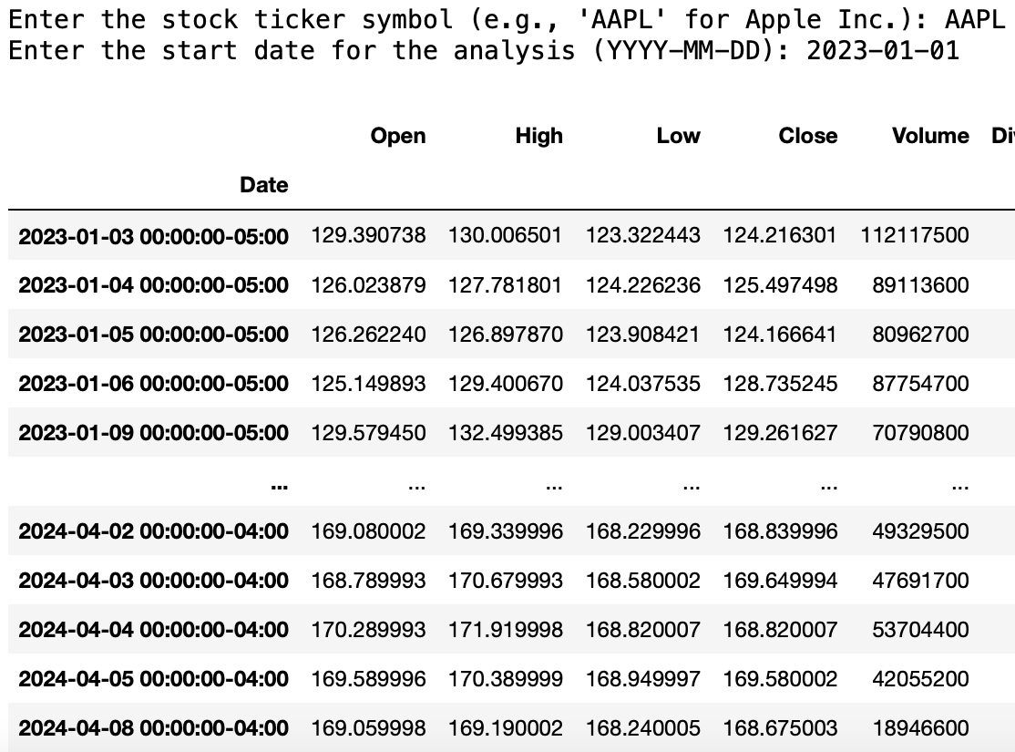
Data Collection
Data Sources
Download real-time market data from Nasdaq directly in our code
Allow user to input the company and start date they want to predict
Feature Collected
Date (YYYY-MM-DD)
Open, high, low, close
Volume

Slide 5

Ethical Considerations
Remain steadfast in upholding ethical considerations in our analysis
Privacy
Leveraging publicly available stock data, we uphold individuals' privacy rights by refraining from seeking or analyzing private information
Bias Mitigation
Our quantitative approach tries to minimize biases, ensuring our analysis remains objective and impartial

Slide 6
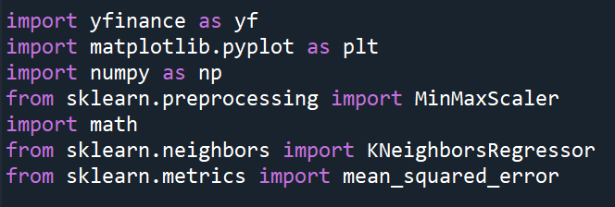
Exploratory Data Analysis
Library Imported (Using)
Yfinance: This library provides a way to access the financial data available on Yahoo Finance.
Matplotlib: An extensively used Python library for creating static, interactive, and animated visualizations in Python
NumPy: Short for Numerical Python, this library is fundamental for scientific computing in Python.
Scikit-learn (sklearn)
MinMaxScaler: It's a method for normalization that scales each feature to a given range, typically 0 to 1.
KNeighborsRegressor: This is an implementation of the k-nearest neighbors algorithm for regression.
Mean_squared_error: A risk metric corresponding to the expected value of the squared error or loss.
Notes:
For data analysis, we used four libraries mainly. YFinance is a library provides …. . Matplotlib is a lib for creating visuliazation. Numpy is a lib for fundamental scientific computing in python. We r also using Sci-kit learn library for three functions. MinMaxScaler is for normalization that scales each feature to a given range, typically from 0 to 1. KNeighborsRegressor is an implementation of the k-nearest neighbors algorithm for regression. It predicts the value for a new data point by averaging the values of the k nearest neighbors to this new point. Mean squared error is A risk metric corresponding to the expected value of the squared error or loss. It’s used to measure the difference between the values predicted by a model and the values actually observed from the environment that is being modeled.
Yfinance: This library provides a way to access the financial data available on Nasdaq Finance. It's typically used to fetch historical market data, access financial statements of companies, stock prices, and other financial information.
Matplotlib: An extensively used Python library for creating static, interactive, and animated visualizations in Python.
NumPy: Short for Numerical Python, this library is fundamental for scientific computing in Python.
Scikit-learn (sklearn):
MinMaxScaler: It's a method for normalization that scales each feature to a given range, typically 0 to 1. which is important for many machine learning algorithms that assume all features are centered around zero and have a similar variance.
KNeighborsRegressor: This is an implementation of the k-nearest neighbors algorithm for regression. It predicts the value for a new data point by averaging the values of the k nearest neighbors to this new point.
Mean_squared_error:A risk metric corresponding to the expected value of the squared error or loss. It’s used to measure the difference between the values predicted by a model and the values actually observed from the environment that is being modeled.

Slide 7
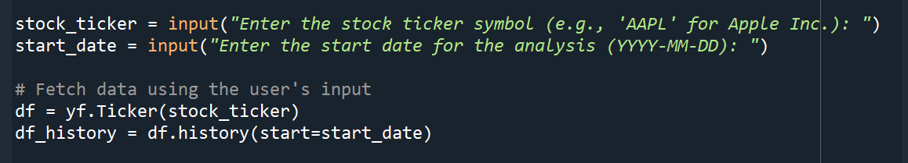
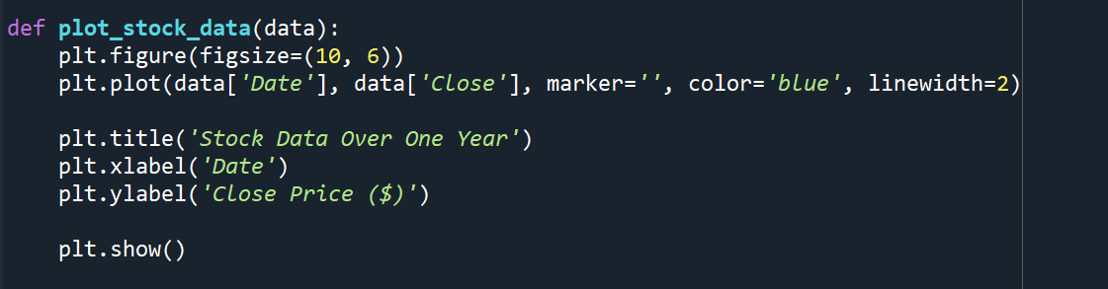
Exploratory Data Analysis
Input → Fetch data → Plot data → Train model → Predict → Save model
Input Collection: Collects user inputs for the stock ticker and the start date for data analysis
Data Fetching: Retrieves historical stock data from Yahoo Finance using inputs for plotting
Plot Creation: Defines a function to plot stock data from a DataFrame, setting the figure size and line properties for the visualization
User Input:
Plotting the data:
Notes:
User Input: The script prompts the user to input a stock ticker symbol and a start date for the analysis in the format 'YYYY-MM-DD'. These inputs are used to fetch the corresponding stock data.
Data Retrieval: Using the yfinance library, the code creates a Ticker object for the specified stock ticker and then retrieves its historical data starting from the user-provided start date, storing this in df_history. This data can then be passed to the plot_stock_data function to visualize the stock's closing price over time.
Plot Function: The plot_stock_data function takes a DataFrame data as an argument and plots the closing stock prices against dates. The plot is configured to be 10x6 inches, with the closing prices connected by a blue line of width 2 without markers.

Slide 8
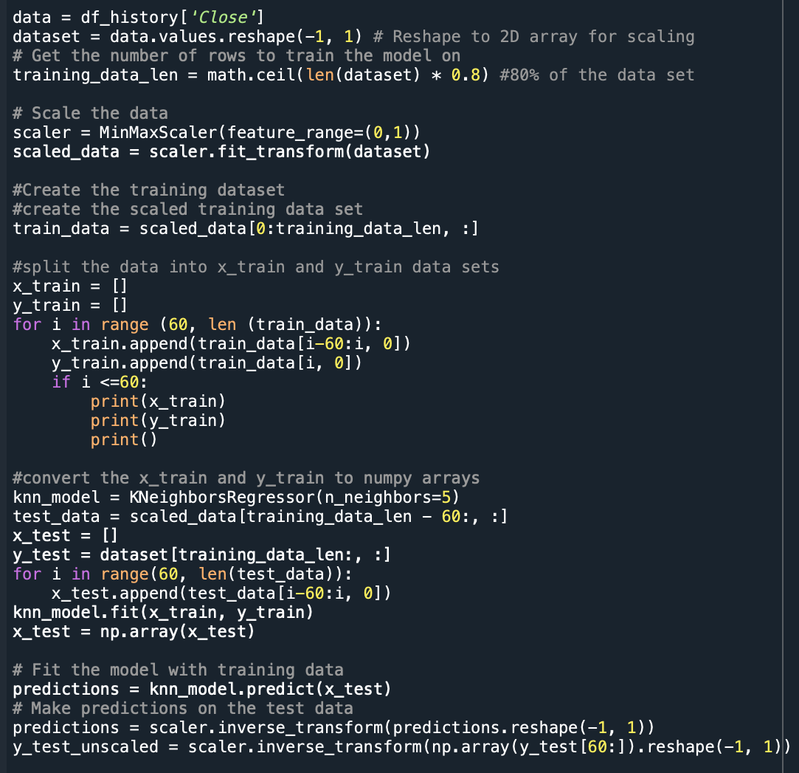
Model Selection, Training, and Validation
Model Training Process
KNN classification model
KNeighborsRegressor
Evaluation
Root Mean Square Error (RMSE)
Feature Scaling
Normalization

Slide 9
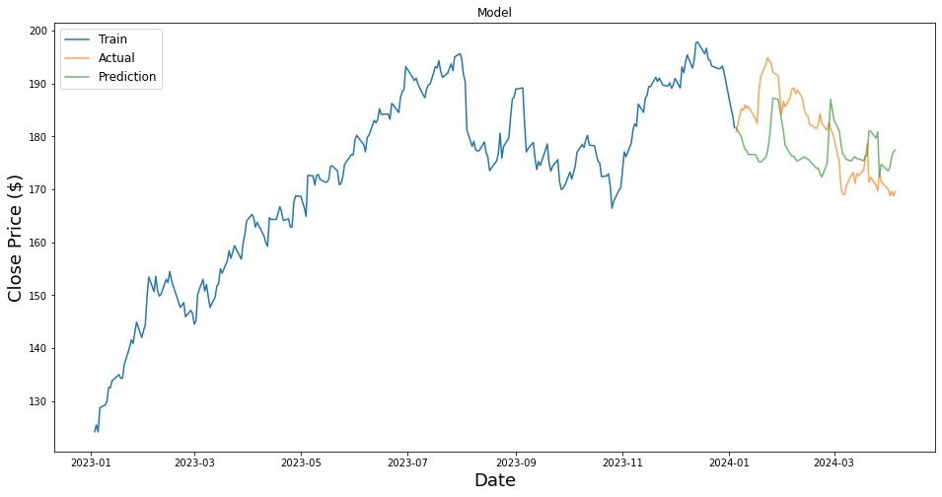
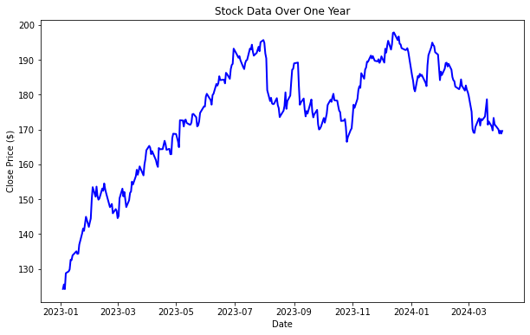
How the program works
User input the stock ticker and date they want for analysis
The program creates the visualization of stock data over time
3. The program creates the visualization of prediction and actual stock data over time using knn model and return a RMSE score
Notes:
The program starts by asking the user to input a stock ticker symbol (like 'AAPL' for Apple Inc.) and a start date for fetching the stock's historical data. The 'Close' prices are extracted and reshaped to fit the requirements of the scaler. The data is then split into a training set (80% of the data) and a test set (remaining 20%). Since the predictions are in the scaled format, they are inversely transformed to the original price scale. The RMSE is calculated by comparing the unscaled test data ('y_test_unscaled') and the predictions, providing a measure of the model’s accuracy.
The script creates a new DataFrame containing the training data and a separate DataFrame with the test data and the corresponding predictions. Finally, it plots the training 'Close' prices, actual 'Close' prices from the test set, and the predicted prices on a line graph to visualize the model's performance.

Slide 10
Future Improvements
Use lifetime data to predict patterns that could occur over several year periods
Lower the RMSE (more accuracy)
Enhance the proposed model by implementing sentiment analysis and neural networks
Consider the inflation, political events, and traders’ expectation to the model
Notes:
Incorporate a more extensive dataset that spans the entire lifetime of the stock, which could reveal patterns that emerge over multiple years.
Experiment with more advanced machine learning algorithms that might provide better accuracy for this particular type of data. Use ensemble methods to combine the predictions of several models and potentially reduce the RMSE.
Apply neural network architectures, particularly deep learning models such as Convolutional Neural Networks (CNNs) for pattern recognition and Long Short-Term Memory networks (LSTMs) for time series forecasting, which may capture complex stock price movements better than traditional models.
Expand the model to include these new features alongside historical price data. This could mean adding additional input layers to a neural network or including the features in a regression model's design.

Slide 11
Resources
https://www.statisticssolutions.com/ethical-considerations-in-qualitative-research/
https://slidesgo.com/theme/commercial-trading-company-profile#search-stock&position-11&results-38&rs=search&rs=search
https://www.nasdaq.com/
https://pypi.org/project/yfinance/

Slide 12
Questions?

