Slide 1
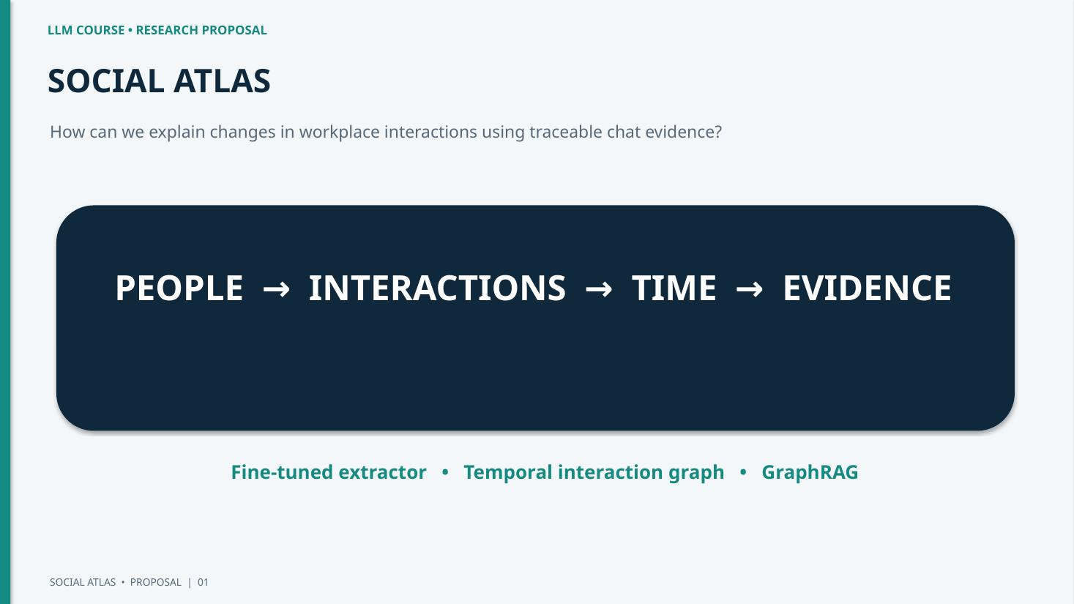

Slide 2
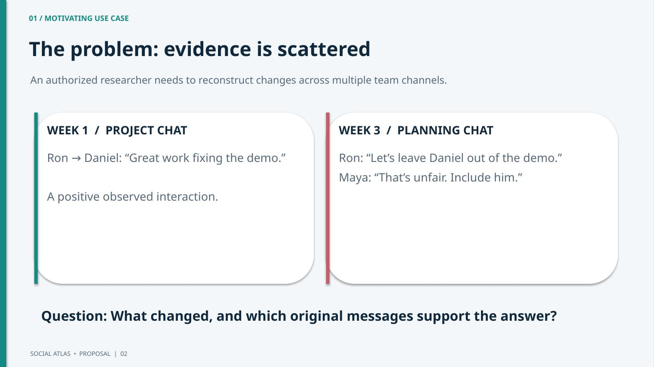

Slide 3
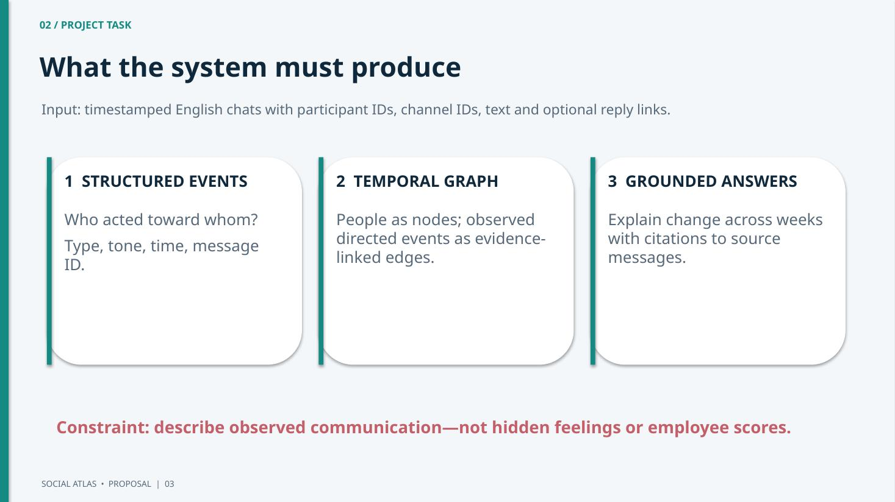
Constraint: describe observed communication- not hidden feelings or employee scores

Slide 4
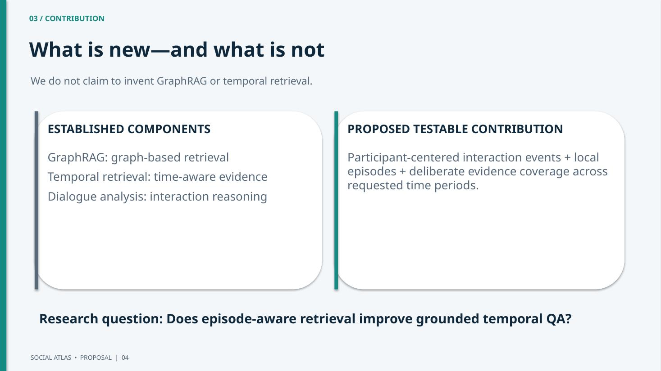
-

Slide 5
04 / METHODS
Training once, analyzing new conversations
Qwen + LoRA is a candidate approach; feasibility and model size require a pilot.
OFFLINE TRAINING
NEW CONVERSATIONS
WHY QWEN + LORA?
Verified labeled chat windows
↓
Qwen + supervised LoRA
↓
Reusable event extractor
Only the interaction extractor is fine-tuned.
Chats → trained extractor → directed events → episode grouping + NetworkX → evidence retrieval → answering LLM
New conversations do not retrain the model. Graph and retrieval logic are rule-based, not separately trained.
Qwen instruction model: reads multi-message context and produces structured JSON events.
Compare same checkpoint before/after fine-tuning.
LoRA trains compact adapters; QLoRA if memory constrained.
Test: GPU memory, valid JSON, event F1, latency.
Model checkpoint and hardware feasibility are not yet confirmed.

Slide 6
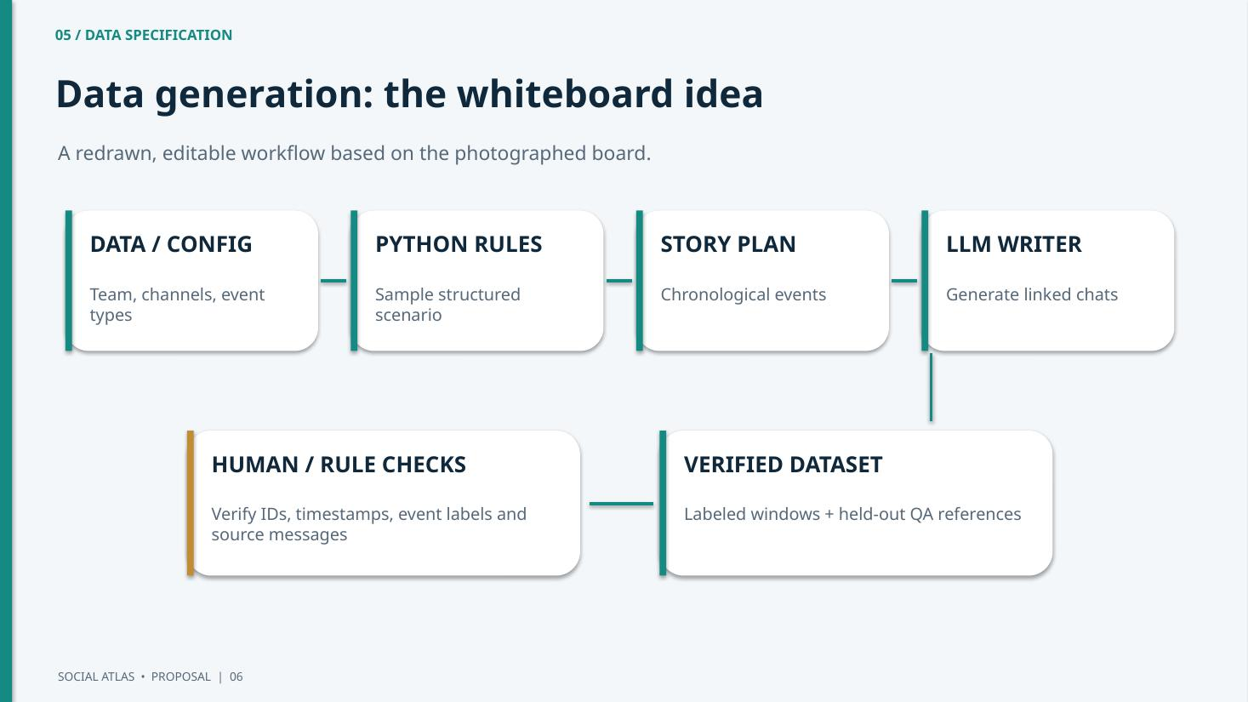
Python:
random- relationships, # of messages for every relationship, % of negative messages
LLM:
story for every relationship
LLM:
messages for every scenario

Slide 7
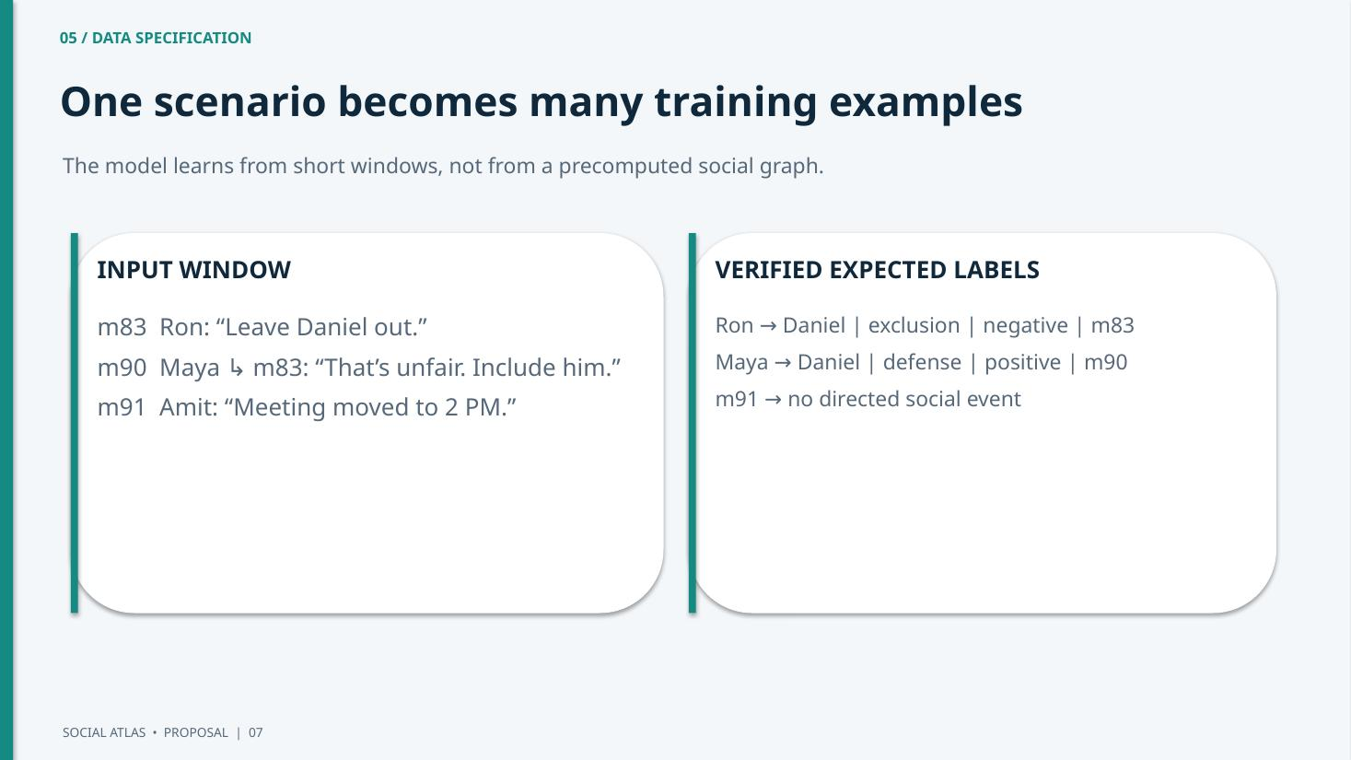

Slide 8
05 / DATA SPECIFICATION
Dataset targets, checks, and external-data limitation
Planned counts are targets—not collected data or measured results.
PROVISIONAL DATASET
QUALITY GATES
OPEN EVALUATION ISSUE
12–15 pilot scenarios
80–100 train scenarios
15–20 validation scenarios
20–25 held-out test scenarios
Controlled fictional workplace chats with verified event labels and held-out scenarios.
Candidate storyline events are not ground truth until supported by actual messages.
Check message IDs and evidence. Split complete scenario families to prevent leakage. Independently review held-out answers.
Synthetic-only evaluation is a limitation highlighted in the course guidance.
Identify a feasible, permission-safe real-world or independently sourced evaluation set.
External data source and labeling protocol remain undecided; do not claim they are secured.
Risk: synthetic dialogue may not generalize to real workplace conversations.

Slide 9
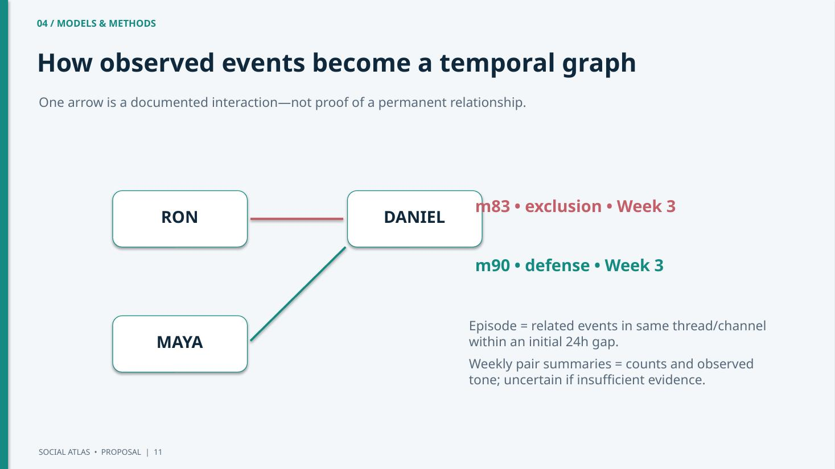

Slide 10
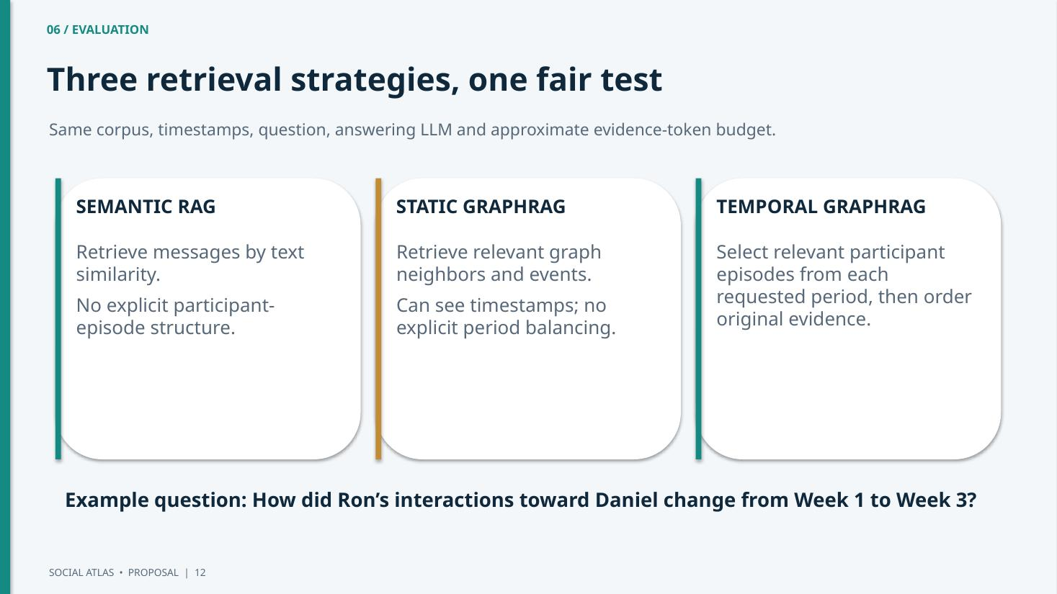

Slide 11
06 / EVALUATION
Metrics, end-to-end tests, and failure analysis
Evaluate both the individual components and the raw-chat → grounded-answer pipeline.
COMPONENT METRICS
DATA + EXTRACTION RISKS
RETRIEVAL + QA RISKS
Directed-event extraction: Precision / Recall / F1
Weekly tone summaries: macro-F1
Evidence retrieval: Recall@K
Temporal QA accuracy; correct message-ID citations; insufficient-evidence handling.
Paired comparisons grouped by scenario.
Generator bias and unnatural dialogue
Neutral-event imbalance
Unsupported labels
Wrong source/target or ambiguous reply
Review evidence and test the trained extractor on unseen scenario families.
Missed early-period evidence
False merging of unrelated incidents
Unsupported claims in final answers
Diagnostic: compare verified versus predicted events.
Success: better temporal QA than Static GraphRAG without weaker citation support.
The success criterion is a hypothesis to test—not an existing result.

Slide 12
FEASIBILITY / PROPOSAL STATUS
Build plan, deliverable, and open decisions
Prioritize scientific evaluation before polishing the dashboard.
PHASE 1 — DATA + MODEL
PHASE 2–3 — EVALUATE + DEMO
PILOT-DEPENDENT DECISIONS
-
-
Pilot scenario generation
Review labels
Test Qwen + LoRA extraction
Defined: supervised event extraction, evidence-linked temporal graph, three-way RAG comparison, held-out quantitative evaluation.
Build graph and retrieval
Run matched RAG baselines
Evaluate QA and citations
Then build lightweight Streamlit demo: week selector, graph edges, click to inspect source messages.
Fallback: verified events if extraction is noisy.
Real or independent evaluation source
Qwen checkpoint and GPU feasibility
Annotation thresholds and QA rubric
Final scenario counts
These are open assumptions, not established results.
Research only • Synthetic/authorized conversations • No personnel scoring.

Slide 13








