Slide 1
Chad Game
Andy Thai, Roger Hannagan, Miles Blaisus, Steven Cisneros, Badr Hashmi

Slide 2
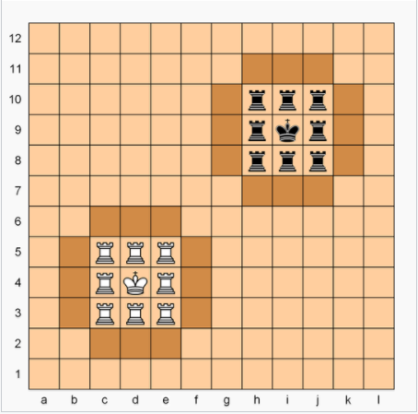
Chad
- Variation of Chess
-Rooks can move horizontally or vertically
-Queens can move vertically, horizontally, or diagonally
-King can move one square in any direction or an “L” shape and behave like a Knight in chess
-King is confined to 3X3 castle but other piece can move freely
-Rooks or queens can only capture opponent’s piece when they are on the opponent’s castle and the other piece is within the castle
-Pieces cannot be captured if they are outside of the castle, can only act as “blockers”
-Checkmate occurs when King is “threatened” with capture and it isn’t possible to move the King out of the situation

Slide 3
Android: pros
Benefits: fast, tons of tools, easy UI creation, multi-platform compatibility (when using java).
Can be programmed in c++ (not recommended).
Flexible UI allows for fast and beautiful UI changes.

Slide 4
Android: cons
More difficult implementation.
Poor design can lead to sluggish and/or crashing UI elements (If the UI takes too long to respond, Android OS will kill your app to save resources).
Every possible action that can be done on the UI must be handled or app will crash.
Ex: If the back button isn’t implemented, using it will cause your app to crash.

Slide 5
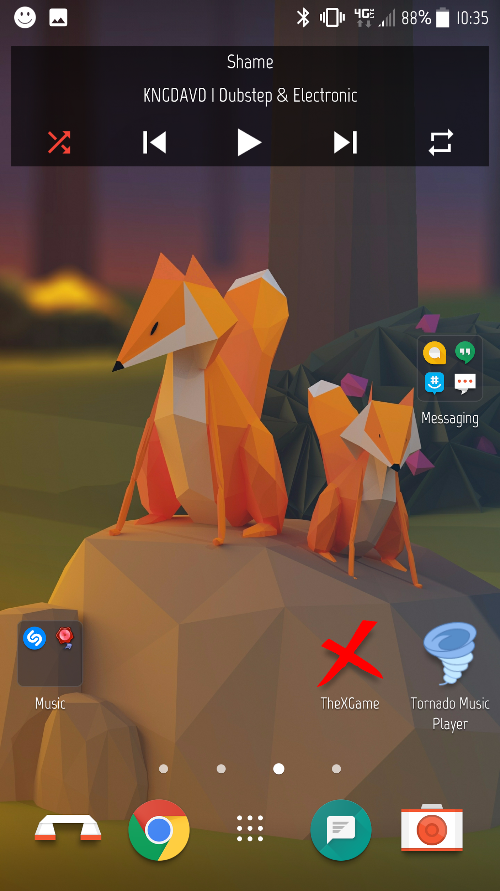
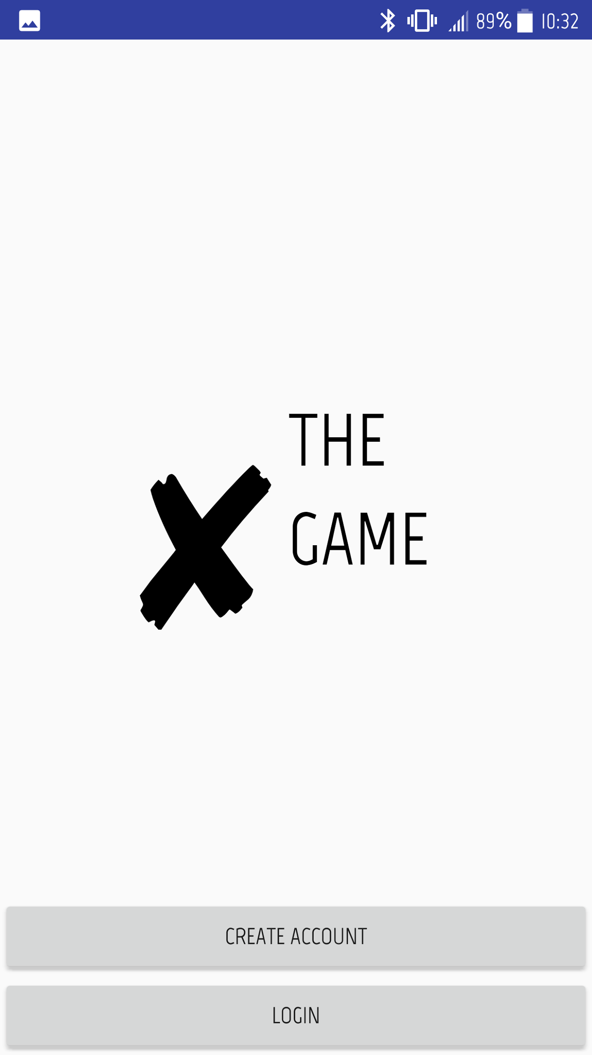
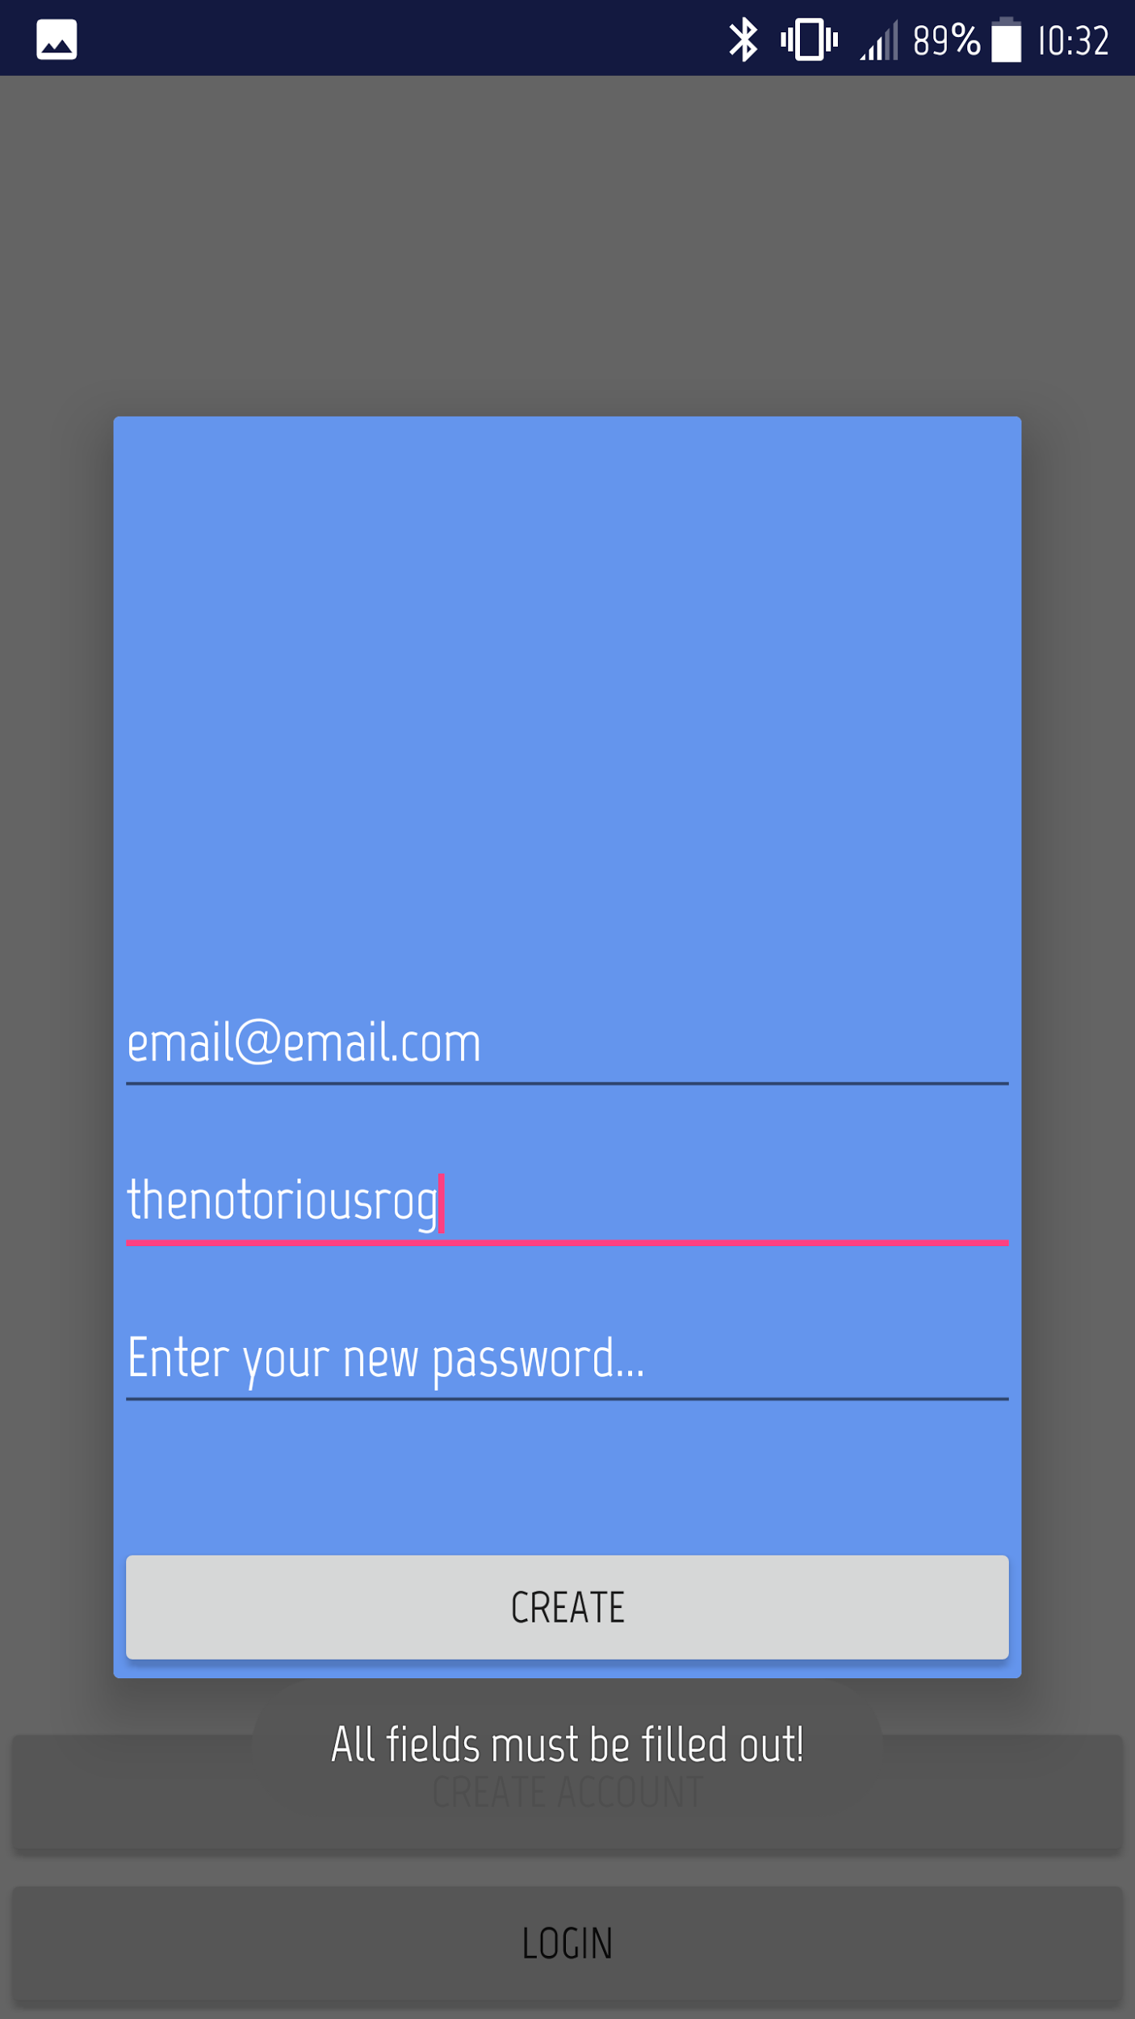
App: First Steps

Slide 6
Risk Analysis
Low risk project overall
Slight chance of leaking user emails if the security on user data is breached
The system is not connected to any critical resources

Slide 7
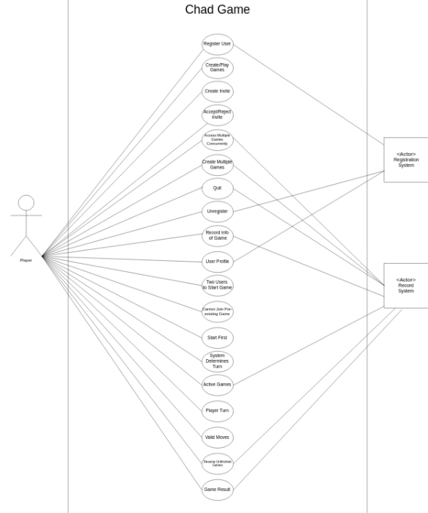
link

Slide 8
Questions?

