Slide 1
Chad Game
Team: Polymorphs
Andy Thai, Miles Blaisus, Roger Hannagan, Steven Cisneros, Badr Hashmi

Slide 2
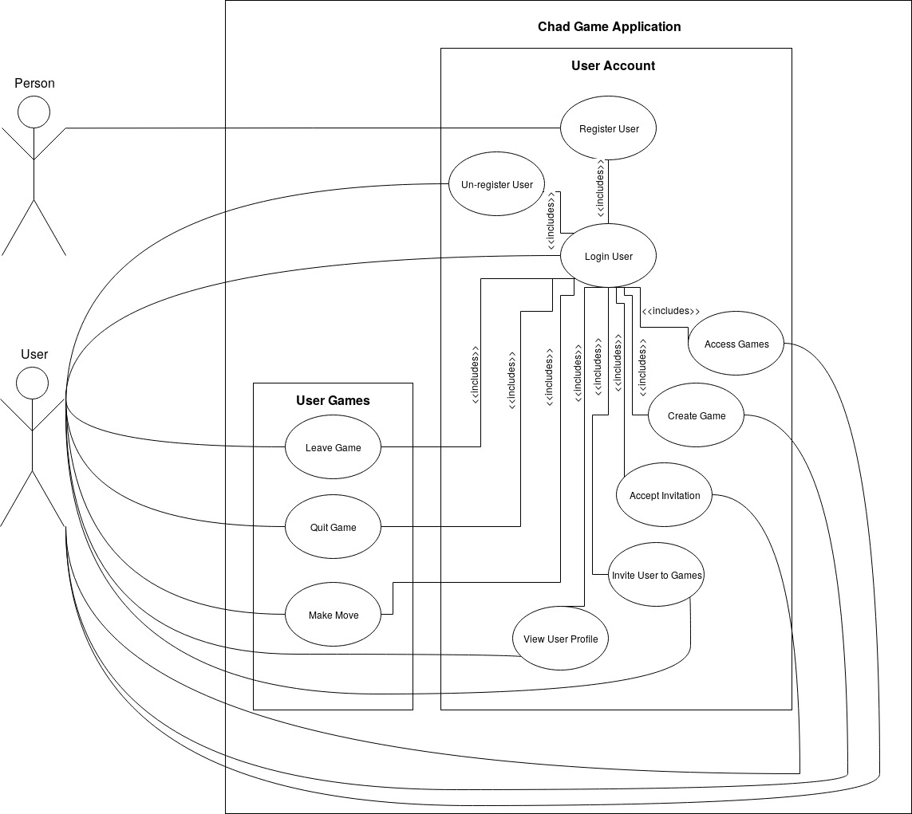
Updated Use Cases
Reordered to use Login use case
Simplified to just the public interface of the system
Removed all use cases about backend operations and restrictions
Separated into two major subsystems User Account and User Games

Slide 3
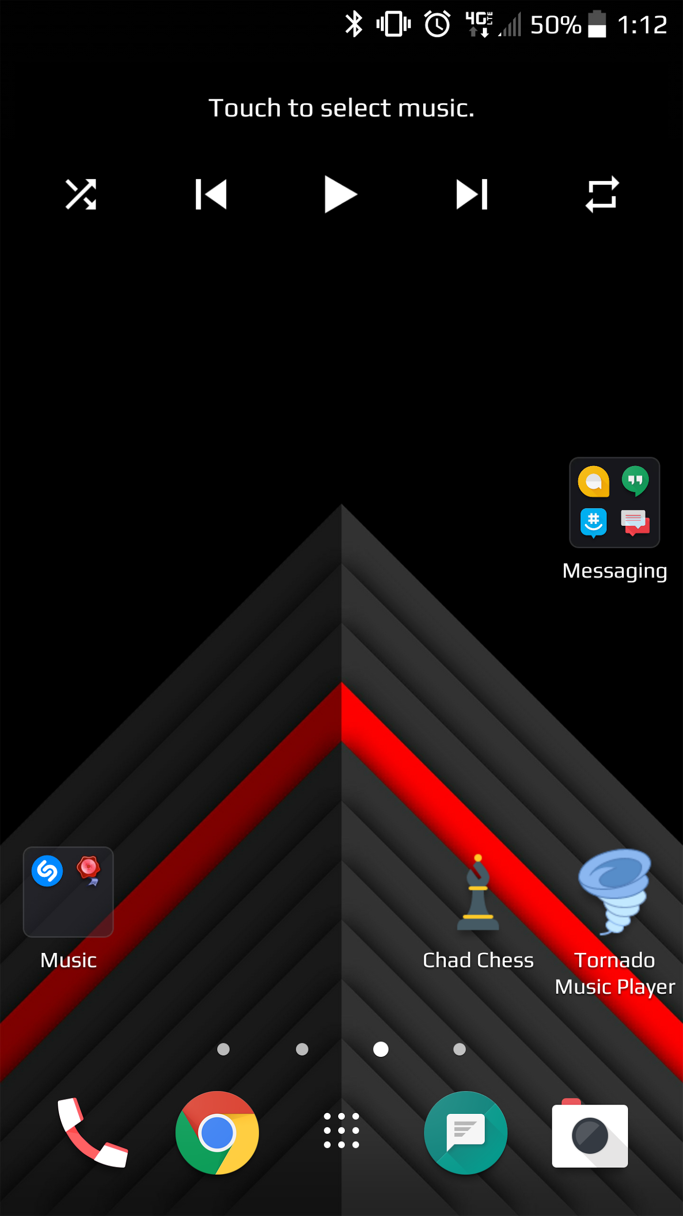
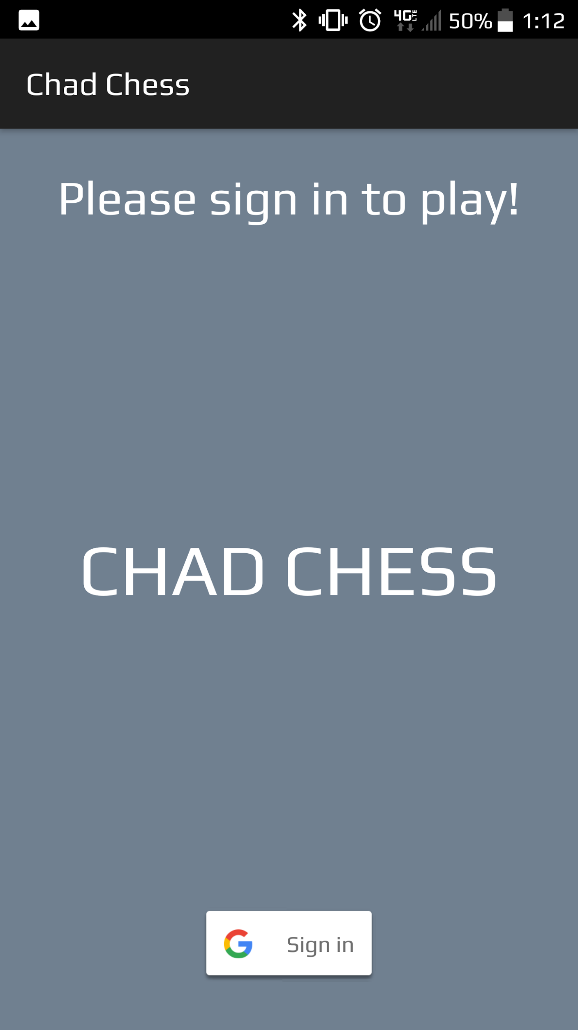
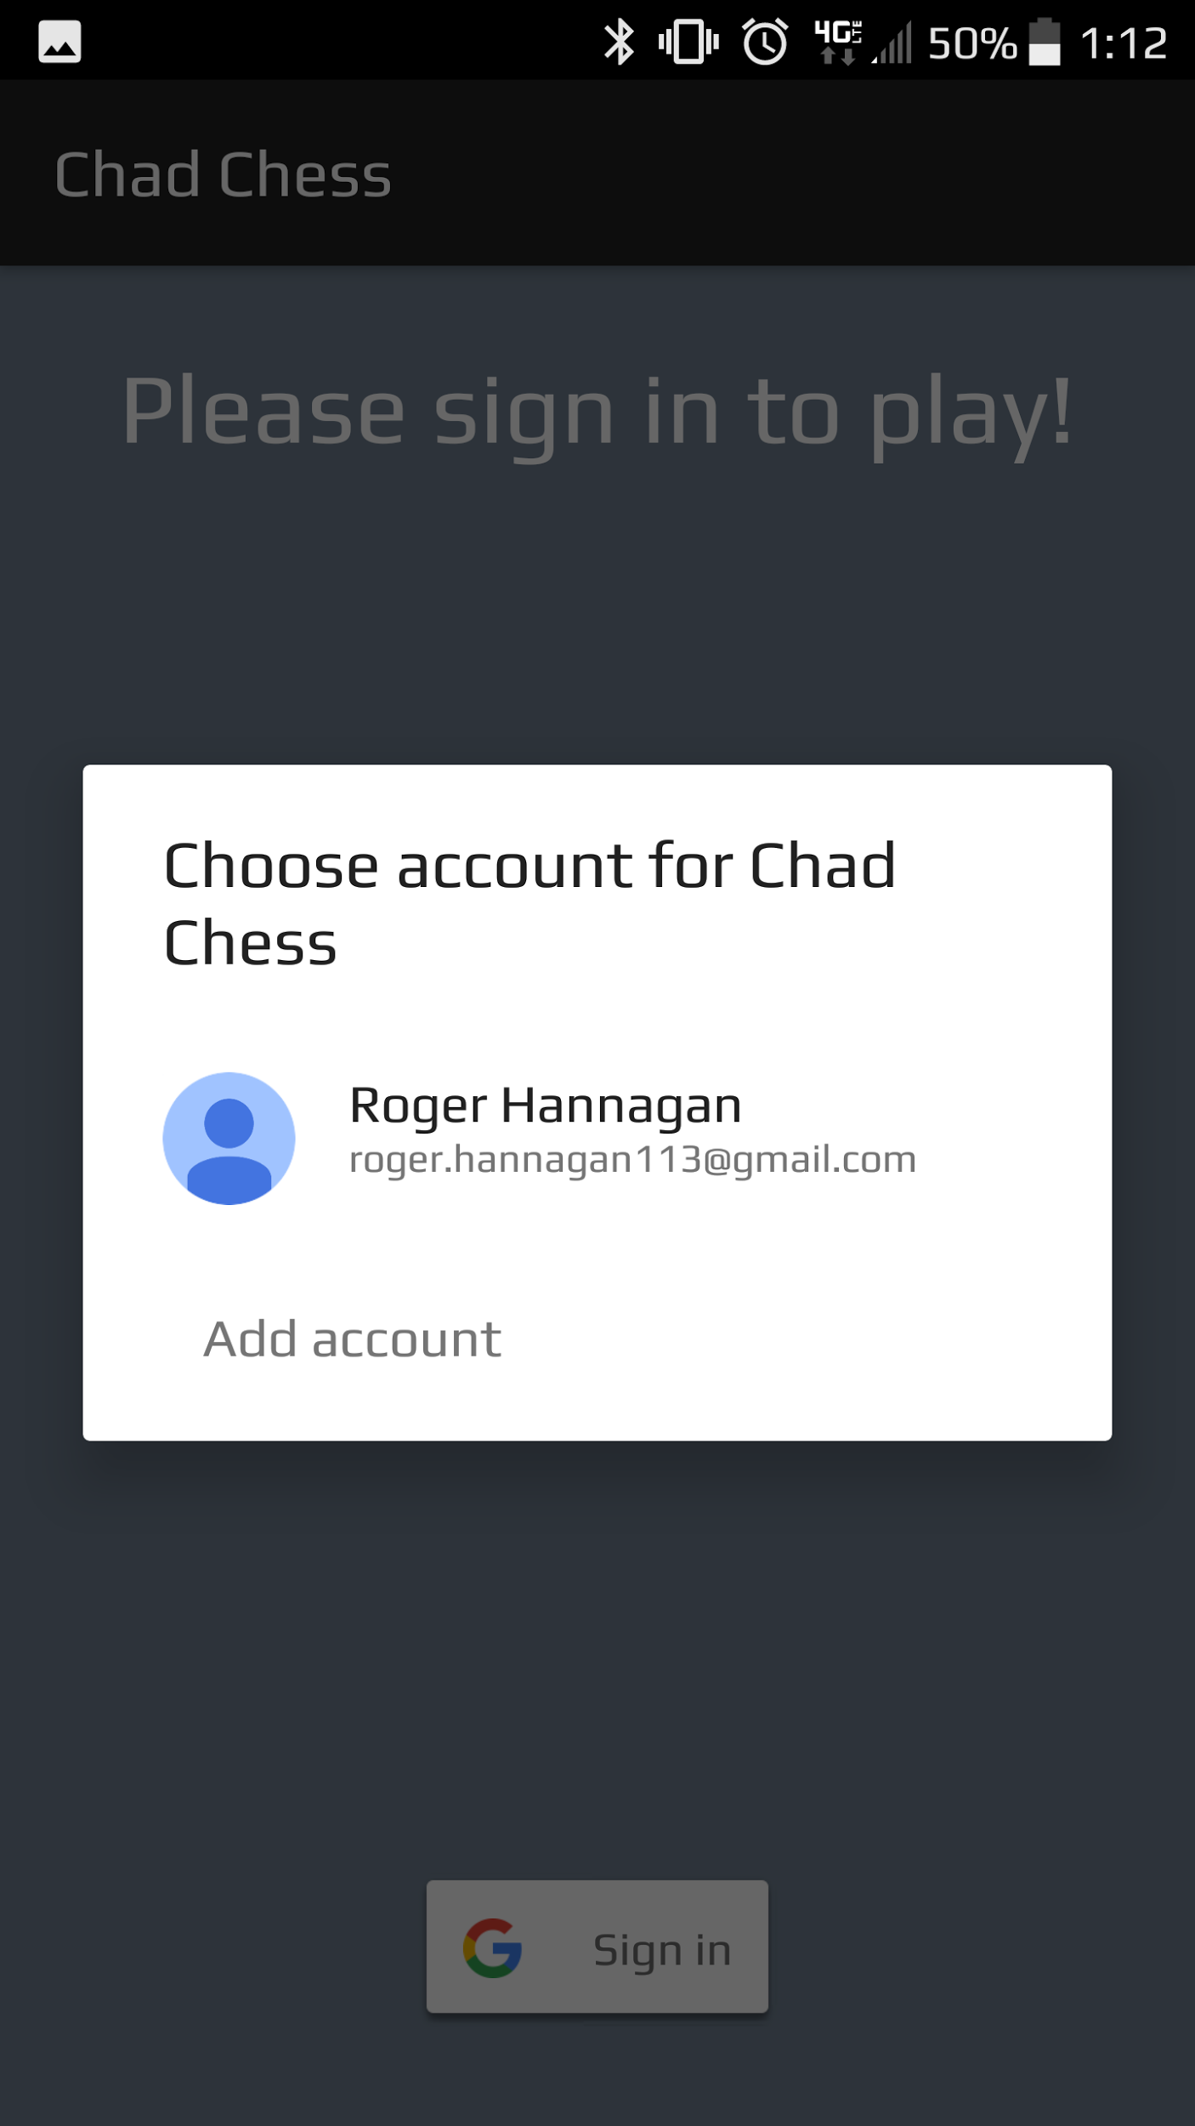
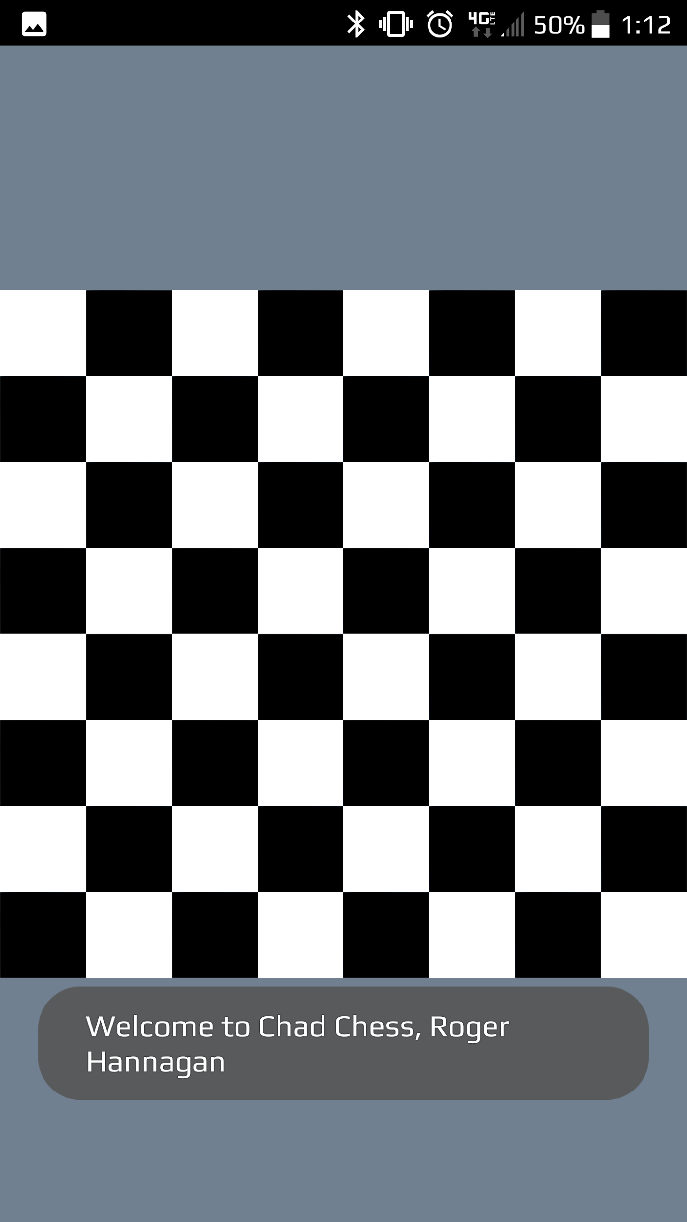
Project Updated Prototype

Slide 4
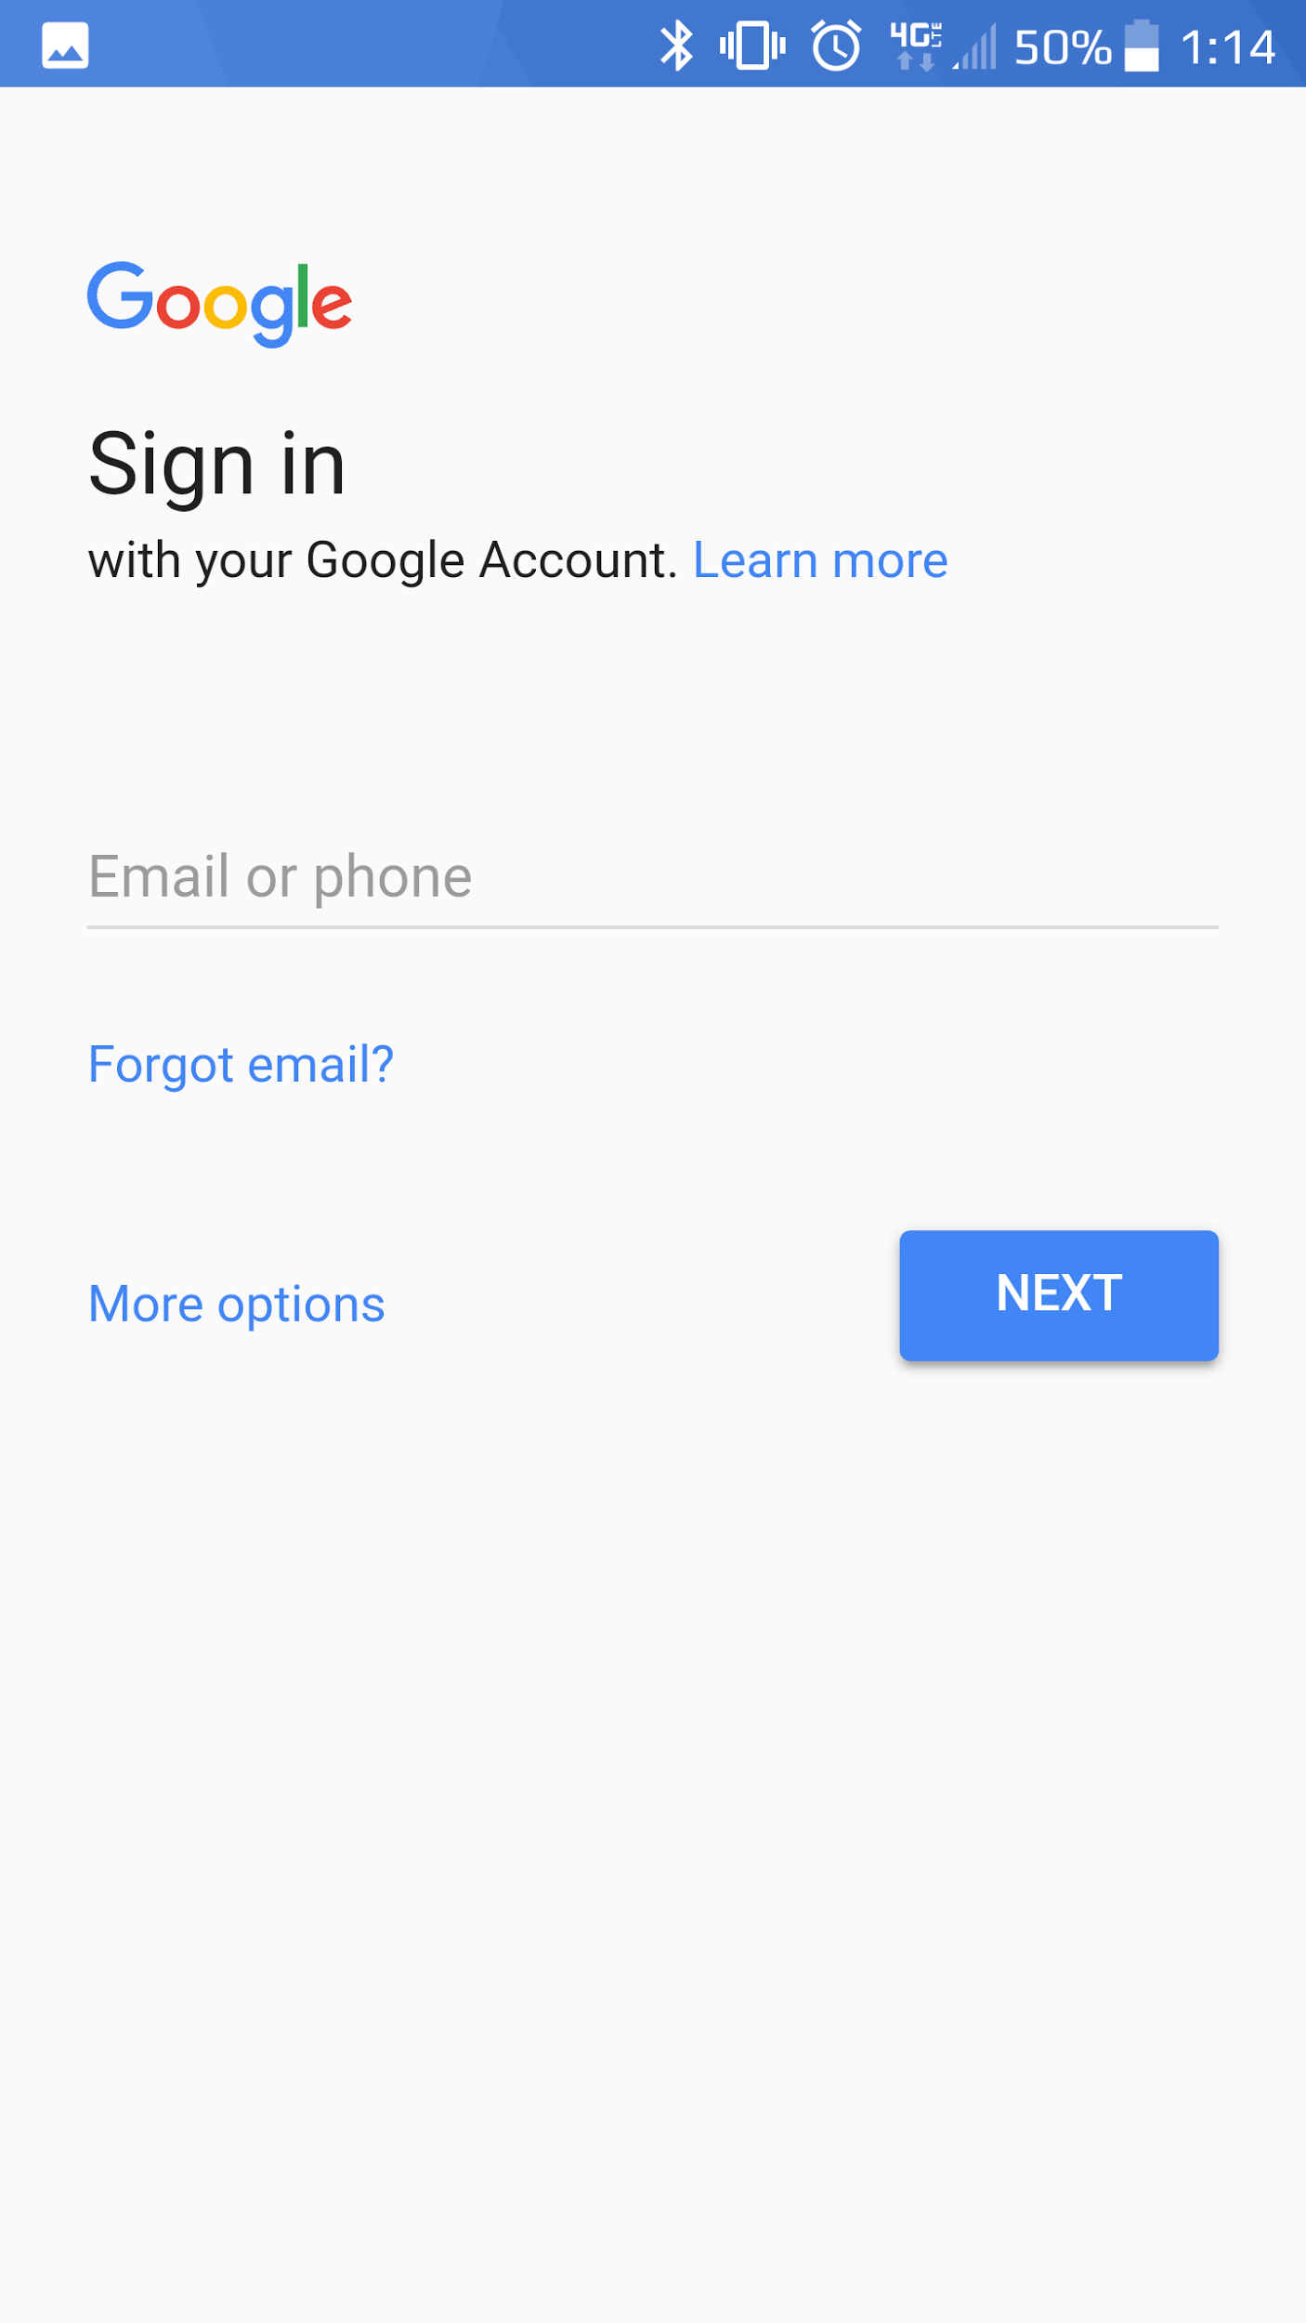
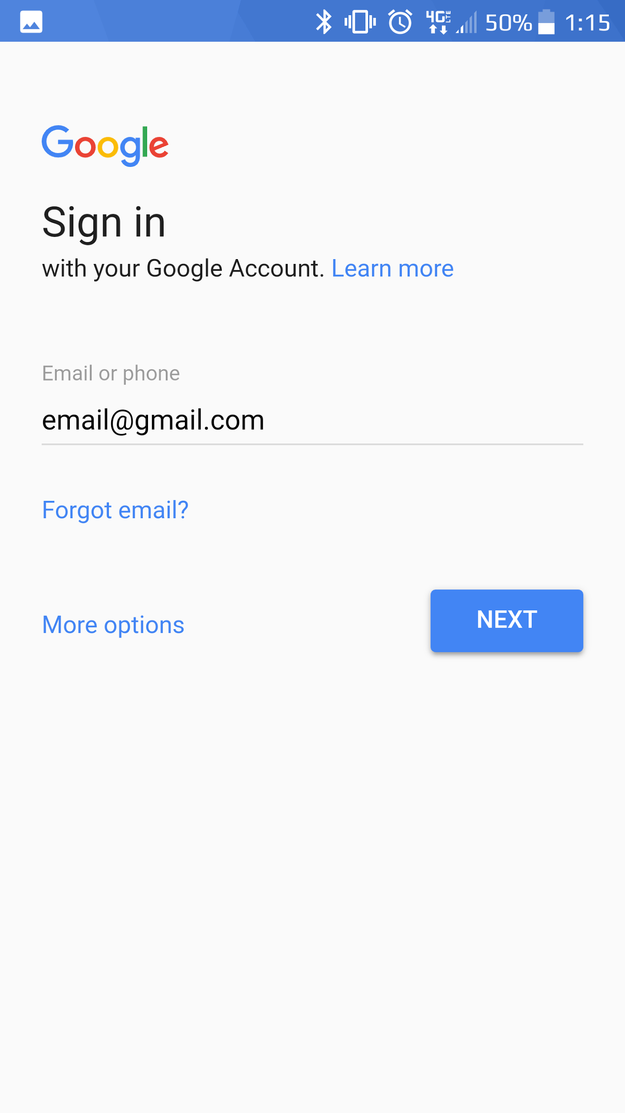
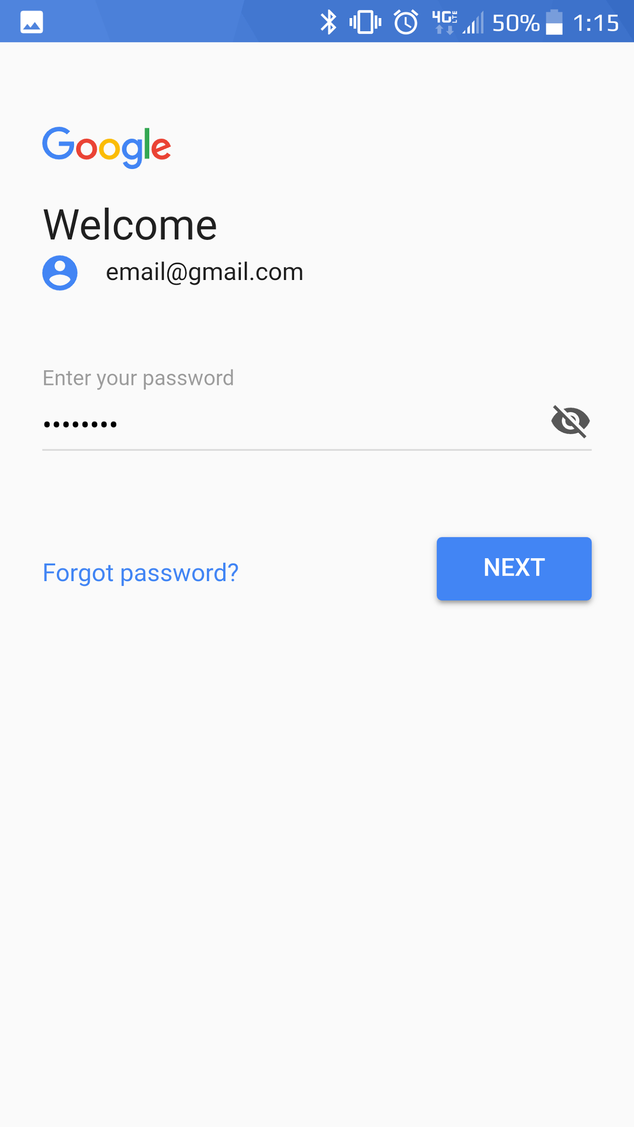
Project Updated Prototype (part 2)

Slide 5
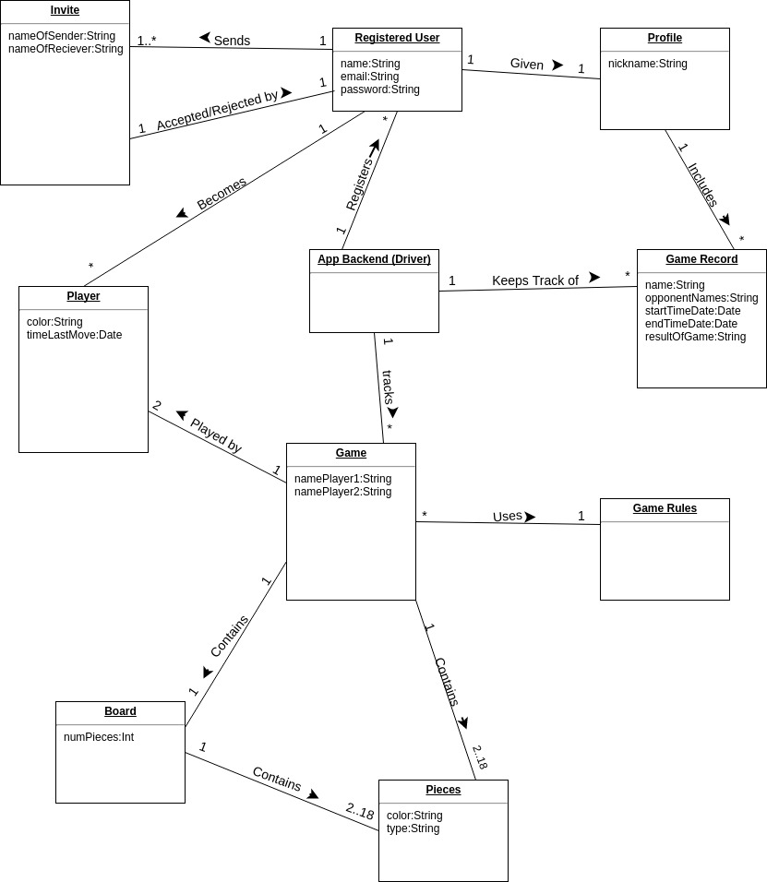
Domain Model

Slide 6
Glossary
GlossaryLink

