Slide 1
Chad Chess
Polymorphs
Andy Thai, Badr Hashmi, Miles Blaisus, Steven Cisneros, Roger Hannagan

Slide 2
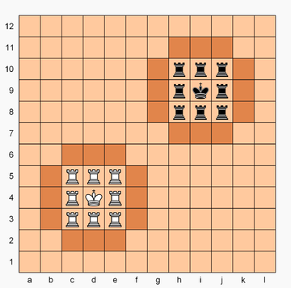
Chad Review
Objective: Capture opponent’s King
King cannot leave 3X3 square
Only pieces on castle walls can capture inside castle
Rooks become a Queen once they are on an enemy castle wall

Slide 3
User Interface
23 XML Files
18 UI Classes (not including classes within classes)
Activities
Fragments
UI class Diagram

Slide 4
UI Problems
Activities VS Fragments
Gradle
The Cursed Machines
Click Listeners

Slide 5
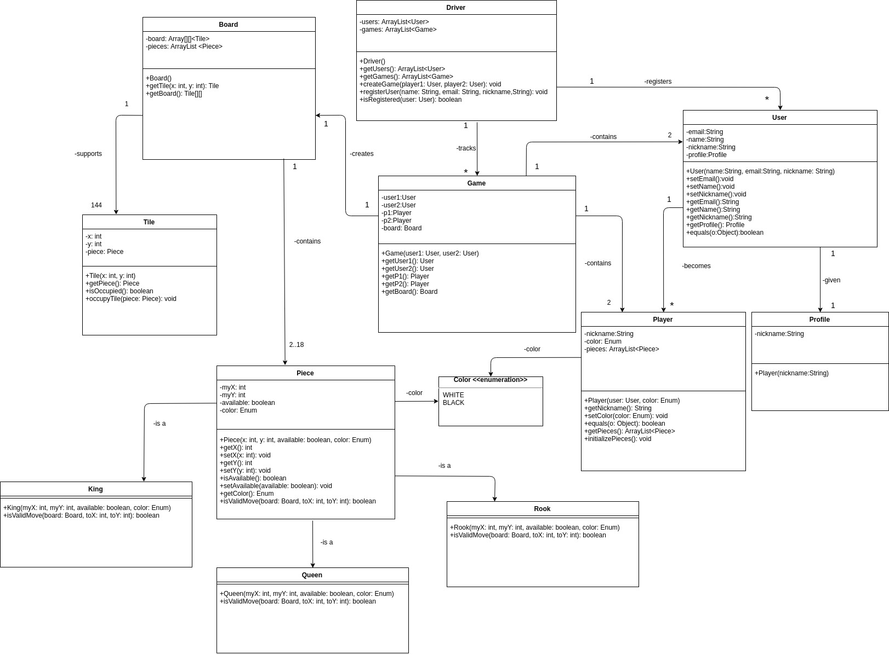
App Backend

Slide 6
Persistence
Firebase real time database from Google
Relatively easy integration with Android
Consistent communication between discrete devices

Slide 7
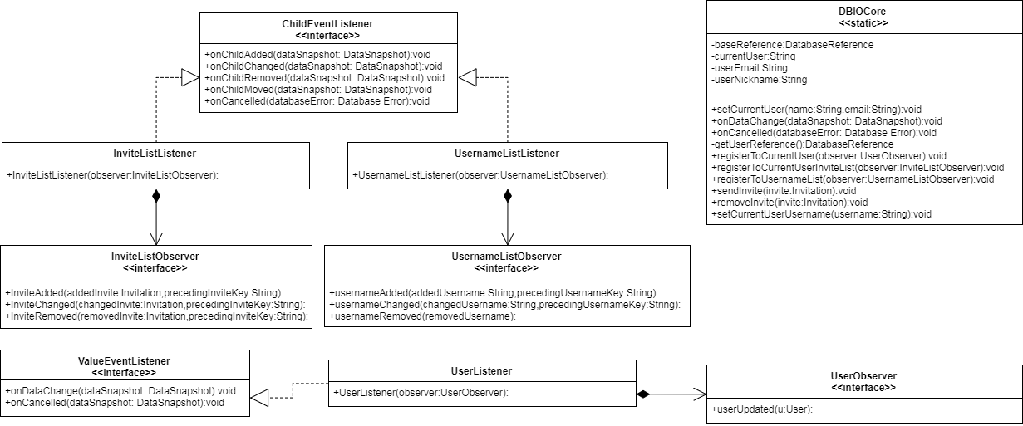
Persistence Class Diagram

Slide 8
Persistence Problems
Working with a realtime database
Using listeners to retrieve data
Difficulties balancing encapsulation with functionality
Issues with unit testing via JUnit

Slide 9
Next Iteration
Material Design && Polishing of UI elements
Entire core functions implemented

Slide 10
Questions?

