Slide 1
LSbM-tree:一个读写兼优的大数据存储结构
StevenChoi
俄亥俄州立大学
The Ohio State University, USA

Slide 2
计算机 系统和应用进程的三个阶段
计算机是为 “计算 (computing)” 而研制的(1930s -1990s)
CPU芯片，操作系统，存贮系统，编译软件， 高性能计算。。。
物质和物理世界被转变为数字世界， 快速计算和深度分析
人类社会有了前所未有的科技突破：气象，新型材料， 。。。。
计算机是为 “网络 (connectivity)” 而研制的 (1990s – 2010s)
互联网和无线上网是一个全新数据世界的基础:
1981-2017: Bandwidth: from 50K bps to 100P bps (2 M times)
1981-2017: # of devices/users: from 0.1 to 10 (100 times)
网络电话， 微博，QQ, 微信，网上购物， 网上查询， 。。。
计算机是为 “数据中心 (data)” 而研制的 (从21世纪开始)
今天大数据的爆炸并不是已有的物理和物质的数字世界的一个延续
这个新的数据世界精确地记录和追踪人类自身的行为
有史以来90%的数据是过去两年产生的

Slide 3
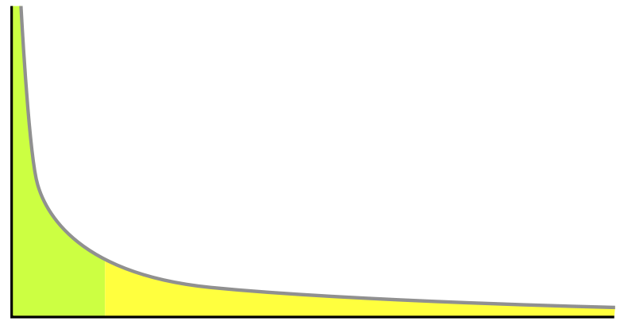
Data Access Patterns and Power Law
# of hits to
each data object
Popularity ranks
of each data object
To the rights (the yellow region) is the long tail of lower 80% objects; to the left are the few that dominate (the top 20% objects). With limited space to store objects and limited search ability to a large volume of objects, most attentions and hits have to be in the top 20% objects, ignoring the long tail.

Slide 4
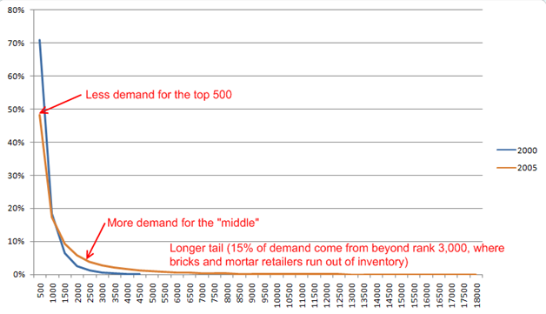
Distribution Changes in DVDs in Netflix 2000 to 2011
2011 and after (predicted)
The growth of Netflix selections ( today: 30 million US users, 40 million users total, 1/3 streaming traffic of Internet)
2000: 4,500 DVDs, 2005: 18,000 DVDs
2011: over 100,000 DVDs (the long tail would be dropped even more slowly for more demands)
Note: “breaks and mortar retailers”: face-to-face sell shops.

Slide 5
Big data access pattern is no longer power law
Stretched exponential distribution (PODC 2008)
Facebook photo access patterns (SOSP 2013)
IPTV channel selections in US (SIGMETRICS 2009)
PPLive streaming access patterns in China (ICDCS 2009)
Bug Music Access patterns in Korea (ICIS 2010)
BitTorrent streaming on demand accesses (NSM 2010)
Internet TV-on-demand in Sweden (IMC 2012)
Wikipedia/Yahoo! Answer posting distributions (KDD 2009)
Many other cases
The computer systems are not originally built for this pattern

Slide 6


The Real Reasons for Big Data
Almost every action in the world is digitalized and stored
Communications, various types of files, human behavior, ….
Can we store and make fast access the ocean of the data?
Yes we can
Low cost and unlimited storage space
Low latency search
If the growing data is largely useless, Waste Management works well
The real reasons:
not just about amount
But mainly about analytics
Notes:
长尾效应， 群体智慧。

Slide 7
Major Data Formats in Storage Systems
7
Sequentially archived data
Indexed data, e.g. sorted data by a defined key, …
Read/write largely by B+-tree and LSM-tree
Relational tables
Structured data formats for relational databases, e.g. MySQL
Read/write operations by relational algebra/calculus
Key-value store
A pair of key/value for a data item, e.g. redis, memcached
Read/write: request -> index –> fetching data
Graph-databases
Free-style text files
A file may be retrieved by KV-store, indexed directory, …

Slide 8
New Challenges to Access Performance in Big Data
8
Sequentially archived data
Can we massively process both reads and writes concurrently?
but LSM-tree favors writes and B+-tree favors reads
Relational tables
Tables must partitioned/placed among many nodes, e.g. Apache Hive
How to minimize data transfers among nodes and from local disks?
Key-value store
Key indexing becomes a bottleneck as # concurrent requests increase
How to accelerate data accesses for in-memory key-value store?

Slide 9
Fast Accesses to Sequentially Archived Data in both memory and disks

Slide 10
What is LSM-tree?
It is a Log-structured merge-tree (1996):
Multiple levels of sorted data, (e.g. each by a B+ tree)
Each level increases exponentially, forming a “pyramid”
The smallest level is in memory and the rest on disk
C₀
DRAM
HDD
C₀
C₁
C₁
C₂
C₂
Notes:
LSM-tree maintains multiple levels of sorted data for efficient random data access and range query
The data size of each level increases exponentially
The top level is located in memory as a write buffer, and the rest levels are on disks
All new data are inserted into the write buffer first and then being merged onto on-disk levels in cascade mode.

Slide 11






LSM-tree is widely used in production systems
RocksDB

Slide 12
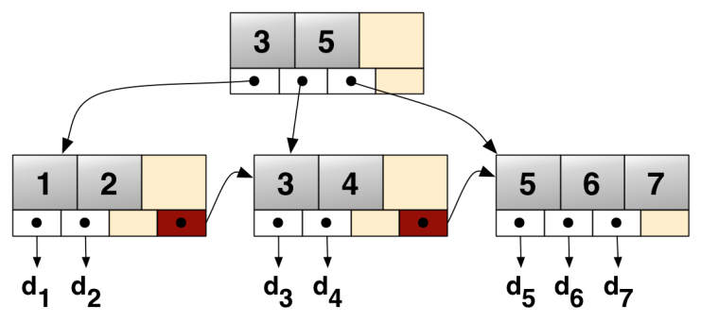
Why Log-structured merge-tree (LSM-tree)?
B+ tree
In-place update
Random I/Os
Low write throughput
LSM-tree
Log-structure for sequential I/O
Merge for sorting
Batched I/O operations
High write throughput
Insert 2.5
seek
2.5
d₂’
LSM-tree
Log-structured update
Merge/compaction for sorting
Sequential I/Os
High write throughput
writes
DRAM
merges
HDD
12

Slide 13
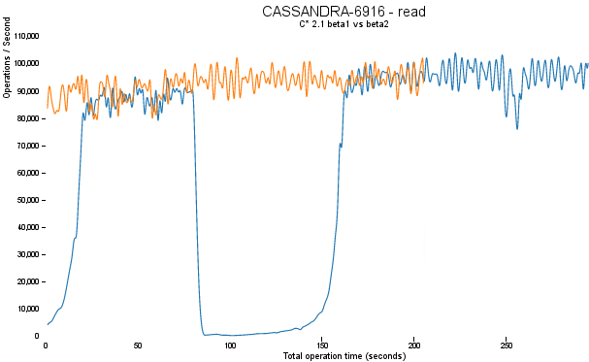
A buffer cache problem reported by Cassandra in 2014
effective caching
warming up
disenabled caching
*https://www.datastax.com/dev/blog/compaction-improvements-in-cassandra-21

Slide 14
Basic function of Buffer Cache
Buffer cache is in DRAM or other fast devices
Data entries in buffer cache refer to disk blocks (page)
Cache the frequently read disk blocks for reuse
Buffer cache
a
b
c
disk
a
c
b

Slide 15
Buffer Cache in LSM-tree
DRAM
HDD
C₀
get a
C₁
index structure
a b c d e f
C₂
a-f
root
multi-page
block
a-c
d-f
Queries are conducted level by level
In each level, an index is maintained in memory to map keys to disk blocks
The index is checked to locate the disk block for the key/key range
The found disk block(s) will be loaded into buffer cache and serve there
a
buffer cache
disk
single-page
block
a
b
c
d
e
f

Slide 16
Buffer Cache in LSM-tree
DRAM
HDD
C₀
get a
C₁
index structure
a b c d e f
C₂
a-f
root
multi-page
block
a-c
d-f
Any future request on the same key/key range still need to go through the index
The found disk block(s) can be served from the buffer cache directly after then
a
buffer cache
disk
single-page
block
a
b
c
d
e
f

Slide 17
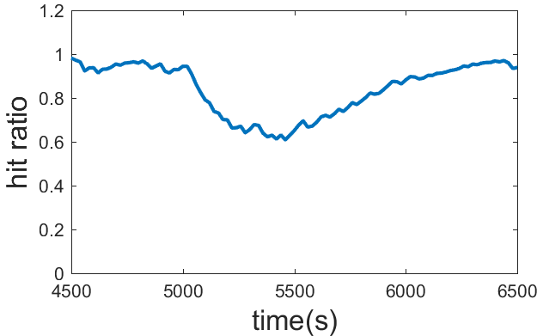
LSM-tree induced Buffer Cache invalidations
Buffer cache
DRAM
writes
a
a
c
d
disk
HDD
b
a
b
c
d
c
C₀
a e
merges
a c e
C₁
a
b
c
d
e
f
a b c d e f
a
e
b d f
C₂
b
d
f
a
c
e
Read buffer (buffer cache) and LSM-tree write buffer (C0) are separate
Frequent compactions for sorting
Referencing addresses changed
Cache invalidations => misses
Notes:
Insert data into write buffer will not update the data in the read buffer

Slide 18
Inability of Buffer Caching in LSM-tree
*https://www.datastax.com/dev/blog/compaction-improvements-in-cassandra-21

Slide 19
Existing representative solutions
Building a Key-Value store cache
E.g. raw cache in Cassandra, RocksDB, Mega-KV (VLDB 2015)
Providing a Dedicated Compaction Server
“Compaction management in distributed key-value data stores” (VLDB’ 2015)
Lazy Compaction: e.g., stepped merge
“Incremental Organization for Data Recording and Warehousing” (VLDB’ 1997)
Notes:
Independent hash-table based key-value store cache

Slide 20
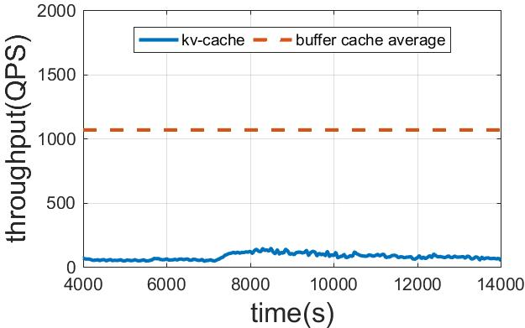
Key-Value store: No address mapping to Disk
hash
function
a
1
b
2
d_value
DRAM
writes
d
3
4
b_value
disk
HDD
5
a_value
merges
c
C₀
6
a e
a c e
C₁
b d f
C₂
a
e
b
d
f
a
c
e
An independent In-Memory hash table is used as a key-value cache
+: KV-cache is not affected by disk compaction
-: The hash-table cannot support fast in-memory range query

Slide 21
Dedicated server: prefetching for buffer cache
Buffer cache
a
c
e
DRAM
writes
a
Compaction server
d
HDD
b
c
C₀
disk
a e
a c e
C₁
b d f
C₂
a
e
b
d
f
A dedicated server is used for compactions
+: After each compaction, old data blocks in buffer cache will be replaced by newly compacted data

Slide 22
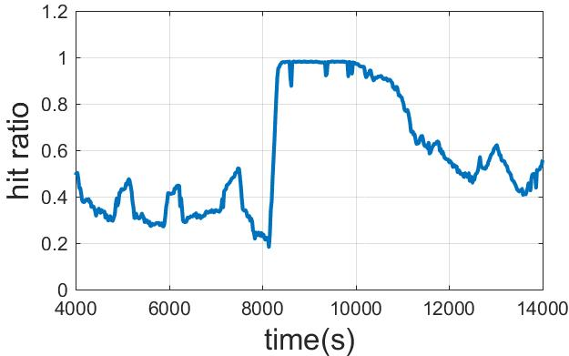
Dedicated server: prefetching for buffer cache
a b
a b
c d
c d
e f
Buffer cache
e f
DRAM
writes
a f
a b
e f
Compaction server
c d
HDD
C₀
disk
merges
a f
C₁
a b c d e f
a f
b c d e
C₂
b c
d e
Buffer cache replacement is done by comparing key ranges of blocks
-: The prefetching based on compaction data may load unnecessary data

Slide 23
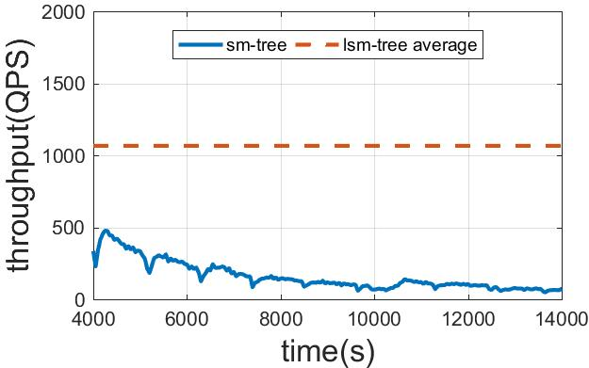
Stepped-merge: slowdown compaction
Buffer cache
DRAM
writes
d
disk
HDD
a
b
append
c
C₀
c
a
e
C₁
a
c
b d f
C₂
b
d
f
e
The merging is changed to appending
+: compaction-induced cache invalidations are reduced
-: Since each level is not fully sorted, range queries are slow
Notes:
C is appended to level 1, thus original data a and e in level 1 will not be influenced. As a result, the corresponding data blocks in the buffer cache will not be invalidated

Slide 24
LSbM-tree: aided by a compaction buffer
LSbM-tree
Retains all the merits of an LSM-tree by maintaining the structure
Compaction buffer re-enable buffer caching
Compaction buffer directly maps to buffer cache
Slow data movement to reduce cache invalidations
Keep cached data in compaction buffer for cache hits
writes
Buffer cache
C₀
append
c
a
merges
C₁
c
B₁
C₂
a
B₂
underlying LSM-tree
Compaction buffer

Slide 25
Compaction Buffer: a cushion between LSM-tree and cache
DRAM
writes
HDD
append
c
C₀
a c e
append
c
a
e
merges
a e
C₁
B₁
a b c d e f
b d f
B₂
b d f
C₂
underlying LSM-tree
compaction buffer
During a compaction from Ci to Ci+1, Ci is also appended to Bi+1
E.g. while data in C0 is merged to C1 in LSM-tree, it is also appended to B1 in compaction buffer
No additional I/O, but only index modification and additional space
Buffer cache
c
a
b
d
disk
c
a
e
a
b
c
d
e
f
a
e
b
d
f
a
c
e

Slide 26
Compaction Buffer: a cushion between LSM-tree and cache
DRAM
writes
HDD
C₀
merges
C₁
c
a
e
B₁
a b c d e f
C₂
a c e
b d f
B₂
underlying LSM-tree
compaction buffer
During a compaction from Ci to Ci+1, Ci is also appended to Bi+1
E.g. while data in C0 is merged to C1 in LSM-tree, it is also appended to B1 in compaction buffer
No additional I/O, but only index modification and additional space
As Ci is merged into Ci+1, the data blocks in B_{i} are removed gradually
Buffer cache
a
c
c
a
b
d
disk
c
a
e
a
b
c
d
e
f
b
d
f
a
c
e

Slide 27
Buffer Trimming: Who should stay or leave?
DRAM
writes
HDD
C₀
newly
appended
merges
C₁
B₁
removed
a b c d e f
C₂
a c e
b d
f
B₂
underlying LSM-tree
compaction buffer
To keep the cached data only, the compaction buffer is periodically trimmed
In each level, the most recently appended data blocks stay
For other data blocks, make them stay only if they are cached in the buffer cache
The removed data blocks are noted in the index for future queries
Buffer cache
a
c
b
d
disk
a
b
c
d
e
f
b
d
f
a
c
e
Notes:
In each level, most recently appended data blocks stay, that’s because those data blocks may still being actively loaded into the buffer cache

Slide 28
Birth and Death of the compaction buffer
Workloads | Compaction buffer
Read only | No data is appended into compaction buffer (is not born)
Write only | All data are deleted from compaction buffer by the trim process (dying soon)
Read & write | Only frequently visited data are kept in the compaction buffer (dynamically alive)

Slide 29
Why LSbM-tree is effective?
Underlying LSM-tree
Contains the entire dataset
Fully sorted at each level
Efficient for on-disk range query
Updated frequently for merge
LSM-tree induced buffer cache misses are high
Compaction buffer
Attempt to keep cached data
Not fully sorted at each level
Not be used for on-disk range query
Not updated frequently
LSM-tree induced buffer cache misses are minimized
LSbM best utilizes both the underlying LSM-tree and
the compaction buffer for queries of different access patterns

Slide 30
Querying LSM-tree
i=0
Any block in C_{i} holding k?
yes
Use the block found in C_{i}
no
no
Is level i the last level?
Is the block in cache?
yes
i++
no
yes
Load the block into cache
Parse out K-V pair from the block
Not found
Found
Notes:
Queries are conducted level by level until the last level is reached, or the target key is found
In traditional LSM-tree, once an on-disk block is found that contain the target key, it will be loaded directly from buffer cache or disk
In LSbM-tree, we further check the same level of the compaction buffer to see whether any data block in it contains the target key. If found, serve the read from the compaction buffer other wise, from the underlying LSM-tree.

Slide 31
Querying LSbM-tree
i=0
Any block in C_{i} holding k?
yes
Any block in B_{i} holding k?
yes
no
Use the block found in C_{i}
Use the block found in B_{i}
no
no
Is level i the last level?
Is the block in cache?
yes
i++
no
yes
Load the block into cache
Parse out K-V pair from the block
Not found
Found
Notes:
Queries are conducted level by level until the last level is reached, or the target key is found
In traditional LSM-tree, once an on-disk block is found that contain the target key, it will be loaded directly from buffer cache or disk
In LSbM-tree, we further check the same level of the compaction buffer to see whether any data block in it contains the target key. If found, serve the read from the compaction buffer other wise, from the underlying LSM-tree.

Slide 32
Querying LSbM-tree
DRAM
HDD
C₀
get a
C₁
get a
B₁
removed
a b c d e f
C₂
a c e
b d
f
B₂
underlying LSM-tree
compaction buffer
Step 1: the underlying LSM-tree is checked level by level to locate the disk block(s) holding the requested key/key range
Step 2: the same level(s) of the compaction buffer is checked to locate the disk block(s) holding the requested key/key range
Step 3: if any block is found in Step 2, the request will be served by the block(s) in the compaction buffer
Buffer cache
a
c
b
d
disk
a
b
c
d
e
f
b
d
a
c
e
Notes:
Example of reading one key which can be found in the compaction buffer, according to the trim process,

Slide 33
Querying LSbM-tree
DRAM
HDD
C₀
get f
C₁
get f
B₁
removed
a b c d e f
C₂
a c e
b d
f
B₂
underlying LSM-tree
compaction buffer
Step 1: the underlying LSM-tree is checked level by level to locate the disk block(s) holding the requested key/key range
Step 2: the same level(s) of the compaction buffer is checked to locate the disk block(s) holding the requested key/key range
Step 3: if no block(s) is found in Step 2, the request is served with the block(s) found in the underlying LSM-tree
Buffer cache
a
c
f
b
d
disk
a
b
c
d
e
f
b
d
a
c
e

Slide 34
Experiments
Setup
Linux kernel 4.4.0-64
Two quad-core Intel E5354 processors
8 GB main memory
Two Seagate hard disk drives (Seagate Cheetah 15K.7, 450GB) are configured as RAID0

Slide 35
Dataset and Workloads
98% reads(Hot Range)
2% reads
3GB
17GB
20GB
100% writes
Dataset
20GB unique data
Write workload
100% writes uniformly distributed on the entire dataset
Read workload (RangeHot workload)
98% reads uniformly distributed on a 3GB hot range
2% reads uniformly distributed on the rest data range

Slide 36
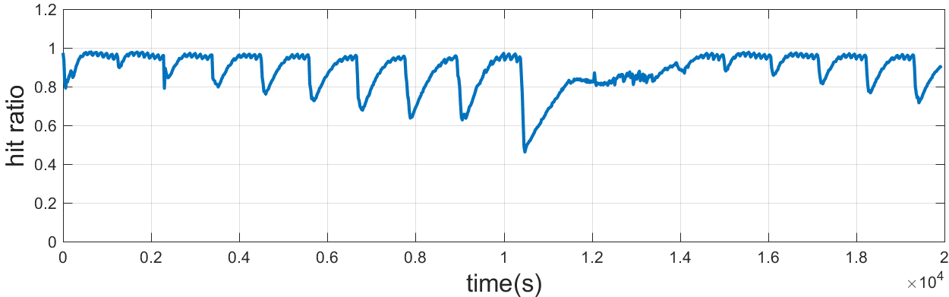
LSM-tree induced cache invalidation
Test on LSM-tree
Writes
Fixed write throughput 1000 writes per second
Reads
RangeHot workload

Slide 37
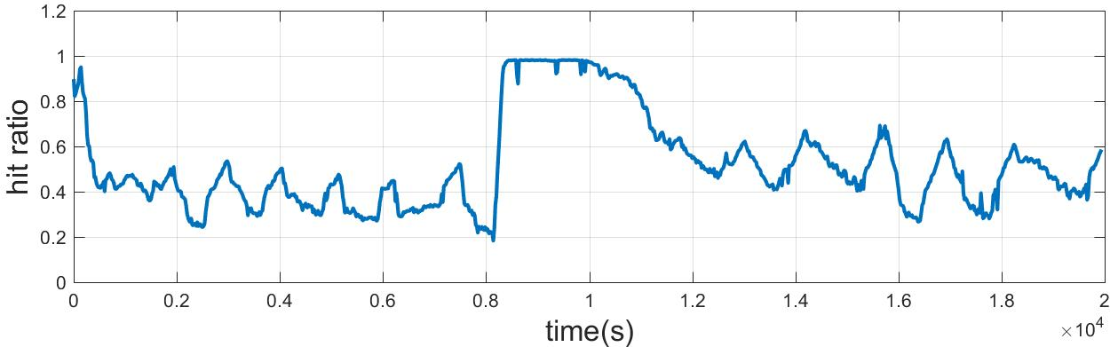
Ineffective of the Dedicated-server solution
Test on LSM-tree with dedicated compaction server
Writes
Fixed write throughput 1000 writes per second
Reads
RangeHot workload

Slide 38
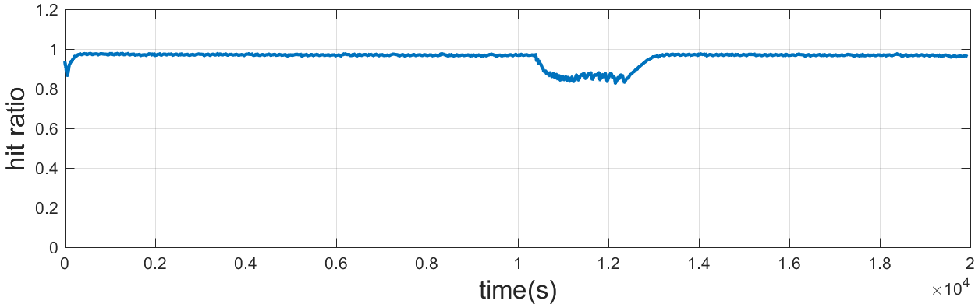
Effectiveness of LSbM-tree
Test on LSbM-tree
Writes
Fixed write throughput 1000 writes per second
Reads
RangeHot workload

Slide 39
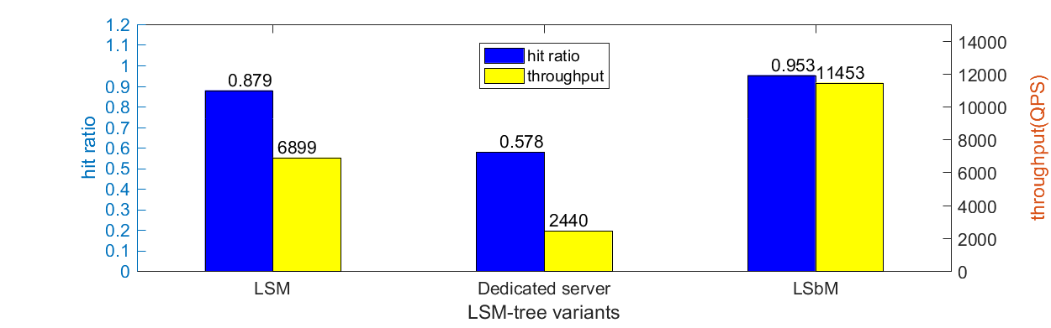
Random access performance
Buffer cache cannot be effectively used by LSM-tree
The Dedicated server solution doesn’t work for RangeHot workload
LSbM-tree effectively re-enables the buffer caching and achieves the best random access performance

Slide 40
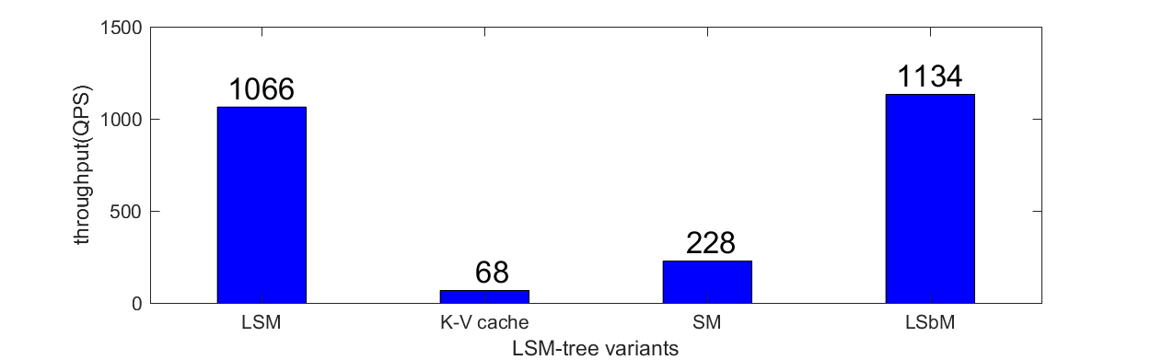
Range query performance
LSM-tree is efficient on range query
Each level is fully sorted
The invalidated disk blocks in cache can be loaded back quickly by range query
Key-Value store cache cannot support fast in-memory range query
SM-tree is inefficient on on-disk range query
LSbM-tree achieves the best range query performance by best utilizing the underlying LSM-tree and the compaction buffer

Slide 41
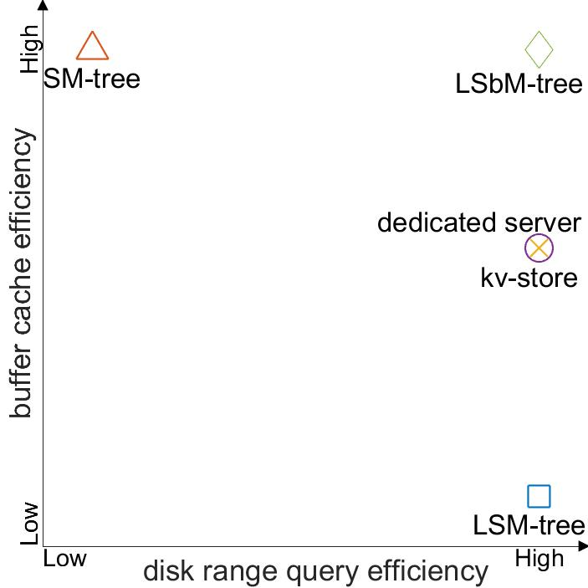
Where are these methods positioned?
high disk range query efficiency
high buffer caching efficiency

Slide 42
Conclusion
LSM-tree is a widely used storage data structure in production systems to maximize the write throughput
LSM-tree induced cache misses happen for workloads of mixed reads and writes
Several solutions have been proposed to address this problem, but raising other issues
LSbM-tree is an effective solution to retain all the merits of LSM-tree but also re-enable buffer caching
LSbM-tree is being implemented and tested in production systems, e.g. Cassandra and LevelDB

Slide 43
Thank you

Slide 44
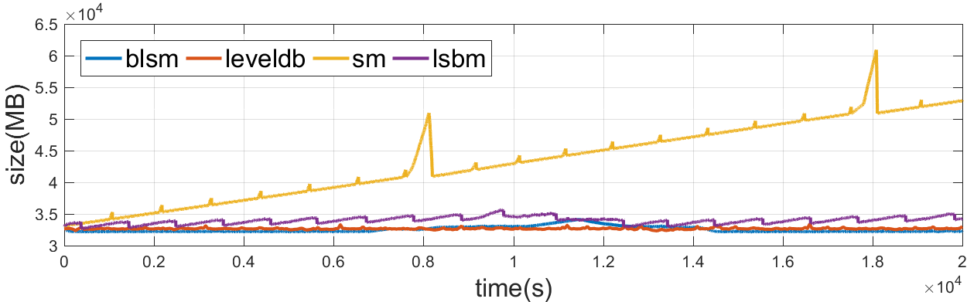
dbsize

Slide 45
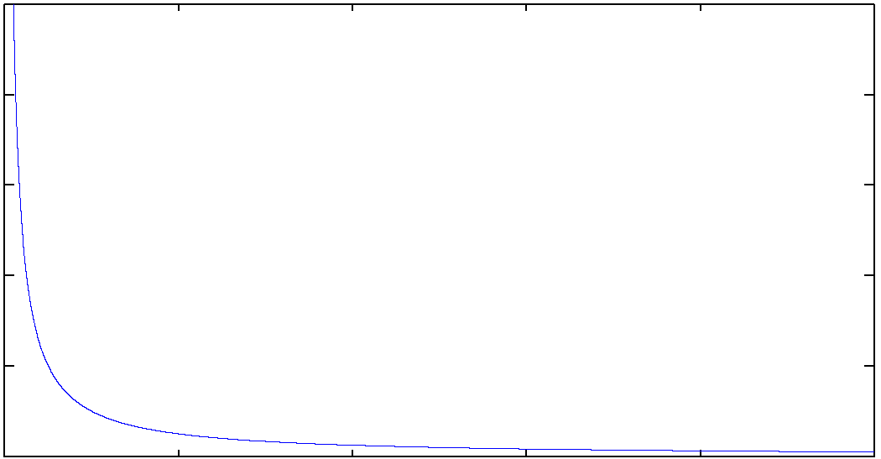
Zipfian workload
20GB
100% read/writes

Slide 46
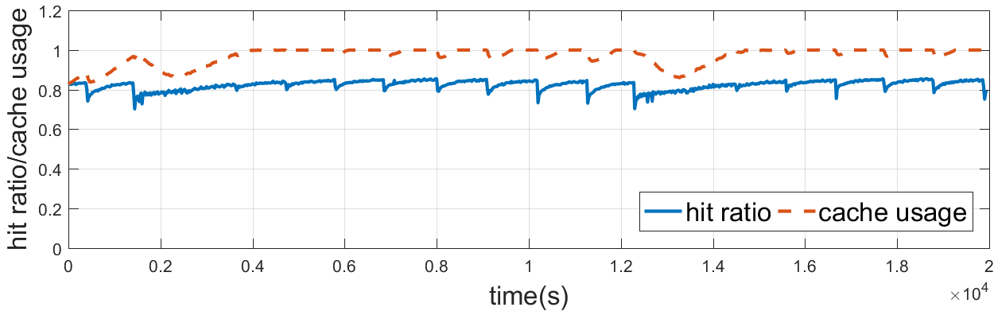
Zipfian workload on bLSM

Slide 47
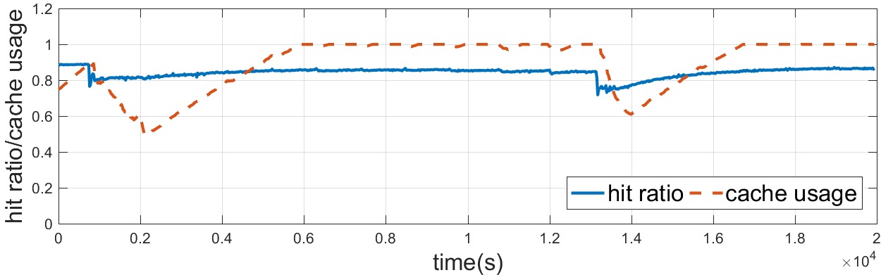
Zipfian workload on LSbM

