Slide 1
Deep Reinforcement Learning using Attention Augmented Agents
CS 172B Project Group 17
Chen Zhang, Litian Liang, Ted Zadouri, Yaosheng Xu, Yilong Huang

Slide 2
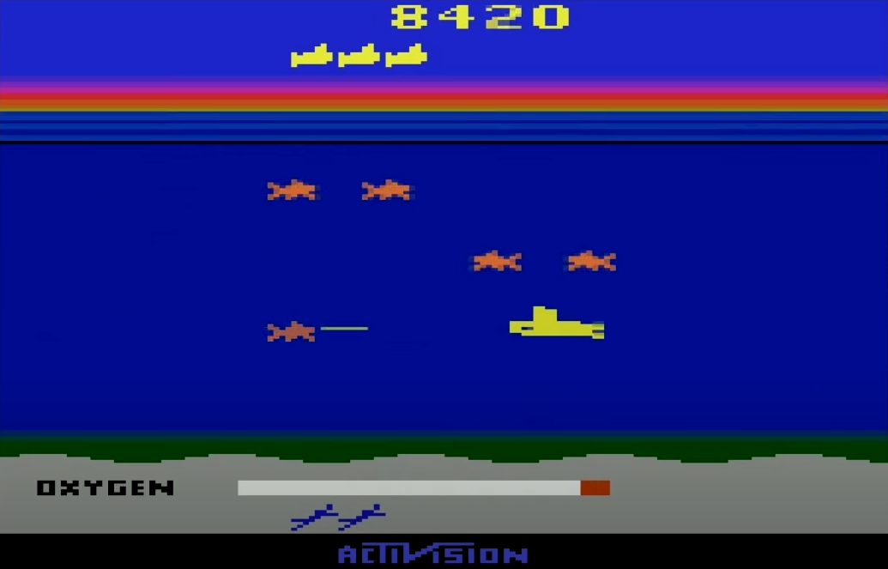
Our Task: learn to play Seaquest (Atari 2600)
Train a Machine Learning Agent play the video game Seaquest
Overview of the problem
Deep Reinforcement Learning Method
Vision Based Policy
Saliency Attention Visualization / Augmentation Techniques
Proposed Models
Model Performance Comparison
Conclusions
Further Improvements

Slide 3
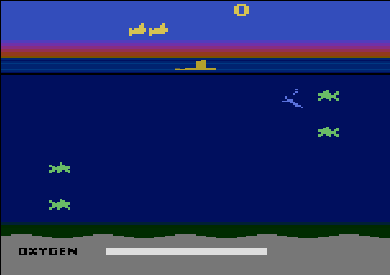

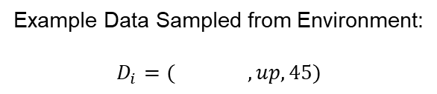
Dataset: Observation Data and Reward Signal
Dataset: $D=\{(s, a, R)\}$
State Observation $s$:
RGB image: 210 x 160 x 3 (uint8 array)
Discrete Action Space: $a∈\{0, 1, …, 17\}$ (which includes up, down, shoot, etc)
Reward: $r\left(s, a\right)∈\text{ℝ}$
Discounted Future Return: $R\left(s,a\right)=\sum_{t^{′}>t}{γ^{t^{′}−t}r(s_{t^{′}},a_{t^{′}})}$
Goal: Maximize Trajectory Undiscounted Total Return
Example Data Sampled from Environment:
$$D_{i}=( , up, 45)$$

Slide 4
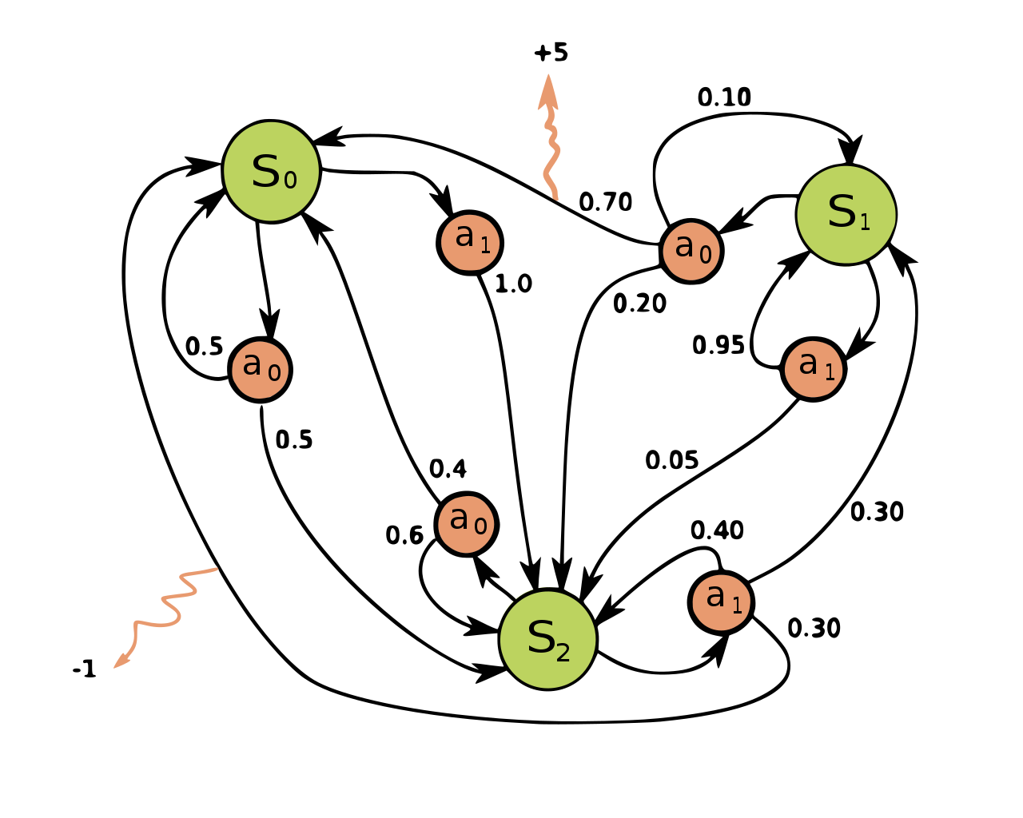
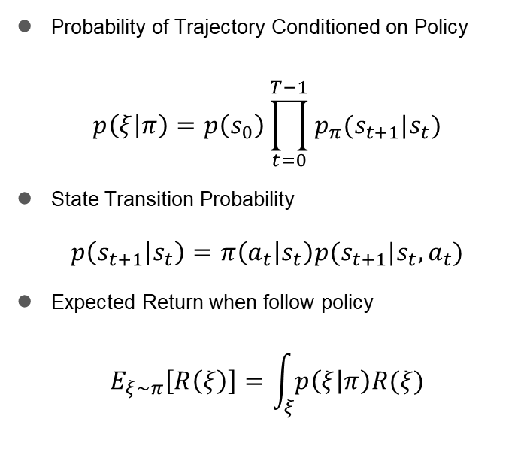
Markov Decision Process (MDP)
Probability of Trajectory Conditioned on Policy
$$p\left(ξ | π\right)=p\left(s_{0}\right)\prod_{t=0}^{T−1}{p_{π}(s_{t+1}|s_{t})}$$
State Transition Probability
$$p\left(s_{t+1} | s_{t}\right)=π\left(a_{t} | s_{t}\right)p(s_{t+1}|s_{t},a_{t})$$
Expected Return when follow policy
$$E_{ξ∼π}\left[R\left(ξ\right)\right]=\int_{ξ}{p\left(ξ | π\right)R(ξ)}$$

Slide 5
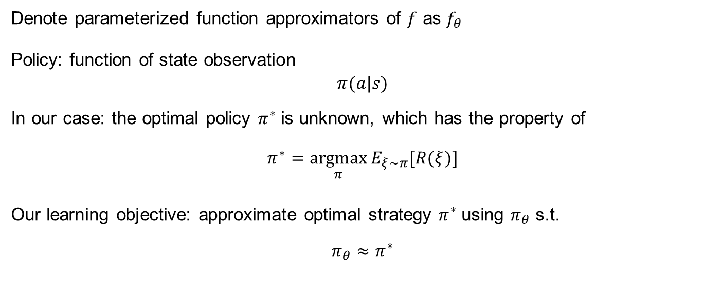
Function Approximation: Deep Neural Network
Denote parameterized function approximators of $f$ as $f_{θ}$
Policy: function of state observation
$$π(a|s)$$
In our case: the optimal policy $π^{∗}$is unknown, which has the property of
$$π^{∗}=\underset{π}{argmax}{E_{ξ∼π}[R(ξ)]}$$
Our learning objective: approximate optimal strategy $π^{∗}$using $π_{θ}$ s.t.
$$π_{θ}≈π^{∗}$$

Slide 6
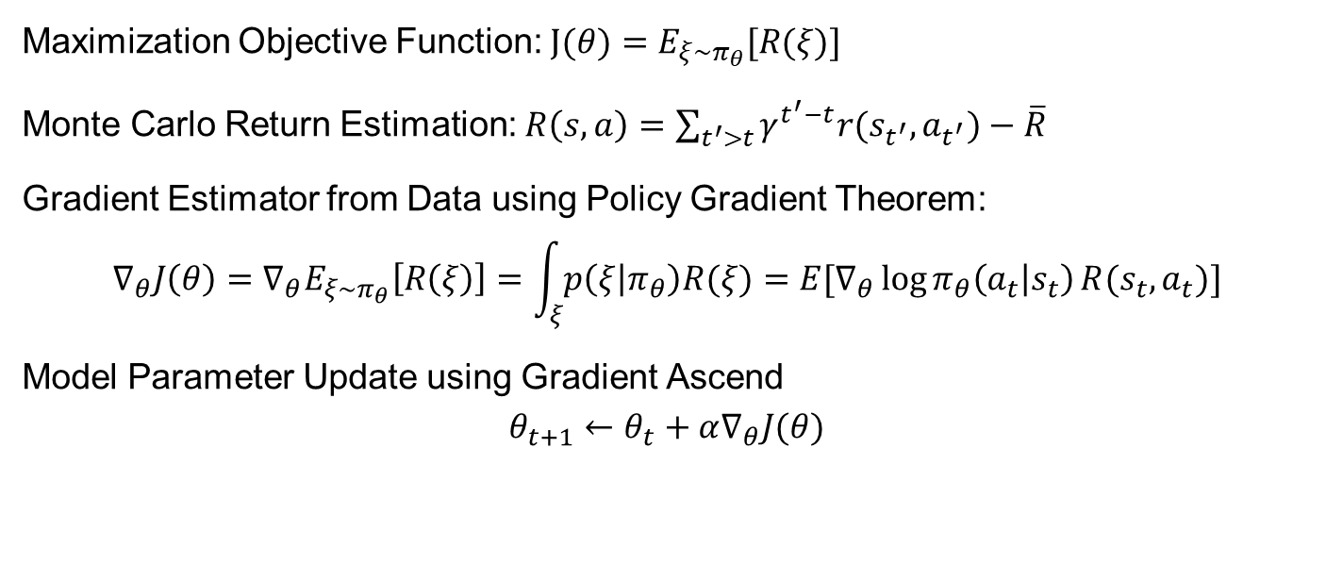
Policy Optimization: Monte Carlo Policy Gradient
Maximization Objective Function: $J(θ)=E_{ξ∼π_{θ}}[R(ξ)]$
Monte Carlo Return Estimation: $R\left(s,a\right)=\sum_{t^{′}>t}{γ^{t^{′}−t}r(s_{t^{′}},a_{t^{′}})}−\overline{R}$
Gradient Estimator from Data using Policy Gradient Theorem:
$$∇_{θ}J\left(θ\right)=∇_{θ}E_{ξ∼π_{θ}}\left[R\left(ξ\right)\right]=\int_{ξ}{p\left(ξ | π_{θ}\right)R(ξ)}=E[∇_{θ}\log{π_{θ}\left(a_{t} | s_{t}\right)}R(s_{t},a_{t})]$$
Model Parameter Update using Gradient Ascend
$$θ_{t+1}←θ_{t}+α∇_{θ}J(θ)$$

Slide 7
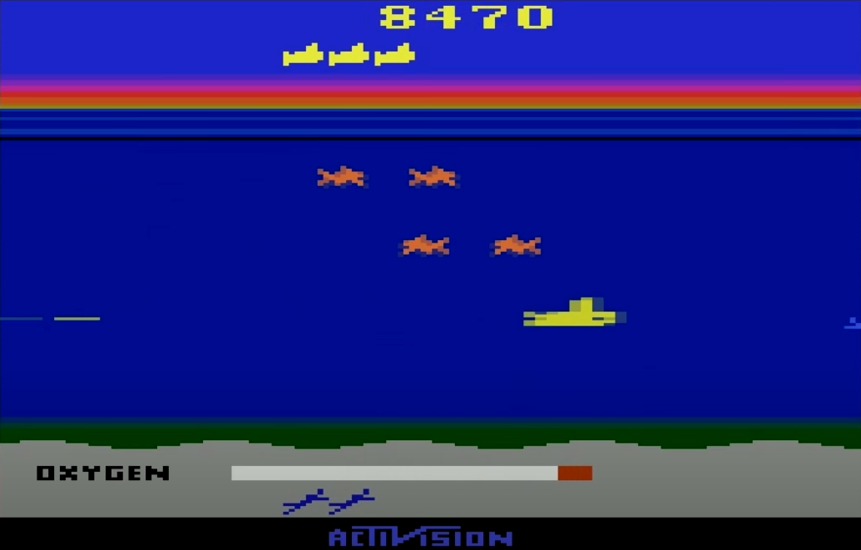
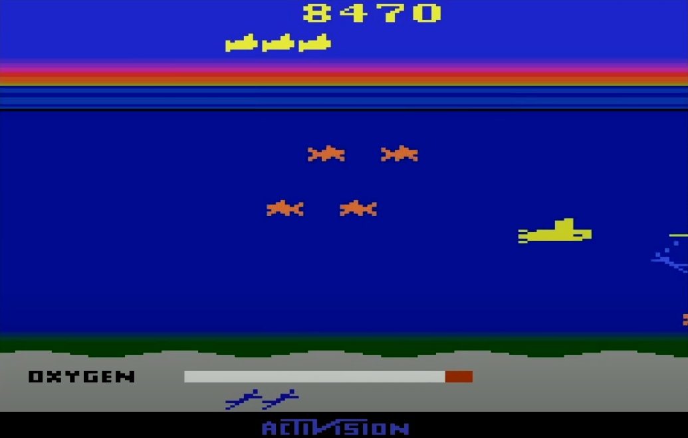
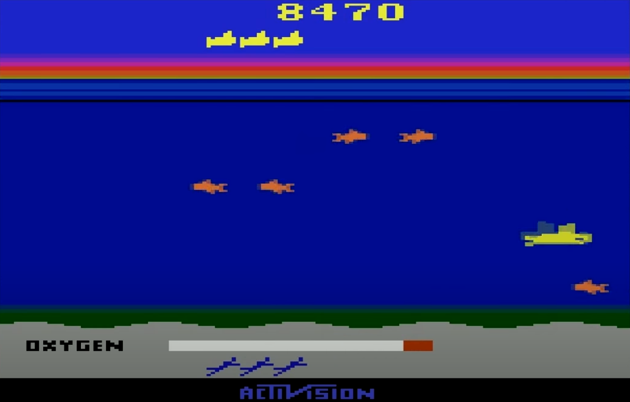
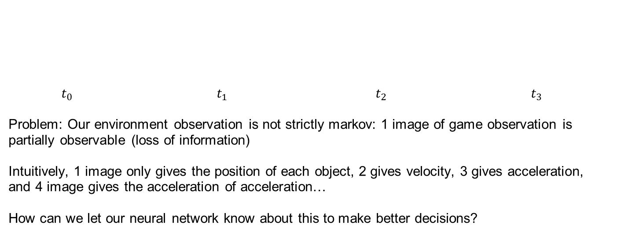
Impact of Partially Observable MDP (POMDP)
$t_{0}$ $t_{1}$ $t_{2}$ $t_{3}$
Problem: Our environment observation is not strictly markov: 1 image of game observation is partially observable (loss of information)
Intuitively, 1 image only gives the position of each object, 2 gives velocity, 3 gives acceleration, and 4 image gives the acceleration of acceleration…
How can we let our neural network know about this to make better decisions?

Slide 8
Impact of Partially Observable MDP (POMDP)
Solutions to Policy Network Structure:
Frame stacking Convolution:
Change input of 1 image to 4 image stacked together, and use Feed Forward Structures
Close, but still partially observable (lose of earlier information)
Convolutional RNNs:
belief of state as model hidden state, belief conditioned action distribution
memory consuming, vanishing gradients

Slide 9
Policy Network Architectures
Feed Forward
Recurrent

Slide 10
Skip connections: Residual Blocks

Slide 11
Studying Vision and Attention: Saliency Maps

Slide 12
Model Baseline and Variants
model name \ properties | Convolutional | Recurrent | Skip connection (residual blocks)
Baseline | √
Resnet-50 | √ |  | √
Attention | √ | √
Res-Attention | √ | √ | √

Slide 13
Model 1: Baseline

Slide 14
Model 2: Resnet-50

Slide 15
Model 3: Attention

Slide 16
Model 4: Resnet-Attention

Slide 17
Model Comparison 1: Performance

Slide 18
Model Comparison 2: Model Interpretability using Saliency

Slide 19
Conclusion

Slide 20
Further Improvements

Slide 21
Thank You
CS 172B Project Group 17
Chen Zhang, Litian Liang, Ted Zadouri, Yaosheng Xu, Yilong Huang

