Slide 1
Deep Reinforcement Learning using Attention Augmented Agents
CS 172B Project Group 17
Chen Zhang, Litian Liang, Ted Zadouri, Yaosheng Xu, Yilong Huang

Slide 2
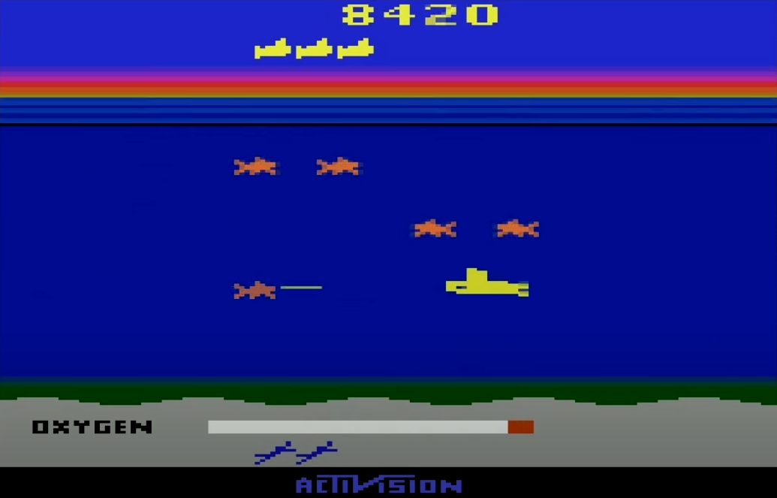
Our Task: learn to play Seaquest (Atari 2600)
High level goal for this project:
Train a Machine Learning Agent play the video game Seaquest and visualize the agent’s attention, or using that for augmentation
Overview of the problem
State of the Art Performance on Seaquest
Deep Reinforcement Learning Method
Vision Based Policy
Saliency Attention Visualization / Augmentation Techniques
Proposed Models
Model Performance Comparison
Conclusions
Further Improvements

Slide 3
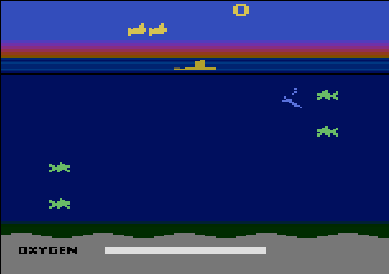

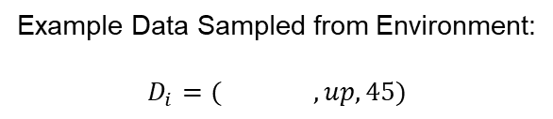
Dataset: Observation Data and Reward Signal
Dataset: $D=\{(s, a, R)\}$
State Observation $s$:
RGB image: 210 x 160 x 3 (uint8 array)
Discrete Action Space: $a∈\{0, 1, …, 17\}$ (which includes up, down, shoot, etc)
Reward: $r\left(s, a\right)∈\text{ℝ}$
Discounted Future Return: $R\left(s,a\right)=\sum_{t^{′}>t}{γ^{t^{′}−t}r(s_{t^{′}},a_{t^{′}})}$
Goal: Maximize Trajectory Undiscounted Total Return
Example Data Sampled from Environment:
$$D_{i}=( , up, 45)$$

Slide 4
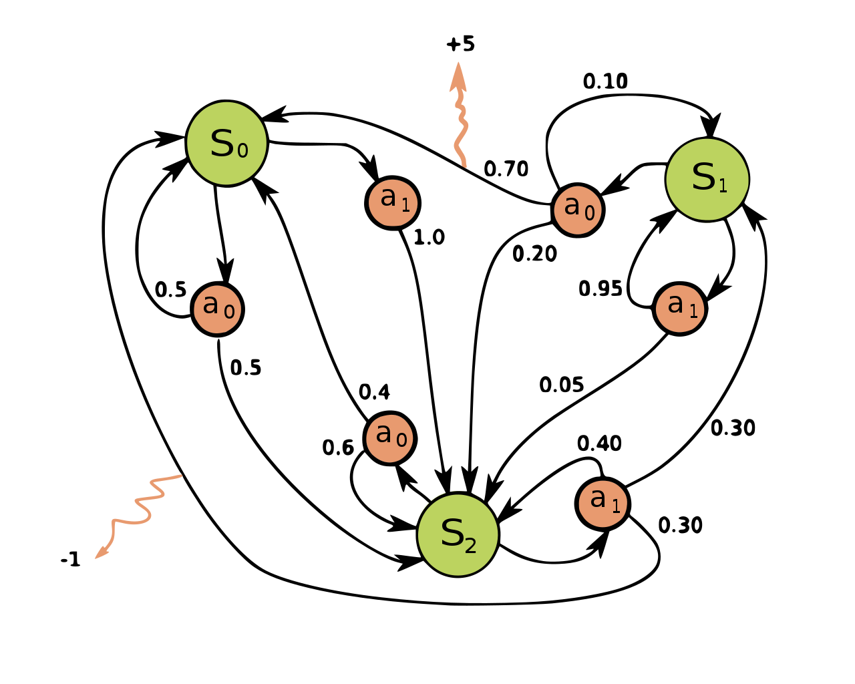
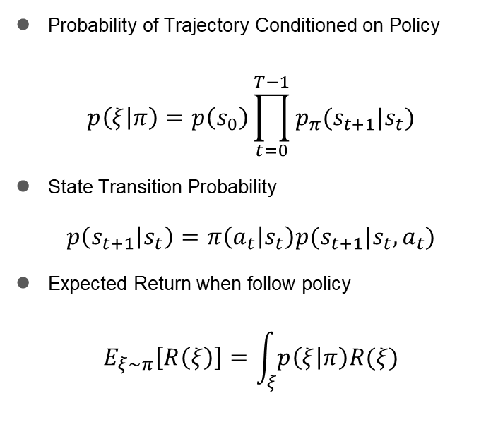
RL Theory: Markov Decision Process (MDP)
Probability of Trajectory Conditioned on Policy
$$p\left(ξ | π\right)=p\left(s_{0}\right)\prod_{t=0}^{T−1}{p_{π}(s_{t+1}|s_{t})}$$
State Transition Probability
$$p\left(s_{t+1} | s_{t}\right)=π\left(a_{t} | s_{t}\right)p(s_{t+1}|s_{t},a_{t})$$
Expected Return when follow policy
$$E_{ξ∼π}\left[R\left(ξ\right)\right]=\int_{ξ}{p\left(ξ | π\right)R(ξ)}$$

Slide 5
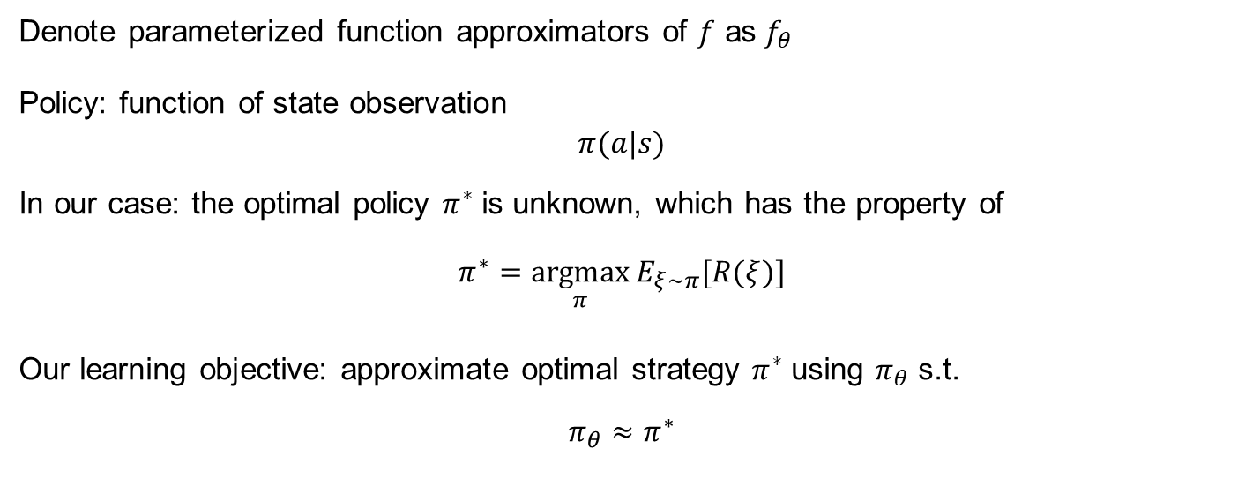
Function Approximation: Deep Neural Network
Denote parameterized function approximators of $f$ as $f_{θ}$
Policy: function of state observation
$$π(a|s)$$
In our case: the optimal policy $π^{∗}$is unknown, which has the property of
$$π^{∗}=\underset{π}{argmax}{E_{ξ∼π}[R(ξ)]}$$
Our learning objective: approximate optimal strategy $π^{∗}$using $π_{θ}$ s.t.
$$π_{θ}≈π^{∗}$$

Slide 6
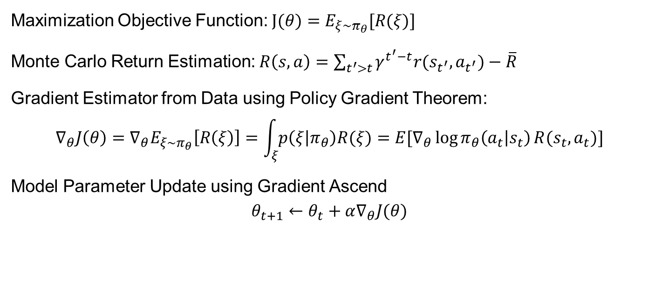
Policy Optimization: Monte Carlo Policy Gradient
Maximization Objective Function: $J(θ)=E_{ξ∼π_{θ}}[R(ξ)]$
Monte Carlo Return Estimation: $R\left(s,a\right)=\sum_{t^{′}>t}{γ^{t^{′}−t}r(s_{t^{′}},a_{t^{′}})}−\overline{R}$
Gradient Estimator from Data using Policy Gradient Theorem:
$$∇_{θ}J\left(θ\right)=∇_{θ}E_{ξ∼π_{θ}}\left[R\left(ξ\right)\right]=\int_{ξ}{p\left(ξ | π_{θ}\right)R(ξ)}=E[∇_{θ}\log{π_{θ}\left(a_{t} | s_{t}\right)}R(s_{t},a_{t})]$$
Model Parameter Update using Gradient Ascend
$$θ_{t+1}←θ_{t}+α∇_{θ}J(θ)$$

Slide 7
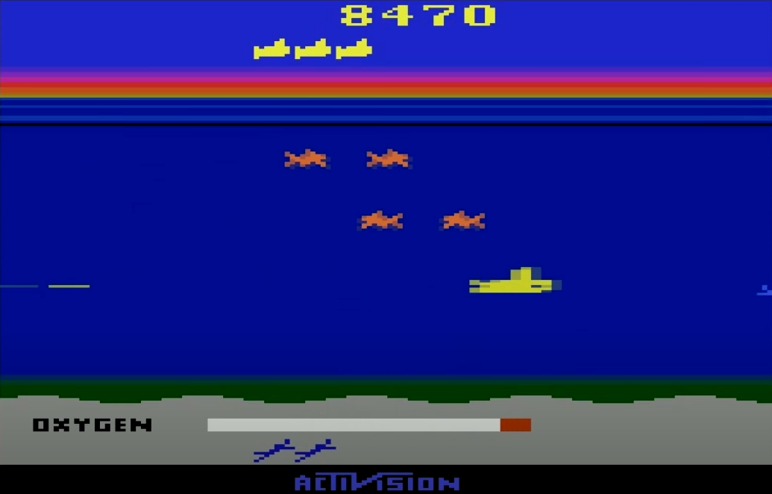
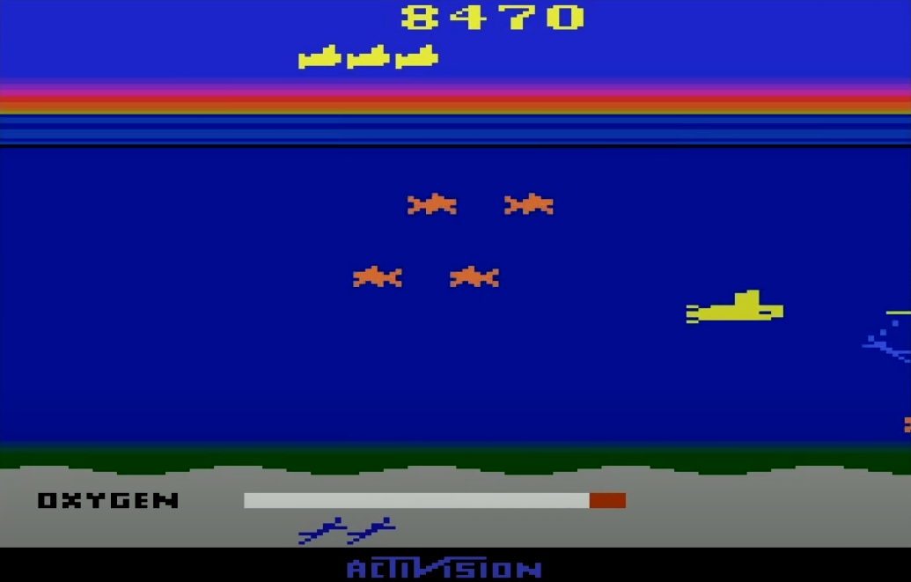
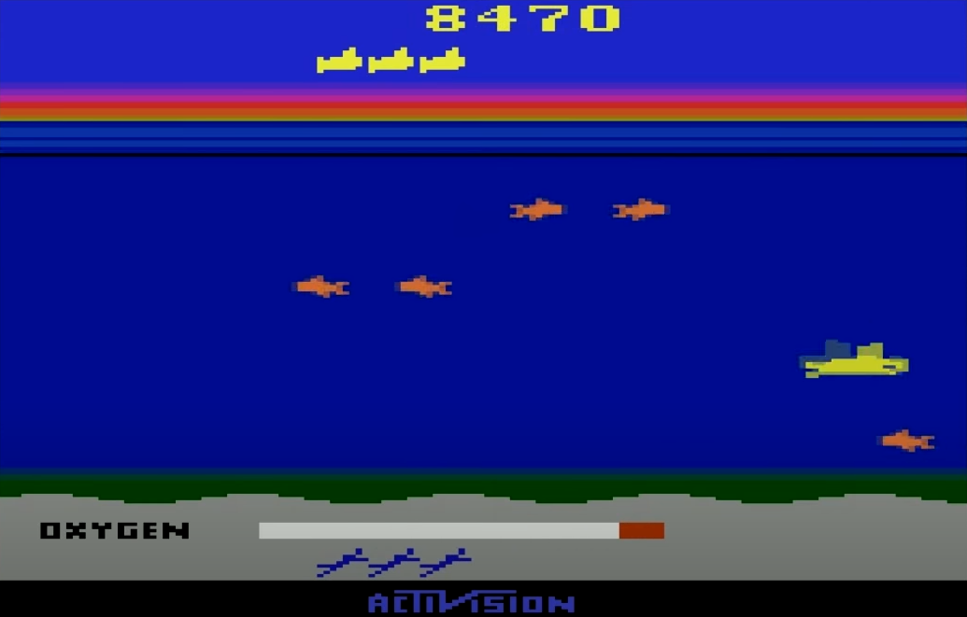
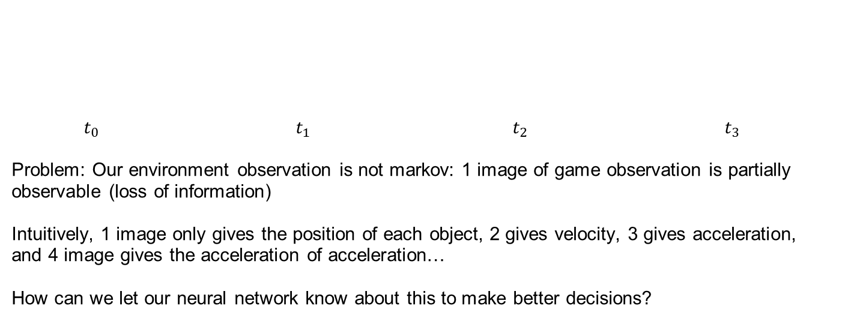
Impact of Partially Observable MDP (POMDP)
$t_{0}$ $t_{1}$ $t_{2}$ $t_{3}$
Problem: Our environment observation is not markov: 1 image of game observation is partially observable (loss of information)
Intuitively, 1 image only gives the position of each object, 2 gives velocity, 3 gives acceleration, and 4 image gives the acceleration of acceleration…
How can we let our neural network know about this to make better decisions?

Slide 8
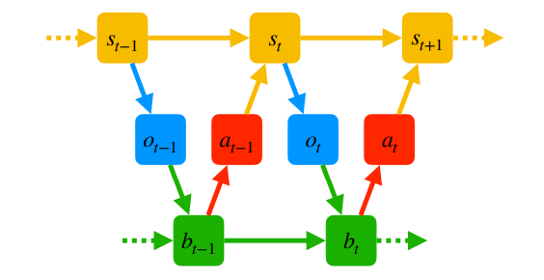
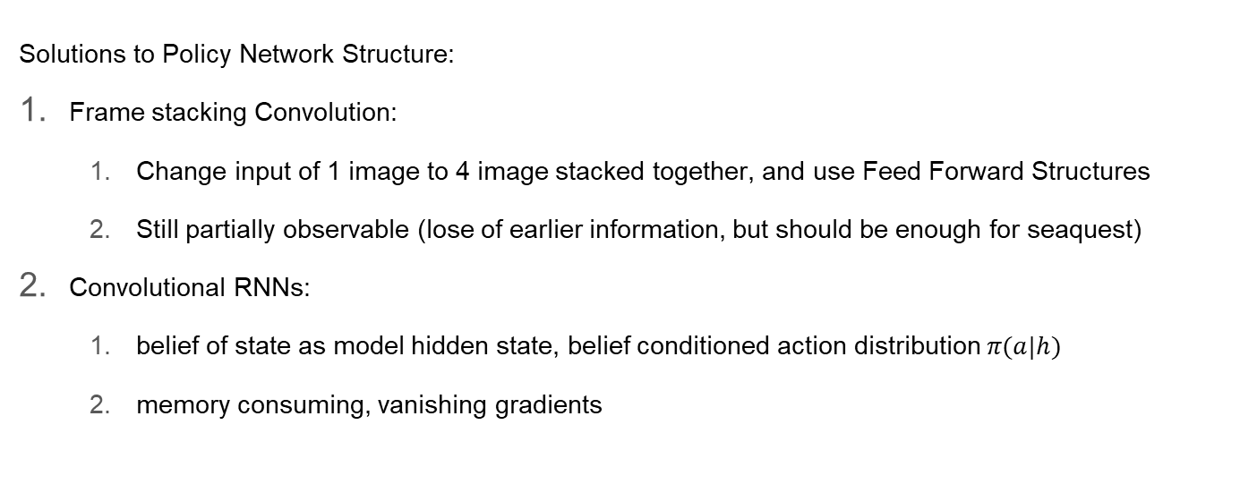
Impact of Partially Observable MDP (POMDP)
Solutions to Policy Network Structure:
Frame stacking Convolution:
Change input of 1 image to 4 image stacked together, and use Feed Forward Structures
Still partially observable (lose of earlier information, but should be enough for seaquest)
Convolutional RNNs:
belief of state as model hidden state, belief conditioned action distribution $π(a|h)$
memory consuming, vanishing gradients

Slide 9
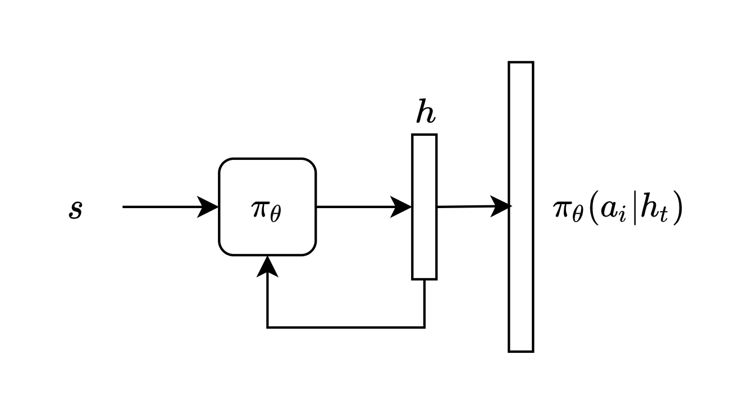
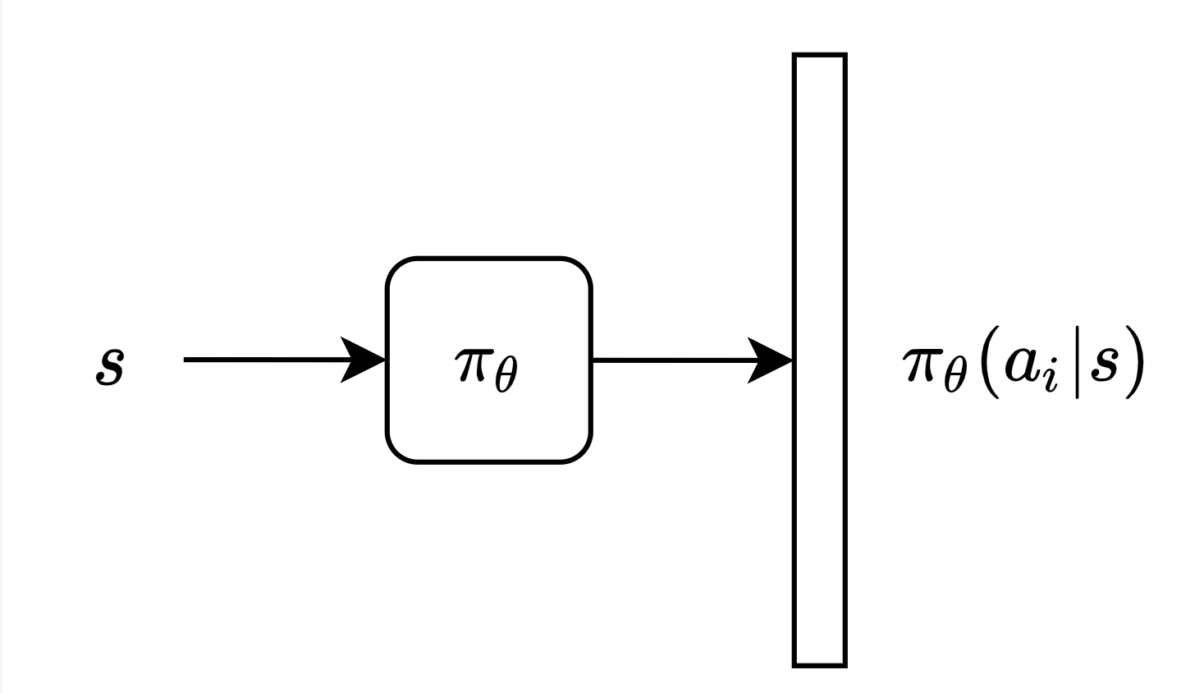


Policy Network Architectures
Feed Forward
Assume 4 stacked image $s$ is Markov
Neural Network as state conditioned policy
Recurrent
$h$ as a belief of actual state distribution
Neural Network as belief conditioned policy

Slide 10
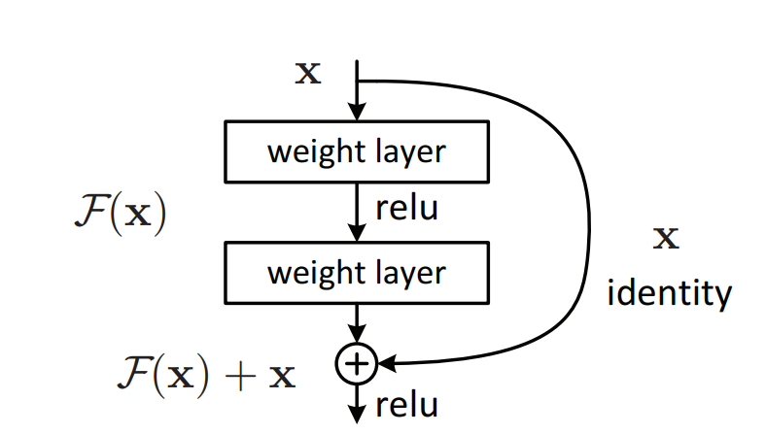
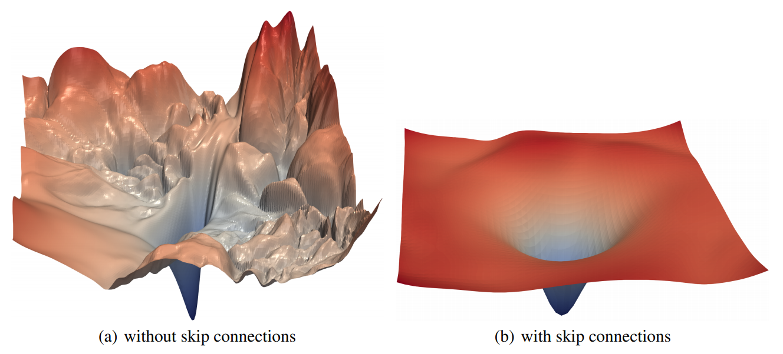
Skip connections: Residual Blocks in Feed Forward Nets
Main Idea: Instead of approximating F(x), let feed forward part approximate F(x) - x
He et. al. Deep Residual Learning for Image Recognition
Li et. al. Visualizing the Loss Landscape of Neural Nets

Slide 11
Studying Vision and Attention: Saliency Maps

Slide 12
Model Baseline and Variants
model name \ properties | Convolutional | Recurrent | Skip connection (residual blocks)
Baseline | √
Resnet-50 | √ |  | √
Attention | √ | √
Res-Attention | √ | √ | √

Slide 13
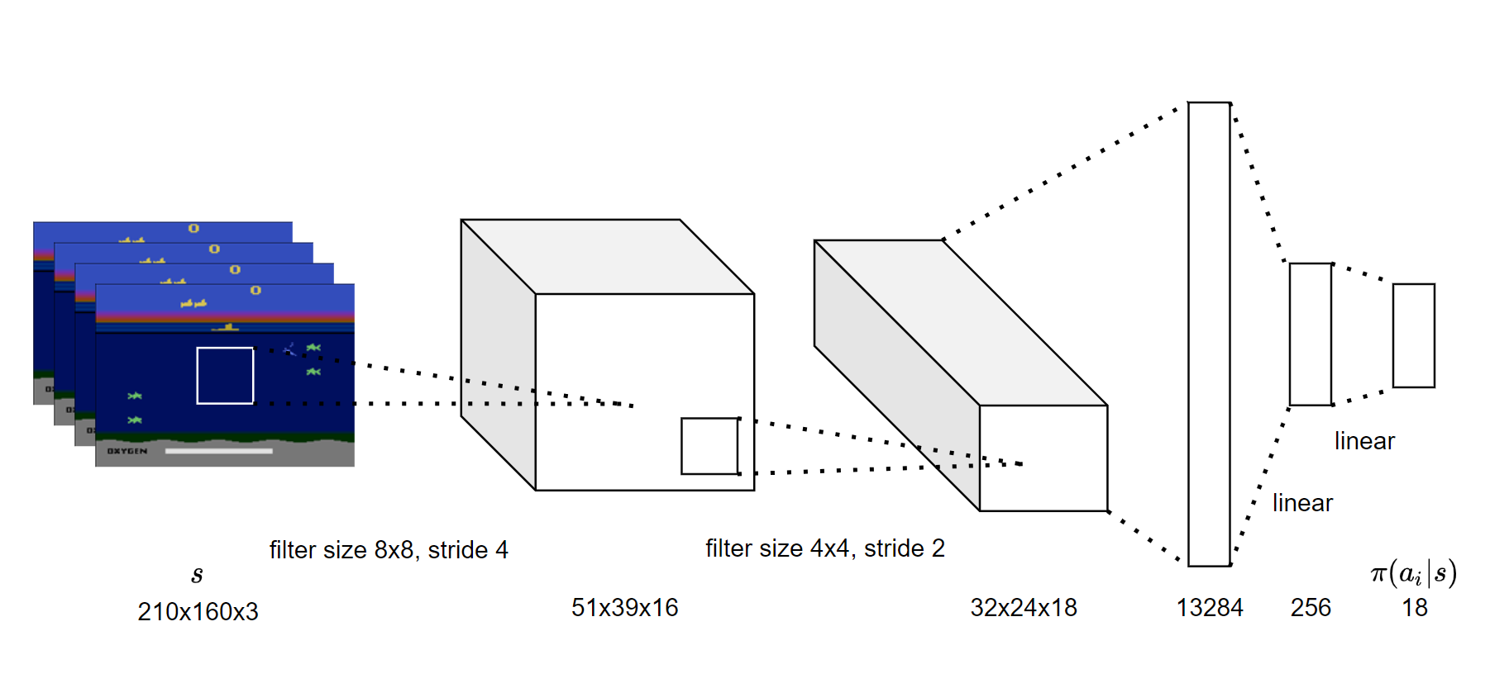
Model 1: Baseline

Slide 14
Model 2: Resnet-50 (Ted’s Model)

Slide 15
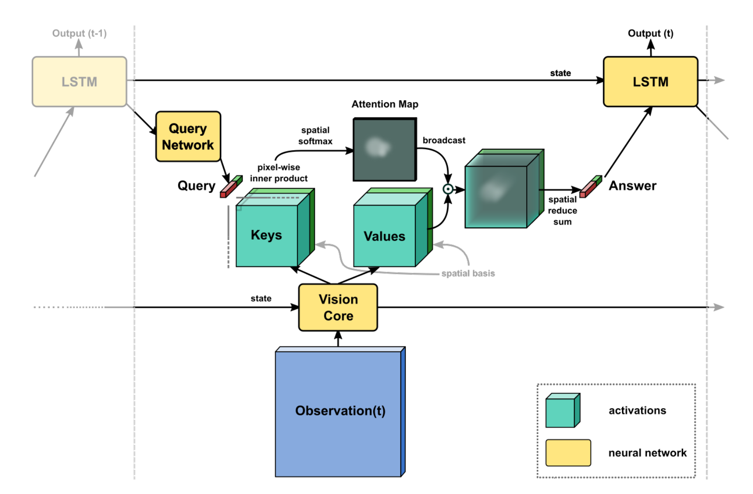
Model 3: Attention (Paper)
Mention paper and author
Show their results
Mott et. al. Towards Interpretable Reinforcement Learning Using Attention Augmented Agents

Slide 16
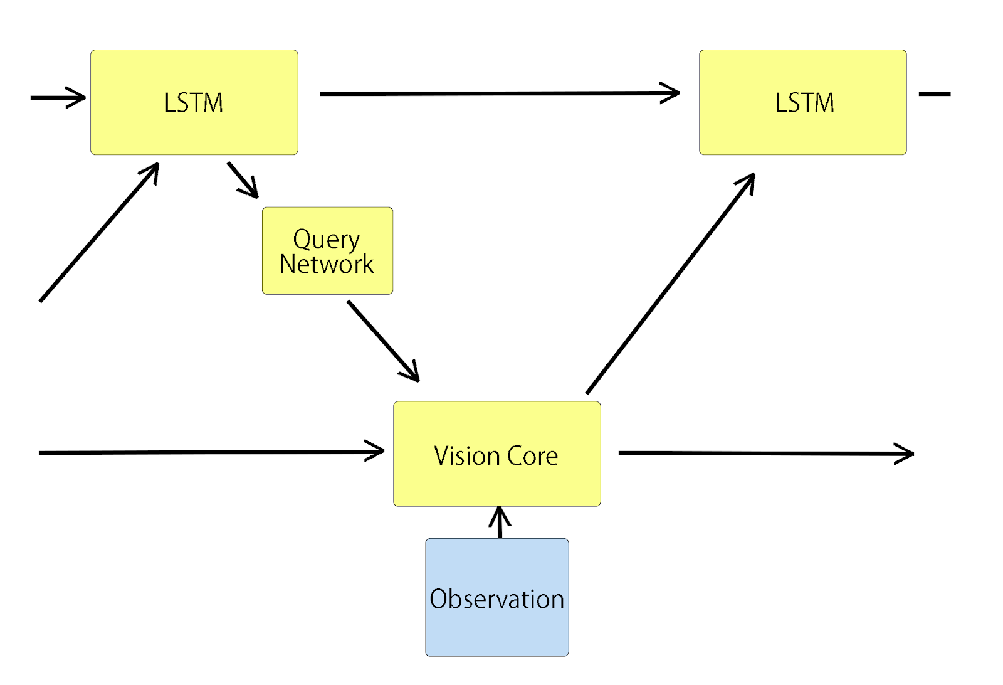
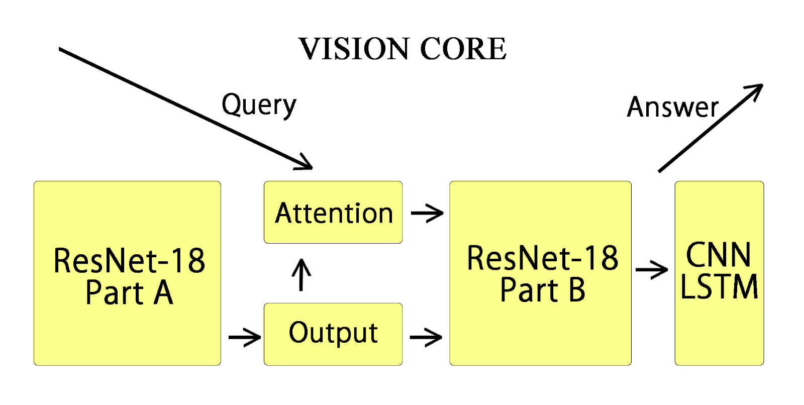
Model 4-1: Resnet-Attention (Chen and Yilong)

Slide 17
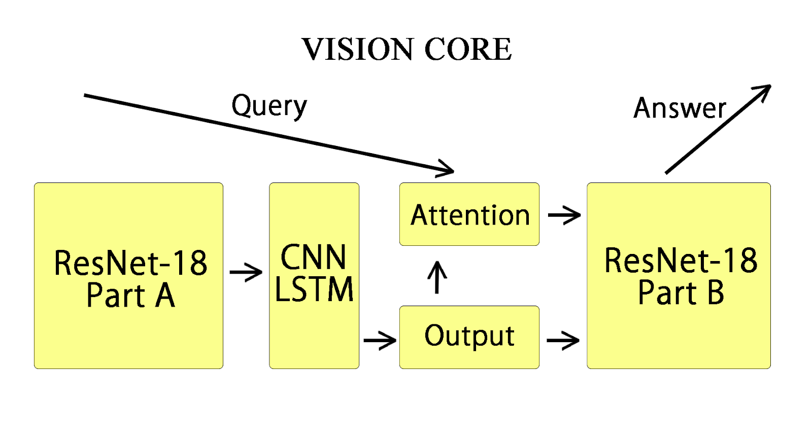
Model 4-2: Resnet-Attention (Chen Zhang and Yilong)

Slide 18
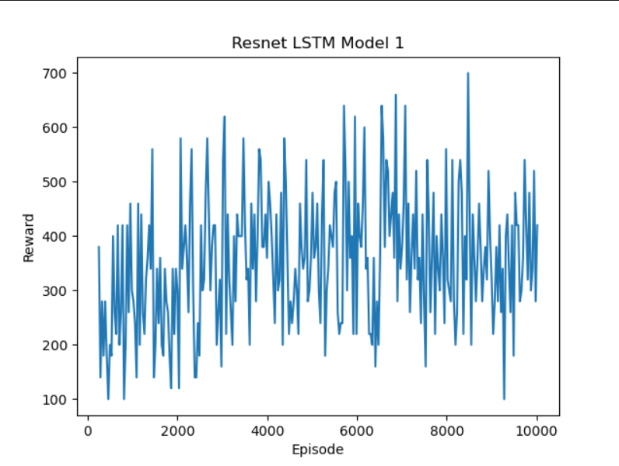
Model Comparison 1: Performance
Baseline | Resnet-50 | Attention | Res-Attention-1 | Res-Attention-2

Slide 19
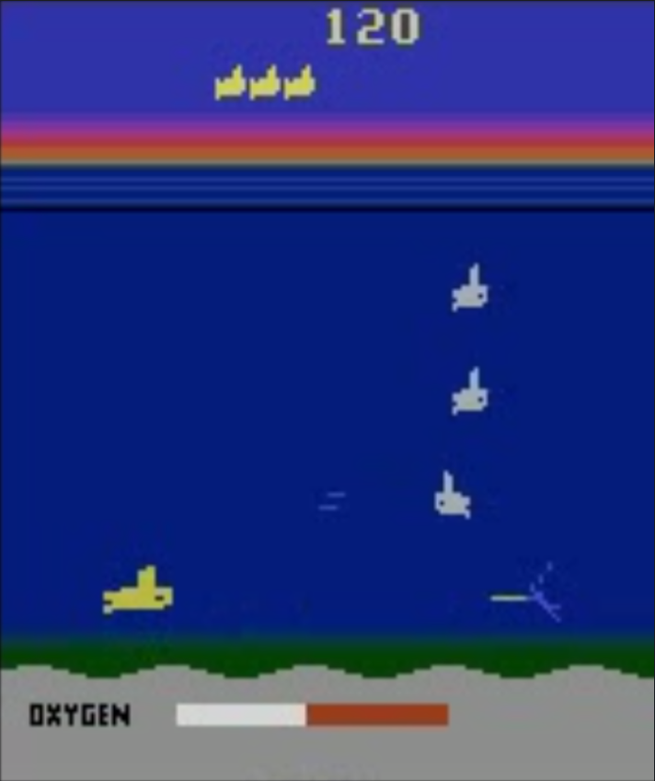
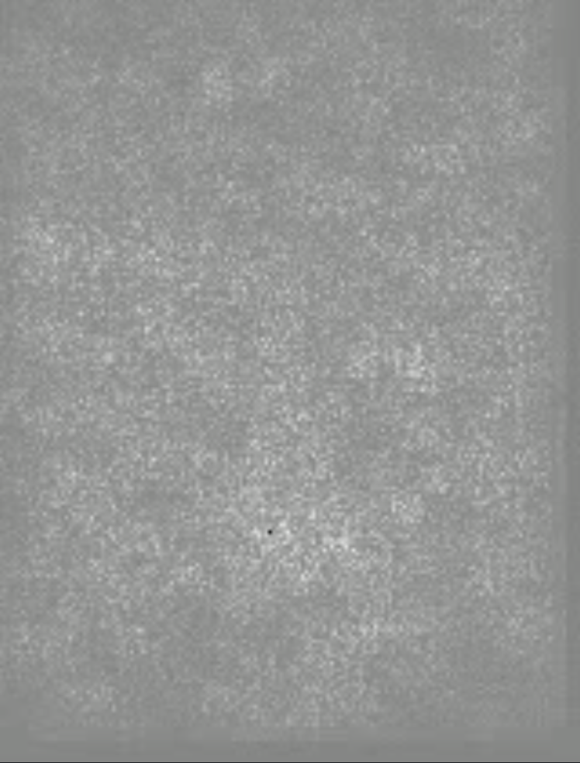
Model Comparison 2: Model Interpretability using Saliency
 | Baseline | Resnet-50 | Attention | Res-Attention-1 | Res-Attention-2
Observation
Attention

Slide 20
Conclusion

Slide 21
Further Improvements
Update the RL Algorithm to Asynchronous Advantage Actor Critic (AC3)
Update the model output to dueling for policy and value prediction
Change the recurrent connection to transformer network

Slide 22
Thank You
CS 172B Project Group 17
Chen Zhang, Litian Liang, Ted Zadouri, Yaosheng Xu, Yilong Huang

