Slide 1
IBM Attrition Data
Steven Nasseri

Slide 2
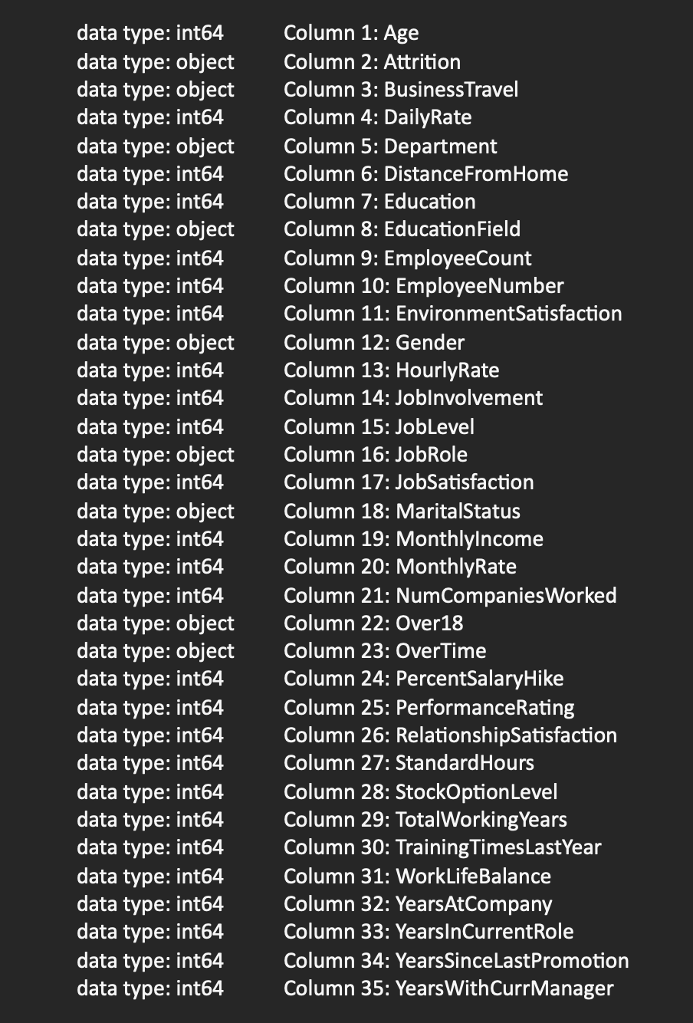
Introduction to the dataset
This dataset was found on Kaggle in CSV format and contains information regarding employee attrition at IBM. It was cleaned from the start, with only a few columns having data type issues.
The main columns we will focus on are:
Attrition
WorkLifeBalence
PercentSalaryHike
Department
Overtime
Python Libraries used
Matplotlib
Seaborn
Pandas

Slide 3

MY GOAL
Educate myself on how to not lose my job
This is it – Climb the ladder and not fall

Slide 4
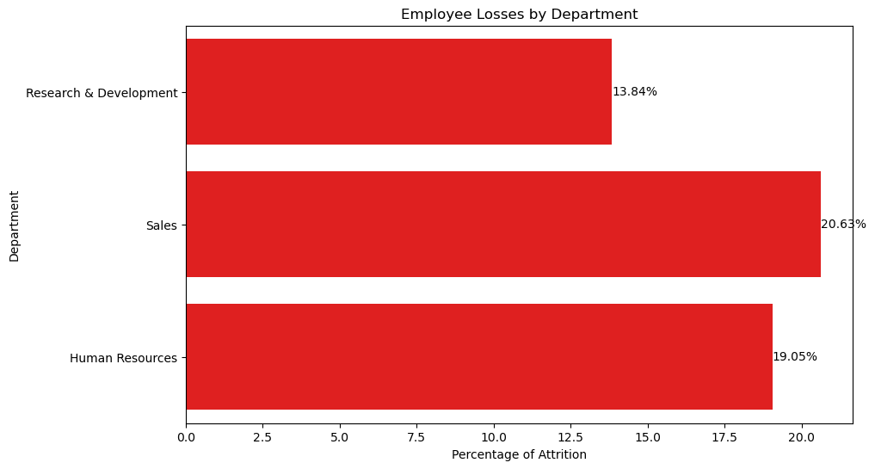
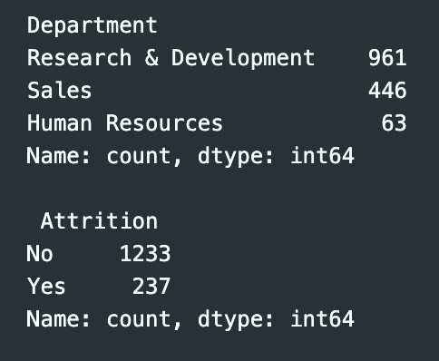
Which department suffered the most losses in employees?

Slide 5
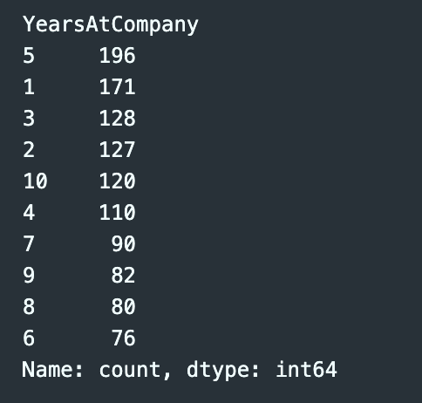
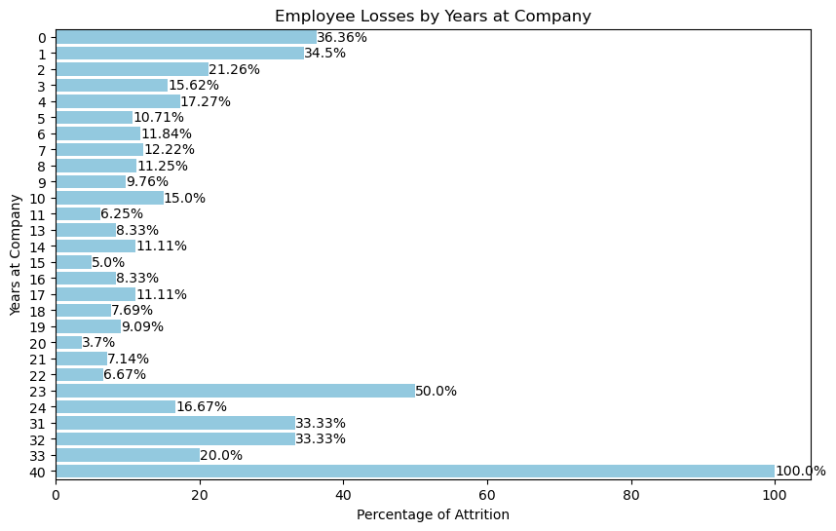
Did People with more years at the company have more security?

Slide 6
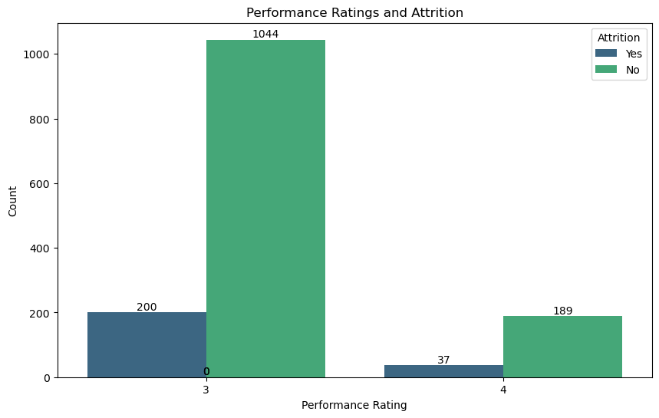
Do the performance ratings directly reflect who gets fired?

Slide 7
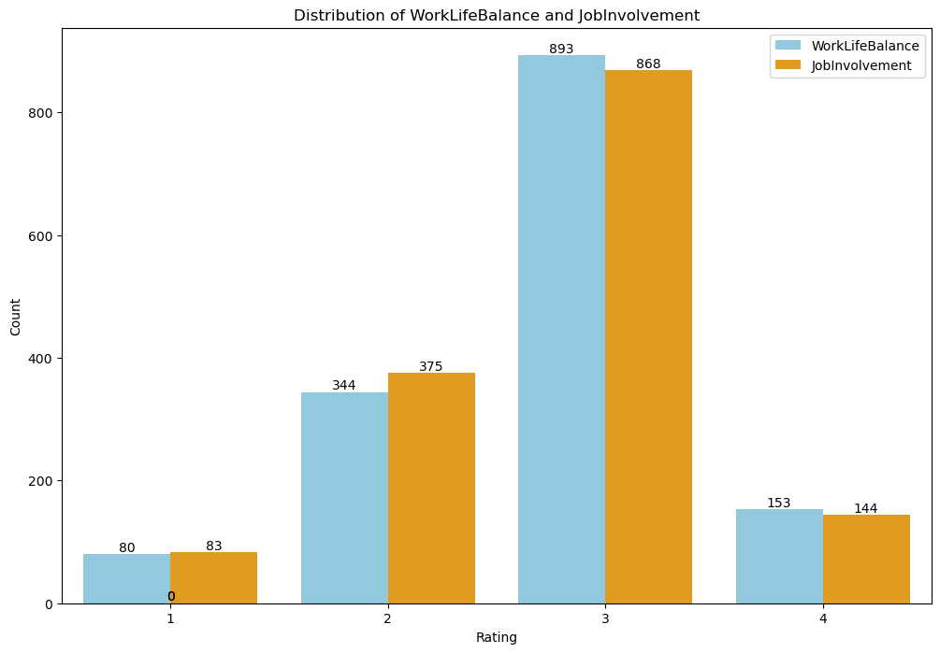
What effect does a good work life balance have on employee effort?

Slide 8
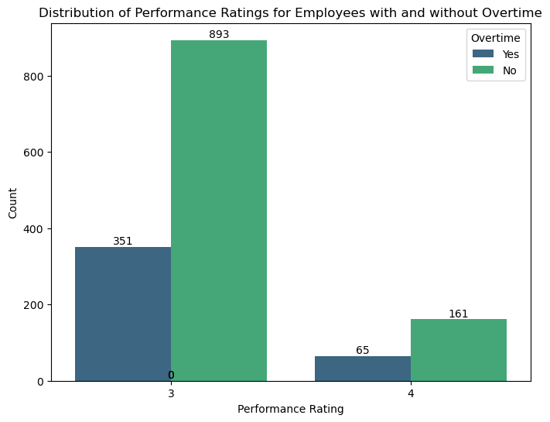
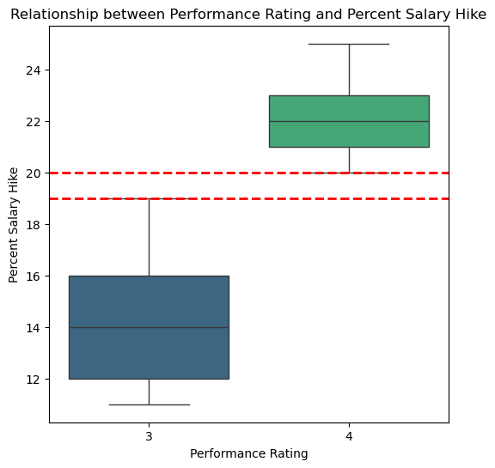
Do employees who work more hours have higher performance ratings? Is this reflected in their pay?

