Slide 1

Virtual Box Installation
Ir Ts Dr Steven Eu Kok Seng

Slide 2


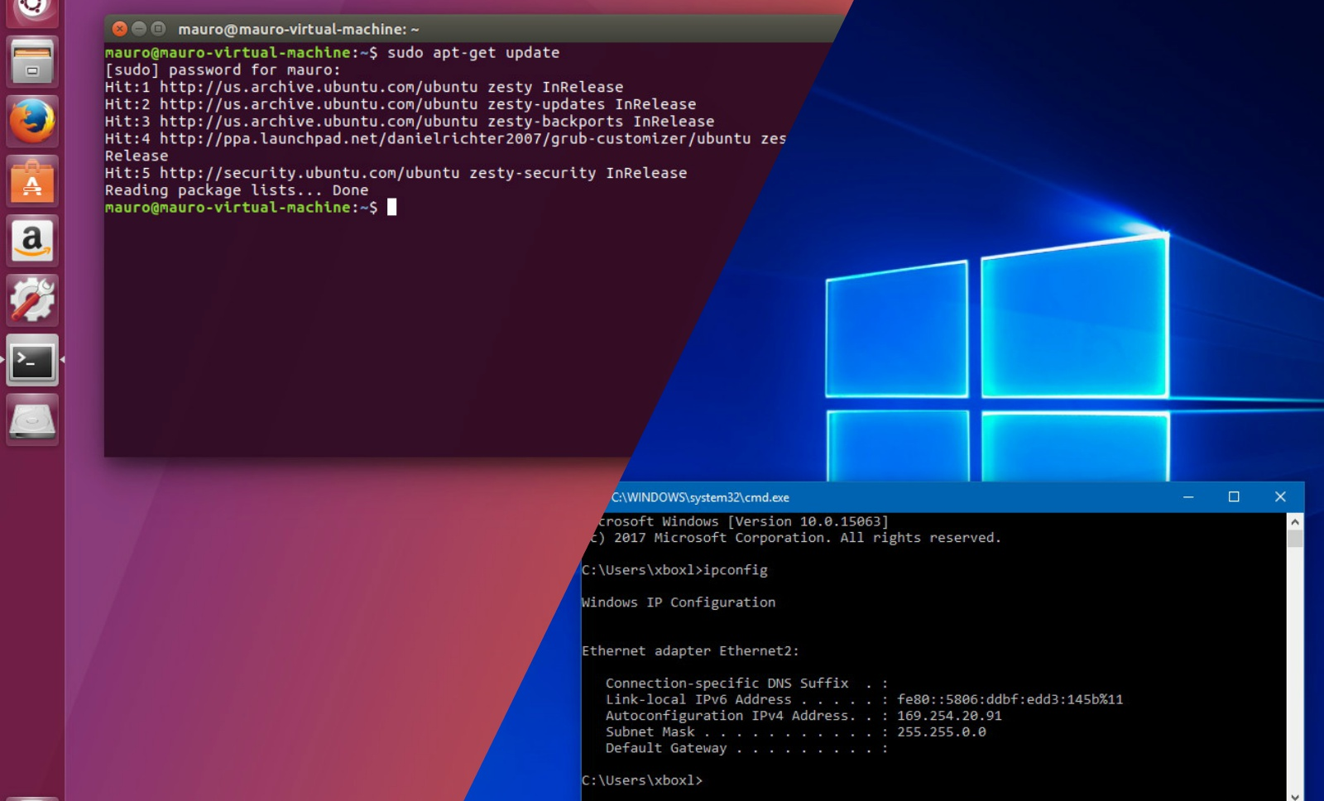
OS Installation
Virtualbox vs Dual boot

Slide 3
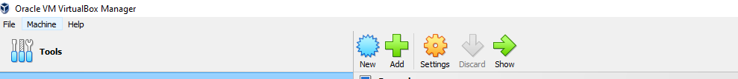
Virtual box

Slide 4
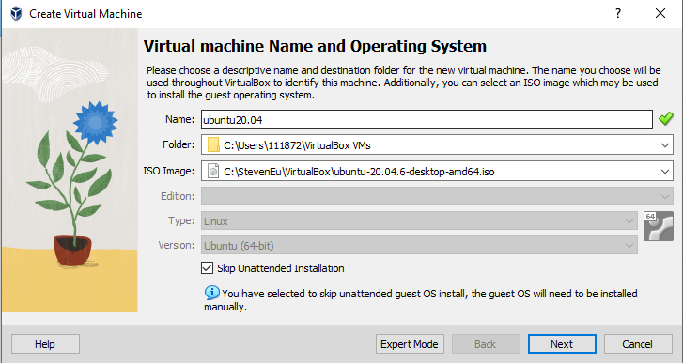
Virtual box

Slide 5
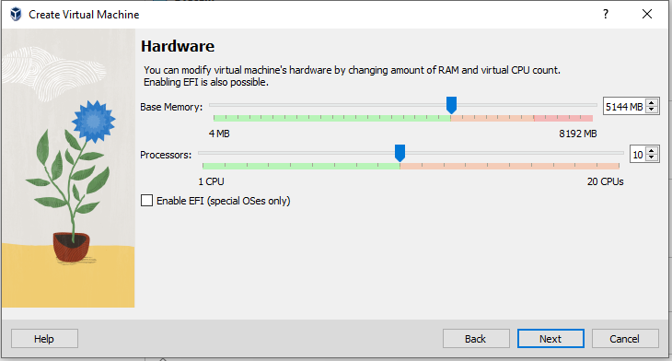
Virtual box

Slide 6
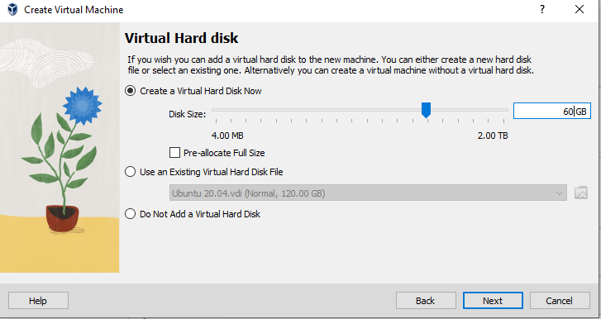
Virtual box

Slide 7
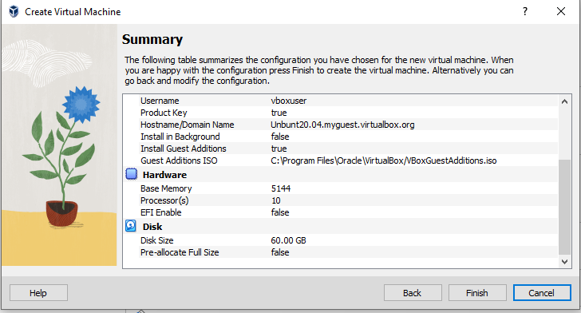
Virtual box

Slide 8
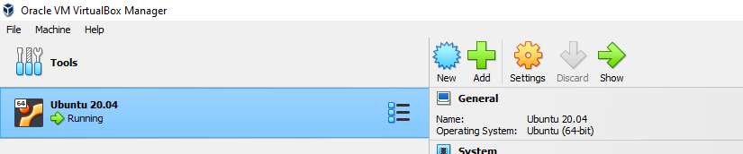
Virtual box

Slide 9
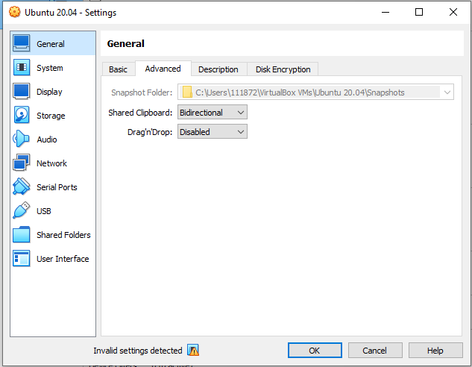
Virtual box

Slide 10
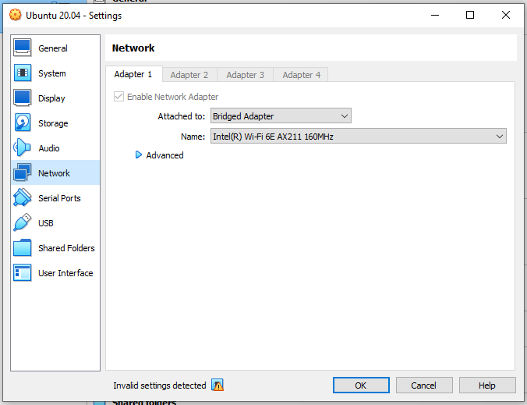
Virtual box

Slide 11
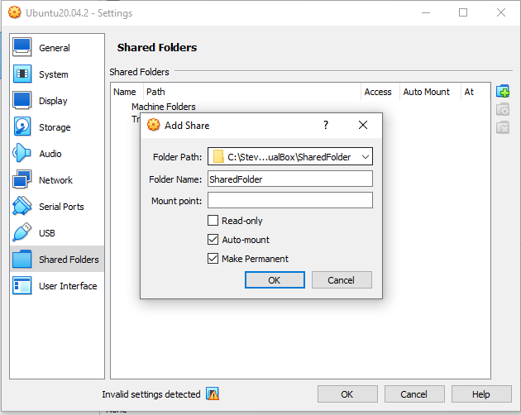
Virtual box

Slide 12
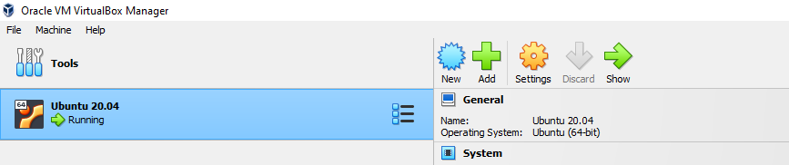
Virtual box

Slide 13
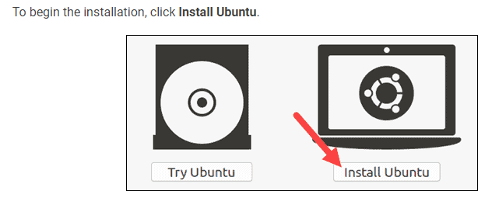
Ubuntu 20.04

Slide 14
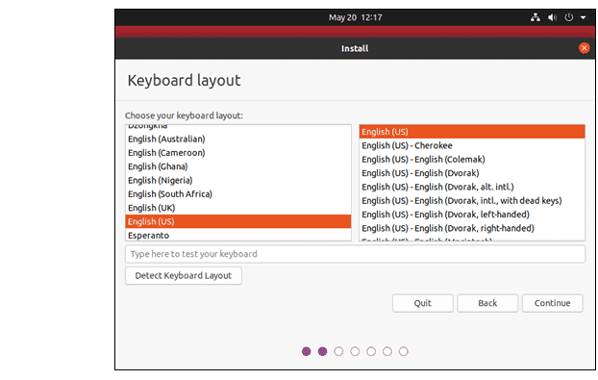
Ubuntu 20.04

Slide 15
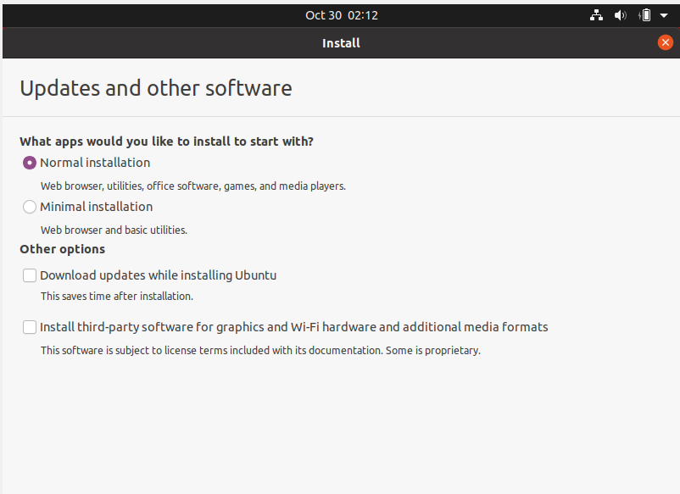
Ubuntu 20.04
uncheck
uncheck

Slide 16
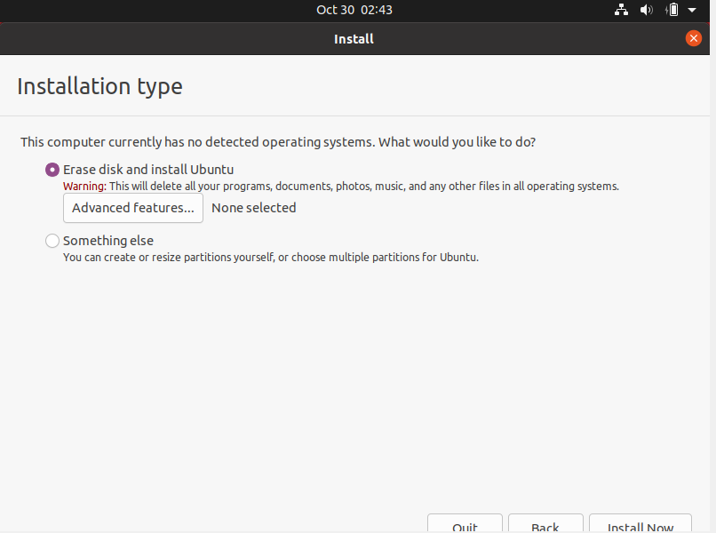
Ubuntu 20.04

Slide 17
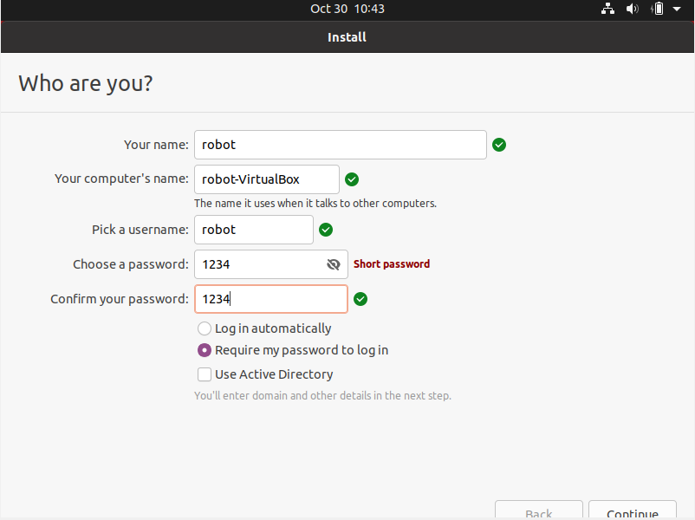
Ubuntu 20.04

Slide 18
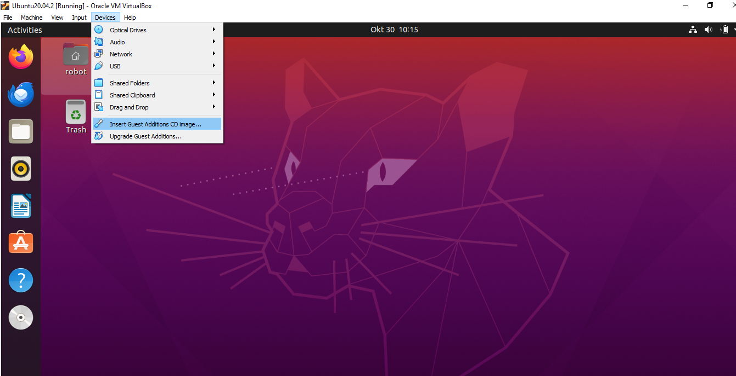
Ubuntu 20.04

Slide 19
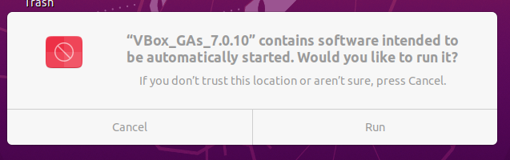
Ubuntu 20.04

Slide 20
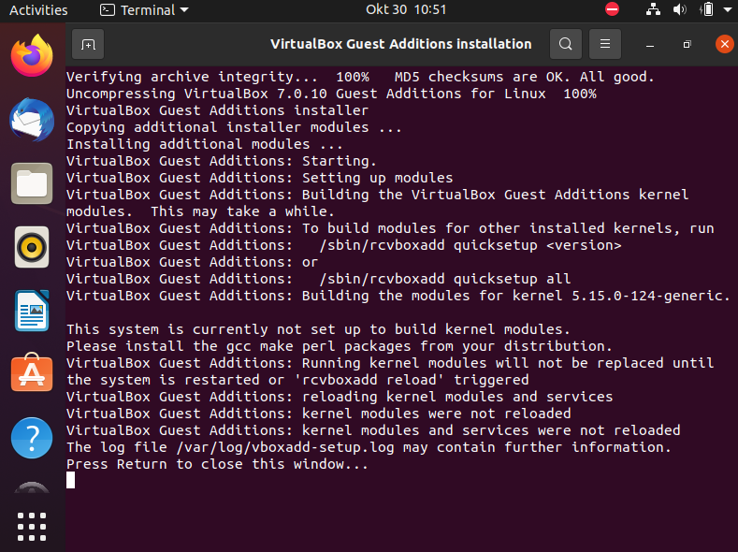
Ubuntu 20.04

Slide 21
Ubuntu 20.04
In a new terminal (ctrl + alt + T) and run:
whoami
sudo adduser <username> vboxsf
sudo reboot

