Slide 1
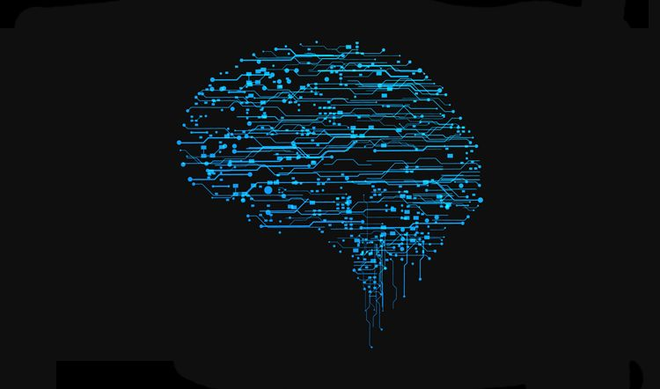
Deep convolutional generative adversarial network
reporter: LIU QUAN
Date: 2020.03.19

Slide 2
CONTENT
CONTENT
1. CelebA Dataset
2. Basic Theory of GAN
3.The Architecture of DCGAN

Slide 3
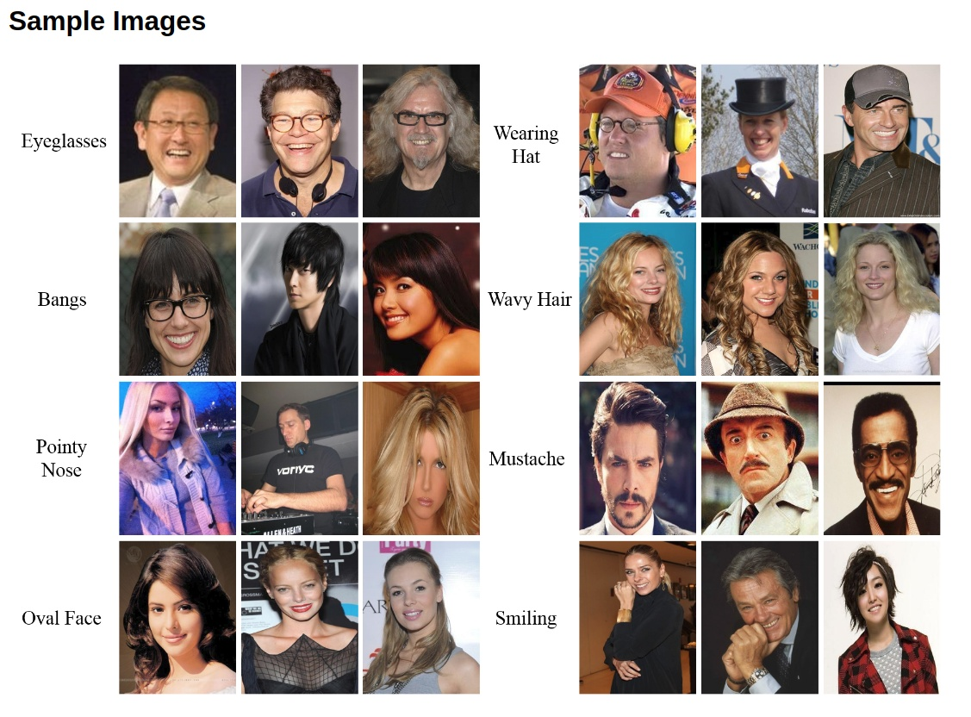
1. CelebA dataset
CelebA is also called CelebFaces Attribute. There are 202,599 faces photos of 10,177 celerities. At the same time, each picture has some feature labels, including bounding box of face, 5 coordinates of the face and 40 attributes annotations. In the attributes annotations, there are some attributes like Bangs, Wearing Hat, Wavy Hair and so on.

Slide 4
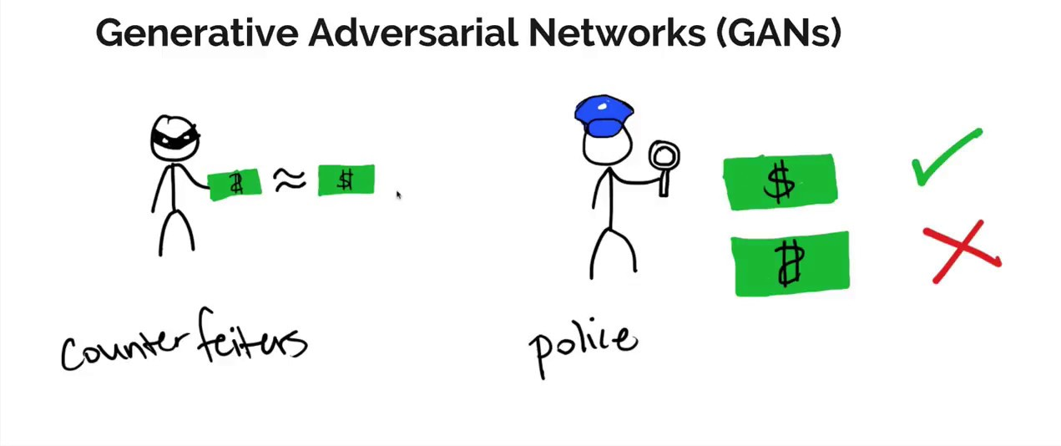
2. Basic Theory of GAN
CHEATING GAME

Slide 5
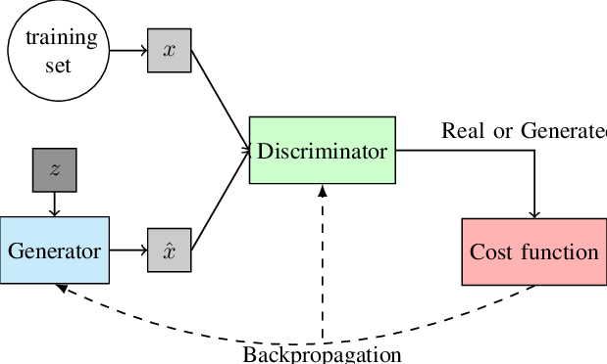
2. Basic Theory of GAN
1. Basic Structure
The GAN mainly consists of 2 neural network——the generator and the discriminator.
2. Loss Function
A Binary Entropy function is used as the loss function in this procedure.
3.Training Procedure
、

Slide 6
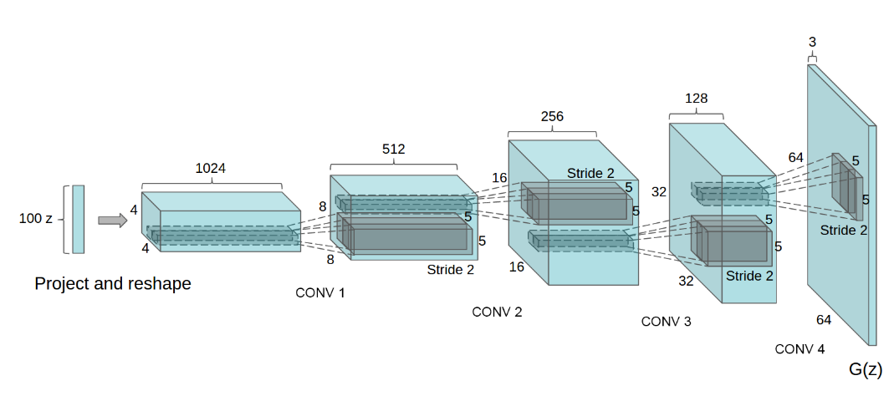
3.The Architecture of DCGAN
1. Generator
Basic Block:
A.Transpose Convolution + BatchNorm + ReLU
B. Transpose Convolution + Tanh
Totally 4 A + B
2. Discriminator
Basic Block:
A. Convolution + Leaky ReLU
B. Convolution + BatchNorm + Leaky ReLU
C. Convolution + Sigmoid
Totally A + 3 B + C
、

Slide 7
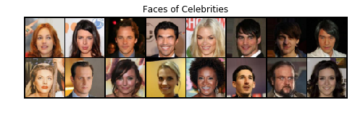
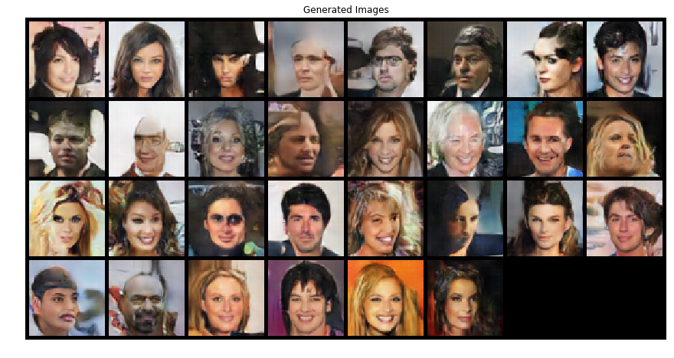
3.The Architecture of DCGAN
3. Procedure
A. Definition of the super parameters:
learning rate = 0.0002
beta1 = 0.5
epochs = 10
batch size = 128
B. Definition of loss function and optimizer:
BCE
AdamOptimizer
、

Slide 8
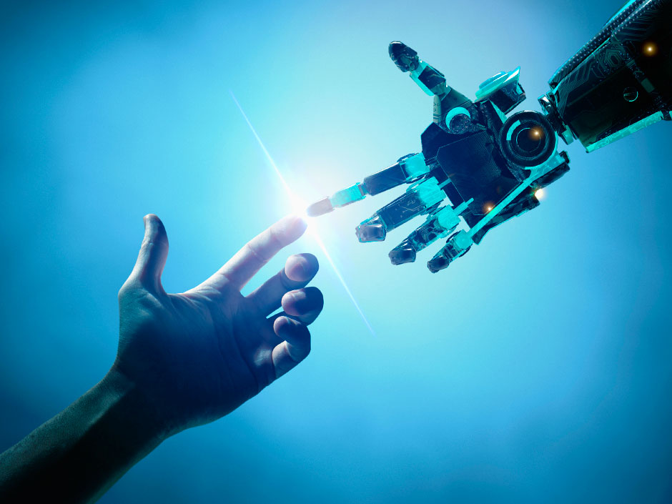
Thank you for your attention https://BLOG.csdn.net/LouisD5Luka

