Slide 1
Assignment 1 Game proposition
ISCG 6442 Game Programming
Steven Bellamy, Aquila Halpé, Jesse Schollitt

Slide 2
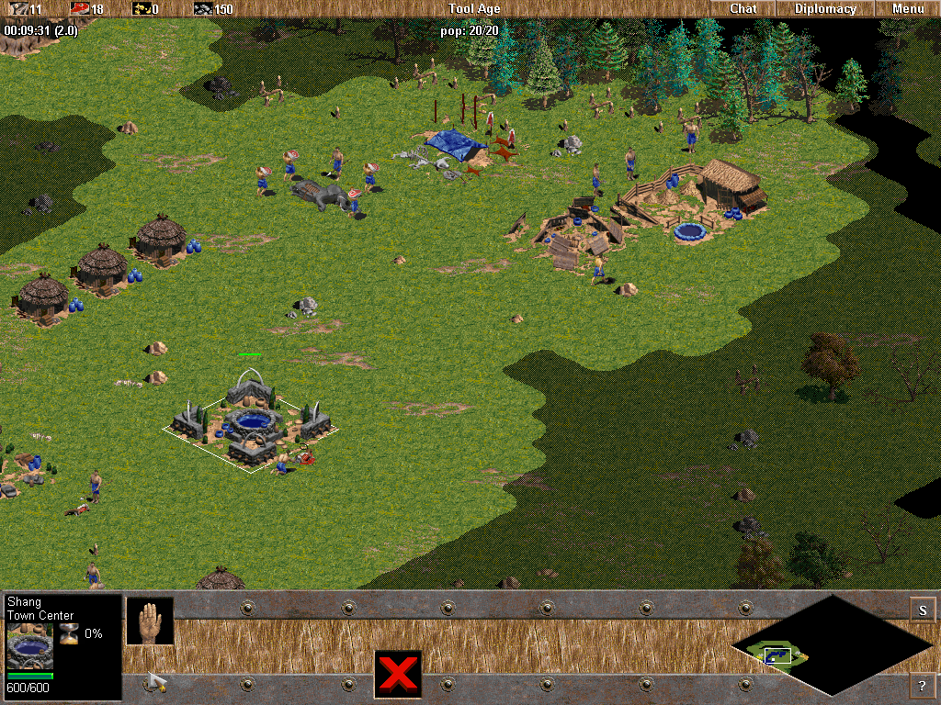
Initial Ideas
Age of Empires style, Real Time Strategy civilisation management.
Isometric view
Mouse based interaction
Hot bar for menus and adjustments
Fog of War map discoverability
Unit grouping (Boids)
Competing against AI civilisation
Far too complicated for the time allocated and our knowledge level

Slide 3
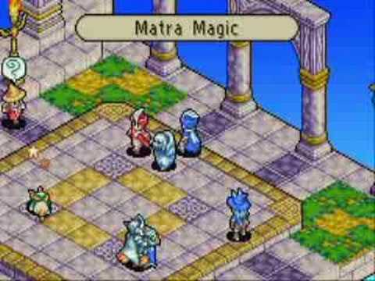
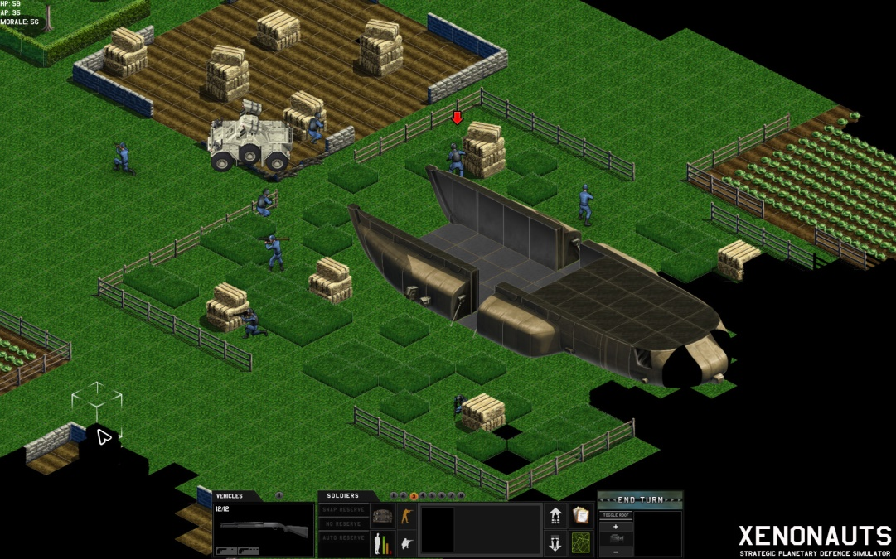
Adjusting Ideas
Look at other games such as X-Com, Xenonauts and Final Fantasy Tactics Advance
Change from RTS to Turn-Based Strategy
Simplify Fog-of-War to a smaller view window of a larger world
Change the sub-genre from civ management to shooter/action
Simplifies hot bar
Reduces the number of units and interactive object types

Slide 4
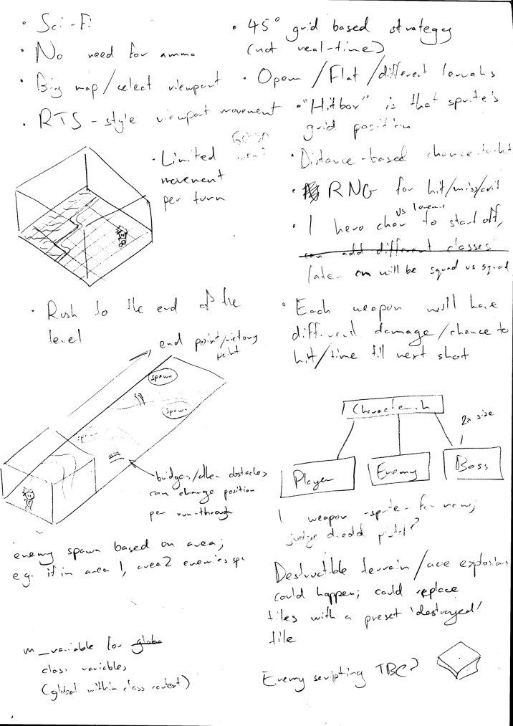
Initial Concept
Sci-Fi, Turn based shooter
Isometric view
Grid map
Open environments, tree obstacles
Rivers separating ‘Zones’, joined by bridges (variable)
Goal: to escape, path is unknown by player
Enemies within each zone
Click to move (A*/BFS pathfinding)
Limited actions per turn
Accuracy based on weapon type, distance and character

Slide 5
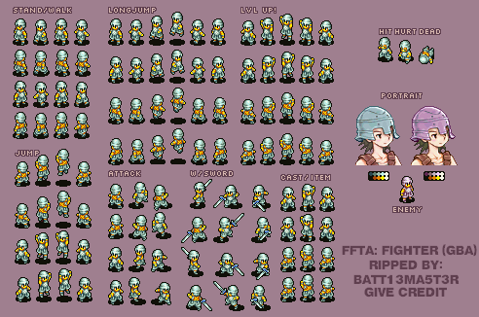
Sprites
Angles need to match the world offset
FFTA sprite sheet as reference for now as this is done in isometric view
Using SFML’s sf::texture and sf::sprite classes for implementation
Using the sprite sheet to the left (modified for implementation) as a placeholder, proper sprite design is secondary so this will be done only if there is extra time after main game logic has been implemented

Slide 6

Character
Information stored in character class/script file
One of three weapons: Pistol, Sniper rifle, Shotgun
Strengths and weaknesses(accuracy, movement, health, etc)
Characters, enemies, bosses will all be under a character class, but subclasses under these will dictate unique parameters

Slide 7
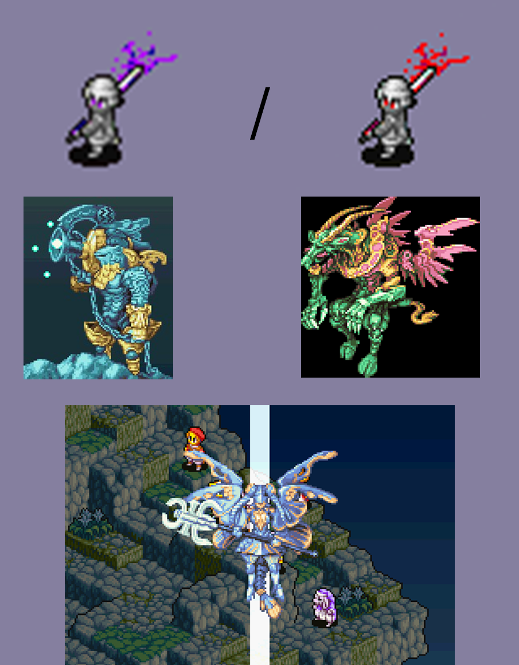
Enemies
Standard enemies and boss enemy
Random accuracy, strength, health, movement (perhaps based on a difficulty setting / variable)
Limited roaming area (zone restricted?)
Etc
Boss enemies could take up double the space on the grid (2x2)
Characters, enemies, bosses will all be under a character class, but subclasses under these will dictate unique parameters

Slide 8
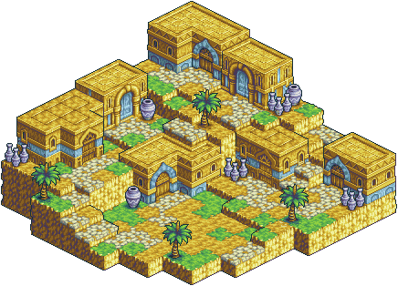
World
Using Tiled for world construction, will be primarily focusing on flat plane level for now
Will implement elevated terrain if there’s time
Will be aiming to implement obstacles and differing terrain types (e.g., ground, bridge, river, out-of-bounds) that have conditional movement.

Slide 9
Pathfinding
Breadth First Search or A* Algorithm
Check each grid location surrounding
Weighted nodes based on distance from finish
If node is an obstacle, close node
Once finish is found, use shortest path
Very efficient and performance friendly
https://www.youtube.com/watch?v=moUOV-zzJ0Q

Slide 10
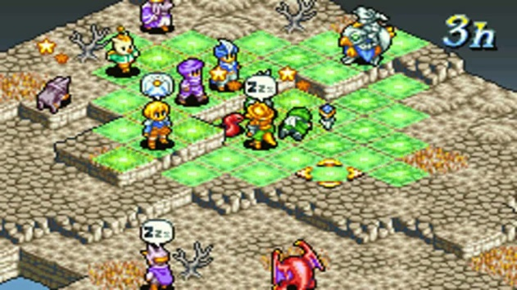
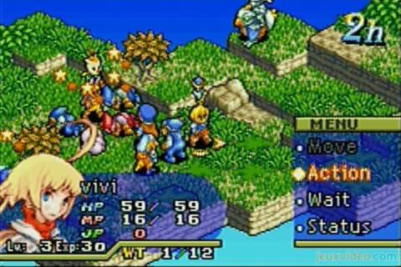
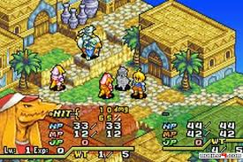
Combat Interaction
Combat done in phases;
Movement phase -> action phase -> RNG phase
After all actions have been decided, the game will run through a sequence that goes in turn and performs actions based on the decisions made and RNG will dictate damage, chance to hit etc.
After this the computer will cycle back to the movement phase for the player who’s first in turn order.
Will likely be implemented using a variable to dictate current phase state, and then while loops will decide what code will be running (what actions are available) during that phase. Minimal actions will be available during the RNG phase (likely just pause ability, if that.)

Slide 11
Isometric View
View rotation
60,30 angle
Angle adjusted sprites
etc

