Slide 1
Assignment 1 Game proposition
ISCG 6442 Game Programming
Steven Bellamy, Aquila Halpé, Jesse Schollitt

Slide 2
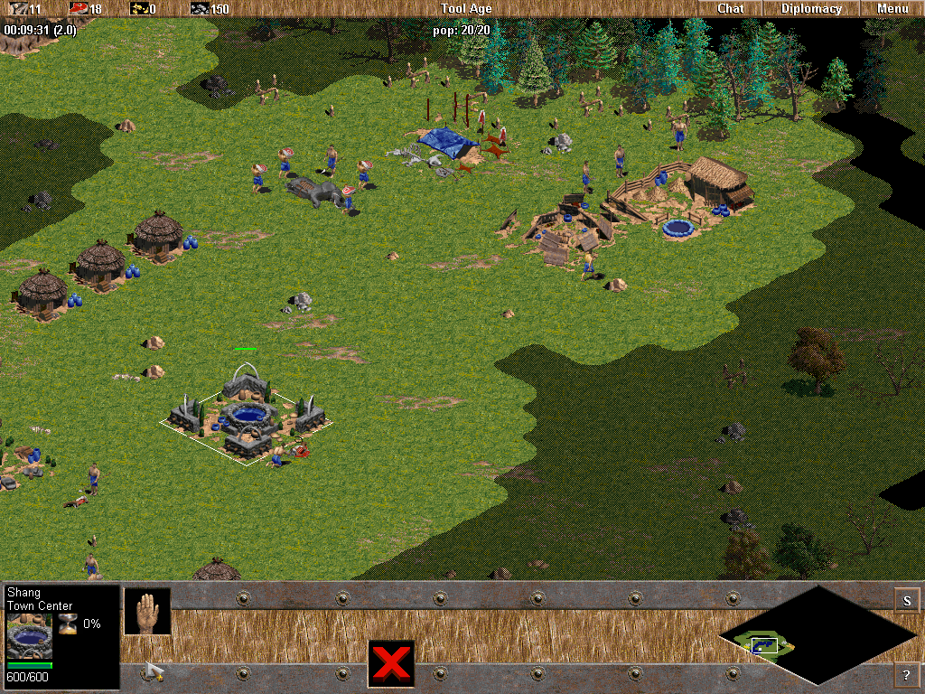
Initial Ideas
Age of Empires style, Real Time Strategy civilisation management.
Isometric view
Mouse based interaction
Hot bar for menus and adjustments
Fog of War map discoverability
Unit grouping (Boids)
Competing against AI civilisation
Far too complicated for the time allocated and our knowledge level

Slide 3
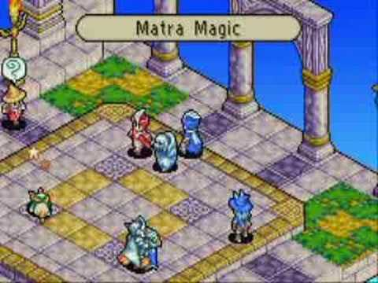
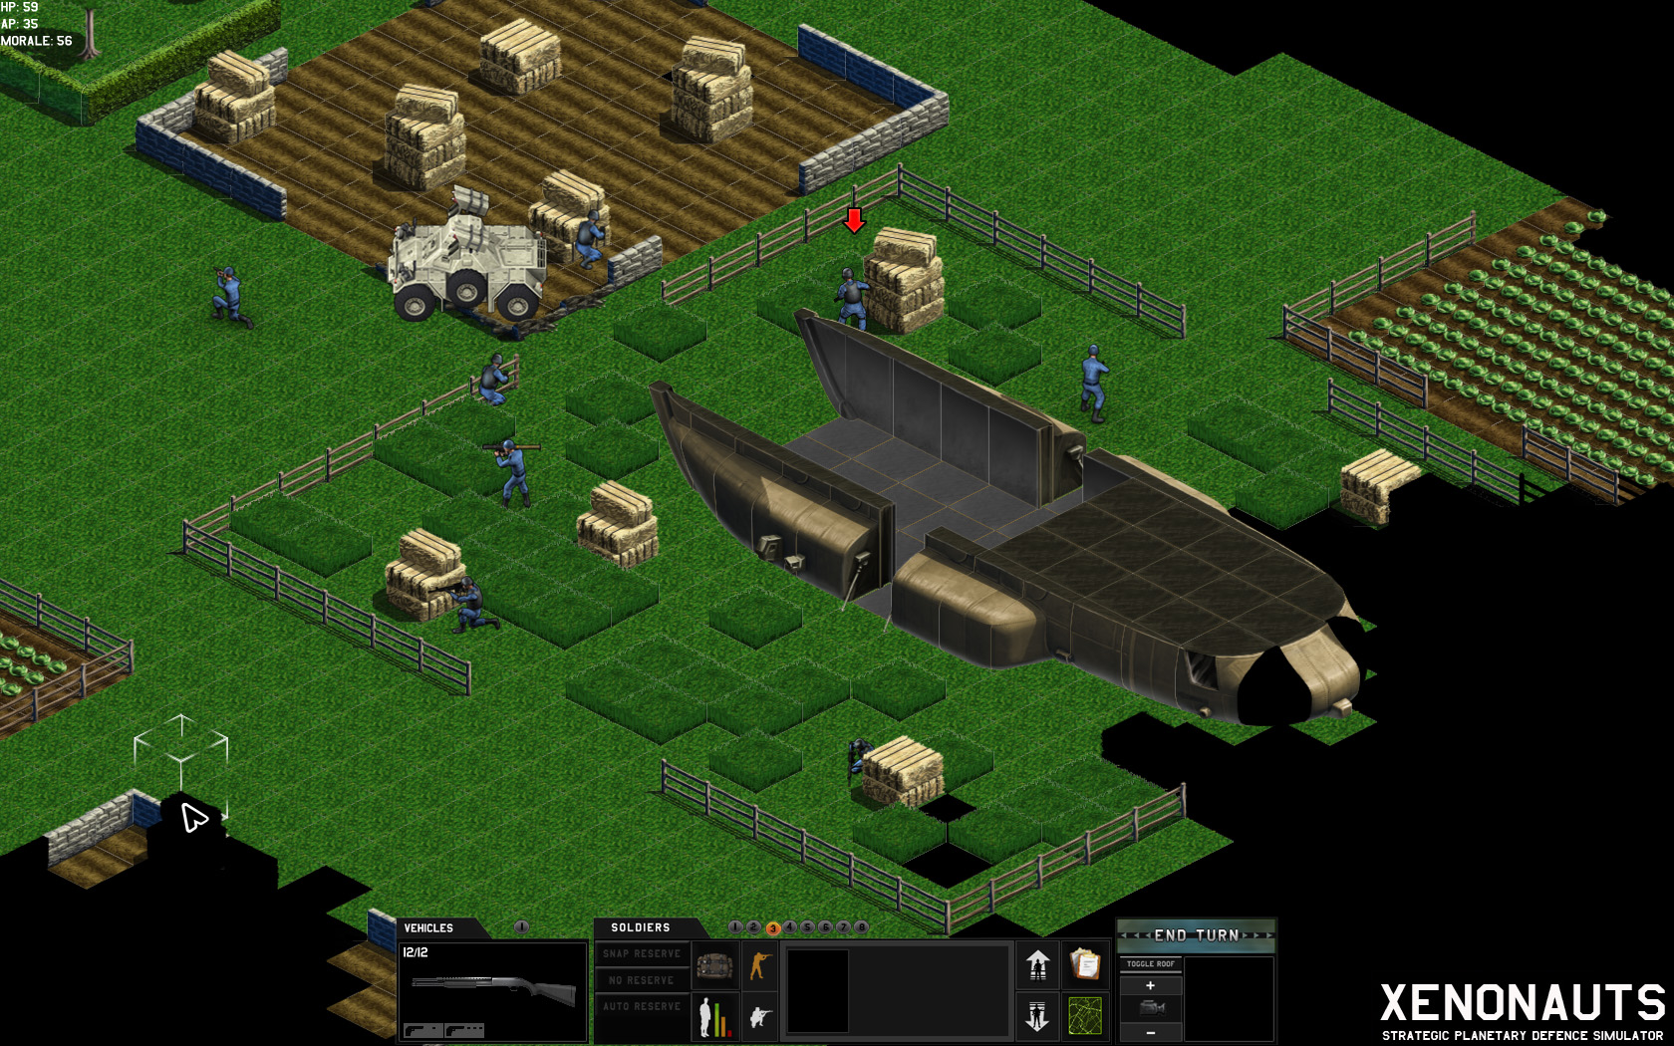
Adjusting Ideas
Look at other games such as X-Com, Xenonauts and Final Fantasy Tactics Advance
Change from RTS to Turn-Based Strategy
Simplify Fog-of-War to a smaller view window of a larger world
Change the sub-genre from civ management to shooter/action
Simplifies hot bar
Reduces the number of units and interactive object types

Slide 4

Initial Concept
Sci-Fi, Turn based shooter
Isometric view
Grid map
Open environments, tree obstacles
Rivers separating ‘Zones’, joined by bridges (variable)
Goal: to escape, path is unknown by player
Enemies within each zone
Click to move (A*/BFS pathfinding)
Limited actions per turn
Accuracy based on weapon type, distance and character

Slide 5
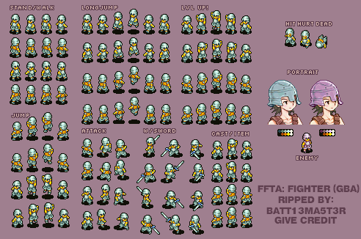
Sprites
Angles need to match the world offset
//sprite sheet sub rect info

Slide 6
Character
//information stored in character class/script file
One of three weapons: Pistol, Sniper rifle, Shotgun
Strengths and weaknesses(accuracy, movement, health, etc)

Slide 7
Enemies
Standard enemies and boss enemy
Random accuracy, strength, health, movement
Limited roaming area (zone restricted?)
etc

Slide 8
World
placeholder

Slide 9
Pathfinding
Breadth First Search or A* Algorithm
Check each grid location surrounding
Weighted nodes based on distance from finish
If node is an obstacle, close node
Once finish is found, use shortest path
Very efficient and performance friendly
https://www.youtube.com/watch?v=moUOV-zzJ0Q

Slide 10
Combat Interaction

Slide 11
Isometric View
View rotation
60,30 angle
Angle adjusted sprites
etc

