Slide 1
Assignment 1 Game proposition
ISCG 6442 Game Programming
Steven Bellamy, Aquila Halpé, Jesse Schollitt

Slide 2
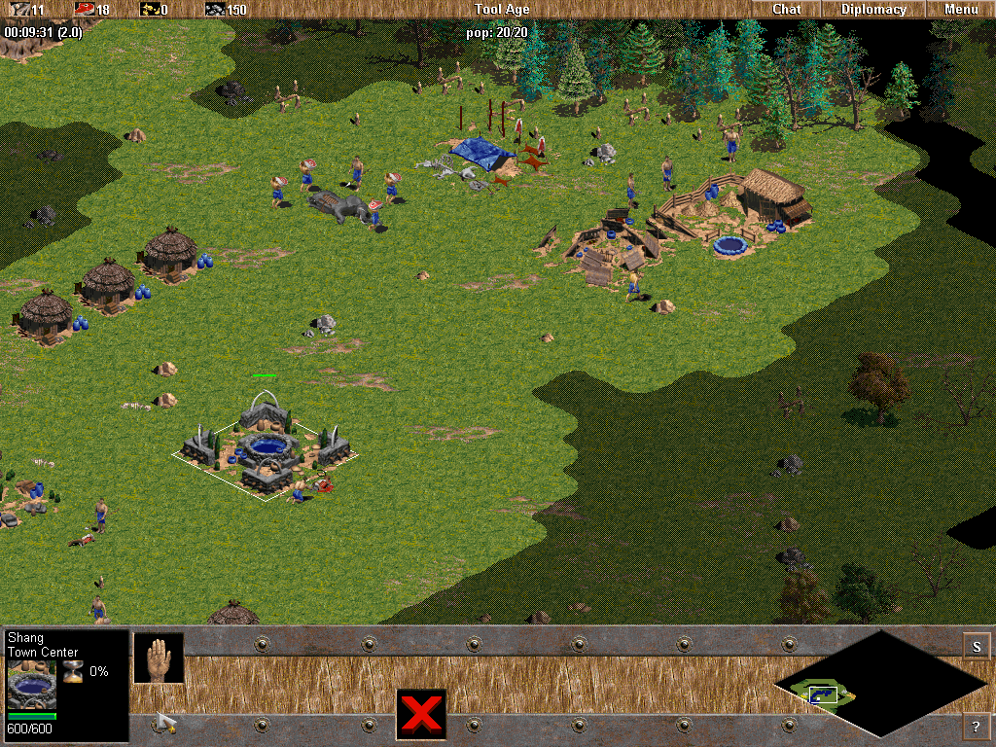
Initial Ideas
Age of Empires style, Real Time Strategy civilisation management.
Isometric view
Mouse based interaction
Hot bar for menus and adjustments
Fog of War map discoverability
Unit grouping (Boids)
Competing against AI civilisation
Far too complicated for the time allocated and our knowledge level

Slide 3
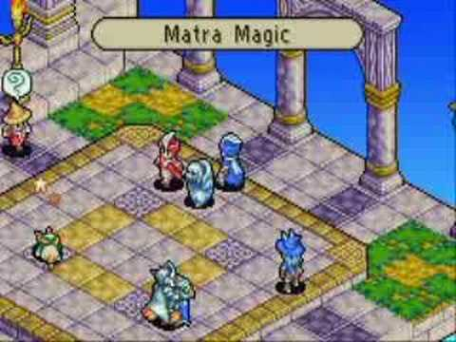
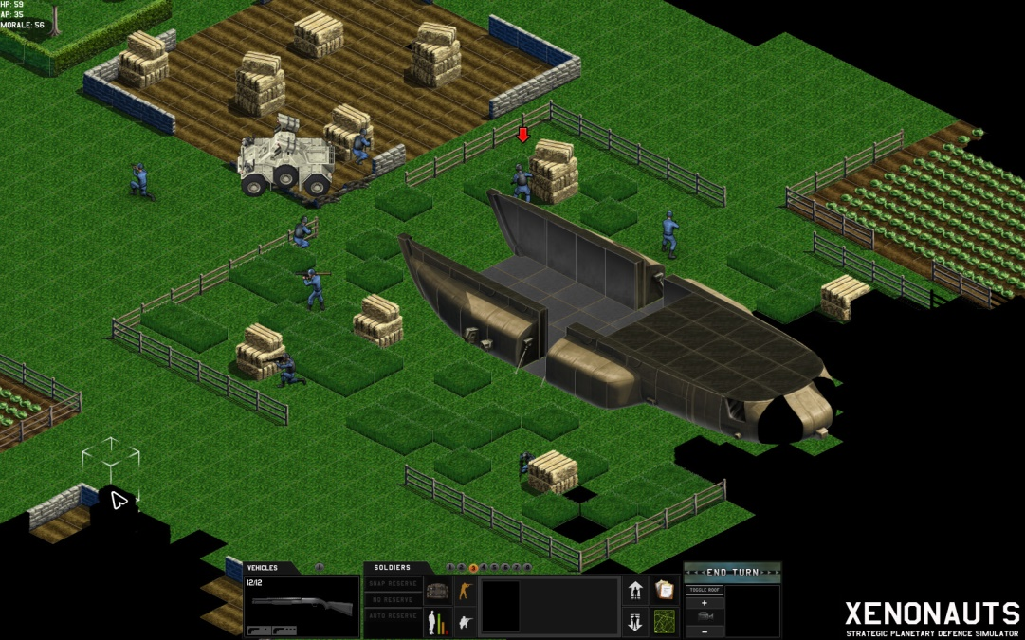
Adjusting Ideas
Look at other games such as X-Com, Xenonauts and Final Fantasy Tactics Advance
Change from RTS to Turn-Based Strategy
Simplify Fog-of-War to a smaller view window of a larger world
Change the sub-genre from civ management to shooter/action
Simplifies hot bar
Reduces the number of units and interactive object types

Slide 4
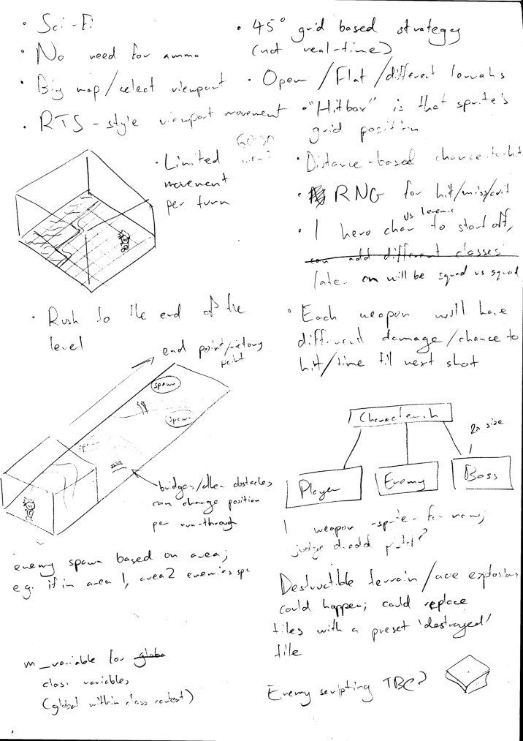
Initial Concept
Sci-Fi, Turn based shooter
Isometric view
Grid map
Open environments, tree obstacles
Rivers separating ‘Zones’, joined by bridges (variable)
Goal: to escape, path is unknown by player
Enemies within each zone
Click to move (A*/BFS pathfinding)
Limited actions per turn
Accuracy based on weapon type, distance and character

Slide 5
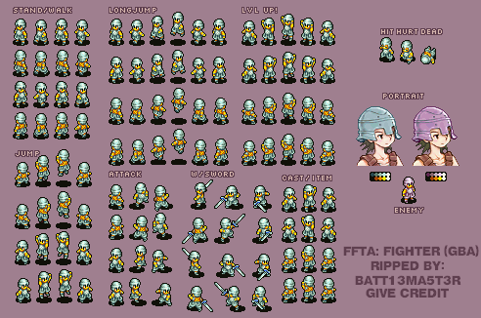
Sprites
Angles need to match the world offset
FFTA sprite sheet as reference for now as this is done in isometric view
Using SFML’s sf::texture and sf::sprite classes for implementation
Using the sprite sheet to the left (modified for implementation) as a placeholder, proper sprite design is secondary so this will be done only if there is extra time after main game logic has been implemented

Slide 6

Character
Information stored in character class/script file
One of three weapons: Pistol, Sniper rifle, Shotgun
Strengths and weaknesses(accuracy, movement, health, etc)
Characters, enemies, bosses will all be under a character class, but subclasses under these will dictate unique parameters

Slide 7
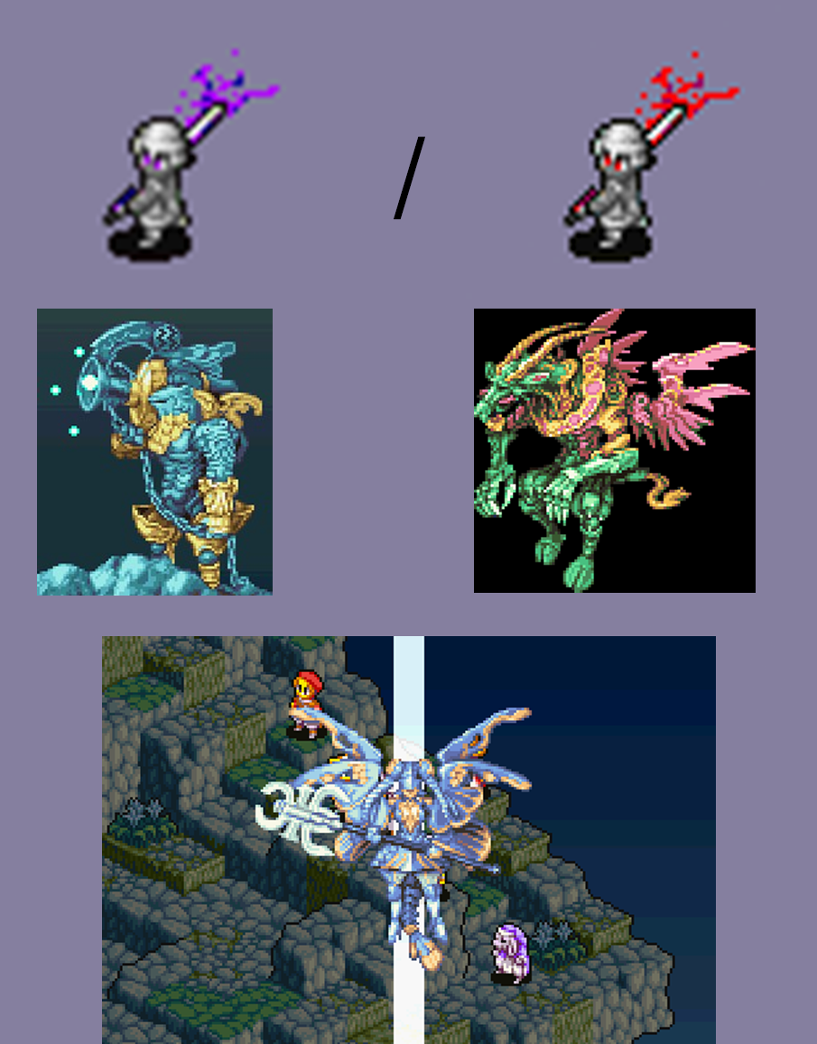
Enemies
Standard enemies and boss enemy
Random accuracy, strength, health, movement (perhaps based on a difficulty setting / variable)
Limited roaming area (zone restricted?)
Etc
Boss enemies could take up double the space on the grid (2x2)
Characters, enemies, bosses will all be under a character class, but subclasses under these will dictate unique parameters

Slide 8
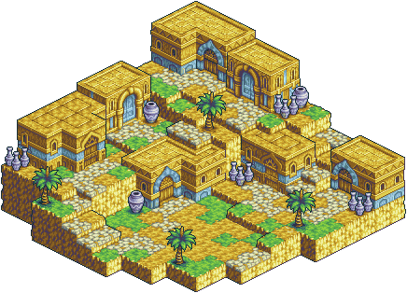
World
Using Tiled for world construction, will be primarily focusing on flat plane level for now
Will implement elevated terrain if there’s time
Will be aiming to implement obstacles and differing terrain types (e.g., ground, bridge, river, out-of-bounds) that have conditional movement.

Slide 9
Pathfinding
Breadth First Search or A* Algorithm
Check each grid location surrounding
Weighted nodes based on distance from finish
Once finish is found, use shortest path
Very efficient and performance friendly
Notes:
https://www.youtube.com/watch?v=moUOV-zzJ0Q

Slide 10
Breadth First Search
// Simple bfs
structure node
position pos
node *parent
end
function bfs(node start_position)
add start_position to the queue
while the queue is not empty
pop a node off the queue, call it "item"
color item on the graph // make sure we don't search it again
generate the 8 successors to item
set the parent of each successor to "item" // this is so we can backtrack our final solution
for each successor
if the successor is the goal node, end the search
else, push it to the back of the queue // So we can search this node
end
end
if we have a goal node, look at its ancestry to find the path (node->parent->parent->parent..., etc)
if not, the queue was empty and we didn't find a path :^\
end
Unlike Depth First Search, BFS guarantees a path and gives the shortest route to the target location (vs no or first path)

Slide 11
A*
// A*
initialize the open list
initialize the closed list
put the starting node on the open list (you can leave its f at zero)
while the open list is not empty
find the node with the least f on the open list, call it "q"
pop q off the open list
generate q's 8 successors and set their parents to q
for each successor
if successor is the goal, stop the search
successor.g = q.g + distance between successor and q
successor.h = distance from goal to successor
successor.f = successor.g + successor.h
if a node with the same position as successor is in the OPEN list \
which has a lower f than successor, skip this successor
if a node with the same position as successor is in the CLOSED list \
which has a lower f than successor, skip this successor
otherwise, add the node to the open list
end
push q on the closed list
end
Combines Dijkstra’s Algorithm and best-first. Uses weight based on distance travelled and linear distance to the target to prioritise more likely nodes/path.

Slide 12
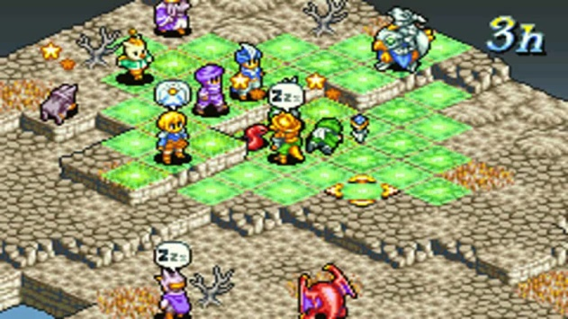
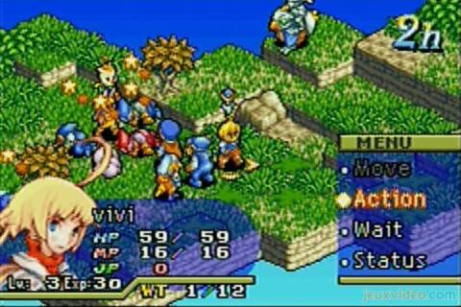
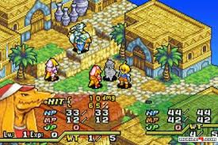
Combat Interaction
Combat done in phases;
Movement phase -> action phase -> RNG phase
After all actions have been decided, the game will run through a sequence that goes in turn and performs actions based on the decisions made and RNG will dictate damage, chance to hit etc.
After this the computer will cycle back to the movement phase for the player who’s first in turn order.
Will likely be implemented using a variable to dictate current phase state, and then while loops will decide what code will be running (what actions are available) during that phase. Minimal actions will be available during the RNG phase (likely just pause ability, if that.)

Slide 13
Class Diagram
Targetver.h
Private:
(tbd)
Targetver.cpp
(tbd)
Animation.hpp
Private:
std::vector<sf::IntRect> m_frames;
const sf::Texture* m_texture;
Game.h
Private:
sf::RenderWindow m_window;
World m_world;
sf::View m_view;
sf::View m_miniMap;
sf::RectangleShape m_miniMapSprite;
bool m_fullscreen = true;
UI m_ui;
sf::Clock m_tickTimer;
const int m_tickRate = 20;
void handleEvents();
void beginDraw();
void endDraw();
void tick();
void update();
void toggleFullscreen();
World.h
Private:
void draw(sf::RenderTarget& target, sf::RenderStates states) const;
sf::Texture m_texture;
Animation.cpp
Animation();
void addFrame(sf::IntRect rect);
void setSpriteSheet(const sf::Texture& texture);
const sf::Texture* getSpriteSheet() const;
std::size_t getSize() const;
const sf::IntRect getFrame(std::size_t n) const;
World.cpp
World();
~World():
void tick();
Void update();
Game.cpp
Game();
~Game();
Void Run();
AnimatedSprite.hpp
Private:
const Animation* m_animation;
sf::Time m_frameTime;
sf::Time m_currentTime;
std::size_t m_currentFrame;
bool m_isPaused;
bool m_isLooped;
const sf::Texture* m_texture;
sf::Vertex m_vertices[4];
virtual void draw(sf::RenderTarget& target, sf::RenderStates states) const;
Path.h
Private:
(tbd)
Path.cpp
(tbd)
AnimatedSprite.cpp
void update(sf::Time deltaTime);
void setAnimation(const Animation& animation);
void setFrameTime(sf::Time time);
void play();
void play(const Animation& animation);
void pause();
void stop();
void setLooped(bool looped);
void setColor(const sf::Color& color);
const Animation* getAnimation() const;
sf::FloatRect getLocalBounds() const;
sf::FloatRect getGlobalBounds() const;
bool isLooped() const;
bool isPlaying() const;
sf::Time getFrameTime() const;
void setFrame(std::size_t newFrame, bool resetTime = true);
UI.h
Private:
int m_drawTime = 0;
sf::Clock m_drawTimer;
sf::Text m_txtFps;
sf::Font m_fontArial;
void draw(sf::RenderTarget& target, sf::RenderStates states) const;
UI.cpp
UI();
~UI();
void handleInput(sf::Keyboard::Key key);
void handleInput(sf::Mouse::Button button);
sf::RectangleShape m_debugOverlay;
bool m_debugOverlayEnabled = false;
void toggleDebugMenu();
void updateDrawTime();

