Slide 1

ISEC 2022 | Final Assignment
Firewall, VPN’s, IPS, Endpoint Final Assignment

Slide 2

Regarding the alerts on Feb 21 2020
Document created by:
Steve Oliver, Matt Usher, Ibrahim Yusuf

Slide 3
Synopsis of Events
On Feb 21 2020, between the hours of 12:53am and 1:12am a malicious file called yrkbdmt.bin was downloaded to host computer DESKTOP-TZMKHKC.
It came from a server called one-hot-mess and the file is confirmed using a malware hash matching database to be a known Trojan.
Using Kibana it appears that the geo-location is Germany and Ukraine, however it may just be already compromised computers distributing the Trojan.

Slide 4
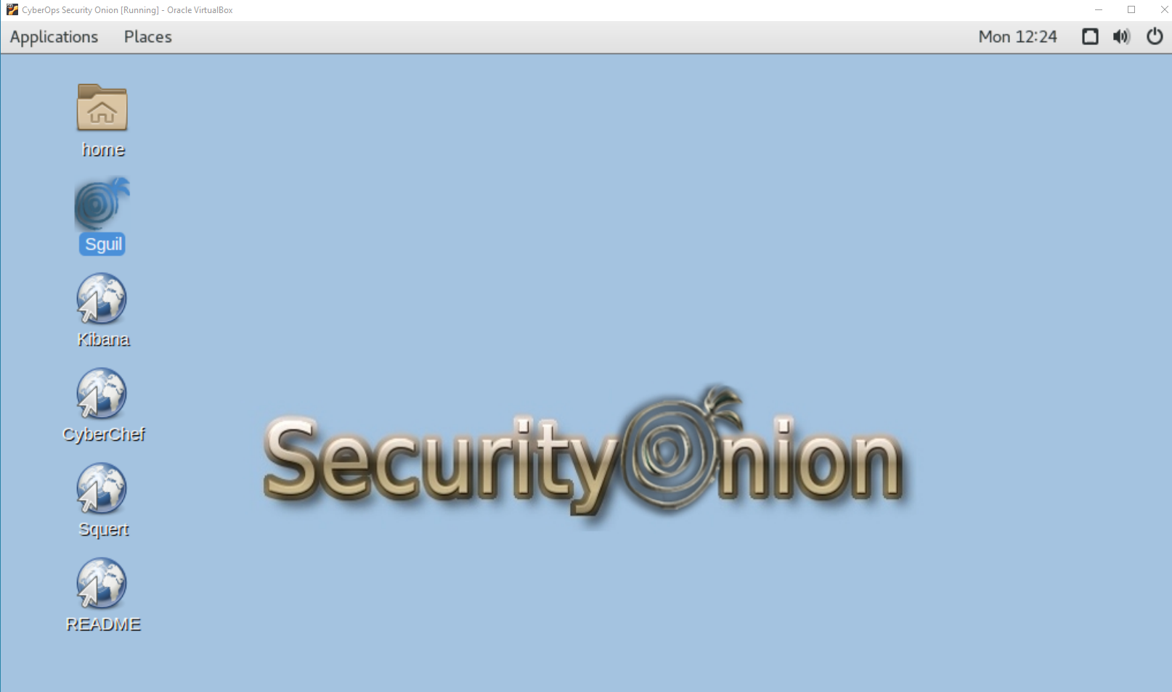
To find the information we open Sguil and go to the alerts in February

Slide 5
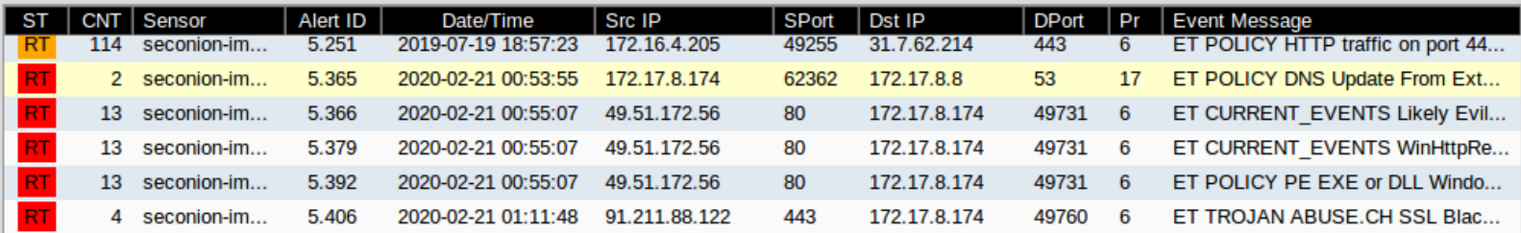











5 Alerts from Feb 21 2020 00:53:55 to 01:11:48. The alerts show suspicious activity for a little over 17 minutes, but most of the alerts took place for a little over 1 minute and 12 seconds As verified in Sguil

Slide 6
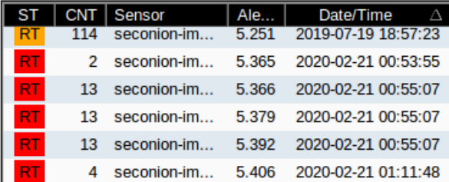






Alert ID’s involved: 5.365, 5.366, 5.379, 5.392, 5.406

Slide 7
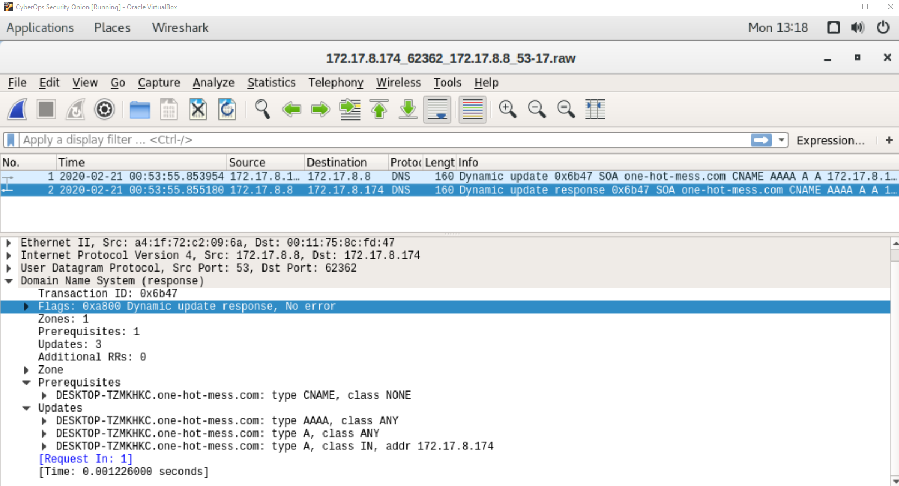


Opening Wireshark with ID 5.365 reveals Host computer involved DESKTOP-TZMKHKC, Domain one-hot-mess.com

Slide 8
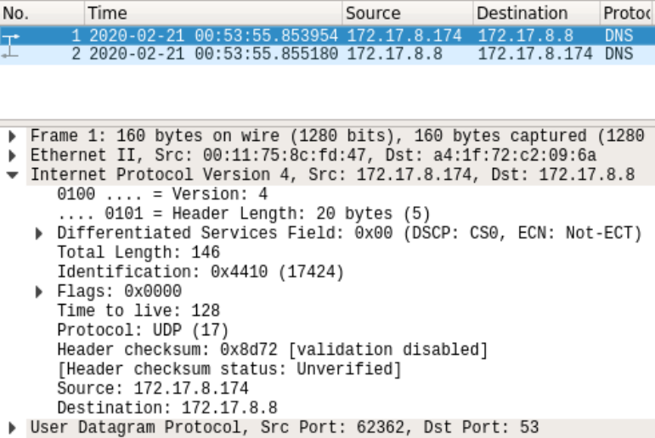
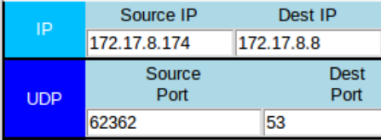







The 5-tuples involved in Alert 5.365 are: Source 172.17.8.174:62362 Dest 172.17.8.8:53 Using UDP

Slide 9
5 Tuples
First alert: Protocol: UDP
Source IP: 172.17.8.174 Source Port: 62362
Destination IP: 172.17.8.8 Dst Port: 53
2nd, 3rd, 4th: Protocol: TCP
Source IP: 49.51.172.56 Source Port: 80
Destination IP: 172.17.8.174 Dst Port: 49731
Last alert: Protocol: TCP
Source IP : 91.211.88.122 Source Port: 443
Destination IP: 172.17.8.174 Dst Port: 49760

Slide 10
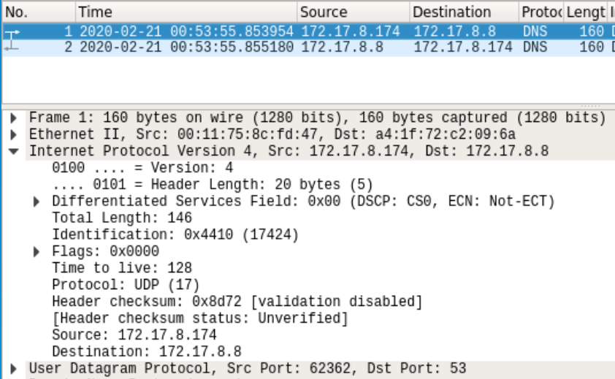


Protocols involved
Alert 5.365: UDP, DNS dynamic update and response
Alert 5.366: TCP, HTTP
Alert 5.379: TCP, HTTP
Alert 5.392: TCP, HTTP
Alert 5.406: TCP

Slide 11
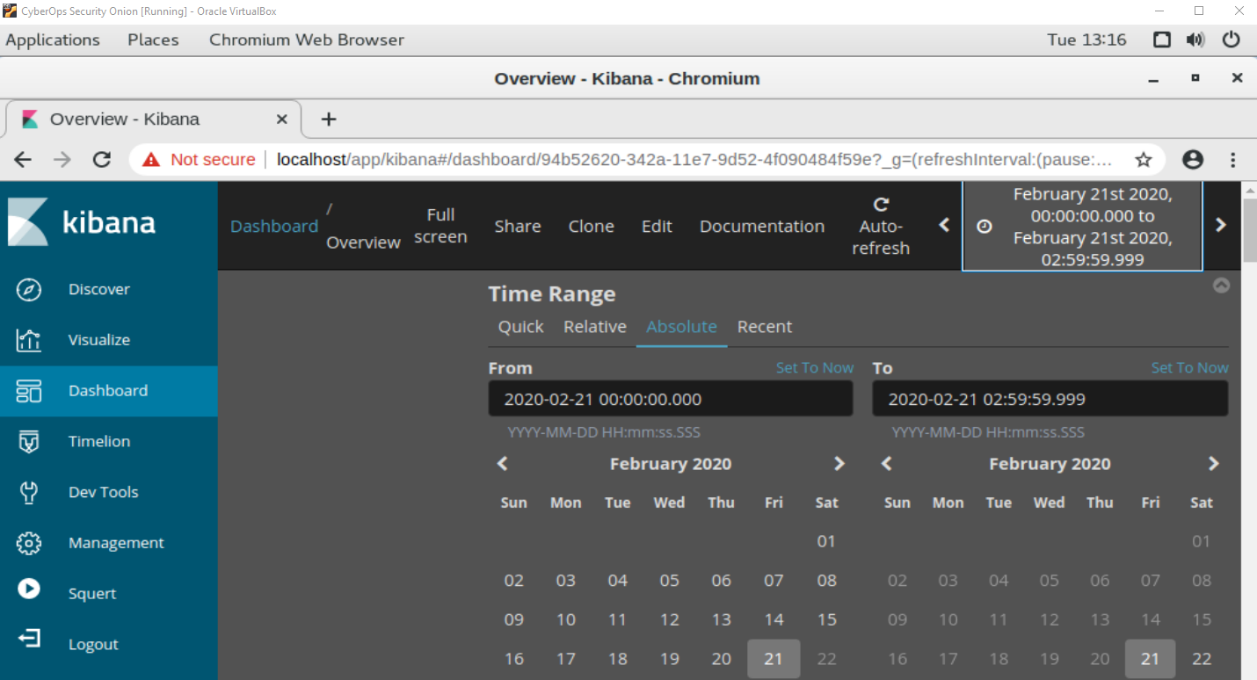
Narrowing time frame in Kibana to time of attack to see more info

Slide 12
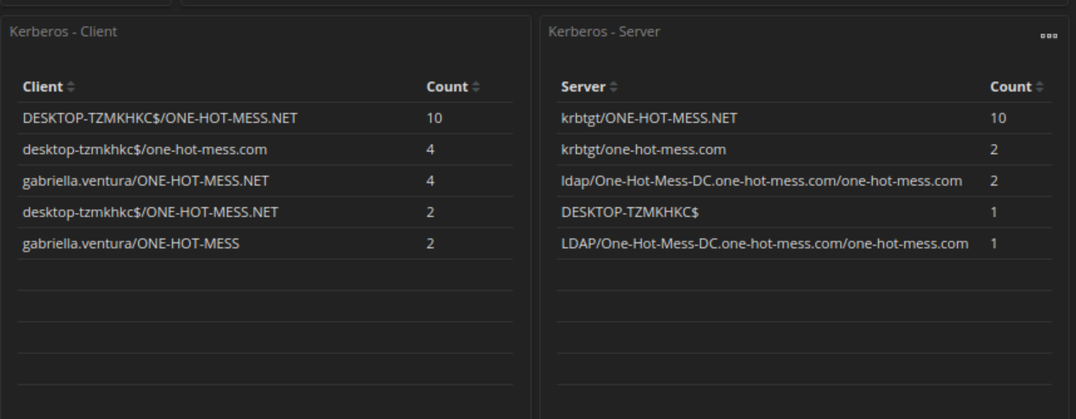
Users As verified in Kibana

Slide 13
Ports involved
Alert 5.365 - Source port: 62362 Destination port: 53
Alert 5.366 - Source Port: 80 Destination Port: 49731
Alert 5.379 - Source Port: 80 Destination Port: 49731
Alert 5.392 - Source Port: 80 Destination Port: 49731
Alert 5.406 - Source Port: 443 Destination Port: 49760

Slide 14
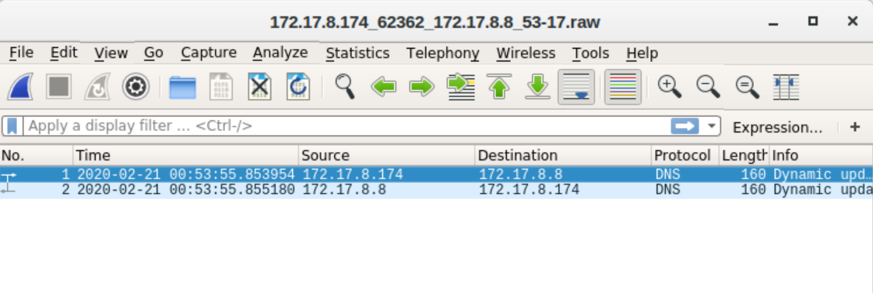
Type of communication used
The type of communication used is DNS Query and response. This is evident from the use of the DNS protocol over UDP, which is the standard for DNS lookups. The first line represents a query sent from 172.17.8.174 to the DNS server at 172.17.8.8, while the second line shows the server’s response returning to the original source.

Slide 15
Geo-locations involved as verified with Kibana
Alert 5.365: No geo-location
Alert 5.366: Germany
Alert 5.379: Germany
Alert 5.392: Germany
Alert 5.406: Ukraine

Slide 16
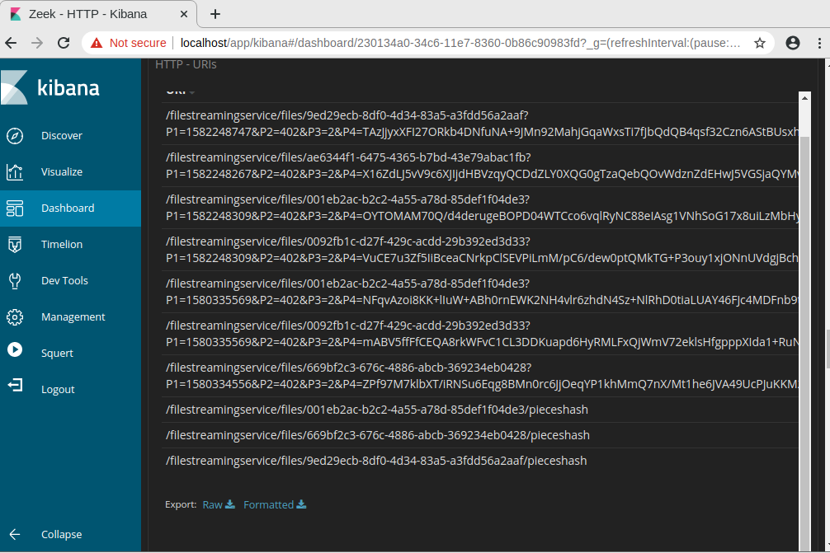
URIs involved as verified in Kibana by filtering by HTTP and event

Slide 17
Was a host infected?
Yes, the host computer DESKTOP-TZMKHKC, was infected with a malicious file called yrkbdmt.bin, a PE32 executable for MS Windows called Win.Dropper.Zenpack.

Slide 18
Alerts triggered?
Alert 5.365: alert udp $EXTERNAL_NET -> $HOME_NET
Alert 5.366: alert tcp $EXTERNAL_NET $HTTP_PORTS -> $HOME_NET
Alert 5.379: alert tcp $EXTERNAL_NET $HTTP_PORTS -> $HOME_NET
Alert 5.392: alert tcp $EXTERNAL_NET $HTTP_PORTS -> $HOME_NET
Alert 5.406: alert tcp $EXTERNAL_NET any -> $HOME_NET

Slide 19
If alerts were triggered, were they valid?
Alert 5.365: Dynamic DNS update from a domain called one-hot-mess.com, virustotal.com has found no vendors have flagged this URL as malicious.
Alert 5.366: Likely evil EXE download from WinHTTPRequest, valid alert.
Alert 5.379: WinHTTPRequest downloading EXE, valid alert.
Alert 5.392: PE EXE or DLL Windows Downloading EXE, valid alert.
Alert 5.406: Backlisted malicious SSL certificate detected Dridex, valid alert.

Slide 20
Were files downloaded?
Yes, one file was downloaded, it is called yrkbdmt.bin.

Slide 21
If yes, were they malware?
Yes, the malware is PE32 executable (console) Intel 80386, for MS Windows, a trojan malware
The name of it is Win.Dropper.Zenpak::.03c962ebb5.ART.RET.TPD2.SBX.TG

Slide 22
Any other information relevant to this potential incident
Alert 5.366, 5.379 and 5.392 all have a file signature of MZ, which indicates a Windows/DOS executable file.
All communication is encrypted to obfuscate what was happening.

Slide 23
Mitigate Future Attacks
Training: Have employees trained to be aware of potential threats such as phishing, suspicious files and websites to prevent future incidents.
Isolation: When a computer is suspected to contain malware, isolate the infected computer immediately to prevent further spread.
Removal: When a computer is infected, perform a thorough sweep and remove any malware on any infected computers.
Block: Block IP’s of offending servers that are distributing malware.

Slide 24
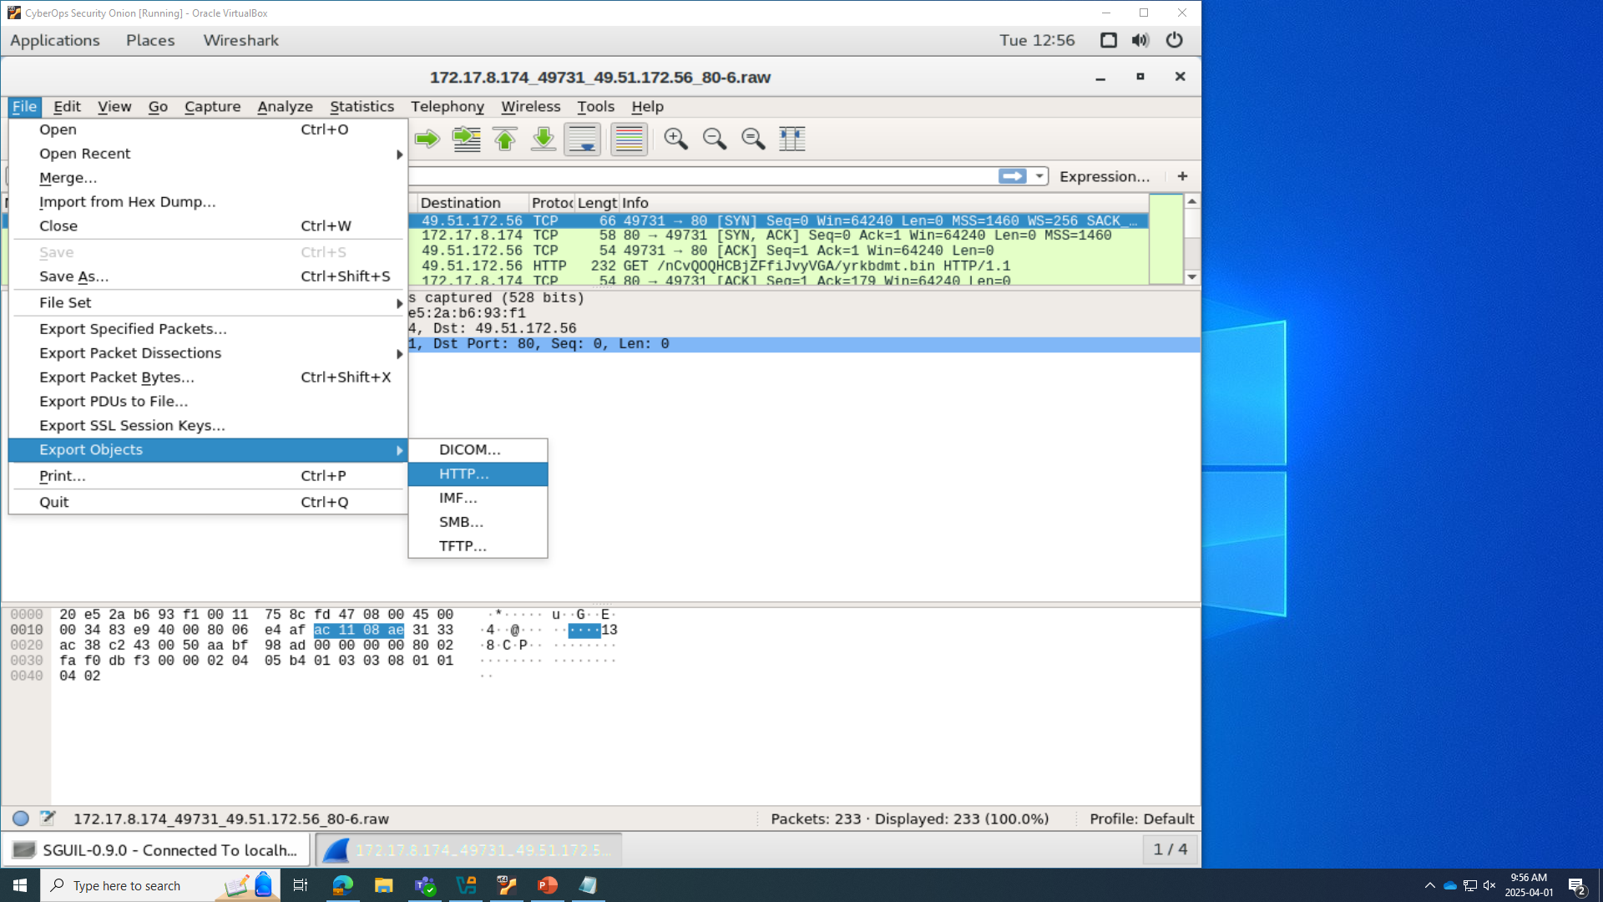
How we know file was malicious using Wireshark

Slide 25
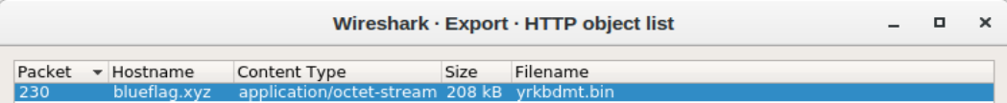
From Alert ID 5366

Slide 26
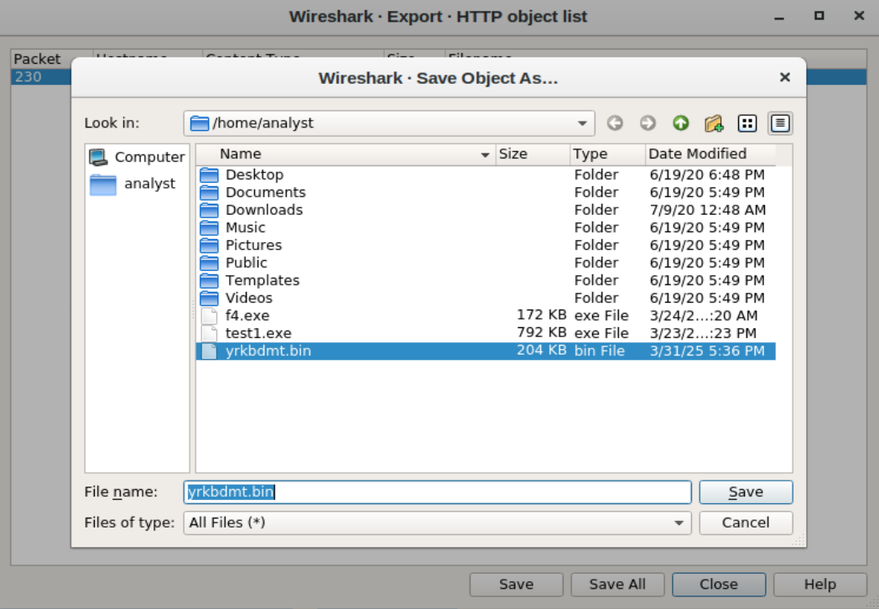
Saving the file from Alert ID 5366

Slide 27
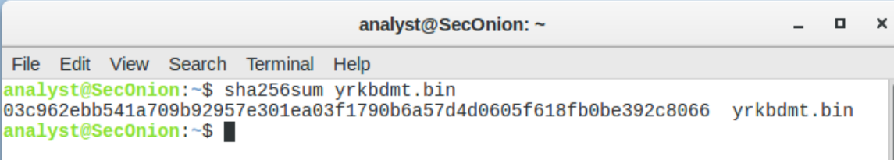
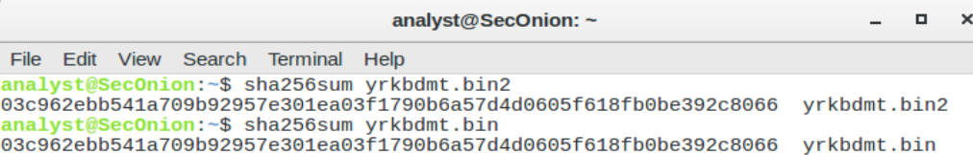
Get Hash of bin file from Alerts 5.366, 5.379 and 5.392 to compare to known malware database

Slide 28
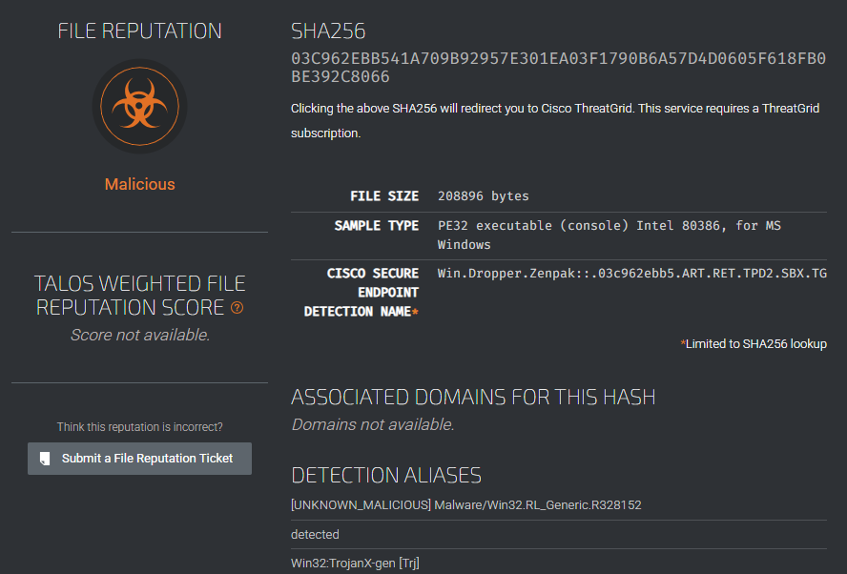
Alert ID 5366 Hash compared on Talos, found to be malicious (Trojan)

Slide 29

End of Report

