Slide 1
Weather Monitor project
University of St. Thomas
SEIS 785 Internet of Things
Justin Grammens
by
Steve Rozaitis

Slide 2
Justification
Many people perform the same queries every day.
Traditionally, user needs to start the computer, or navigate smart phone to a weather app., indicate location, select from various options to get desired detailed information.
The Weather Monitor enables quick access to information from several pre-programmed, static queries.
Is customizable and re-programmable
In addition, calm principles can be used to convey at-a-glance information via LED colors and patterns.

Slide 3
Use Case
User is in a hurry
Wants to know:
Current weather
Weather forecast
Astronomical information
Current weather alerts
User presses a single button to get specific weather query output to LCD (serial monitor in current prototype).
Certain information may be called via a timer, with the results output “calmly” to LED(s).

Slide 4
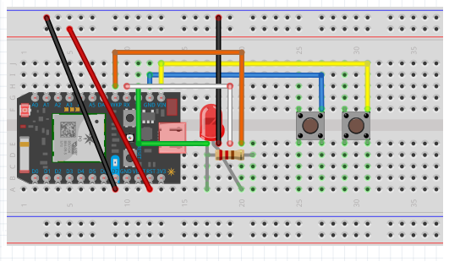
Circuit layout
Simple layout including:
Particle Photon
2-4 Buttons (can double using long/short press)
RGB LED
Piezo, and LCD can be added in finished design

Slide 5
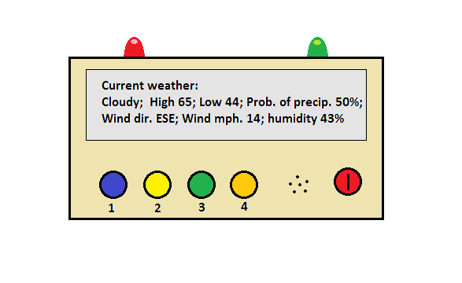
Conceptual product design

Slide 6
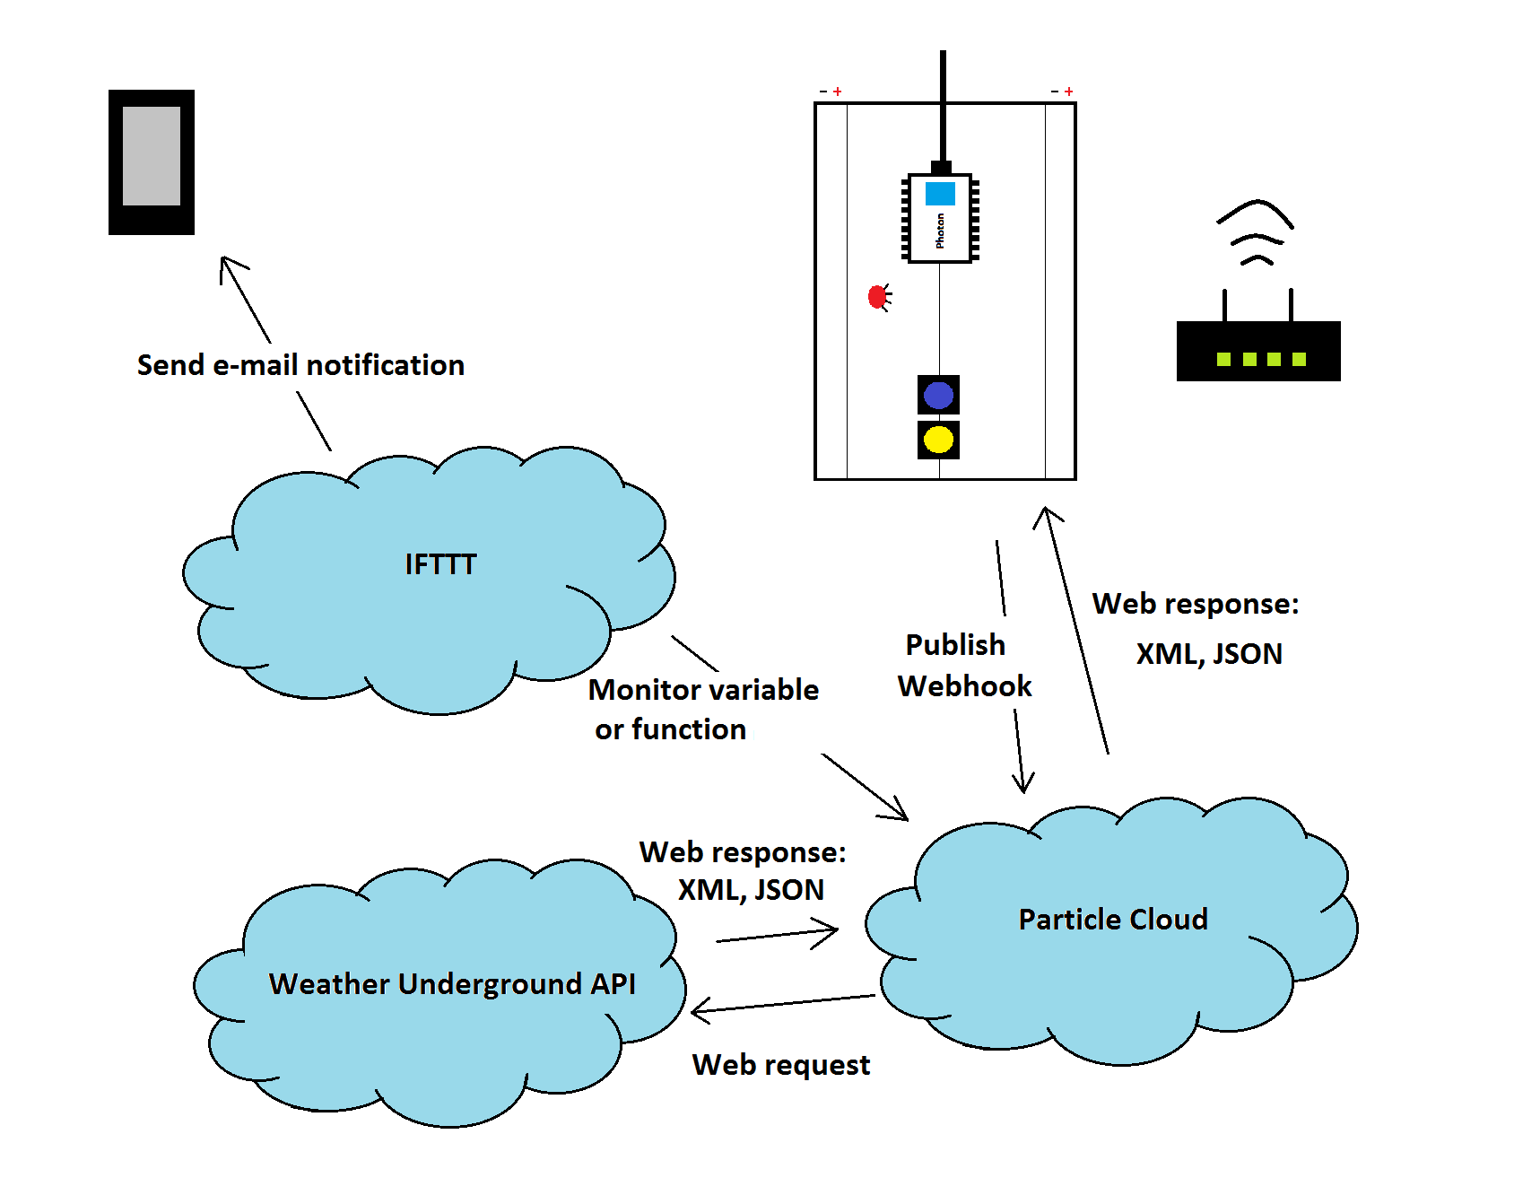
Architecture

Slide 7
Marketability
Could be customized for:
Sports
Stocks
Traffic
News
Etc.
*Probably requires a certain level of technical understanding…

Slide 8
Setup Requirements
Would require a lot of customization including:
Wifi setup
Localization (city, state)
Return fields (Hight temp, humidity, etc.)
LED display and configuration (e.g. colors, patterns)
Particle setup (claim photon)
IFTTT and e-mail setup for notifications
Would require reflashing!

Slide 9
Challenges
Setup – many users expect “out-of-the-box” operation.
Customized programming of the unit needs to be performed.
The device would need to be re-flashed.
The user interface (program) supplied with the product would need to be user-friendly and intuitive to use.

