Slide 1




Continuous Delivery in a Brownfield World
Jimmy Bogard
@jbogard
github.com/jbogard
jimmybogard.lostechies.com

Slide 2
My First Brownfield Build

Slide 3
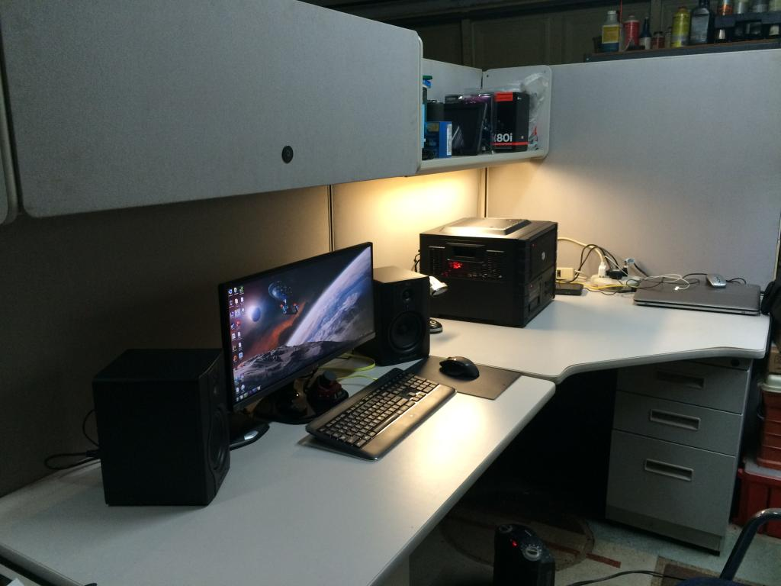

Slide 4
The Build Manual

Slide 5
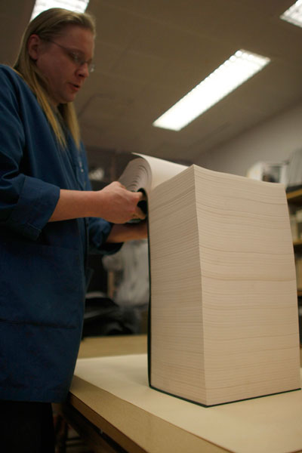

Slide 6
Deployment Weekend

Slide 7
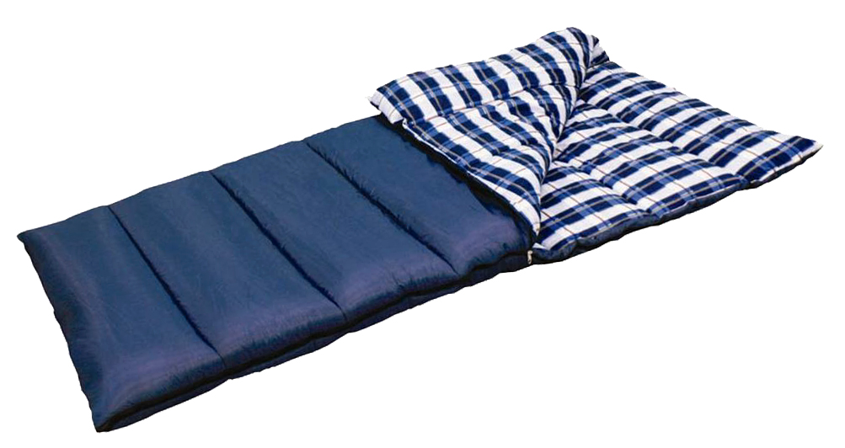
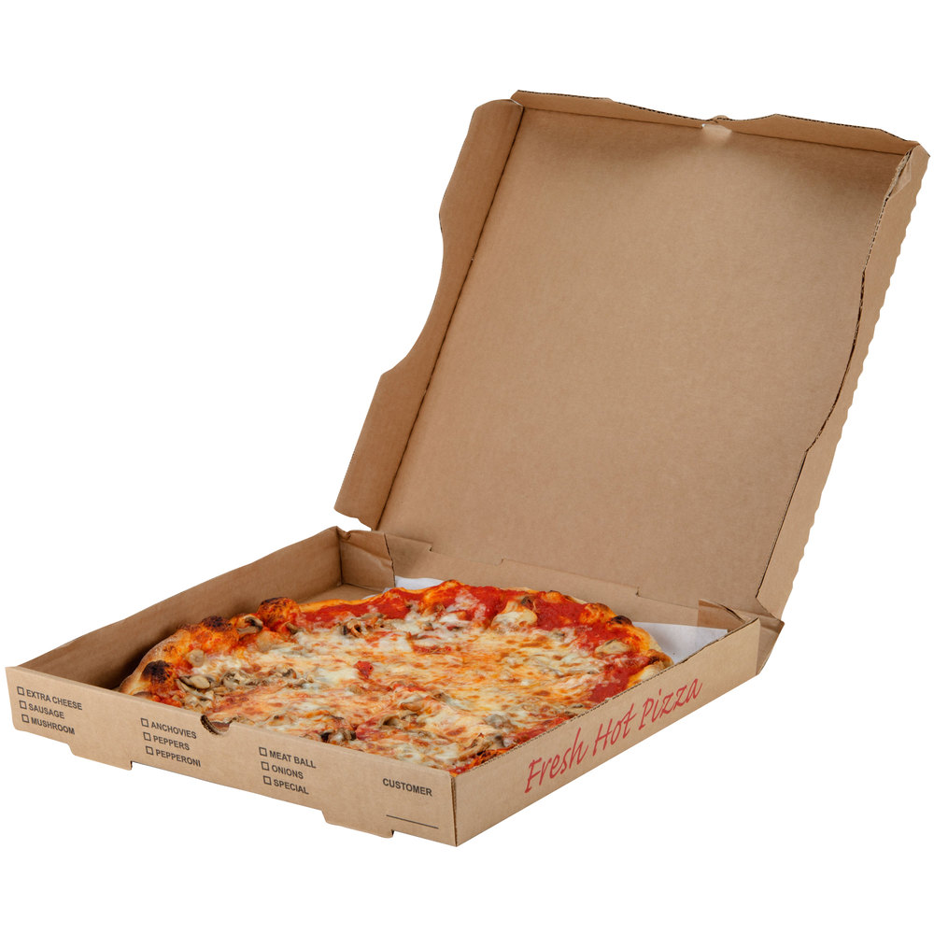

Slide 8
Baseline
Everything related to build is in source control
Entire build and deployment pipeline is automated
Environment configuration in configuration management

Slide 9
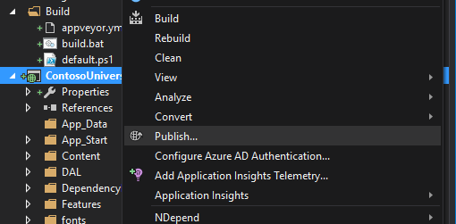
This is NOT CI/CD

Slide 10
Setup
Dev
Build
Version Control
NuGet Repository
Deploy
Test
Test
Promote
Package
Prod
AppVeyor
Octopus Deploy

Slide 11

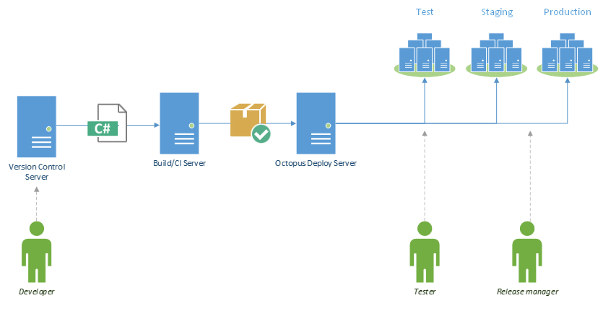


Logical Architecture

Slide 12
Continuous Delivery in a Brownfield World
Jimmy Bogard
@jbogard
github.com/jbogard
jimmybogard.lostechies.com
11xengineering.com
github.com/jbogard/presentations
Promo Code:
KCDC

