Slide 1
A trading program in Python
RegressionChannelSimple.py

Slide 2
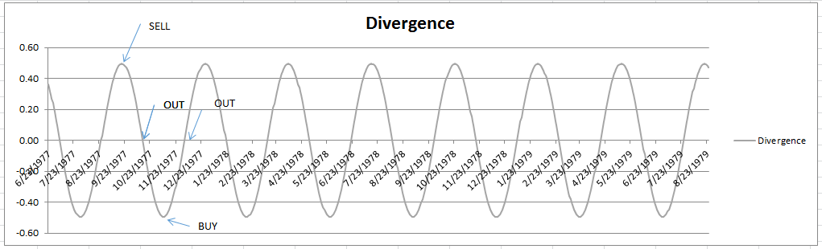
Trading a series that reverts to the mean

Slide 3
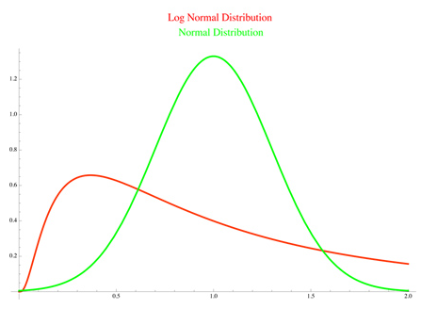
Lognormal vs Normal distributions
prices
log(prices)
https://support.instreamwealth.com/hc/en-us/articles/202386009-What-is-the-difference-between-a-Normal-Distribution-and-a-Lognormal-Distribution-

Slide 4
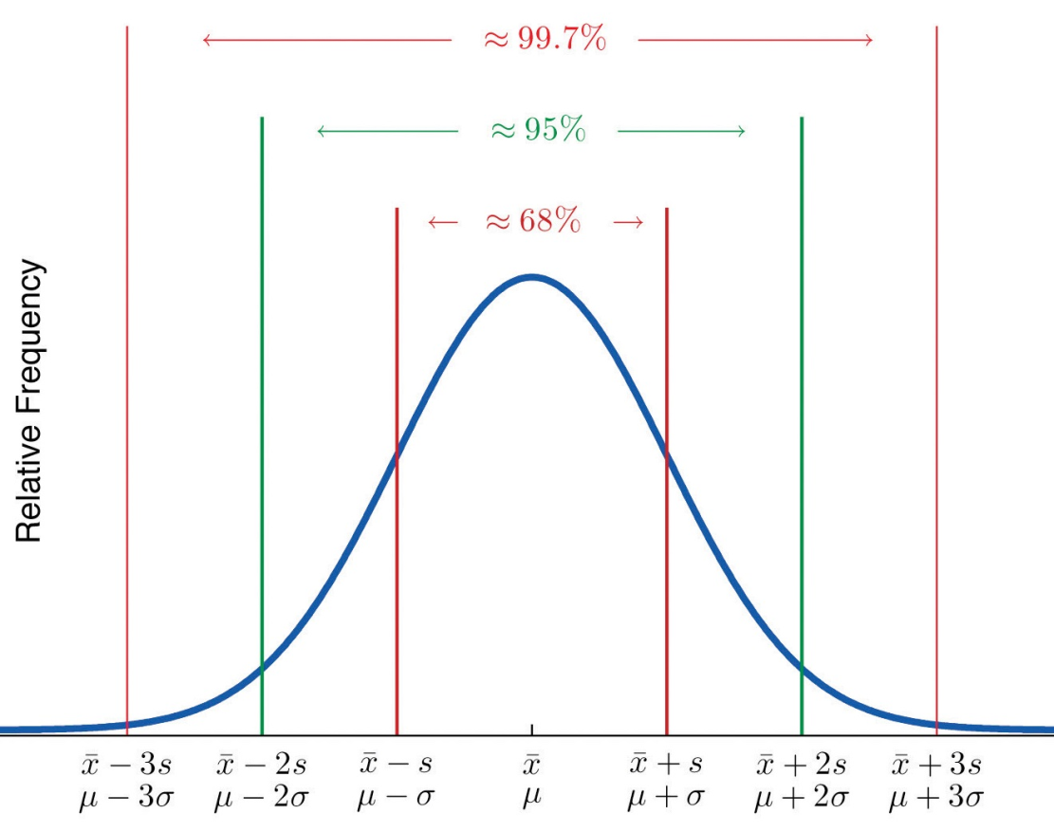
The Empirical Rule and Chebyshev's Theorem for bell shaped distributions
Approximately 68% (95%) of the data lie within 1 (2) standard deviation of the mean
https://stats.libretexts.org/Textbook_Maps/Introductory_Statistics/Book%3A_Introductory_Statistics_(Shafer_and_Zhang)/02%3A_Descriptive_Statistics/2.5%3A_The_Empirical_Rule_and_Chebyshev's_Theorem

Slide 5
Example of a trading rule for the mean reverting series
Assuming the histogram of series is bell shaped:
Long the stock if:
series_{t} == MA(series) - 2* std(series)
i.e. the stock is oversold (cheap)
Short the stock if:
series_{t} == MA(series) + 2* std(series)
i.e. the stock is overbought (expensive)
Neutralize the position if:
series_{t} == MA(series)
If you use this strategy you will encounter oversold and overbought stock only 5% of the time because of Chebyshev's Theorem

Slide 6
Example of a trading rule for the mean reverting series
Easy rule (assuming the histogram of series is bell shaped):
Long the series if:
series_{t} == MA(series) - 2* standard deviation of the series
i.e. the currency is oversold
Short the series if:
series_{t} == MA(series) + 2* standard deviation of the series
Neutralize positions if:
series_{t} == MA(series)
i.e. the currency is overbought
If you use this strategy you will encounter oversold and overbought assets only 5% of the time because of Chebyshev's Theorem
Bollinger
Bands

Slide 7
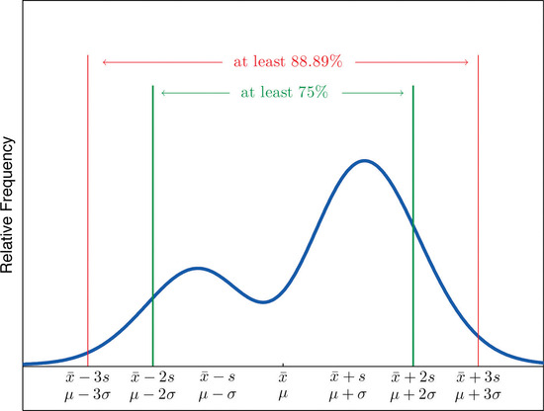
The Empirical Rule and Chebyshev's Theorem for any Shape of Distribution
Stringent rule: Approximately 75% of the data lie within 2 standard deviations of the mean
Tests for one vs two means
#Wilcoxon-Mann-Whitney (non-parametric) “W-test” for two independent samples (20 obs and up)
from scipy.stats import mannwhitneyu
import numpy as np
import scipy.stats as stats
# Create two groups of data
group1 = [1, 5 ,7 ,3 ,5 ,8 ,34 ,1 ,3 ,5 ,200, 3]
group2 = [10, 18, 11, 12, 15, 19, 9, 17, 1, 22, 9, 8]
# Calculate u and probability of a difference
u_statistic, pVal = stats.mannwhitneyu(group1, group2)
# Print results
print ('P value:')
print (pVal)
OUT:
P value:
0.02081882005772675
https://stats.libretexts.org/Textbook_Maps/Introductory_Statistics/Book%3A_Introductory_Statistics_(Shafer_and_Zhang)/02%3A_Descriptive_Statistics/2.5%3A_The_Empirical_Rule_and_Chebyshev's_Theorem

Slide 8
Parts of a back-testing trading program
Data downloading and pre-processing
Signal engineering
Trading rule enunciation
Stance calculation
System return calculation
Equity curve calculation
First Level Evaluation Metrics
Annual return, CAGR, SHARPE, DrawDown etc.
Second Level Evaluation Metric:
White’s Reality Check
Machine Learning
Machine Learning

Slide 9
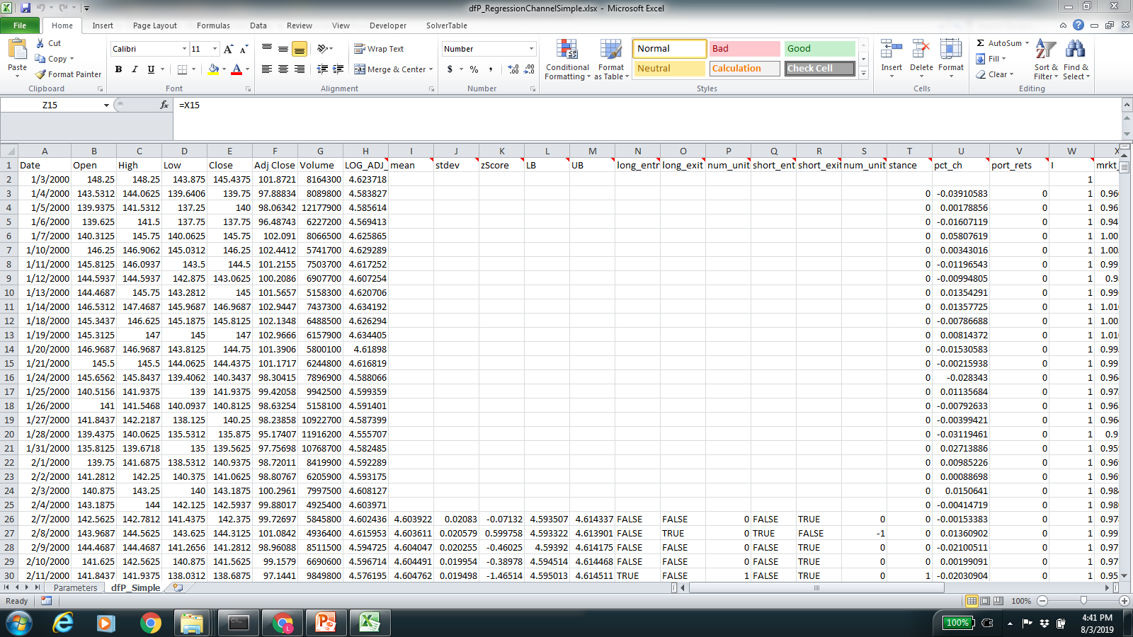
dfP_RegressionChannelSimple.xlsx

Slide 10
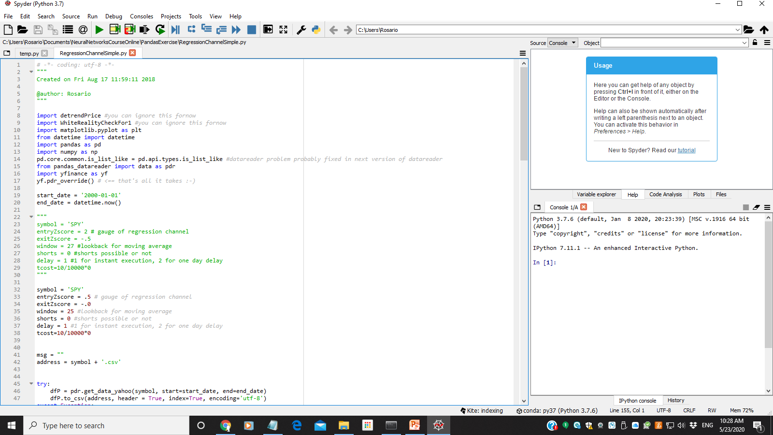
RegressionChannelSimple.py

Slide 11
Importing the modules
import matplotlib.pyplot as plt
from datetime import datetime
import pandas as pd
import numpy as np
pd.core.common.is_list_like = pd.api.types.is_list_like #datareader problem probably fixed in next version of datareader
from pandas_datareader import data as pdr
import yfinance as yf
yf.pdr_override() # <== that's all it takes :-)

Slide 12
Declaring variables
start_date = '2000-01-01'
end_date = '2018-12-31'
symbol = 'SPY'
entryZscore = .5 # gauge of regression channel
exitZscore = -.0
window = 25 #lookback for moving average
shorts = 0 #shorts possible or not
delay = 1 #1 for instant execution, 2 for one day delay
tcost=10/10000*0

Slide 13
Downloading and saving the data
msg = ""
address = symbol + '.csv'
try:
dfP = pdr.get_data_yahoo(symbol, start=start_date, end=end_date)
dfP.to_csv(address, header = True, index=True, encoding='utf-8')
except Exception:
msg = "yahoo problem"
dfP = pd.DataFrame()

Slide 14
Reading and store the data into a well formed data frame
dfP = pd.read_csv(address, parse_dates=['Date'])
dfP = dfP.sort_values(by='Date')
dfP.set_index('Date', inplace = True)

Slide 15
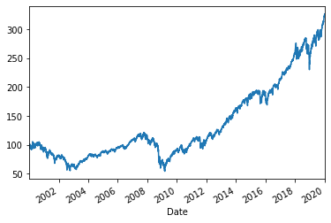
Plotting the data
#dfP['Adj Close'].plot()
#plt.show()

Slide 16
Data pre-processing
dfP = dfP.assign(LOG_ADJ_CLOSE = np.log(dfP['Adj Close'])) #DO NOT USE ASSIGN (problematic)
#dfP['LOG_ADJ_CLOSE']= np.log(dfP['Adj Close']) another way of doing the same thing
#dfP.LOG_ADJ_CLOSE = np.log(dfP['Adj Close ']) another way of doing the same thing? (won’t work)

Slide 17
Signal Engineering
mean = dfP['LOG_ADJ_CLOSE'].rolling(window=window).mean()
std_dev = dfP['LOG_ADJ_CLOSE'].rolling(window=window).std()
dfP['zScore'] = (dfP['LOG_ADJ_CLOSE']-mean)/std_dev
dfP['mean'] = mean
dfP['stdev'] = std_dev
dfP['LB'] = mean - entryZscore*std_dev
dfP['UB'] = mean + entryZscore*std_dev

Slide 18
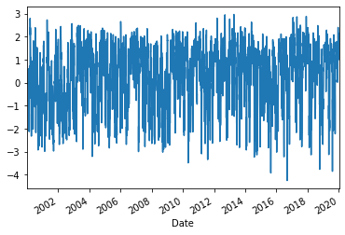
Plotting the Signal
#dfP['zScore'].plot()
#plt.show()

Slide 19
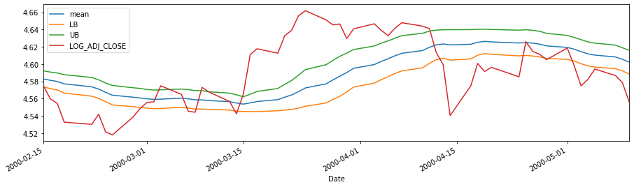
Plotting the Signal
dfP[30:90].plot(y=["mean", "LB", "UB", "LOG_ADJ_CLOSE"], figsize=(15,4))

Slide 20
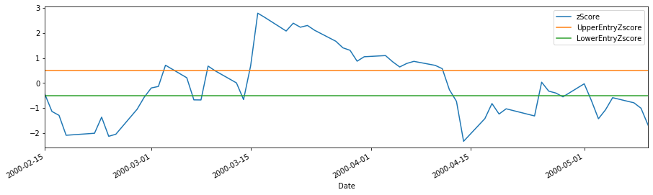
Plotting the Signal
dfP[30:90].plot(y=["zScore", "UpperEntryZscore", "LowerEntryZscore"], figsize=(15,4))

Slide 21
Trading Rule for Going Long
#set up num_units_long
dfP['long_entry'] = ((dfP.zScore < -entryZscore))
dfP['long_exit'] = ((dfP.zScore > -exitZscore))

Slide 22
Calculating long contracts
dfP['num_units_long'] = np.nan #it is important to start with nan in this column otherwise padding wont work
dfP.loc[dfP['long_entry'],'num_units_long'] = 1
dfP.loc[dfP['long_exit'],'num_units_long'] = 0
dfP.iat[0,dfP.columns.get_loc("num_units_long")]= 0
dfP['num_units_long'] = dfP['num_units_long'].fillna(method='pad')

Slide 23
Trading rule for Going Short
#set up num units short
dfP['short_entry'] = ((dfP.zScore > entryZscore))
dfP['short_exit'] = ((dfP.zScore < exitZscore))

Slide 24
Calculating short contracts
dfP['num_units_short'] = np.nan #it is important to start with nan in this column otherwise padding wont work
dfP.loc[dfP['short_entry'],'num_units_short'] = -1
dfP.loc[dfP['short_exit'],'num_units_short'] = 0
dfP.iat[0,dfP.columns.get_loc("num_units_short")]= 0
dfP['num_units_short'] = dfP['num_units_short'].fillna(method='pad')

Slide 25
Calculating the total num_units or STANCE and the system returns
1. dfP[‘stance'] = dfP['num_units_long']*(1-tcost) + dfP['num_units_short']*shorts*(1-tcost)
2. dfP['syst_rets'] = dfP['pct_rets'] * dfP['stance'].shift(delay)

Slide 26
Calculating system cumulative returns (2 ways)
If using log returns:
dfP['cum_rets'] = np.cumsum(dfP['log_returns'])
If using percent returns:
dfP[‘cum_rets'] =np.cumprod(1+dfP['percent_returns'])-1
Note:
If you want the cumulative (log or percent) returns to start at 1
To reflect a starting investment of 1 dollar,
You can optionally add a 1 to both formulas above

Slide 27
Calculating the system cumulative returns
dfP['syst_cum_rets']= np.cumprod(1+dfP['syst_rets']) -1 + 1

Slide 28
RESULTS: Plotting the system (vs market) cumulative returns
title=symbol
dfP[['market_cum_rets','syst_cum_rets']].plot(grid=True,figsize=(8,5))
plt.ylabel(symbol)
plt.show()

Slide 29
Evaluation metrics calculation
start = 1
start_val = start
end_val = dfP[‘syst_cum_rets'].iat[-1]
start_date = dfP.iloc[0].name
end_date = dfP.iloc[-1].name
days = (end_date - start_date).days

Slide 30
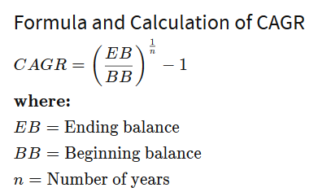
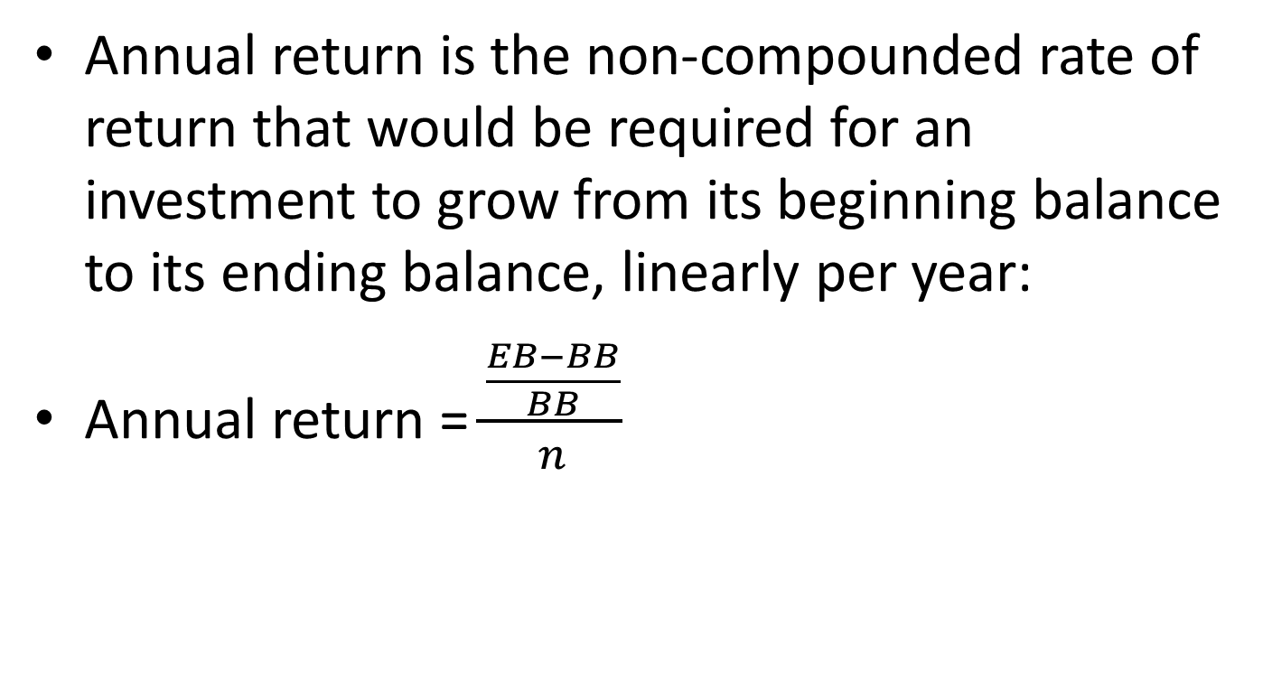
Annual Return
Annual return is the non-compounded rate of return that would be required for an investment to grow from its beginning balance to its ending balance, linearly per year:
Annual return = $\frac{\frac{EB−BB}{BB}}{n}$

Slide 31
Evaluation metrics: Annual Return
periods = 360 #360 accounting days
trading_periods = 252 #252 trading days
TotaAnnReturn = (end_val-start_val)/start_val/(days/periods)
TotaAnnReturn_trading = (end_val-start_val)/start_val/(days/trading_periods)

Slide 32
CAGR
Compound annual growth rate (CAGR) is the rate of return that would be required for an investment to grow from its beginning balance to its ending balance, assuming the profits were reinvested at the end of each year of the investment’s lifespan.
https://www.investopedia.com/terms/c/cagr.asp

Slide 33
Evaluation metrics: CAGR
years = days/periods
CAGR = ((end_val/start_val)^(1/years)-1)

Slide 34
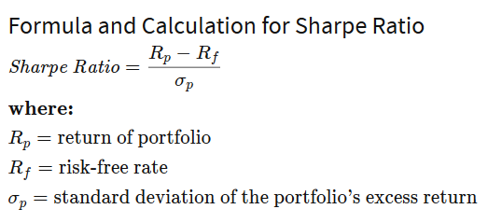
Sharpe Ratio
The ratio is the average return earned in excess of the risk-free rate per unit of volatility or total risk.
Simplified: (period ** (1.0/2.0)) * np.mean(dailyRet) / np.std(dailyRet)
period=365 days in a year
period=252 trading days in a year (stricter)
annualization_factor = period ** (1.0/2.0)
Note:
Use this metric
to evaluate
goodness of
trading system
https://www.investopedia.com/terms/s/sharperatio.asp

Slide 35
Evaluation metrics: Sharpe ratio
try:
sharpe = (dfP[‘syst_rets'].mean()/ (dfP[‘syst_rets'].std()) * np.sqrt(periods))
except ZeroDivisionError:
sharpe = 0.0

Slide 36
Profit Factor
#Profit Factor
dfP['profits'] = np.where((dfP['syst_rets'] >= 0),dfP['syst_rets'], 0)
dfP['losses'] = np.where((dfP['syst_rets'] < 0), dfP['syst_rets'], 0)
profit_ratio = dfP['profits'].sum()/np.sum(np.abs(dfP['losses']))
print ("Profit Factor (should be above 1.3) = %f" %(round(profit_ratio,2)))

Slide 37
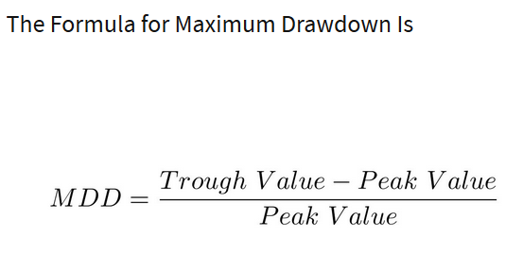
Maximum Draw Down
A maximum drawdown (MDD) is the maximum observed loss from a peak to a trough of a portfolio, before a new peak is attained. Maximum drawdown is an indicator of downside risk over a specified time period.

Slide 38
Maximum Draw Down Program
def calculateMaxDD(cumret):
highwatermark = np.zeros(len(cumret))
drawdown = np.zeros(len(cumret))
drawdownduration = np.zeros(len(cumret))
for t in range(1, len(cumret)):
highwatermark[t] = np.max([highwatermark[t-1], cumret[t]])
drawdown[t] = (1+cumret[t]) / (1 + highwatermark[t]) - 1
if (drawdown[t]==0):
drawdownduration[t] = 0
else:
drawdownduration[t] = drawdownduration[t-1] + 1
return np.min(drawdown), np.max(drawdownduration)

Slide 39
Calmar Ratio
The Calmar ratio is a comparison of the average annual compounded rate of return and the maximum drawdown risk of commodity trading advisors and hedge funds. The lower the Calmar ratio, the worse the investment performed on a risk-adjusted basis over the specified time period; the higher the Calmar ratio, the better it performed.
Simplified: -cagr/maxDD

Slide 40
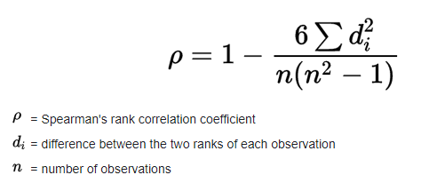
Information Coefficient
The Information Coefficient is the (Pearson) correlation between the return on a common stock predicted by a valuation model or analyst and the actual return.
Some researchers convert predicted and actual values to ranks before correlating.
This means their correlation is the Spearman's rank correlation coefficient --Spearman's rho.
Spearman's rho is similar to Pearson's r (ranges between -1 and 1), but exchanges the Pearson’s r linear relationship for a monotonic relationship.
Spearman’s rho slightly understates the strength of the Pearson r relationship, but its sampling error is about the same.
Any IC based on fewer than several thousand samples will suffer from significant sampling error.
See: ICAndCorrelation.pdf on the sampling error
Spearman Rank Correlation RHO
https://archive.md/g6hOF
https://archive.md/VfNkG

Slide 41

Phik
Phik (𝜙k) is a new and practical correlation coefficient that works consistently between categorical, ordinal, interval (continuous) and even mixed variables, captures non-linear dependency and reverts to the Pearson correlation coefficient in case of a bivariate normal input distribution.
Like Cramer’s Phi or matthews_corrcoef (Phi), Phik is based on the Pearson Chi-squared test and ranges between 0 and 1, but it corrects the former’s defects.
It is especially useful for categorical models like logistic regression.
https://towardsdatascience.com/phik-k-get-familiar-with-the-latest-correlation-coefficient-9ba0032b37e7 (https://archive.is/TksK7 )

Slide 42
White’s Reality Check
import detrendPrice
import WhiteRealityCheckFor1
dfP['Det_Adj_Close'] = detrendPrice.detrendPrice(dfP['Adj Close']).values
dfP['Det_pct_rets'] = (dfP['Det_Adj_Close']-dfP['Det_Adj_Close'].shift(1))/dfP['Det_Adj_Close'].shift(1)
dfP['Det_syst_rets'] = dfP['Det_pct_rets'] * dfP['stance'].shift(delay)
WhiteRealityCheckFor1.bootstrap(dfP['Det_syst_rets'])

Slide 43
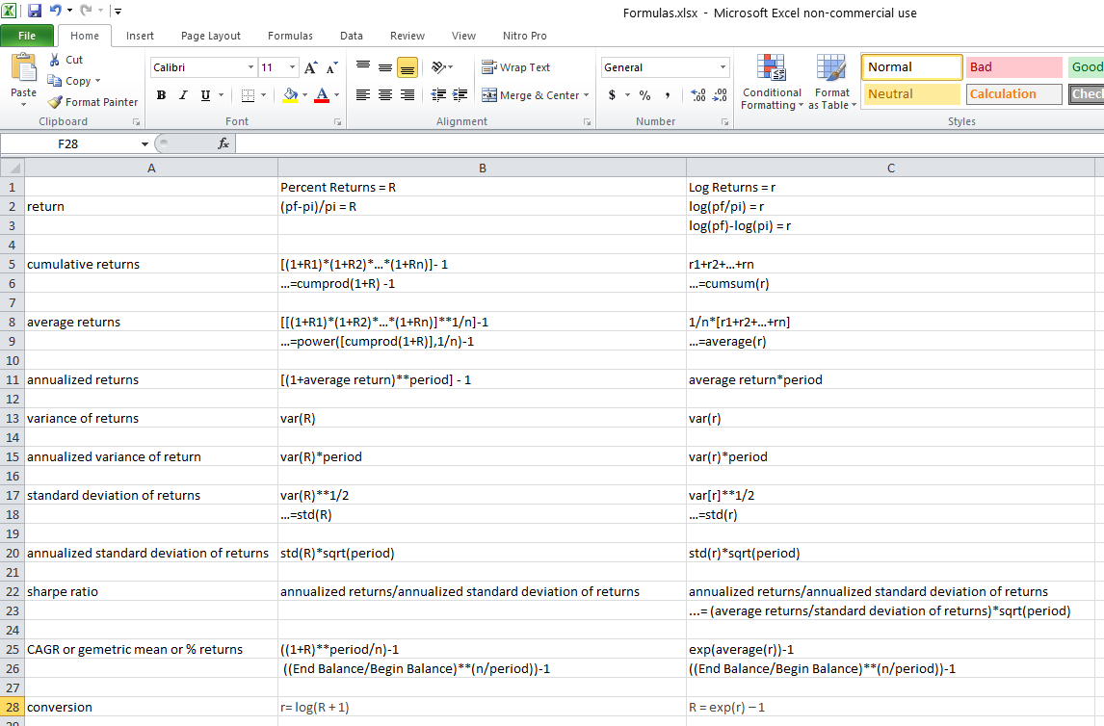
Returns.xlsx

Slide 44
Conclusions
A typical algorithmic trading workflow involves the calculation of a trading signal and a trading rule.
This trading signal or rule will often take advantage of the normality of the distribution of log returns or log prices.
Machine learning can be applied to the calculation of the trading signal and trading rule.
Financial performance metrics used to evaluate a typical algorithmic trading system often involve the calculation of percent returns.
This is especially true if the Sharpe ratio is used, which is probably the most important financial performance metric.
Log returns and percent returns require different formulas.

Slide 45
Conclusions
Favored financial metrics are not included “out of the box” in Scikit-Learn or Keras:
Annual return
CAGR
Sharpe Ratio
Profit Factor
Maximum Draw Dawn
Calmar Ratio
Information Coefficient (Spearman's rho)
Phik
White’s Reality Check

