Slide 1
Technical Indicators
RSI ADX SAR

Slide 2
RSI
What Is Relative Strength Index – RSI?
The relative strength index (RSI) is a momentum indicator that measures the magnitude of recent price changes to evaluate overbought or oversold conditions in the price of a stock or other asset. The RSI is displayed as an oscillator (a line graph that moves between two extremes) and can have a reading from 0 to 100. The indicator was originally developed by J. Welles Wilder Jr. and introduced in his seminal 1978 book, New Concepts in Technical Trading Systems.
Traditional interpretation and usage of the RSI are that values of 70 or above indicate that a security is becoming overbought or overvalued and may be primed for a trend reversal or corrective pullback in price. An RSI reading of 30 or below indicates an oversold or undervalued condition.
https://www.investopedia.com/terms/r/rsi.asp

Slide 3
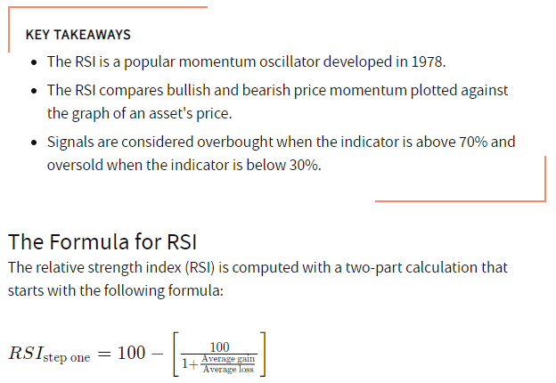
RSI
The formula for
ADX is very
complex,
This is why it is
advisable to use
a trading package
such as Talib
to calculate it

Slide 4
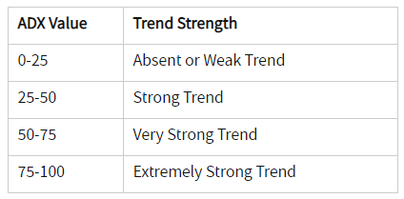
ADX
ADX values help traders identify the strongest and most profitable trends to trade. The values are also important for distinguishing between trending and non-trending conditions. Many traders will use ADX readings above 25 to suggest that the trend is strong enough for trend-trading strategies. Conversely, when ADX is below 25, many will avoid trend-trading strategies.
https://www.investopedia.com/articles/trading/07/adx-trend-indicator.asp
https://www.investopedia.com/terms/a/adx.asp

Slide 5
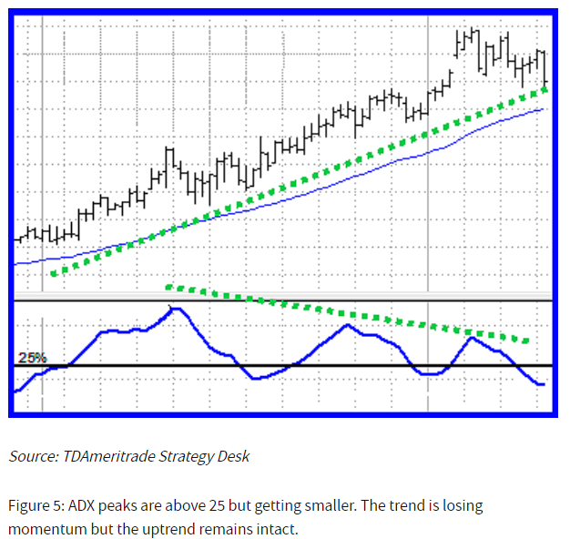
ADX
The series of ADX peaks are also a visual representation of overall trend momentum. ADX clearly indicates when the trend is gaining or losing momentum. Momentum is the velocity of price. A series of higher ADX peaks means trend momentum is increasing. A series of lower ADX peaks means trend momentum is decreasing. Any ADX peak above 25 is considered strong, even if it is a lower peak. In an uptrend, price can still rise on decreasing ADX momentum because overhead supply is eaten up as the trend progresses (Figure 5).

Slide 6
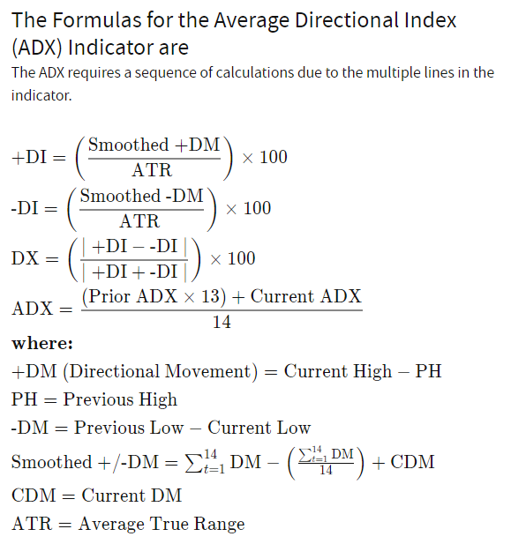
ADX
The formula for
ADX is very
complex,
This is why it is
advisable to use
a trading package
such as Talib
to calculate it

Slide 7
SAR
The parabolic SAR indicator, developed by J. Wells Wilder, is used by traders to determine trend direction and potential reversals in price. The indicator uses a trailing stop and reverse method called "SAR," or stop and reverse, to identify suitable exit and entry points. Traders also refer to the indicator as the parabolic stop and reverse, parabolic SAR, or PSAR.
For best results, traders should use the parabolic indicator with other technical indicators that indicate whether a market is trending or not, such as the average directional index (ADX), a moving average or trendline.
https://www.investopedia.com/terms/p/parabolicindicator.asp

Slide 8
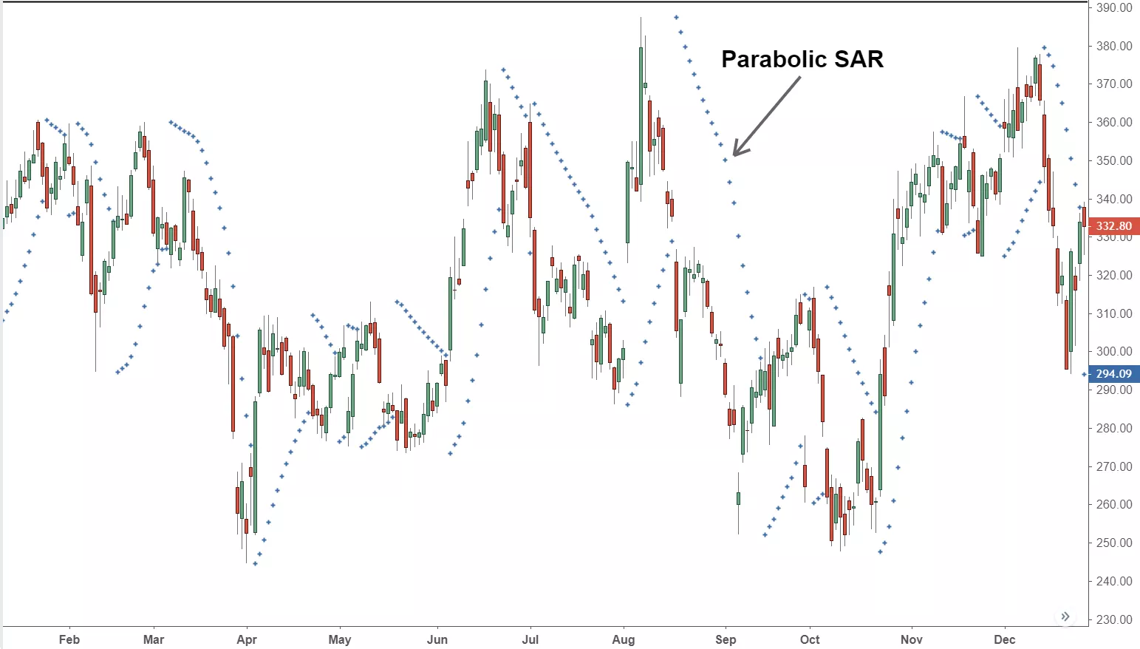
SAR
The parabolic SAR indicator appears on a chart as a series of dots,
either above or below an asset's price, depending on the direction the price is moving.
A dot is placed below the price when it is trending upward, and
above the price when it is trending downward.

Slide 9
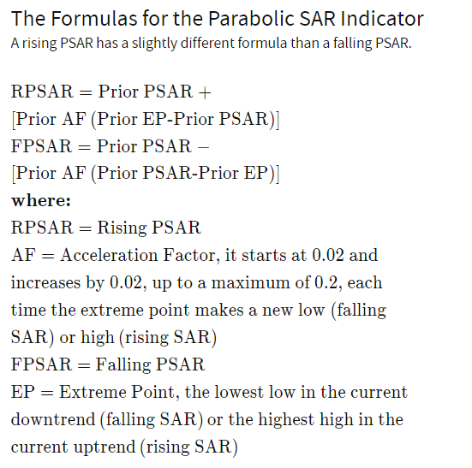
SAR
The formula for
SAR is very
complex,
This is why it is
advisable to use
a trading package
such as Talib
to calculate it

