Slide 1
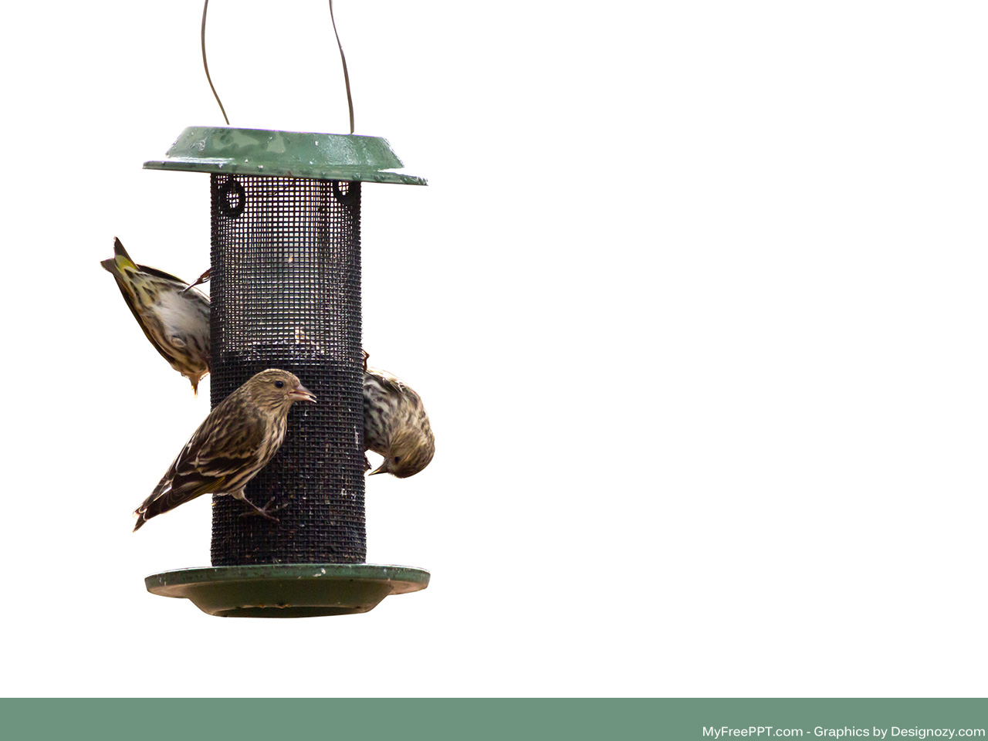

Smart Bird Feeder
Stevie Nicks and the Xaybanha Zhous – Group 9 – 12/9/2020 – Version 1.0
Stephanie “Stevie” Taylor, Calvin Xaybanha, Zeming Zhou, Nickolas Short

Slide 2

Problem Statement
Crows and squirrels eat the seed meant for small birds in most commercial bird feeders on the market today.
Who is this a problem for?
Bird watchers
Urbanites who suffer from inflammatory diseases or asthma
Notes:
per the 2016 National Survey of Fishing, Hunting, and Wildlife-Associated Recreation

Slide 3
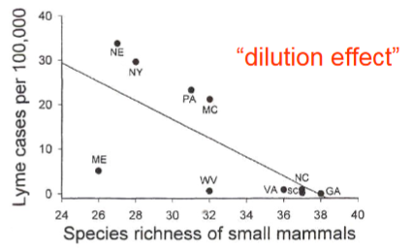
Motivation
An easy way for bird watchers to feed small birds.
It is important because the species richness of urban ecology is what keeps us healthier.
Ostfeld & Keesing. 2000. Biodiversity and disease risk: the case of Lyme disease. Con. Bio. 14:722-728.

Slide 4
Concept of Operation
The automatic bird feeder was designed to dispense
bird feed to birds when a small bird is “detected”.
The automatic bird feeder detects the small bird if it
mounts onto the perch where the force sensor is affixed if it weighs less
than 500g and if the bird’s chirping is audible to the microphone and
above 50Hz.
After a bird is detected, the servo motor will rotate +90 degrees to
open a gate to the bird feed reservoir, and bird feed will fall into a
basin. Less than one second after the gate has opened, the motor will
close the gate with a -90 degree rotation to stop the flow of bird feed
and return to its original position.

Slide 5
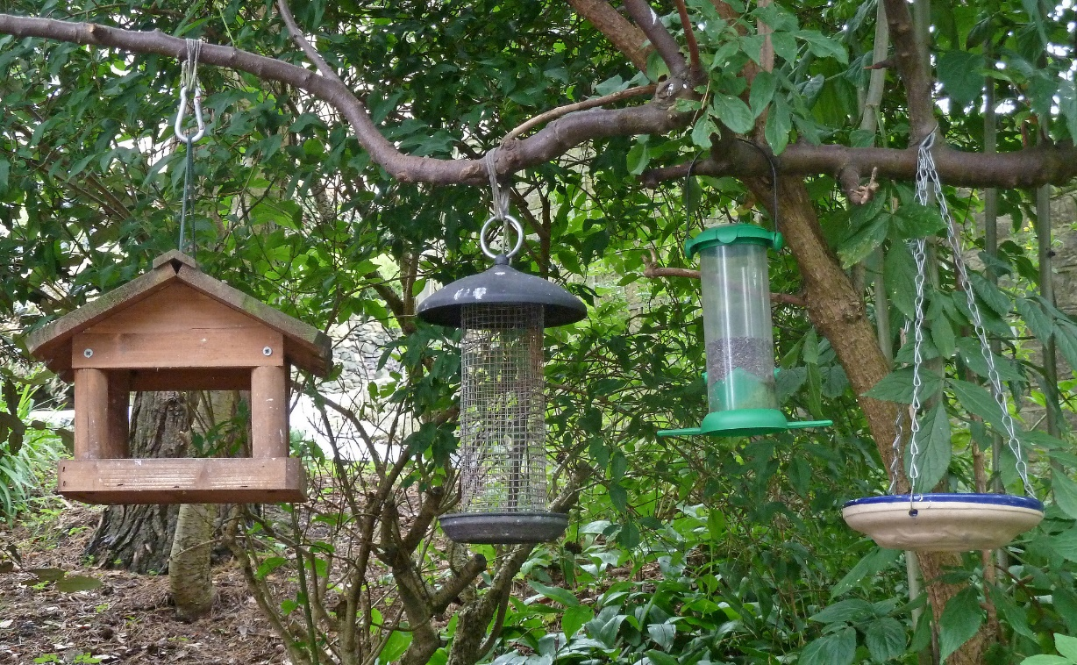
Alternatives
Bird feeders already available on the market can feed small birds. The success or even attempt to repel squirrels and crows depends on the bird feeder, but in all cases they don’t also teach the bird to chirp for its food.

Slide 6
Requirements
Must automatically dispense bird feed when a bird is "detected“
Must be able to "feed" only small birds
Must use a microcontroller to control servo based on microphone and weight sensor

Slide 7
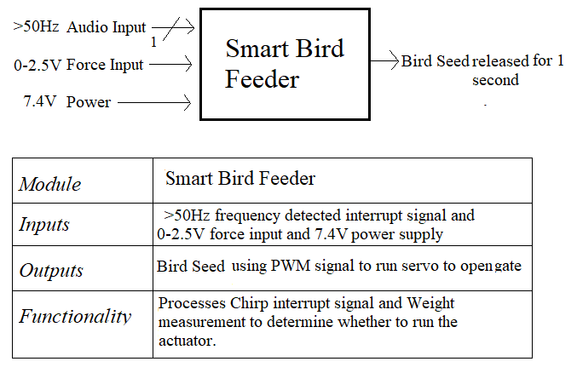
Design – Hardware – Level 0

Slide 8
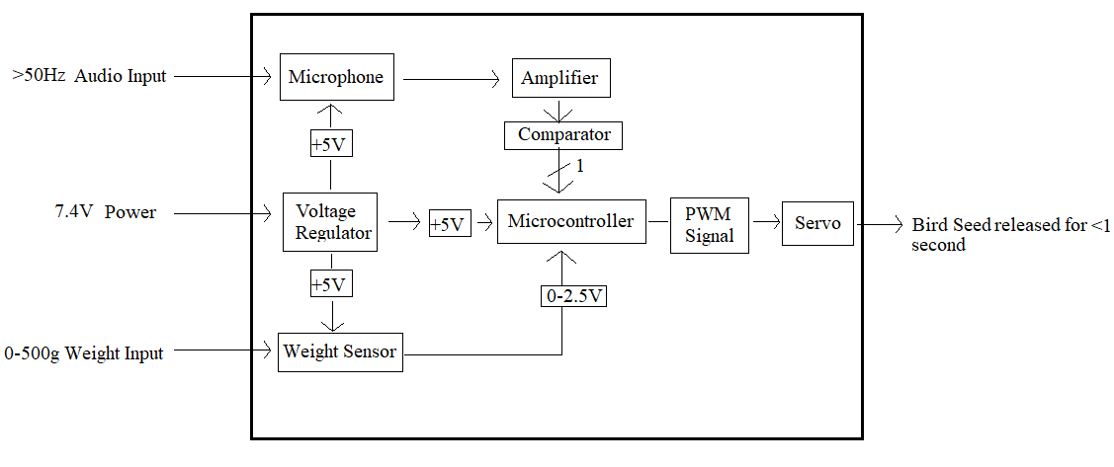
Design – Hardware – Level 1

Slide 9
Design – State Transition Diagram
SOUND
SOUND
READING
NO_SOUND
IDLE
ADC
WRONG_MASS
FEED_AGAIN
RIGHT_MASS
WAIT
DOOR
DOOR_CLOSED
DOOR_MOVING
DOOR_CLOSED

Slide 10
Design – Software (Overview)
Utilized Arduino IDE for its good selection of built-in functions (analogRead, digitalWrite, etc.) as well as prepackaged libraries—namely the Servo library.
Fairly simple program with few lines of code when using the IDE.

Slide 11
Design – Software (Code)
// Some useful #defines
#define WT_MIN 100
#define WT_MAX 450
#define MIC_PIN 2
#define WEIGHT_PIN A5
#define SERVO_PIN 3
#define TRAVEL_ANGLE 90
#define ANGLE TRAVEL_ANGLE / 2
#define OPEN_TIME 1500
#define WAIT_TIME 30000
// Variables
Servo gateServo;
int weightMeasurement = 0;
void setup() {
gateServo.attach(SERVO_PIN);
pinMode(WEIGHT_PIN, INPUT);
pinMode(MIC_PIN, INPUT);
}
//in the loop the sensors are read and open the gate if requirements are met
void loop() {
if(digitalRead(MIC_PIN)) {
weightMeasurement = analogRead(WEIGHT_PIN);
if( (WT_MIN <= weightMeasurement) &&
(weightMeasurement <= WT_MAX) ) {
cycleChuteDoor();
}
else delay(250);
}
}
//for cycle chute door function the servo opens and closes
void cycleChuteDoor() {
myservo.write(90-ANGLE);
delay(OPEN_TIME / 2);
myservo.write(90+ANGLE);
delay(OPEN_TIME / 2 + WAIT_TIME);
}

Slide 12
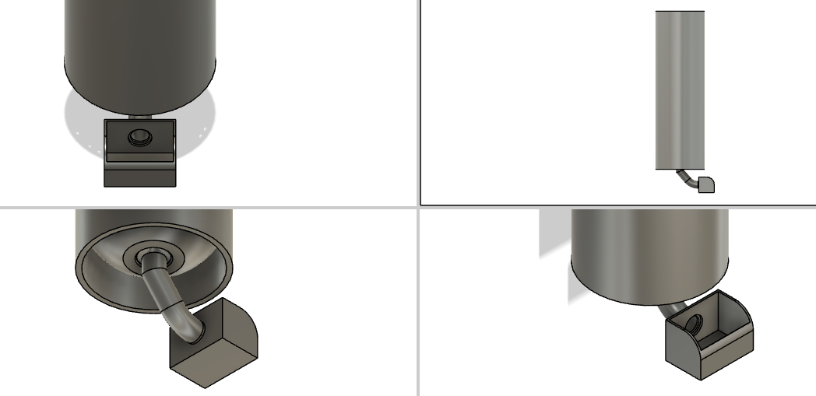
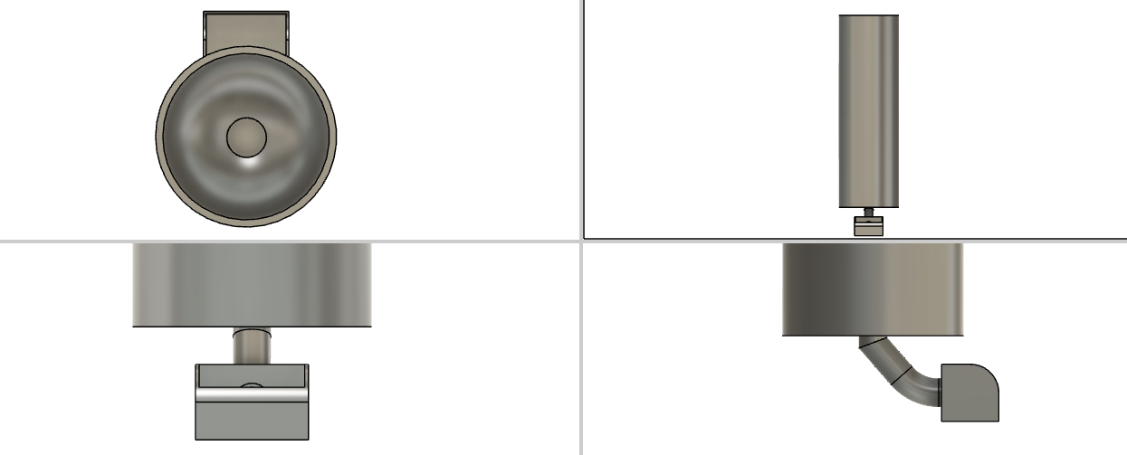
Design - CAD

Slide 13
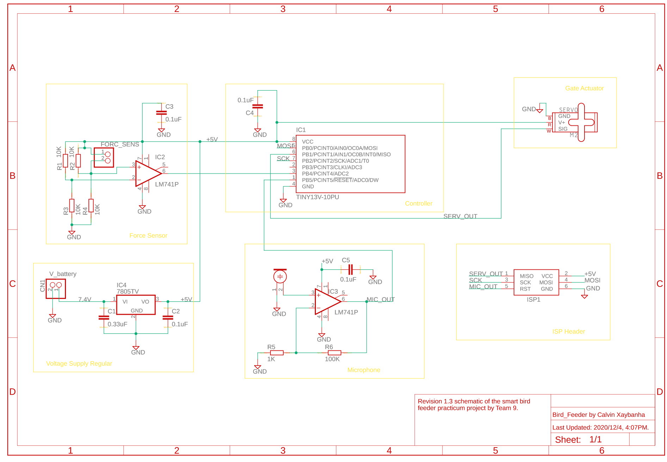
Implementation - Schematic

Slide 14
Implementation - Tools
Hardware:
Oscilloscope
Digital Multimeter
Power Supply
Software:
EagleCAD
Fusion360
Arduino IDE
Microsoft Project

Slide 15
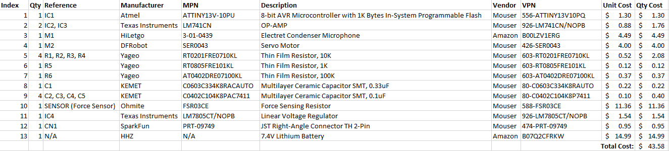
Implementation - BOM
Notes:
Total cost per person for this project was $43.58 x 4 = $174.32

Slide 16
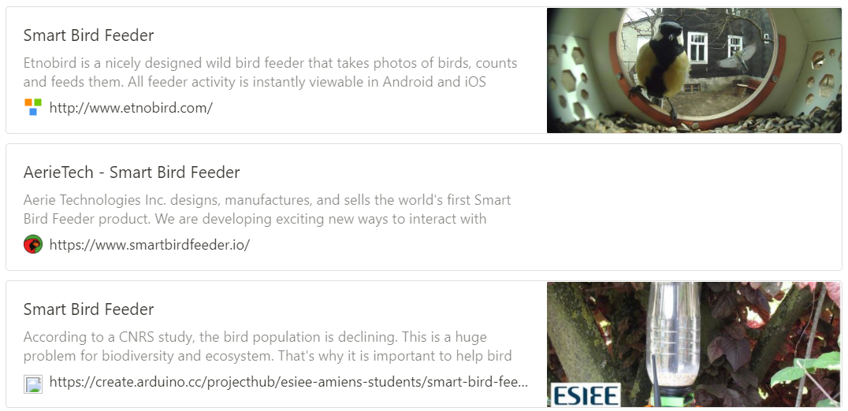
Prior Work
The competition for smart bird feeders are focused on bird watchers with smart cameras – none focus on smart selectivity in using weight to not feed squirrels and crows.
These are currently in development, there is no existing smart bird feeder that a user can buy off the market.

Slide 17
Contributions
Calvin – Schematic, board design, prototyping the ATTiny to control the servo motor
Stevie – Organizing, ordering parts, prototyping, writing
Zeming – Ordering parts, prototyping, writing
Nick – Prototyping, coding, testing, board layout
Notes:
Calvin - I contributed to the schematic and board design. I did some tests using the ATTiny to control the servo motor, such as finding the PWM signal whose duty cycle is controlled by a 10K ohm potentiometer to get a clockwise rotation, counterclockwise rotation, and no rotation.

Slide 18
Lessons Learned
Calvin – Always view the datasheet of a part before purchasing it and use parts more suitable for prototyping.
Stevie – Do better research on parts before purchasing and check rubrics (i.e. client emails, paperwork explaining the requirements) before turning in homework (paperwork the client asked for).
Zeming - How to communicate effectively with teammates, look for electrical components, and design some simple PCBs.
Nick –Implement the 1-wire Debug functionality in the device to allow for outputting register values.
Notes:
Calvin - I learned that you should always view the datasheet of a part before purchasing it, unless it is not provided. I would definitely change some parts to be more suited to prototyping. For example, the continuous rotation servo motor changed to a normal servo, and ATTiny13 to a different controller IC with more I/O pins, and more allocated memory for uploading programs.

Slide 19
Lessons Learned – Design Review
Schematic:
Need to add linear regulator and make sure voltage nets are applied properly.
Add ISP header.
Board:
Need thicker traces all around.
Primarily surface mount components.
Need to add stitching vias.
Notes:
Calvin - I learned that you should always view the datasheet of a part before purchasing it, unless it is not provided. I would definitely change some parts to be more suited to prototyping. For example, the continuous rotation servo motor changed to a normal servo, and ATTiny13 to a different controller IC with more I/O pins, and more allocated memory for uploading programs.

Slide 20
Questions?
Notes:
Calvin - I learned that you should always view the datasheet of a part before purchasing it, unless it is not provided. I would definitely change some parts to be more suited to prototyping. For example, the continuous rotation servo motor changed to a normal servo, and ATTiny13 to a different controller IC with more I/O pins, and more allocated memory for uploading programs.

Slide 21
…On to the demo! https://youtu.be/FhXBFi9wiv4 https://youtu.be/82VhC-g9Ptc
Notes:
Calvin - I learned that you should always view the datasheet of a part before purchasing it, unless it is not provided. I would definitely change some parts to be more suited to prototyping. For example, the continuous rotation servo motor changed to a normal servo, and ATTiny13 to a different controller IC with more I/O pins, and more allocated memory for uploading programs.

