Slide 1
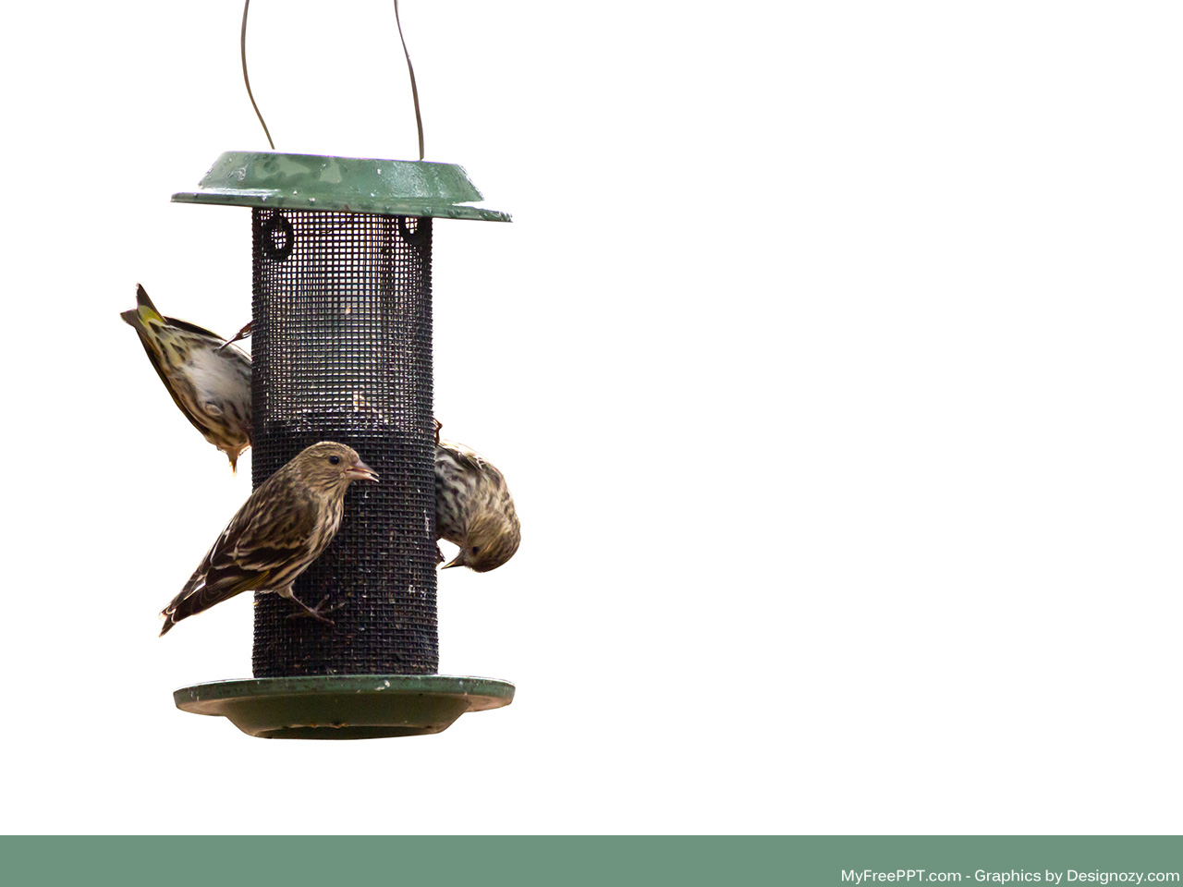

Smart Bird Feeder
Stevie Nicks and the Xaybanha Zhous – Group 9 – 12/9/2020 – Version 1.0
Calvin Xaybanha, Stephanie “Stevie” Taylor, Zeming Zhou, Nickolas Short

Slide 2

Problem or Need
The problem is that crows and squirrels eat the seed meant for small birds.
If squirrels and crows were trained by the device not feeding them to keep away from the smart bird feeder, the around 46 million Americans considering themselves bird watchers per the 2016 National Survey of Fishing, Hunting, and Wildlife-Associated Recreation will be satisfied.

Slide 3
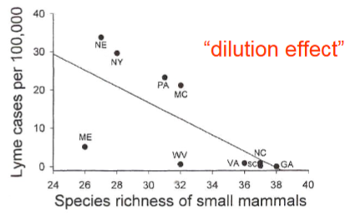
Motivation
It is important because the species richness of urban ecology is what keeps us healthier.
Ostfeld & Keesing. 2000. Biodiversity and disease risk: the case of Lyme disease. Con. Bio. 14:722-728.

Slide 4
Objective
Use a microcontroller to only release seed if the microphone is activated above a threshold frequency, which is to check that a bird is chirping, and the weight sensor feels a weight less than the threshold, above which is assumed to be a crow or squirrel.

Slide 5
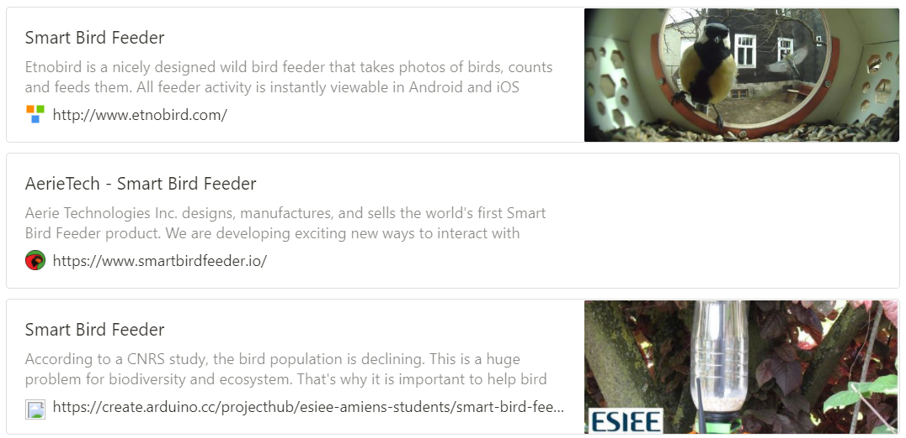
Alternatives
The existing smart bird feeders are focused on bird watchers with smart cameras – none focus on smart selectivity in using weight to not feed squirrels and crows.

Slide 6
Requirements
Must automatically dispense bird feed when a bird is "detected“
Must be able to "feed" only small birds
Must use a microcontroller to control servo based on microphone and weight sensor

Slide 7
Project Schedule
Brief overview of your approach and your project schedule

Slide 8
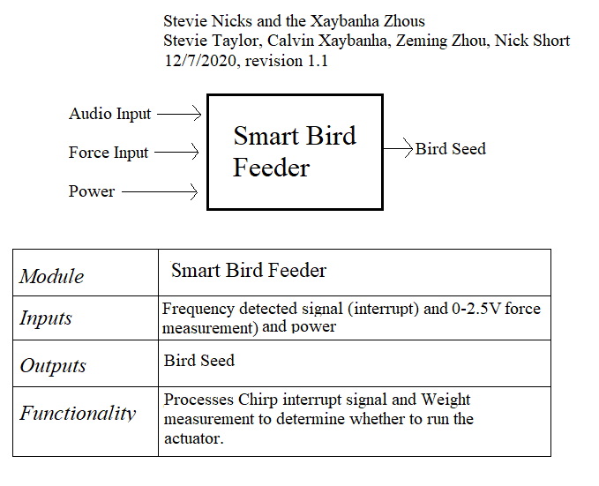
Design – Hardware – Level 0
We had to redesign to use a weight/force sensor to determine small bird vs crow/squirrel instead of only frequency. There isn’t sufficient difference between frequency of squirrels to birds to only use audio.

Slide 9
Design - Software
Describe design using appropriate methods (e.g. block diagrams, UML models, algorithms)
Discuss design alternatives, trade-offs, decisions made

Slide 10
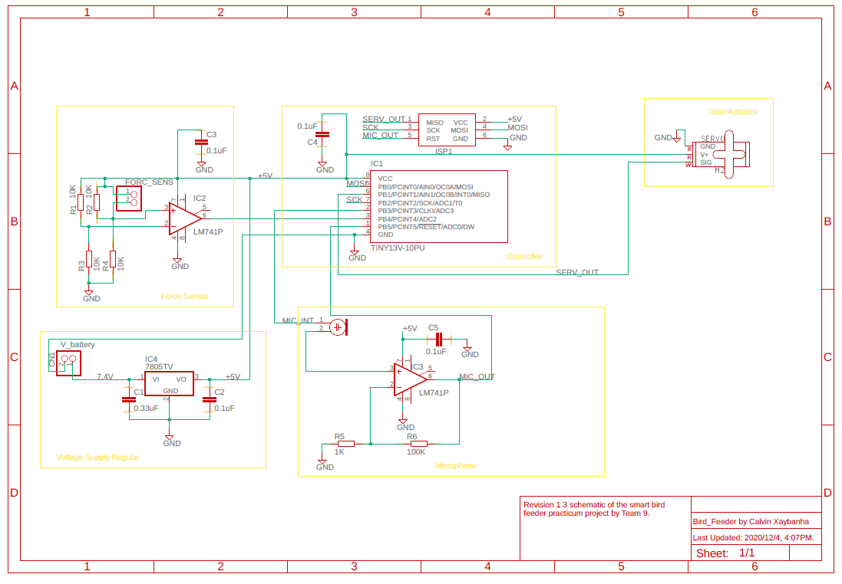
Implementation - Schematic

Slide 11
Implementation - Tools
Oscilloscope
EagleCAD
DMM
Power Supply
Fusion360
Arduino IDE

Slide 12
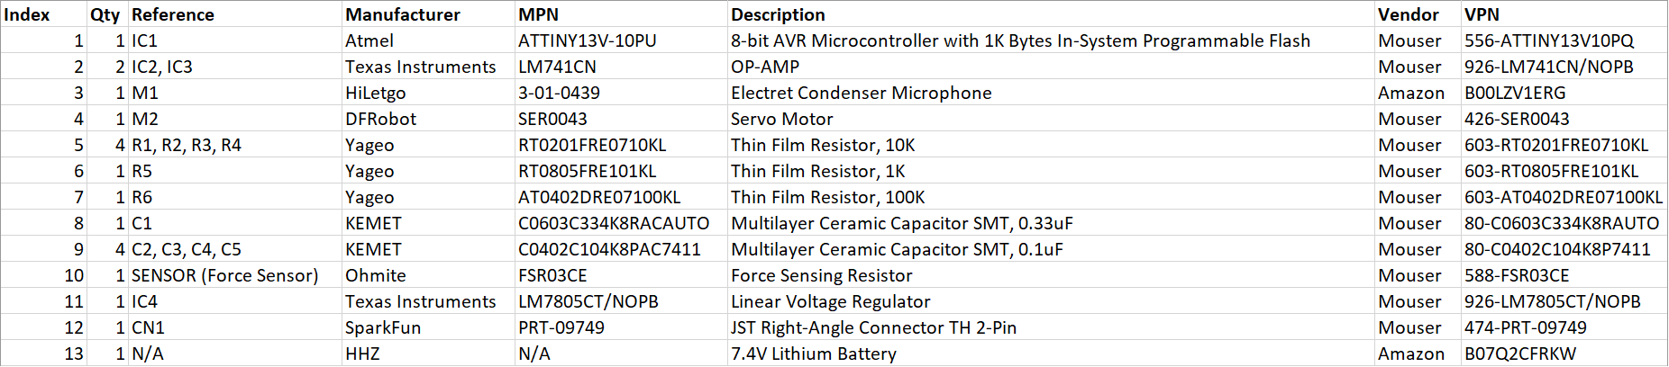
Implementation - BOM

Slide 13
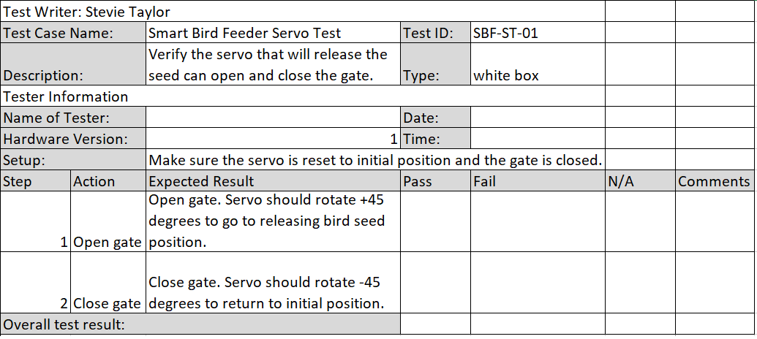
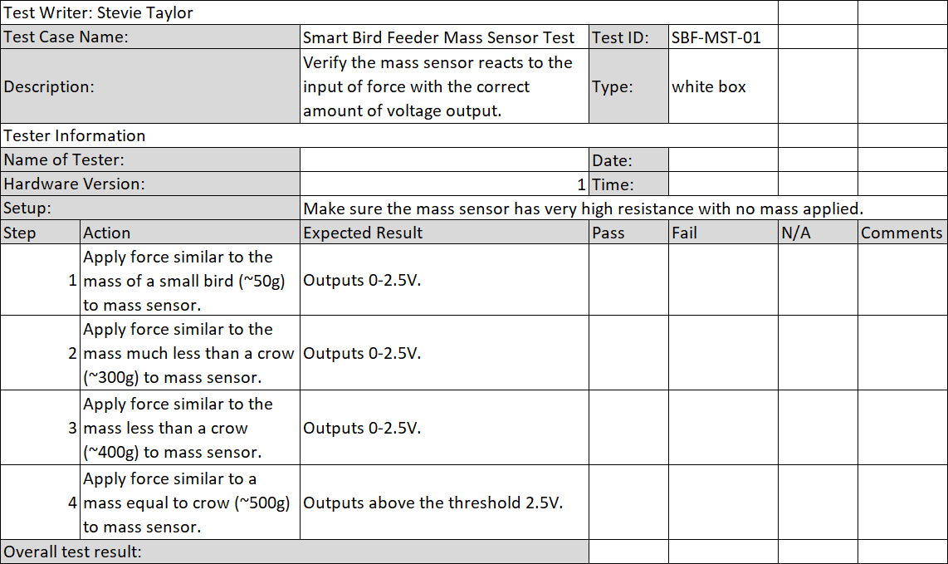
Testing – The Test Cases

Slide 14
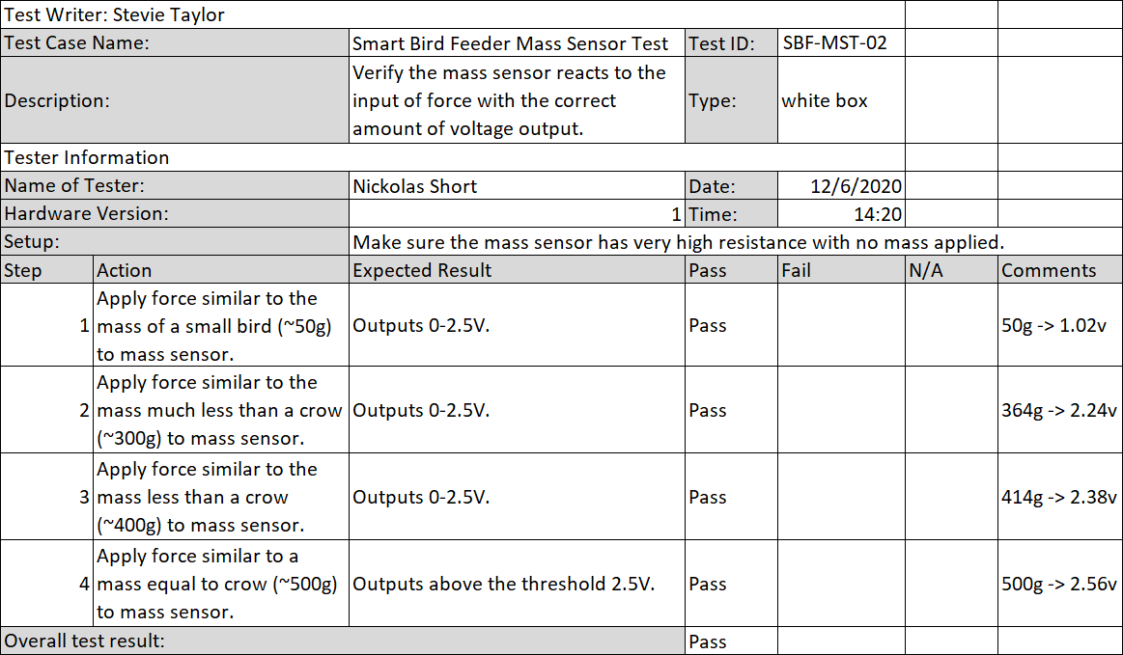
Results
The first mass sensor resistor values had to be modified to get a decent response. The 10k resistors forced too rapid of a rise and we would have been close to the maximum signal at 500g. The resistor in parallel with the sensor is a 12kohm resistor and the one to ground is a 1kohm resistor.
With these changes after the first failed test, we were able to successfully test the mass sensor and achieve results within our threshold.

Slide 15
Contributions
Calvin – Schematic, board design, testing the ATTiny to control the servo motor
Stevie – Organizing, ordering parts, prototyping, writing
Zeming – Ordering parts, prototyping, writing
Nick – Prototyping, coding, testing
Notes:
Calvin - I contributed to the schematic and board design. I did some tests using the ATTiny to control the servo motor, such as finding the PWM signal whose duty cycle is controlled by a 10K ohm potentiometer to get a clockwise rotation, counterclockwise rotation, and no rotation.

Slide 16
Lessons Learned
Calvin – Always view the datasheet of a part before purchasing it and use parts more suitable for prototyping.
Stevie – Do better research on parts before purchasing and check rubrics (i.e. client emails, paperwork explaining the requirements) before turning in homework (paperwork the client asked for).
Zeming - How to communicate effectively with teammates, look for electrical components, and design some simple PCBs.
Nick -
Notes:
Calvin - I learned that you should always view the datasheet of a part before purchasing it, unless it is not provided. I would definitely change some parts to be more suited to prototyping. For example, the continuous rotation servo motor changed to a normal servo, and ATTiny13 to a different controller IC with more I/O pins, and more allocated memory for uploading programs.

