Slide 1
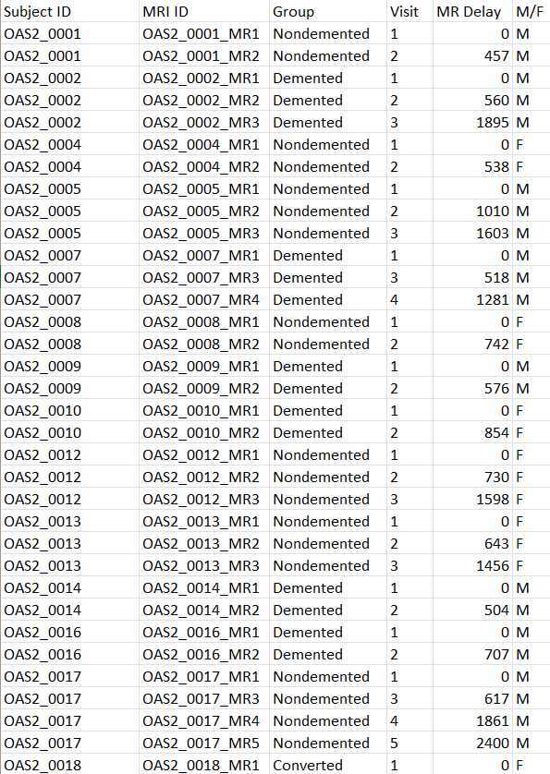
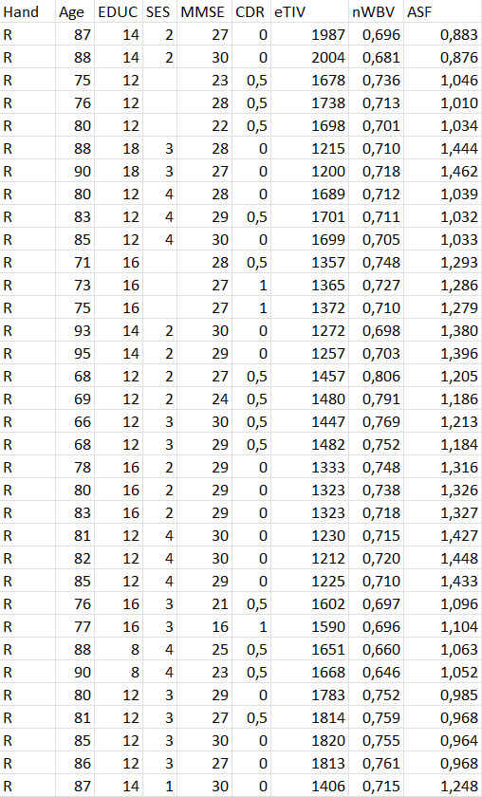
Philip Stewart
Dataset / project name: Predicting dementia status using MRI and clinical data of 150 subjects aged 60 to 96
Brief description: Dementia is a progressive neurodegenerative condition that affects millions worldwide. Applying machine learning to MRI and clinical data can help predict dementia onset and progression, enabling earlier diagnosis and personalized interventions.
Type of problem: Dimensionality reduction and supervised learning (classification problem)
Type of data: Features X: Clinical and MRI-based variables. Target labels y: Dementia status (demented/nondemented).
Dataset in numbers: 373 MRI scans, 150 individuals of which 72 nondemented subjects, 64 demented subjects, 14 converted subjects (nondemented at initial visit but demented at later visit)
Online source: https://sites.wustl.edu/oasisbrains/home/oasis-2/ (OASIS-2 Longitudinal Subject Data)

