Slide 1
FIBRE

Slide 2
FIBRE
smallest unit of a textile material that has length many times greater than its diameter
considered as a form of trace evidence that can be transferred from the clothing during the commission of the crime
helps to establish links between individuals, objects, and crime scenes.
aids law enforcement agencies and legal professionals in solving cases and ensuring justice.
Unlike DNA and fingerprints, fibres are not specific to a single person

Slide 3
CLASSIFICATION
Natural Fibers: obtained from plants, animals, or mineral sources.
Plant-Based Natural Fibers
1. Cotton: Derived from the cotton plant's seed fibers (softness and absorbency)
2. Flax (Linen): Extracted from the flax plant's stem (durable, breathable)
Animal-Based Natural Fibers:
1. Wool: Obtained from the fleece of sheep (warmth, moisture-wicking properties, and elasticity)
2. Silk: Produced by silkworms (luxurious feel, strength, and natural sheen)

Slide 4
Mineral-Based Natural Fibers:
1. Asbestos: Although banned in many countries due to health risks, asbestos was historically used for its fire-resistant properties.
Synthetic Fibers:manufactured from chemical compounds
-offer various desirable properties such as durability, wrinkle resistance, and color retention.
Polymer-Based Synthetic Fibers:
1. Polyester: ethylene glycol + terephthalic acid.
-Made from petroleum-based chemicals (versatile, strong,used in apparel, home furnishings, and industrial applications)
2. Nylon: composed of polyamides
-Known for its strength and elasticity,used in clothing, parachutes etc.

Slide 5
Other Synthetic Fibers:
1. Acrylic: acrylonitrile
-mimic wool's appearance (lightweight, warm, and resistant to sunlight,suitable for sweaters and outdoor gear)
2. Polypropylene: Resistant to moisture and stains,used in activewear, upholstery, and carpets.
Semi-Synthetic Fibers:derived from natural materials +chemically modified
Cellulose-Based Semi-Synthetic Fibers:
1. Rayon: Created from wood pulp (NaOH+CS2+H2SO4)
-soft, breathable, and versatile,used in clothing, home textiles, and medical applications.
2. Lyocell (Tencel): wood pulp+amine oxide
Similar to rayon but produced in a more environmentally friendly process (smooth texture, sustainable)

Slide 6
FORENSIC SIGNIFICANCE
1. Linking Individuals to Crime Scenes:
fibers from a suspect's clothing at a crime scene or on a victim-direct link
fibers from a crime scene on a suspect's clothing or belongings can link them to the scene.
2. Corroborating Statements:
fiber analysis can support or contradict the claims of witnesses about their interactions and whereabouts.

Slide 7
3. Crime Scene Reconstruction:
The distribution of fibers within a crime scene- reconstruct events and interactions.
fiber patterns analysis- the movements of individuals and objects- reconstructing the sequence of events.
4. Suspect Profiling:
lifestyle, activities, and habits (suspect profiles and investigative strategies)
5. Cold Case Resolution:
new leads or corroborating existing evidence.
old fibers to be reanalyzed using modern methods.

Slide 8
6. Linking Multiple Crime Scenes:
same type of fiber at different crime scenes- common perpetrator or modus operandi (help in connecting seemingly unrelated cases)

Slide 9
OPTICAL PROPERTIES
1. FLUORESCENCE
emission of light when exposed to external light of a shorter wavelength.
The emitted light has a longer wavelength and lower energy than the excitation light.
Mechanism:
occurs due to the absorption of photons by atoms or molecules in the material, causing them to become excited.
As these excited states return to their ground state, they release energy in the form of fluorescent light.

Slide 10
Applications:
used to detect and analyze fibers (especially those containing fluorescent dyes or naturally fluorescing compounds)
use specialized lighting and filters to reveal hidden or altered fibers

Slide 11
2. REFRACTIVE INDEX
measure of how much light is bent or refracted when it passes from one medium (air) into another medium (fiber).
η= velocity of light in vacuum
velocity of light in medium
Importance:
RI of a fiber affects how light interacts with it.
Differences in RI between fibers used to identify and differentiate various types of fibers.
Factors affecting RI
Temperature: as temperature increases, the refractive index decreases
Wavelength: Different wavelengths of light experience different refractive indices, leading to the phenomenon of chromatic dispersion.

Slide 12
Standard RI- when any transparent material examined at a wavelength of 589nm and at a temperature of 25℃
3. BIREFRINGENCE
Birefringence is the optical property of a material that causes it to have two different refractive indices for light polarized in two perpendicular directions (one polarized parallel to the fibre axis and the other polarized perpendicular to the fibre axis)
results from the anisotropic arrangement of molecules within a material.
Δn = n1 – n2
Greater the value of birefringence- most molecules to the parallel to the fibre axis
Value of birefringence zero- it is randomly directed

Slide 13
Mechanism:
occurs when light passes through a birefringent material, splitting into two polarized rays that travel at different speeds and follow different paths
Applications:
to identify and characterize fibers, especially in cases involving textiles or polymer materials.
Polarized light microscopy- to visualize and measure birefringence, helping in fiber differentiation.

Slide 14
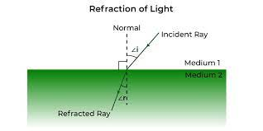
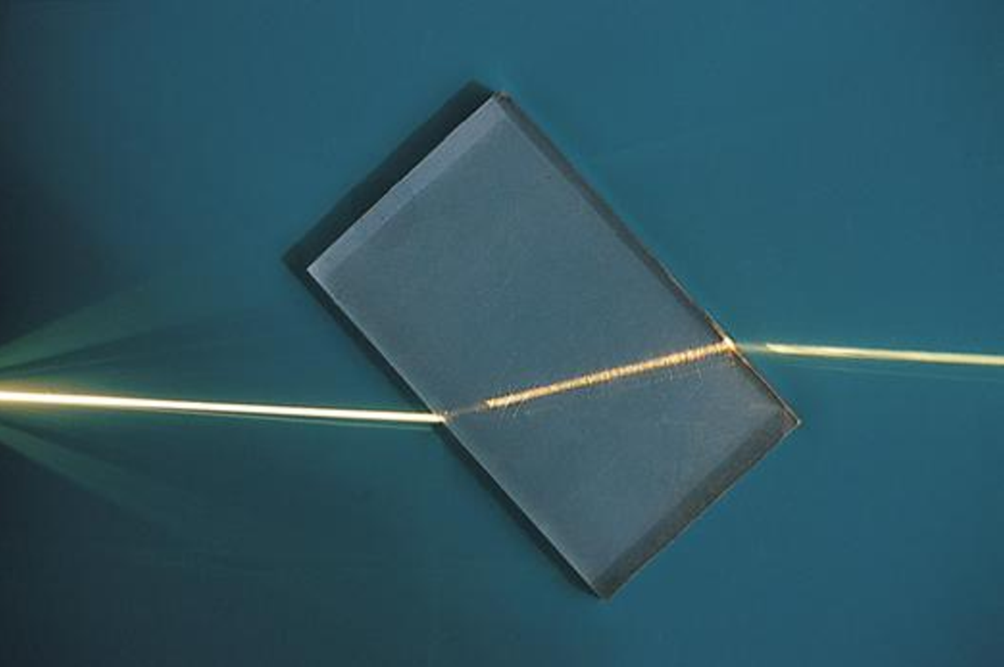
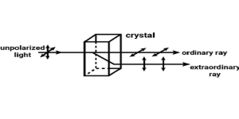
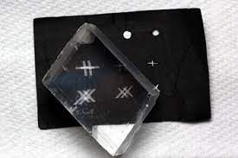

Slide 15
EXAMINATION OF FIBRE EVIDENCE
1. FLOATATION TEST: information about the composition and nature of the fibers
PRINCIPLE:
based on the principle of buoyancy
immerse fibers in liquids of known densities, forensic experts can assess whether the fibers' densities match those of the liquids, helping to identify the fiber's composition.

Slide 16
PROCEDURE:
1. Selection of Liquids:Prepare a series of liquids with known densities ( water, ethanol, acetone, and mixtures of these substances)
2. Immersing the Fiber:fiber gently placed onto the surface of the first liquid. Observe whether the fiber sinks, floats, or remains suspended in the liquid. Repeat the process for each liquid in the series.
3. Observation:If the fiber sinks, floats, or remains at a specific level in the liquid, then insights about the fiber's density and composition.

Slide 17
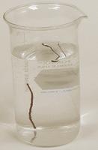
INTERPRETATION
Floating Fiber: If the fiber floats on the surface of a liquid,indicates that fiber's density is lower than that of the liquid (fiber -lower specific gravity -lighter material).
Sinking Fiber: If the fiber sinks to the bottom of a liquid, its density is higher than that of the liquid (fiber -higher specific gravity -denser material).
Suspension: If the fiber remains suspended in a liquid at a specific level, its density closely matches that of the liquid (specific gravity similar to the liquid).

Slide 18
2. BURNING TEST
Classify fiber based on their behaviour when exposed to heat
useful in differentiating between natural and synthetic fibres as well as fibre types
PROCEDURE:
1. Sample Collection and Preparation:
Place the fiber sample on a non-flammable surface, such as a ceramic tile.
2. Ignition:
Using a pair of tweezers, hold the fiber sample with the tip of the flame of a Bunsen burner or a lighter.
Observe and record the fiber's reaction to the heat and flame.

Slide 19
Observations and Interpretations:
a) Flame Behavior:
Natural Fibers:
Natural fibers typically burn with a steady, glowing flame.
The flame may be orange, yellow, or reddish in color.
Synthetic Fibers:
Synthetic fibers often melt, shrink, and curl away from the flame.
They may produce black smoke and may drip or form plastic-like beads.
b) Odor:
Natural Fibers:emit a distinct smell resembling burning hair or leaves.
Synthetic Fibers:may emit a chemical or plastic-like odor.

Slide 20
c) Ash Formation
Natural Fibers: leave behind a soft, crumbly ash that is often gray or black in color.
Synthetic Fibers: leave behind hard, bead-like residue or no ash at all.
Limitations:
1. Variability: influenced by factors such as fiber composition, dye, and treatment, leading to some degree of variability.
2. Subjectivity: Interpretation may require expertise and experience
3. Safety Precautions: Care should be taken to prevent accidental fires or burns. Proper ventilation is important.

Slide 21
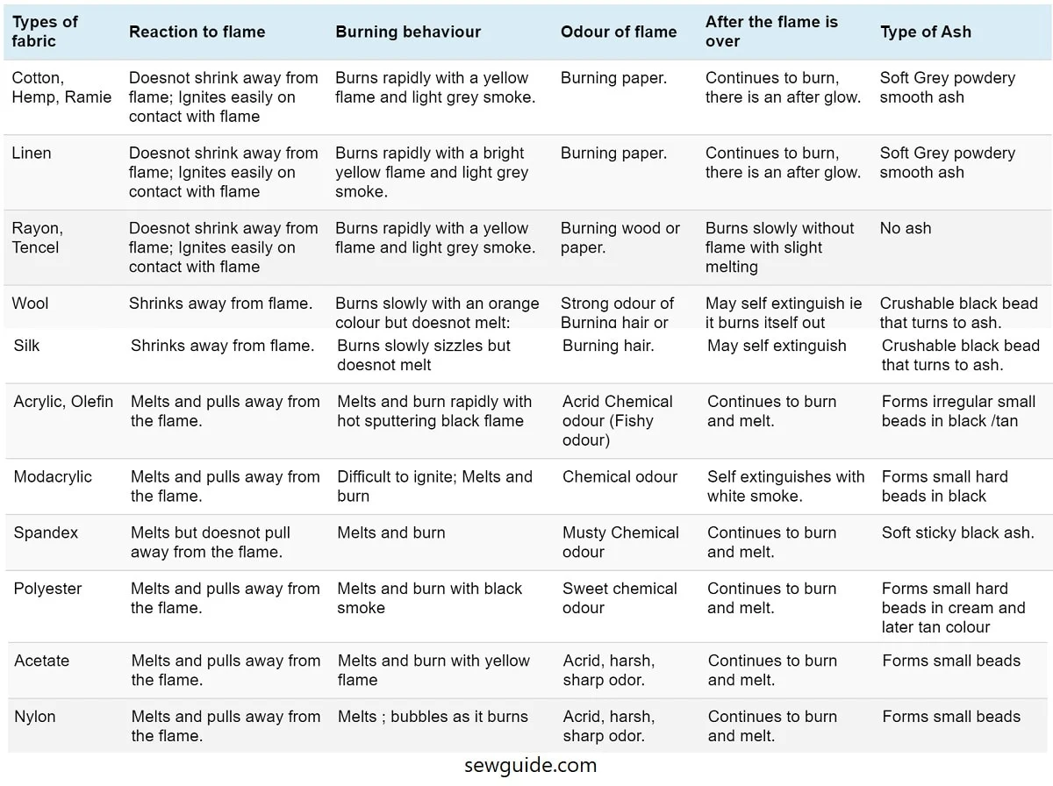

Slide 22
3. SOLUBILITY TEST
differentiation based on their solubility in different chemical reagents.
PROCEDURE
1. Sample Collection and Preparation:
Cut the fiber into smaller pieces or strands if needed.
2. Reagent Preparation:
Prepare a series of different chemical reagents that are commonly used (water, acetone, chloroform, sulfuric acid, and sodium hydroxide solution).
3. Solubility Testing:
Place a small piece of the fiber sample into each of the prepared reagents.
Observe the fiber's behavior in each reagent and record your observations.

Slide 23
Observations and Interpretations:
a) Water:
Natural Fibers: may be soluble in water and dissolves in water (esp. plant-source)
Synthetic Fibers:insoluble in water and will not dissolve or undergo notable changes.
b) Acetone and Chloroform:
Natural Fibers: may partially dissolve or insoluble in acetone or chloroform(cotton)
Synthetic Fibers:typically insoluble in acetone and chloroform (polyester/nylon)

Slide 24
c) Sulfuric Acid:
Natural Fibers:will char or turn dark when exposed to concentrated sulfuric acid.(sensitive)
Synthetic Fibers: donot dissolve or degrade significantly when exposed to sulfuric acid, depending on their composition.
d) Sodium Hydroxide Solution:
Natural Fibers:Cellulosic fibers donot dissolve whereas animal fibers may dissolve in a concentrated sodium hydroxide solution.
Synthetic Fibers:do not dissolve or significantly react with sodium hydroxide solution.

Slide 25
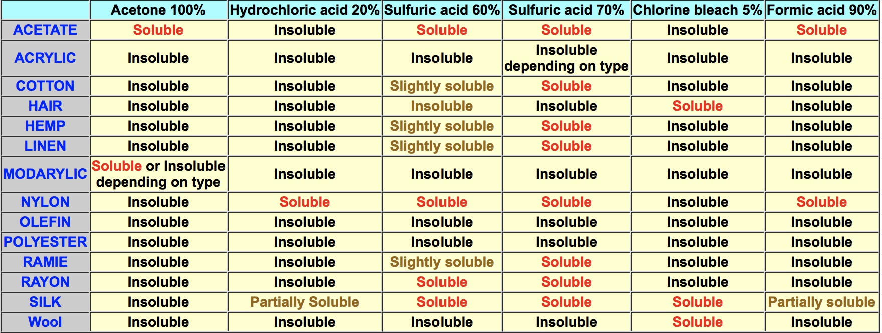

Slide 26
CHALLENGING YOURSELF
1. Scenario: A forensic investigator finds a set of fibers at a crime scene. To determine the nature of the fibers, they perform a solubility test. When the fibers are immersed in water, they dissolve completely. What can be inferred about the nature of these fibers?
A) They are synthetic fibers.
B) They are plant-based fibers.
C) They are animal-based fibers.
D) They are mixed fibers.

Slide 27
2. Scenario: Another set of fibers is recovered from a suspicious fire incident. To identify the fibers, the forensic investigator conducts a burning test. The fibers burn quickly, release a black smoke, and leave behind a brittle ash. What type of fibers are these?
A) Synthetic fibers.
B) Cellulose fibers.
C) Protein fibers.
D) Mineral fibers.

Slide 28
3. Scenario: A suspect's clothing is collected as potential evidence. The forensic analyst decides to perform a combination of tests to determine the nature of the fibers. The fibers dissolve in water, burn with a steady flame, emit a smell of burning hair, and leave behind a soft, gray ash. What can be concluded about these fibers?
A) They are plant-based fibers.
B) They are animal-based fibers.
C) They are synthetic fibers.
D) They are mixed fibers.

Slide 29
4. Puzzle: Unscramble the letters to form a keyword.
L I B I T O U S L Y
Clue: "A test to determine if a fiber dissolves in a particular solvent."
5. Puzzle: Rearrange the letters to reveal a keyword.
T R E H A S
Clue: "A method of identifying fibers by observing their behavior when subjected to flame."

Slide 30
2. FIBER CHARACTERISTICS
Fibre diameter
Fibers vary in size (10-50 micrometers)
softer material- smallest fibre, durable materials- largest fibre
size of the fibre can tell its origin
Fibre cross-section
it is the cross section that varies with the type
Natural fibre from plant and animal source- rough at edge
Microtome- used to make cross section

Slide 31
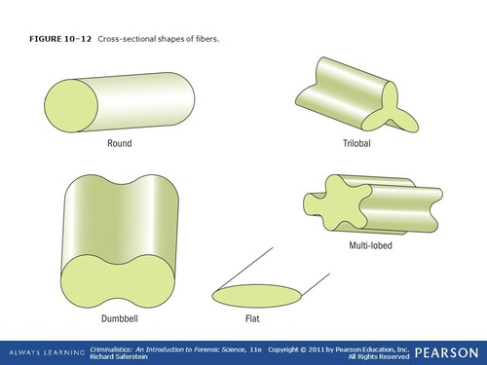
Microscopic view of various cross section of fibres

Slide 32
Fibre number
Identifying the number of fibres on the clothing of a victim as matching the clothing of the suspect is important in determining the actual physical contact.
greater the number of fibres; it is more likely that contact actually occurred between these individuals.
Fibre color
Often dyes are used to give colors.
Individual fibers Yarns Fabric
Color fading and discoloration can also lend increased value to a fabric association

Slide 33
Fiber Location
The location of fibres on different areas of the body or specific items at the crime scene influences the significance of fibre association.

Slide 34
3. MICROSCOPIC EXAMINATION
SCANNING ELECTRON MICROSCOPY
a method of photography which requires an instrument called scanning electron microscope.
uses electrons to form an image.
allows a large amount of sample to be in focus at one time.
information on morphology, structure & composition
PROCEDURE
1. Sample Preparation:
mount the fiber on sample holder using conductive adhesive
coat fibers with thin layer of conductive material (Au/ C)

Slide 35
2. Sample Loading:
sample holder loaded into SEM chamber
operates in vacuum environment
3. Instrument Set-up
set the operating parameters ( accelerating voltage,working distance, magnification)
Choose secondary electron/ backscattered electron imaging mode.
4. Imaging:
SE mode: electron beam scan the sample surface and electron from the surface detected to create image
BSE- higher energy is gathered to get information on fiber composition

Slide 36
5. Adjustment & Navigation:
Adjust focus, brightness, contrast
Navigate the sample surface to locate the area of interest for analysis
6. Capturing Image:
Capture high-resolution image
reveals the surface morphology

Slide 37
ATOMIC FORCE MICROSCOPY
carried out using an atomic force microscope.
analyze and characterize samples at the microscopic level.
looks at the surface characteristics with very accurate resolution ranging from 100 micrometers to even less than 1 micrometer.
PROCEDURE
1. Sample Preparation:
Sample should be thin for the AFM tip to interact with the surface.
2. Mounting sample:
Prepared sample mounted on AFM stage

Slide 38
3. Cantilever and Tip Assembly:
uses a tiny cantilever with sharp tip at end
for probing the surface of the fiber
Tip brought close to sample surface
Measures the deflection of cantilever when it interact with the forces between tip and sample
4. Scanning:
Tip scanned across sample surface (constant force/ distance between tip & sample)
Interaction generate data which is used to create image
5. Data Collection:
As tip scans, system measures variation in height & force
Data collected and used to create topographical map of fiber’s surface

Slide 39
6. Image generation:
Collected data processed to create image
Reveals fiber structure at nanoscale resolution

Slide 40
Microscopic examination involves analyzing physical and morphological properties of fiber
1. Color: Observe the color under different lighting conditions. Note any variation along the length or width of fiber.
2. Size: Measure the diameter of fiber.
3. Shape: Examine the shape (flat, round, triangular or irregular)
4. Cross-section: Analyze the cross-sectional shape
5. Surface Texture: Look for feature like striations, ridges,scales/ twists
6. Birefringence: Use polarized light microscopy. Different fibers exhibit varying degrees of birefringence
7. Transparency/Opacity: Examine whether it is transparent/ transluscent/opaque under microscope

Slide 41
8. Length: Measure the length. Fiber may break/fray (length may not be same as when it was originally deposited)
9. Coatings/Treatments: Check for coatings, treatments that affect its appearance
10. Contaminants: Look for foreign substances, particles or debris adhered to the surface
11. Twist: Examine the presence and direction of twisting along the length of fiber
12. Fracture characteristics: If fiber broken, examine fracture characteristics (appearance of ends, signs of stretching/tearing)
13. Internal structure: Internal structure under microscope reveals unique patterns/features

Slide 42
14. Dye/ Color variation: Check whether uniformly colored/ any variation due to dye distribution
15. Morphological features: Look for unique features (nodes, fibrils, surface patterns)

Slide 43
DYE ANALYSIS
to identify and characterize fibers based on their coloration or dye content
Provide info on origin, composition and processing
PROCEDURE:
1. Sample Preparation: small piece of fiber collected
2. Extraction: Immerse fiber sample in suitable solvent that can dissolve dyes
3. Seperation & Identification: Extracted dyes seperated and identified using various chromatographic techniques (TLC,HPLC).helps in seperation of different dye components in the sample

Slide 44
4. Spectroscopic Analysis: After seperation, individual dye components analysed using spectroscopic techniques 9UV-Vis spectrophotometry).Each dye has characteristic absorption spectrum
5. Mass Spectrometry: to identify molecular masses of dye molecules (distnguish identity & dye types)
6. Microscopic Examination: Polarised light microscopy-reveal unique features of dye and fiber interaction
7. Comparison: Data obtained from analysis compared to databases of known dye standards(identify specific dyes)

Slide 45
Dyes are coloring organic material which has affinity to adhere with solvent medium
Dyes are colorful. They absorb light in vis spectrum range
Dye in its structure contains atleast 1 chromophore
It is easily recognised as they consist of conjugated system, as a result exhibit resonance of electrons which is responsible for the color
Other groups other than chromophore for imparting color, Oxochromes
eg: carboxylic acid, Sulfonic acid,amino and hydroxyl group etc
Wavelength of light absorption Vs Color in organic dyes: If color seen is observed in 400-435nm, absorbed color is violet but complementary yellow green will be observed.

Slide 46
Synthetic dyes- discovered by William Perkins-1856
Most synthetic dyes are prepared from coal-tar derivatives
Dyes Vs Pigments
Mordants: Substances which help in the chemical reaction that take place between dye and fiber so that the dye is absorbed.
eg: Alum,Iron,Cu
DYES | PIGMENTS
1. Soluble in water as well as organic solvents | 1. Insoluble in water and organic solvents
2. Used to color any substance | 2. Used to color only polymeric substrate

Slide 47
CHARACTERISTICS
It must have suitable and attractive color
It should be able to attach itself to the material from solution/ to be capable of fixed on it
It should be soluble in water/ must form stable & good dispersion in water
When fixed on surface, should not remove easily

Slide 48
TYPES: 1. Natural Dyes
2. Synthetic Dyes
NATURAL DYES
Acquired from natural resources
Colored organic compound
Patterened fabrics-use resist dyeing technique
Types:- Plant dyes, Animal dyes, Mineral dyes
Plant dye- Indigo
Animal dyes- Cochineal dye, Tyrian purple
Mineral Dyes- Prussian Blue

Slide 49
SYNTHETIC DYES
Man-made
First human made synthetic organic dye-mauveine or mauve by William Henry Perkin
Most of the synthetic dyes made from coal-tar derivatives
Obtained by adding different colors to natural dyes
Easy to use, less expensive & have explicit range of colors
eg: alizarin, triphenylmethane etc
Colorants dispersed in suitable solvent for the dye formation and then bringing it to contact with material to be dyed.

Slide 50
CLASSIFICATION BASED ON DYEING PROCESS:
1. ACID DYES
Water soluble
Containing Na salts of the color acids which may contain sulfonic acid groups
Usually present as sodium sulfonate salts & phenolic acid groups
Used to dye fibers which have basic groups
eg: picric acid, methanol yellow, naphthol yellow
Typical fixation percentage- 80-93%

Slide 51
2. BASIC DYES
Cationic stains and react with negatively charged material
Comprise of amino/alkyl amino group which are protonated under acidic conditions of fiber by the formation of salt linkages with anionic/acidic groups in fibers.
Give rise to intense and brilliant shades & have poor light fastness
eg: methyl violet, crystal violet, methylene blue, rhodamine
Fixation percentage- 97-98%

Slide 52
3. ADJECTIVE DYES
poor affinity for fibers
dyes require a pre-treatment of fibers with mordant material designated to bind dyes
Mordant get attached to fiber and then combines with dye to form an insoluble complex called lake.
They are fixing agents & help in improving color fastness
eg:Mordants like Al,Cr, Fe salts used

Slide 53
4. DIRECT DYES
Substantive dyes
Most frequently used as paper dyes
Exhibit capability to adsorb onto surface from an aqueous medium as well as the ability to become bound to fiber (ionic bond)
Class of dyes that become strongly absorbed on cellulose
usually bear sulfonic acid groups
Large, flat, linear molecule which can enter water-swollen, amorphous of cellulose
eg:Congo Red
Fixation %- 70-95%

Slide 54
5. REACTIVE DYES
Dyes which form covalent bond between dye & fiber
These have a reactive group, which once applied to fiber in an alkaline dye bath, forms a chemical bond with a hydroxyl group on cellulosic fiber (mostly dicholorotriazene)
Chromophore has substituent which is activated and react to surface of substrate
Fixation %- 60-90%

Slide 55
6. VAT DYES
insoluble, therefore applied in reduced forms
treated the compound with reducing agent (alkaline sodium hydrosulfide) in a large wooden vat
After absorption of reduced dye on fiber, original insoluble dye is reformed by oxidation
Primeval class of dyes
Based on original natural dyes; indigo and its close chemical relative-tyrian purple
Only soluble in oxygen free reduced form
Dyeing take place in a bucket/vat
eg: Anthraquinone
Fixation %- 80-95%

