Slide 1


Precipitation forecasting based on deep learning strategy using empirical wavelet transform, Markov chain-incorporated long-short term memory network
1) The action plans are about the deep learning and attribute reduction and their application; 2) There are no papers publicated or submitted;
3) the journal papers written now are as following works
TWO WORKS
Multi-objective decomposition-ensemble optimizer with rough set and mutual information for attribute reduction
Supervisor: Simon James Fong
Student No.YB774077
yb77407@um.edu.mo
JIE YANG

Slide 2
Precipitation forecasting based on deep learning strategy using empirical wavelet transform, Markov chain incorporated long short term memory network
Supervisor: Simon James Fong
Student No.YB774077
yb77407@um.edu.mo
JIE YANG

Slide 3
Precipitation forecasting based on deep learning strategy using empirical wavelet transform, Markov chain-incorporated long-short term memory network
1 Brackground
Precipitation plays an important role in hydrological research and meteorological disaster warning.
Auto Regressive
Auto Regressive Moving Average
Auto Regressive Moving Average
The physical prediction models
…
The precipitation forecasting models
linear methods
SVM
The statistical prediction models
nonlinear methods
Grey Forecasting
hybrid methods
ANN
…
Data preprocessing
Decomposition algorithms
The hybrid methods
Forecast modeling
Prediction algorithms

Slide 4
Precipitation forecasting based on deep learning strategy using empirical wavelet transform, Markov chain-incorporated long-short term memory network
2 Methodology
Empirical Wavelet Transform
(1) Segment the Fourier spectrum of the original precipitation series into N continuous segments.
(2)Construct a series of empirical wavelets based on the Little-wood-Paley and Meyer’s wavelets.
(3)Reconstruct the precipitation series.
J. Gilles, "Empirical Wavelet Transform," IEEE Transactions on Signal Processing, vol. 61, no. 16, pp. 3999-4010, 2013.

Slide 5
Precipitation forecasting based on deep learning strategy using empirical wavelet transform, Markov chain-incorporated long-short term memory network
2 Methodology
Long-short term memory network

Slide 6
Precipitation forecasting based on deep learning strategy using empirical wavelet transform, Markov chain-incorporated long-short term memory network
2 Methodology
The input just changes what is stored in memory
The output only depends on memory
The Gif below shows 4 time steps：
The first one is only affected by the input data
The second one mixes the second input with
the first hidden layer, and so on…
The black one is the prediction
The error is bright yellow
The derivative is mustard (dark yellow)

Slide 7
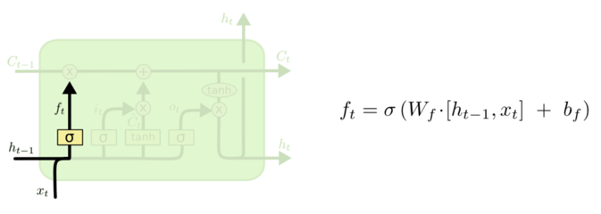
Precipitation forecasting based on deep learning strategy using empirical wavelet transform, Markov chain-incorporated long-short term memory network
2 Methodology
Long-short term memory network

Slide 8
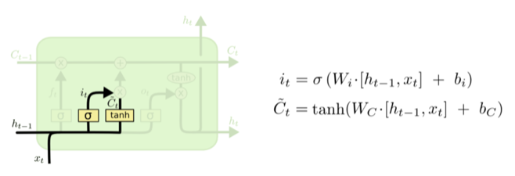
Precipitation forecasting based on deep learning strategy using empirical wavelet transform, Markov chain-incorporated long-short term memory network
2 Methodology
Long-short term memory network

Slide 9
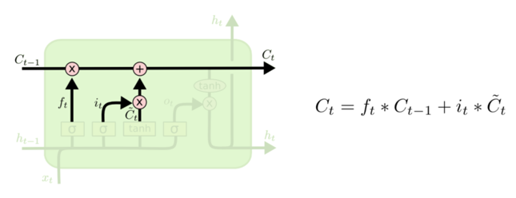
Precipitation forecasting based on deep learning strategy using empirical wavelet transform, Markov chain-incorporated long-short term memory network
2 Methodology
Long-short term memory network

Slide 10
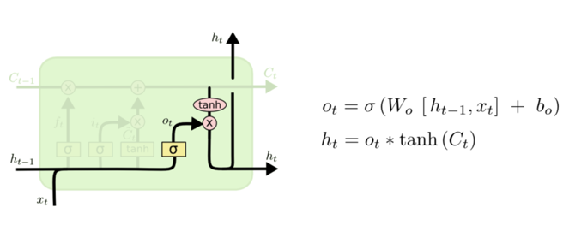
Precipitation forecasting based on deep learning strategy using empirical wavelet transform, Markov chain-incorporated long-short term memory network
2 Methodology
Long-short term memory network

Slide 11





Precipitation forecasting based on deep learning strategy using empirical wavelet transform, Markov chain-incorporated long-short term memory network
2 Methodology
Input sequence:
4
4
output sequence:
store
2
2
given Initial values
0
0
All the weights are “1”, no bias
1
1
All activation functions are linear

Slide 12





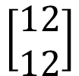
Precipitation forecasting based on deep learning strategy using empirical wavelet transform, Markov chain-incorporated long-short term memory network
2 Methodology
Input sequence:
12
12
output sequence:
store
6
6
2
2
All the weights are “1”, no bias
1
1
All activation functions are linear

Slide 13





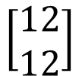

Precipitation forecasting based on deep learning strategy using empirical wavelet transform, Markov chain-incorporated long-short term memory network
2 Methodology
Input sequence:
32
32
output sequence:
store
16
16
6
6
All the weights are “1”, no bias
2
2
All activation functions are linear

Slide 14
Precipitation forecasting based on deep learning strategy using empirical wavelet transform, Markov chain-incorporated long-short term memory network
2 Methodology
Markov chain-incorporated model
The probability matrix P = (p_{ij} ) specifies the transition rules. If |S| = N, then P is an N × N stochastic matrix where each entry is non-negative and the sum of each row is 1. The conditional probability p_{ij} defines the probability that the chain transitions to state j at time t + 1, given that it is in state i at time t,
A Markov chain is called time-homogeneous if the probability matrix (p_{ij} ) does not depend on the time n. In other words, every time the chain is in state i, the probability of jumping to state j is the same. If a Markov chain is time homogeneous, then the vector π is called a stationary distribution of the Markov chain if for all j ∈ S it satisfies

Slide 15
Precipitation forecasting based on deep learning strategy using empirical wavelet transform, Markov chain-incorporated long-short term memory network
2 Hybrid EWT-MC-LSTM Model
Fig. 2 The framework of the proposed EWT-MC-LSTM model

Slide 16
Precipitation forecasting based on deep learning strategy using empirical wavelet transform, Markov chain-incorporated long-short term memory network
3 Study Area & Data Collection

Slide 17
Precipitation forecasting based on deep learning strategy using empirical wavelet transform, Markov chain-incorporated long-short term memory network
3 Model Construction and Development
Table 1. Statistical characteristics of monthly total precipitation data recorded at Hong Kong, Macau, Lanzhou, and Alashanmeng meteorological stations
region | Month | 1 | 2 | 3 | 4 | 5 | 6 | 7 | 8 | 9 | 10 | 11 | 12
Hong Kong | Mean (mm) | 36.70 | 25.61 | 75.39 | 155.43 | 311.37 | 501.81 | 360.71 | 435.98 | 315.99 | 106.76 | 47.48 | 31.23
 | St. Dev. (mm) | 57.62 | 24.89 | 63.68 | 121.61 | 147.24 | 297.63 | 155.36 | 214.45 | 182.38 | 139.14 | 37.19 | 26.23
 | Cv | 14.24 | 7.43 | 1.13 | 4.50 | 0.41 | 2.49 | -0.57 | 1.29 | -0.62 | 9.91 | -0.48 | -0.88
 | Cs | 3.58 | 2.33 | 1.40 | 1.79 | 1.14 | 1.61 | -0.08 | 1.02 | 0.59 | 2.86 | 0.59 | 0.46
 | Max (mm) | 266.90 | 113.10 | 238.70 | 547.70 | 687.30 | 1346.10 | 656.40 | 971.30 | 723.00 | 624.40 | 131.30 | 88.30
 | Min (mm) | 0.10 | 0.10 | 17.50 | 12.40 | 162.00 | 144.70 | 76.90 | 143.30 | 87.90 | 2.30 | 0.40 | 0.10
Macau | Mean (mm) | 36.92 | 29.57 | 73.14 | 156.52 | 286.50 | 368.47 | 258.70 | 311.02 | 241.29 | 82.29 | 41.84 | 32.40
 | St.Dev. (mm) | 24.09 | 58.03 | 160.42 | 147.71 | 248.82 | 172.28 | 137.81 | 162.77 | 86.69 | 30.55 | 29.52 | 0.00
 | Cv | 3.51 | 1.07 | 1.44 | 2.90 | 1.11 | 2.12 | 1.72 | 1.57 | 0.82 | 1.19 | 0.21 | 0.63
 | Cs | 13.40 | 1.47 | 1.62 | 9.76 | 1.30 | 5.85 | 4.28 | 3.25 | -0.25 | 0.35 | -1.21 | -0.76
 | Max (mm) | 278.24 | 96.26 | 230.83 | 749.45 | 677.84 | 1204.02 | 805.40 | 731.22 | 588.62 | 287.64 | 99.43 | 92.02
 | Min (mm) | 0.01 | 0.00 | 12.86 | 18.64 | 77.67 | 74.26 | 33.02 | 151.05 | 8.24 | 1.03 | 0.09 | 0.03
Lanzhou | Mean (mm) | 2.40 | 4.36 | 8.70 | 17.07 | 39.98 | 48.67 | 57.98 | 59.12 | 49.15 | 22.82 | 4.11 | 1.35
 | St.Dev. (mm) | 1.85 | 2.73 | 5.00 | 10.77 | 13.52 | 14.06 | 23.26 | 20.28 | 13.54 | 9.20 | 3.49 | 0.69
 | Cv | 1.75 | 1.22 | 0.30 | 2.78 | -0.04 | 0.89 | 0.53 | 0.16 | 0.13 | 1.18 | 1.54 | 1.26
 | Cs | 3.97 | 0.94 | -0.60 | 10.26 | -1.05 | 0.68 | -0.34 | -0.20 | -0.65 | 1.76 | 2.57 | 1.24
 | Max (mm) | 8.13 | 10.67 | 17.78 | 56.90 | 62.99 | 85.09 | 105.16 | 101.09 | 72.90 | 48.51 | 13.21 | 3.05
 | Min (mm) | 0.25 | 0.76 | 0.51 | 4.06 | 18.80 | 30.73 | 22.61 | 22.86 | 22.35 | 10.41 | 0.00 | 0.51
Alashan meng | Mean (mm) | 0.66 | 0.93 | 1.91 | 2.98 | 8.13 | 14.21 | 16.87 | 15.32 | 13.89 | 3.61 | 1.14 | 0.85
 | St.Dev. (mm) | 0.61 | 1.04 | 2.24 | 3.72 | 6.02 | 9.49 | 11.05 | 8.48 | 9.44 | 3.38 | 1.69 | 0.77
 | Cv | 1.30 | 1.74 | 1.77 | 2.07 | 0.48 | 0.80 | 1.11 | 0.06 | 2.37 | 1.55 | 2.97 | 1.09
 | Cs | 1.51 | 3.17 | 2.58 | 3.73 | -1.13 | 0.35 | 1.69 | -0.74 | 7.42 | 2.57 | 10.09 | 0.87
 | Max (mm) | 2.29 | 4.06 | 8.13 | 12.95 | 19.81 | 37.08 | 47.75 | 30.99 | 46.74 | 13.46 | 7.37 | 2.79
 | Min (mm) | 0.00 | 0.00 | 0.00 | 0.25 | 0.76 | 2.03 | 2.29 | 0.76 | 3.05 | 0.00 | 0.00 | 0.00

Slide 18
Precipitation forecasting based on deep learning strategy using empirical wavelet transform, Markov chain-incorporated long-short term memory network
3 Model Construction and Development
Fig 4. The EWT decomposed results of the original monthly precipitation series for the four regions

Slide 19
Precipitation forecasting based on deep learning strategy using empirical wavelet transform, Markov chain-incorporated long-short term memory network
3 Model Construction and Development
Table 2. Transition probabilities of the 2/1/0 3-state Markov chain

Slide 20
Precipitation forecasting based on deep learning strategy using empirical wavelet transform, Markov chain-incorporated long-short term memory network
4 Results and Analysis
Table 3. Forecasting performance of the models for the four regions

Slide 21
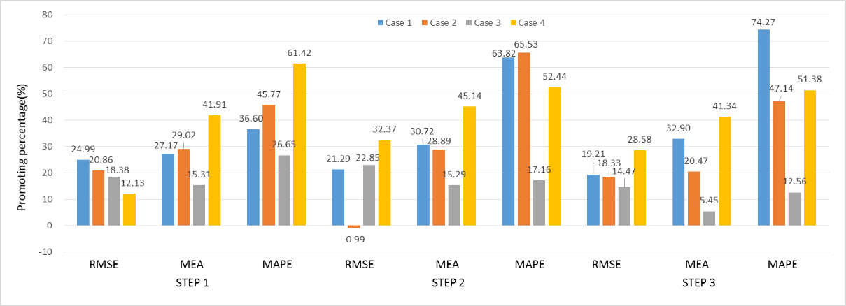
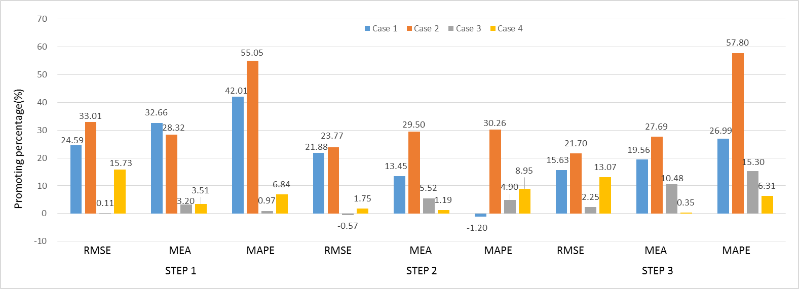
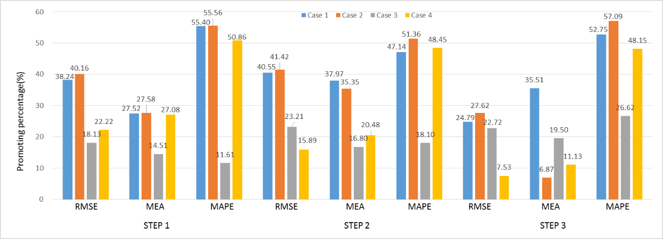
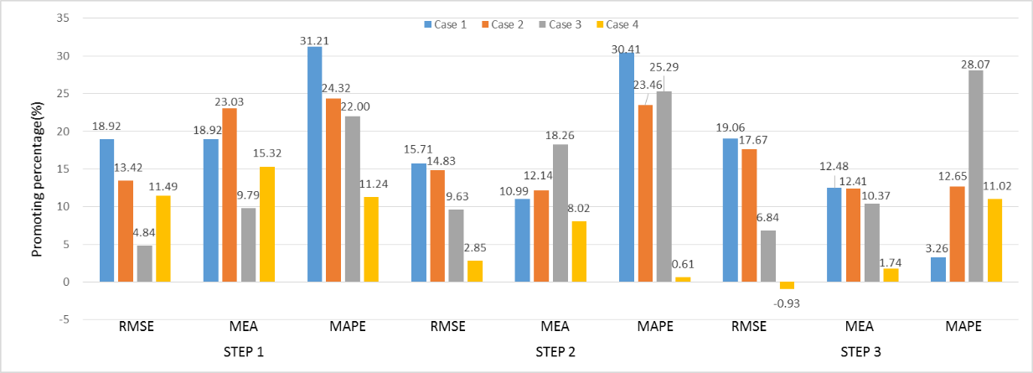
Precipitation forecasting based on deep learning strategy using empirical wavelet transform, Markov chain-incorporated long-short term memory network
4 Results and Analysis

Slide 22
Precipitation forecasting based on deep learning strategy using empirical wavelet transform, Markov chain-incorporated long-short term memory network
4 Results and Analysis

Slide 23
Precipitation forecasting based on deep learning strategy using empirical wavelet transform, Markov chain-incorporated long-short term memory network
4 Results and Analysis
Fig.10 Empirical cumulative distribution function (ECDF) of the forecasted error |FE| (mm) generated
by the proposed hybrid EWT-MC-LSTM model versus its counterpart models in step one for the four cases.

Slide 24
Precipitation forecasting based on deep learning strategy using empirical wavelet transform, Markov chain-incorporated long-short term memory network
4 Results and Analysis
Fig.11 Box-plots of the forecasted error |FE| (mm) in step one for the propsed hybrid EWT-MC-LSTM model
with counterpart models of monthly forecasted rainfall for the four cases.

Slide 25
Precipitation forecasting based on deep learning strategy using empirical wavelet transform, Markov chain-incorporated long-short term memory network
5 Conclusion
1. The EWT data preprocessing decomposition technique improves the prediction performance of the model, which demonstrated that EWT is suitable for data pre-analysis for precipitation time series.
2. Compared with the LSTM model, MC technology incorporated with LSTM deep learning network obtains better forecast results.
3. The proposed model is suitable for different magnitudes and fluctuations of monthly rainfall sequence prediction in Hong Kong, Macau, Lanzhou, and Alashanmeng.

Slide 26
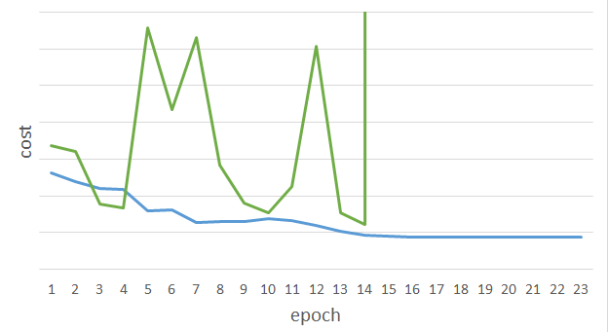
Precipitation forecasting based on deep learning strategy using empirical wavelet transform, Markov chain-incorporated long-short term memory network
6 Future Work
LSTM-based network is not always easy to learn
Real experiments on time series modeling
sometimes
Total Loss
Lucky
Epoch

Slide 27
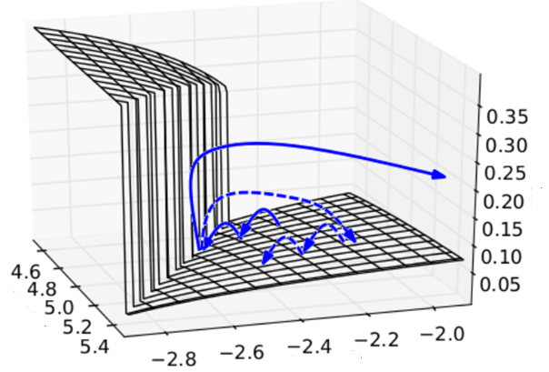

Precipitation forecasting based on deep learning strategy using empirical wavelet transform, Markov chain-incorporated long-short term memory network
6 Future Work
The error surface is rough
The error surface is either very flat or very steep.
Clipping
Cost
Total Loss
w₂
w₁
[Razvan Pascanu, ICML’13]

Slide 28
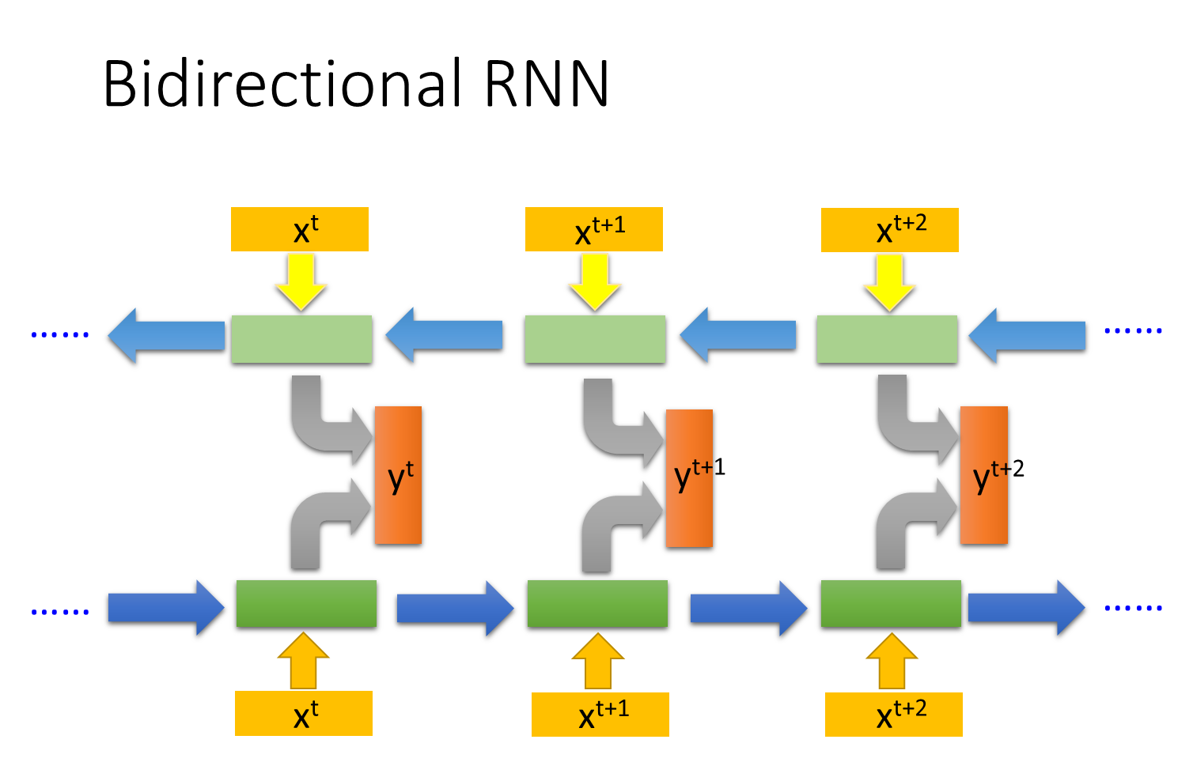
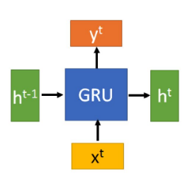

Precipitation forecasting based on deep learning strategy using empirical wavelet transform, Markov chain-incorporated long-short term memory network
6 Future Work
Problem: Gradient Explode/Gradient Vanishing
Advanced heuristic optimisation methods
Traning
……
……
……
^{Social Algorithm}
^{Bat-inspired algorithms}

Slide 29
Precipitation forecasting based on deep learning strategy using empirical wavelet transform, Markov chain-incorporated long-short term memory network
References

Slide 30
Multi-objective decomposition-ensemble optimizer with rough set and mutual information for attribute reduction
Supervisor: Simon James Fong
Student No.YB774077
yb77407@um.edu.mo
JIE YANG

Slide 31
Multi-objective decomposition-ensemble optimizer with rough set and mutual information for attribute reduction
1 Introduction
● Rough set theory is formal mathematical tool for attribute reduction
● Fuzzy rough set theory is found to be a very effective tool for attribute reduction
● ENTROPY AND MUTUAL INFORMATION are fuzzy measures that express the extent to which two fuzzy sets differ from each other.

Slide 32
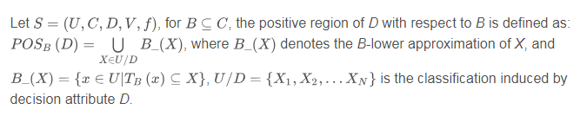

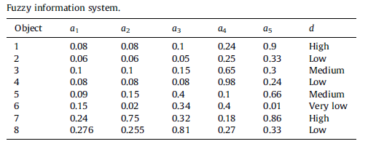
Multi-objective decomposition-ensemble optimizer with rough set and mutual information for attribute reduction
1 Introduction

Slide 33
Multi-objective decomposition-ensemble optimizer with rough set and mutual information for attribute reduction
2 PROPOSED ALGORITHM

Slide 34
Multi-objective decomposition-ensemble optimizer with rough set and mutual information for attribute reduction
3 DATASETS & COMPARED ALGORITHMS
TABLE I DATASET BASIC INFORMATION
ID | Data | Features | Class | Samples
1 | Redwine | 11 | 4 | 1571
2 | Wine | 13 | 3 | 178
3 | Breast | 9 | 2 | 277
4 | Iris | 4 | 3 | 150
5 | ILPD | 10 | 2 | 583
6 | Seeds | 7 | 3 | 210
7 | Ionosphere | 34 | 2 | 351
8 | Sonar | 60 | 2 | 208
9 | HillValley | 100 | 2 | 606
10 | Madelon | 500 | 2 | 4400

Slide 35
Multi-objective decomposition-ensemble optimizer with rough set and mutual information for attribute reduction
4 COMPARISON RESULTS

Slide 36
Multi-objective decomposition-ensemble optimizer with rough set and mutual information for attribute reduction
4 Results

Slide 37
Multi-objective decomposition-ensemble optimizer with rough set and mutual information for attribute reduction
4 Results
FIGURE 8. Error rates of classification performance by BLS for four data sets: Ionosphere, Sonar, Hillvalley and Madelon

Slide 38
Multi-objective decomposition-ensemble optimizer with rough set and mutual information for attribute reduction
References

Slide 39
THANKS
for your time

