Slide 1
MSI 360
Final Client Presentation
A musculoskeletal injury risk assessment prototype for WorkSafeBC.
Group 12: Cole Campbell, Jonah Botelho, Nicholas Ng, Abdullah Asmy, Kyle Cheon
Client: Stewart Rogers, WorkSafeBC | Supervisor: Hoda Rashedi
Notes:
Speaker: Cole. Open with who we are, what MSI360 is, and that the presentation includes a mandatory live demo, not a video or screenshot walkthrough. Suggested time: 45 seconds.

Slide 2
COLE
Team, client, and context
Client
Context
Stakeholders
WorkSafeBC
Stewart Rogers, Geoff Wright
WorkSafeBC supports workplace injury prevention, compensation, and rehabilitation across B.C.
Workers, supervisors, employers, etc.
Roles
Cole
Team lead
Jonah
Back-end Engineer
Kyle
Full-stack Engineer
Nick
AI Logic/Translation support
Abdullah
UI/UX & Report Design
MSI360 | WorkSafeBC | Group 12
Notes:
Speaker: Cole. Introduce Group 12 and the sponsor. Keep this non-technical. Make clear that the audience should not need project background to follow the rest of the presentation. Suggested time: 1 minute.

Slide 3
COLE
The problem
Workers can often tell when a task feels unsafe, but they may not have a simple way to assess, document, and communicate MSI risk.
Impact
Current gap
Project need
MSIs (Musculoskeletal injuries) are the most common workplace injury in B.C., 1/3 of all injuries.
Current paper based assessments take too long, only support English, or depend on MSI expertise that few people have.
A fast, worker-friendly questionnaire available in other languages that creates a clear risk report.
ErgoCheck: old prototype that takes >20 min, asks unneeded questions, produces lengthy report.
MSI360 | WorkSafeBC | Group 12
Notes:
Speaker: Cole. State the problem in simple non-technical terms. Connect the issue to workers, supervisors, and employers. Mention that the original process can be difficult for workers to complete independently. Suggested time: 1.5 minutes.

Slide 4
COLE
Project purpose and value
Save the user time
Purpose
1
MSI 360 will save the user ~50% of time per survey compared to older versions.
Guide a worker through a task-specific MSI risk assessment and produce a professional risk report using AI.
Support many languages
2
MSI 360 supports the top 40 spoken languages in B.C., allowing almost everyone in this diverse province access to the app.
Not a medical, legal, or regulatory decision tool.
Highlighted body diagram
3
The final PDF report includes a dynamically highlighted body diagram, showing where the risks are.
MSI360 | WorkSafeBC | Group 12
Notes:
Speaker: Cole. Distinguish the client need from the team implementation: client asked for an accessible MSI assessment prototype; the team implemented the web flow, scoring/report structure, and technical approach. Suggested time: 1.25 minutes.

Slide 5
COLE
Starting point and project scope
Built from scratch
Resources provided
Scope boundaries
MSI 360 is a new MVP web application. There was no inherited codebase from WorkSafeBC.
Project brief
MSI reports
WorkSafeBC CSS examples
Client feedback
Prototype only. No WorkSafeBC internal systems, production data, or long-term maintenance.
MSI360 | WorkSafeBC | Group 12
Notes:
Speaker: Cole. Make the starting point clear: this was built from scratch, using client requirements and reference materials. Also explain scope limits to keep expectations controlled. Suggested time: 1 minute.

Slide 6
COLE
What our team built or improved
Dynamic questionnaire
Automatic answering
Risk scoring
Users see only relevant questions instead of a long one-size-fits-all form.
Questions already answered from the task description will not be asked.
Scoring for MSI risk using likelihood and severity logic.
Translation support
Report generation
Responsive UI
MSI 360 supports 40 languages.
MSI Risk Analysis Report for printing, downloading, and sharing.
Designed for mobile, supports desktop.
MSI360 | WorkSafeBC | Group 12
Notes:
Speaker: Cole. This is the inherited versus built distinction. Say that what existed before was the problem context, paper-based process, and ErgoCheck-style reference idea; what the team added is the working MSI360 prototype and its core modules. Suggested time: 1 minute.

Slide 7
COLE
Technical solution at a glance
Languages used
Report generation
AI enhancements
React, TypeScript, HTML, CSS for a responsive app.
React PDF library, SVG files for dynamic body diagram.
Gemini AI for interpreting user input and assigning dynamic questionnaire.
Project support tools
GitHub
Trello
Figma
Notion
OpenAI Codex
Discord
Why this approach?
Fast enough for a 4-week MVP, easy for the team to learn, and simple while still fitting our project needs.
MSI360 | WorkSafeBC | Group 12
Notes:
Speaker: Cole. Keep this high level. The point is not to prove every implementation detail, but to show that the stack was practical for a short MVP, responsive UI, rule-based scoring, translation, and report generation. Suggested time: 1 minute.

Slide 8
COLE
System architecture
User
Describe task
Question routing
Scoring
Report output
Opens MSI 360
User inputs in chosen language
Shows relevant questions only
Takes average risk score
PDF report that user can print/share
AI enhancements
Gemini AI interpretation and question assignments
MSI360 | WorkSafeBC | Group 12
Notes:
Speaker: Cole. Explain the system flow from worker input to report output. Emphasize that the scoring engine is rule-based and explainable, while AI and translation are support layers. Suggested time: 1.25 minutes.

Slide 9
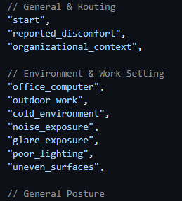
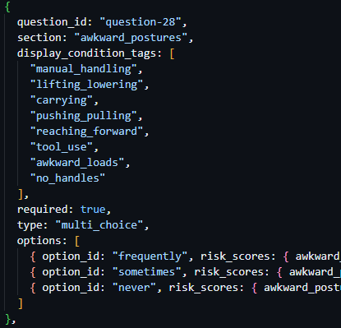
JONAH
Question routing system - tags
Tags define questions
Questions have tags
Tags control visibility
Pre-defined metadata for defining questions, so different system components can understand them.
Each question was assigned several relevant tags
The program state keeps a list of active tags, and any questions matching one or more of these tags are displayed.
MSI360 | WorkSafeBC | Group 12
Notes:
Speaker: Jonah. Blank draft slide reserved for this section.

Slide 10
JONAH
Question routing system - question pruning
Task Description
Tag Extraction
Pre-answering
Answer-Based Routing
User describes task in natural language
Text analyzed by AI for relevant tags
Questions pre-answered by AI based on user input
Tags added based on user answers
Tagging fallback
Pre-answering fallback
Local keyword matching
No questions pre-answered
MSI360 | WorkSafeBC | Group 12
Notes:
Speaker: Jonah. Blank draft slide reserved for this section.

Slide 11
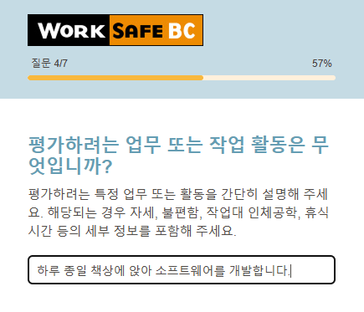
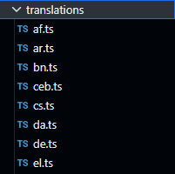
JONAH
Translation support
Static language translation files
Multilingual response interpretation
Separate language text files for each supported language, dynamically served depending on the user’s selection.
Multilingual user input is handled in the Gemini API calls, producing near-identical tag lists to english descriptions.
MSI360 | WorkSafeBC | Group 12
Notes:
Speaker: Jonah. Blank draft slide reserved for this section.

Slide 12
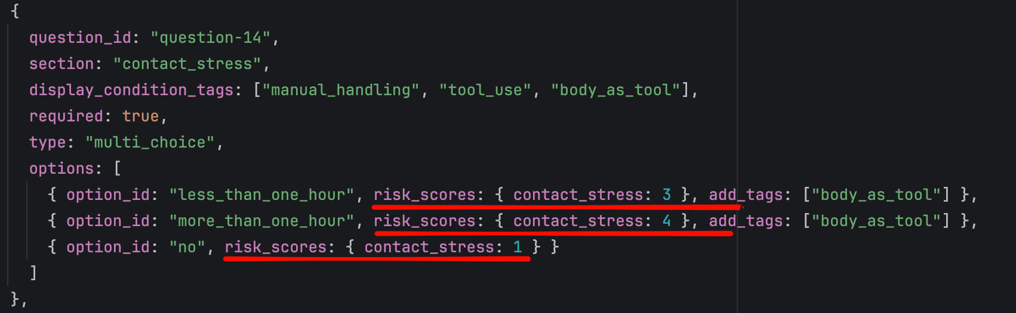
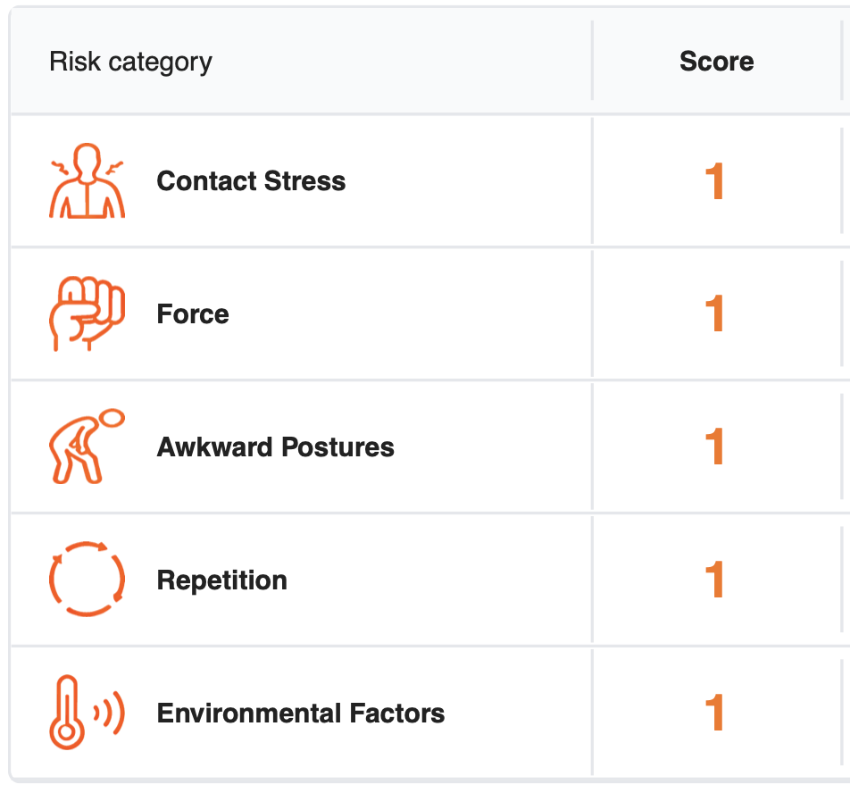

KYLE
Risk scoring and reporting
Contact Stress
Q11 - Q14
Force
Q15 - Q19
Awkward Postures
Q20 - Q29
Repetition
Q30 - Q36
Code
Environmental
Q37 - Q42
Category-specific
Questions
Report
MSI360 | WorkSafeBC | Group 12
Notes:
Speaker: Kyle. Blank draft slide reserved for this section.

Slide 13
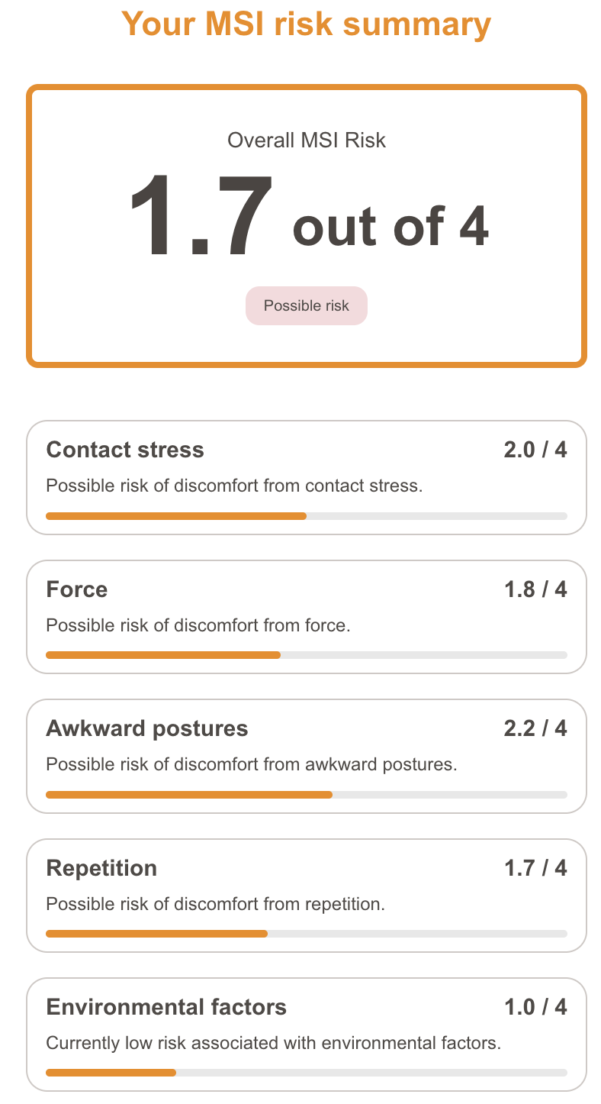
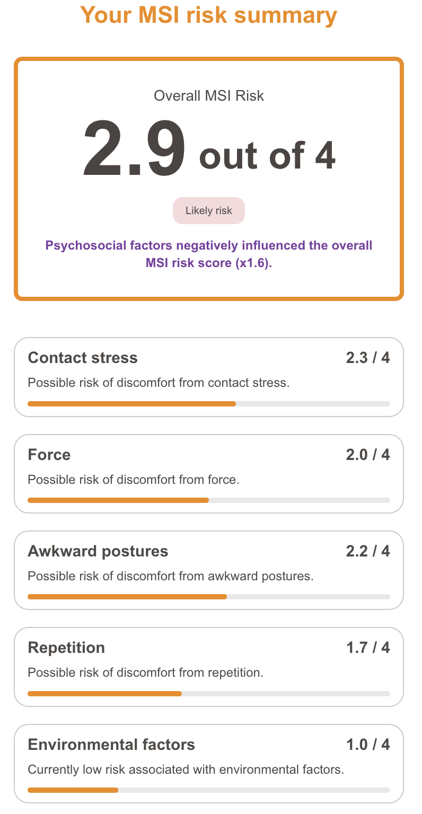


KYLE
Risk scoring and reporting
Psychosocial
Factors
Q7, Q8, Q41, Q42
MSI360 | WorkSafeBC | Group 12
Notes:
Speaker: Kyle. Blank draft slide reserved for this section.

Slide 14
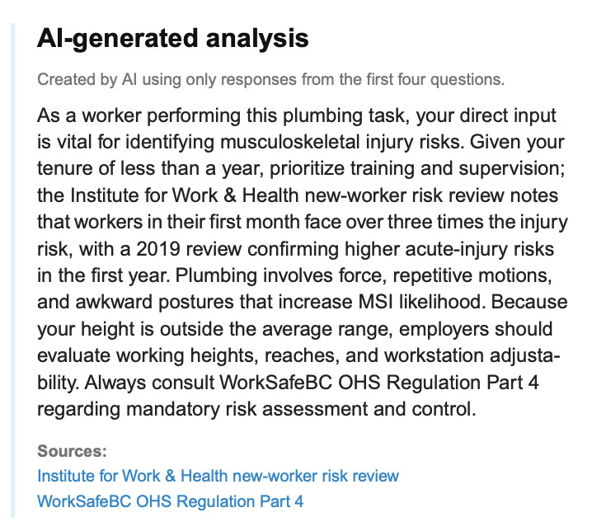
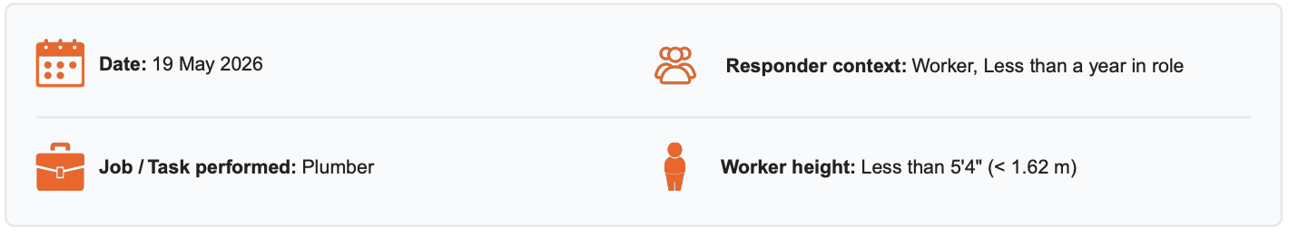
KYLE
Risk scoring and reporting
Wait for the AI response while the user answers other questions
Include the response in the generated PDF report
Meta-categorical
Factors
Q1 - Q4
Collect the answers
Example Case
MSI360 | WorkSafeBC | Group 12
Notes:
Speaker: Kyle. Blank draft slide reserved for this section.

Slide 15
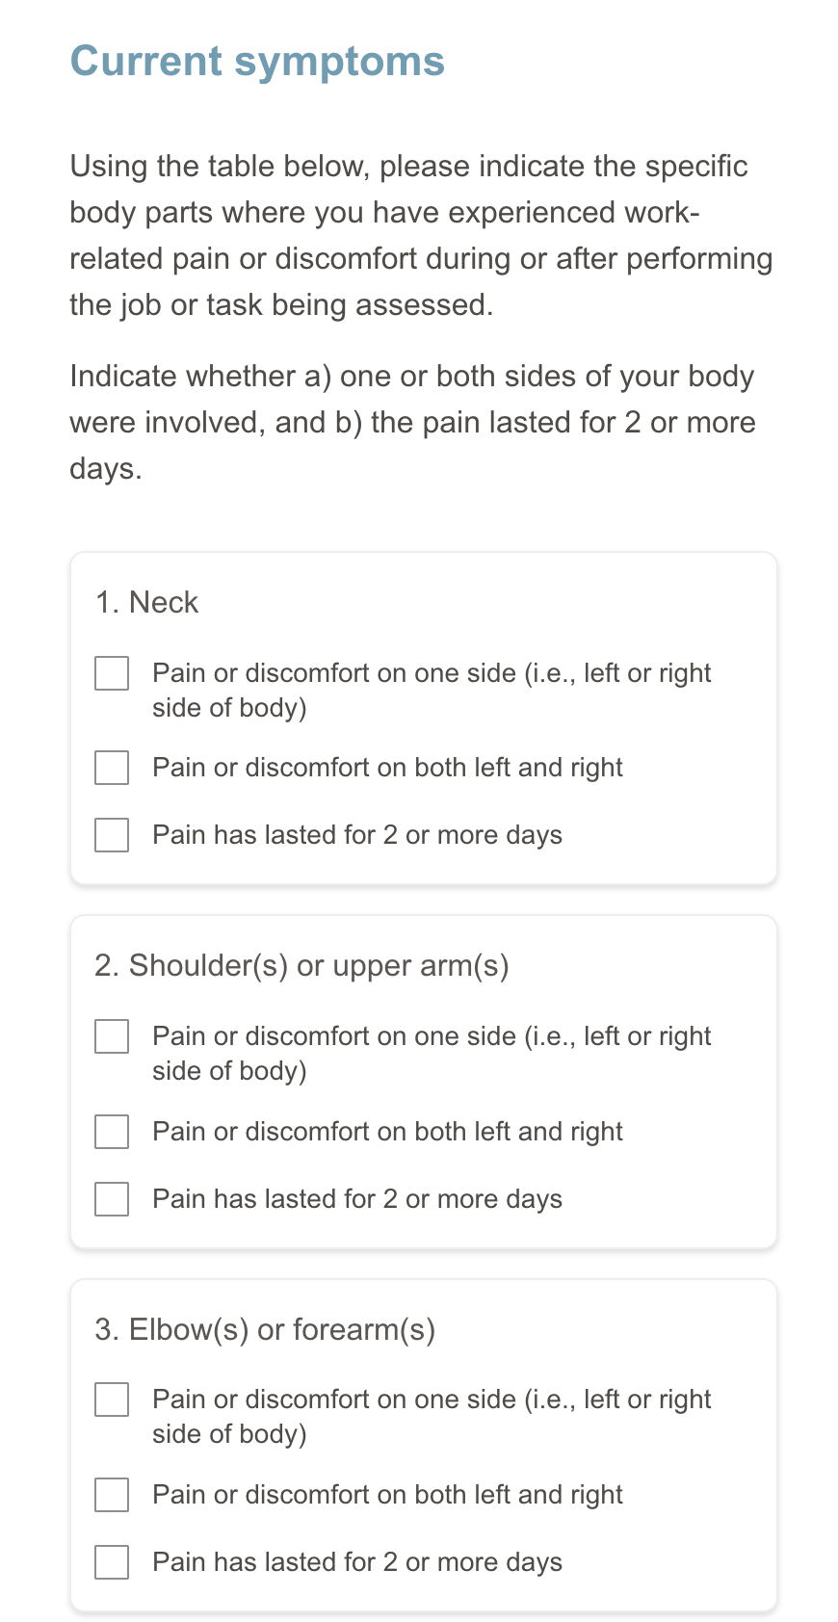
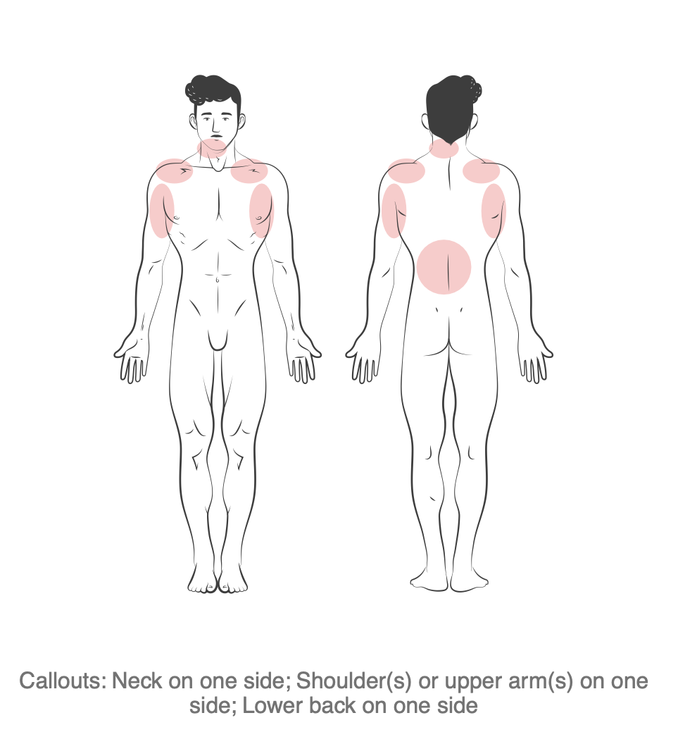
KYLE
Risk scoring and reporting
Report
Current Symptoms Checklist
Q10
MSI360 | WorkSafeBC | Group 12
Notes:
Speaker: Kyle. Blank draft slide reserved for this section.

Slide 16
NICK
Live demo: questionnaire flow
Original survey
Survey rebuilder
Key improvement
Asked over 30 questions for each task/job, with some being irrelevant.
Uses AI and tag system to prune questions for a shorter survey.
Shorter surveys will allow users to finish their surveys in 10 minutes.
MSI360 | WorkSafeBC | Group 12
Notes:
Speaker: Nick. Blank draft slide reserved for this section.

Slide 17
ABDULLAH
Live demo: report walkthrough
Original report
Redesigned report
Key UX improvement
Text-heavy pages with useful content, but harder to scan quickly.
Clearer layout, summary-first structure, and better visual hierarchy.
Dynamic body diagram highlights worker-reported discomfort areas visually.
MSI360 | WorkSafeBC | Group 12
Notes:
Speaker: Abdullah. Start by briefly showing the original ErgoCheck report, then switch to the redesigned MSI360 report. Focus on readability, report structure, visual hierarchy, the dynamic body diagram, and action-oriented category pages

Slide 18
KYLE
Project management and delivery
Phase
Planned work
Actual status
Sprint 1
Requirements, SOW, diagrams, repo setup, technical stack confirmation, initial setup
100% complete
Sprint 2
Dynamic questionnaire, scoring engine, results page, early PDF report prototype
100% complete
Sprint 3
Translations, final PDF report, testing, bug fixes, demo, hand-off
100% complete
Total actual hours
Main risks
How risks were handled
500+ hours
Dynamic PDF layout stability
AI/multilingual content accuracy and QA
Client/supervisor clarification for scoring gaps
Review/QA and regression testing
Bug-fix tickets and hand-off documentation
MSI360 | WorkSafeBC | Group 12
Notes:
Speaker: . Replace bracketed actual status and total hours before the final presentation. Discuss planned versus actual work, sprint outcomes, risks, blockers, and how the team handled them. Suggested time: 1.5 minutes.

Slide 19

KYLE
Complexity, creativity, and innovation
Technical complexity
Design complexity
Innovation
Rule-based MSI scoring engine
Integrated scoring, AI analysis, translations, and PDF generation
Simplified complex ergonomic assessment for non-technical users
Dynamic report design for different jobs, tasks, and risk categories
AI-assisted question filtering and report enrichment
Psychosocial factors and contextual information added beyond physical risk scoring
Gemini returns question tags for any language
Body diagram for intuitive, creative assessment visualization
MSI360 | WorkSafeBC | Group 12
Notes:
Speaker:. Explain why this was not just a form. The challenge was balancing accessibility, safety, scoring transparency, and a professional output. Suggested time: 1 minute.

Slide 20
COLE
Teamwork and collaboration
Coordination model
Short sprint cycles, detailed task tracking, frequent client/supervisor check-ins, daily team meetings, and review before merging on GitHub.
Cole
Jonah
Kyle
Organized and led all team meetings, documents, submissions, high-level project organization.
Designed question routing system, assisted with translations.
Implemented all risk scoring logic, assisted with UI/UX and PDF report.
Nick
Abdullah
Implemented all translation features, assisted with question routing/AI.
Designed app UI/UX and created new PDF report.
MSI360 | WorkSafeBC | Group 12
Notes:
Speaker: Cole. Keep this concrete. Explain how work was divided and coordinated. Suggested time: 1 minute.

Slide 21
COLE
Conclusion and next steps
MSI 360 addresses the original problem by giving workers a clearer way to identify, score, and communicate MSI risks for a specific work task.
Key outcome
Future improvements
Main lesson
A prototype that moves MSI risk assessment from a complicated and long process to an easier, digital version with language support.
More user testing, accessibility features, and even more language support.
We learned how valuable these concise reports can be to assist users with MSI risk conversation.
Thank you to WorkSafeBC, Stewart Rogers, Geoff Wright, and Hoda Rashedi for all your support.
MSI360 | WorkSafeBC | Group 12
Notes:
Speaker: Cole. Revisit the original problem, summarize the outcome, acknowledge the sponsor and supervisor, and transition into Q&A. Suggested time: 1 minute.

Slide 22
Questions & Answers
MSI360 | WorkSafeBC | Group 12
Notes:
Speaker: Cole. This slide is mainly for team preparation. It can be included at the end or hidden before presenting, depending on supervisor expectations. Suggested time: use only if needed before Q&A.

