Slide 1
Attend-in
By Team Geo: Cameron Sumlin-eskridge, eric Kelley, Steven Stewart, Nicole grizzle, hard thakkar

Slide 2
Overview
Create an app that let’s students sign in to class
Teachers can view attendance
Made for Android

Slide 3
Epic 1: where to start
Android Studio
Nexus 6
Android Ice Cream API 15

Slide 4
Epic 2: Designing the splash screen
Design logo
Agree on font
Decide how it transitions to next page

Slide 5

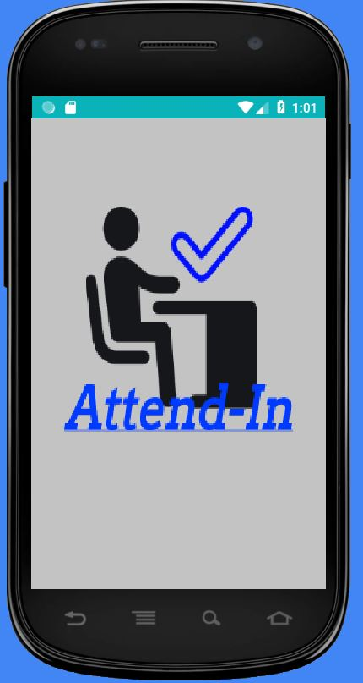


Slide 6
Epic 3: Create log-in page
Create username
Determine if first time logging in
Create classes
Choose class to attend

Slide 7
Epic 4: diagrams
Two state diagrams
Three use case diagrams

Slide 8
Backlog
Create MD5 hash
Start timer when class begins
Compare time and hash
Hash options (late, present, error)
View attendance

Slide 9
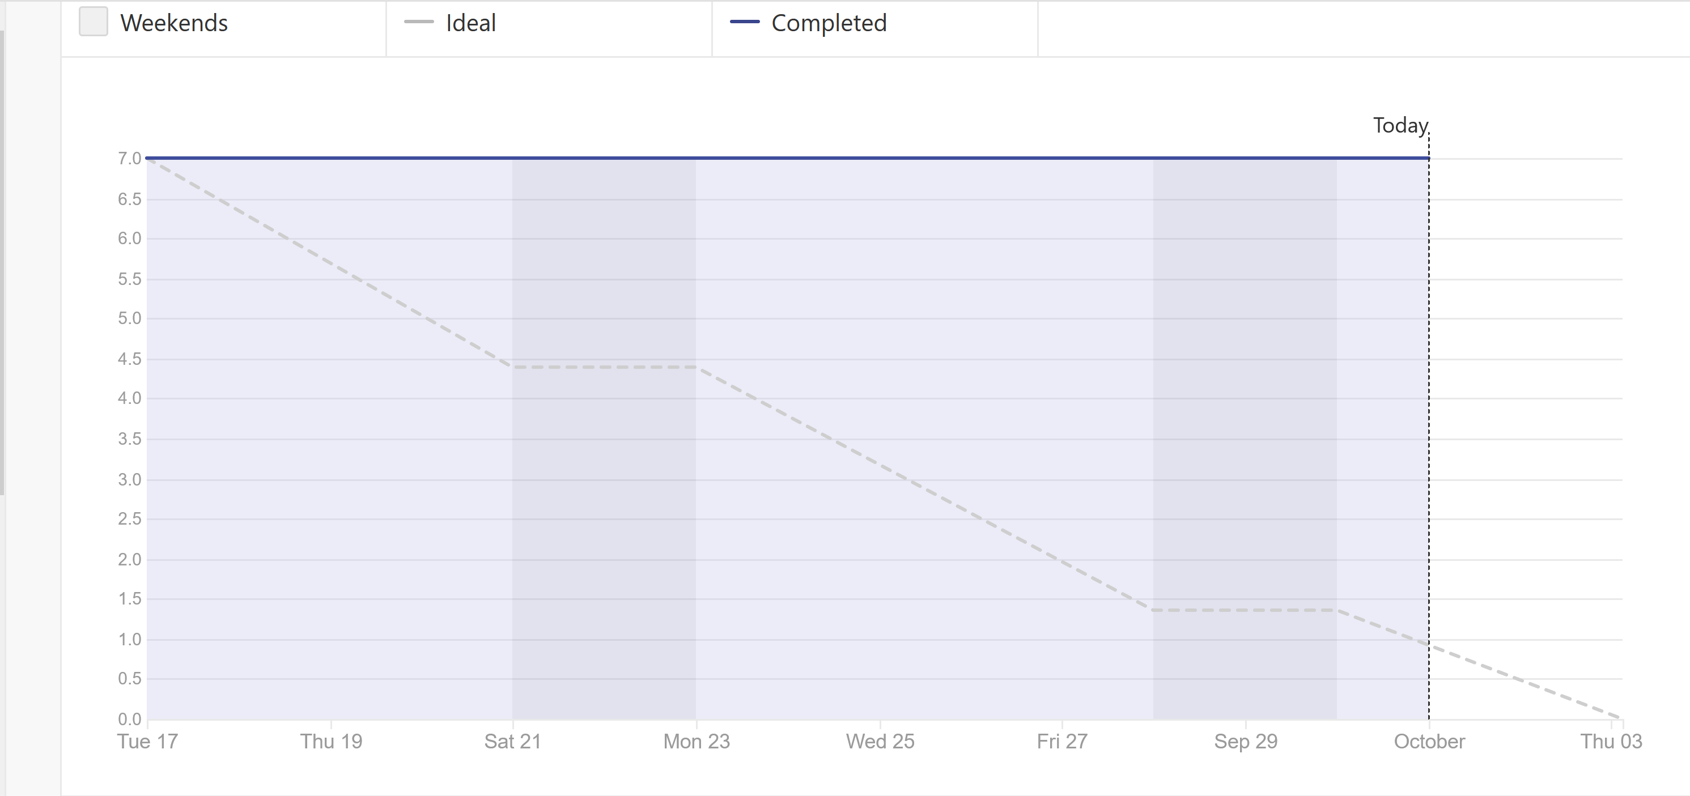
Burndown

Slide 10
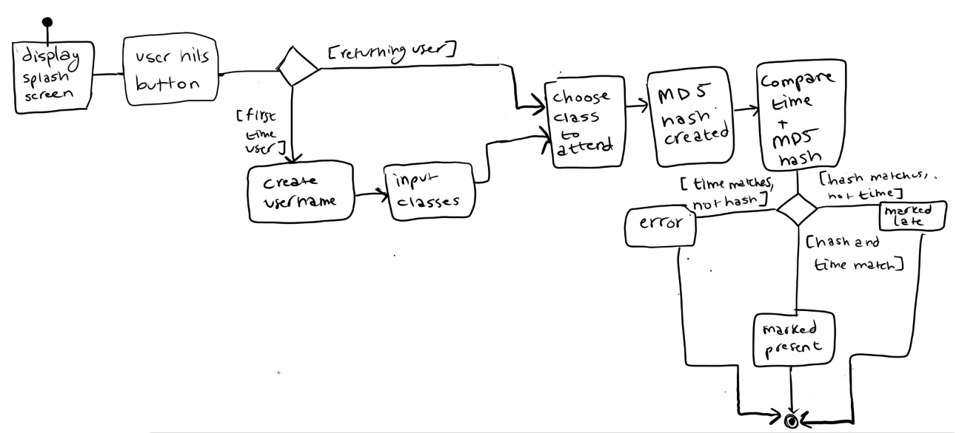
State diagram (student)

Slide 11
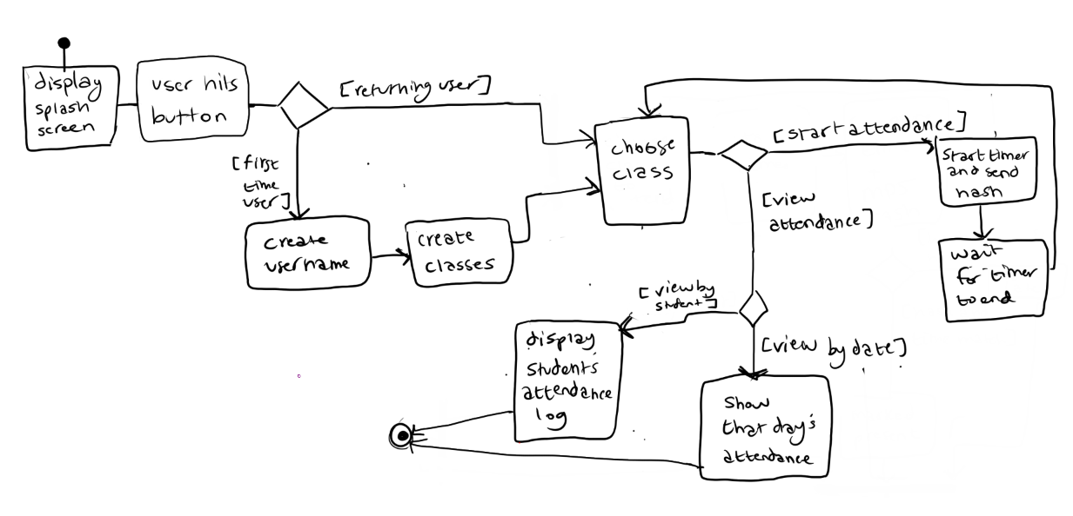
State diagram (Teacher)

Slide 12
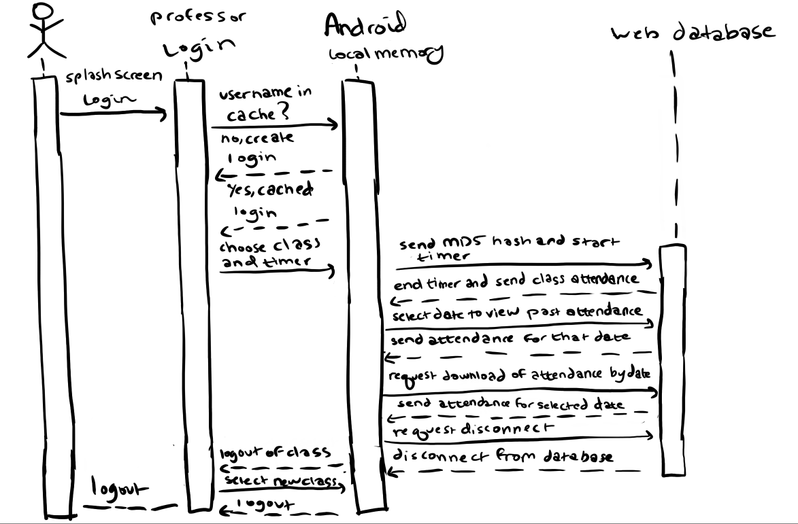
Sequence diagram (teacher)

Slide 13
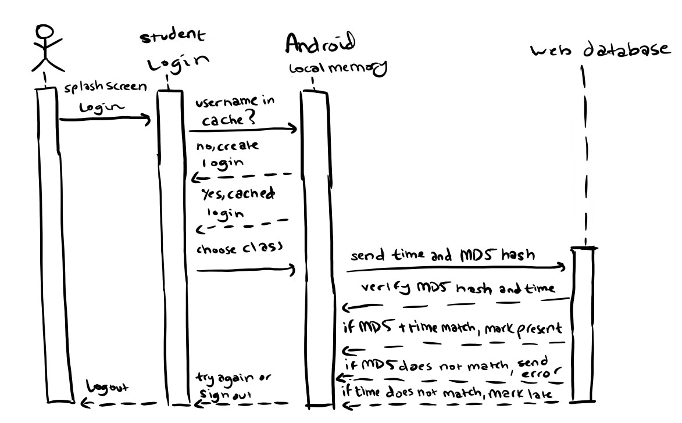
Sequence diagram (student)

Slide 14
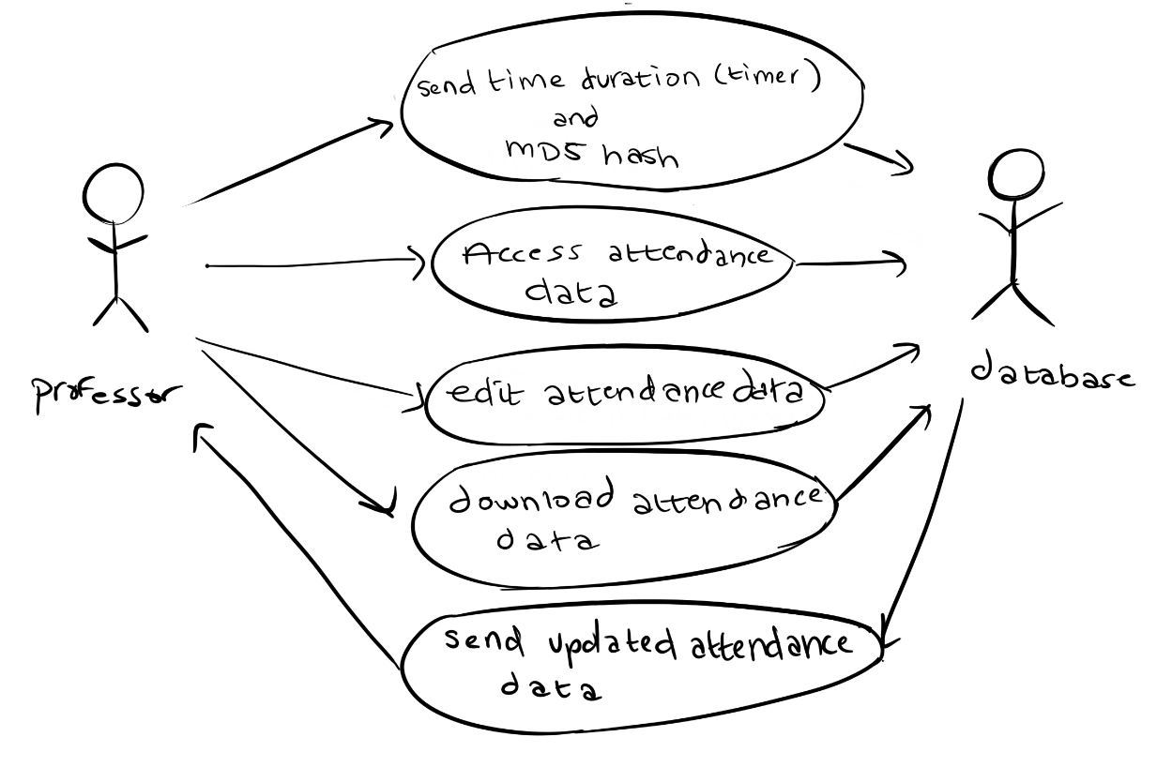
Use case diagram 1

Slide 15
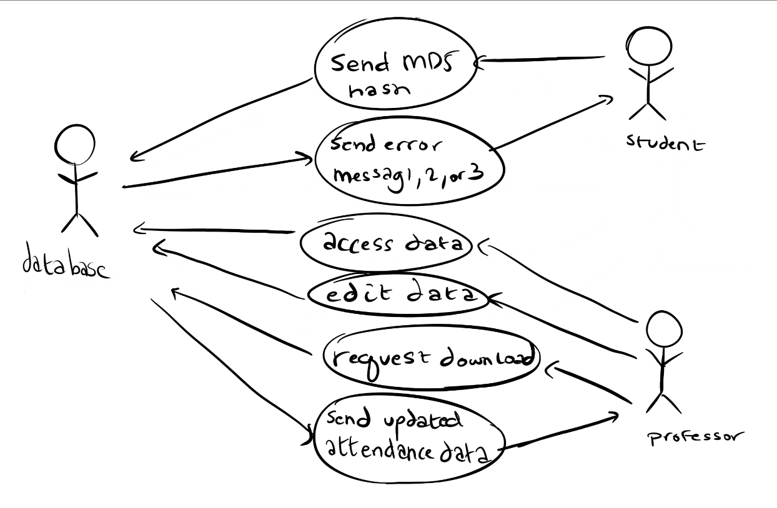
Use case diagram 2

Slide 16
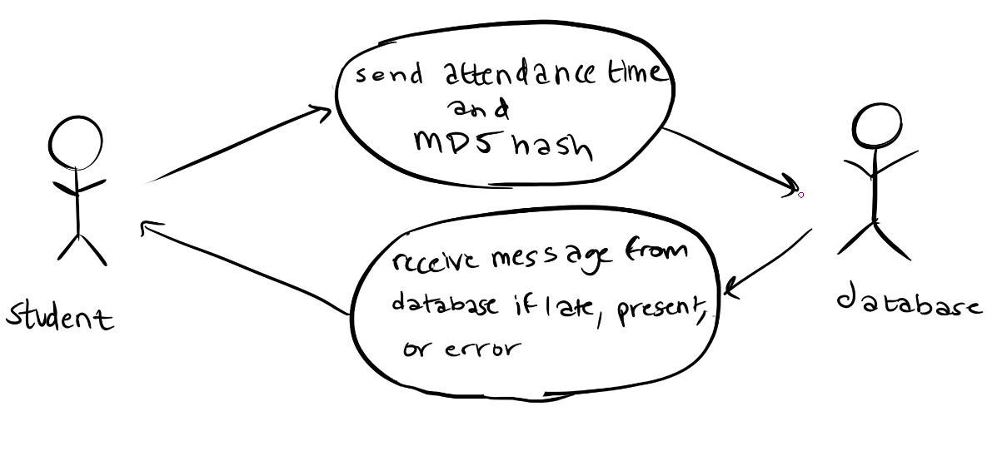
Use case diagram 3

Slide 17
Risks
Everyone is new to Android Studio
Work schedules
Creating a secure log-in screen
Learning Zenhub

Slide 18
Questions?

