Slide 1
Attend-in
By Team Geo: Cameron Sumlin-eskridge, eric Kelley, Steven Stewart, Nicole grizzle, hard thakkar

Slide 2
Overview
Create an app that let’s students sign in to class
Teachers can view attendance
Made for Android

Slide 3
Epic 1: where to start
Android Studio
Nexus 6
Android Ice Cream API 15

Slide 4
Epic 2: Designing the splash screen
Design logo
Agree on font
Decide how it transitions to next page

Slide 5

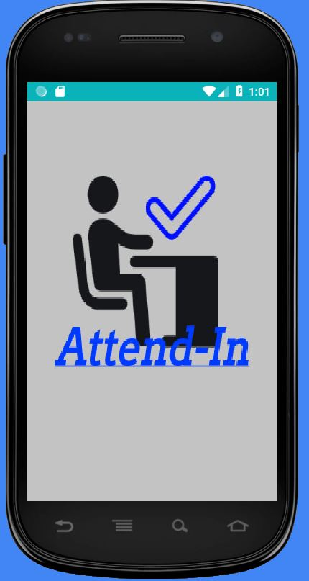


Slide 6
Epic 3: Create log-in page
Create username
Determine if first time logging in
Create classes
Choose class to attend

Slide 7
Epic 4: diagrams
Two state diagrams
Three use case diagrams

Slide 8
Backlog
Create MD5 hash
Start timer when class begins
Compare time and hash
Hash options (late, present, error)
View attendance

Slide 9
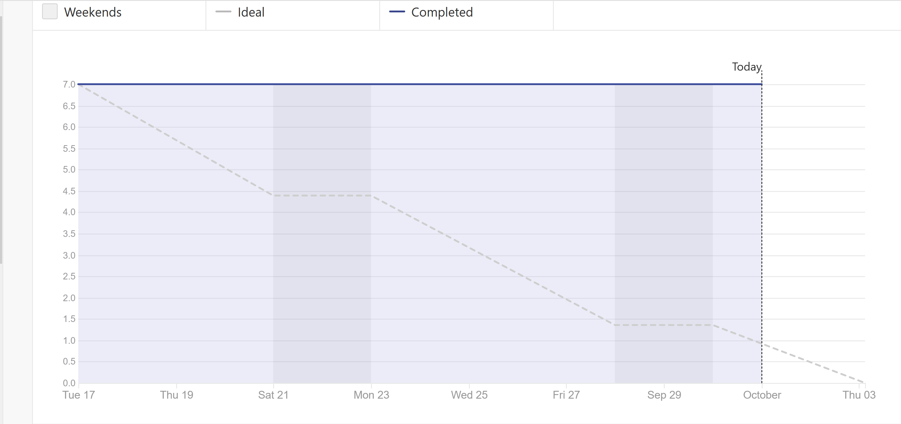
Burndown

Slide 10
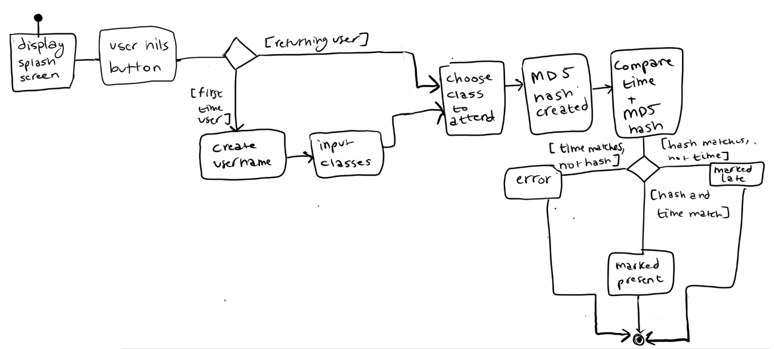
State diagram: student view

Slide 11
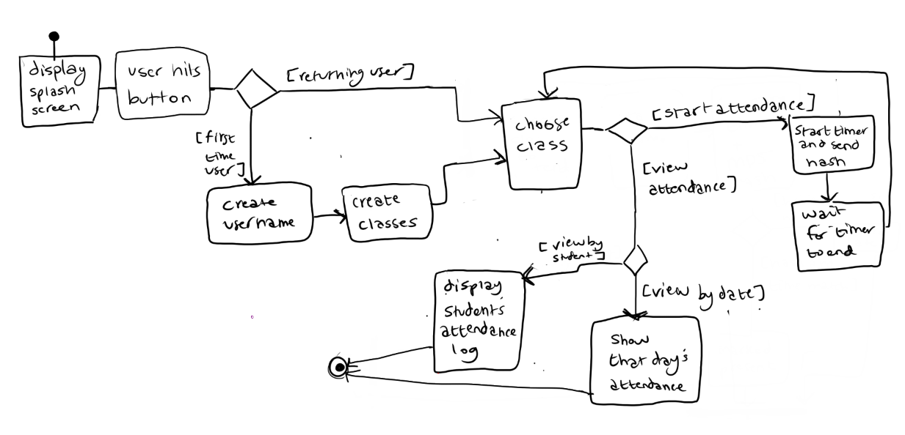
State diagram: teacher view

Slide 12
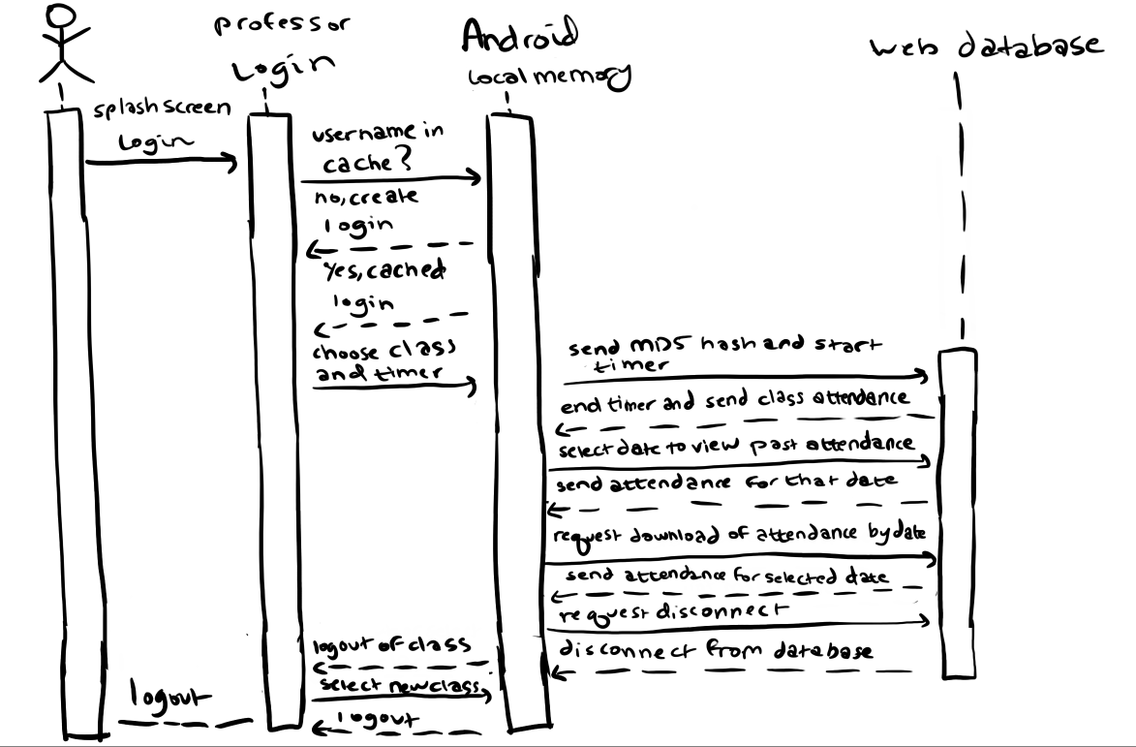
Sequence diagram (teacher)

Slide 13
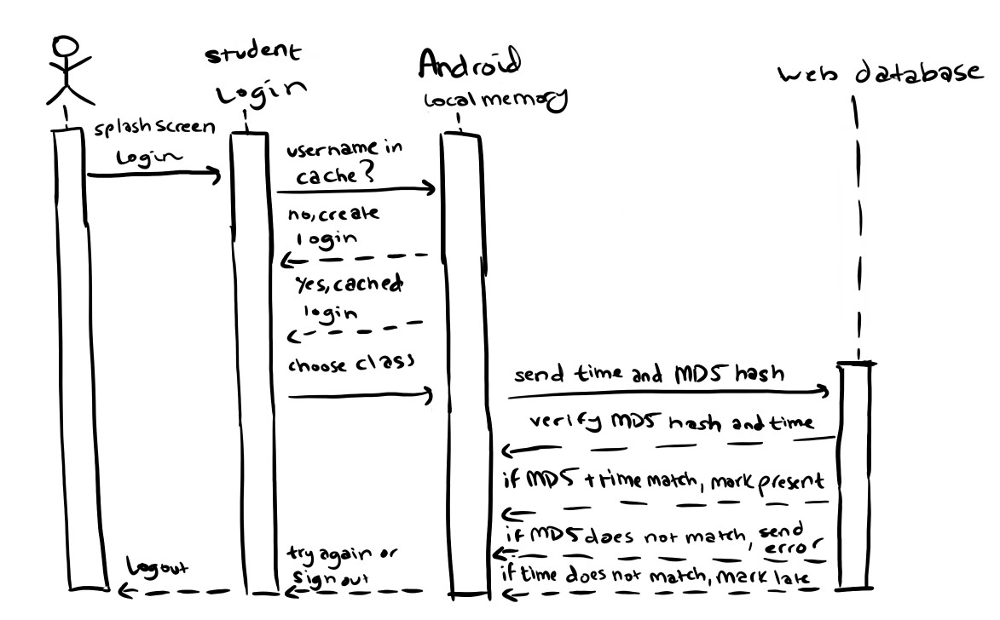
Sequence diagram (student)

Slide 14
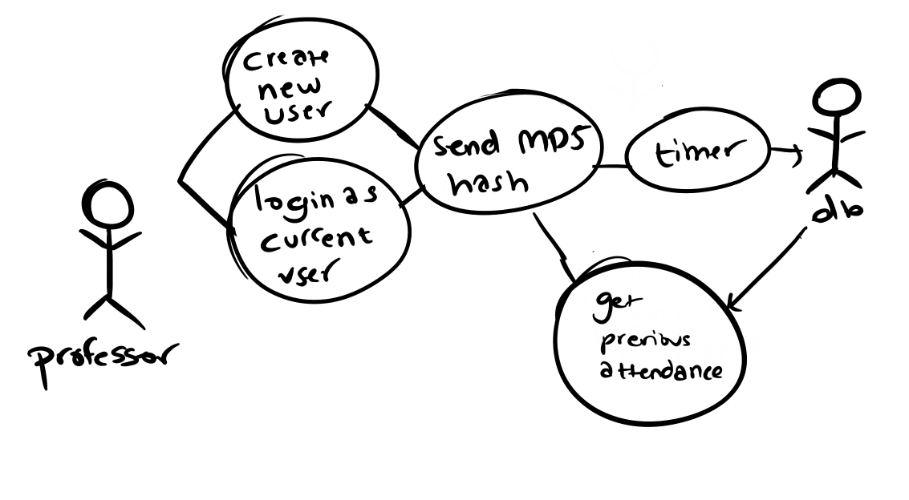
Teacher Use case diagram

Slide 15
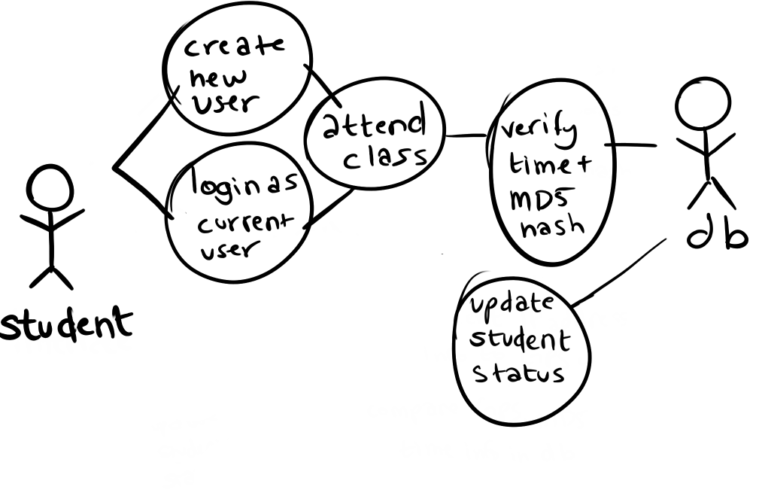
Student Use case diagram

Slide 16
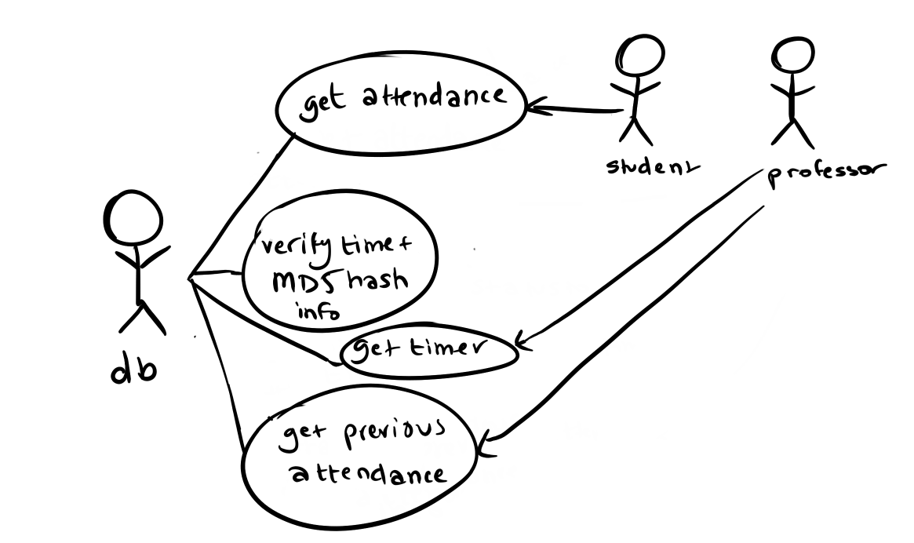
Database use case diagram

Slide 17
Risks
Everyone is new to Android Studio
Work schedules
Creating a secure log-in screen
Learning Zenhub

Slide 18
Questions?

