Slide 1
Attend-in
By Team Geo: Cameron Sumlin-eskridge, eric Kelley, Steven Stewart, Nicole grizzle, hard thakkar

Slide 2
Overview
Create an app that let’s students sign in to class
Teachers can view attendance
Made for Android

Slide 3
Epic 1: where to start
Android Studio
Nexus 6
Android Ice Cream API 15

Slide 4
Epic 2: Designing the splash screen
Design logo
Agree on font
Decide how it transitions to next page

Slide 5

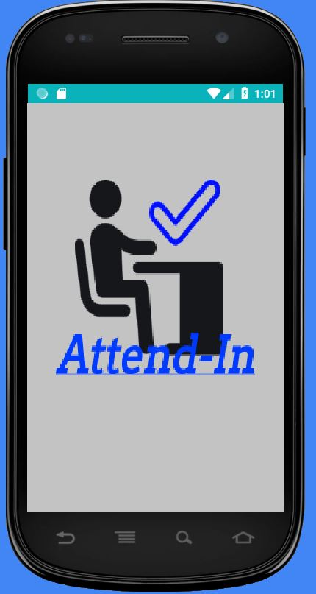


Slide 6
Epic 3: Create log-in page
Create username
Determine if first time logging in
Create classes
Choose class to attend

Slide 7
Epic 4: diagrams
Two state diagrams
Three use case diagrams

Slide 8
Backlog
Create MD5 hash
Start timer when class begins
Compare time and hash
Hash options (late, present, error)
View attendance

Slide 9
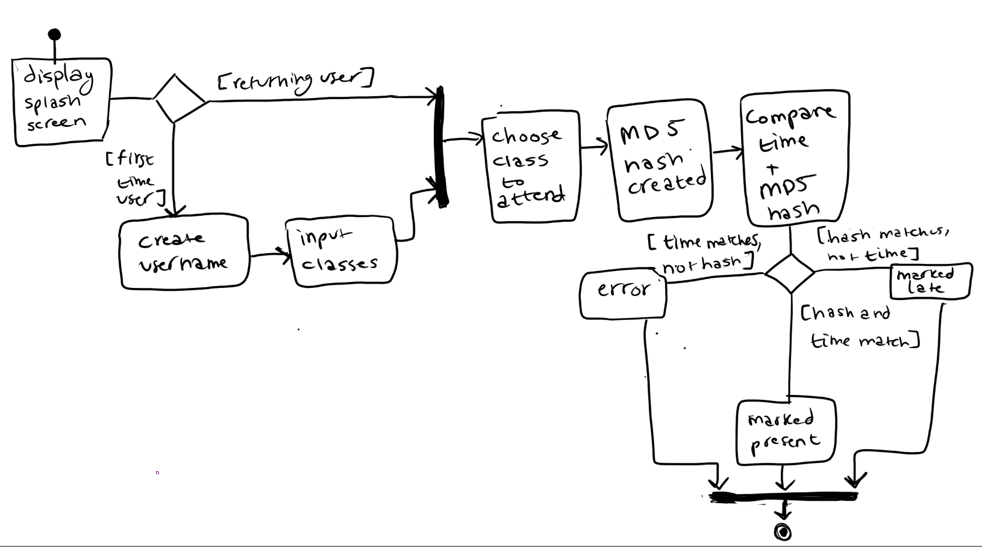
State diagram: student view

Slide 10
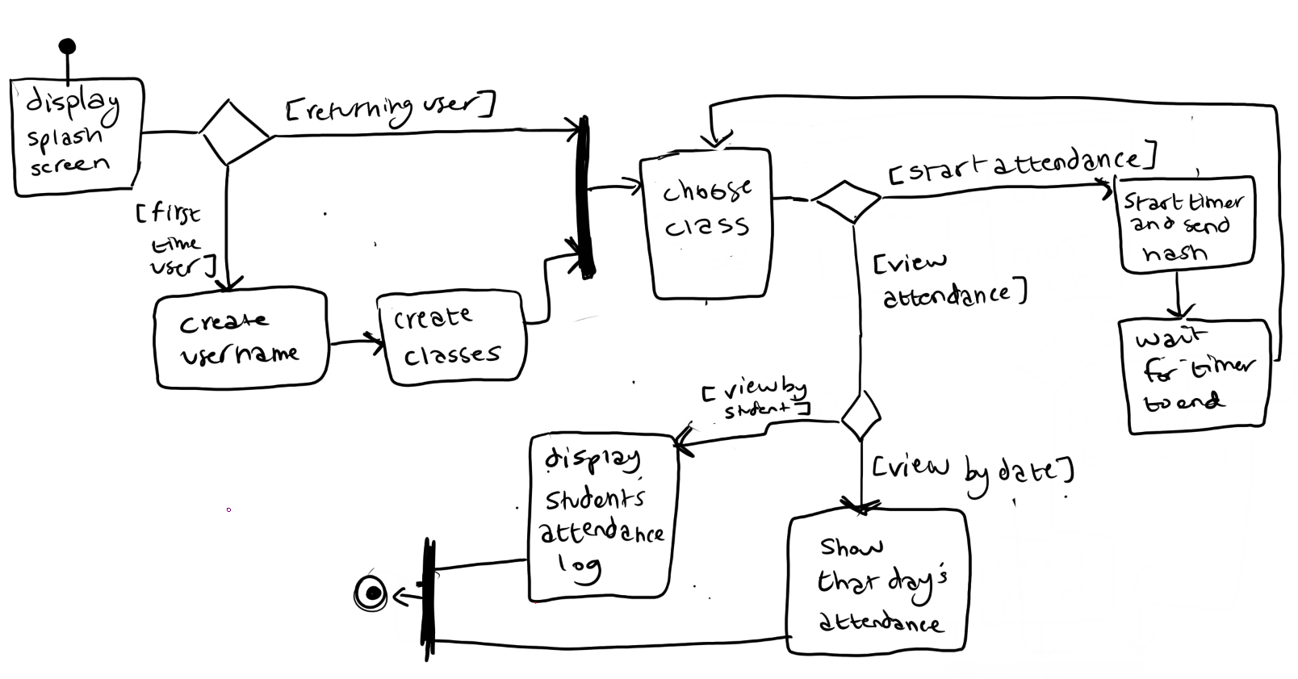
State diagram: teacher view

Slide 11
Use case diagram 1

Slide 12
Use case diagram 2

Slide 13
Use case diagram 3

Slide 14
Burndown chart
[programmers have until Tuesday to close issues]

Slide 15
Risks
Everyone is new to Android Studio
Work schedules
Creating a secure log-in screen
Learning Zenhub

Slide 16
Questions?

