Slide 1
Project #1 CSS: ‘Herk’s Adventure’
from ‘Dragon Web Industries’
Group members:
Riley Greene
Chau Mai
Steven Stewart

Slide 2
Introduction
The idea of ‘Herk’s Adventure’ arose from the goal of creating a game that uses exclusively HTML and CSS without using Javascript.
The main idea behind the game is that you are an adventurer that wants to embark on an adventure.
You are given a choice of three quests that each have their own story lines and endings.
Each quest was independently written and coded by each member.

Slide 3
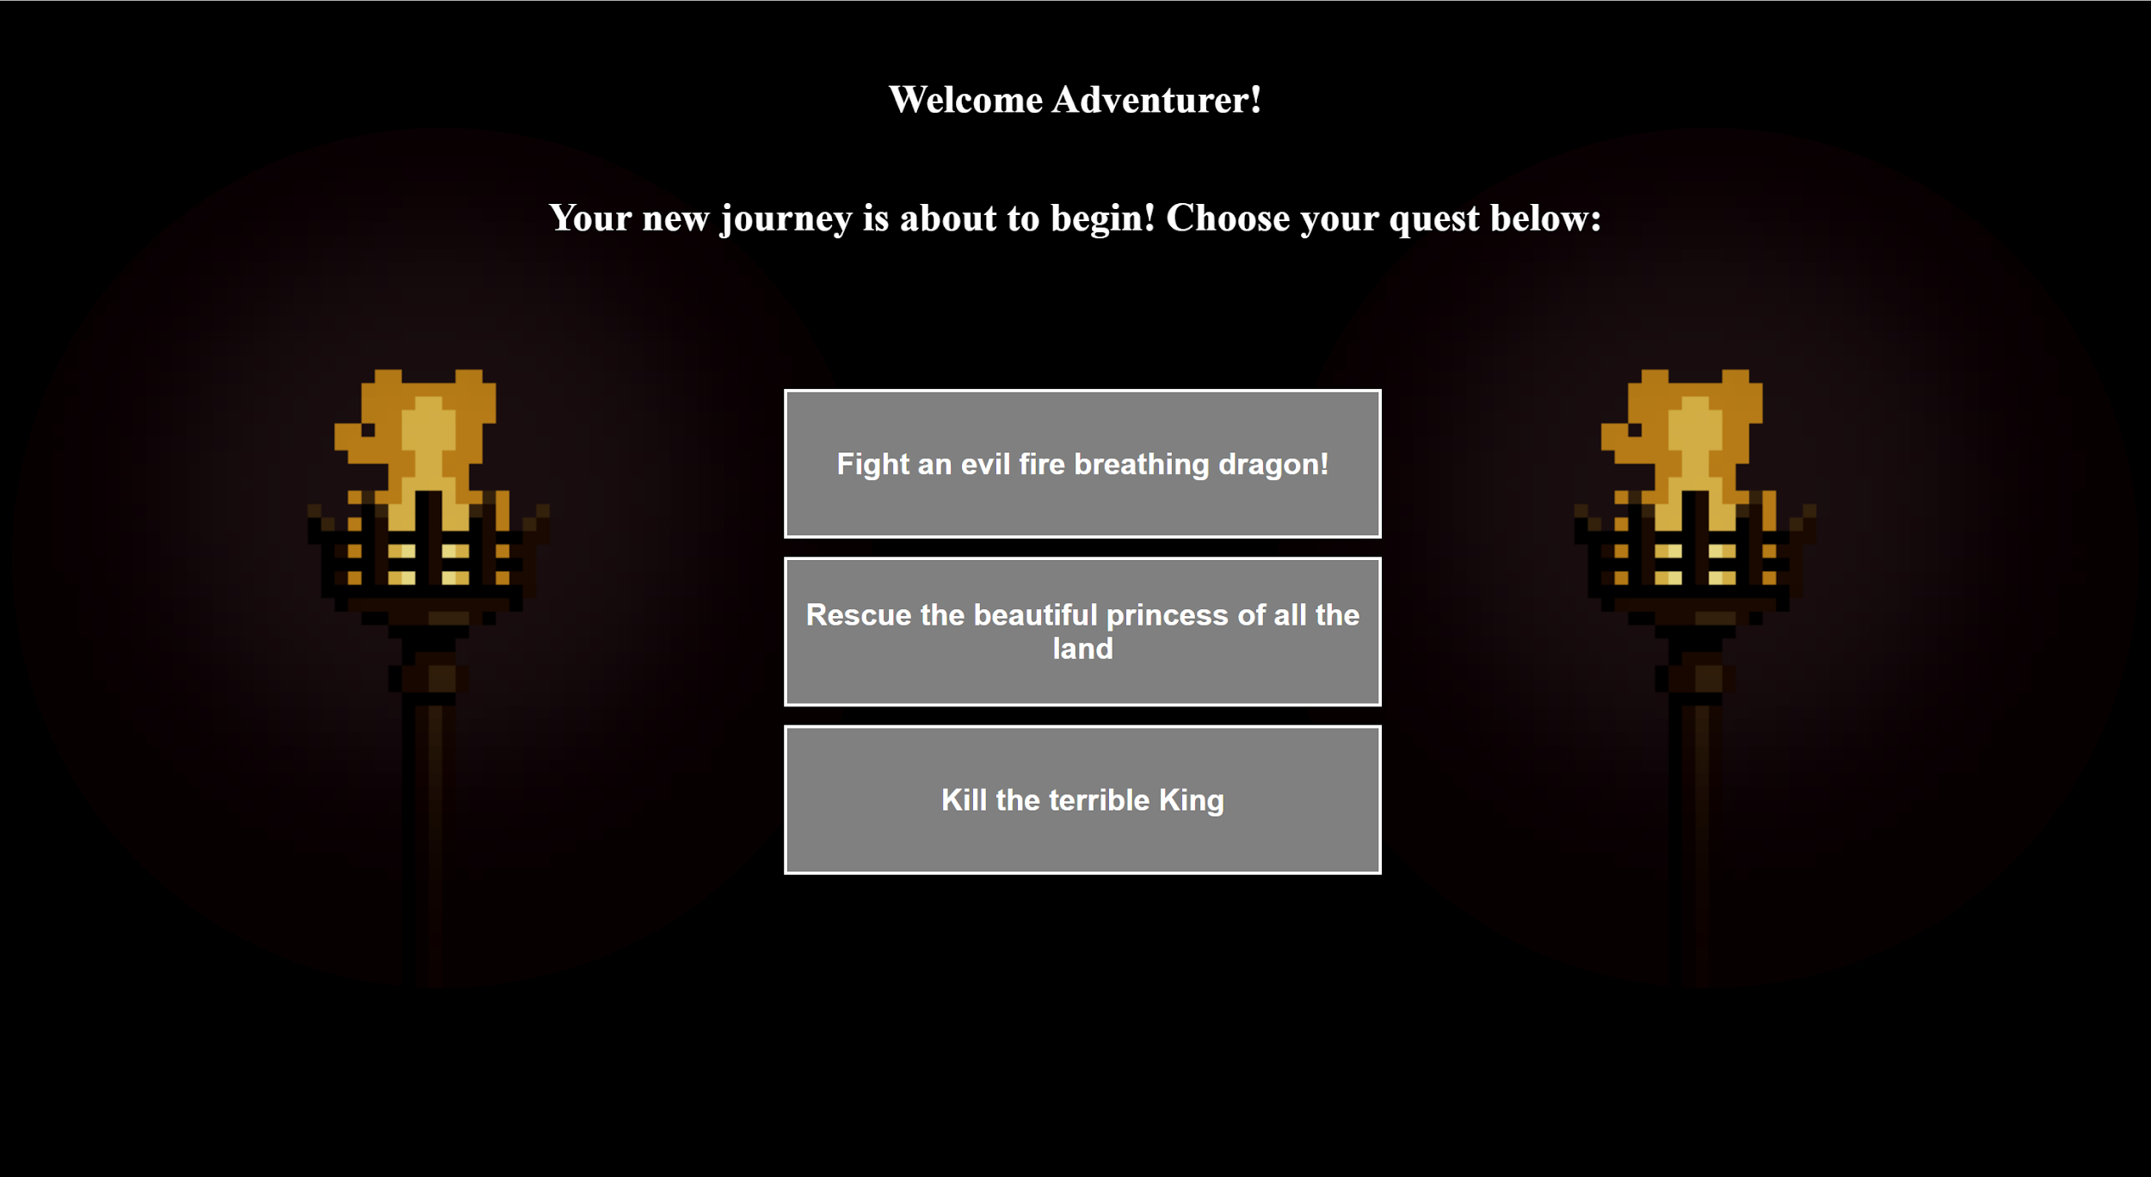
Implementation
We based the idea main idea of this adventure game on the old ‘choose your own adventure’ style. However, due to time limitations the game is not nearly as long.
As shown here the title page is a simple design that fades in with CSS animation and has redirecting buttons to other HTML pages.

Slide 4
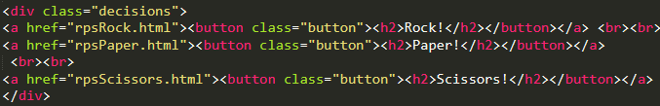
Key Features
The Button and display for each choice is a link to the corresponding page.
This allowed us to simulate the experience of a “responsive” game.

Slide 5
CSS Transforms, Transitions and Animations
The main focus of the project is to include the CSS transforms, transitions, and animations.
For animations you will find that each page uses the ‘Fadein’ animation to fade the page or some text in depending on the page.
The transforms code is used on the ‘Dragon Path’ when you find a map and it spins 360 degrees.
The transition is used in every animation and transform as it controls the time is takes to perform such action.

Slide 6
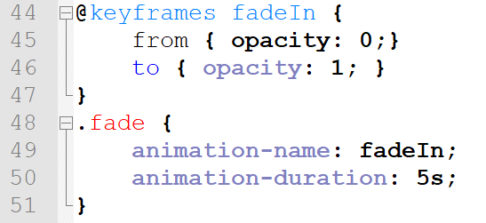
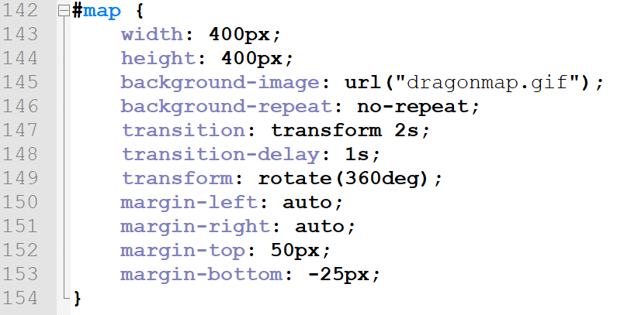
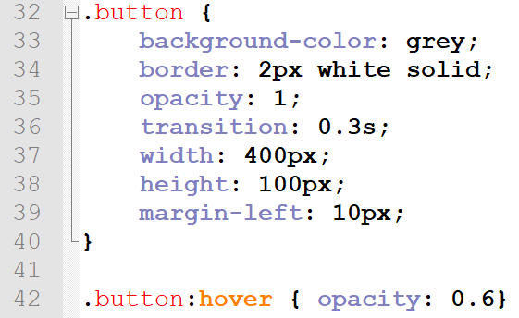
Code Snippets
The code for the animation Fadein
The map transform code
The standard button code

Slide 7
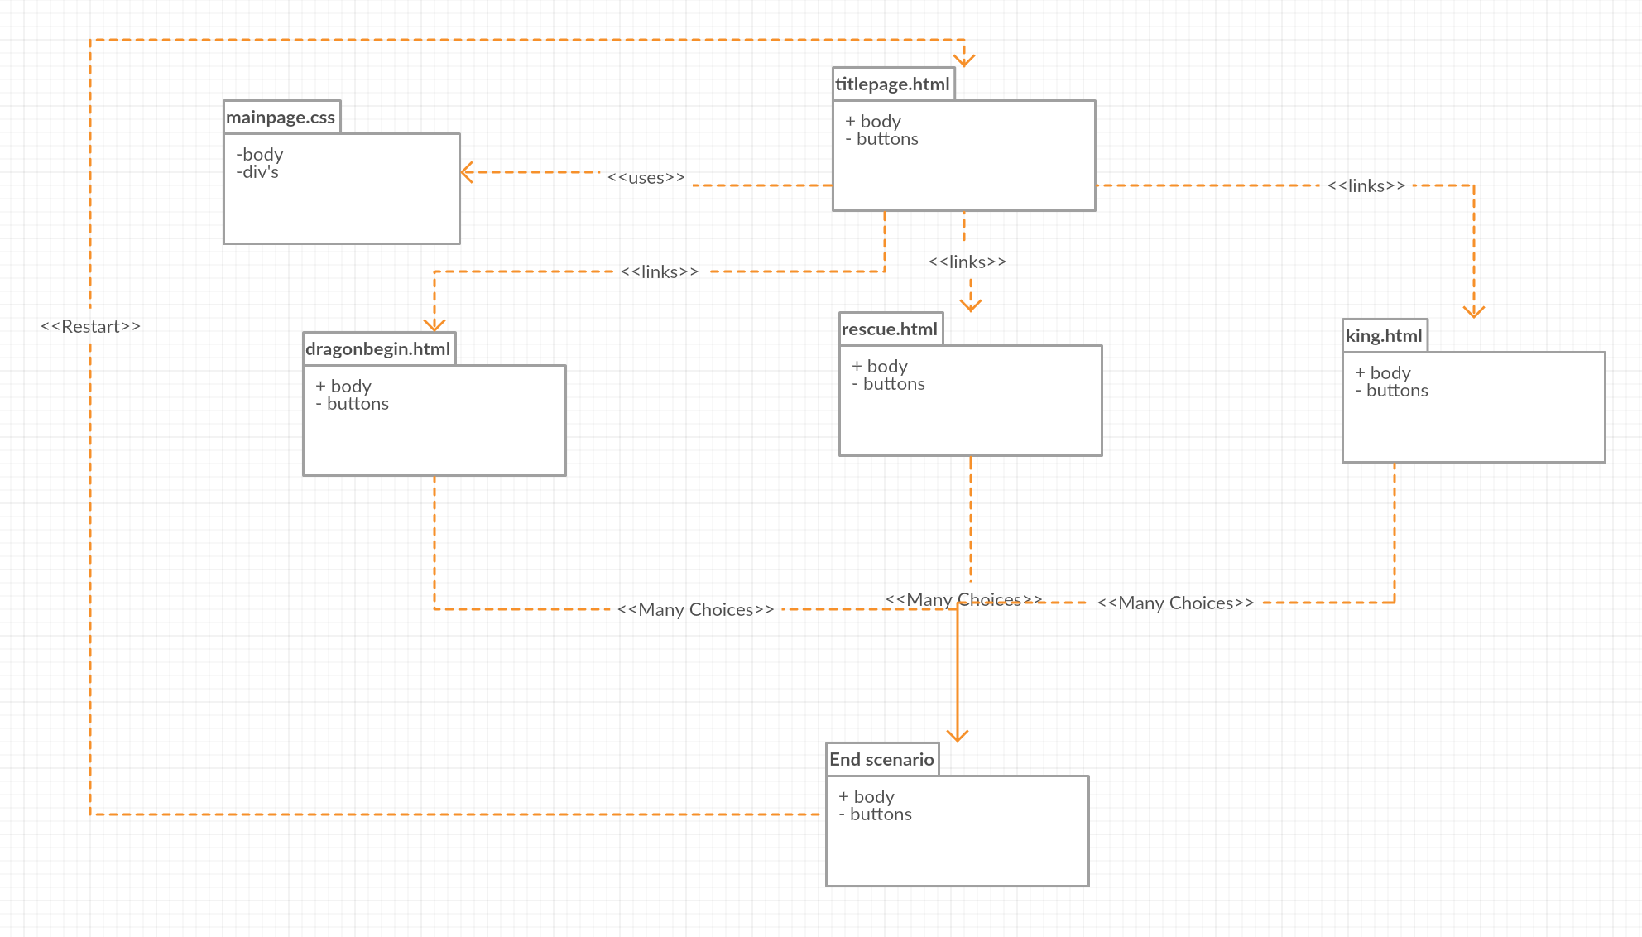
UML Diagram

Slide 8
Conclusion
Codd links (Interactive live project):
Riley: http://codd.cs.gsu.edu/~rgreene12/project1/titlescreen.html
Chris: http://codd.cs.gsu.edu/~cmai2/titlescreen.html
Steven: http://codd.cs.gsu.edu/~sstewart47/Project1/titlescreen.html
Youtube link (presentation): https://www.youtube.com/watch?v=JNB15wbcYlU&feature=youtu.be

