Slide 1

ST. JOSEPH'S INSTITUTE OF TECHNOLOGY
St. Joseph's Group of Institutions | OMR, Chennai - 119
Department of Electronics and Communication Engineering
COURSE: SD0212 RTL DESIGN AND VERIFICATION
RTL DESIGN AND VERIFICATION OF ML-BASED CPU DVFS GOVERNOR USING EDA PLAYGROUND
Project Acronym: DVS TROOPER (Predictive Dynamic Voltage & Frequency Scaling Engine)
PROJECT TEAM MEMBERS
ACADEMIC LEADERSHIP
1. Bernice Eleora Judson (312424106032)
2. Jayachandiran S (312424106068)
3. John Stewartsson J R (312424106073)
4. Kishore R (312424106087)
5. Rozario Shaan Soris J (312424106136)
Project Supervisor:
Dr. R. Nirosha, M.E., Ph.D.
Head of the Department:
Dr. P G V Ramesh, M.E., Ph.D.
Principal:
Dr. R. Priscilla, M.E., Ph.D.

Slide 2
CHAPTER 1 & 2: MOTIVATION & BACKGROUND
Introduction & Problem Statement
THE POWER DELIVERY NETWORK (PDN) CHALLENGE
LIMITATIONS OF CONVENTIONAL REACTIVE GOVERNORS
Nanosecond Current Surges (di/dt):
Modern high-frequency CPU cores transition rapidly between idle and peak SIMD compute bursts, causing immense transient currents.
Parasitic Inductive Droop:
Package inductance (L) and resistance (R) induce rapid supply rail collapse: Vdroop = L(di/dt) + I*R.
Timing Violation Risk:
If rail voltage breaches the minimum operational threshold (Vmin), logic gate delays spike, causing setup timing faults and system crashes.
Post-Event Detection Latency:
Conventional governors act only AFTER the voltage has already collapsed below critical limits (10 to 30 ns detection and PLL reaction lag).
Wasteful Voltage Guardbands:
To prevent crashes during this latency gap, silicon vendors permanently inflate nominal supply voltage by +15% to +25%.
Severe Energy Overhead:
Since dynamic power scales quadratically (P = alpha*C*V^2*f), excessive voltage guardbands cause massive waste in battery and thermal efficiency.
DVS TROOPER INNOVATION: Replaces slow reactive thresholds with a lightweight Machine-Learning decision rule in SystemVerilog that predicts voltage droop 1 cycle (10 ns) in advance, allowing clock throttling before timing margin collapse and slashing required guardband voltage.
SD0212 RTL DESIGN AND VERIFICATION | DVS TROOPER
Slide 2 of 7

Slide 3
CHAPTER 3: SYSTEM ARCHITECTURE
Proposed Architecture & ML Decision Engine
MACHINE LEARNING FORMULATION & FEATURES
GATE-LEVEL PIPELINE & HARDWARE CIRCUITS
Dual-Feature Execution Vector:
Trained classifier maps two key physical parameters to impending voltage droops:
1. Delta_V(t) = Vnominal - Vactual (12-bit signed ADC voltage sag)
2. busy(t) (8-bit saturating counter tracking consecutive execution cycles)
Trained Hardware Decision Boundary:
Droop Alert = (Delta_V >= 40 mV) AND (busy >= 3 cycles)
Zero-Overhead Hardware Inference:
Eliminates power-hungry floating-point DSPs, complex activation functions, and multiply-accumulate (MAC) arrays.
Single-Cycle Combinational Latency:
Evaluates the entire decision within the 100 MHz clock cycle without pipeline stalls.
1. 12-Bit Fast Subtractor Block:
Computes rail voltage sag (1000 mV nominal - measured Vrail). Implemented with high-speed carry-lookahead adder logic.
2. 8-Bit Saturating Counter:
Tracks consecutive execution burst cycles. Increments while busy=1; clamps at 8'hFF to eliminate overflow rollover hazards.
3. Magnitude Comparator Stage:
Parallel combinational comparators verify: Delta_V >= 12'd40 and counter >= 8'd3.
4. Synchronous Early Alert Register:
Registers early warning signal 'droop_warn', firing synchronously to govern the clock divider before rail reaches danger zone.
SD0212 RTL DESIGN AND VERIFICATION | DVS TROOPER
Slide 3 of 7

Slide 4
CHAPTER 3: RTL IMPLEMENTATION
Modular RTL Design & Dual-Governor State Machine
SYSTEMVERILOG RTL MODULAR HIERARCHY
FINITE STATE MACHINE (FSM) EXECUTION FLOW
Module 1: droop_predictor.sv
- Implements feature extraction and ML decision rule.
- Contains 12-bit subtractor and 8-bit saturating counter.
- Outputs: 'droop_warn' and 'busy_count'.
Module 2: dvs_governor.sv
- Core governor controlling 'fast_throttle' frequency scaling.
- Implements 3-cycle healthy recovery sequencer.
- Hysteresis filter eliminates high-frequency limit-cycle chattering.
Module 3: dvs_compare.sv (Top Verification Core)
- Instantiates predictive governor and reactive governor in parallel.
- Feeds identical clock, reset, and workload stress stimuli.
- Directly compares response latency and timing margins.
State 0: IDLE / NOMINAL (Full 100 MHz)
CPU operates at maximum clock frequency; continuous monitoring of execution activity and rail voltage.
State 1: PREDICTIVE THROTTLE (Immediate Action)
On 'droop_warn=1', governor instantly asserts 'fast_throttle=1'. Clock divider switches to safe half-rate to curtail di/dt transient.
State 2: RECOVERY SEQUENCING (Hysteresis Buffer)
When rail voltage recovers above safe margin, internal 3-cycle countdown begins. Throttle remains asserted to ensure stability.
State 3: HEALTHY RELEASE (Seamless Restoration)
After 3 consecutive healthy cycles, throttle deasserts. Clock restores to 100 MHz without oscillation.
SD0212 RTL DESIGN AND VERIFICATION | DVS TROOPER
Slide 4 of 7

Slide 5
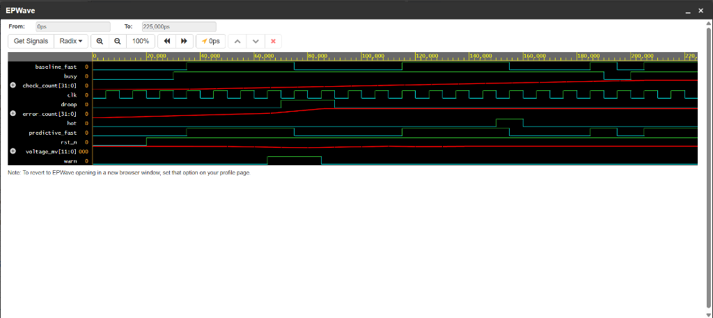
CHAPTER 3: RTL VERIFICATION & SIMULATION
RTL Verification & EDA Playground Simulation Waveforms
TESTBENCH METHODOLOGY (tb_dvs.sv)
EPWAVE SIMULATION WAVEFORM (1-CYCLE PREDICTIVE LEAD)
Verification Environment:
- EDA Playground Web IDE
- Synopsys VCS / Cadence Xcelium
- EPWave Interactive Waveform Viewer
18 Directed & Randomized Scenarios:
- Nominal steady-state load
- Abrupt multi-cycle compute bursts
- Thermal throttling events
- High-frequency noise ripples (<40mV)
- 3-cycle healthy recovery sequences
- Asynchronous reset assertion
Verification Results:
- 100% Assertion Pass Rate
- 0% False Alarms on transient ripples
- Live EDA URL:
edaplayground.com/x/BSTX
Key Waveform Transition Analysis:
- t = 30 ns: Compute burst begins (busy=1); voltage starts decaying toward 950 mV.
- t = 40 ns: ML condition met (Delta_V >= 40mV, busy >= 3) -> predictive_fast asserts IMMEDIATELY!
- t = 50 ns: Reactive governor finally triggers -> baseline_fast asserts 10 ns (1 full cycle) LATER.
Verified Breakthrough: 10 ns (1 Clock Cycle) Predictive Lead Time completely prevents timing violation!
SD0212 RTL DESIGN AND VERIFICATION | DVS TROOPER
Slide 5 of 7

Slide 6
CHAPTER 3: SYNTHESIS & BENCHMARKING
FPGA Synthesis & Comparative Performance Metrics
XILINX VIVADO SYNTHESIS (ARTIX-7)
COMPARATIVE PERFORMANCE BENCHMARKING
Target Device:
Xilinx Artix-7 (xc7a35tcpg236-1)
LUT Utilization:
41 LUTs (< 0.2% of device logic capacity)
Flip-Flop Utilization:
31 FFs (Minimal sequential footprint)
Timing Closure:
Target Frequency: 100 MHz (Tclk = 10 ns)
Worst Negative Slack (WNS): +2.42 ns (Met)
Dynamic Power Overhead:
< 1.2 mW estimated consumption
Metric / Feature | Reactive Baseline | Proposed DVS Trooper
Detection Mechanism | Under-voltage threshold (V < Vcrit) | ML Dual-Feature Decision Rule
Response Timing | 10 to 30 ns post-droop delay | 1-Cycle Early (10 ns Lead Time)
Timing Violation Risk | High during sharp di/dt steps | Zero (Safe state pre-asserted)
False Alarm Rate | Prone to high-frequency ripples | 0% (Filtered by busy >= 3)
Required Vdd Guardband | +15% to +25% voltage buffer | < 5% nominal headroom
Dynamic Power Savings | Baseline (0% reduction) | 12% to 18% Energy Reduction
SD0212 RTL DESIGN AND VERIFICATION | DVS TROOPER
Slide 6 of 7

Slide 7
CHAPTER 3 & SUMMARY: VERIFICATION & CLOSURE
Team Verification Links, Conclusion & Future Scope
TABLE 3.5: MEMBER PROJECT VERIFICATION LINKS (EDA PLAYGROUND & GITHUB)
S.No | Student Name | Register No. | Assigned Project Module | EDA Playground Link | GitHub Repository Link
1 | Bernice Eleora Judson | 312424106032 | RTL Module Design & Architecture | https://edaplayground.com/x/BSTX | https://github.com/Stewartsson/dvs-trooper
2 | Jayachandiran S | 312424106068 | Testbench Stimuli & Verification | https://edaplayground.com/x/BSTX | https://github.com/Stewartsson/dvs-trooper
3 | John Stewartsson J R | 312424106073 | Predictor & Governor Integration | https://edaplayground.com/x/BSTX | https://github.com/Stewartsson/dvs-trooper
4 | Kishore R | 312424106087 | EPWave Waveform Trace Analysis | https://edaplayground.com/x/BSTX | https://github.com/Stewartsson/dvs-trooper
5 | Rozario Shaan Soris J | 312424106136 | Vivado FPGA Synthesis & Timing | https://edaplayground.com/x/BSTX | https://github.com/Stewartsson/dvs-trooper
PROJECT SUMMARY & ACHIEVEMENTS
FUTURE RESEARCH & APPLICATION SCOPE
1. Advance Voltage Protection: Proved 10 ns (1-cycle) early throttle lead over traditional reactive governors.
2. Ultra-Lightweight RTL: Synthesized to 41 LUTs & 31 FFs with positive slack (+2.42 ns) at 100 MHz.
3. Rigorous Functional Coverage: Validated through 18 test cases on EDA Playground with 0% false alarms.
1. RISC-V SoC Core Integration: Integrate governor directly into an open-source RISC-V CPU (e.g., Ibex/RocketChip).
2. Multi-Threshold Non-Linear ML: Extend to multi-stage DVFS gearing with adaptive online threshold tuning.
3. Physical Silicon Tapeout: Tapeout on SkyWater 130nm / TSMC 28nm with on-chip high-speed voltage ADCs.
SD0212 RTL DESIGN AND VERIFICATION | DVS TROOPER
Slide 7 of 7

